Slide 1
The Governed Data Product for AI
Making a bank's data safe for an AI assistant to answer questions from
Berka (PKDD'99) dataset · 1,079,680 rows · one database, one language
Built and verified end to end in 4 minutes 28 seconds, from an empty database
Notes:
Opening line: "I'll show you three things - that the data is trustworthy, that
the meaning is pinned down, and that people only see their own customers. Each
one is backed by something that runs, not by a description."
Set expectations: about 20 minutes of walkthrough, and I'd rather be
interrupted than talk for 20 minutes straight.

Slide 2
THE PROBLEM
A bank wants to ask its data questions in plain English
Eight lists: people, accounts, loans, cards, who may use which account, every payment, standing orders, towns.
An AI assistant can only answer correctly if three things are true. All three.
1. The data is tidy
2. The words mean one thing
3. People see only their own
If one payment is written down twice, every total that
includes it is too big - and nothing shows an error.
If "a bad loan" means something different to you and to me,
we will both be confident, and we will disagree.
A bank is not allowed to let everyone see everything.
And the AI must not be the thing deciding that.
Miss any one of them and the assistant gives an answer that looks right and is wrong - which is worse than no answer.
Notes:
The key sentence is the red one. A wrong-but-confident answer is worse than a
refusal, because nobody checks it.
If asked why not just point an AI at the database: because all three of these
fail at once. That is the whole project.

Slide 3
THE WAY OF WORKING
Four steps. Like cooking from a messy box of shopping.
1 BRONZE
2 SILVER
3 GOLD
4 SERVE
Photocopy everything.
Change nothing.
Tidy up. Check everything.
Grade what is broken.
Build the shelves.
Agree what words mean.
Let the AI ask -
with three safeguards.
So we can always say what
actually arrived.
123 checks. Three grades:
red, orange, green.
Decide once, write it down,
so nobody redefines it.
A dictionary, a bouncer,
and a lock on the shelf.
The names are standard: bronze, silver, gold. What matters is that each step is allowed to do one job and not the next one's.
Notes:
This is the spine of the whole talk. Everything else hangs off these four.
The discipline point: Bronze is not allowed to clean, Silver is not allowed to
delete, Gold is not allowed to reach back past Silver. Each boundary stops a
specific class of mistake.

Slide 4
BRONZE
Step 1 — copy it exactly, and prove you did
Every column arrives as plain text. Nothing is converted, nothing is fixed, nothing is dropped.
A squashed tomato stays a squashed tomato. Fixing it here would hide it from the checks.
Each file gets a fingerprint - a code that changes if a single letter changes.
So when somebody argues about a number six months later, we can prove the file never moved.
Running it twice gives exactly the same result.
Nothing to repair if it is interrupted - just run it again.
1,079,680
< 4 sec
8 of 8
SHA-256
rows landed
to load all eight files
row counts match the published figures
fingerprint recorded per file
Notes:
The temptation at this step is to be helpful - trim a space, fix a date. Do not.
Every repair here is a defect you can no longer find.
The row counts matching the published reference exactly is the first piece of
evidence that the pipeline is sound: we did not get a different dataset.

Slide 5
SILVER: THE CLEANING
Step 2a — make every value mean one thing
Twenty-one steps between the file and the product. Four kinds, and the fourth is the one that makes the data answerable.
Text becomes a date, a number, a true or false.
TYPE IT
1,062,394 dates parsed from six-digit text
The seven ways this source writes "missing" all become one.
NORMALISE IT
1,380 placeholders turned into a real blank
Czech codes get an English label, from one list.
DECODE IT
2,466,175 values labelled from 28 codes
Work out what the source left implicit but never wrote down.
DERIVE IT
5,369 birth dates, 5,369 genders, 1,056,320 signs
Every one of those numbers is measured by running a query at build time, not typed. The full list is the Cleaning tab of the workbook.
Notes:
This slide is the answer to "what did you actually clean", and it is worth
being slow here: the first three kinds are mechanical and nobody argues with
them. The fourth is where judgement enters, and judgement is what a reviewer
should want to interrogate.
Deriving means the pipeline is making a claim the source never made. Gender is
not in this dataset - it is decoded from a national identifier. A month-end
balance is not in this dataset - it is built from postings. Each derivation is
listed in ASSUMPTIONS.md with what changes if the assumption behind it is
wrong.

Slide 6
CLEANING THAT CAN BE CHECKED
The rule that governs all of it: never repair a value
There are three things you can do with a bad value. Two of them make the product impossible to audit.
Repair it
A repaired value is indistinguishable from a real one a week later. Nobody can tell the bank's number from ours.
Guess the missing rate, correct the odd balance, fix the duplicate.
Drop it
Silently changes every total and every percentage. The report then describes what survived the loader, not the data.
Throw away any row with something wrong in it.
Keep it, and say so
CHOSEN
Of 21 cleaning steps, exactly ONE removes a row. It removed 1. The arithmetic is proved: product = staging minus quarantine, on rows and on money.
Transform without overwriting. Grade the problem separately.
And every value the cleaning did change is still readable in its original form, beside the cleaned one. A cleaning step you cannot undo is one you have to take on trust.
Notes:
The third column is the whole argument. "We cleaned the data" is not a
checkable statement; "exactly one step removes rows, it removed one, and here
is the reconciliation" is.
If pushed on the cost: yes, the product carries known-bad rows, and a consumer
has to be willing to read a caveat. The 55 accounts whose balance chain does
not reconcile are still there, still answerable, still marked. That is the
honest result and it asks more of the reader than a quietly corrected number
would.

Slide 7
WHY THE SIGN IS RESOLVED ONCE
The cleaning step worth the most, in one picture
The source never says whether money went in or out. It says it in Czech, in a different column, using two different words for "out".
WHAT THE SOURCE GIVES YOU
WHAT THE PRODUCT GIVES YOU
amount = 3,679.00 type = VYDAJ
amount = 3,679.00 type = VYBER
amount = 3,679.00 type = PRIJEM
Two of those are money leaving. To total "net flow" you must know that VYDAJ and VYBER both mean out — and the one that is easy to miss is VYBER, because it also names a cash withdrawal elsewhere.
signed_amount = -3,679.00
signed_amount = -3,679.00
signed_amount = +3,679.00
Resolved once, for all 1,056,320 postings, with the original amount and the Czech code still sitting beside it. "Net flow" is now a sum.
Why this one matters more than the others: a query that gets the sign wrong does not crash. It returns a confident, plausible, wrong number — and the most likely way for that to happen is an AI that saw VYDAJ in its notes and did not see VYBER.
The way to stop a generated query being wrong is to make the right answer the easy one to write. Not to inspect the query afterwards.
Notes:
If only one slide survives from the cleaning section, make it this one. It is
the clearest example of the principle the whole submission rests on.
Note what is NOT being claimed: this does not stop an AI writing a wrong query.
It removes one specific, high-frequency way of being wrong, by moving the
decision from query time to build time, where it is made once by a person and
tested.
Cost, if asked: one derived column on the biggest table, and three columns that
could in principle disagree. The balance reconciliation rules are what keep
them honest.

Slide 8
FOUND IN THIS REVISION
A cleaning step that quietly did not happen
The best evidence that cleaning is being taken seriously is a cleaning bug found and owned, not a claim that there were none.
WHAT HAPPENED
Standing orders carry a category code. 341 of them say LEASING — and LEASING was missing from the one list that turns codes into English. Those 341 rows went through the whole first build with no label.
WHY NOTHING CAUGHT IT
There IS a check that every code in the data is in the list. It covered the transactions table and not the standing orders table. The profiler printed LEASING in its report; no rule read it. The only rule that noticed said "this column is often empty", which reads like a fact about the data rather than a step that did not run.
WHAT IT COST, AND WHY IT WAS SURVIVABLE
Nothing, as it happens: no question reads standing orders. That is also why it survived — a table nothing consumes is a table whose defects nobody meets.
WHAT CHANGED
LEASING is in the list. The check now covers every coded column, not a hand-picked few. A new rule reports unknown order categories the way its transaction twin always did. And two tests now fail if any row carries a code without a label, or if a coded column is missing from the check.
Notes:
Offer this one. It is small, it cost nothing, and it says more about how the
pipeline is built than a clean report would.
The lesson is the transferable part: a guarantee enforced per column has to be
enumerated per column, and a hand-maintained enumeration will eventually miss
one. The fix is not "be more careful" - it is a test that derives the list from
the data instead of trusting the list.
It is the same lesson as the stale test count in the workbook, which is why
both are in the review rather than quietly corrected.

Slide 9
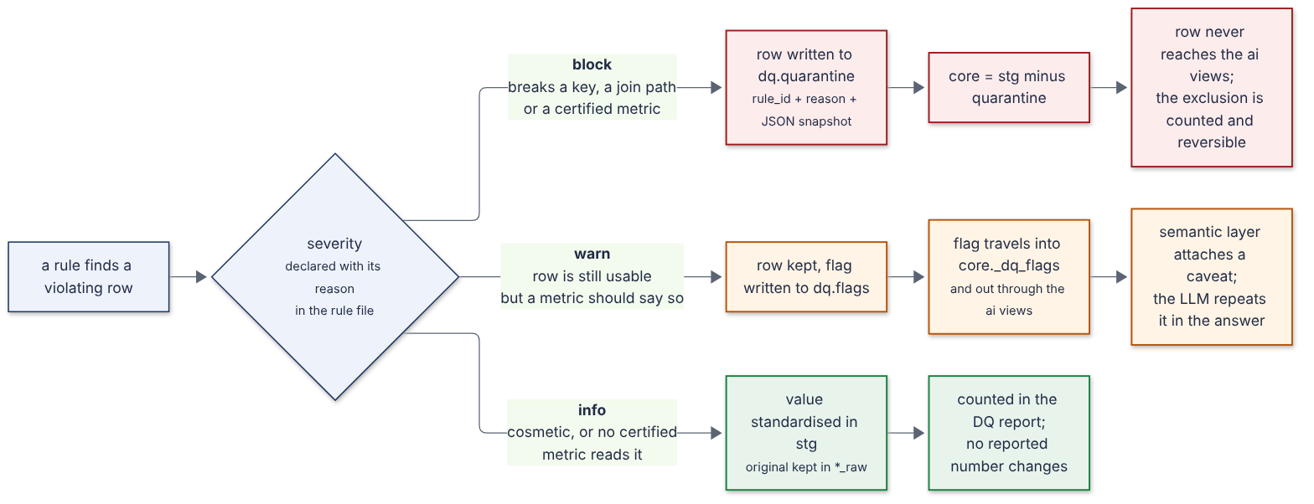
SILVER
Step 2b — grade everything that is still broken
We never throw a row away quietly. Red is removed and counted. Orange stays, with a warning that reaches the final answer. Green is tidied and logged.
Notes:
Walk the three lanes left to right. The point is that each colour has a
MECHANICAL consequence, not just a label in a report.
Orange is the one people miss: the warning travels with the row all the way
into the answer the AI gives, so the caveat cannot get lost in a document
nobody opens.

Slide 10
THE DECISION THAT MATTERS
The grading is the hard part. The check is the easy half.
14 payments of exactly zero
A payment of minus 500
A rule saying "every payment must be more than zero" sounds obviously right.
At RED it would delete 14 real interest payments and break 14 customers' running balances — to fix nothing at all.
So it is GREEN.
Same column, same kind of rule.
But a minus sign has been applied twice, so money would move the wrong way. There is no reading of this row that is correct.
So it is RED.
Same column. Opposite decision. And we can say why for each one.
That is what the brief is really testing. A rule without a justified grade scores the same as no rule — because the grade is where the judgement lives.
Notes:
This is the slide to spend time on. If they remember one thing, make it this.
The general principle: before setting a severity, ask what ACTING on it would
cost. A defensible rule with the wrong grade does more damage than the defect.
Expect the question "isn't zero always wrong?" - answer with the interest run:
the bank charged interest, it worked out to nothing, the posting is real.

Slide 11
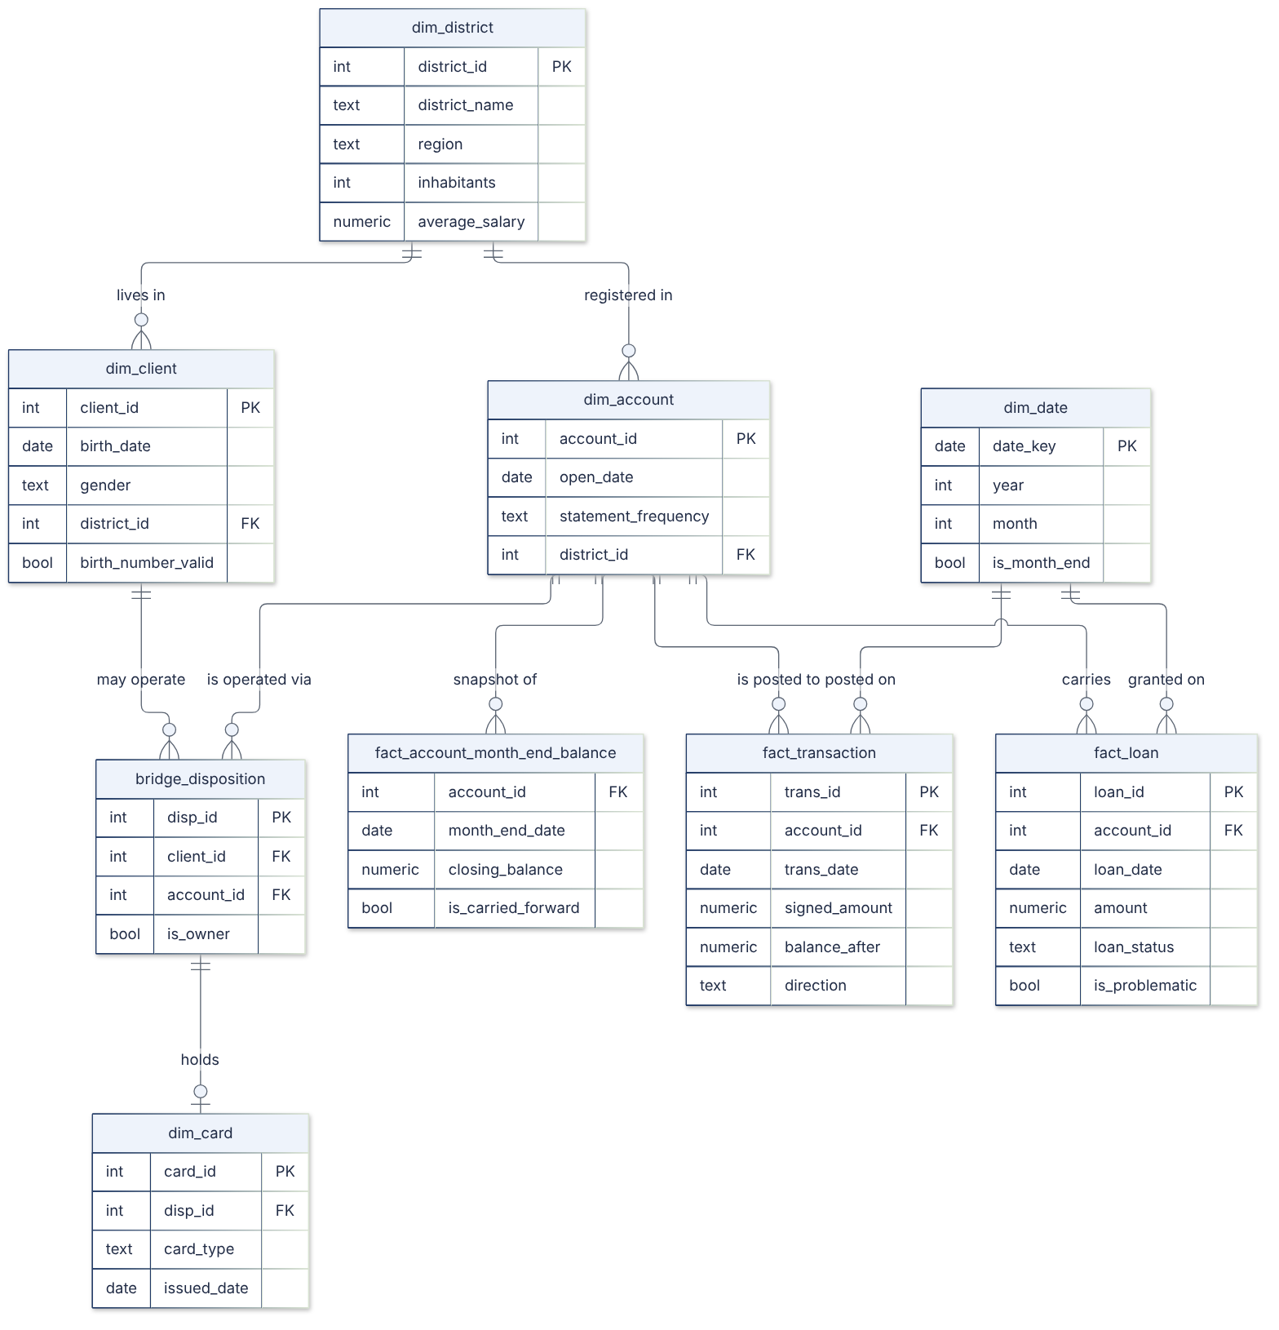
GOLD
Step 3 — build the shelves, and pin down the words
One shelf per kind of thing, and a rule about what one row means. Customers do not connect to accounts directly — they connect through a record that says in what capacity, which is what makes "the account owner" a phrase with one meaning.
Notes:
Point at bridge_disposition. That is the shape that matters: a husband may be
allowed to use an account he does not own, and his gold card must not make the
owner look like a gold card holder.
If the grain is wrong - say the customer shelf has someone twice - every count
is wrong and NOTHING errors. So we check it on every build, not by eye.

Slide 12
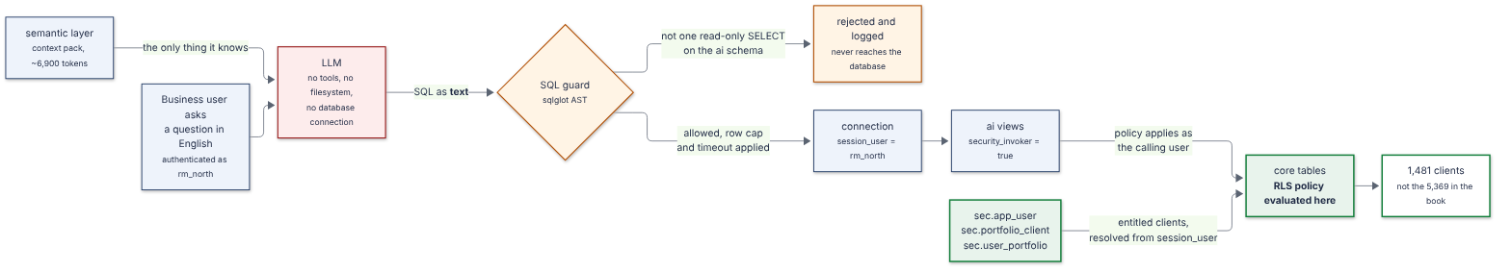
SERVING
Step 4 — let the AI in, with three safeguards
A dictionary
A bouncer
A lock on the shelf
it sees the meaning of the data, never the data
reads the AI's instruction properly before it runs
the shelf itself hands over only your rows
Notes:
The lock is the one to dwell on. You could ask the AI nicely to only show
someone their own customers - that is not a lock, it is a REQUEST. You are
asking the thing you are limiting to limit itself.
Instead the lock is on the shelf. The AI writes text; the predicate that limits
the rows is never in that text, so no rewriting of the text can remove it.

Slide 13
PART 2
What it found, and what it answered
The three tasks the brief sets, and the evidence behind each
Notes:
Part 1 was how it works. Part 2 is what it actually found and answered.
Everything from here is a number that came out of a run, not a capability
being described. If a figure on a slide cannot be traced to the database or
the run log, it does not belong on the slide.

Slide 14
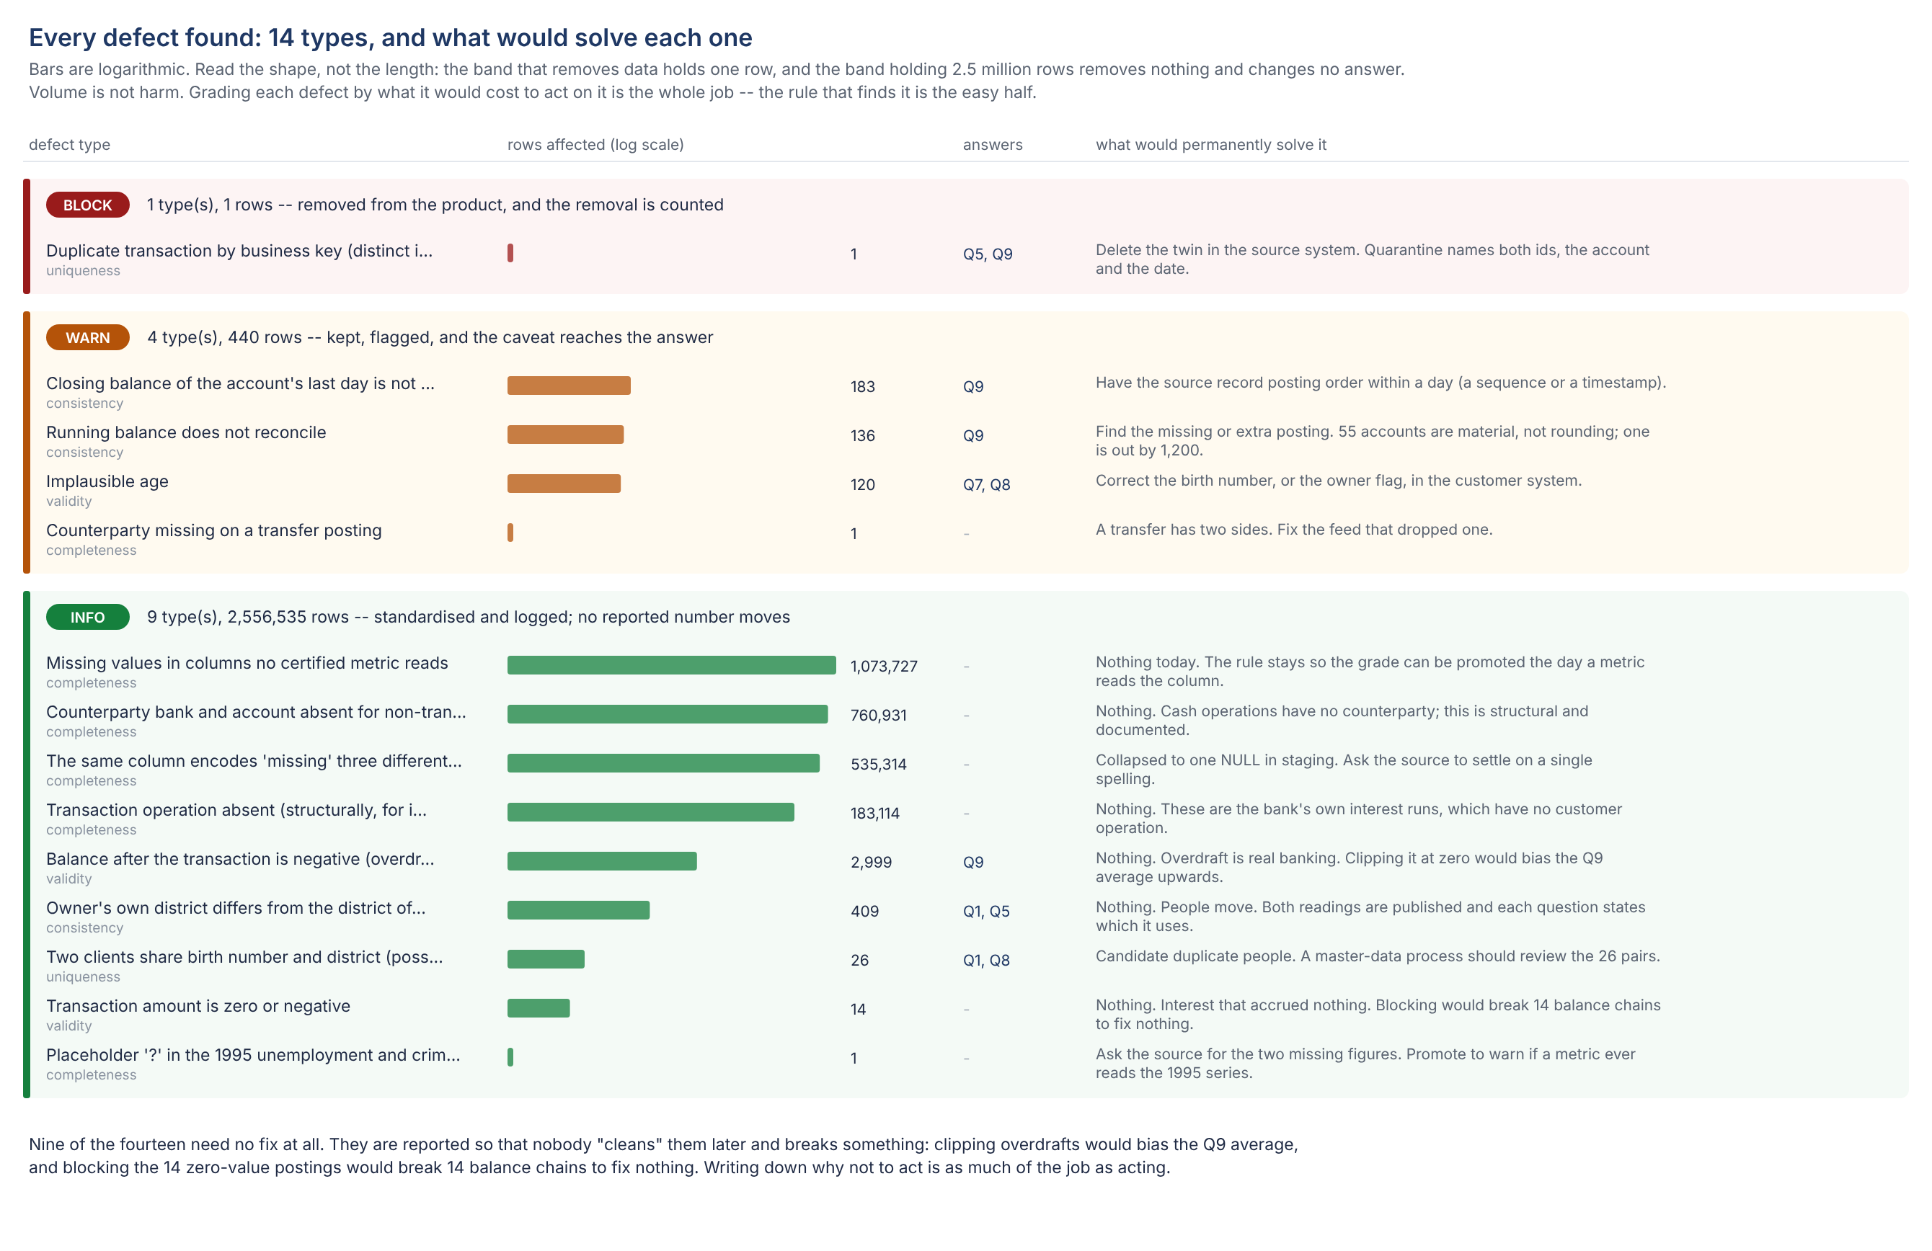
DATA QUALITY
Task 1 — every defect found, and how to solve it
Volume is not harm. One row in the red band changes two answers; 2.5 million rows in the green band change none. Nine of the fourteen need no fix at all.
Notes:
Do not read the list. Point at the shape: the bars get longer as the colour
gets safer.
Nine of fourteen need no fix, and they are reported precisely so nobody
"cleans" them later. Clipping overdrafts would bias the Q9 average upwards.
That is a real risk - it is the obvious thing a well-meaning person does.

Slide 15
DATA QUALITY
Three things we found that the documentation does not mention
The balance chain does not add up
Testing order-independently: 3,869 of 4,500 accounts differ between the sum of their payments and their last stated balance. Most is rounding — every amount carries one decimal. But 55 accounts are out by more than 100, and one by exactly 1,200 with only 55 payments. That is a missing or duplicated posting, not rounding.
Same-day order is simply not recorded
Payment IDs are not in time order within a day. For 183 accounts that uncertainty lands on their very last active day — so "the closing balance" is a documented choice we made, not a fact the data contains. That is exactly what Q9 asks for.
One duplicate no primary key could catch
Same account, same date, same type, same amount, same resulting balance — different ID. A genuinely separate payment would have moved the balance. This is the single row that gets removed, and the product reports 1,056,319 where the file has 1,056,320.
Notes:
These are the slides that show we actually looked, rather than running the
rules the dataset documentation suggests.
The 1,200 one is worth naming specifically: 55 payments on that account, and a
gap of exactly 1,200.00. That is not rounding, that is a posting.

Slide 16
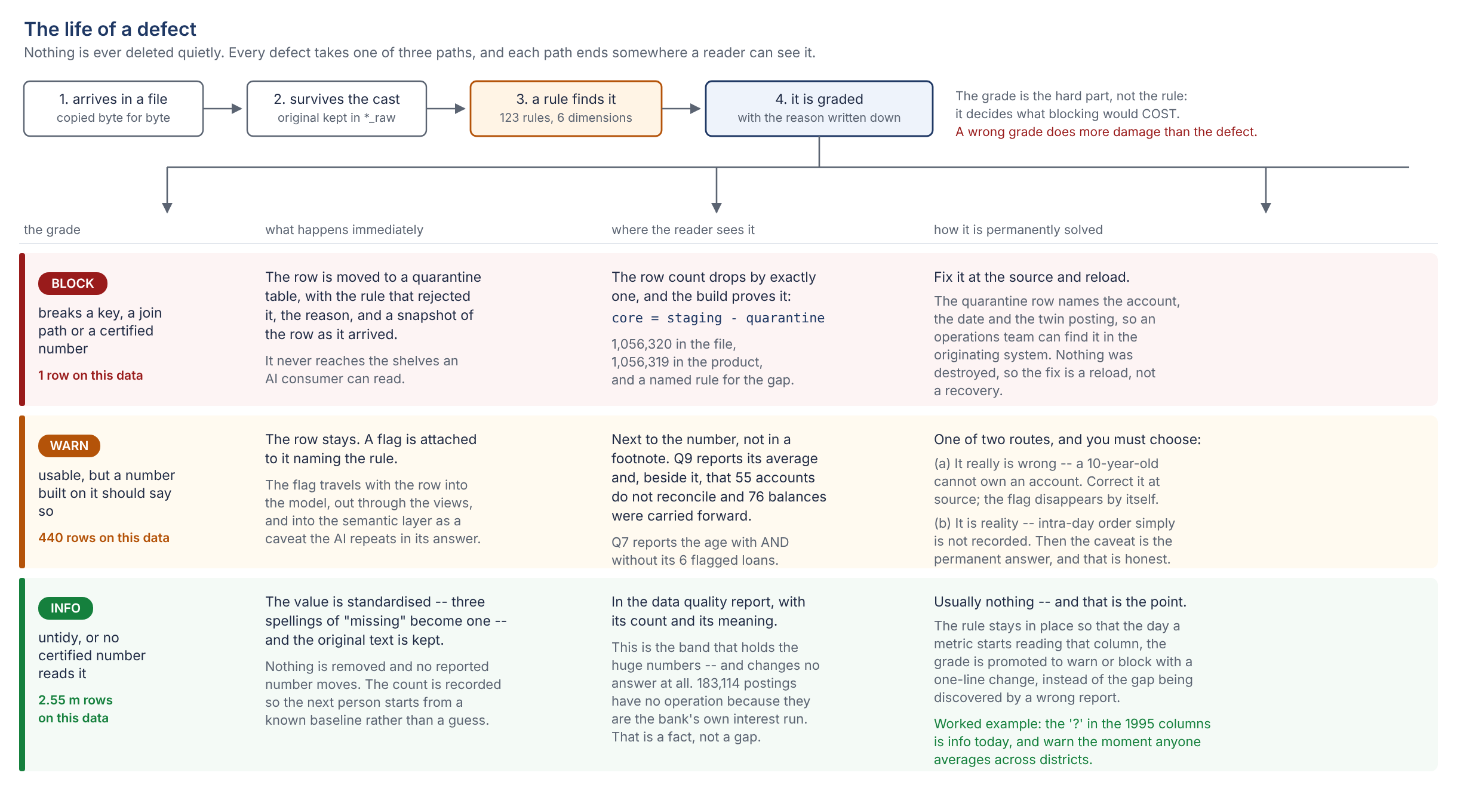
DATA QUALITY
And what "solving" one actually means
Red: fix at source and reload — nothing was destroyed. Orange: correct it, or accept it is reality and keep the caveat. Green: usually nothing, and the rule waits.
Notes:
The orange column is the honest one. Sometimes the right permanent answer is
"this is reality, and the caveat stays forever" - intra-day ordering is not
recorded anywhere, so no amount of work makes that uncertainty go away.
Saying so is better than pretending a cleanup will fix it.

Slide 17
MODEL AND SEMANTIC LAYER
Task 2 — the AI answered all ten, first time
It never saw the database. It got the dictionary and the question, and nothing else.
Q1 clients per region
south Moravia 937, north Moravia 920, + 6 more
Q2 loans granted per year
1993: 2.6m · 1994: 13.4m · 1995: 13.3m · 1996: 18.3m · +2
Q3 problematic loans
76 of 682 = 11.14% (matches the published figure exactly)
Q4 average loan by owner's card
junior 221,970 · gold 161,881 · no card 148,865 · classic 148,809
Q5 top districts, 1997
Prague 115.1m · Karvina 28.5m · Ostrava 27.7m · +7
Q6 new accounts per month 1996
all twelve months present — Jan 106, Feb 104, Mar 124 …
Q7 owner age at loan start
paid 37.1 · unpaid 39.6 · running 38.7 · in debt 37.0
Q8 gender split, gold cards
53 men (60.2%) · 35 women (39.8%)
Q9 average balance Dec 1998
43,808.94 over 4,500 accounts (+ 2 caveats attached)
Q10 frequency with worst share
after each transaction 18.75% — but only 6 of 32 loans
10 of 10 matched the answers a person had worked out by hand beforehand. No retries. No SQL corrected by hand.
Notes:
The marking scheme was written first, by hand, before the model saw anything.
That is what makes 10/10 mean something.
If asked about Q3 matching 11.14% exactly: that figure is published with the
dataset, so it is an independent check on the whole pipeline, not just on the
query.

Slide 18
ENTITLEMENTS
Task 3 — four people, four different answers to the same question
Measured by logging in as each one and counting — not by reading the settings.
cro_global
rm_north
rm_south
rm_unassigned
group risk
northern book
southern book
brand new, no book yet
5,369
1,481
1,386
0
clients visible
clients visible
clients visible
clients visible
The zero is the important one. A badly built system defaults to showing everything.
And "sees everything" is not an exemption — the risk manager holds a portfolio containing every client and goes through exactly the same lock as everyone else.
9
9
4 inserts
0
ways we tried to break in
that failed
to onboard a new person
code changes to do it
Notes:
Nine bypass attempts: pretending to be another user, going round the back of
the views straight to the base tables, reading the raw layer, setting a
session variable to someone else's name, editing the permission tables,
turning the lock off, dropping it, writing, and joining outwards to widen the
result. All nine refused.
Onboarding is four inserts and one credential. No policy, view or query
changes - that was an explicit requirement in the brief.

Slide 19
PART 2b
One client, all the way through
The same claims, told small enough to check: client 11409, from the line of text she arrives as to who is allowed to read her.
Notes:
Everything so far has been about a million rows. This part is one person, and
it is the part to slow down on, because a reviewer can actually verify it.
She was not picked for being tidy. She was picked because her record is
awkward in four different ways, each of which exercises a different part of
the build. A clean record would have demonstrated nothing.

Slide 20
AND ALMOST NOTHING IS ANSWERABLE
What arrives: three lines of text
This is the whole of what the bank's files say about her.
client.asc line 5179 client_id=11409 birth_number=805502 district_id=32
account.asc line 109 account_id=9265 frequency=POPLATEK MESICNE date=930204
loan.asc line 70 loan_id=6888 amount=39576 duration=12 status=A
trans.asc 643 more lines for this one account
805502
is not a date of birth. It is three facts in one number.
POPLATEK MESICNE
is not something anyone can group a report by.
A
is not a loan outcome. It is a letter.
930204
is not a date until someone decides which century.
Closing that gap is the whole job. Everything else is downstream of it.
Notes:
Read the four red boxes out. They are the gap between a file and a product,
and they are why "just point the AI at the database" does not work.
805502 is the one to dwell on: 80 is the year, 55 is the month, 02 is the day.
There is no month 55. Women carry month plus 50, so 55 means May - and that
single convention is both her birth date AND her gender, neither of which
exists as a column anywhere in this dataset.

Slide 21
EACH ONE TRACEABLE
What the cleaning did to her, step by step
C07
805502
born 1980-05-02
month 55 = May, +50 marks a woman
C08
805502
gender: female
the same digits again, read differently
C05
930204
opened 1993-02-04
YYMMDD, and 19xx not 20xx
C09
POPLATEK MESICNE
statement: monthly
one decode map, checked
C09
status A
finished, paid in full
A/B/C/D are outcomes
C11
status A
is_problematic: false
the certified definition, once
C10
643 postings
each one signed + or -
so "net flow" is just a sum
Her original birth_number is still in the row, next to the two columns derived from it. The decoding can be checked rather than trusted — which is the rule every one of these steps follows.
Notes:
The step ids are not decoration: each one is a row in the cleaning ledger,
where the same step is measured across all 1.06 m rows. This slide is that
ledger applied to one person.
The green ones are derivations - the pipeline making a claim the source never
made. Those are the ones worth challenging, and each has an assumption written
against it.

Slide 22
THE CAVEATS TRAVEL WITH HER
And two things about her that are odd
Her account was opened when she was 12 years old
Born 1980-05-02. Account opened 1993-02-04. That is 12.74 years old, which is not a plausible age for an account holder.
WARN — flagged on the row, NOT removed. The bank's record says this. Deleting it would hide a real problem; the flag travels into any answer about her.
She lives in one district and banks in another
Client district 32 (Ceska Lipa, north Bohemia). Account district 1 (Prague). 409 of 4,500 owners are like this.
INFO — logged. It is exactly why two of the ten questions deliberately use different districts: "clients per region" and "money per region" are not the same question.
Neither is corrected. Cleaning makes a value usable; it does not make it true, and pretending otherwise is how a number nobody can reconcile gets published.
Notes:
The 12-year-old is the better story. The temptation is to "fix" it - assume a
typo, shift the year. Do not: the bank's own file says this, and the useful
output is a flagged row that somebody investigates, not a quietly plausible
one that nobody does.
That flag is on her published row, in a column the semantic layer exposes, so
an AI answering a question about her carries the caveat into its answer.

Slide 23
THE SAME QUERY, SIX LOGINS
Now: who is allowed to read any of it
One identical SQL statement. Six connections. Only the login differs — nobody wrote a different query, and nobody could.
login
who they are
clients
accounts
loan value
sees 11409
sees 3763
client_11409
the customer herself
1
1
39,576
YES
no
client_3763
another customer, same region
1
1
123,216
no
YES
rm_north
their relationship manager
1,481
1,241
25,392,348
YES
YES
rm_south
a different manager
1,386
1,157
28,938,528
no
no
rm_unassigned
a new employee, no book yet
0
0
0
no
no
cro_global
group risk, whole bank
5,369
4,500
103,261,740
YES
YES
Both customers live in the north, so their MANAGER sees them both. Neither of them can see the other. That is the test that matters — isolating two customers in different books would have proved nothing.
Notes:
Point at the rm_north row and then at the two client rows. One person sees
1,481 clients; each customer sees one. Same query, same database, same moment.
If asked how: the filter is a policy on the table, and the policy asks "which
clients may the caller see". For a manager the answer is their book; for a
customer the answer is one row - herself. No policy was changed to add
customers. One column and one UNION, and the seven policies never learned that
customer logins exist.
rm_unassigned is the row people skip. It proves the default is SEE NOTHING,
not see everything.

Slide 24
13 ATTEMPTS, 13 BLOCKED
One customer trying to read the other, on purpose
Logged in as client 11409, asking for client 3763's data by name. A row count can pass while a targeted lookup leaks, so these name her actual account.
Ask for her records through the published views
her client row - her account - her loan - her transactions - her balances - her cards
0 rows, six times. The query runs; the engine filters the answer.
Go around the views, straight to the underlying table
SELECT ... FROM core.fact_transaction WHERE account_id = (hers)
0 rows. The policy is on the TABLE, so there is nothing to go around.
Read the uncleaned copies, where no policy exists at all
stg.trans, raw.trans
Refused outright. The role was never granted those schemas.
Attack the entitlement itself
edit sec.app_user to grant herself the other client - read who else is a user - disable the policy - become the manager
Refused, four times. She may read her data, not the machinery around it.
Two different kinds of block, and the second is the stronger one: a refusal says "not allowed"; a policy says "here is your answer" and the answer is already narrowed.
Notes:
Make the distinction at the bottom explicitly, because it is the heart of why
this works for an AI.
A privilege refusal stops a query. A policy does not stop the query - it
rewrites what the query can see, inside the engine, before any row is
returned. That is why an LLM-generated query needs no inspection for WHOSE
data it asks about: it cannot ask about anyone else's. The predicate is not in
the query, so rewriting the query cannot remove it.
All thirteen are in docs/WORKED_EXAMPLE.md with the exact error each one
produced, and they run again on every `make demo`.

Slide 25
PERFORMED, NOT ASSERTED
Adding a new customer: one insert
The brief asks how a new user is onboarded without code changes. This ran live during the same execution that produced the write-up.
Create the login
A credential. The only DDL, and it is not business logic.
Query before granting anything
0 clients visible. The default is see nothing.
One INSERT into sec.app_user
user_type 'client', subject_client_id. No portfolio needed.
Query on the very next statement
1 client, 1 account — their own, and nobody else's.
Try to read the example customer
0 rows. Isolated from her too, immediately.
Revoke: one UPDATE
is_active = false → 0 clients visible. Offboarding is symmetric.
No policy written. No view altered. No deployment. The entitlement is data, so the next statement already honours it — and that is true for a customer and for a whole relationship-manager book alike.
Notes:
This is the "without code changes" claim, and it is worth having actually
executed rather than described - the write-up contains the real output of this
run, not a worked-out example of what would happen.
The revoke step is the one to mention unprompted. Onboarding stories are easy;
a model where removing access is also one statement, taking effect on the next
query, is the one that survives an audit.

Slide 26
PART 2c
Proving who you are, and what that earns you
Two questions that are easy to confuse: are you who you say you are, and given that, what may you reach?
Notes:
These are separate questions and the build answers them separately. Most
access bugs come from answering one when you meant the other.
The order to present in: identity first (what do we even call a client), then
access (who may reach what, and why), then authentication (how do we know it
is them). Each one is useless without the other two.

Slide 27
AND ONLY ONE OF THEM IS PUBLIC
Three ways to name the same person
The product used to have one: a row number. It was never a breach — the lock already held — but it was the wrong thing to publish.
client_id
Joins, foreign keys, policy predicates. A customer never sees it.
3763
internal only
client_ref
Scrambled from the id with a secret. Unguessable, and it does not reveal how many customers the bank has.
BRK-TQ8D-RCB3
what a customer quotes
account_ref
A real IBAN shape with genuine check digits, so a typo fails the way a typo in production would.
CZ84 8888 0000 0000 0000 3112
the number they recognise
Why bother, when the lock already works? Because a guessable id invites people to try. Every guess becomes an access attempt the system has to refuse, instead of one that was never made — and a sequential id quietly tells you how big the book is.
Join on the number. Refer to people by the reference.
Notes:
The honest framing, if challenged: this is defence in depth, not a fix for a
hole. Row level security already stops one customer reading another.
What the reference removes is the enumeration surface and the correlation
handle - the ability to put a customer id in a URL and walk it, or to match
the same person across two systems that both received one. Cheap to add, and
impossible to retrofit once ids are in other people's logs.

Slide 28
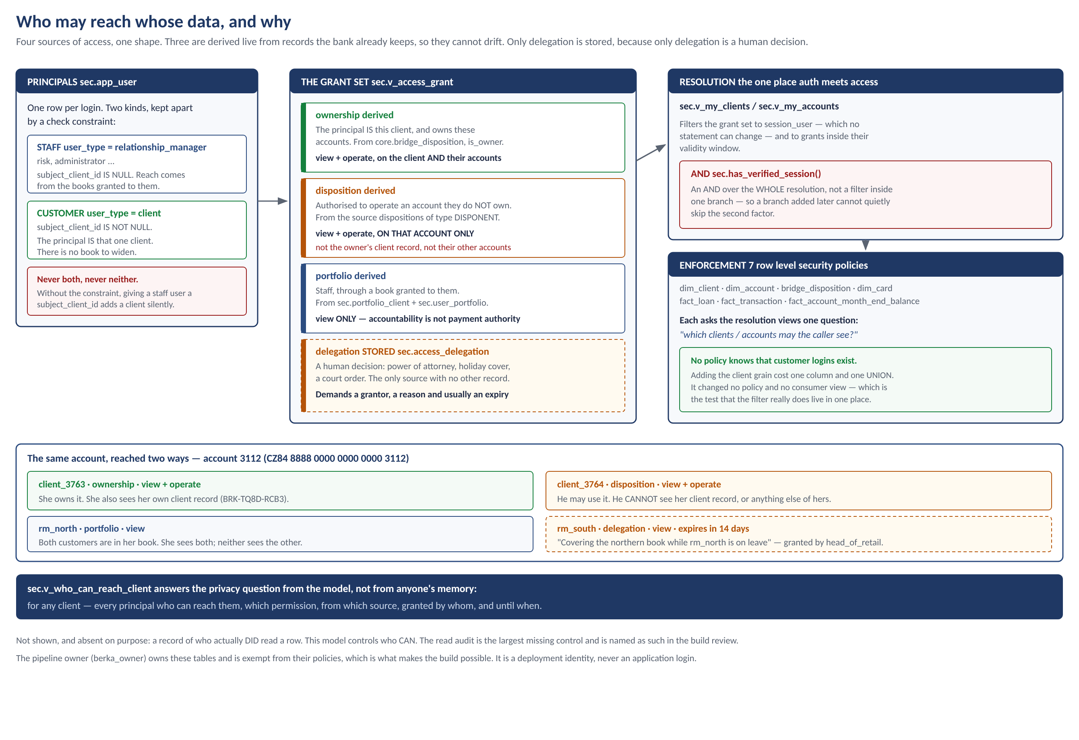
FOUR SOURCES, ONE SHAPE
Who may reach whose data, and why
Notes:
Leave this up for questions. The column to point at is grant_source: the
answer to "why can this person see that account" is one word, and it leads
back to evidence.
Three of the four are derived live from records the bank already keeps, so
they cannot drift. The first version of this materialised them into a table
and a test caught the consequence within the hour: granting a portfolio did
nothing until the next rebuild, while the entitlement tables said it should
have worked. That is the exact failure a single access model is meant to
remove, so the model now derives rather than stores.
Only delegation is stored, because only delegation is a human decision - and
it is the only one that can be wrong in a way the data cannot reveal, which
is why it demands a grantor, a reason and an expiry.

Slide 29
THE MOST CONSEQUENTIAL LINE IN THE MODEL
Using someone's account is not seeing them
Petr is authorised to operate Klara's account. A real relationship in the bank's own records, and the obvious implementation gets it wrong.
THE LAZY VERSION — grant the client
WHAT WE BUILT — grant the account
The chain already runs client → accounts, so grant Petr the client and let her accounts follow.
He now reads her OTHER accounts, her loans, her date of birth. Authorising someone to pay a bill becomes authorising them to read you.
Nobody signing that arrangement would expect it.
The right is over the account, so the grant is over the account.
He reaches account 3112, its 439 postings, its loan and its balances — and gets zero rows for Klara herself.
Tested by name, both directions.
3764
1
0
869
1,481
can use the account
client he can see: himself
rows about its owner
clients in this position
clients their manager sees
The model carries subject_kind so a grant can be over a person or over an account. Disposition grants are always over the account.
Notes:
This is the slide that shows the thinking rather than the plumbing. The lazy
version is not a strawman - it is what you get if you reuse the existing
client -> accounts chain without stopping to ask what the relationship means.
If asked why it matters when both are "authorised": because the arrangement is
about an account. A joint account holder, a carer paying bills, a business
partner. None of those is consent to read the other person's whole financial
life, and the data model should not quietly turn one into the other.

Slide 30
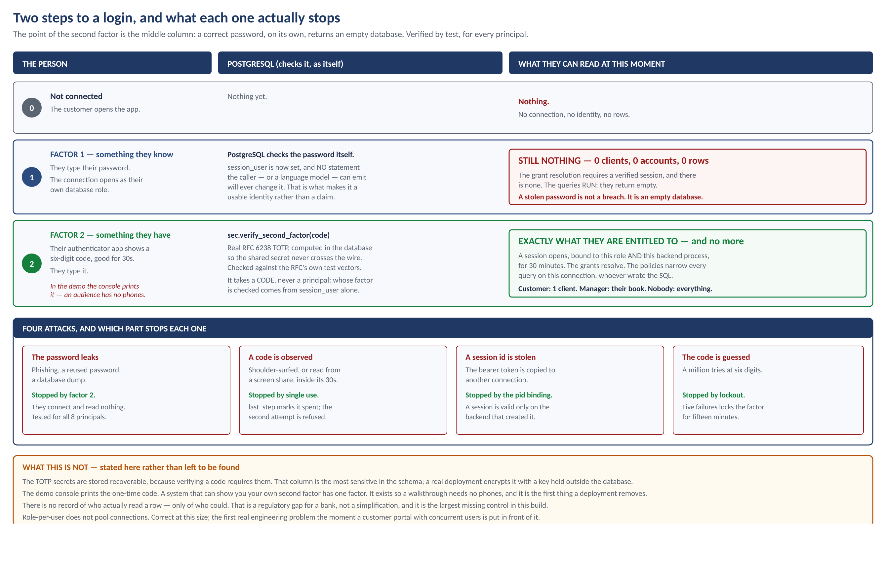
AUTHENTICATION
Two steps to a login, and what each stops
Notes:
The middle column of row 1 is the whole argument: a correct password, on its
own, returns an empty database. Not an error - the queries run and come back
with nothing, because the entitlements resolve only for a verified session.
Tested for all eight principals across seven views. A stolen password is not
a breach here.
Be ready for "is this real 2FA or a mock-up": real RFC 6238, the same
algorithm as any authenticator app, checked against the standard's own
published test vectors. Codes are single use, locked out after five failures,
and a session is bound to one connection. The only pretend part is that the
demo console prints the code instead of a phone showing it.

Slide 31
MAKE DEMO-LOGIN
Seeing it: eight logins, live
A fifteen-minute walkthrough. Every login is real; the only simulated part is the phone showing the code.
1
A customer logs in
One client, one account, her 439 postings. That is her whole bank.
2
A second customer, same manager
Reaches the same account. Cannot reach its owner.
3
One tries to read the other
Seven attempts by name. Seven refusals, two different kinds.
4
Their manager, and a new joiner
1,481 clients and 0. The default is see nothing.
5
The admin with the wrong code
Password correct. Zero rows. THE slide to show.
6
Why each person can reach what they do
Six principals, each with a recorded reason.
7
What the model is
Four sources. Three derived, one chosen by a human.
docs/DEMO_SCRIPT.md has the narration, the questions to expect, the answers, and what to do if it breaks live. make demo-interactive hands the keyboard to the audience.
Notes:
Offer to run it rather than describe it. Act 5 is the one that lands: the
administrator, who can see all 5,369 clients, holding the correct password and
reading nothing at all.
If you hand over the keyboard in demo-interactive, the thing to let someone
try is asking for another customer by id. Watching your own query come back
empty is worth more than watching mine.

Slide 32
PART 3
Why it is built this way
Six decisions, each with the options considered and what the choice cost
Notes:
Every slide in this part has the same four parts: the options that were real,
the one chosen, why, and what it cost. The cost box is not modesty - a decision
with no stated cost usually means the alternatives were never priced.
All six are in the Design Decision Record, with six more that did not need a
slide.

Slide 33
DESIGN DECISION 1
Where should the entitlement filter sit?
In the prompt
Ask the AI to filter itself. Defeated by the model simply omitting it.
In the application
A gateway rewrites every query. Real, but one unanticipated query shape defeats it — and the blast radius is every user.
In the database
CHOSEN
A rule attached to the shelf itself, applied inside every single statement.
WHY
WHAT IT COSTS
The AI only ever writes text. The thing that limits the rows is not in that text, so no rewriting of the text can remove it. Nine bypass attempts, nine failures.
One login per person, which complicates connection pooling. The answer is a pool per role, or a trusted gateway that picks the role.
Notes:
This is the strongest slide in the deck. The one-liner: asking the model to
filter itself is a REQUEST, not a control - you are asking the thing being
limited to limit itself.
Also note the identity choice: we use the logged-in database user, not a
setting the connection can change. A setting can be changed by anything that
can send SQL. There is a test that tries exactly that.

Slide 34
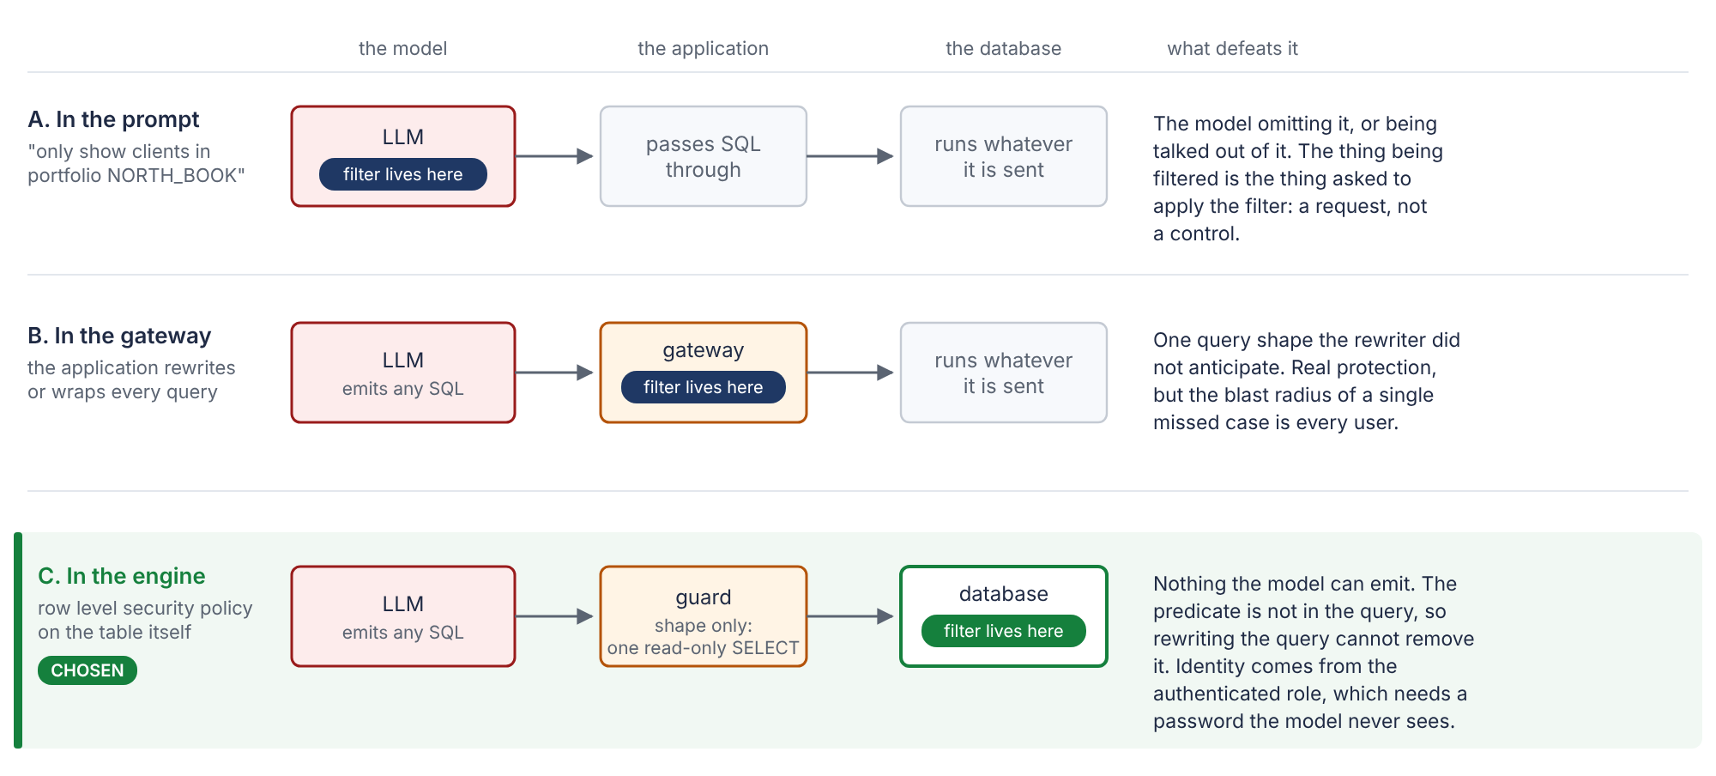
DESIGN DECISION 1
The same request, three places the lock could sit
Notes:
Point at the dark lozenge moving down the three rows. Everything else is held
constant, so the choice is the only thing changing.

Slide 35
DESIGN DECISION 2
One big table, or a proper model?
One big table
Flatten everything onto the payment. No joins — which is why many AI tools prefer it.
Data Vault
Right for integrating many sources with history. There is one source and a single extract.
Star schema with a bridge
CHOSEN
One table per kind of thing, joined through a record that says in what capacity.
WHY
WHAT IT COSTS
The ten questions have four different grains — customer, account, loan, payment. One table can only have one of them, so every other count becomes a DISTINCT the query author has to remember, and gets wrong with no error.
Joins, and a month-end balance table that has to be rebuilt. The curated views give the AI a join-free surface anyway.
Notes:
The killer detail: in one big table, a customer with 300 payments is counted
300 times unless someone remembers DISTINCT. Nothing errors. That is exactly
the failure mode we are trying to design out.
Second reason, less obvious: the entitlement filter. On a customer table it is
one check against 5,369 rows. Flattened, it is evaluated per payment -
1,056,319 times.

Slide 36
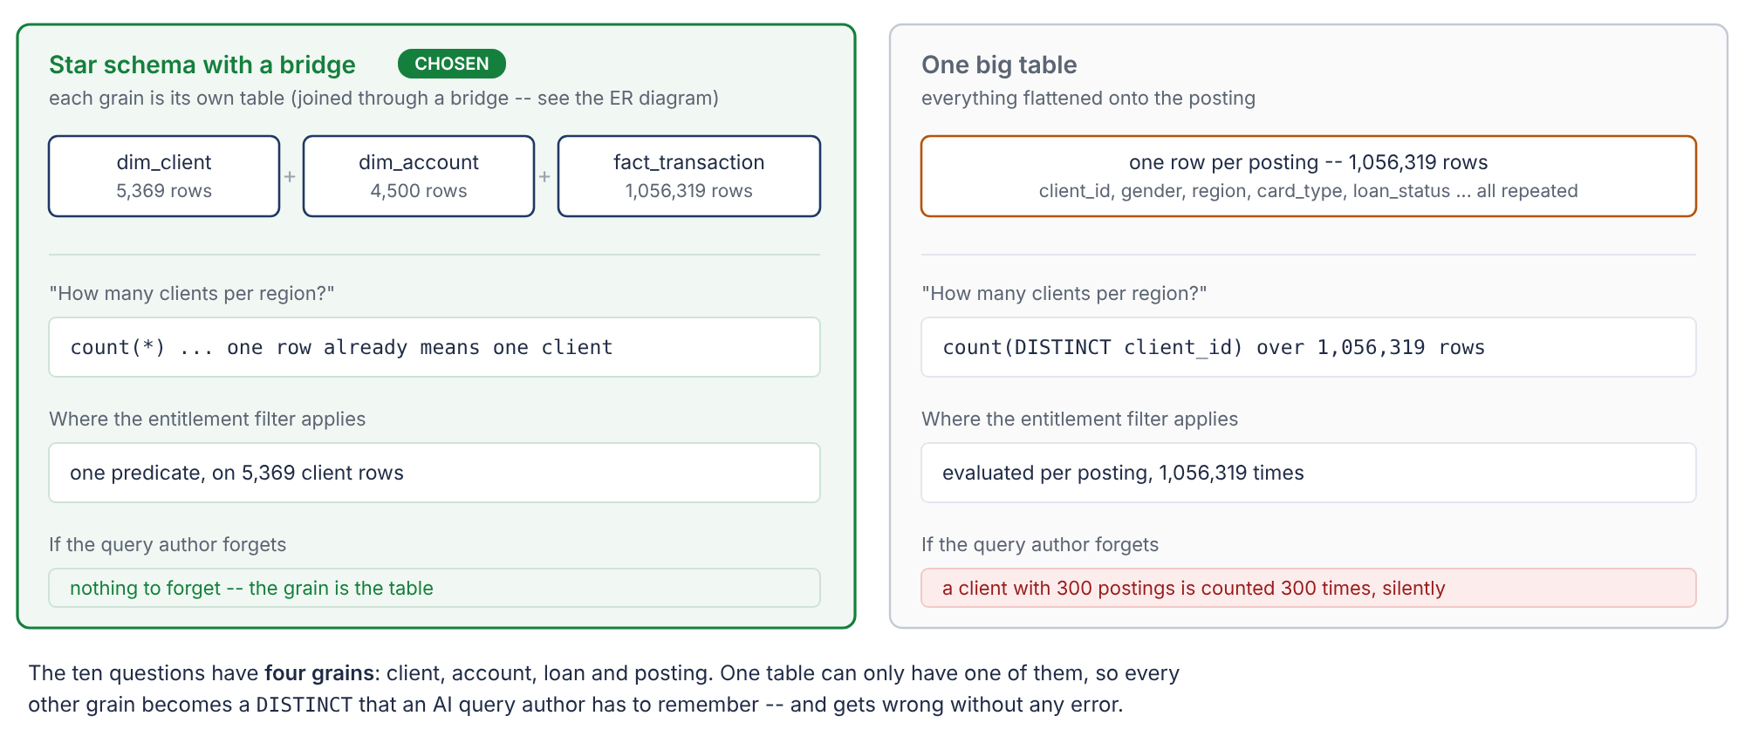
DESIGN DECISION 2
The same two tasks, priced against both shapes
Notes:
Left is what we built. Right is what we would have paid for removing the joins.

Slide 37
DESIGN DECISION 3
What should happen to a broken row?
Reject everything broken
Clean data, but 2.5 million rows deleted for cosmetic reasons, and the answers change.
Repair it quietly
Looks tidy. Hides the incident, and nobody can audit what was changed.
Grade it: red, orange, green
CHOSEN
Each grade has a mechanical consequence, and the reason is written down.
WHY
WHAT IT COSTS
A grade without a consequence is a comment. Red removes and counts; orange keeps and attaches a warning that reaches the answer; green standardises and logs.
Three code paths instead of one, and a quarantine table to keep. In exchange every exclusion is reversible, countable and attributable to a named rule.
Notes:
Link back to the zero-amount slide. The grade is where the judgement lives,
and the brief says explicitly that an ungraded rule scores the same as no rule.
If pushed on "why not just reject everything broken": 2.5 million rows are in
the green band and change no answer. Rejecting them would be deleting most of
the dataset to improve nothing.

Slide 38
DESIGN DECISION 4
How does the AI learn what the data means?
Describe it in the prompt
Fast to write. Drifts silently the moment the schema changes.
A BI tool's metrics layer
Mature, but another product to buy, run and keep on-premises.
A written file the build checks
CHOSEN
Meanings, grains and caveats in one file, verified against the live database.
WHY
WHAT IT COSTS
A dictionary that has drifted is worse than none, because it gives the model confident wrong information and the model cannot check it. A described column that does not exist, or a column nobody described, fails the build.
The file has to be maintained alongside the model. The verification is what makes that safe rather than a liability.
Notes:
This is the piece that produced the 10/10. The model had no database access -
only this file and the question.
The verification matters more than the file: 100 columns described, and the
build fails if any of them stops matching reality.

Slide 39
DESIGN DECISION 5
How much should we trust the AI?
Trust it; give it the database
It would answer by looking at the data, which tests the agent and not the data product.
Trust it; check the answer
Too late. By then the query has already run against production.
Treat it as an untrusted author
CHOSEN
No tools, no filesystem, no connection. Its SQL is parsed before anything runs.
WHY
WHAT IT COSTS
We are testing whether the semantic layer is good enough for a model to be right — not whether a model can go digging. And a query author you do not control should not be able to reach anything you have not deliberately published.
A parser dependency, and legitimate queries are occasionally stricter than necessary.
Notes:
Twenty bypass attempts were put through the parser - comment-hidden second
statements, writes buried in a WITH clause, reading internal schemas, file
functions. All rejected.
Important honesty point: the parser is NOT the security boundary. The three
attempts that got past it were then refused by the database itself, because
the account is unprivileged. Two independent controls, and we tested both.

Slide 40
DESIGN DECISION 6
PostgreSQL, or something lighter?
DuckDB, in-process
Fastest to set up. Has no row-level security — so Task 3 becomes prose and untested SQL.
A cloud warehouse
Powerful. Contradicts the bank's own direction of travel, which is back on-premises.
PostgreSQL 16
CHOSEN
One database. Row-level security that we can connect to and prove.
WHY
WHAT IT COSTS
Task 3 is about enforcement, and the only honest way to show a query cannot bypass a filter is to put the filter in the engine and prove it by logging in as a restricted user and counting rows.
No built-in lineage or scheduling, and a single node. Neither is on the critical path of this brief, and both are named in the scaling section.
Notes:
If asked why not DuckDB, which would have been faster: the one task that is
purely about control would have had no evidence behind it.
The brief warns in bold about spending the time on infrastructure. Total
infrastructure cost here: one 50-line shell script that starts Postgres.

Slide 41
SCALING HONESTLY
What breaks at 100,000 times the data
100 billion payments. 450 million accounts. Around 10 terabytes. Four things break, in this order.
1
The full rebuild
Everything is rebuilt from scratch each run. At 10 TB that is hours of rewriting data that did not change. It becomes an incremental load, month by month.
2
The quality checks
123 rules, each reading everything. They have to check only what arrived, and the running-balance check needs to remember where it got to.
3
The month-end balance table
450 million accounts times 72 months is 32 billion pre-computed rows. It becomes one new slice per month instead of a rebuild.
4
The entitlement lookup
Cheap over 4,500 accounts, expensive when one portfolio holds millions. It becomes a stored, indexed list sitting next to the data.
Two things do not break, and they are the parts worth keeping: the dictionary (a few thousand words, whatever the volume) and where the lock sits.
Notes:
Being specific here is the point. "It would need more hardware" is not an
answer; "the month-end balance table becomes 32 billion pre-computed rows" is.
The design does not change for the entitlement one - it is still a rule on the
table, and onboarding is still an insert. Only the lookup's shape changes.

Slide 42
PART 4
Is it ready?
What was built, what it is worth, and what is still thin - said out loud rather than left for a reviewer to find.
Notes:
This part answers three different questions that tend to get merged: is it
complete against the brief, is it trustworthy, and what would happen next.
Completeness is a checklist and it is on two slides. Trustworthiness is the two
bugs the build found in itself, and the thin column. Next steps are in
dependency order.

Slide 43
THE WHOLE BUILD, IN ONE PICTURE
What exists
One command - make clean all - builds every number in every deliverable from the four source files. It takes four and a half minutes.
12 of 12
4m 28s
137
123
1.06 m
pipeline steps green
empty database to deliverables
tests passing
quality rules executed
rows checked
10 of 10
9 of 9
20 of 20
135
0
LLM answers correct
bypass attempts refused
seeded defects caught
files in the submitted ZIP
numbers typed by hand
Why the last one matters most: a deck or a spreadsheet goes stale the moment a number changes. Every figure on these slides is read out of the database or the run log by a script. If the pipeline changes, the deck is wrong until it is re-run - and re-running it is one command.
Notes:
Lead with the reproducibility, not the counts. The counts are only credible
because of it.
The "0 numbers typed by hand" claim is not free, and section 2.1 of the review
is the honest footnote: one hard-coded test count had gone stale in the
workbook's Overview tab. It was found by grepping the generators for literals
and is now derived by collecting the suite. The lesson stated in the review is
the one to say here: the honesty rule only works where it is mechanised.

Slide 44
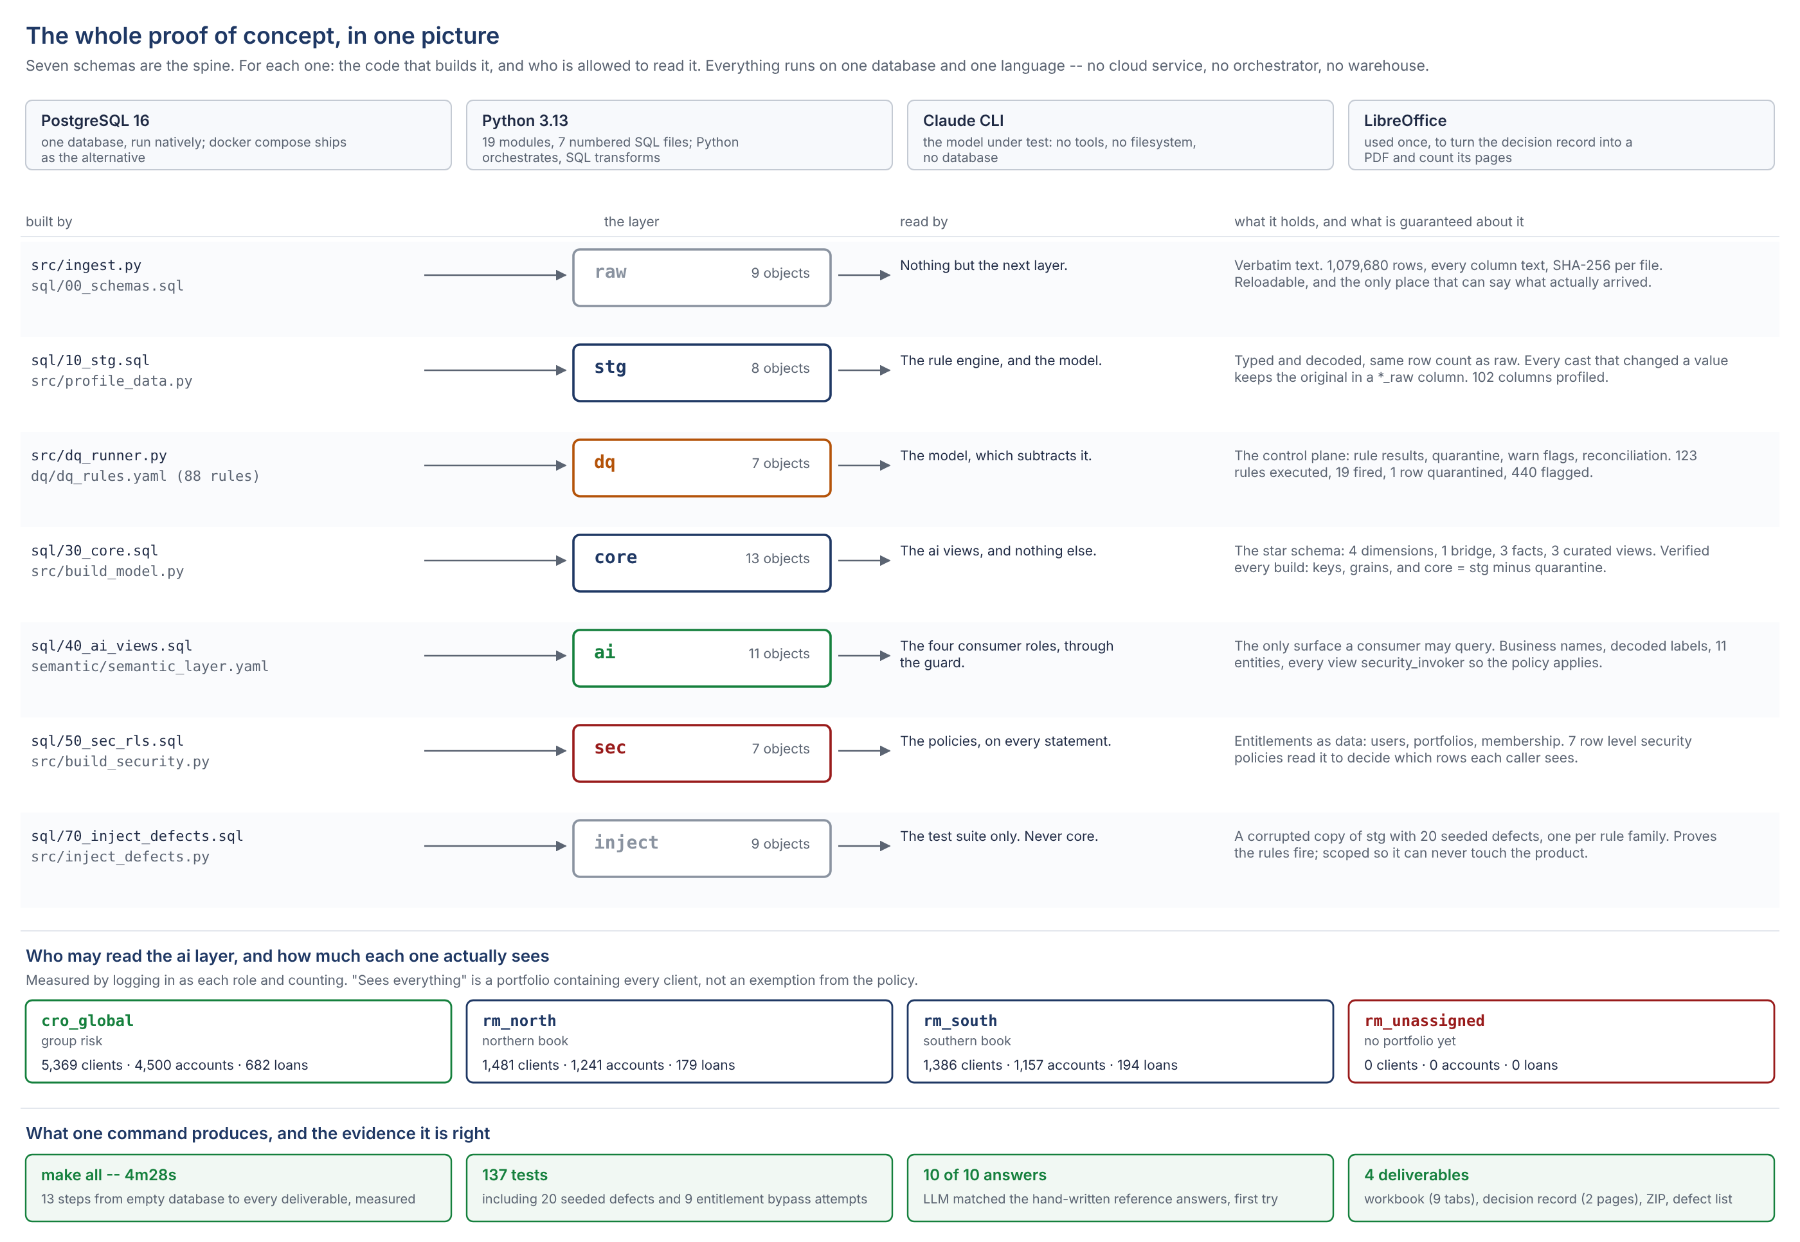
ONE MAP OF THE WHOLE THING
Everything that was set up
Notes:
This is the slide to leave up during questions.
Seven schemas, four roles, eleven consumer views, one guard, one LLM call per
question. Nothing on this map is a product that had to be bought or a service
that had to be configured: it is one PostgreSQL database, a YAML file of rules,
a YAML file of meaning, and about 3,900 lines of Python.
Total infrastructure setup: a 50-line shell script that starts Postgres. The
brief warns in bold about spending the time on tooling; this is the evidence
that the warning was heeded.

Slide 45
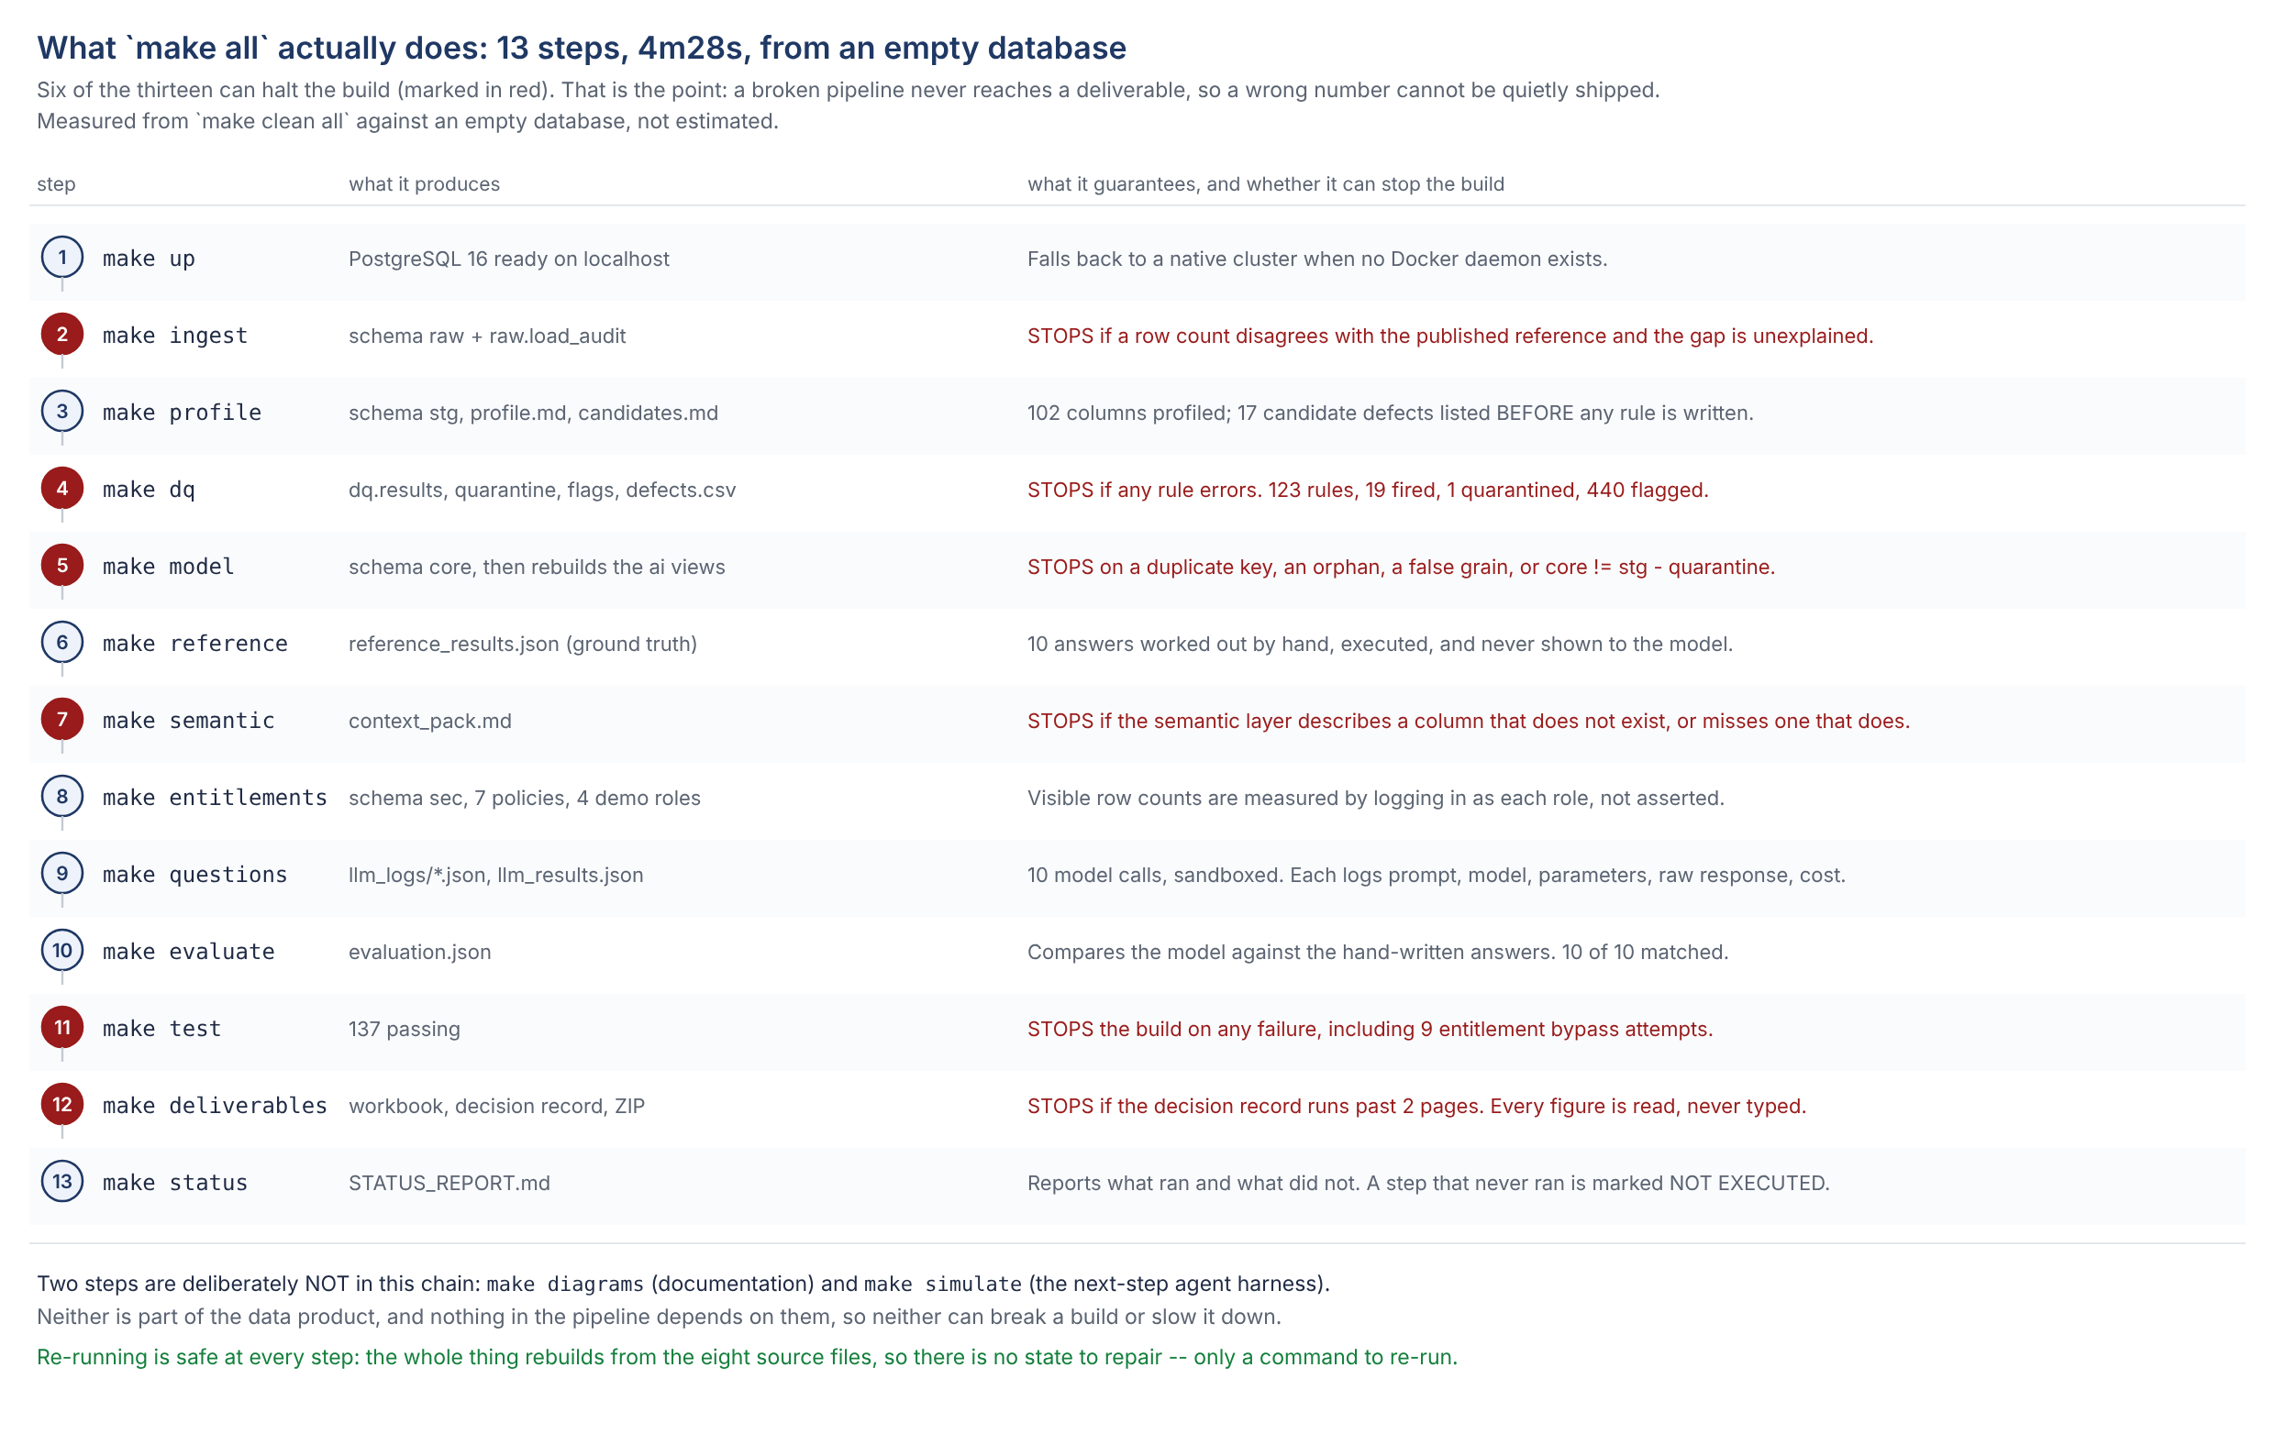
AND WHY THE ORDER IS A CONTROL, NOT A HABIT
The order it runs in
Notes:
Two orderings on this map are load-bearing and were both learned the hard way.
Security is built BEFORE the consumer views, because a consumer view reads the
entitlement list; building it the other way round fails. And the model is
rebuilt whenever the consumer views are, because dropping them cascades.
Both of those are in DECISIONS as D008 and D012. They are in the diagram so
that nobody has to rediscover them.

Slide 46
THE PART WORTH TRUSTING
Two bugs this build found in itself
Both would have been invisible to a reviewer. Both were caught by a check that runs every time, not by someone reading the code.
The quarantine list was not told which room to look in
Testing the rules means planting known defects in a copy of the data. But the list of rows to throw away did not say which copy, so a planted defect deleted a REAL row: 76 districts instead of 77, and 11,024 payments left pointing at nothing.
1
Caught by the model build, which counts every parent before it accepts a child. Fixed by scoping the list to one schema. Written up as D008.
A view politely dropped the lock
The rule that hides other people's clients sits on the table. A view on top of that table normally runs as its owner - so it read the table as the owner and handed back all 682 loans to a user entitled to none.
2
Caught by logging in as that restricted user and counting, which is the only test that would have found it. Fixed with one setting per view, plus a test that reads the setting back. Written up as D010.
Notes:
Offer these before being asked. A build with no bugs found in it either had no
checks or is not being honest about them.
The second one is the one to dwell on for Task 3: it is exactly the failure
mode that reading the policies would have passed. The policy was correct the
whole time. The view in front of it was not.
Say the consequence plainly: this is why the entitlement claim is made by
authenticating as four roles and counting rows, and not by quoting SQL.

Slide 47
SAID BEFORE ANYONE HAS TO ASK
Strong here, thin there
STRONG
THIN
Severities have consequences, not labels
Bronze has no dedicated tests
block quarantines and the exclusion is counted and reversible; warn flags the row and the flag travels into the answer; info changes no number.
Its guarantees are assertions inside the ingest module and are never re-checked. Largest hole in the suite, and first item of next-step work.
Three findings not in the dataset's own documentation
Four modules are over 500 lines
55 accounts whose balance chain does not reconcile; intra-day order undefined for 183 accounts; one duplicate payment no primary key can catch.
dq_runner in particular mixes execution, quarantine, flagging, reconciliation and two report writers. Coherent, but due a split.
The entitlement claim is tested by logging in
The rule engine pulls violations into Python
Four roles, 5,369 / 1,481 / 1,386 / 0 clients. That is what caught bug 2.
Fine at 1.06 m rows; named in the Design Decision Record as one of the four things that break at 100,000 times the volume.
Rules proven on clean data
No CI, and the page count is checked by regex
20 seeded defects in a separate schema, one per rule family, each caught by the rule meant to catch it.
Everything is reproducible by one command; nothing runs it automatically. The DDR two-page check reads the PDF bytes.
Notes:
Read the right-hand column out loud. Volunteering the thin parts is cheaper
than having them found, and it is the difference between a demo and an
engineering review.
Each one has a next step attached in REVIEW_AND_NEXT_STEPS section 4, in
dependency order: the six Bronze tests come first because nothing else in the
layered plan can be verified until they exist.

Slide 48
1 OF 2 - THE THREE TASKS
Completeness: every ask in the brief
What the brief asks for
Where it is delivered
Evidence it is real
Rules for completeness, uniqueness,
referential integrity, validity,
cross-table consistency
dq/dq_rules.yaml - 88 written rules
plus a sweep, 123 executed over
six dimensions
dq.results, one row per rule
per run; DQ rules tab
Each defect type with the rule it
breaks and a severity
Defect types tab and defects.csv -
rule id, dimension, severity,
rationale, handling
Generated from the run, not
typed; 08_defect_catalogue
A justified severity for every rule
("a rule without one scores as
no rule")
severity_rationale on all 88 rules,
each stated in terms of which of
the ten questions it would move
Rendered into the workbook;
test asserts no rule lacks one
AI-ready data product with a
semantic layer
core star schema + ai consumer
views + semantic/semantic.yaml,
validated against the live database
Model tab; grain, key and FK
checks; core = stg - quarantine
An LLM answering ten questions
with generated SQL and result
Questions and Q detail tabs - prompt,
model, raw response, guarded SQL,
result, reference answer
10 of 10 correct first attempt;
every call logged to disk
Entitlements: each user sees only
their own clients, and an LLM query
cannot bypass it
Row level security on the base tables
+ security_invoker views; onboarding
is two inserts, no code change
Entitlements tab: 5,369 / 1,481 /
1,386 / 0; nine bypass attempts
refused
Notes:
This slide exists because "completeness" is a grading criterion, not a feeling.
Read it as a checklist; every row has an artefact and a piece of evidence, and
nothing is marked done on the strength of prose.
The row to point at is the third. The brief says a rule without a justified
severity scores the same as no rule, so the justification is a required field
on every rule and a test fails if one is missing.

Slide 49
2 OF 2 - THE ARTEFACTS AND THE DISCLOSURE
Completeness: every deliverable
What the brief asks for
What was handed over
State
Excel: defect types, model
explanation, questions
Berka_TakeHome_Submission.xlsx -
nine tabs; the three required plus
Q detail, DQ rules, Assumptions,
Entitlements, Run log, Overview
Complete; every cell
generated
A ZIP of the semantic solution
and the code
semantic_solution.zip - 135 files,
with a manifest that says which part
is the assessed pipeline and which
is next-step work
Complete
Design Decision Record, max two
pages: options, choice, why, cost,
and what breaks at 100,000x
DDR.pdf and DDR.docx - twelve
decisions in options / chosen / why /
cost form, plus the four things that
break, named specifically
Complete; two pages,
checked
Full AI-tooling disclosure
AI_DISCLOSURE.md - which model, for
what, with what access, and what was
hand-written: the reference answers
and all 88 rules
Complete
Assumptions stated explicitly
ASSUMPTIONS.md - A1 to A24, each
with what was assumed, why, and what
would change if it were wrong
Complete; rendered
into the workbook
Plain-language walkthrough
(asked for in this session)
HOW_WE_WORKED_SIMPLY.md, VISUAL_GUIDE
with ten figures, and this deck
Complete
Notes:
The disclosure row is the one not to skip past. The split is the point: the
model wrote code and answered the ten questions; the reference answers it was
graded against and all 88 quality rules were hand-written first, before the
model saw them.
That ordering is what makes "10 of 10 correct" mean anything. Grading against
answers the same model produced would mean nothing at all.

Slide 50
IN DEPENDENCY ORDER, NOT BY APPEAL
What would be done next
Nothing below is needed for the brief. It is the order the work would continue in, and each item unblocks the next.
1
Write the six Bronze tests
Nothing else in the layered plan can be verified until they exist.
2
Split the test suite by layer
tests/bronze | silver | gold, and make bronze | silver | gold. An hour, no production code moves, and the agents' acceptance criteria become runnable.
3
Add a session-start hook so the database comes up by itself
The cluster stopped three times during the build and needed a manual restart. Fifteen minutes.
4
Then move the layers into isolated Python packages
Bronze first - 250 lines, one consumer. Silver last, because that is where a mistake costs most. Simulated already: four packages, five gates, 21 tests, four faults injected and all four refused.
5
Freeze the control dataset only once the boundaries stop moving
Freezing a surface that is still shifting turns every change into a proposal.
Deliberately not doing: renaming the schemas to bronze / silver / gold, and one container per layer - right for a platform, wrong for this brief.
Notes:
Three deliberate omissions are as much a part of the answer as the five steps.
Saying what was decided against, and why, is what separates a plan from a wish
list.
If asked whether the package migration is in scope: it is not, and the
simulation is the deliberate answer to "what would you do next" - dummy code
that proves the boundary is checkable, not production code refactored on a
guess.

Slide 51
Three claims, and how each one is proved
The data is graded, not just checked
123 rules, each with a severity and a reason for it, proven by 20 planted defects.
The model can be asked questions in English
A semantic layer validated against the live database; 10 of 10 answers correct, first attempt, every call logged.
The lock is in the engine, not in the question
Row level security on the base tables; four roles counted; nine bypass attempts refused. Onboarding a portfolio is two inserts.
make clean all - four and a half minutes, 12 of 12 steps, 137 tests. Every number on these slides came out of that run.
Notes:
Close on the three claims, then stop. Do not re-summarise the deck.
If there is one sentence to leave behind: the hard part of this brief was never
writing rules or writing SQL - it was deciding what each defect costs, and
making the entitlement something the question cannot argue with.

Slide 52
PART 5
What this data can still become
The gold layer that is built, and the one the cleaned data will carry without a single new source file.
Notes:
This part exists because the product that was built is the part the ten
questions needed, and the cleaned data supports roughly twice as much.
The distinction to hold on to: nothing in this part is more cleaning. It is all
modelling on data that is already clean, which is why it is cheap and safe.

Slide 53
THE GAP BETWEEN THE TWO
What is built, and what is sitting there cleaned
BUILT — because the ten questions needed it
CLEANED, AND CONSUMED BY NOTHING
4 dimensions — client, account, district, card
1 bridge — who may operate which account
2 base facts — 682 loans, 1,056,319 postings
1 derived fact — 185,615 month-end balances
1 calendar, 1 code catalogue
11 consumer views, every one entitlement-filtered
A complete star for the questions asked. Not a complete product for the data held.
6,471 standing orders — a whole table, typed, decoded and rule-checked, reaching no product at all
21,228,994 CZK of committed monthly payments, across 3,758 of 4,500 accounts (83%)
273,508 postings carrying a counterparty bank — 13 banks, never grouped by
The district unemployment and crime figures, which are a two-year history flattened into one row
892 card issue dates, so card tenure is available and unused
The standing orders are the one worth dwelling on. They are the bank's record of what customers have COMMITTED to pay — as opposed to what they happened to pay. For affordability, for disposable income, for why a balance behaves as it does, it is the most informative table in the dataset. It is also the table where the LEASING gap was found, which is not a coincidence.
Notes:
The honest framing: the gap is not cleaning that has not happened. Everything
on the right is clean. It is cleaned data that nothing consumes.
That is a normal and defensible state for a product built against ten specific
questions - but it should be said out loud rather than left for someone to
discover, because "we have a data product" and "we have a data product for
these ten questions" are different claims.

Slide 54
GOLD CANDIDATES
Eight tables buildable with no new data
Every input below is already typed, decoded and rule-checked. None of this is more cleaning — it is modelling on clean data.
G1
fact_standing_order
one standing order · 6,471
Committed outgoings and affordability. The largest gap, the smallest effort.
G2
fact_account_month
account × month · ~185,057
Flow beside the stock we already have. Every trend question in one scan.
G3
dim_client_profile
one client · 5,369
Collapses the four-table join every "clients who..." question needs today.
G4
fact_loan_performance
one loan · 682
From 13,580 repayment postings: how a loan went wrong, not just that it did.
G5
fact_district_year
district × year · 154
Unpivots 1995/1996 pairs, so a year stops being part of a column name.
G6
fact_card_activity
account × month · 8,036 postings
Card usage and dormancy. Limited: postings carry no card id.
G7
fact_interbank_flow
bank × month · 273,508 postings
Counterparty concentration — a question the product cannot answer at all today.
G8
the metric layer
definitions, not rows
Certified metrics promoted out of YAML into objects with an owner and a test.
Build order: G1, G5, G2, G3. G4, G6 and G7 each need a business owner to agree an attribution rule first — building them before that conversation is how a product acquires a number nobody trusts.
Notes:
Do not read the table out. Pick G1 and G2 and let the rest sit there as
evidence that the list was thought about.
G1 because it is a whole business concept missing from the product, not an
attribute. G2 because it is the one that changes what the product costs to
query - and it pairs with the month-end balance table that already exists:
flow beside stock, on the same grain.
The last line is the one to say deliberately. Three of the eight carry a
caveat that is a business decision, not a technical one: how to attribute a
card posting, how to attribute a loan repayment. Those are conversations, and
guessing at them is how you get a confidently wrong table.

Slide 55
STATED SO THE LIST ABOVE IS BELIEVABLE
And what this data cannot become
Five things no amount of modelling will produce from this source. Each one is a place where a plausible-looking table would be an invention.
No product or channel dimension
There is no product catalogue anywhere in the extract. Card type is the only product-like attribute that exists.
No customer segment or demographics
Beyond derived age and gender, there is nothing. Any "segment" would be this pipeline's invention wearing a business name.
No history on any dimension
Clients, accounts and districts each appear exactly once. A slowly changing dimension cannot be built from a snapshot — it can only be started from today.
No intra-day ordering
183 accounts have an ambiguous last posting of the day. No derived table can resolve what the source did not record; it can only state the tie-break.
No opening balance
The balance before an account's first posting is unknown, which is why the month-end table starts at the first active month, not at the account open date.
A list of what you can build is only worth reading next to a list of what you cannot.
Notes:
This slide is short and it is the one that makes the previous one credible.
Anybody can list eight tables they could build. The question a reviewer is
actually asking is whether you know where the data stops.
The third is the one with the most consequence for a real deployment: this is a
snapshot, so the history has to start being captured now. Every month that
passes without capturing it is a month of history that cannot be reconstructed
later.

