Slide 1

Defending the Governed Data Product for AI
Eight raw banking files, made into data an AI assistant can query correctly — and only for the clients each user may see
Berka (PKDD'99) take-home · technical walkthrough · November 2026
Notes:
[30 seconds] Thank you. I'll tell this as one story in five parts — the problem, the principle I designed around,
three proofs (one per task), the evidence, and what I would challenge myself on. About 25 minutes, then questions.
Everything is from the version I handed in, commit fc0c281; where I mention later work, I'll say so.

Slide 2








One story in five parts
1 The problem
2 The principle
3 Three proofs
4 The evidence
5 Honesty & next
Natural-language questions on bank data
Treat the AI as a dumb and dangerous client
Trustworthy data · one meaning · access it can't bypass
10 questions, measured — and its limits
What I'd challenge, what I learned, what's next
The thread through all five
Traceable
No silent repairs
Never trusted blindly
Filter in the engine
every number comes from a command you can re-run
nothing is fixed or dropped without a record
the AI gets no chance to be quietly wrong
where the model's text cannot reach it
Notes:
[1 minute] This is the whole talk on one slide. If you only remember the bottom box, you have the project:
traceable numbers, no silent repairs, an AI that is never trusted blindly, and a filter in the engine.
Timing: problem and principle 4 minutes, the three proofs about 12, evidence 4, honesty and next steps 6.

Slide 3



The problem: an answer that looks right and isn't
Task 1 · Data quality
Three things must be true — all three
Rules with a severity — and a reason for every severity
The data is clean — a duplicate payment inflates every total
Every word means one thing — 'a bad loan' cannot mean two things
Every user sees only their own clients — a bank may not show everyone everything
Task 2 · AI-ready product
A model, a semantic layer, and an LLM answering 10 questions
Task 3 · Entitlements
Each user sees only their clients; the LLM cannot bypass it
Miss one, and the assistant gives an answer that looks right and is wrong — or leaks.
1,079,680
10
5,369
1–2 days
rows in 8 source files
business questions
clients, 4,500 accounts
expected effort (more on that later)
Notes:
[90 seconds] The brief: the public Berka bank data, ten questions, three tasks. The business wants to ask questions in
plain English. That only works if three things hold at once — clean data, one meaning per word, and entitlement.
Miss one, and you get the worst outcome: an answer that looks right. I'll come back to the 1–2 day estimate honestly
at the end. Documents: the brief; DDR context section.

Slide 4

The principle: treat the AI as a dumb and dangerous client
Dumb — it guesses
Dangerous — its SQL runs
A column that sounds right
The wrong date or quarter
A count where a share was asked
Its own meaning of 'problematic'
A second statement smuggled in
Internal schemas, huge results
Trying to see more clients
Anything it writes hits customer data
So every layer removes a reason to guess, or a way to do harm:
Meaning
Shape
Rows
Semantic layer
SQL guard
Row level security
removes the reasons to guess
one read-only SELECT, bounded
the only security boundary
Notes:
[90 seconds] This is the design principle behind every decision. Dumb: the model will confidently guess anything the data
doesn't spell out. Dangerous: whatever it writes runs against customer data. So three defences, doing different jobs:
the semantic layer for meaning, the guard for shape, row level security for rows. Say it clearly: only the third is a
security boundary — it would hold even if the first two failed. And the guard proves a query is safe, never that it is right.

Slide 5

The map: six schemas in one PostgreSQL database
raw
stg
dq
core
ai
BRONZE
SILVER
CONTROL
GOLD
SURFACE
8 files
verbatim text, SHA-256 per file
typed, decoded, nothing filtered
124 rules, quarantine, flags
star schema = stg − quarantine
11 security-invoker views
inject
sec · ACCESS
20 seeded defects — tests only
grants, 2FA sessions → 7 RLS policies on core
question
semantic layer
LLM → SQL
guard
2FA login
ai views + RLS
answer
Notes:
[90 seconds] This is the map I'll keep returning to — you'll see it small in the top corner of the next slides.
Data flows left to right: raw keeps the files verbatim and hashed, staging types and decodes but filters nothing,
the dq control plane grades every defect, core is the star schema — staging minus the quarantine, checked on rows and
money after every build — and ai is the only surface anyone may query. sec sits beside core: its policies decide rows.
The bottom row is the AI path; one database, SQL files, plain Python. Why PostgreSQL: Task 3 is enforcement, and DuckDB
has no row level security. Documents: DDR §1–2, VISUAL_GUIDE.

Slide 6



Proof 1 · Trustworthy data, nothing silently changed
raw
stg
dq
core
ai
sec
you are here
8 files
21 cleaning steps
124 rules
1 quarantined
landed verbatim
only 1 removes a row
19 fire · 14 defect types
440 warn flags
BLOCK
WARN
INFO
How I know it's true
Quarantined with a reason; excluded, reversible
Kept; the flag travels to the answer as a caveat
Standardised or logged; no answer changes
20 of 20 seeded defects caught by the right rule
raw = stg on 11 checks
core = stg − quarantine on 9 checks (rows and money)
Every changed value keeps its original in a _raw column
1 row
440 flags
12 rules
Same check, opposite decision
14 zero-amount postings are real interest runs → info (blocking would break 14 balance chains to fix nothing). A negative amount would be block: money moves the wrong way.
Notes:
[3 minutes] Task one. The files land verbatim; staging converts without overwriting — 21 steps, and exactly one removes
a row, a duplicate posting. Then 124 rules grade every defect, and each severity does something: block quarantines,
warn flags and the flag reaches the answer, info logs. The zero-amount example shows the severity is reasoned, not felt.
Proof: seeded defects prove the rules fire; reconciliation proves nothing was lost.
If asked about the only blocked row: it's a 0.00 duplicate — the rule needs an identical resulting balance, so it can only
catch zero-amount duplicates (Lessons L-04). Documents: workbook 'Defect types' and 'DQ rules', CLEANING_LEDGER, dq_report.

Slide 7
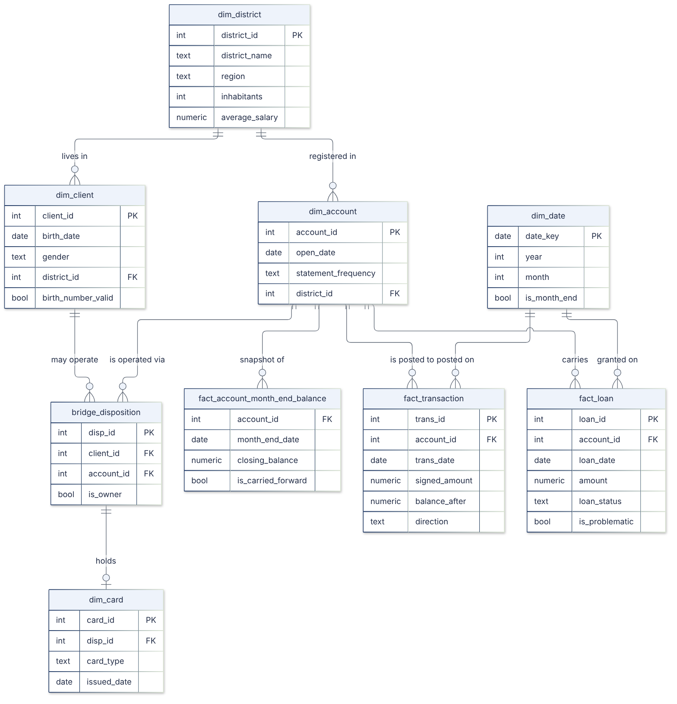




Proof 2 · One meaning, checked on every build
raw
stg
dq
core
ai
sec
you are here
11
entities, grain and every column described
12
certified metrics with their time column
19
joins with measured cardinality
7
caveats with row counts
Decided once
The build fails if …
Owner = the OWNER disposition
Problematic = status B or D (76 / 682)
Incoming = credits, unsigned
Month-end = last posting, carried forward
a column doesn't exist or isn't described
a grain isn't one row per key
a join's cardinality changed
a metric names a missing column
Star schema: 4 grains (client, account, loan, posting), natural keys, verified every build
Notes:
[3 minutes] Task two. A star schema, because the questions live at four grains, and a wide table turns every count into
count(distinct) — exactly what generated SQL gets wrong quietly. Each business word is decided once, in the model and in
the semantic layer. The semantic layer is not prompt text: it's a file the build validates against the live database.
A layer that drifted gives the model confident wrong information it cannot check. Its 'is not' glossary is the AI-ready part:
a disponent is not the owner, incoming is not a net flow.
Raise it here: the month-end fact breaks same-day ties by the highest transaction id — disclosed; I'll come back to it.
Documents: model_explanation.md, semantic_layer.yaml, DDR §3 and §5.

Slide 8
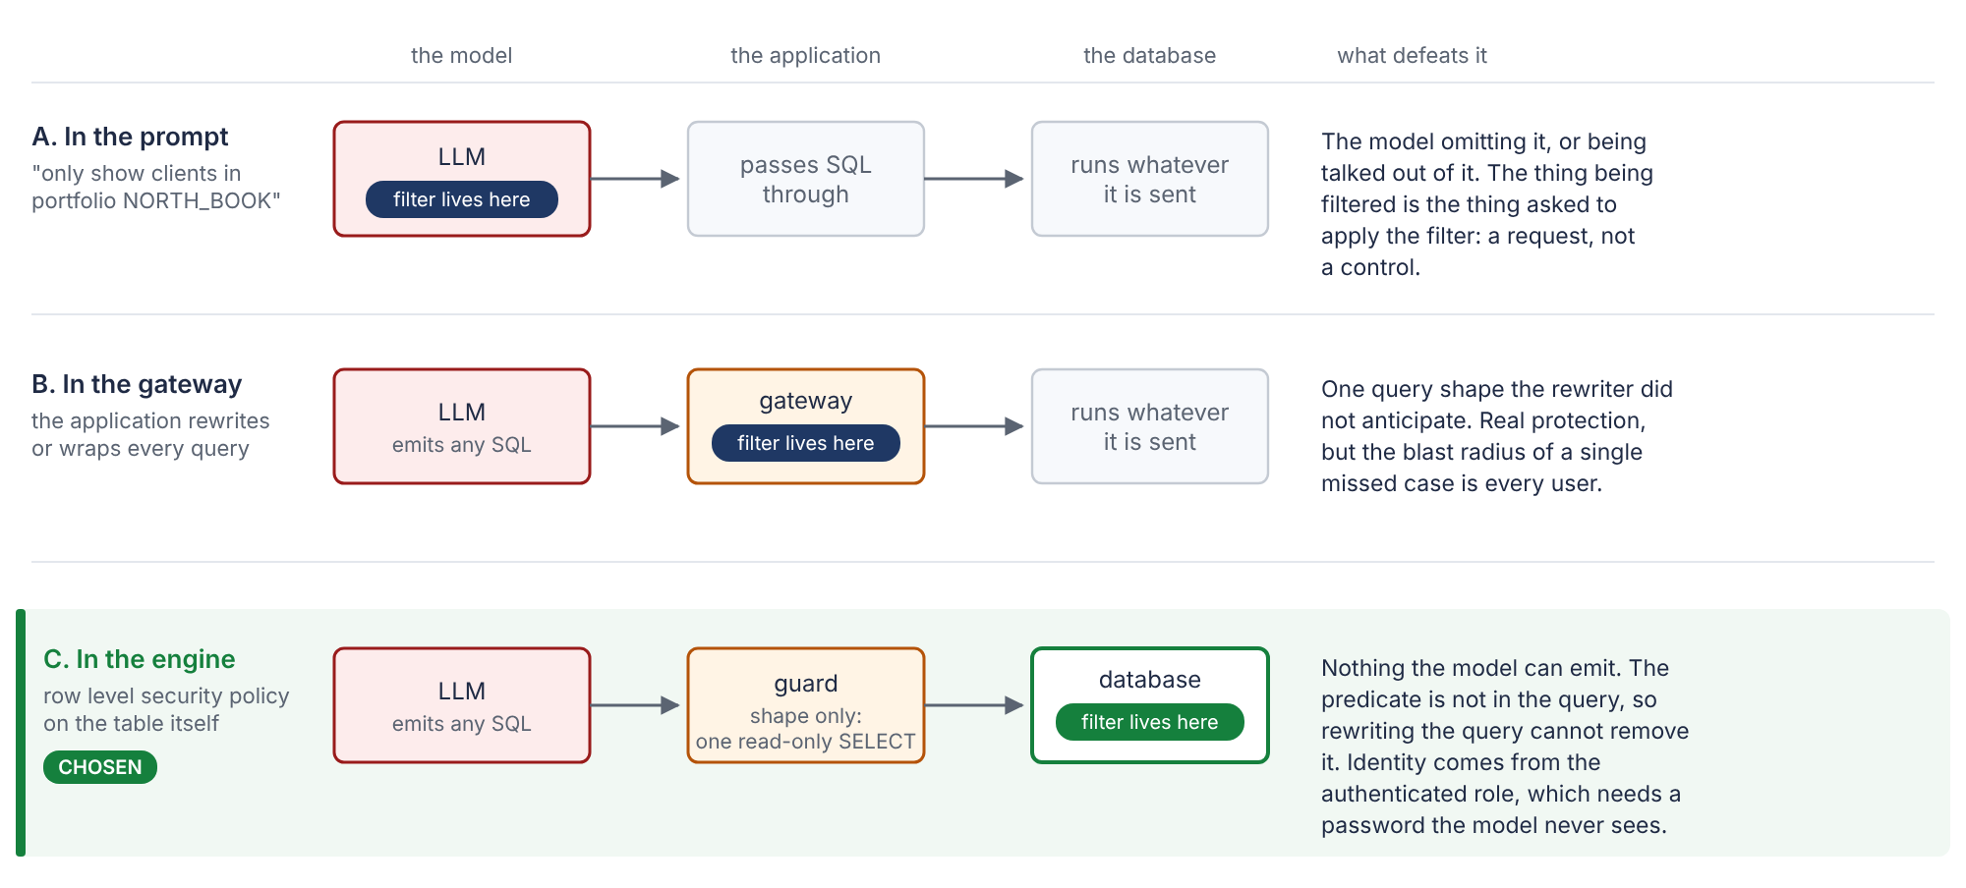


Proof 3 · Access the model cannot bypass
raw
stg
dq
core
ai
sec
you are here
Where
7 RLS policies on the client-bearing core tables; every view in between is security_invoker
Why no bypass
The predicate isn't in the model's text; identity is session_user; no BYPASSRLS
Onboarding
Insert a user + portfolio, create the role, enrol TOTP — no code. Offboarding: one UPDATE
Two factors
Password alone → 0 rows; the code is verified inside the database
Notes:
[3 minutes] Task three asked me to explain — I built and tested it. The filter is a row level security policy on the base
tables, so it sits inside every statement's plan, evaluated as the caller because every view in between is security_invoker.
The caller is session_user, which no SQL can change. The model only writes text; the predicate isn't in the text, so there's
nothing to remove. The bank-wide user is a portfolio of every client, not an exemption — and a new user with no portfolio sees
zero, not everything. Nine bypass attempts in the tests fail. Onboarding is inserts; the grants are derived live.
Know the limits: a disponent sees the owner's card (L-05); a direct client can roll back failed codes (L-09).
Documents: ACCESS_AND_AUTH, workbook 'Entitlements', DDR §6.

Slide 9

One question, end to end — and who protects what
Question
Semantic layer
LLM writes SQL
Guard
2FA login
RLS on core
Answer + log
“What % of loans are problematic?”
the model's whole world: no data, no tools
one JSON: sql + reasoning
one read-only SELECT on ai, LIMIT ≤ 10,000
the user's own session, 60 s timeout
only this user's rows exist
rm_north 179 loans · cro_global 76 / 682
MEANING — removes reasons to guess
SHAPE
ROWS — the security boundary
CHECK
The guard proves a query is safe to run — not that it answers the question.
Observed: “Find male or female loans in Q1 1995” → SQL used T2.gender on ai.account_owner → guard allowed → database: column does not exist. Safe failure, but valid-and-wrong SQL would have returned a plausible number.
Later we fixed it (not in the delivered version): an intent check (D029) refuses this query before it runs.
Notes:
[2 minutes] One question all the way through. The model sees only the semantic layer and the question. Its SQL is parsed
by the guard, then runs on the user's own two-factor session, where row level security decides the rows; every call is logged.
The coloured band is the point: meaning, shape and rows are different jobs. And the orange box is the honest limit:
the guard is a shape filter. The gender question passed it and failed in the database — a safe failure. A query that is valid
but wrong would not fail. In the delivered version the intent checker was a prototype; after delivery I built it in (D029).
Documents: src/sql_guard.py, DDR §7, Lessons L-07.

Slide 10
The evidence — and what it does not prove
What it shows
The semantic layer is good enough for a strong model on these questions
No SQL hand-corrected; references never shown to the model
A weak model fails in exactly the ways the layer warns about
What it does not show
Generalisation: no hold-out set, and the pack names the questions
Stability: one sample per question
Currency: recorded on the pack before the semantic audit
10/10
~2 min
327
first attempt
USD 0.40, every call logged
tests passed (1 skipped)
Notes:
[2 minutes] The evidence. Claude answered all ten on the first attempt; all ten match hand-crafted reference SQL, compared
by value — two correct queries name columns differently, so comparing SQL text would measure style. The small local model
scored six: it counted instead of computing a share, and fanned out a join — exactly the traps the layer warns about.
Then say what it doesn't prove before anyone asks: no hold-out, one sample, an older pack. The honest claim is 'good enough
for a strong model on these ten', not 'it generalises'. Every figure is mapped to its source in DELIVERY_AUDIT.md.
Precise authorship: the reference SQL wasn't written by the model under test, and every answer was re-derived from raw (L-12).

Slide 11


Where I would challenge myself
Month-end tie-break
Highest trans_id picks the closing posting — right 0.4% of the time where the balance chain decides
Disclosed · fixed after
Guard ≠ meaning
A safe query can be wrong; the intent checker was a prototype
Disclosed · fixed after
10/10 is narrow
No hold-out, question labels in the pack, one sample
Partly disclosed
Disponent privacy
Sees the owner's card; a hidden owner shows as 'no card' — false, not hidden
Found after delivery
Scope vs a 1–2 day brief
2FA, web tour, deployment guide, agents — tasks first; I'd cut those first
Talk track
Notes:
[2 minutes] Before you ask, these are the five things I would challenge myself on. The first two I disclosed at delivery and
fixed afterwards on a separate branch. The evaluation is narrower than 10 out of 10 suggests. The disponent finding is one I
made after delivery: row level security changed the meaning of a column — hidden became a false value. And scope: the tasks
came first; if I had to cut, the deployment guide, the simulated agents, then the web page.
Detail and wording for each: Lessons Learned document, L-01, L-07, L-08, L-05/L-06, L-19.

Slide 12

The lesson I'd take to any data team
My best-looking defect — “an account off by exactly 1,200: a missing posting” — was my own bug.
opening
+1.30 interest
−1,200.00 withdrawal
What I learned
10,500.00
id 3,467,643 → 10,501.30
id 1,137,901 → 9,301.30
A derived check inherits the bugs of what it reads
'Unknowable' is a hypothesis — test it before documenting it
When a number makes a great story, check it twice
Account 3888, 31 Jan 1998 — each posting starts where the previous one ended. The chain says the withdrawal came last; my rule (highest id) read 10,501.30.
0.4%
55 → 14
+1.53
107
how often the highest id was the true closing posting
material reconciliation breaks after the fix
change in the Q9 average (43,808.94 → 43,810.47)
accounts with a different closing balance
Notes:
[2 minutes] This is the story I'd tell any data team. I assumed the source had no intra-day order and broke same-day ties by
the highest id — and disclosed it. Going back, the running balance records the order: each posting starts where the previous
ended. The highest id was right 0.4% of the time. The average barely moved, 1.53 CZK, but 107 accounts did.
And my most convincing defect — an account off by exactly 1,200, 'a missing posting' — was this account: an interest credit
with a higher id than the withdrawal after it. My reconciliation rule read my own wrong balance: 55 material breaks became 14.
Also worth one sentence: my checks caught me twice before delivery — the self-test that nearly deleted real data, and the view
that leaked all 682 loans. Documents: Lessons L-01–L-03, chapter 7.

Slide 13
What I did next, and what changes at 100,000×
After delivery — on a separate branch
At 100,000× (≈ 100 bn postings, 10 TB)
 | Delivered | After
Closing posting | highest trans_id | balance chain (D028)
Q9 average | 43,808.94 | 43,810.47
Material breaks | 55 | 14
Accounts that change | — | 107 (max 1,200.00)
Meaning of SQL | guard only | intent verified (D029)
Gender question | DB error | refused before running
Where | fc0c281 (handed in) | this branch, with tests
Rebuild-from-scratch becomes incremental: month partitions, merge not replace
Rules check what arrived; info sampled, block exact
Month-end maintained from last month + new postings
Entitlements as a materialised (role, account) set
A hold-out question set and monitoring
Not merged: it changes a certified number — that needs the business to sign off the rule.
Unchanged: the filter stays in the engine, onboarding stays an insert, the semantic layer stays the same size.
Notes:
[90 seconds] After delivery I fixed the two most important limitations on a branch, with tests and before/after evidence, and
deliberately did not merge them: changing a certified number during a freeze, without sign-off, is what a governed product
should not do. At a hundred thousand times, everything 'rebuild from scratch' becomes 'maintain incrementally', and the
entitlement join becomes a materialised set — but the design does not change. Documents: DDR '100,000×', DECISIONS D028–D029.

Slide 14
Traceable numbers. No silent repairs. A filter the model cannot reach.
Where it is weak, it is written down — with the evidence and the fix. Questions welcome.
Notes:
[30 seconds] Three things to remember: every number traces to a command; nothing is silently repaired or dropped; and the
filter sits where the model's text cannot reach it. Where it's weak, I've told you, with evidence and the fix.
Backup slides: how the documents fit, the ten answers, the decision map, question anchors, security residuals.

Slide 15
Backup · how the documents fit the story
1–2 Problem & principle
3 Trustworthy data
3 One meaning
Brief + questions.csv
DDR — context, decisions 1 and 7
Workbook: Defect types, DQ rules, Cleaning
dq_rules.yaml · dq_report.md
CLEANING_LEDGER.md · DDR decisions 2 and 4
model_explanation.md · Workbook: Model
semantic_layer.yaml → context_pack.md
DDR decisions 3 and 5
3 Access
4 Evidence
5 Honesty & next
ACCESS_AND_AUTH.md · WORKED_EXAMPLE.md
Workbook: Entitlements
DDR decision 6
Workbook: Questions, Q detail
llm_results / evaluation.json · llm_logs/
DELIVERY_AUDIT.md — every claim → source
Lessons Learned (02) · DECISIONS.md
ASSUMPTIONS.md · DDR 100,000×
Study guide (01 / 01b) for depth
Notes:
Use when asked "where is the evidence for X?". The single map of every claim to its source is docs/DELIVERY_AUDIT.md.

Slide 16
Backup · the ten answers, as delivered
Q | Question | Answer
1 | Clients per region | south Moravia 937 · north Moravia 920 … (client's own district, all 5,369)
2 | Loans granted per year | 1993 2.62 m (half year) … 1997 peak 30.73 m · total 103,261,740
3 | Share of problematic loans | 76 / 682 = 11.14% (status B or D)
4 | Average loan by owner's card | junior 221,970 (n = 21) · gold 161,881 · no card 148,865 · classic 148,809
5 | Top 10 districts, incoming 1997 | Hl.m. Praha 115.13 m · Karvina 28.51 m · Ostrava 27.69 m …
6 | New accounts per month 1996 | 106 · 104 · 124 · 101 · 91 · 113 · 137 · … · 125 (1,363)
7 | Owner age at loan start | A 37.07 · B 39.60 · C 38.70 · D 37.00
8 | Gold-card owners by gender | male 53 (60.23%) · female 35 (39.77%)
9 | Average balance end Dec 1998 | 43,808.94 over 4,500 accounts (76 carried forward)
10 | Highest problematic share by frequency | after transaction 18.75% (6 of 32 — not significant)
Notes:
Interpretations: A1–A16. Least confident: Q10 (small n), Q4 (odd population), Q9 at account level (tie-break).

Slide 17
Backup · decisions by layer
raw
stg
dq
core
ai
sec
D003 verified public mirror
D004 defects only in inject
D013 never repair in place
D014 placeholders → NULL
D015 19xx dates, NULL on failure
D016 derived gender, labelled
D018 sign resolved once
D020 graded, not gated
D008 quarantine scoped to stg
D006 / D017 one code map, checked
D007 natural keys
D019 month-end decided once
D012 rebuild restores ai
D005 sandboxed LLM
D010 every view security_invoker
D011 value-based evaluation
D009 filter in the engine
D021 a customer IS a client
D023 / D024 account, not person
D025 three identifiers
D026 2FA in the database
D027 derive grants
Notes:
D001 (repository at the git root) and D002 (PostgreSQL) span all layers. D022 is superseded by D023. Full text: DECISIONS.md, study guide chapter 18.

Slide 18
Backup · likely questions and where the answer is
If they ask … | Short answer | Go to
Why not DuckDB / a warehouse? | Task 3 needs enforcement in the engine; DuckDB has no RLS | DDR §1
Why never repair a value? | A repaired value looks observed a week later | D013, Proof 1
Your only block is 0.00 CZK? | The rule can only catch zero-amount duplicates; warn rule for batches | L-04
Can the LLM bypass the filter? | It writes text; the predicate isn't in it; identity = session_user | Proof 3
Does passing the guard mean correct? | No — shape only. The gender query proves it | L-07
Is 10/10 meaningful? | Narrow: no hold-out, one sample, older pack | L-08
Biggest mistake? | The tie-break; the 1,200 story was my own artefact | L-01–L-03
Why so much for 1–2 days? | Tasks first; extras requested; cut deployment guide first | L-19
Notes:
Full question bank: study guide chapter 17; mistake answers: Lessons Learned chapter 10.

Slide 19
Backup · security residuals, stated before they are asked
Residual | Status | Fix
Direct client rolls back failed second-factor guesses | Disclosed (strict xfail) | Count attempts outside the caller's transaction, or gateway-only logins
Session bound to backend PID only | A45 | Compare backend_start too
Disponent sees the owner's card and disposition row | Found after delivery | Holder-based card policy; own-row dispositions; tests
Hidden owner fields shown as 'no card' / NULL | Found after delivery | No coalesce over RLS-hidden joins; say 'not visible'
TOTP secrets recoverable; demo shows codes | A44, A46 | Encrypt with an external key; real enrolment
No read audit, no masking, role-per-user pooling | Recommended | Audit log; masking; pool per role or SET ROLE gateway
Notes:
Row level security itself is unaffected by all of these: without the second factor a principal reads no rows.

