Slide 1

LANG -F -301
Academic English II
Game-Theoretic Question Selection for Tests
Antoine de Selys Longchamp
Robin Engels

Slide 2
Introduction
How to test people ?
- Problem with large scale test
- Algorithms

Slide 3
Examples
Driving licences
- MOOCs
- Certificates

Slide 4
Examples
Monitored test centres
- Generate random questions

Slide 5
Basis statement
What’s an algorithm ?
- Complexity
- NP-complete

Slide 6
Basis statement
Zero-sum game
- Nash-equilibrium

Slide 7
Binary Test
Pass or fail
- NP-hard
- General Linear Program

Slide 8
Scored Test
Monitored test centres
- Generate random questions

Slide 9
Constant memory size
Test size not constant
- Np-hard

Slide 10
Bayesian game
What is that ?
- Stackelberg strategy

Slide 11
Experiments
General LP
Marginal LP
Scored test
Edmond-Karp
Push-Relabel

Slide 12
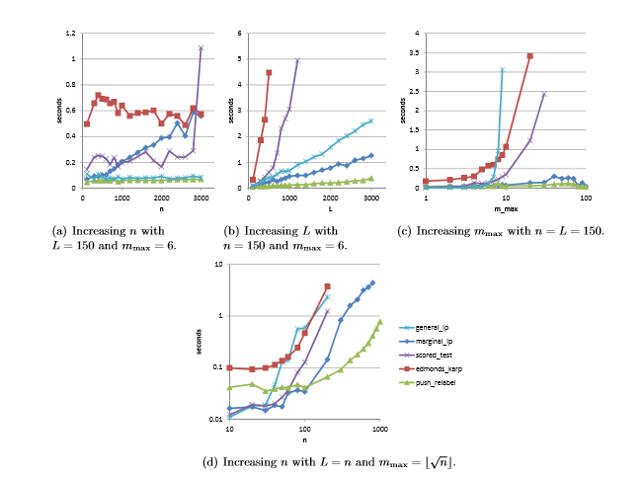
Runtime for an optimal tester strategy

Slide 13
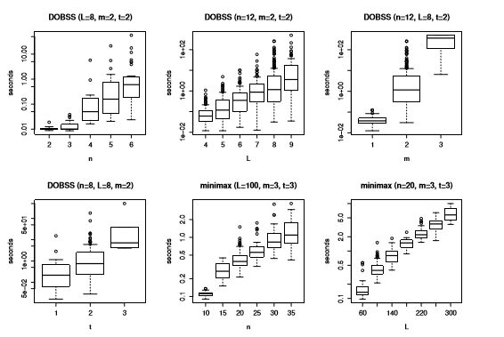
Runtime for an optimal tester strategy

Slide 14
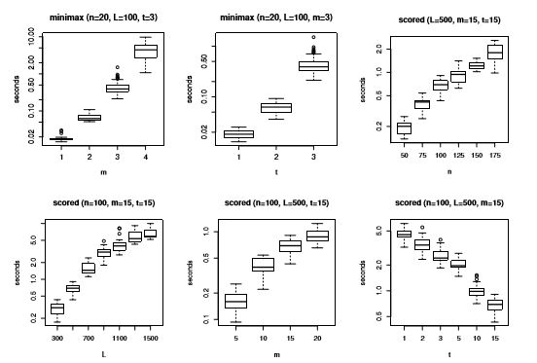
Runtime for an optimal tester strategy

Slide 15
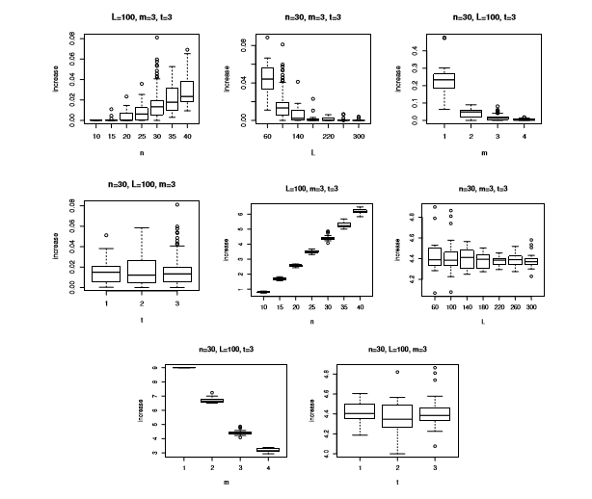
Increase in tester utility

Slide 16
Discussion
What we can conclude about these graphs ?

Slide 17
Questions ?

