Slide 1

LANG -F -301
Academic English II
Game-Theoretic Question Selection for Tests
Antoine de Selys Longchamp
Robin Engels

Slide 2
Introduction
How to test people ?
- Problem with large scale test

Slide 3
Examples
Driving licences
- MOOCs
- Certificates
- Monitored test centres

Slide 4
Introduction
How to test people ?
- Problem with large scale test
- Algorithms

Slide 5
Basis statement
What’s an algorithm ?

Slide 6
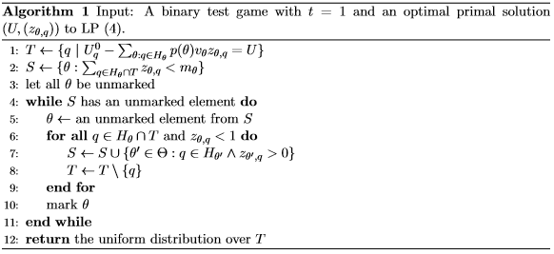
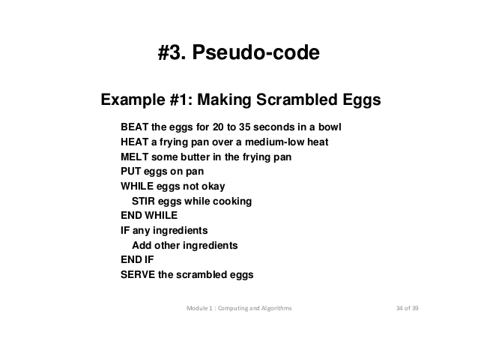
Basis statement

Slide 7
Basis statement
What’s an algorithm ?
- Complexity

Slide 8
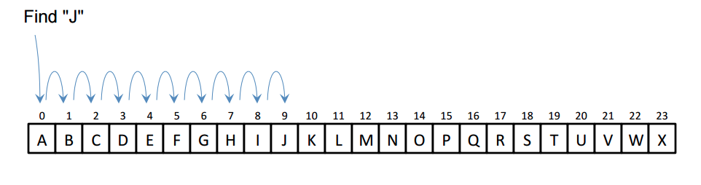
Basis statement
Linear search

Slide 9
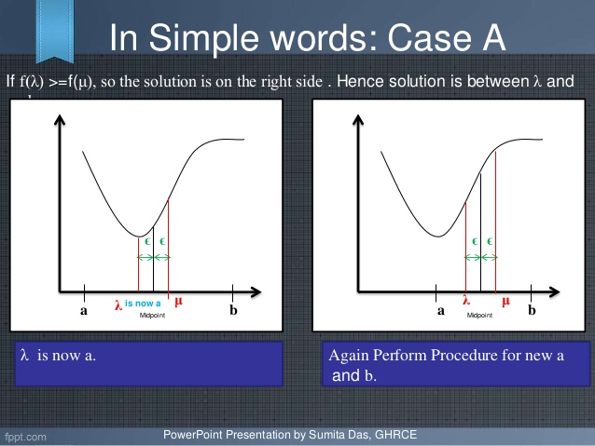
Basis statement
Dichotomous search

Slide 10
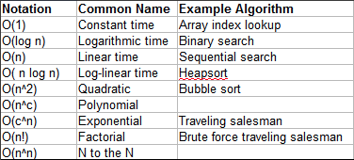
Basis statement
What’s an algorithm ?
- Complexity

Slide 11
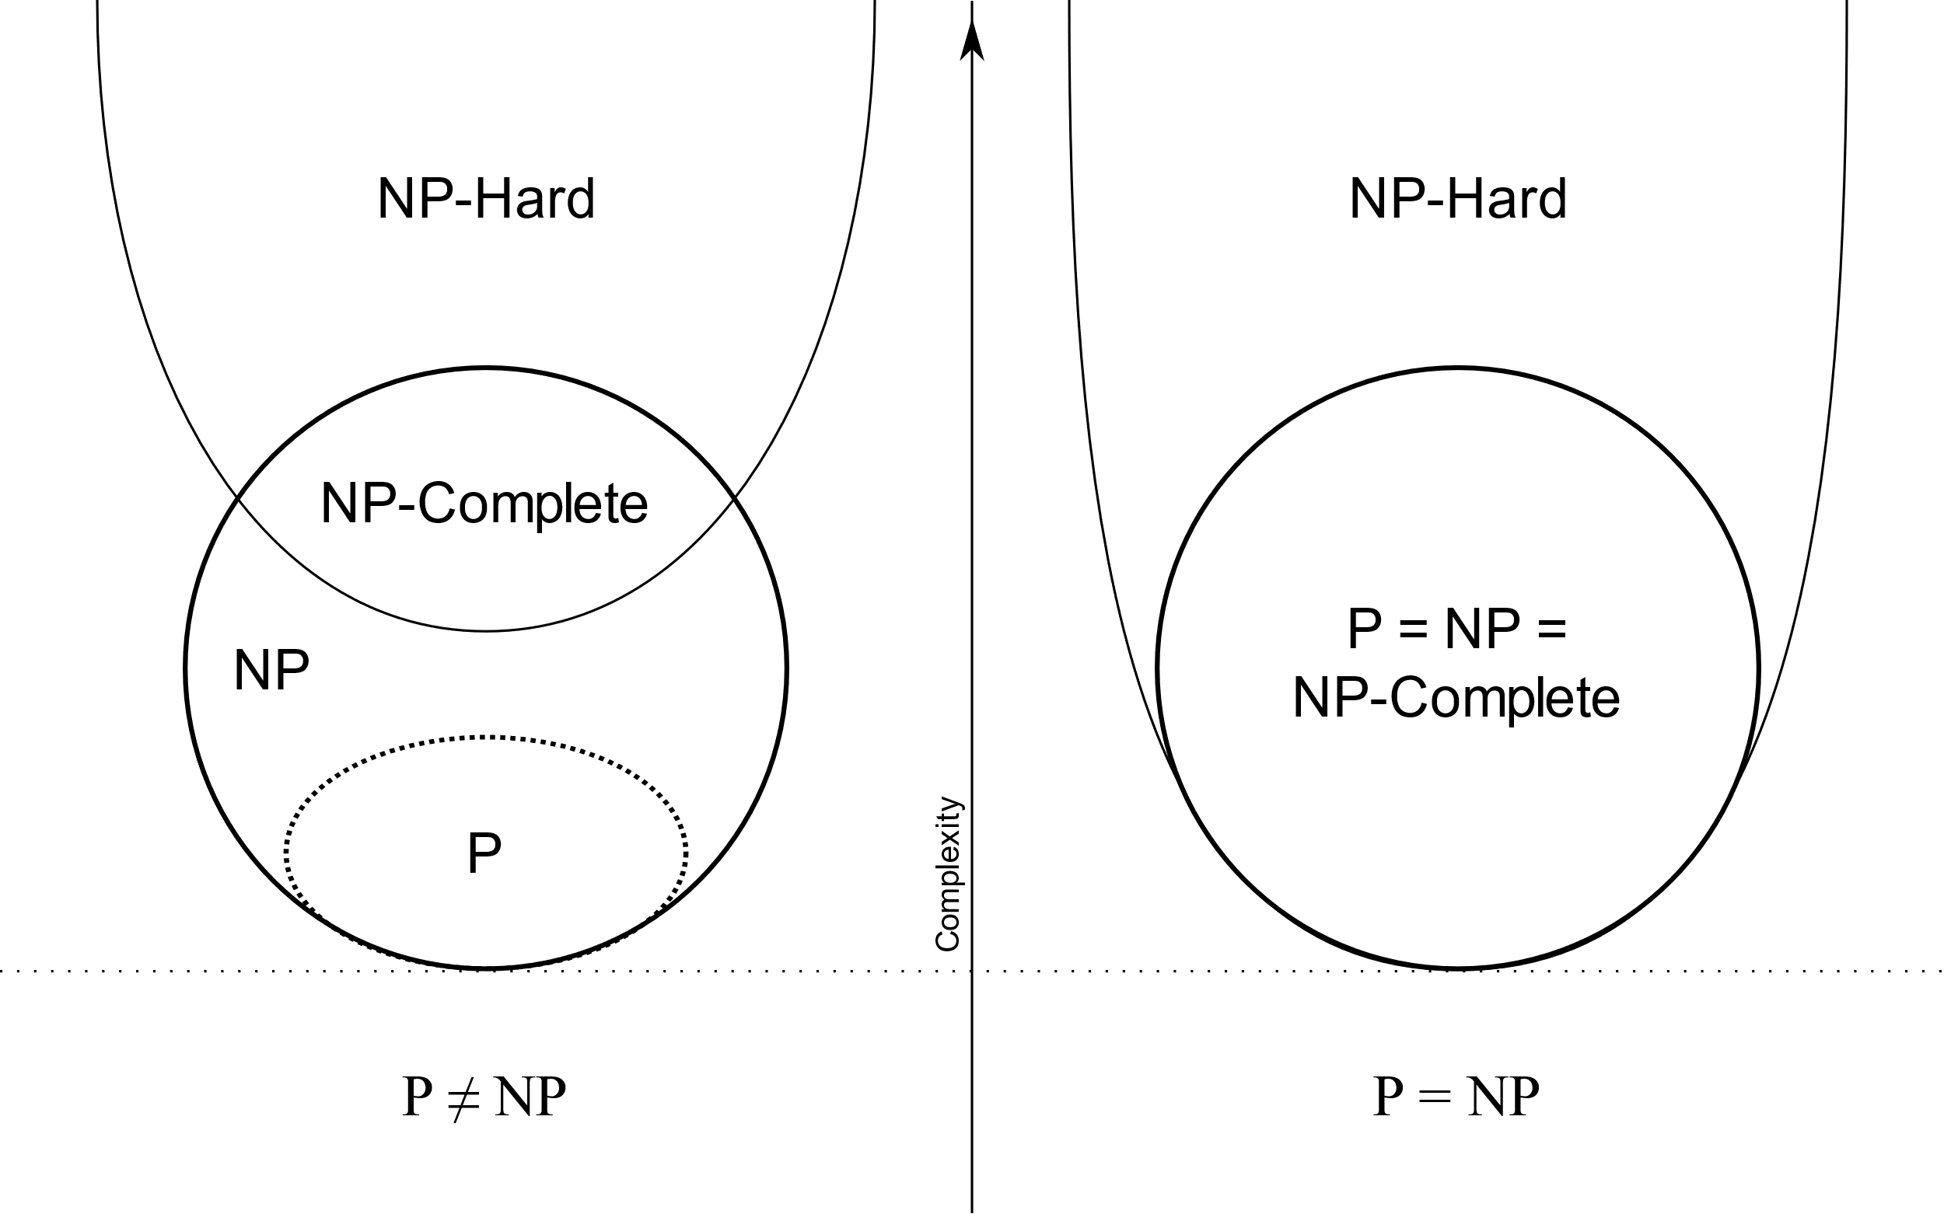
Basis statement
What’s an algorithm ?
- Complexity
- NP-complete

Slide 12
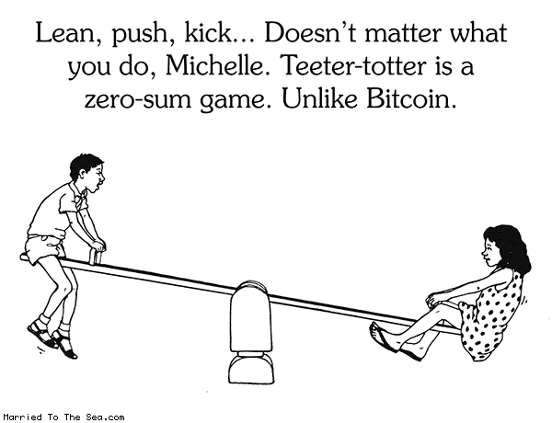
Basis statement
Zero-sum game

Slide 13
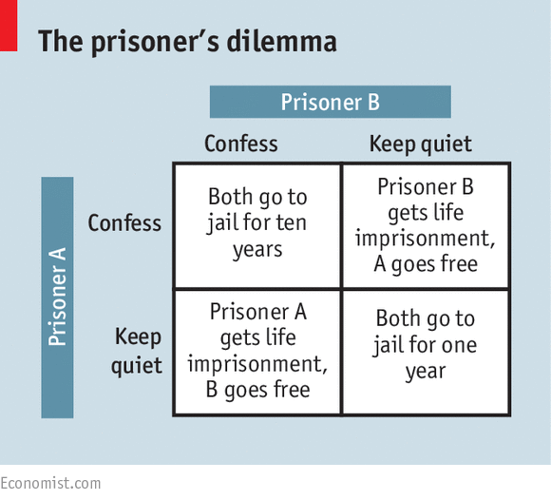
Basis statement
Zero-sum game
- Nash-equilibrium

Slide 14
Binary/Scored Test
Pass or fail / Score
- NP-hard
- General Linear Program

Slide 15
Bayesian game
What is that ?
- Stackelberg strategy

Slide 16
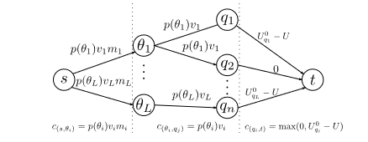
Experiments
General LP
Marginal LP
Scored test
Edmond-Karp
Push-Relabel

Slide 17
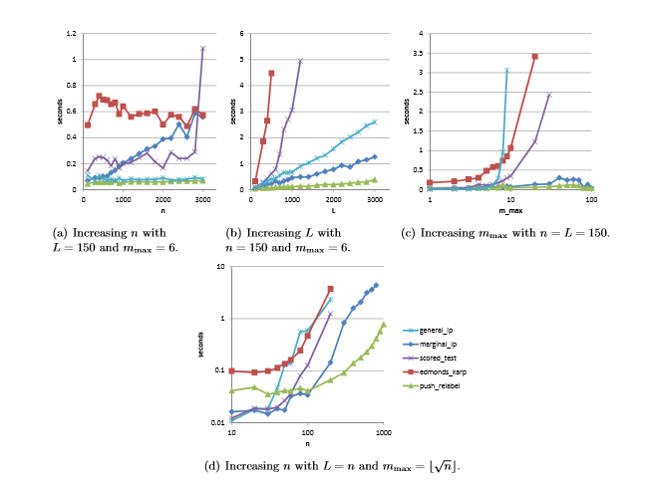
Runtime for an optimal tester strategy
L = Number of test taker types
M_{max} = Number of question that can be memorized
n = Number of question available

Slide 18
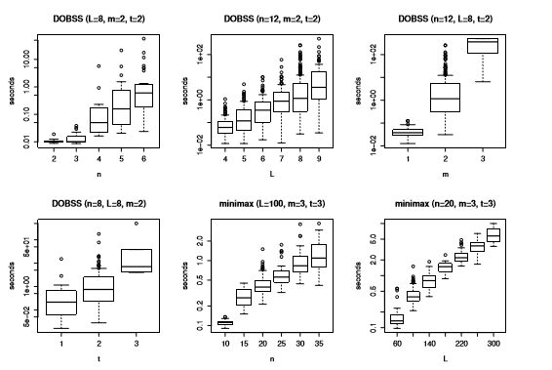
Runtime for an optimal tester strategy

Slide 19
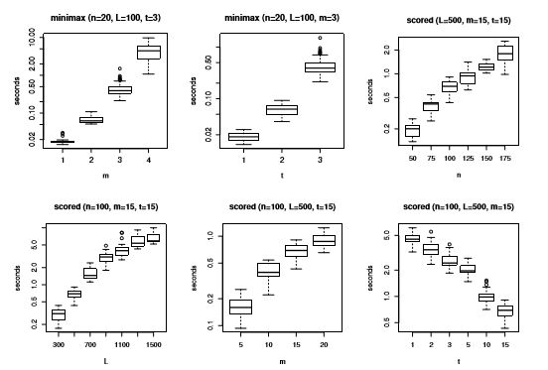
Runtime for an optimal tester strategy

Slide 20
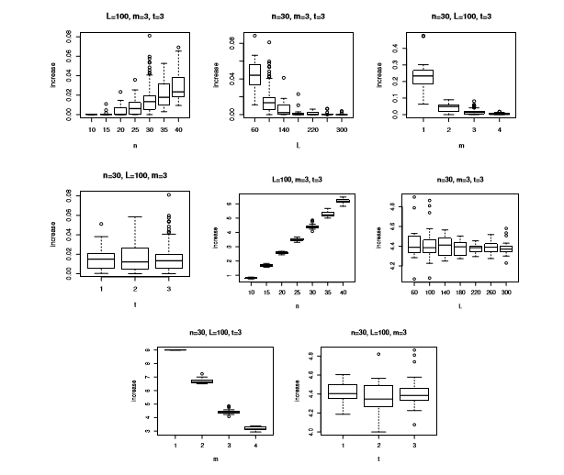
Increase in tester utility

Slide 21
Discussion
What we can conclude about these graphs ?

Slide 22

Questions ?

