Slide 1
CAFE
SALES
ANALYSIS
Use this space for legal copy.
State whether the information is confidential and how it's intended to be used.
M1 Final Project
Thierno & Kabbo

Slide 2
Thierno & Kabbo
THE MARCY LAB SCHOOL
AGENDA
01
INTRODUCTION
02
DATA CLEANING STRATEGIES
03
KEY FINDINGS
04
VISUALIZATIONS
05
RECOMMANDATIONS
06
REFLECTIONS
07
THANK YOU

Slide 3
THIERNO & KABBO
THE MARCY LAB SCHOOL
INTRODUCTION
This project provides a comprehensive analysis of café sales data to help the café owner make data-driven decisions for marketing campaigns and operational improvements. We analyzed 10,000 transactions from 2023 to identify peak business periods, customer preferences, and revenue optimization opportunities. The analysis was conducted using both Python (Jupyter notebooks) and Excel to provide multiple perspectives on the data, focusing on when the busiest and most profitable times are, general sales trends, and data quality issues.

Slide 4
Thierno & Kabbo
THE MARCY LAB SCHOOL
HOW DID WE CLEAN THE DATA ?
Item Column: Filled missing values with 'UNKNOWN'
Quantity Column: Used median imputation
Price Per Unit: Used mean imputation
Total Spent: Recalculated using formula: Price Per Unit × Quantity
Transaction Date: Dropped 460 rows with missing dates (final dataset: 9,540 transactions)
Payment Method & Location: Left missing values as-is for analysis (31.78% and 39.61% missing respectively)
Standardization
Imputation
All blanks, errors, and unknown values were standardized as "UNKNOWN"
Missing values were handled using appropriate statistical methods based on data distribution

Slide 5
Thierno & Kabbo
THE MARCY LAB SCHOOL
KEY FINDINGS
Total Revenue: $85,152.12 across 9,540 transactions
Average Transaction Value: $8.93
Peak Revenue Month: June ($7,409.88)
Top Revenue Day: Sunday ($12,420.65)
Highest Sales Months: June ($7,409.88), October ($7,343.66), January ($7,249.60)
Lowest Sales Month: February ($6,667.20)
Highest Sales Day: Sunday ($12,420.65)
Lowest Sales Day: Wednesday ($11,774.85)
REVENUE PERFORMANCE
TIME BASED INSIGHTS
METRICS
PRODUCT ANALYSIS
CUSTOMMER BEHAVIOR
Top Product by Revenue: Salad $16,186.84, 19%
Top Product by Quantity Sold: Coffee 3,425 units
Least sold Product : Sandwich 3,266 units
Finding : Treat consumption remains consistent regardless of busy periods
Preferred Payment: Digital Wallet

Slide 6
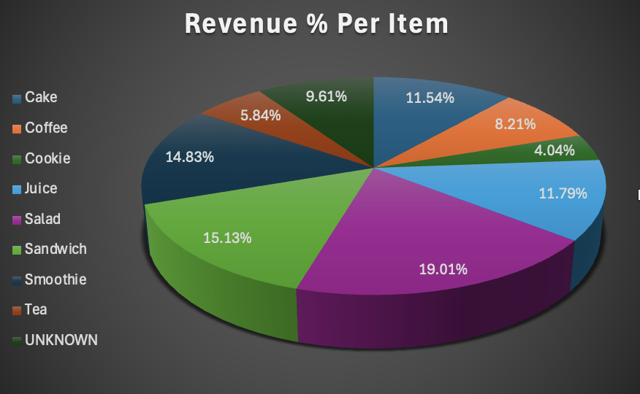
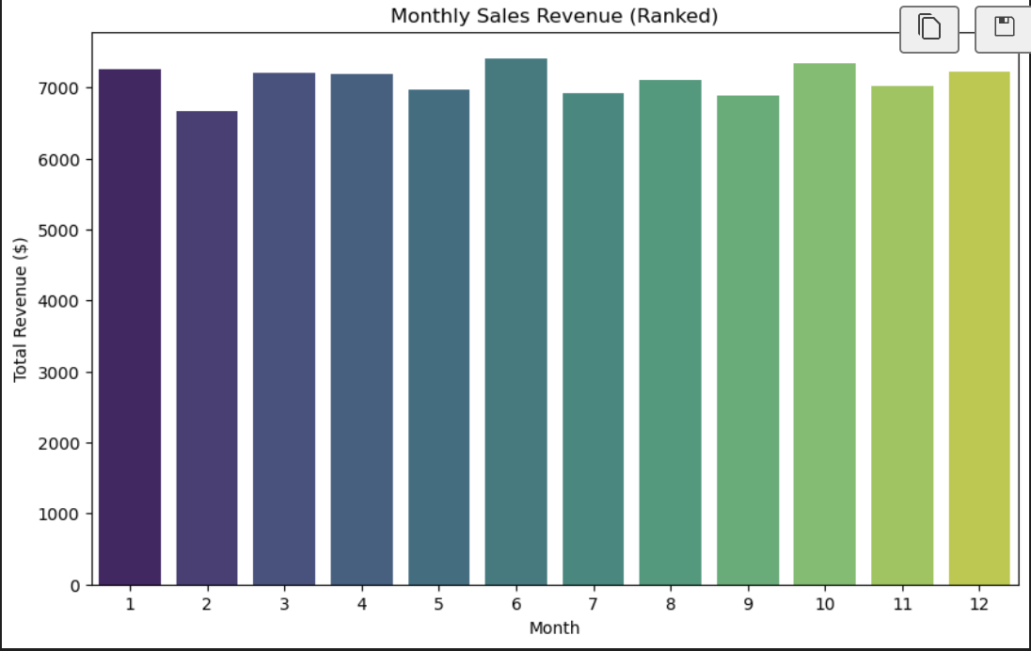
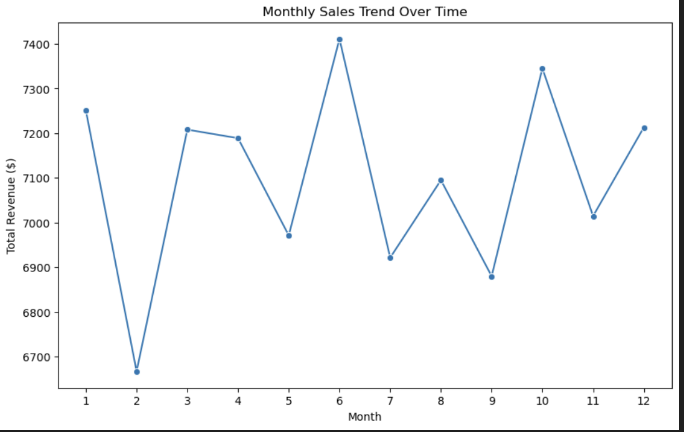
Pie chart, % Revenue Per Item
Bar chart, Monthly Sales
Line Trend, Sales over Months
VISUALIZATION
Salad with 19 % is the product with the highest sales
June is the highest Sales Month
The sales don’t follow a specific trend over months. There is no linear evolution of sales

Slide 7
RECOMMENDATIONS
THE MARCY LAB SCHOOL
Focus Marketing on Peak Times
Product Portfolio Optimization
Operational Improvements
Based on the analysis of seasonal trends and consumer behavior, the following recommendations are proposed to optimize campaign timing and drive engagement.
To enhance sales performance and customer engagement, the following product-focused strategies are recommended based on item popularity and revenue contribution:
The following operational insights aim to maintain efficiency while improving data quality and decision-making across payment and location channels:
Target June, October, and January for major campaigns
Leverage Sunday traffic with special promotions
Consider weekday-specific strategies given higher transaction volume
Promote High-Revenue Items: Focus marketing on Salad and Sandwich offerings
Leverage Popular Items: Use Coffee and Juice as traffic drivers
Treat Strategy: Maintain consistent treat offerings as consumption patterns are stable
Optimize inventory based on monthly trends (more stock on months like June)
Adjust staffing for peak days and times (Extra staff member on Sundays and Thursdays)
Focus marketing on high-performing products ( Promos and combos associated to Salad)
Improve payment processing for preferred methods, add self check register as most customers pay digitally to improve the pace.

Slide 8

Thierno & Kabbo
THE MARCY LAB SCHOOL
REFLECTIONS
Working with real-world, messy data was a new and eye-opening experience.
We faced missing values and inconsistencies that needed careful cleaning.
We learned that data preparation is just as important as analysis itself, if not more.
The process pushed me to ask better questions and focus on meaningful insights.
It helped me grow both technically and in how I approach complex problems.
Using Git with my partner showed me that collaboration isn’t always easy, but it’s essential for staying organized and aligned.
Managing our tasks and timelines with Notion helped us build project management skills and stay on track.

Slide 9
CONCLUSION
THE MARCY LAB SCHOOL
THANK YOU
Any questions?

