Slide 2
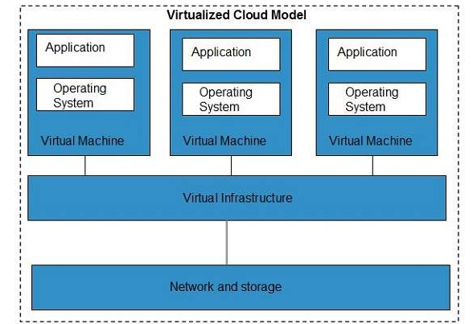
Cloud Computing Technologies
Virtualization
allows to share single physical instance of an application or resource among multiple organizations or tenants (customers).

Slide 3
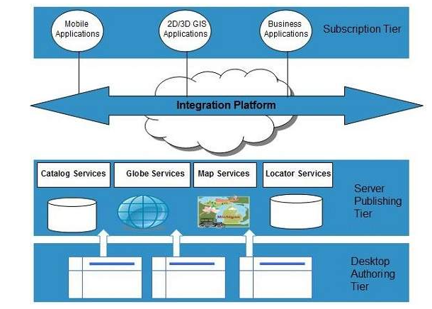
Cloud Computing Technologies - Service-Oriented Architecture
To use applications as a service for other applications regardless the type of vendor, product or technology.
Dr.M.Pyingkodi,MCA Department

Slide 4
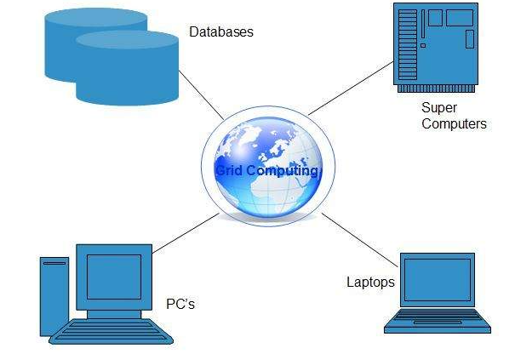
Cloud Computing Technologies - Grid Computing
To distributed computing, in which a group of computers from multiple locations are connected with each other to achieve a common objective
Dr.M.Pyingkodi,MCA Department

Slide 5
Based on Pay-per-use model.
It offers computational resources on demand as a metered service.
Cloud computing, grid computing, and managed IT services are based on the concept of utility computing.
Cloud Computing Technologies - Utility Computing

Slide 6
Essential Concepts
Abstraction
CC abstracts the details of system implantation from the users
Applications runs on physical systems that aren’t specified
Data is stored in locations that are unknown
Virtualization
CC virtualizes systems by pooling and sharing resources
Systems and storage can be provisioned as needed from a centralized infrastructure
Costs are assessed on a metered basis, multi tendency is enabled and resources are scalable with agility
Dr.M.Pyingkodi, Dept of Computer Applications, Kongu Engineering Colege, Erode, Tamilnadu

Slide 7
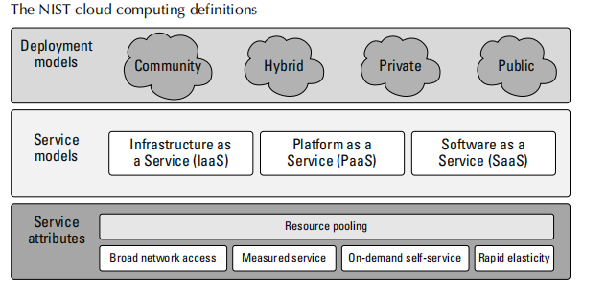
NIST

Slide 8
Cloud Types
Deployment Models
To the Location and management of the cloud’s infrastructure
Public
Private
Hybrid
Community
Services Models
IaaS (infrastructure as a Services)
Paas ( Platform as a Services)
Saas (Software as a Services)

Slide 9
Types of Cloud Services
Infrastructure as a Service
IaaS provides virtual machines, virtual storage, virtual infrastructure, and other hardware assets as resources that clients can provision.
Platform as a Service
PaaS provides virtual machines, operating systems, applications, services, development frameworks, transactions, and control structures.
Software as a Service
SaaS is a complete operating environment with applications, management, and the user interface.

Slide 10
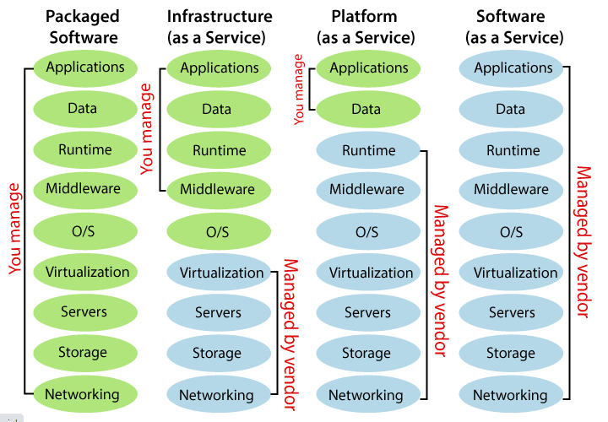
Types of Cloud Services

Slide 11
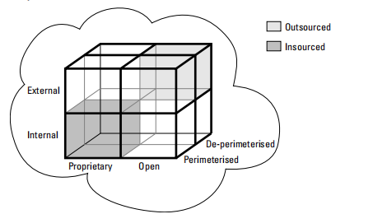
Cloud Cube Model

Slide 12
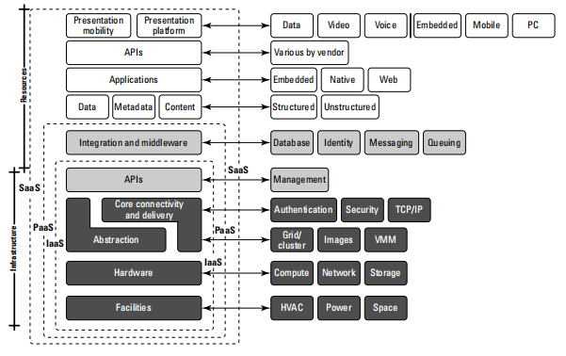
Cloud Reference Model

Slide 13
IaaS Service Provider
Amazon Elastic Compute Cloud(EC2)
Eucalyptus
GoGrid
FlexiScale
RackSpace Cloud
Linode
Terremark
All these vendors offer direct access to hardware resources
A client would provision a computer in the form of a virtual machine image, provision storage, and then go on to install the operating system and applications onto that virtual system.

Slide 14
PaaS
A PaaS service adds integration features, middleware, and other orchestration and choreography services to the IaaS model.
Examples of PaaS services are
  Force.com
  GoGrid CloudCenter
  Google AppEngine
  Windows Azure Platform

Slide 15
SaaS
When a cloud computing vendor offers software running in the cloud with use of the application on a pay-as-you-go model, it is referred to as SaaS.
With SaaS, the customer uses the application as needed and is not responsible for the installation of the application, its maintenance, or its upkeep.
A good example of an SaaS offering is an online accounting package
      GoogleApps
      Oracle On Demand
      SalesForce.com
      SQL Azure

Slide 16
Top five cloud applications
Collaboration applications
Web applications/Web serving
Cloud backup
Business applications
Personal productivity applications

Slide 17
Benefits of Cloud
On-demand self-service:
A client can provision computer resources without the need for interaction with cloud service provider personnel.
Broad network access:
Access to resources in the cloud is available over the network using standard methods in a manner that provides platform-independent access to clients of all types.
This includes a mixture of heterogeneous operating systems, and thick and thin platforms such as laptops, mobile phones, and PDA.
Resource pooling:
A cloud service provider creates resources that are pooled together in a system that supports multi-tenant usage

Slide 18
Benefits of Cloud
Rapid elasticity
Resources can be rapidly and elastically provisioned.
The system can add resources by either scaling up systems (more powerful computers) or scaling out systems (more computers of the same kind), and scaling may be automatic or manual.
Measured service:
The use of cloud system resources is measured, audited, and reported to the customer based on a metered system.

Slide 19
Benefits of Cloud
Lower costs:
Because cloud networks operate at higher efficiencies and with greater utilization, significant cost reductions are often encountered.
Ease of utilization:
Depending upon the type of service being offered, you may find that
you do not require hardware or software licenses to implement your service.
Quality of Service:
The Quality of Service (QoS) is something that you can obtain under
contract from your vendor.
Reliability
The scale of cloud computing networks and their ability to provide load balancing and failover makes them highly reliable, often much more reliable than what you can achieve in a single organization.

Slide 20
Outsourced IT management
A cloud computing deployment lets someone else manage
your computing infrastructure while you manage your business.
Simplified maintenance and upgrade:
Because the system is centralized, you can easily apply patches and upgrades. This means your users always have access to the latest software versions.
Low Barrier to Entry:
In particular, upfront capital expenditures are dramatically reduced. In cloud computing, anyone can be a giant at any time.

Slide 21
Disadvantages of Cloud
if your application needs large amounts of data transfer, cloud computing may not be the best model for you.
cloud computing is a stateless system, That lack of state allows messages to travel over different routes and for data to arrive out of sequence
additional overhead in the form of service brokers, transaction managers, and other middleware must be added to the system
When your data travels over and rests on systems that are no longer underyour control, you have increased risk due to the interception and malfeasance of others.
You can’t count on a cloud provider maintaining your privacy in the face of government actions.
Dr.M.Pyingkodi, Dept of Computer Applications, Kongu Engineering Colege, Erode, Tamilnadu

Slide 22
Assessing the Role of Open Standards
Platform Virtualization of Resource
Service oriented architecture
Web Applications Framework
Deployment of Open Source Software
Standard Web Services
Autonomic Systems
Grid Computing

Slide 29
Dr.M.Pyingkodi, Dept of Computer Applications, Kongu Engineering Colege, Erode, Tamilnadu

Slide 30
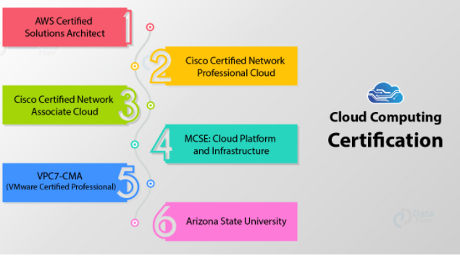
List of Certifications

