Slide 1

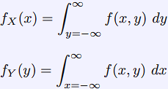




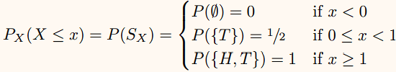


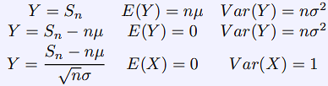








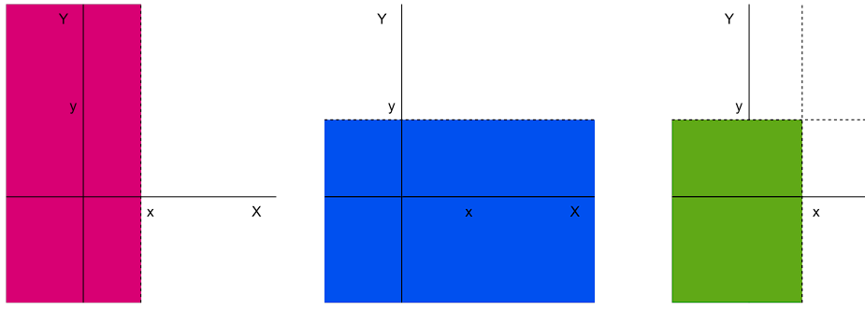





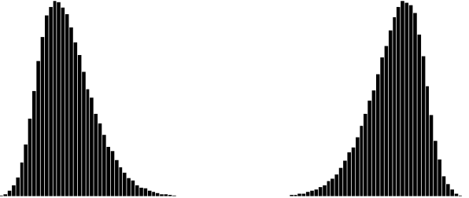





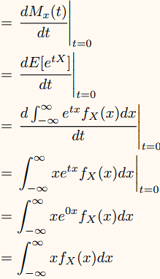












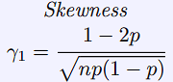
1) Basic Probability Theory
Sample Space – Set of possible outcomes of a random experiment. Usually denoted with set notation, can be finite, countably or uncountably infinite. e.g. Coin Toss,
S={H, T}, 2 Coin Tosses, S={(H, H),(H, T),(T, H),(T, T)}
Choice of Odd number S = {x ∈ N|∃y ∈ N.[2y + 1 = x]}
Event – a subset of the sample space. It is the collection of some of outcomes e.g. Coin Tossing E = {H}, Even Dice Roll E = {2, 4, 6}.
Extreme events (Ø) never happen) - empty set
Event S always happens as it is the entire sample space.
1.1) Probability – if sample space S is Finite or Countable, we can assign probabilities. If uncountably infinite, we cannot have the probabilities reasonably sum to 1. Thus when defining a probability function on S, we define the collection of subsets we’ll measure as F.
F has the following properties:
1. Nonempty 2. Closed under complement
3. Closed under countable union.
A collection of sets is known as a σ-algebra
Probability Measure: A function P : F → [0, 1] on the pair (S, F) such that:
1. ∀E ∈ F.[0 ≤ P(E) ≤ 1] 2. P(S) = 1
3. Countably additive, for disjoint sets E₁, E₂, ··· ∈ F:
From this we derive on a probability measure:
1. P(E) = 1 – P(E) 2. P(∅) = 0
3. Countably additive, for disjoint sets E₁, E₂, ··· ∈ F:
1.2) Probability Interpretations
1) Classical: P(E) = |E| / |S|
2) Frequentist: Through repeated observations of identical random experiments in which E can occur, the proportion of experiments where E occurs tends towards the probability of E. At an infinite number experiments, the proportion of occurrences of E is equal to P(E).
3) Subjective: Probability is the degree of belief held by the individual.
1.3) Joint Events
Joint Events: events E and F that occur at the same time. AKA the and event E ∩ F.
Independent:
Two events are independent if P(E ∩ F)=P(E)P(F).
This can be extended to n events. The events are dependent if this doesn’t hold.
Propositions:
1) If events E and F are independent, then !E and F are also independent. Easily provable with set algebra.
2) P(E ∪ F) = P(E) + P(F) − P(E ∩ F).
We can solve these problems using tables quite easily.
1.4) Conditional Probability
Definition of
Conditional
Probability:
P(E|F) = P(E) if E and F are independent which makes sense and is easily proved with set algebra manipulation.
Conditional Independence: P(•|F) defines probability measure obeying the axioms of probability on set F (When have just reduced S to F).
Three events E1, E2, F are conditionally independent if and only if: P(E1 ∩ E2|F) = P(E1|F) × P(E2|F)
Bayes Theorem:
Partition Rule: (The Law of Total Probability):
Consider a set of events {F₁, F₂, ...} which form a partition of S. Then for any event E ⊆ S, the Law of Total Probability states that:
This makes complete sense! The probability of E is of course the sum of the probability of each event occurring, and then E occurring given them.
Remember: Probabilities of the form P(E | F) are conditional probabilities
Probabilities of the form P(E ∩ F) are joint probabilities. Probabilities of the form P(E) as marginal probabilities
2) Random Variables
Probability Space: (S, F, P) Models a random experiment where probability measure P(E) is defined on subsets E ⊆ S belonging to sigma algebra F.
Random Variable: Random variable is a mapping from the sample space to the reals, e.g: X: X : S → R
Each element in the sample space s ∈ S is assigned to a numerical value by X(s). When referring to the value of a random variable we use its name, e.g X in P(5 < X ≤ 30) Simple RV: Finite set of possible outcomes. (dice faces)
Discrete RV: Countable outcomes. (distance (m))
Continuous RV: Can be a continuous range (temp)
M1) Example Discrete Random Variable
S = {1,2,3,4,5,6}, for any s ∈ S.P({s}) = 1/6. We can define an RV st: X(1) = 1, X(2) = 2 … X(6) = 6. Then we can use X: P_{x}(1 < X <= 5) = P({2,3,4,5}) = 2/3. We can also define a random variable Y, Y(e) = 0 if e is odd, 1 if e is even. P_{Y}(Y = 0) = P({1, 3, 5}) = 1/2
2) Induced Probability
Induced Probability: The probability measure P defined on a sample space S induces (creates) a probability distribution on the rand var in R (distribution of its outcomes): S_{X} = {s ∈ S|X(s) ≤ x}.
P_{X}(X ≥ x) = P(S_{X}). P_{x}(…) is often written as P(…).
Example: We define random variable X : {H, T} → R over the continuum R such that: X(T) = 0 and X(H) = 1.
X represents the number of heads flipped.
Now we can use x to compactly show some probabilities: P_{x}(X=1) = ½. Overall, Induced Probability just refers to the creation of a Probability Dsitribution on a sample space for some probability of some event we want to measure.
Support (Range): The set of all possible values of a random variable X.
supp(X) ≡ X(S) = {x ∈ R|∃s ∈ S.X(s) = x}
P_{X}(X ≤ x) is defined for all x ∈ supp(X)
2.1) Cumulative Distribution Functions
The CDF of a random variable X is the probability that X takes some value less than or equal to some x:
F_{X} : R → [0, 1] such that F_{X}(x) = P_{x}(X ≤ x)
To be a valid CDF:
1) Probability must be between 0 and 1:
∀x ∈ R.0 ≤ FX(x) ≤ 1
2) Monotonicity: ∀x₁, x₂ ∈ Rx₁ < x₂ ⇒ F_{x}(x₁) ≤ F_{x}(x₂)
3) Infinite Bounds: F_{X}(−∞) = 0, F_{X}(∞) = 1
Thus CDFs are right continuous. We can determine the probability over finite intervals using the cumulative distribution: for (a, b] ⊆ R P_{x}(a < X ≤ b) = F_{x}(b) − F_{x}(a)
2.2) Probability Mass Functions:
Gives probability that a DRV is exactly equal to its value.
The sample space of S is mapped onto elements in the support of X. We can then partition the sample space into a countable, disjoint collection of event subsets:
s ∈ E_{i} ⇔ X(s) = x_{i}, i = 1, 2...
A PMF is valid only if:
1) No Negative Probabilities: ∀x ∈ supp(X).p_{X}(x) ≥ 0
2) Probabilities sum to 1:
Expectation: The mean of the distribution X.
E(x) = Σ_{x} x p(x)
E(g(x)) = Σ_{x} x g(x)p(x)
E(aX+b) = aE(X) + b
E(g(X) + h(X)) = E(g(X)) + E(h(X))
Variance: Measure of spreadness of values X can take
Var(X) = E[(X − E(X))²] ⇒ Var(X) = E(X²) − E(X)². Var(aX + b) = a²Var(X).
Standard Deviation = root Var.
Skewness: Measure of asymmetry of a distribution:
Can be positive or negative as seen on the diag (P, N)
2.3) Discrete Random Variables
For a DRV, we define the PMF as: p_{X}(x_{i}) = P(X=x_{i}) =
P(E_{i}) where x_{i} ∈ supp(X), x_{i} is the outcome of event E_{i}.
We can define it in terms of PMFs or CDFs:
p_{X}(x_{i}) = P_{X}(X=x_{i}) = P(X≤x_{i}) - P(X≤x_{i-1}) = F_{X}(x_{i}) - F_{X}(x_{i−1})
Discrete CDFs have the follow properties:
1) Limiting Cases: lim_{x→-∞}F_{x}(x) = 0 lim_{x→∞} F_{x}(x) = 1
2) Continuous from right:
For x ∈ R lim_{h→0+} F_{X}(x + h) = F_{X}(x)
3) Non-Decreasing: a < b ⇒ F_{X}(a) ≤ F_{X}(b)
4) Covers a range: For a < b. P(a<X≤ b)=FX(b)-FX(a)
2.4) Combining Random Variables
Let X₁, X₂, …, X_{n} be n random variables with diff distribution and not necessarily independent: Let
S_{n} = Σ^{n}_{i=1}X_{i}, and S_{n} / n be their average.
E(S_{n}) = Σ^{n}_{i=1}E(X)_{i}, E(S_{n} /n) = E(S_{n}) / n.
Var(S_{n}) = Σ^{n}_{i=1}Var(X_{i}), Var(S_{n} / n) = Var(S_{n}) / n².
Combining IID Distributions: If X₁, X₂, …, X_{n} are IID with E(X_{i}) = ux, Var(X_{i}) = σ²_{x}
E(S_{n} / n) = ux, Var(S_{n} / n) = σ²_{x} / n
2.5) Probability Distributions
1) Bernoulli Distribution: Basically a binomial but only 1 trial. It models an experiment with two outcomes, a random variable X takes values 1 with p or 0 with (1-p).
X ~ Bernouilli(p), pmf is p(x) = p^{x}(1-p)^{1-x}, x = 0, 1
µ = p, σ² = Var(X) = p(1 − p)
2) Binomial Distribution: Given n trials with two options, binomial models the number of outcomes. (e.g 3 tosses, num of ways for 2 heads from total outcomes).
X ∼ Binomial(n, p) where X takes values 0, 1, 2,...,n and 0 ≤ p ≤ 1:
PMF: P_{x}(x) =
E(X) = np
Var(x) = np(1-p)
Skewness =
2.5.3) Poisson Distribution
Given a constant mean number of events per fixed item interval, provides probabilities of different numbers of events occurring. (e.g we find avg 6p an hour, what is probability that we find 10p in a given hour)
PMF: P_{x}(x) =
E(X) = λ
Var(x) = E(X) = λ
Skewness = 1 / (λ)^{1/2} (always positive).
4) Geometric Distribution
A potentially infinite number of trials to get an outcome (attempts required to shoot a target, given probability of hit). We can consider it infinite Bernoulli trials X₁, X₂, ... , where X = {i|X_{i} = 1} (X is number of attempts to get outcome 1).
For X ∼ Geometric(p) where X takes all values in Z⁺ = {1, 2, ...} and 0 ≤ p ≤ 1:
PMF = p_{x}(x) = p(1-p)^{x-1}
u = E(x) = 1/p
Var(x) = 1-p / p²
Skewness = 2 – p / (1-p)^{1/2}
We can also consider the number of
trials before we get an outcome too:
Y = X – 1 takes values N ={0,1,2,…}:
PMF = p(1-p)^{Y}
U = E(Y) = 1-p / p
Variance and Skewness are unchanged.
5) The Discrete Uniform Distribution
Where a discrete number of outcomes are equally likely (e.g fair dice).
For X ∼ U({1, 2, ... , n}):
PMF = p_{x}(x) = 1/n
u = E(X) = n+1 / 2
Var(x) = n²-1 / 12
Skewness = 0
2.6) Poisson Limit Theorem:
We can use the Binomial Distribution to approximate the Poisson Distribution. Poisson(λ) ≈ Binomial(n, p) when λ = np and n is very large, p is very small
Explanation:
This is for a Poisson distribution mean and variance are equal and for binomial, mean is np, variance np(1−p) so as p gets smaller (and n larger) np ≈ np(1 − p).
3) Continuous Random Variables
For continuous random variables we want to track quantities in R (e.g temperature, volume).
3.1) Probability Density Function:
For a random variable X : S → R the induced probability is defined as: P_{X}((−∞, x]) = P(S_{X})
= F_{X}(x)
A variable x is absolutely continuous if
∃f_{X}: R → R such that: F_{x}(x) =
f_{x}(x) = F’(x) = d/dx F_{x}(x). f_{x}(x) is a probability density function, and F_{x} is the CDF.
To find the probability X ∈ (a, b]:
P_{X}(a<X≤b) = P_{x}(X≤b) − P_{x}(X≤a) = F_{x}(b) − F_{x}(a) = the integral of f_{x}(x) wrt x from a to b.
Notes:
1) We can use < and <= interchangeably as the probability of a specific event P(X=x) = 0 ⬄ P(X <= x) = P(X < x). 2) The sum over a range != 0.
3) Hence the range of a CRV is uncountable. The integral from infinity to minus infinity is 1.
3.2) Mean, Variance and Quantiles
The mean of a CRV X:
U_{x} = E_{x}(X) =
E_{x}(g(X)) =
E(aX + b) = aE(X) + b
E(g(X) + h(X)) = E(g(X)) + E(h(X))
The Variance of a CRV X:
Var_{x}(X) = E(X²) – (E(X))²
Var(aX+b) = a₂Var(X)
Quartiles of a CRV X:
To find LQ, median, UQ, or the nth percentile just integrate the pdf for 0.25, 0.5, 0.75 or n/100 respectively (or use the CDF).
3.3) Notable Continuous Distributions
1) The Uniform Distribution: X ~ U(a, b)
PDF: f_{x}(x) =1 / (b-a)
CDF: 0 for x <= a, x-a/b-a for a < x < b, 1 for x >= b
E(x) = u = a + b / 2
Variance = (b-a)² / 12
The standard uniform distribution is X~U(0,1).
2) Exponential Distribution
Given a rate of events λ, what is the probability of waiting X time for the event to occur.
PDF: f_{X}(x) = λe^{−λx}
CDF: F_{x}(x) = 1 – e^{-λx} , where x >= 0
E(x) = u = 1 / λ
Variance = 1 / λ²
This distribution is memoryless – the time waited already does not affect the future behaviour of the distribution.
Given X ∼ Poisson(λ) the time between events is modelled by X ∼ Exp(λ) (interval time for one event).
There is a variant with Exp(θ), θ = 1/λ.
3) Normal Distribution: A symmetric distribution with a mean value u and variance σ². For X ∼ Normal(µ, σ²) or X ∼ N(µ, σ²) where σ > 0:
PDF:
CDF:
The standard normal distribution is
X ~ N(0, 1). It has PDF and CDF:
M2) Convert to Standard Normal
X ~ N(u, σ²), aX + b ∼ N(aµ + b, a²σ²)
So, X~N(u, σ²) ➔ X – u / σ ~ N(0,1) and so P(X <= x) = Φ(x-u / σ)
So we can use P(X <= x) = (x-mean) / standard deviation.
Example: P(X <= 7), in X~N(4, 2²) = 0.9332 = P(X <= x) = (7-4) / 2 = Φ(1.5) = 0.9332
4) Lognormal Distribution
X ∼ N(µ, σ²) and Y = e^{x} we
f_{y}(y) =
3.4) Central Limit Theorem
A Moment Generating Function M_{x}
for a Continuous Random Variable X is:
The nth moment is given by the following, assuming our integral is valid:
MGFs provide a way of generating properties about our distributions such as the Expectation, Variance (these properties are known as moments).
Moments are important because they provide a way to summarize the properties of a probability distribution and compare different distributions.
Example: Deriving E(x) and Var
E[X] =
For E[X²] we start with
We end up applying the differentiation step twice and end with x²f_{x}(x) dx in the integral instead.
Var[X] = E[X²] – (E[X])²
3.5) Product of Random Variables
Given independent random variables Z₁, Z₂ . . . , Z_{n}:
The sum of the random variables is the products of their Moment Generating Functions.
M_{z1+z2}(t) = E[e^{t(Z1+Z2)}] = E[e^{tZ1}e^{tZ2}] = E[e^{tZ1}]E[e^{tZ2}] = M_{Z1}(t)M_{Z2}(t)
3.6) Central Limit Theorem
Given X₁, X₂, ... , X_{n} are independent and identically distributed random variables from any distribution with mean µ and finite variance σ², S_{n} = sum from to n of all x_{i}.
Hence, we have a distribution with known expectation (µ) and variance so we can form a Normal Distribution:
Y can be used to approximate the standard normal:
Thus, for large finite n,
Where X bar is the average value of our random variables X_{i} from 1 to n.
4) Joint Random Variables
4.1) Joint Cumulative Density Functions
Suppose we have random variables X and Y s.t:
X : S_{X} → R and Y : S_{Y} → R
We can define Z operating on sample space S s.t:
S = S₁ × S₂ , with S = {(s_{X}, s_{Y})|s_{X} ∈ S_{X} ∧ s_{Y} ∈ S_{Y}}
Z = (X, Y): S → R²
Hence the induced probability function for Z will be: F(x, y) = P_{Z}(X ≤ x, Y ≤ y) = P_{Z}((−∞, x],(−∞, y]) = P(S_{XY}). We can use the marginals of the joint distribution to get the distribution of the two random variables:
F_{X}(x) = F(x, ∞)
F_{Y} (y) = F(∞, y)
For valid Joint CDFs we require Monotonicity:
∀x₁, x₂, y₁, y₂ ∈R.[x₁< x₂ ⇒ F(x₁, y₁) ≤
F(x₂, y₁) ∧ y₁<y₂ ⇒ F(x₁, y₁) ≤ F(x₁, y₂)]
∀x, y ∈ R. F(x, −∞) = F(−∞, y) = 0
F(∞, ∞) = 1
To compute the interval of a CDF:
P_{Z}(x₁ < X ≤ x₂, y₁ < Y ≤ y₂) =
F(x₂, y₂) − F(x₁, y₂) − F(x₂, y₁) + F(x₁, y₁)
4.2) Joint Probability Mass Function
p(x, y) = P_{Z}(X = x, Y = y) where x, y ∈ R
We can get the original pmfs of the two variables as:
To be a valid pmf:
4.3) Joint Probability Density Function
When the variables being joined are continuous we have R × R → R, in this case:
We differentiate to get the PMF from the PDF, for CRVs remember.
To be valid:
1. ∀x, y ∈ R.f(x, y) ≥ 0
2.
4.4) Marginal Density Functions
AKA: We integrate over all of y to get marginal pdf for x, and integrate over all of x to get marginal pdf for y.
Example: Given continuous variables (X, Y) ∈ R²:
To determine the marginal PDFs for x and y, we use the formulae from above.
First notice that: |x|+|y|< 1/√2 ⇔ |y| < 1/√2 - |x|.
So, given an x, y must be between:
-1/√2 + |x| < y < 1/√2 - |x|
F_{x}(x) = ∫∞ _{y=-∞}f(x, y) dy = ∫ª_{b} 1 dy = 2/√2 - 2|x|.
Where a = 1/√2 - |x|, b = -1/√2 + |x|.
X follows a similar process to yield 2/√2 - 2|y|.
4.5) Multinomial Distribution
Given a sequence of n independent, identical experiments (same distribution and parameters), r possible outcomes for each experiment, each probability q_{i} corresponds to the outcome i, and the sum of all q_{i}s is 1, we can model this with the Multinomial Distribution. We have a set of random variables where each X_{i} represents the number of experiments resulting in outcome i: P(X₁=n₁, X₂=n₂, ... , X_{r}= n_{r}) = n!/n₁!*n₂!* ···*n_{r}!
* q₁^{n1} × q₂n² × · · · × q_{r}^{nr}
Example:
Given 4 different political parties with popularities: Ingsoc 40%, Techno Union 20%, Norsefire 15% Birthday Party 25%
We ask 10 people of what party they prefer, what is the probability that: 2 support Ingsoc, 4 support the Techno Union, 1 supports Norsefire, 3 support the Birthday Party?
P(X_{ingsoc} = 2, X_{techno-union}=4, X_{norsefire}=1, X_{birthday} = 3) = 10! / (2! * 4! * 3! * 1!) x (0.4)² x (0.2)⁴ x (0.15)³ x (0.25)¹ = 0.756%.
4.6) Joint Conditional Random Variables
Given random variables X and Y: if they’re independent F(x, y) = F_{x}(x)F_{y}(y)
Specifically:
For Discrete Variables p(x, y) = p_{X}(x)p_{Y}(y) (pmf)
For Continuous Variables f(x, y) = f_{X}(x)f_{Y}(y) (pdf)
Consider the previous example:
f_{x}(x) = 2/√2 - 2|y|.
f_{y}(y) = 2/√2 - 2|x|.
f(x, y) =/= f_{X}(x)f_{Y}(y); X and Y are dependent.
4.7) Conditional PMFs
p_{X|Y} (x|y) = p(x, y) / p_{Y}(y) where ∀y.pY (y) > 0
Bayes’ Theorem: states that on some partition of the sample space S, P₁, ... P_{k}:
P(X) = Σ^{k}_{i=1} P(X|E_{i}) P(E_{i})
Given each partition the probability of some X occurring sums to the total probability of X occurring.
Using the conditional joint pmf we can also express this theorem (over a single partition) as:
p_{X|Y}(x|y) × p_{Y|X}(y) = p_{Y|X}(y|x) × p_{X}(x)
Conditional Margin PDF properties:
p(x) = Σ_{y}P_{X|Y}(x|y)p_{y}(y)
(To find the probability of x, go through every y, summing the probability of x occurring with that y, multiplied by the probability of that y)
4.8) Conditional PDFs
We class the joint PDF as f_{X|Y}(x|y) = f(x, y) / f_{Y}(y)
X and Y independent ⇔ ∀x, y ∈ R. f_{X|Y}(x, y) = f_{X}(x)
So Bayes’ Theorem is: f_{X|Y}(x|y) = f_{Y|X}f_{X}(x) / f_{Y}(y)
Conditional PDF Marginal Joint Probabilities:
With the culmulative distribution:
Example:
Given X ∼ Exp(λ) and Y ∼ Exp(µ) what is P(X < Y).
P(X<Y) = ∫_{x<y}f(x,y)dx dy
= ∫∞_{y=-∞} ∫∞_{c=-∞} f(x, y) dx dy
=∫∞_{y=-∞} ∫∞_{c=-∞} f_{X}(x) f_{Y}(y) dx dy (independent X, Y)
= ∫∞_{y=-∞}F_{x}(y) * µe^{−µy} dx dy
From here we continue substituting definitions and integrating and end with λ / λ + µ
4.9) Expectation and Variance for Joint Random Variables
Joint Expectation: g is a function of two variables on random variables X, Y:
For discrete variables: E(g(X, Y)) = Σ_{y}Σ_{x}g(x,y)p(x,y)
For continuous variables: E(g(X, Y ))=
Hence:
For all g(X, Y) = g₁(X) + g₂(Y) ⇒ E(g₁(X) + g₂(Y)) = E_{X}(g₁(X)) + E_{Y}(g₂(Y))
If X and Y are independent E(g₁(X) × g₂(Y)) = E_{X}(g₁(X))) × E_{Y}(g₂(Y))
If g(X, Y) = X × Y we have E(XY) = E_{X}(X) × E_{Y}(Y).
4.10) Covariance – Similar to variance but for two variables. Calculated the same way – σ_{XY} = Cov(X, Y) = E[(X − µ_{X})(Y − µ_{Y})] = E[XY] − µ_{X}µ_{Y}. When X and Y are independent, it is 0.
4.11) Correlation – a version of covariance that is ignorant to the scale of X and Y: ρXY = Cor(X, Y ) = σ_{XY} / σ_{X} * σ_{Y}
4.12) Multivariate Normal Distribution
Given a random vector X=(X₁,...,X_{n}) with means µ=(µ₁,..., µ_{n}) has joint pdf:
Where Σ is the covariance matrix, with Σ(i, j) = Cov(X_{i}, X_{j}). The covariance matrix is positive definite for a pdf to exist.
4.13) Conditional Expectation
In general E(XY) = ̸= E_{X}(X) E_{Y}(Y). For discrete random the conditional expectation of Y given that X = x is:
For continuous random variables:
The conditional expectation is a function of x and not y in both cases. Intuition: We get the weighted sum over all Ys, for each value (x) of X.
Expectation of a Conditional Expectation: E_{Y}(Y) = E_{X}(E_{Y|X}(Y|X))
Intuitively, the expected value of Y can be calculated in two step:1) calculate the conditional expected value of Y given X, which is denoted by EY|X 2) Take the expected value of EY|X over the entire range of X.
This can be generalised into the Tower Rule which calculates chained conditional expectations:
E(Y) = E_{X1}(E_{Y}(Y|X₁)) =
E_{X2}(E_{X1}(E_{Y}(Y|X₁, X₂)|X₂)) = …
= E_{Xn} (E_{Xn−1}(...E_{X1}(E_{Y}(Y|X₁, ... , X_{n})|X₂, ... , X_{n})...|X_{n}))
5) Discrete Time Markov Chains:
• A series of random variables modelling the state at each time step: X_{0,}X₁…
• The state at step n is denoted as J_{n}
• A stochastic process is a Markov Chain if the probability of from the
current state to the next state depends only on the current state.
Important:
• The state space J contains all the states that we can be in at any step
• A sequence is just a path through the states X₀, X₁ …
• The initial probability vector π determines the starting state.
• The transition probability matrix r determines our probability of moving into each of the next states from our current state.
Example:
Consider an urn that contains initially two red balls and one green ball. At every time step you draw a ball at random. This is then put back into the urn and another ball of the same color is also added to the urn before the next draw. Assume that the experiment is stopped after n draws, when the urn contains n + 3 balls in total. Upon stopping, the urn is emptied and the experiment is restarted placing again two red balls and one green ball in the urn. Assume throughout that n = 2:
The state space for the urn is:
A B C D E G
J = {<2R, 1G>, <2R, 2G>, <2R, 3G>, <3R, 1G>, <3R, 2G>, <4R, 1G>}
Since we start in state 1 always, the initial probability vector π is [1 0 0 0 0 0]
The transition probability matrix: (we should organise it so our ingoing states are on the left (going down) and our outgoing states are on the top (going right)).
a) Let X be the number of
red balls in the urn observed after the nth draw and immediately before emptying the urn. Calculate
the probability P(X < 4).
This probability = P(Not G),
since G is the only state with
4 red balls.
We compute this by doing
intial probability vector * transition matrix = [0 1/3 0 2/3 0 0]. Now we have 3 balls. Repeat, [0 1/3 0 2/3 0 0] * transition matrix = [0 0 1/6 0 1/3 ½].
We have done it twice now, as needed, as n = 2. So P(x<4) =
P(Not G After 2 Draws) = 1 – ½ = 1/2 .
^Marginal of X ^Marginal of Y ^Marginal
of X and Y

Slide 2
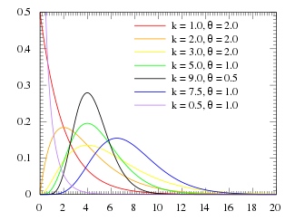

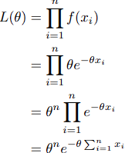
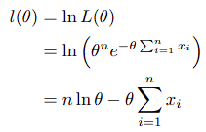
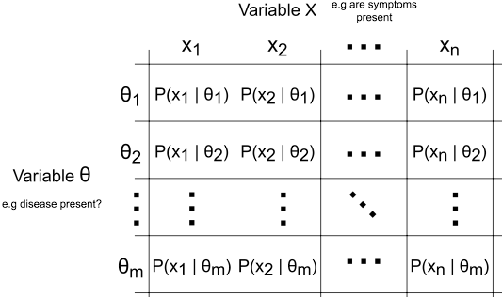

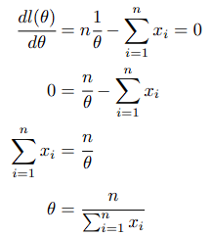



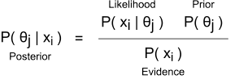
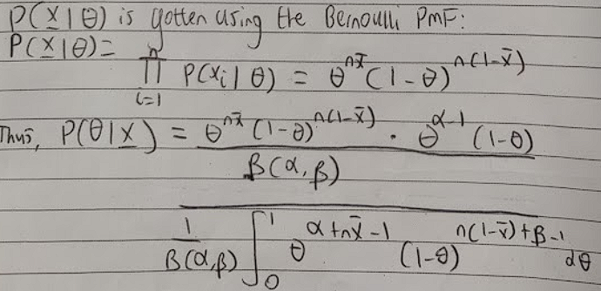
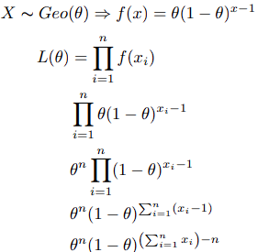
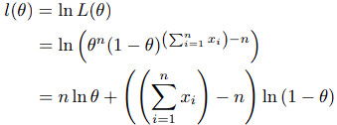

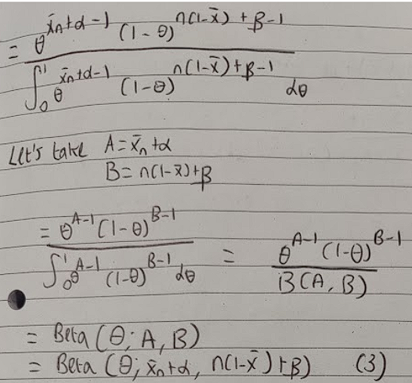
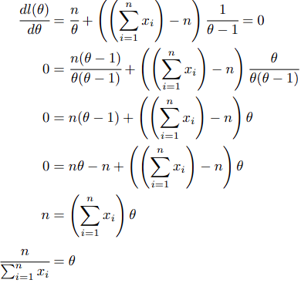




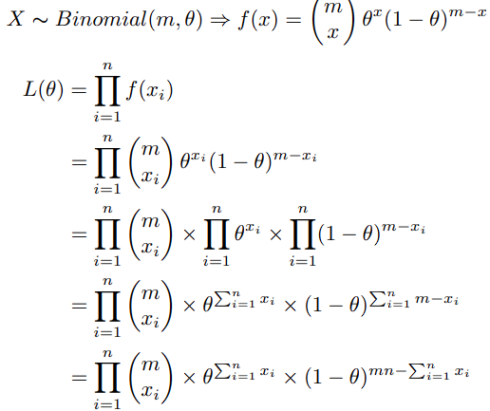





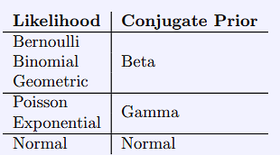
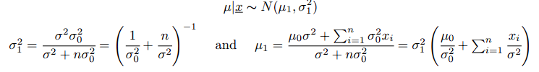
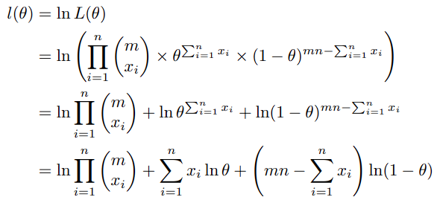




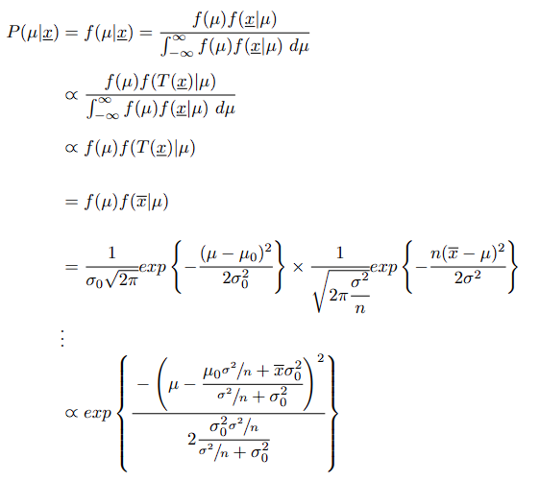

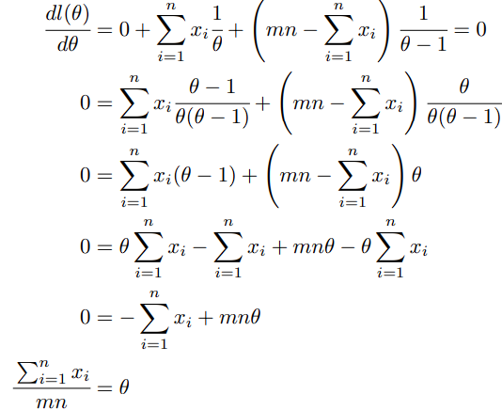

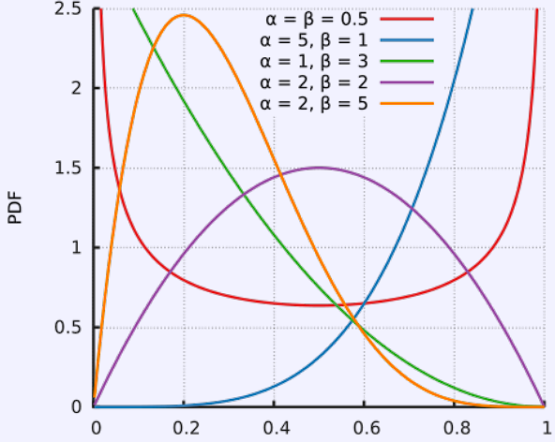


6) Statistics and Estimation
Statistics and Probability are kind of opposite - in probability we used distributions to predict the likelihood of events. In statistics, we use events/empirical data to determine or validate the probability distribution that models these results.
Sample – A subset of the population. Statistical methods use it to make inferences about the population.
Statistical Models – a structure (often a distribution) developed from a sample that can be used to make inferences about a population. They’re parametric, ie: can be described entirely by their parameters, they have a finite set of parameters. If the probability of each outcome only depends on their parameters, then we can assume those parameters are IID.
X₁, X₂, ... , X_{n} ∼ Model(θ₁, θ₂, ... , θ_{k}) given IID.
Examples: Normal, Poisson.
6.1) Central Limit Theorem for Statistics
Given a random variable X belonging to a distribution, the mean value of the sample size from X is:
Y ∼ N(µ, σ²/n). As the sample size increases, the variance in mean between different samples increases. At infinity we can use standard normal. AKA, the CLT lets us form a distribution without needing to know it.
6.2) Estimators
Statistic – a function operating on random variables of a sample. T = T(X₁, X₂, ... , X_{n}) = T(X). It is a function of random variables, and so it is a random variable itself. Hence if distribution X’s parameters are known, we can use it, if T is the sum of ages of a class of 10, and we know the mean age, variance we can calculate probabilities for various T. When given some sample x = (x₁, x₂, ... , x_{n}) we have: t = t(x) = t(x₁, x₂, ... , x_{n}). Examples: mean, stdev, median.
Estimator: A statistic used to approximate the parameter of the distribution of its arguments. Given a sample x the estimator t = t(x) is called an estimate. If we can approximately identify the sampling distribution of the statistic (P_{T|θ}) we can find the expectation, variance (and more) related to our statistic. The CLT holds still
Examples of Estimators (some are better):
1) Using the first / any X_{i} as the estimator:
T[X₁, X₂, ... , X_{n}] = X₁ ∼ P_{X|θ}
2) Median: T_{median}[X₁, X₂, ... , X_{n}] = X |(n + 1) / 2| ∼ P_{X|θ}
3) Mean
Estimators can be biased thanks to being based on a sample rather than the population. bias(T) = E[T|θ] − θ
Unbiased estimator: bias = 0.
For any distribution the sample mean x is an unbiased estimate for the population mean µ.
For the variance: If we know the population mean µ we can use the unbiased estimator:
The sample variance is a biased estimator and is defined as:
We apply Bessel’s Correction to get the unbiased
sample variance
6.3) Efficient Consistent Estimator
We can quantify how exactly good estimators are. We use a metric called Estimator Efficiency:
Given two unbiased estimators E₁(X) and E₂(X) where X = (X₁, ... , X_{n}) (a sample containing n observations X...)
We can compare the mean, variance etc to see which estimator is more efficient. We want a low variance.
E₁ is more efficient than E₂ if:
∀θVar E₁(E₁|θ) ≤ ∀θVar E₂(E₂|θ)
or ∃θ ∀θVar E₁(E₁|θ) < ∀θVar E₂(E₂|θ)
More efficient means less variance in estimates. If an estimator is more efficient than any other possible estimator, it is called efficient.
Example:
Given a population with mean µ and variance σ².
We have a sample: X = (X₁, ... , X_{n})
Consider two estimators:
1. E₁ = X (sample mean) 2. E₂ = X₁
We can compute the bias for both:
1. The expected value of the sample mean is the population mean µ, hence E₁ is unbiased.
2. The expected value of any observation is µ, so the first observation in the sample is also unbiased.
Now, we compute the variance: For a single sample the variance is σ² hence: VarE₂(E₂|µ and σ²) = Var(X₁) = σ²
For the sample mean, we use the CLT – so the variance is the mean of the sample divided by the size = σ²/n
So the variance of E₂ <= E₁ variance, so E₁ is the more efficient estimator.
The consistency of an estimator grows as the sample size grows. Note that the sample mean is a consistent estimator always.
7) Confidence Intervals
Case 1) We know the true variance of a population. We work out the sample mean, and it is distributed as:
X ∼ N(x, σ²/n)
If µ (population mean) = x then (using the standard normal distribution) we can say that there is a 95% probability that the observed statistic is in the range
[x – 1.96 σ / n, x + 1.96 σ / n]. This is using a two tailed standard normal value at the 95% confidence level.
So the formula is [x - z σ / n, x + z σ / n] where z is the two tailed standard normal value at the right confidence interval.
Case 2) The true variance is unknown. We have to obtain the bias corrected variance:
S_{n-1} =
We must use the student’s t distribution to calculate our t score:
We set degrees of freedom: ν = n − 1.
For a double ended confidence (100 − α)%, we compute t_{ν=n−1, 1−α/2} to find the critical values.
So the formula is:
[x – t_{v=n-1, 1-a/2} S_{n-1} / √n, x + t_{v=n-1, 1-a/2} S_{n-1} / √n]
When using the tables for t values, we use the size we want (e.g 0.975 for 95% double-ended confidence interval), and then use the degrees of freedom (n − 1).
To do these questions we simply just find each parameter and slot it into the appropriate formula.
8) Hypothesis Testing:
Given two samples we determine whether the difference is significant enough to suggest the parameters of the distribution are different for the two of them. I know Null Hypothesis H₀, Alternative Hypothesis H₁.
We can have a 1) “has changed” two sided test
(H₀: θ=θ₀ versus H₁: θ= ̸= θ₀) or a “is less than” or “is more than” one sided test (H₀: θ > θ₀ versus H₁: θ < θ₀)
Steps:
1. Choose a test statistic T(X) to use on the data.
2. Find a distribution P_{T} under H₀ from the test statistic. 3. Determine the rejection region (the region in which a result would invalidate H0).
4. Calculate the observed test statistics t(x).
5. If t(x) is in the rejection region, reject H0 and accept H₁, else retain H₀.
8.1) Test Errors
The significance level α ∈ (0, 1) of a hypothesis test determines the size of the rejection regions.
α → 0 Less and less likely to reject H₀, rejection region smaller, confidence in our result is lower - easier test. (remember we use 1-a for the p value).
α → 1 More and more likely to reject H₀, rejection region larger, confidence higher - stricter test / easier to fail.
(5% significance is standard).
The p-value of a test is the significance level threshold between rejection/acceptance of H0 for a given test.
Type 1: Reject H₀ when it is actually true.
α = P(T ∈ R|H₀)
Type 2: Accepting H₀ when H₁ is true. β = P(T ̸∈ R|H₁) Probability a test statistic is not in the rejecting region, when H₁ is true
Test Power - The probability of correctly rejecting the null hypothesis.
Power = 1 − β = 1 − P(T ̸∈ R|H₁) = P(T ∈ R|H₁)
For a given significance level: α = P(T ∈ R|H₀)
A good test statistic T and rejection region R will have a high power, the highest power test under H₁ is called the most powerful.
M3) Testing for Population Mean
We derive a new distribution in terms of the standard normal which we use to compute our confidence interval:
Example:
A manufacturer sells packets listed as having weight 454g. From a sample size of 50, we get the mean weight of a bag as 451.22g. Assume the variance of bag weights is 70. Is the observed sample consistent with the claim made by the company at the 5% significance?
H₀ : µ = 454g, H₁: µ = ̸= 454g
We have this information:
x = 451.22g, σ² = 70, n = 50, α = 0.05.
Sample variance = 70/50. So, X ∼ N (454, 70/50)
Z = X − 454/√35/5 ∼ N(0, 1) (standard normal dist.)
Critical value = 0.95 two tails = 1.96
Hence in order to accept H₀, X must be in the interval: 451.6809 < X < 456.3191 (Using the confidence interval formula for known variance).
As x = 451.22 we reject H₀. At the 95% significance there is sufficient evidence to reject the company’s claim.
If we have unknown variance, then we have to compute the bias corrected variance. We then use the student’s t distribution instead for our confidence interval as outlined in case 2.
M4) Sample from Two Populations
If we are given two random samples and have two sample means, we do a Hypothesis test for equality.
Paired Data: A special case when X and Y are paired – each X_{i} and Y_{i} are possibly dependent on each other. We consider a sample of the differences, and test if this has mean 0:
Z_{i} = X_{i} − Y_{i} testing H₀ : µZ = 0 versus H₁: µ_{Z} =/= 0
Example: Heart Rate before and after exercise.
8.2) Known Variance, X, Y are Independent
Given X = (X₁, ... , X_{n1}), X_{i} ∼ N(µ_{X}, σ²X), X∼N(µX, σ²X/n₁) Y = (Y₁, ... , Y_{n2}), Y_{i} ∼ N(µ_{Y}, σ^{2Y}), Y ∼ N(µY, σ²Y/n₂)
We get the distribution of difference in sample means:
X − Y ∼ N(µ_{X} - µ_{Y}, σ²X/n₁ + σ²Y/n₂)
We then put this distribution in the standard normal:
~ N(0, 1)
For H₀ we assume u_{x} = u_{Y} so we end with z = the above formula with that bracket as 0.
8.3) Unknown Variance, X, Y are independent but with equal variance
We can combine their variance again
and get an overall variance.
Example:
Compiler1: n₁ = 15, x = 114s, s²₁₄ = 310
Compiler2: n₂ = 15, y = 94s, s²₁₄ = 290
We assume that the variances of the
population variances are the same for both.
… (other hypothesis test work done)
We can get the Bias-Corrected Pooled Sample
Variance: S28 =
(14 × 310 + 14 × 290) / ( 14 + 14) = 300
Hence our test statistic is: x − y / σ √(1/n₁ + 1/n₂) =
20 /(300√(2/15)) = √ 10 ≈ 3.162
We proceed with Welch’s T Test in this example.
8.4) Chi Squared Testing
M5) Chi Squared Test for Model Checking
1. Determine expected distribution
2. Create a hypotheses based some parameters θ:
H0 : θ = θ₀ versus H1 : θ = ̸= θ₀
3. Construct our E_{i} table
4. Calculate the Chi-Square Test Statistic X² .
5. Calculate the degrees of freedom as:
ν = (number of possible values X can take) – (number of parameters being estimated) - 1.
6. Calculate the Chi Squared Statistic
7. Calculate the significance a, using a table with v, the degrees of freedom.
8. If X² > χ² _{ν, 1−α} (test statistic larger than critical value) Note that:
All expected values must be larger than 5 for a good test. Hence some bins may have to be merged.
The number of values X can take is typically the number of bins.
M6) Chi Squared Test for Independence
This is the variant done back in A levels. We have a contingency table which has each combination of values of x and y. The only change we do is we count df = (rows-1) x (columns - 1). Questions will be worded like “Determine … a link between…“
9) Maximum Likelihood Estimate
Given a distribution with unknown parameter θ:
X ∼ Distribution(...θ...), and a sample of the distribution X: X = (X₁, X₂, ..., X_{n}), we want to determine the most probable value for parameter θ, given our data.
9.1) The Likelihood Function (L(θ))
The likelihood of some observations x₁, x₂, ... , x_{n} occurring given some θ is:
L(θ) = P(x₁, x₂, ..., x_{n}|θ) =
Works because f is the probability mass function,
and as each observation is independent we can
multiply their probabilities.
The Log Likelihood Function (l(θ)) - Used
more often than likelihood, much easier to
work with l(θ) = ln L(θ)
To get this most probable value for θ, we construct the likelihood function, then get the log likelihood function, and differentiate to determine the value of l(θ) for
which we have the maximum. This value is known as the Maximum Likelihood Estimate (θ’).
10) Posterior
MLE has weaknesses: Sensitive to Sample Size, Does not use any Prior, Returns a single val
rather than a distribution – so we don’t how close
other θ are, or how strong our estimate is. Cannot Assess – confidence intervals also rely on the sample.
Bayes’ Theorem:
P(A|B) = P(B|A) × P(A) / P(B)
We can re-express this as:
P(A|B) = P(B|A) × P(A) / P(B|A)×P(A) + P(B|A)(1-P(A))
Intuition about Posterior, Prior and Likelihood:
The Posterior is the probability we have the disease given we have symptoms.
The Likelihood is the probability we have symptoms
given we have the disease. They are not the same.
What we really want to know is the probability we have symptoms (P(x=1), the evidence or the probability we have the disease P(θ) the prior).
Posterior ∝ Likelihood x Prior
10.4) Gamma Prior Distribution
Used for the poisson and exponential.
Mean/bayesian estimate = α / β
Variance = α / β²
Maximal value (aka Mode, aka θ_{MAP}) = α -1 / β
for α >= 1, 0 for α < 1.
Bayesian Inference Example: Bernoulli Distribution
Let X_{i} | θ ~ Bernoulli(θ) and θ ∼ Beta(θ; a, b) where a > 1 and b > 1.
a) i) Derive the posterior distribution for θ|x₁, x₂, ..., x_{n}. What are the formulas for ˆθ_{B}, ˆθ_{MAP}, ˆθ_{MaxPrior}, ˆθ_{MeanPrior} andˆθ_{MLE} estimates?
Posterior: Using Bayes Theorem:
Denominator:
Substituting for the numerator:
t
ii. If n = 30, ¯x = 0.6, a = 15, b = 10 then compute ˆθB, ˆθMAP , ˆθMaxPrior, ˆθMeanPrior and ˆθMLE estimates and arrange these in ascending order.
We get the ˆθB, ˆθMAP, and ˆθMLE by simple formula applications. MeanPrior = ˆθB, and MaxPrior = MAP for iteration 1. For iteration 2, we take the ˆθB and MAP respectively of the previous iteration (of the posterior we fed in).
Normal Distribution Example
1) Single datapoint x sample: Given some x|µ ∼ N(µ, σ²) where σ² is known, µ unknown. U We get the likelihood using the normal distribution PDF:
P(x|u) = f(x|u) =
9.2) Common Maximum Likelihood Estimates
Given a sample x = (x₁, x₂, ..., x_{n}), we can use formulas for the maximum likelihood.
1) Exponential Distribution:
X ~ Exp(θ) => f(x) = θe^{-θx}
1) Determine the 2) Obtain log likelihood
likelihood in terms of θ:
3) Differentiate and set to 0:
4) Hence, the maximum
likelihood estimator is
the reciprocal of the mean
of the sample.
2) Geometric Distribution:
1)Determine the likelihood 2) Obtain log likelihood
in terms of θ:
3) Differentiate and set to 0
4) Hence, the
maximum likelihood
estimator is the
reciprocal of the
mean of the sample.
3) Binomial Distribution
10.1) Maximum a Posterior
Given some prior information (P(θ)) we can effectively get the MLE, but each probability is weighted by the prior information:
θ'MAP =
This does require us to put prior information P(θ) about θ.
10.2) Conjugate Priors and Bayesian Inference
In Bayesian Inference, we compute the posterior distribution P(θ|x) ∝ P(x|θ) * P(θ). We keep updating our Posterior Distribution as we see new data. We feed our prior and likelihood to produce a posterior. This becomes our new prior, to calculate the next posterior, and so on.
Posterior formula:
Conjugate Prior: When continually inferring new prior distributions, if the prior distribution is in the same family of distributions (i.e parameters can be different, but same distribution) as the posterior, then it is a conjugate prior.
10.3) The Beta Prior Distribution
Where α, β > 0 are hyper-parameters that determine the shape of the distribution, the parameter is θ:
Where the normalising value (ensures total integral sums to 1 so it is a valid pdf) is:
1) When α = β it is
symmetrical about 0.5
2) Higher values result in
steeper/narrower distribution
3) The MAP estimate pulls the
estimate towards the prior.
4) As α → 1 and β → 1
Beta(θ; α, β) → U(0, 1)
and ˆθMAP → ˆθMLE.
This gives us the posterior distribution for θ|X₁,X₂…X_{n}
We then continue with this process normally, yielding:
µ|X ∼ N(µ₁, σ ₁²)
2) We can extend this for a sample x = x₁, ... , x_{n} and distribution x_{i}|µ ∼ N(µ, σ²) where σ is
known.
We end with:
Sufficient Statistic:
A statistic is sufficient for a given model (our chosen distribution) and its associated parameter if no other statistic can be calculated from a sample that provides additional information in computing the value/estimate of the unknown parameter.
For a normal distribution the sufficient statistic is the sample mean:
1. We can calculate the posterior distribution using the likelihood and prior
We now have the
Exponential part of the
PDF for our normal.
2. We can now calculate
Posterior Distribution
µ|x ∼ N(µ₁, σ₁²)

