Slide 1
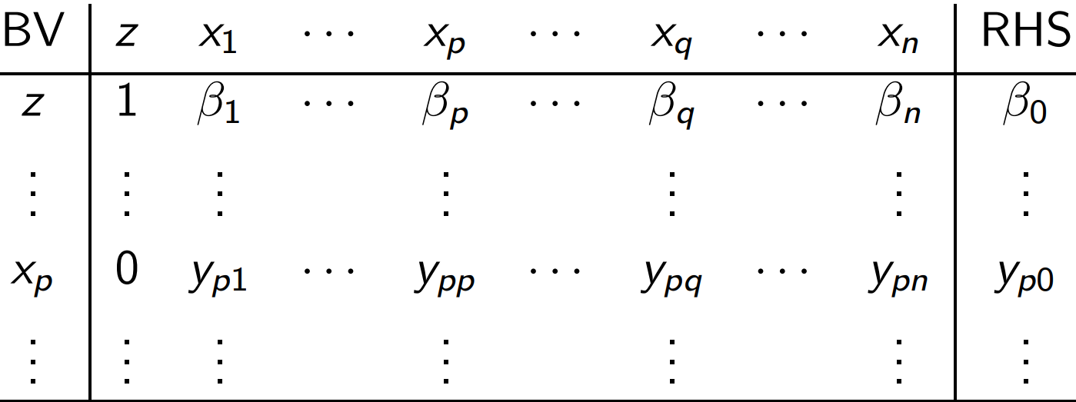
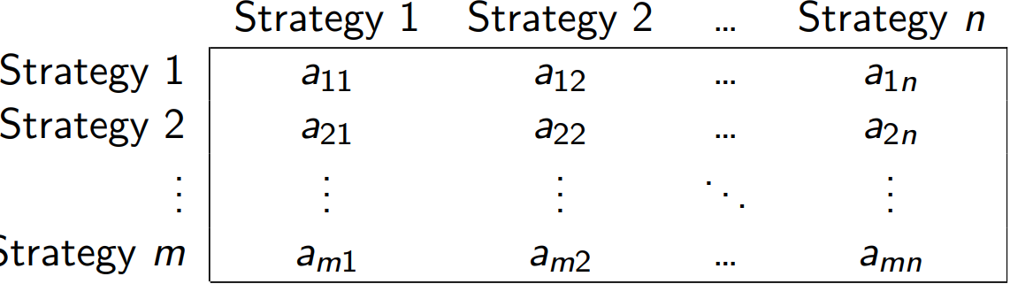
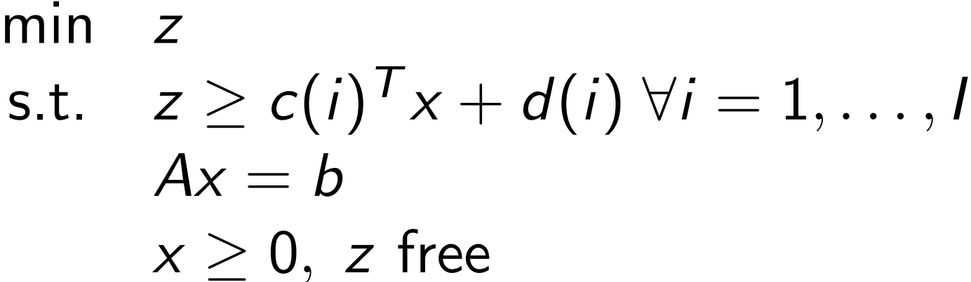
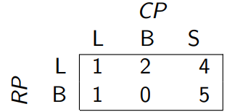
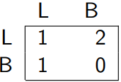
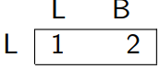
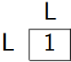
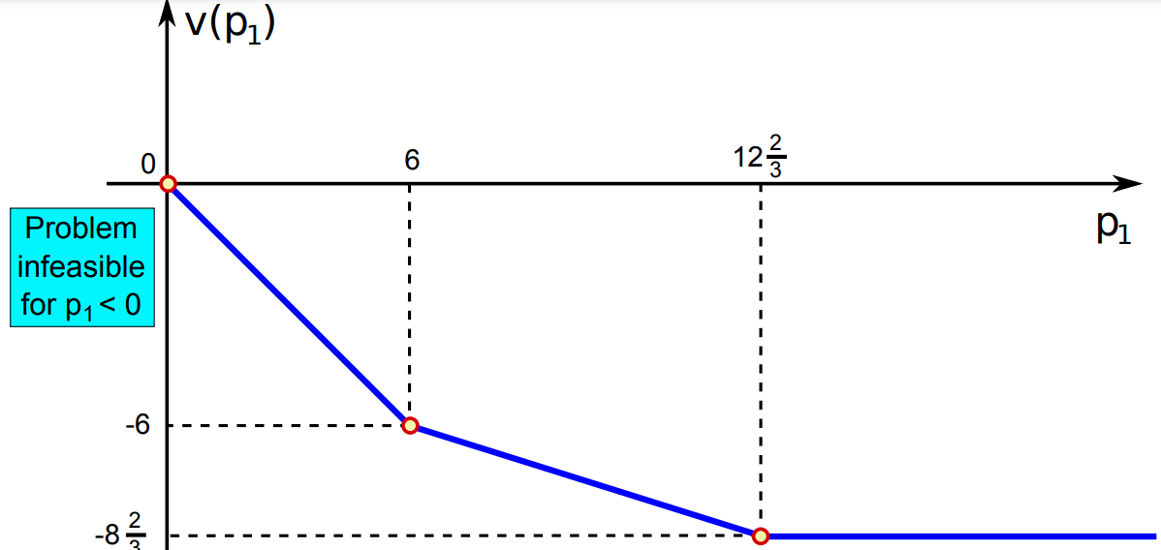
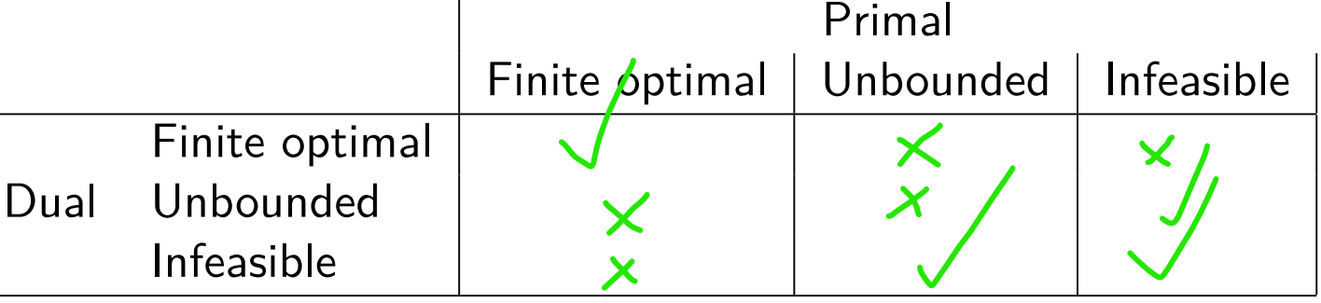

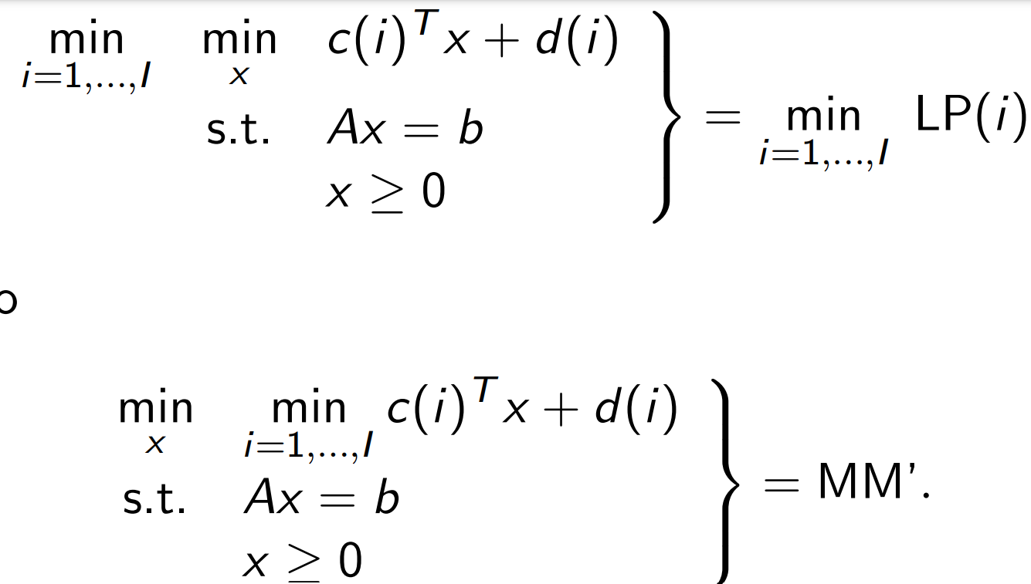
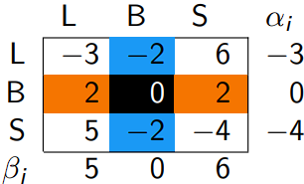
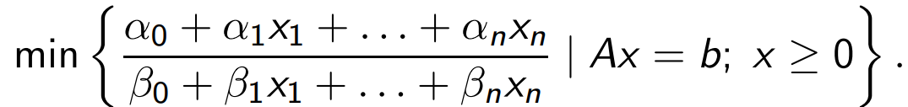
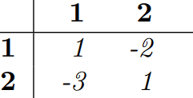
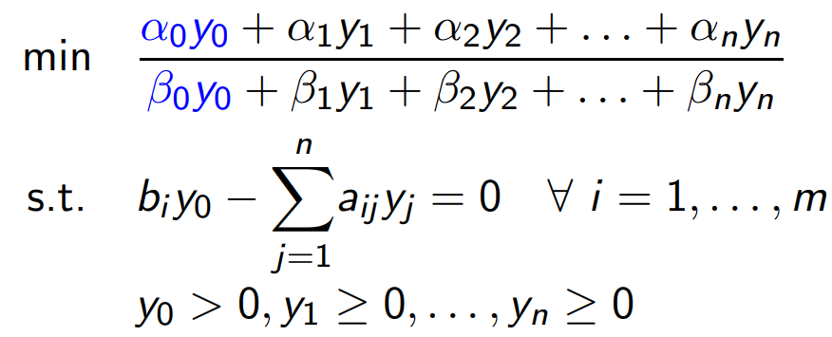
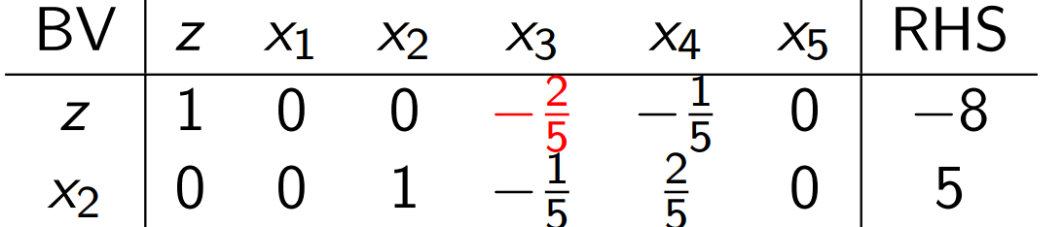
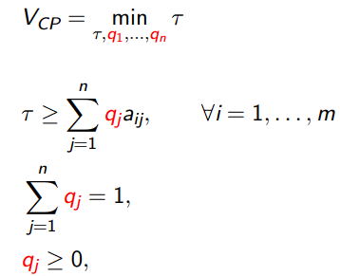
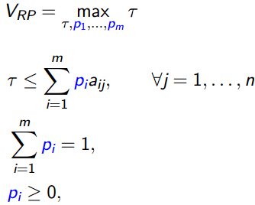

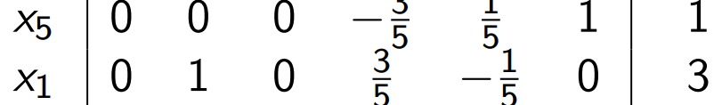
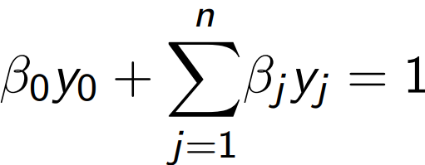
1) Operations Research: Linear Programming (LP)
1.1) Standard Form (SF): A linear program is in SF if:
1) The aim is to minimise a linear objective function;
2) All constraints are linear equality constraints;
3) All constraint right hand sides are non-negative;
4) All decision variables are non-negative.
The structure of an LP in Standard Form:
Minimize z = c₁x₁+ c₂x₂ + … + c_{n}x_{n}
a₁₁x₁ + a₁₂x₂ + … + a_{1n}x_{1n} = b₁
..........................................
a_{m1}x₁ + a_{m2}x₂ + … + a_{mn}x_{mn} = b_{m}
∀i ∈ [1..n], ∀j ∈ [1..m], x_{i} ≥ 0, b_{j} ≥ 0
1.2) Standardizing LP Problems
1) For an LP with obj fun Z = f(x), max z ≡ -min z = f(x)
2) Add negative slack variable to tighten ax_{s} … ≥ b_{i};
positive to tighten ax_{s} … ≤ b_{i}
3) Multiply equations where the RHS (b_{i}) < 0.
4) Constrain variables to be strictly positive by either:
1) Using Free Variables: substitute the x_{j} that has no constraint for the decision variables x_{j}⁺ and –x_{j}⁻. We now have an extra variable in our LP, and they are both ≥ 0. Solve the LP! One of them will end up being 0 though.
2) Substitution: Rewrite the variable in terms of others using the constraint equations.
1.3) Basic Feasible Solutions – Terminology:
1) Index Set: Indices of the linearly independent columns of A that represent the LP. The Matrix B(I) formed by the A(i) columns is known as the basis
2) Basic Solution: A solution x to Ax = b with x_{i} = 0
∀i ∉ I is known as a Basic Solution with respect to the index set I (BS). Valid basis ⬄ linearly indep. cols.
3) Feasible Solution: A solution x satisfying Ax = b and x ≥ 0 is a feasible solution (FS).
4) Basic Feasible Solution: A solution which is both a basic and a feasible solution(BFS). Solutions that satisfy all constraints, with all variables not in the index set to 0.
The basic solution corresponding to I is unique. Thus Bx_{b} = b has a unique solution: X_{b} = B⁻¹b ∈ ℝ^{m}, and this solution is also a unique basic to Ax = b w.r.t I.
Vertices of the feasible set = basic feasible solutions Geometrically: optimum always achieved at a vertex Algebraically: optimum always achieved at a BFS
5) Optimal Basic Feasible Solutions: Given an LP in standard form, a feasible solution to the constraints
{Ax = b; x ≥ 0} that achieves the optimal value of the objective function is called an optimal feasible solution. If the solution is basic then it is an optimal BFS.
6) Basic Variables: the variables that are in the Index set. Non basic variables are those which aren’t.
1.4) The Fundamental Theorem of LP
For an LP in standard form with rank(A) = m ≤ n:
1) ∃ a feasible solution ⇒ ∃ a BFS.
2) ∃ an optimal solution ⇒ ∃ an optimal BFS
(IE: if we can solve the problem, then we can also solve the smaller problem involving just the linearly independent columns)
However, there may be feasible solutions that aren’t
BFS (since the non-index vars might not be zeroed)
There may be optimal solutions that are not BFS.
“An LP has an optimal BFS” is not true always true; the LP may be infeasible or unbounded.
This reduces solving an LP to searching over BFS’s! To find the Optimal BFS we could search through all these possibilities, since there are at most n!/m!(n-m)! basic solutions. Very inefficient, ofc.
1.5) Matrix Partitioning
A is the coefficients of all the constraints
B is the columns of A that are Basic
N is the columns of A that are NOT basic
C is the vector of coeffs of the Obj Func.
C_{N} are those coefs of C that AREN’T basic
C_{B} are those coefs that are basic of C
X_{B} = X_{B}(I) = vector of basic variables (e.g: [x₁, x₂])
X_{N} = X_{N}(I) = vector of nonbasic vars.
b = vector of constraint RHSes e.g:[4 4]^{T}
Ofc this means: Ax = Bx_{B} + Nx_{N} and c^{T}x = c^{T}_{B}x_{B}+c^{T}_{N}x_{N}
1.6) The Basic Representation
The basic representation is: [ z ] = f(x_{N})
where: [x_{B}]
x_{B} = B⁻¹ b – B ⁻¹ N x_{N} z = c^{T}_{B} B⁻¹ b + (c_{N} – N^{T} B^{-T} c_{B})^{T}x_{N}
(equivalently: z = c^{T}_{B} B⁻¹ b + (c^{T}_{N} –c^{T}_{B} B⁻¹ N)x_{N})
Importance of the Basic Representation:
It tells us how z and x_{B} change when the NBVs increase.
1) In particular, the reduced cost vector lets us recognise whether the current BFS is optimal (iff r ≥ 0 then no other FS can have a lower objective value than current BFS)
2) find a new BFS with a lower objective value if the current BFS is not optimal (by increasing a nonbasic variable with a negative reduced cost).
2) Solving Linear Programs – the Simplex Method
“Iteratively examine BFS by pivoting from BFS to BFS until we find the optimal BFS”
Tableau for a feasible index set I (with p ∈ I, q ∉ I):
y_{ii} = 1 ∀i ∈ I and y_{ji} = 0 ∀i ∈ I, j ∈ I \{i}
β_{i} = −r_{i} ∀_{i} ∉ I i ≠ 0 (negative reduced cost)
β_{i} = 0 ∀i ∈ I
Finite Termination Theorem: If all BFS’s are non-degenerate, then the simplex algorithm must terminate after a finite number of steps with either an optimal solution, or a proof that the problem is unbounded.
2.1) Simplex Method Process
1) Pivoting: if vertex x for index set I is not optimal, then in its neighbouring vertices there is a vertex with a better objective value. Pivoting is only possible if y_{pq} ≠ 0 (ie: the value at the intersection row p and column q ≠ 0)
1.1) Pivot Process:
1) divide the row p by pivot element y_{pq} (so that it becomes 1) and relabel it as row q -> as we take p out of the basis and put q in there.
2) Subtract the new value of this row from all other rows.
2) Deciding the pivot: choose the column p with the greatest value in the objective function (> 0), and the row q with the smallest ratio > 0 s.t: RHS / y_{pq} is the lowest.
2.2) Degenerate Basic Solutions (DBS)
A DBS is a BS where one or more BVs are zero – i.e: it has more than n-m zero valued vars (remember, n = num vars, m = num NBV vars). This can lead to cycling
Theorem: Assume that, ∀i = 1,...,n ∃ BS x with x_{i} ≠ 0. Then, a BS x is degenerate if and only if it is associated with more than one index set. Proof:
1) BS x is degenerate <= BS x has more than one I set:
Assume BS x corresponds to different index sets I₁ and I₂
Then x_{i} = 0 for all NBVs x_{i} with either i ∉ I₁, i ∉ I₂ or both.
Since I₁ ≠ I₂, there’s an NBV in I₁ that is a BV in I₂. Since both index sets describe the same BS, x_{i} is also be 0 in I₂
=> x is degenerate.
2) BS x is degenerate => BS x has more than one I set:
Assume x is a degenerate BS. Then in the simplex tableau, we have some row p in I with y_{p0} = 0
Our simplex also contains a column q (that is not in the index set) such that y_{pq} ≠ 0. (otherwise we’d have the row is completely zeroed, which is impossible in our lemma).
Pivoting on (p, q) will give a new BS identical to the current one, since:
This generates two index sets, both of which are degenerate, of BS x. So, we have more than one I set.
2.3) Cycling -> if we are at a degenerate BFS, we will continually pivot to degenerate BFS’s and likely cycle.
But we can also cycle naturally even with a normal BFS.
Bland’s Rule – Prevents Cycling:
Change pivoting conventions – just pick the first column in the BFS that is non-negative. The simplex algorithm cannot cycle and is finite with this rule!
2.4) Degeneracy in Practice
Cycling is rare. Bland’s rule isn’t a good thing in practice, as it slows down LP solving massively. In practice it is acceptable to replace a y_{i0} = 0 by y_{i0} = ϵ > 0 (e.g., ϵ
< 10⁻³ ) and then continue.
2.5) Finding good initial BFS to avoid Degeneracy
We use the Two-Phase Simplex method. Here’s how we recognise to use it:
If we have a constraint of the form:
1. a . x ≥ b; b > 0 => a . x - s = b; b, s >= 0
Then we need to add a slack variable s, but for our initial BFS we’d have to set -s = b, which violates the constraints b, s > 0. Similarly, for a constraint of form:
2. a . x ≤ b; b < 0 => a . x + s = b; b < 0, s >= 0
Or we have ANY case in which setting the original variables to 0 leads to an impossible constraint, e.g: 3. x₁ + x₂ = 3, x_{1,}x₂ ≥ 0.
Then we need to add a slack variable s, but for our initial BFS we’d have to set s = b, which violates the constraints b < 0, s > 0.
Ultimately, we can’t easily pick an initial BFS as usual (the trivial solution of BVs: slacks, NBVs: normal vars). Solution: introduce artificial variables:
1. a . x ≥ b; b > 0 => a . x - s + ε₁ = b; b, s, ε₁ > 0
2. a . x ≤ b; b < 0 => a . x + s + ε₂ = b; b < 0, s, ε₂ > 0
3. x₁ + x₂ = 3, x_{1,}x₂ ≥ 0 => x₁+x₂+ε₃ = 3; x_{1,}x_{2,} ε₃ ≥ 0
From here, we then solve the system as normal, treating ε as any other variable. However, we want to solve the system: min z = ε – e.g: write z in terms of the ε in terms of the other variables. Start doing simplex (this is known as Phase 1) when we get z = 0 (ε = 0) in our simplex then we’ve arrived at a BFS (and can eliminate our artificial variables) and assign to our BVs the RHS values in their row. Note: before moving to Phase 2 (solving the problem as normal with simplex), make sure you represent Z in terms of the NBVs -> either by rearranging, or if that’s not possible, by deriving the basic representation for the system.
3) Solving other types of problem with LP
1) Minmax problems: Consider a family of linear functions: y_{i}(x) = c(i)^{T}x + d(i)
Set φ(x) = max_{i=1,...,I} {c(i)^{T}x + d(i)} for c(i) ∈ ℝ^{n}, d(i) ∈ ℝ
min φ(x) such that: Ax(i) = b, x(i) >= 0 is a minmax problem.
Consider the following linear program:
If (x∗, z∗) is an optimal solution of the LP, x∗ is also an optimal solution of MM; MM has optimal value φ(x∗) = z∗
Proof:
1. The feasible set of (LP) is a superset of feasible set of (MM): So, any (x, z) feasible for (MM) is feasible for (LP)
2. The optimal solution of (LP) is also feasible for (MM): Indeed, if (x∗, z∗ optimal for (LP), then it must satisfy
z∗ = max_{i}{c(i)^{T}x + d(i)}
3. By contradiction, assume this is not the case.
Consider z’ = max_{i}{c(i)^{T}x + d(i)} ≠ z⋆ .
The point (z’, x∗) is feasible for (LP) and gives strictly better value. Contradiction.
4. Thus, optimal solution of (LP) must be optimal for (MM)
2) Minmin Theorem: Consider the following LPs:
min z_{i} = c^{T}(i)x(i) + d(i) s.t. Ax(i) = b x(i) ≥ 0 (LP(i))
Let z_{i}* be the optimal solution to LP(i).
Let LP(j) be the LP with minimal objective z_{j}* = min_{i=1,...,I}z_{i}
and let x*(j) be its optimal solution.
Then x*(j) is optimal in MM’ and ψ* = ψ(x*(j)) = z_{j}*.
Lemma: Let X and Y be arbitrary sets, and
f : X × Y → ℝ be an arbitrary function defined on X × Y
Then:
Proof: The lemma directly implies that the following are equal, as needed:
3) Fractional Linear Programs: here’s one below:
We assume
1) the feasible set of FLP is bounded:
∃L > 0 s.t: ∀x satisfying Ax = b, x ≥ 0 it is ||x|| ≤ L
2) The denominator of the objective function is strictly positive, i.e., β₀ + β₁x₁ + ... + β_{n}x_{n} > 0 for all feasible x.
We solve these via Homogenisation:
1) Introduce new variables y_{i} ≥ 0, i = 1, ..., n and y₀ > 0
2) Setting x_{i} = y_{i}/y₀ i = 1, ..., n we can homogenise the LP like so:
(We need to show that the denom is strictly positive, and that the problem is bounded)
The denominator in the objective of HFLP can always be normalised to unity.
We then add Also, the following is the
a new constraint optimal solution to these
which forces denom = 1: FLPs:
4) Duality Theory - Given an optimization LP problem, we can construct another optimization problem called the dual that will give us information when solved about the original problem -> used for Game Theory or for swapping a problem for an easier version.
Primal Problem: max{c^{T}x: Ax ≤ b, x ≥ 0}, (P)
where c, x ∈ ℝ^{n} , A ∈ ℝ^{m×n} , b ∈ ℝ^{m}.
Dual Problem: min {b^{T}y: A^{T}y ≥ c, y ≥ 0}, (D)
where c, A, b as in (P) and y ∈ ℝ^{m}.
The Dual of (D) is (P). (Symmetric Definition)
Weak Duality:
Assume that the problems max {c^{T}x: Ax ≤ b, x ≥ 0} (P) and min {b^{T}y: A^{T}y ≥ c, y ≥ 0} (D) are both feasible. Let x ∈ ℝ^{n} be feasible for (P) and y∈ℝ^{m} be feasible for (D). Then c^{T}x ≤ b^{T}y.
At all points, the dual problem upper bounds the primal problem:
Proof: (P) has that: Ax ≤ b ⇒ y^{T}Ax ≤ y^{T}b since y ≥ 0.
(D) has that: (A^{T}y)^{T} ≥ c^{T} ⇒ y^{T}Ax ≥ c^{T}x since x ≥ 0t
and (A ^{T}y)^{T} = y^{T}A. Then if both LPs are feasible
c^{T}x ≤ y^{T}Ax ≤ y^{T}b
The theorem follows after noting that y^{T}b = b^{T}y, since both vector multiplications give a scalar (1×1 matrix).
Strong Duality:
Assume that problem (P) is feasible with a bounded optimum. Let B be optimal basis for (P), together with optimal basic solution (x_{B}*, x_{N}*). Then we have that:
a) y* = (B⁻¹)^{T}c_{B} is an optimal solution for (D).
b) c^{T}x* = b^{T}y* - the objective values coincide.
If we have an optimal solution for the primal, then we have an optimal solution for the dual, and those two solutions are the same!
If we have more decision variables (N) than constraints (C) then solving the dual (which has then go C decision variables and N constraints) may be easier.
4.1) Primal Dual Possibilities
(Numbers go columnwise first)
1) Finite Optimal Primal ⇔ Finite Optimal Dual. Cannot be unbounded or infeasible, (Thanks to strong duality).
2) We can’t have Finite Optimal Primal and Unbounded Dual thanks to weak duality (If we are unbounded, then since the dual is a minimization problem that means that it must go below the Primal. But weak duality prohibits that!)
3) We also can’t have an infeasible dual, because then there would be a duality gap (strong duality)
4 & 7) Due to the symmetry of the primal and dual, for these reasons we also cannot have an unbounded primal and finite optimal dual, or an infeasible primal and finite optimal dual.
5) We can’t have both problems be unbounded either - because then the dual would be going down to minus infinity and the primal going to infinity - and that violates weak duality.
6 & 8) Thanks to weak duality if we have a primal that is unbounded we know that the dual is fucked - so the dual must be infeasible. We can also mark primal infeasible dual unbounded as possible thanks to the symmetry.
9) Infeasible Primal and Dual doesn’t violate any of the strong duality or weak duality rules. It just means there are no solutions to either of the problems which makes sense if our constraints are way too strict.
4.2) Indirect Way of Deriving the Dual Problem
Bring the problem to standard form (P or D) (as min/max – but don’t convert to a min if you have a max) then:
1. Replace variables x_{i} ∈ ℝ with (x_{i}⁺ - x_{i}⁻) where x_{i}⁺, x_{i}⁻≥ 0. 2. Replace equality constraints with two inequality constraints.
3. Change constraint direction (≤, ≥) by multiplication with −1 if necessary.
4. Change direction of objective function by multiplication with −1 if necessary.
Obtain dual according to definition:
If LP is in the form of (P), its dual is (D).
If LP is in the form of (D), its dual is (P).
Optionally simplify the dual problem:
1) Replace variable pairs y_{i}, y_{j} ≥ 0, i≠j, that occur in all functions as αy_{i} - αy_{j} by one variable y_{k} ∈ ℝ.
2) Replace matching inequality constraints by equality constraints (compress two ineqs of opposite sides into an eq)
4.3) Direct Way of deriving the Dual
1. For every primal constraint, create one dual variable.
2. For every primal variable, create one dual constraint. 3. Dual coefficient matrix is A^{T}. Former right-hand sides b become new costs. Former costs c become new right-hand sides.
4.If primal is max problem: Dual is min problem.
If i^{th} primal constraint is [≥, =, ≤], then the i^{th} dual
variable is [y_{i} ≤ 0, y_{i} ∈ ℝ, y_{i} ≥ 0], respectively.
If j^{th} primal variable is (in the objective function) [x_{j} ≥ 0,
x_{j} ∈ ℝ, x_{j} ≤ 0], then the j^{th} dual constraint is [≥, =, ≤],
respectively.
5. If primal is min problem: Dual is max problem.
If i^{th} primal constraint (the things at the bottom which
tell you directly what the variables are supposed to be
greater or less than) is [≥, =, ≤],then the i^{th} dual
variable is [y_{i} ≤ 0, y_{i} ∈ ℝ, y_{i} ≥ 0], respectively.
If j^{th} primal variable is [x_{j} ≥ 0, x_{j} ∈ ℝ, x_{j} ≤ 0], then the
j^{th} dual constraint is [≤, =, ≥], respectively.
5) Sensitivity Analysis How does changing the parameters change the solution for the LP? We want to discover this without solving the LP problem each time.
Assume we have an LP like so:
max y = x₁ + x₂ such that 2x₁ + x₂ ≤ p₁ … (more constraints that are irrelevant). Assume p₁ – the “availability” of that equation is not known.
Value Function: v(p₁) expresses the optimal value of the LP as a function of unknown availability parameter p₁:
v(p₁) = min y = -x₁ - x₂ such that 2x₁ + x₂ + x₃= p₁ …
At one point, increasing the constraints no longer helps us (look at the shape of the polygon, and then the line v(x), we care about the best intersection point): Formally:
5.1) Perturbation
Let p ∈ ℝ^{m} denote a general RHS, define value function v(p): ℝ^{m} → ℝ by: v(p) = min{z = c^{T}x | Ax = p; x ≥ 0}
Solving the original LP (the reference problem)
min {z = c^{T}x | Ax = b, x ≥ 0} thus computes v(b)
5.1.1) Shadow Prices
Suppose we solved the original reference problem:
min {z = c^{T}x | Ax = b, x ≥ 0} and found an optimal basis mat satisfying x_{B} = B⁻¹b ≥ 0 (BVs ≥ 0; Feasibility);
r = c_{N} − N^{T}(B⁻¹)^{T}c_{B} ≥ 0 (Reduced Cost Vec; Optimality)
Shadow Prices: The vector of Shadow Prices is defined as Π = (B⁻¹)^{T}c_{B}, where B(I) is an optimal basis. There can be more than one optimal basis, so Shadow Prices aren’t necessarily unique. Shadow Prices give information about the sensitivity of the value function v(p) at p = b.
Theorem: Behaviour of the Value Function:
v(p) = v(b) + Π^{T}(p - b), ∀p ∈ ℝ^{m} with B⁻¹p ≥ 0.
(AKA, the value of the system with constraint p₁ set to p is equal to the system with p₁ set to b + the shadow prices matrix * (p-b).
This is huge -> we can see how affecting a constraint changes the obj value of a system easily).
Indeed, we can interpret shadow prices as follows:
Is it worthwhile to increase the constraint p₁ at price µ? Yes if µ + Π₁ < 0 (overall cost decreases);
No if µ + Π₁ > 0 (overall cost increases).
Therefore, −Π₁ is the maximum price one should pay for one additional unit µ!
Suppose row t is initially a “≤” constraint and a slack variable x_{s} had been added. Then, Π_{t} = β_{s}, where β_{s} is the objective coeffcient of x_{s} in the final (optimal) tableau.
Suppose row t is initially a “≥” constraint and a surplus variable x_{s} had been added. Then, Π_{t} = -β_{s}, where β_{s} is the objective coefficient of x_{s} in the final tableau.
Example: we added slack x₃ to constraint 1. Thus
the shadow price for constraint 1 is -2/5 as that’s
the slack var value in the objective.
6) Game Theory - Each player i = 1, ..., n has a set of actions x_{i} ∈ X_{i}
Player i receives a payoff J_{i}(x₁, ..., x_{i}, ..., x_{n}). We focus on
Two-Person Zero-Sum Games with finite actions:
Two players: row player (RP) and column player (CP)
RP chooses one out of m strategies (row strategies)
CP chooses one out of n strategies (column strategies)
Zero-Sum: RP wins whatever CP loses and vice versa
6.1) Payoff Matrix describes a two-player zero-sum game
If RP plays strategy i and CP plays strategy j, then CP pays a_{ij} to RP
So negative nums are good for CP, bad for RP, positive good for RP, bad CP.
CP
RP
Each player knows the opponent’s strategies, both simultaneously pick a strategy, both try their best to win with no compassion for the opponent, accounting for opponent knowing their list of strategies.
6.2) The Dominant Strategy Equilibrium
Doesn’t always exist, but if it does it is quite powerful:
1) Both strategy L and B are always better than
S for CP. Thus CP won’t ever play S, both players
realise this and ignore it.
2) Strategy L is always better than strategy B for RP.
Both players realise this and decide to ignore the
possibility of RP playing B.
3) Playing L is always better for CP than B. So, we
ignore the possibility of CP playing B.
4) We are only left with 1 possibility ->
both players will play L!
Dominated row strategy: Take row strategies i and i’. i is dominated by i′ if a_{i′j} ≥ a_{ij} for all column strategies j = 1, ..., n and a_{i′j} > a_{ij} for some j. Dominated column strategy: Take col strats j and j’. j is dominated by j′ if a_{ij′} ≤ a_{ij} for all row strats i = 1, ..., m and a_{ij}′ < a_{ij} for some i.
Assumptions when using this equilibrium:
Rational players won’t play dominated strats. Rational opponents know this
Dominant Strategy Equilibrium: If a repeated removal of dominated strategies leads to a game where each player has just one strategy left, then this strategy pair is a dominant strategy equilibrium.
If a dominant strategy equilibrium exists, then it is unique.
If a dominant strategy equilibrium exists, then any rational players will play the associated equilibrium strategies -> dominant strats are very powerful.
6.3) The Pure Nash Equilibrium -> when the dominant strategy doesn’t exist, we can play this. Assumption: “Each player chooses a strategy that enables him/her to do best in face of worst-case opponent”
Doesn’t always exist but helps maximize our takings in the worst-case.
The row player will pick the row with the highest min value. (maxmin)
The column player will pick the column with the lowest peak val (minmax)
Rational outcome for both players – play (B,B)
Strategy pair (B,B) is a pure Nash equilibrium.
The (B,B) payoff (0) is the value of the game.
Players have no incentive to change strategy.
Nash Equilibrium is a strategy pair (i⋆, j⋆) such that no player has an incentive to unilaterally deviate from his/her the strategy if told the strategy of the other player. Doesn’t always exist in pure strategies.
Properties: If (i⋆, j⋆) is a Nash equilibrium, then αi⋆ = βj⋆ The payoff of the Nash equilibrium strategy pair αi⋆ = βj⋆ is called the value of the game.
6.4) The Mixed Nash Equilibrium – When we don’t have a pure strategy, we can use this. Mixed Nash Equilibrium is a pair of mixed strategies (p* , q*) such that V(p, q*) ≤ V(p*, q*) ≤ V(p*, q) for all other mixed strategies (p, q) [i.e., no agent has any incentive in unilaterally deviating].
No incentive in deviating is a powerful assumption:
Take the system on the left.
For column player, let’s they have
probabilitya of playing 1, and 1-a of playing 2.
Systemizing this: we need to pick a such
that the gain from playing either of the
two strategies is equalized for the row player: With the payoff matrix:
a(-1) + 3(1-a) = (a)(2) + (1-a)(-1)
-a + 3 -3a = 2a – 1 + a
-4a + 4 = + 3a
-7a = -4; a = 4/7.
Indeed, the Mixed Nash Equilibrium is a pair of mixed strategies (p* , q*) such that V(p, q*) ≤ V(p*, q*) ≤ V(p*, q) for all other mixed strategies (p, q) [i.e., no agent has any incentive in unilaterally deviating].
Column Player:

Slide 2
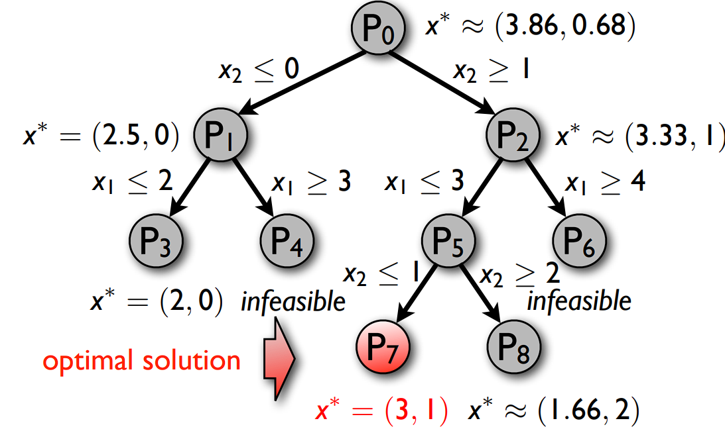
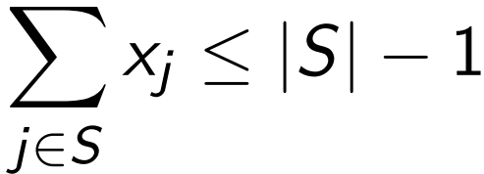
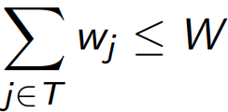
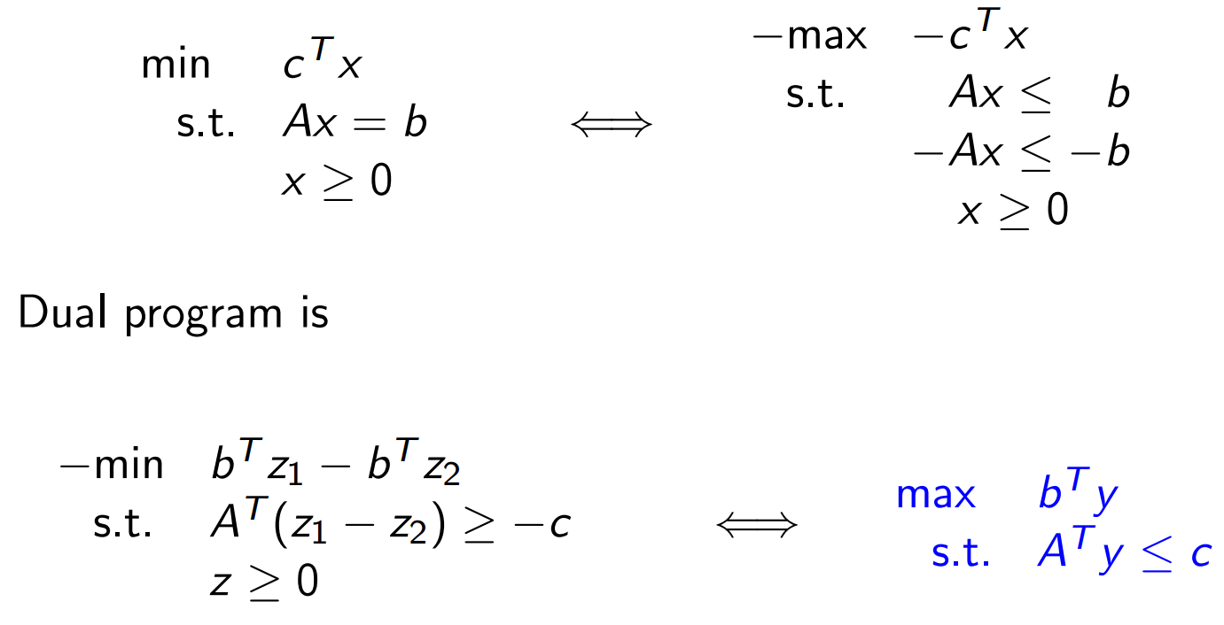
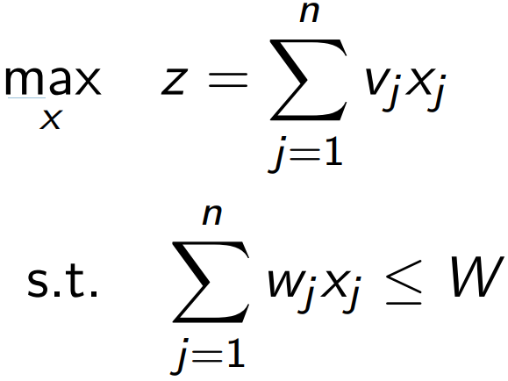
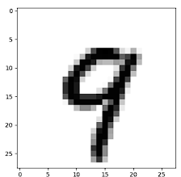
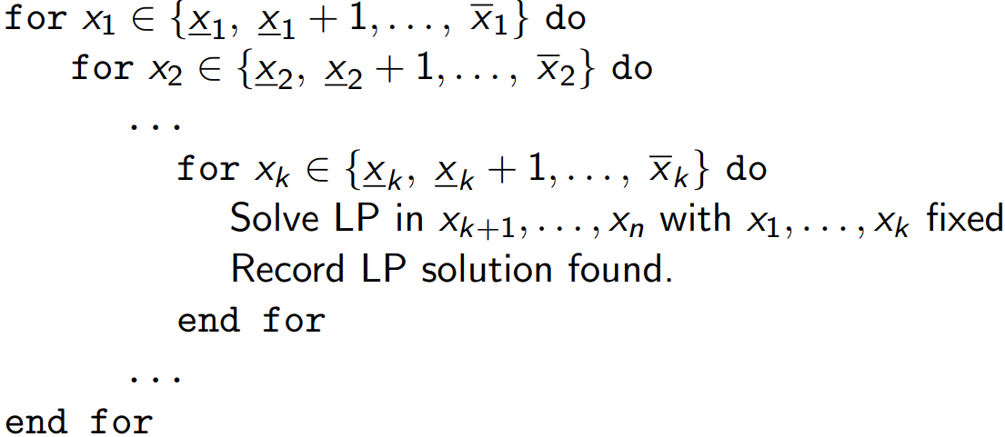
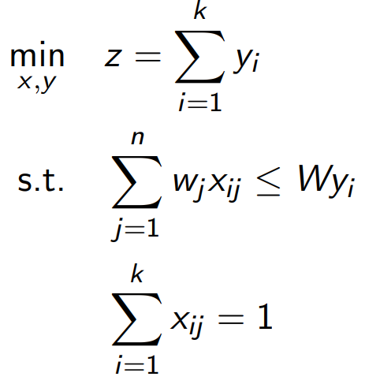
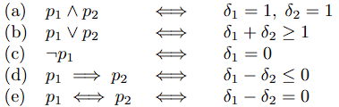
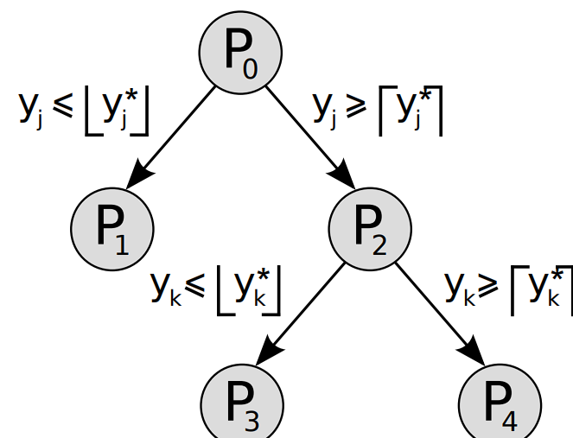
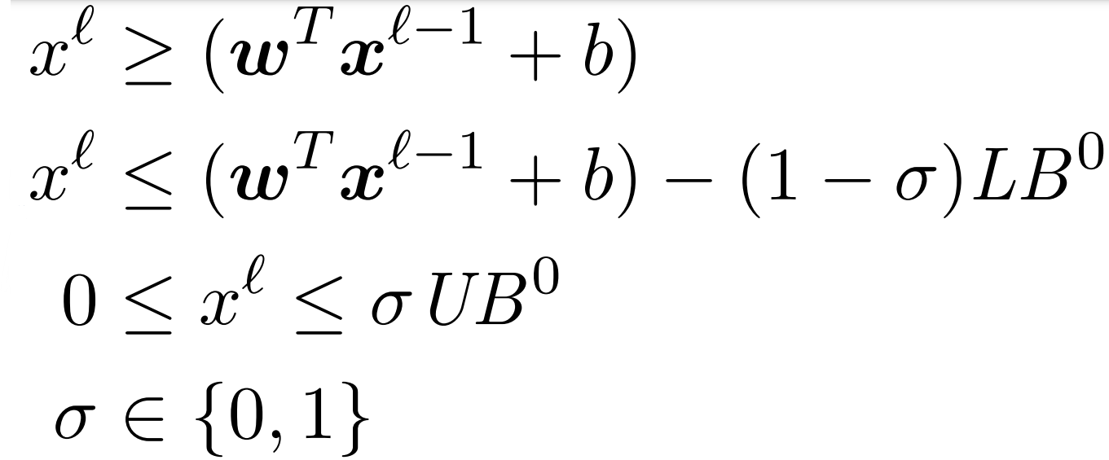
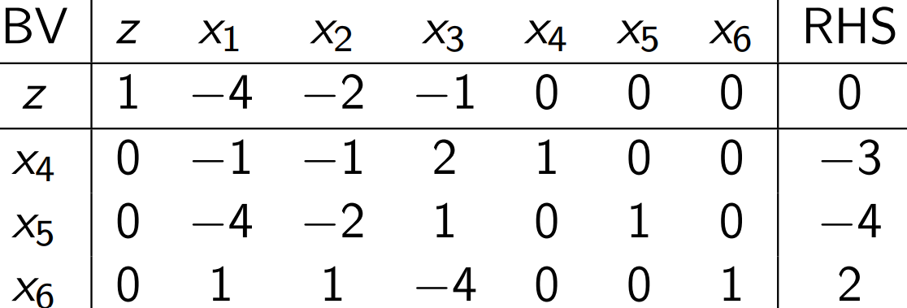
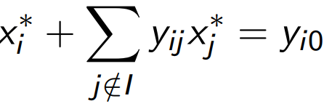

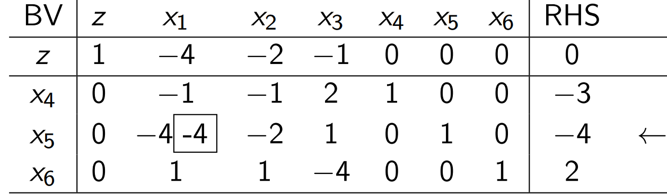
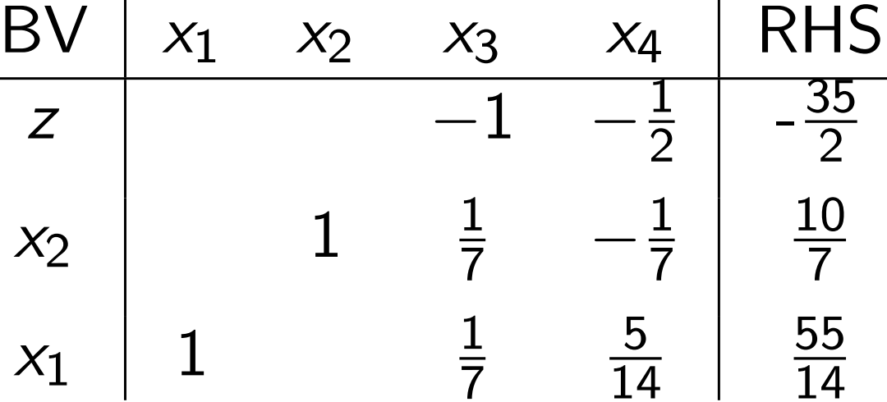
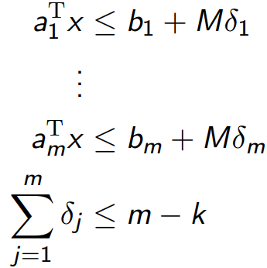
6.4) Minimax Theorem
For every two-person zero-sum game, the RP and CP linear programs have same optimum.
Proof: strong duality since the two programs are the duals of each other.
As a result: Mixed Nash Eq always exists! Players expect identical payoffs.
Neither player has incentive to change p_{i} or q_{j}.
Statement generalises to M players.
7) Dual Simplex Algorithm
The Dual Simplex is simply the Simplex applied to the Dual of the problem.
DUAL
⬅➔
How to get a Dual BS from Primal:
1) Fix basis B for (P): A = [B N] w = [W_{B}]
[W_{N}]
2) Dual constraint A^{T}y+w=c is thus basically:
[B^{T}] y + [W_{B}] = c,
[N^{T}] [W_{N}]
And thus:[B^{T} I 0] [ y ] = c,
[N^{T} 0 I] [W_{B}]
[W_{N}]
3) The blue submatrix is squared, we can write:
[B^{T} 0] [ y ] = c, W_{B} = 0
[N^{T} I] [W_{N}]
And the dual basis is as a result:[B^{T} 0]
It’s inverse is: [ B^{-T} 0] [N^{T} I]
[-N^{T}B^{-T} I]
Denote B^ as Dual Basis, B as Primal.
Primal Dual Basis Properties:
1) If the B^ is optimal for D, then B is optimal for P: w_{N} = −N^{T}B^{−T}c_{B} + c_{N} ≥ 0 ⇐⇒ r ≥ 0
2) If the B^ is optimal for D, then B is feasible for (P). Proof: B^ opt for D ➔ the dual reduced cost ≤ 0 at the max
0-[I 0][B⁻¹ −B⁻¹N][b] = −B⁻¹b≤0 ⬅➔ P feasible
[0 I ][0]
“dual simplex maintains dual feasibility, step to dual optimality” = “dual simplex maintains primal optim, step to primal feasibility”
Useful as we can reuse our initial BFS for a primal for the dual without using Phase I. Dual is on average quicker to solve for typical problems (You might wanna swap to dual if you have lots of constraints but few vars, as many vars and few constraints is easier to solve)
7.1) Running the Dual Simplex Algorithm
initial point: start point ensures optimality
(Reduced costs <= 0).
variable out: row with most negative RHS
variable in: ratio test over columns
halting test: check for feasibility
Example:
max -4x₁ -2x₂ – x₃ min -3y₁ -4y₂ + 2y₃
s.t: -x₁ – x₂ + 2x₃ ≤ -3 s.t: -y₁ - 4y₂ + y₃ ≥ -4
-4x₁ –2x₂ + x₃ ≤ -4 -y₁ -2y₂ + y₃ ≥ -2
x₁ + x₂ + 4x₃ ≤ 2 2y₁ + y₂ – 4y₃ ≥ 1
x ≥ 0 y ≥ 0
Slotting the Primal problem into the Simplex:
We have basic solution (infeasible). But it is feasible for dual (see row of reduced cost ≤ 0), and corresponds to y = 0 -> as we started from optimality. We can use Dual Simplex nicely by setting all BVs to 0, see where slacks end and get an Optimal Infeasible Solution and then work on the Dual!!
Start from Optimality; descend into feasibility:
Pick the most negative RHS (row x₅).
To pick the column, take the objective value’s and divide by the values in their column’s selected row. Pick the one with the greatest ratio. Here’s -4/-4 and -2/-2 are equivalent. So, pivot on column for x₁ or x₂; pick x₁
8) Integer Programming
Problems where 1 or more vars takes int vals. (MILP – Mixed Integer Linear Program)
e.g: max 3x + 4y
s.t. x + y ≤ 4 2x + y ≤ 5
x ≥ 0, y ≥ 0 x, y ∈ N₀
We can drop those constraints that x and y must be integer and obtain an LP.
For a max problem, F_{LP} >= F_{MILP} obviously, since F_{LP} contains a larger solution space.
F_{LP}’s solution unfortunately doesn’t necessarily tell us much about F_{MILP}’s solution.
These problems are not easy to solve -> 2^{n} combinations for n binary variables. No proven algo like simplex. We throw all sorts of techniques at them and try our best…
Since these problems are hard we break them into many different types of problem that we can put dedicated effort into solving:
1) Knapsack Problem:
Consider n items of weight w_{j}, j ∈ {1, ... , n} and a knapsack of weight capacity W. Item j has value v_{j}, not all items may fit the knapsack. How to maximise the total value of knapsack?
LP: ∀ j ∈ {1, ... , n}
∀ x_{j} ∈ {0, 1}
2) Bin-Packing Problem: (Multi-Knapsack)
n items of weight w_{j}, j ∈ {1, ... , n},
k bins of capacity W
x_{ij} = 1 if item j assigned to bin i, 0 otherwise Minimise the number of bins to store all items
∀ j ∈ {1, ..., n}
x_{ij}, y_{i} ∈ {0, 1}
∀ i ∈ {1, ..., k}
3) MILPs: (Mixed Integer Linear Programs):
min z = c^{T}x
s.t. Ax = b x_{j} ≥ 0 for j ∈ N = {1, ..., n} x_{j} ∈ N₀ = {0, 1, 2, ...} for j ∈ Z ⊆ N.
where x_{j} ∈ N \ Z are continuous, as in LPs
(A subset of vars are Integer)
Pure ILP -> all Integer. Binary ILP -> vars are 0/1. MIBP -> Integer vars are 0/1.
8.1) Standard Form of a MILP/PILP
MILP Standard Form:
Similar to LPs, in particular b ≥ 0.
Slack and excess variables in MILPs are continuous.
PILP: Slack and excess variables in Pure IPs are integer-valued. Solution Steps:
1) Apply LP standard form transformations but don’t add of slack/artificial variables, e.g: Min, Positive RHS, Remove Free Variables
2) Scale the equations of the model so that all coefficients are integers. (multiply them up – remember to divide objective func at end)
3) Insert integer slack and/or excess variables.
8.2) Logical Operations:
We can model logical operations on the constraints via integer variables. e.g:
a₁^{T}x ≤ b₁ ∨ a₂^{T}x ≤ b₂
Expressed by: a₁^{T}x ≤ b₁ + M_{δ}
a₂^{T}x ≤ b2 + M(1 − δ)
δ ∈ {0, 1} , where M is a large enough constant called “big-M”. Intuitive enough.
Example: Either-Or
min x s.t. x ∈ [0, 1] ∨ x ∈ [2, 4]:
Becomes the linear program:
min x s.t: x ≥ 0 x ≤ 4
x ≤ 1 + Mδ x ≥ 2 − M(1 − δ)
Satisfying k out of m constraints (complex bool)
a₁^{T}x ≤ b₁, a₂^{T}x ≤ b₂, ..., a_{m}^{T}x ≤ b_{m}
Expressed by:
δ_{j} ∈ {0, 1} , ∀_{j} ∈ {1, ..., m}
8.3) Finite Valued Variables
Assume a variable x_{j} takes a finite number of values: x_{j} ∈ {p₁, ..., p_{m}}. How to model as LP?
We introduce variables z_{j1}, ..., z_{jm} ∈ {0, 1} and add the constraint z_{j1} + ... + z_{jm} = 1 (∗)
Now, we can replace xj = p₁z_{j1} + ... + p_{m}z_{jm} in the objective function and all constraints.
Due to (∗), x_{j} can only assume a single value.
Example:
min z = −2x₁ − 3x₂
subject to 2x₁ + x₂ + x₃ = 4
x₁ ∈ {1, 3, 11}
x₂, x₃ ∈ N₀
Answer: Replace x₁ = z₁₁ + 3z₁₂ + 11z₁₃
min z = −2z₁₁ − 6z₁₂ − 22z₁₃ − 3x₂
subject to 2z₁₁ + 6z₁₂ + 22z₁₃ + x₂ + x₃ = 4
z₁₁ + z₁₂ + z₁₃ = 1
x₂, x₃, ≥ 0 z₁₁, z₁₂, z₁₃ ∈ {0, 1} x₂, x₃ ∈ N₀
9) Linear & mixed-integer linear optimisation of trained ReLU NNs
Image: x
Label: j = 9
Adversary: k = 4.
Verification (Feasibility): Is there an adversary k within a given perturbation via L₁ or L∞ norms?
Optimal Adversary: What image within perturbation via L₁ or L∞ maximises the prediction difference?
Minimally distorted adversary: Smallest perturbation ₁ or L∞ over which the NN predicts label k?
Lossless compression Can I safely remove NN nodes or layers?
For ReLU, our function is like so:
x^{L} = max (0, (w^{T}x^{L-1} + b))
where x^{i} refers to the output of the i_{th} layer.
Equivalently: x^{L} ≥ max (0, (w^{T}x^{L-1} + b))
x^{L} ≤ max (0, (w^{T}x^{L-1} + b))
Remember, W and B are now fixed as we’ve already finished training.
1) For the Optimal Adversary Problem:
We formulate the following LP:
max f_{k}(x^{L}) − f_{j}(x^{L})
such that:
x_{i} ^{l} ≤ max (0, ((w_{i} ^{l -1})^{T}x ^{l -1} + b)) ∀ l ∈ {1, ..., L} = Layer, i ∈ Node ^{l}
x_{i} ^{l} ≥ max (0, ((w_{i} ^{l -1})^{T}x ^{l -1} + b)) ∀ l ∈ {1, ..., L} = Layer, i ∈ Node ^{l}
x ∈ X
Here, f_{k} and f_{j} correspond to the k- and j-th elements of the neural network output layer L.
X defines the domain of perturbations.
The issue is the less than constraint; and that we have this equation for every single node in the network. This makes it difficult to solve.
We can also define these constraints as:
With Big-M coefficients LB⁰ , UB⁰ ∈ R
(w^{T}x ^{l -1} + b) ∈ [LB⁰, UB⁰]
Example: Formulation using Big M
Consider a NN node with a ReLU activation fun-ction with 2 inputs (x₁ and x₂) & 1 output (y). The bounds on the inputs are x₁, x₂ ∈ [0, 1] and we have parameters w₁ = w₂ = 1 and b = -1.5.
Formulate this node using the big-M method:
y = w₁x₁ + w₂x₃ – b ➔ y = x₁ + x₃ – 1.5
➔ y ≥ x₁ + x₃ – 1.5
y ≤ x₁ + x₃ – 1.5 – (1-σ)LB⁰
y ≤ σUB⁰
x₁, x₂ ∈ [0, 1], y ≥ 0, σ ∈ {0, 1}. Just a direct application of the template shown above.
Now, we set LB to -1.5, as that’s the smallest value of the network (this constraint must be active when x₁ = x₂ = 0; y = -1.5 at this).
UB = 0.5, as that’s the biggest (x₁ = x₂ = 1;
y = 0.5).
Show that the point (x1, x2, y, σ) = (1, 0, 0.25, 0.5) is feasible for the LP relaxation:
Substituting in, we see that (x₁, x₂, y, σ) =
(1, 0, 0.25, 0.5) is feasible if the constraint
σ ∈ {0, 1} becomes σ ∈ [0, 1]. (Since sigma is now between 0 and 1 rather than exactly that)
Show that the inequality y ≤ 0.5x₂ is valid for the ReLU activation function but not satisfied by the point (x₁, x₂, y, σ) = (1, 0, 0.25, 0.5).
The inequality is valid: the case that y = 0, since x₂ >= 0. It doesn’t hold for the given point though, trivially, since 0.25 <= 0.5(0) can’t be true.
10) The Cutting Plane Algorithm
Allows us to reuse/extend LP algorithms.
Continuous Relaxation:
LP relaxation: LP program obtained by replacing all integer vars x_{j} ∈ N₀ in a ILP with continuous vars x_{j} ∈ R. Obv, opt LP > opt ILP.
Outline of solution procedure:
Solve a LP relaxation. Contains all originally feasible solutions.
If optimal solution is integer, we are done. Otherwise, tighten the LP relaxation and repeat.
Tightening: restrict feasible set of the LP relaxation without excluding the optimum solution of the ILP.
Cutting Plane Algorithm Procedure:
Step 0. Write the ILP in standard form.
Step 1. Solve the LP relaxation.
Step 2. If the resulting optimal solution x* is integer, stop ⇒ optimal solution found.
Step 3. Generate a cut, a constraint satisfied
by all feasible integer solutions, but not by a solution x* with non-integer components.
Step 4. Add cut to the LP relaxation and go back to Step 1.
The algorithm terminates after finite number of iterations. The resulting x ∗ is integer and optimal.
Generating cuts: The Floor Function:
Assume x₁, … , x_{n} ≥ 0 and integer.
⌊c⌋ = max{ a ∈ Z : a ≤ c } is the floor function
Any real number c = ⌊c⌋ + (c – ⌊c⌋)
Thus write a₁x₁ + … + a_{n}x_{n} = b with a_{j}, b ∈ R
As (⌊a₁⌋ + (a₁ – ⌊a₁⌋))x₁ + … +
(⌊a_{n}⌋ + (a_{n} – ⌊a_{n}⌋))x_{n} = (⌊b⌋+ (b – ⌊b⌋))
We can rearrange terms to get:
f₁x₁ + … + f_{n}x_{n} – f = ⌊b⌋ - ⌊a₁⌋x₁ - … - ⌊a_{n}⌋x_{n}
1) Gomory Cuts:
Assume x ∈ N₀^{n}. Then f₁x₁ + ... + f_{n}x_{n} ≥ f
Proof: Consider:
f₁x₁ + ... + f_{n}x_{n} – f = ⌊b⌋ - ⌊a₁⌋x₁ - … - ⌊a_{n}⌋x_{n}
As x is an integer, the RHS is integer.
So the LHS is too.
Since x >= 0, and each f_{i}: 0 <= f_{i} < 1, the LHS is lower bounded by –f. Since –f > -1, LHS is LHS is lowerbounded by -1, and since it can only be integer... LHS >= 0 as needed.
Suppose Step 1 of cutting plane gives non integer x. Then there is a row in the final simplex tableau s.t:
y_{io} ∉ N₀ . This summation is on NBVs (reduced cost vector)
Gomory Cuts are defined as follows:
Setting f_{j} := y_{ij} - ⌊y_{ij}⌋ c, f := y_{i0} − ⌊y_{i0}⌋
The Gomory Cut:
Example:
Step 1 & 2) Arrive at Optimal tableau solution:
Step 3) Must generate cut: we take a row with a non integer RHS, e.g: x₁ row.
F₁ = 1 - ⌊1⌋ = 0 (basic; not in GC)
F₃ = 1/7 (NBV) F₄ (NBV)
f = 55/14 - ⌊55/14⌋ = 13/14
Gomory Cut (1): 1/7 x₃ + 5/14 x₄ >= 13/14
We continue with our Solution found in relaxation with same NBVs/BVs
Step 4) Add the cut to the LP relaxation; go to Step 1; repeat.
ie: We add: 1/7 x₃ + 5/14 x₄ – x₅ = 13/14
2) Knapsack Cover Cuts
A set S of items in a knapsack prob is a cover if:
Usually we want a minimal cover constraint; e.g a cover constraint such that for all proper subsets T of S:
Example:
3x₁ + 5x₂ + 4x₃ + 2x₄ + 7x₅ ≤ 8
x₁, x₂, x₃, x₄, x₅ ∈ {0, 1}
5 + 4 > 8 ⇒ x₂ and x₃ cannot simultaneously be equal to 1. We can add a Cover Cut. x₂+x₃ ≤ 1
We add knapsack cover cuts at the beginning, restrict problem space and make things easier.
It’s minimal if we can’t remove an item from our set and have it still be a cover cut.
10.1) Complete Enumeration Algorithm
Solve an IP by trying everything lmao:
We fix k variables (k = num of integer vars).
Divide and Conquer on MILP:
1) Solve LP relaxation of problem P₀ ⇒ x*(P₀). 2) Stop if solution satisfies integrality constraints 3) Else, choose non-integer x_{p}*∈ x*(P₀), p ∈ Z:
a) Divide (Branch): Create two subproblems,
P₁ and P₂, adding to P₀ the constraints
x_{p} ≤ ⌊x_{p}*⌋ ∗and x_{p} ≥ ⌊x_{p}*⌋ respectively. I
b) Conquer (Bound/Fathom): Recursively
solve the new subproblems. If optimal
solution of continuous relaxation of P₁ (P₂)
is worse than any known feasible solution
for P₀, disregard P₁ (P₂).
Any solution of P₀ satisfying integrality constraints is feasible in one of P₁ and P₂. Hence, we can solve P₀ by solving P₁ and P₂.
Terminology:
P₀: original MILP problem. P_{i}: i-th subproblem.
x*(P_{i}): Optimal solution for relaxed LP of P_{i}
c^{T}x*(P_{i}): Optimal val for relaxed LP of P_{i}, ∞ if P_{i}
is infeasible.
OPT: objective function value of best BFS of P₀
found so far.
x_{OPT}: Solution producing the best OPT.
A LP solution x*(P_{i}) is feasible for MILP P₀ if it satisfies all integrality constraints of P₀.
Branch and Bound Steps for MILPs:
1) Initialization: Initialize OPT = ∞.
Solve LP relaxation of P₀ ⇒ x*(P₀).
If x*(P₀) feasible for P0, OPT = c^{T}x*(P₀),
x_{OPT} = x*(P₀) and STOP.
Otherwise set list of problems to {P₀}
2) Problem Selection: Extract from list a P_{i} having c^{T}x*(P_{i}) < OPT. If no such Pi exists STOP. 3) Variable Selection: Choose non-integer x_{p}* ∈ x_{p}*(P_{i}) that must be integer in P₀ (p ∈ Z).
4) Branch: Create subproblems P’ and P’’ with x_{p} ≤ ⌊x_{p}*(P_{i})⌋ and x_{p} ≥ ⌈x_{p}*(P_{i})⌉, respectively.
5) Bound P’: Solve LP relaxation of P’.
If c^{T}x*(P’) < OPT:
If x*(P’) feasible for P₀:
Set OPT = c^{T} x*(P’) and x_{OPT} = x*(P’).
Else add P’ to list for further inspection.
6) Bound P’’. (Identical to step 5, but for P’’) Go back to step 2. Output:OPT = ∞ if P₀ is infeasible. OPT < ∞: P₀ feasible; OPT is its optimal Optimal Solution: x_{OPT} associated to OPT. Termination: Under assumption of finite bounds x_{j} , x_{j} for j ∈ Z, algorithm terminates in finitely many steps
Example: 1) Initialise:
max x₁ + x₂
subject to 3x₁ + 5x₂ <= 15
x₁ – 2x₂ <= 5/2
x₁, x₂ >= 0; x₁, x₂ ∈ N
P₀: x* = (3.86, 0.68)
2) Branch: branch on x₂ (we chose to branch on x₂ at random): solve the problems P₁ which has x₂<= 0, P₂: x₂ >= 1
3) Bound on P₁: x₂<= 0: x* = (2.5, 0) (DFS):
P₁ cont: Branch on it: P₃: x₁<=2, x*= (2,0)
P₄: x₁ >= 3 (infeasible)
4) Bound on P₂: x₂ >= 1: x* = (3.33, 1):
P₂ cont: Branch on it:
P₅: x₁ <= 3: x*=(3, 1.2)
P₅ cont: Branch on it: P₇: x₂ <= 1:
x*=(3, 1), P₈: x₂ >= 2: x = (1.66, 2),
terminate P₈ as the LP is weaker than
orig.
P₆: x₁ >= 4 infeasible
Solvers often combine branch and bound / cutting plane. It gives us a faster algo!
At each search tree node, cuts are dynamically generated and added to the LP relaxation to tighten the feasible set. Cuts are further categorised into local cuts that are valid only for a subtree of the branch-and-bound tree, and global cuts that are valid for all nodes.
M1) Basic Solutions, Feasibility, Obj Val
Set variables to 0 in turn (as many vars as needed until the rest = num constraints), and then just solve those simul. eqs.
To find if these are feasible just then check what values the rest of the vars are and see if they fit constraints. Obj val: sub in obj func.
M2) Dual Simplex Misc.
Dual Simplex only reaches feasibility at the end (Red. Cost becomes neg)
Starts from Optimality but not feasibility
M3 Logical Formulae
M4 Restricting to integer bounds
(x₂ = 0 ^ x₁ and x₁ between 0, 2) OR
(x₂ = x₁ – 2 and x₁ between 2, 4)
Well, note that:
X₁ >= 0, x₂ >= 0
X₂ >= x₁ – 2
X₁ <= 4, x₁ between 0, 4 and x₂ between 0, 2 are always true.
We end up with 2 things: x₂ on the <= side of 0 needing to be switched on OR x₂ on the <= side of x₁ – 2 needing to be switched on (they’re exclusive, look at the two sides)
So:
X₂ <= My
X₂ <= x₁ – 2 + (1-y)M
Y is 0 or 1.
M = 4 because the first constraint (with x1 − 2) only gets as small as −2 on the domain and the second constraint with 0 only needs to be as big as 2 on the domain.
M6) Using the Indirect Method to derive dual LP
M7) Using the Direct Method to derive dual LP
M8) Homogenizing a Fractional LP
⌊1⌋
10) Computing the Mixed Nash Equilibrium
12) Dual Simplex

