Slide 1
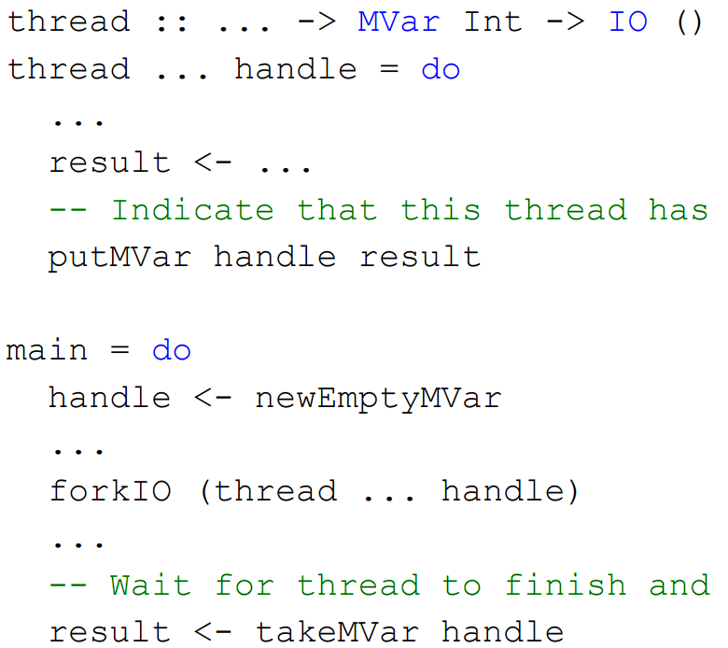
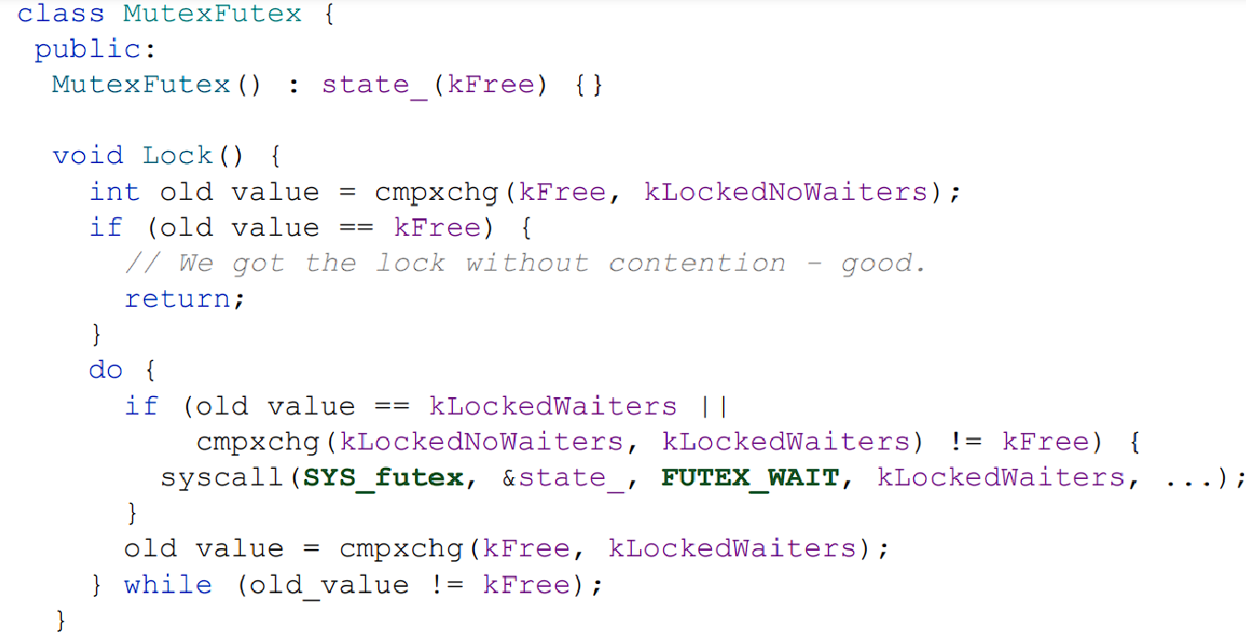
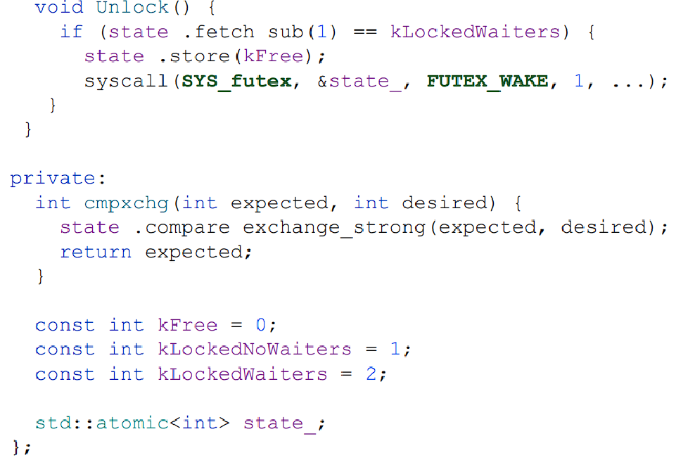
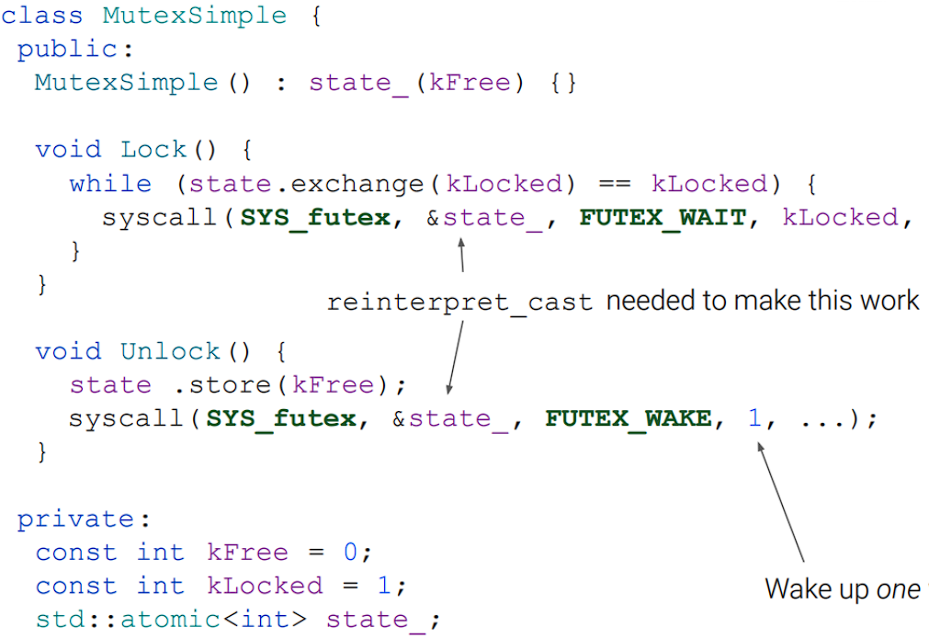
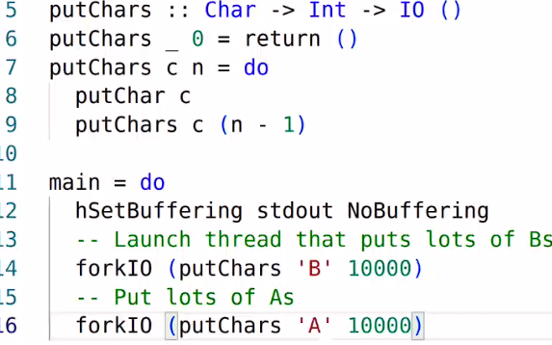
1) The Practice of Concurrent Programming
1.1) Threads: #include <thread>
std::thread my_thread(StartFun, arg1, arg2, …)
auto my_thread = std::thread(StartFun, arg1, …)
When passing args to a thread we need std::ref/std::cref
int a = 42;
std::thread my_thread(foo, std::cref(42));
We usually put the following in a loop: to initialise many threads in a std::vector:
threads.emplace_back(ThreadBody, a, b, c);
threads.push_back requires explicit constructor.
And we can join them all in a loop (for-each):
thread.join()
Sleeping: #include <chrono>
std::this_thread::sleep_for(200ms)
1.2) Locks: std::scoped_lock -> uses RAII, pass in std::mutex& mutex. Can have many mutex, Locks all on init, unlocks all on destruction. No deferred locking, early unlock or std::move to change mutex owner -> RAII!
std::unique_lock -> constructed with only one mutex. Locks on construction, or later. Allows unlock/relock. Unlocks on destruction. std::move allows transfer.
Condition Variable -> allows threads to wait on one another. #include <condition_variable>. .notify_one(), .notify_all().
Scoped Locks are efficient for locking some range.
Unique Locks are best for locking on some condition.
1.3) Race Conditions: Where multiple threads access data and at least one writes. No ordering enforced.
Can be intentional. RW, WR, WW.
What is a problem is Data Races -> leads to UB -> the (compiler optimized) prog can do anything as a result
1.4) Waiting: wait(lock, predicate (a cond var) ):
Requires that the lock is held by the thread calling wait.
Then, we check predicate, and release lock if its false. Then we block until notified, and then reacquire lock
Tsan detects data races automatically. Add
-fsanitize=thread to the compile options.
1.5) Data Race: A data race occurs when: Distinct threads access a memory location
At least one of the accesses modifies the location
At least one of the accesses is non-atomic
The accesses are not ordered by synchronization Synchronization achieved via: Mutexes / Acquire load reading from release store / SC load read from SC store
2) Atomics: allow for well-defined race conditions, and fine-grained synchronization between threads. std::atomic<T> Declares an atomic variable of type T Common use cases: boolean, integral and pointer types #include <atomic>
std::atomic x(1);
std::atomic<MyStruct*> p(&my_struct);
std::atomic size(0u);
std::atomic flag(true);
Operations:
store(x) -> store value x of type T
load() -> return value (type T)
exchange(x) -> store x, return old val.
compare_exchange_strong(expected, desired)
Compare stored value to expected, if equal then implace “desired” and return true, else implace “expected” and return false. (RMW)
compare_exchange_weak(expected, desired)
Spuriously fails. Less costly.
Operations on std::atomic<integral_type>:
fetch_add(x), fetch_sub(x), fetch_and(x), fetch_or(x), fetch_xor(x)
On small enough data types, atomic operations happen behind the scenes lock free. On large ones, we need locks; is_lock_free(x) on some atomic x tells us if so.
Read Modify Write: instr that performs a load&store.
2.1) Memory Models
Every atomic operation can have a second argument for what memory model we operate under.
1) Seq. Consistency: std::memory_order_seq_cst
Tightest. The default. Easy to reason about. Expensive, not what modern CPU’s do.
“... the result of any execution is the same as if the operations of all the threads were executed in some sequential order, and the operations of each individual thread appear in this sequence in the order specified by its program.”
T1: x = 1; print y; T2: x = 1; print x;
1, 1; 0, 1; 1, 0 are allowed prints.
2) Relaxed: std::memory_order_relaxed Weakest memory order – “sequential consistency per location”.
Compiler has more flexibility to reorder instructions - useful for optimisations
Avoids the need to issue expensive memory barriers / fences.
Useful when you really don’t care in which order things happen
Use Case: Parallel find: when there are multiple occurrences we don’t care which one is reported
2.1) Message Passing - one thread prepares some data until it’s ready, and then lets the other thread know when it’s ready using a release/notify. Works well with SC (but is slow) - but NOT with Weak Memory Models! As the instructions may be reordered.
Release-Acquire Consistency is perfect:
T1:
// use data, can be reordered
use_data(data);
flag.store(true, std::memory_order_release);
T2:
while(!flag.load(std::memory_order_acquire)) {//spinlock}
use_(data);
3) Spinlocks Good for small critical sections with low contention -> doesn’t require syscall.
1) Test and Set Spinlocks: Write 1 to a location (set). Return the location’s old value (test)
Lock state: 1 bit.
Lock: Repeatedly test-and-set bit until 0 is returned (where spinning occurs - a thread will keep trying if it is 1, and setting to 1. Some other thread will set to 0 and we break free.)
Unlock: Set the bit to 0
Uses an RMW instruction.
class SpinLock {
public:
SpinLock(): lock_bit_(false) {}
void Lock(){while(lock_bit_.exchange(true)){}}
void Unlock() { lock_bit_.store(false); }
private:
std::atomic<bool> lock_bit_;
}
Problem: Cache Thrashing: We’re writing a value again and again to the same place (even though it’s usually the same value). This invalidates the caches of ALL the other cores (if they have a thread that store this value). Big performance dropoff, higher the more threads that are waiting for the TSL Spinlock.
Solution: Local Spinning. Repeatedly load cached copy of lock state (not the actual lock value - we only refer to the cache). Only do TAS when the lock is seen to be available (so when the cache is updated); atomicload.
void Lock(){
while(lock_bit_.exchange(true)){
while (lock_bit_.load()) {
// Someone still hold’s the lock
}
// Lock’s now free, try grab
}
}
Problem: Bus Traffic flooded with loads.
Solution: Active Backoff: (inside while-exchange loop):
do {
for (volatile size_t i = 0; i < 100; i++) {}
} while (lock_bit_.load))
Problem: Still accelerating around using CPU cycles (energy?). Also 100 is arbitrary.
Solution: Passive Backoff; supported by CPU instrs:
inside the inner spin loop:
#include <emmintrin.h> . . .
_mm_pause(); // for x86; or YIELD() on ARM
Solution: Exponentially grow backoff, and cap it:
Still arbitrary, but the backoff kinda adapts.
const size_t kMinBackoffIters = 4u;
const size_t kMaxBackoffIters = 1u << 10u;
size_t backoffIters = kMinBackOffIters
And then in the loop, use i < backoffIters, and double it each goround.
Problem: Fairness. A thread might go hungry. But if a thread gets to keep staying the cache does stay warm
Solution: Ticket locks. There is contention of Performance vs Fairness. We do need fairness.
3.1) Ticket Locks
When a thread wants the lock, it obtains a ticket.
A thread holds the lock when its ticket number is being served.
When a thread releases a lock, the next ticket number gets served.
A thread a will try and get the ticket number, say “42” using fetch_add(1).
The “Now Serving” variable might be set to 42, which means that a will now have access to the resource.
Meanwhile another thread b might get the ticket number “43” using fetch_add(1).
Threads only sometimes request a resource and that’s when they get a ticket. The key thing is, a thread foo will not be allowed to obtain a ticket if it already has done work AND all the other threads that wanted the lock before foo requested it again have gone.
class SpinLockTicket {
public:
SpinLockTicket(): next_ticket_(0),
now_serving_(0) {}
void Lock(){
const auto ticket = next_ticket.fetch_add(1);
while (now_serving_.load() != ticket) {
_mm_pause();
}
}
void Unlock() {
now_serving_.store(now_serving_.load()+ 1
// not RMW; cheaper than fetchadd.
}
private:
std::atomic<size_t> next_ticket_;
std::atomic<size_t> now_serving_;
}
3.2) Futexes and Hybrid Locks
Spinlock: 1) Great when there is low contention, or short critical sections 2) Prevents CPU from doing other useful work when contention is high
Sleeping lock: Good to sleep a thread if lock won’t be free for a while – yield exec. Bad if about to free.
Futexes offer the best of both worlds:
futex is a linux system call exposing functionality offered by the kernel, works on userspace data, used to implement synchronisation primitives that execute primarily in userspace.
1) FUTEX_WAIT(int *p, int v): return immediately if *p != v, else add thread to wait queue associated with p.
2) FUTEX_WAKE(int *p, int wake_count): Wake up wake_count threads that are on the wait queue for p. 1/INT_MAX only sensible values for wake_count.
FUTEXES work by having the int ptr point to a waiter queue in memory – stores a list of threads waiting to get woken up.
1) If a thread tries to lock at first, it can without going in the loop as state is initialised to 0.
2) Any next thread which tries to acquire before unlock ends up calling FUTEX_WAIT and getting added to the kernel memory waiter queue.
3) If we UNLOCK, then we reset the state to zero. (so we can lock without going in the loop). And then, we syscall wake up one of the waiters in the queue.
4) This design is expensive as we have to do a FUTEX_WAKE on every unlock - even if we have no waiters. We do less syscalls than if we used sleeping,
and less spinning than if we use spinlocks, but still bad.
A smarter Futex based design:
0: mutex is available
1: mutex is locked; the thread that locked it thinks
there are no waiters
2: mutex is locked; the thread that locked it thinks
there might be waiters
In case 1 & 2 there might actually be waiters.
Locking:
First, compare-exchange state_ with 0, setting to 1 on a success. If it succeeds: 1) acquire the lock, set state_ to 1 (acquired + we don’t think there’s waiters).
If it fails, state_ is either 1 or 2. Now, we do another compare_exchange to try change the state from 1 to 2, and call FUTEX_WAIT with 2. If that fails, then state_ was already 2 – there are already waiters, join them. Otherwise the state got set to 0 before we did compare-exchange – FUTEX_WAIT(2) just returns immediately.
When FUTEX_WAIT(2) returns:
Try to compare-exchange state_ with 0, setting it to 2 on success.
If compare-exchange succeeds then: We hold the lock. We have recorded in state_ that it’s locked and we think there may be waiters: we had to fight to get the lock, there may be others!
Job done (lock acquired)
Otherwise: goto label;
2) Unlocking:
Before we unlock, state_ is either 2 or 1
If state_ is 2, we think there were waiters when we locked - we should call FUTEX_WAKE
If state_ is 1, we thought there were no waiters when we locked – don’t call FUTEX_WAKE
Then: atomically decrement state_
Decide whether to call FUTEX_WAKE based on its old value
Ensure that state_ is 0 when Unlock returns
3) Optimizations:
After failing to get the mutex:
Don’t try to compare-exchange state_ from 1 to 2 if it was observed to be 2
If attempt compare-exchanging state_ from 1 to 2 reveals that it is 0, don’t call FUTEX_WAIT - try to get the lock!
Hybrid locking (aka adaptive locking)
Avoid microcontention: Thread misses out on the “fast path” to getting the lock (doing a compare-and-swap) …but lock will become free extremely soon - not worth going to sleep WebKit locking: spin 40 times, calling yield between spins. Reported to be good enough for a wide range of platforms.
4. Concurrency in Haskell
ghc -O2 my_program.hs -threaded -> optimizations and multicore.
./my_program args +RTS -N8 -> tells the runtime to use 8 cores.
1) import Control.Concurrent
forkIO :: IO () -> IO ThreadId
causes a thread to run asynchronously, when main ends, the program is terminated even if threads are still running
2) MVar a: - mutable variable storing a value of type a
An MVar is either: empty - holds no value
full - holds a value of type a
Note: fundamentally different from Maybe, which has nothing to do with mutable state.
Create a new MVar with a given value:
newMVar :: a -> IO (MVar a)
Example: counter <- newMVar 0
counter :: MVar Integer
Create a new empty MVar:
newEmptyMVar :: IO (MVar a)
eg: handle <- newEmptyMVar
handle :: Any
Take value from an MVar:
takeMVar :: MVar a -> IO a
Blocks until the MVar is full, leaves the MVar empty
Yields the value that was in the MVar
Like a one value buffer – take waits until I gets val
Put value into an MVar:
putMVar :: MVar a -> a -> IO ()
Blocks until the MVar is empty
Leaves the MVar full, containing the given value
Read current value from MVar:
readMVar :: MVar a -> IO a
Blocks until the MVar is full
Yields the current value of the MVar, leaving it full
For example, joining threads with MVar, & getting result:
We can use MVars “as locks” – for mutual exclusion:
Treat our handle as a mutex, and thern put putMVar mutex () before our critical section and takeMVar mutex () after. (or swap their ordering before/after)
3) An MVar is a one-place buffer:
Perfect for passing simple messages between threads
No need for condition variables -MVar operations encapsulate waiting and signalling
4) IORef: mutable references
Build a new IORef:
newIORef :: a -> IO (IORef a)
Load value from
IORef: readIORef :: IORef a -> IO a
Write to IORef, issuing barrier to avoid reorderings: atomicWriteIORef :: IORef a -> a -> IO ()
5) AtomicCounter:
Build a new AtomicCounter:
newCounter :: Int -> IO AtomicCounter
Increment counter by a value - returns the new value: incrCounter :: Int -> AtomicCounter -> IO Int
Same, but discard the result:
incrCounter_ :: Int -> AtomicCounter -> IO ()
Read value of counter:
readCounter :: AtomicCounter -> IO Int
4.1) Concurrency in Rust
Type system provides certain safety guarantees
Well-typed programs are free from data races
In Rust, an object has a single owner
When the owner goes out of scope, the object is destroyed, like std::unique_ptr in C++, but ownership rules are enforced.
fn main() {let p = Point{x: 1, y: 2}; show(p);}
// main gives up ownership of p ^
fn show(p: Point){println!("({},{})",p.x,p.y);}
// show becomes the owner of p, and it gets deallocated at the end of the method.
If we did show(p) twice in main, we’d fail the 2nd time.
If we do show(p: &Point) – an immutable ref, then p doesn’t get dealloced, (someone else owns it)
To modify a point, we pass in a reference like so:
fn scale(p: &mut Point, factor: u32)
We have to refer to p as mut when we define it and whenever we pass it to a fn that wants to mutably use it.
Thread body provided as a zero-argument closure || indicates that the closure takes no arguments
use std::thread;
fn main() {
let t1 = thread::spawn(|| {println!("I am thread 1");});
let t2 = thread::spawn(|| {println!("I am thread 2");});
t1.join().unwrap();
t2.join().unwrap();
}
join() returns a Result, which can be Ok or Err unwrap() panics if the result is not Ok.
A Rust closure borrows data by default
But a thread cannot (easily) borrow data because the thread might outlive the thread that launches it
Instead, move causes all accessed data to be moved
But then it can’t be shared between multiple threads, or by the launching thread!
Arc - Atomically reference-counted pointers to the rescue:
An Arc<T> can be cloned. Each clone() call hands out a new pointer to a piece of data, and increases a reference count
When one of these pointers goes out of scope, the reference count is decremented. When refcount reaches 0, object gets dealloced
Arc<T> manipulates reference count using atomics => safe
Arc<T> allows multiple threads to access read-only shared data. Allowing unrestricted mutable access could lead to data races
For shared mutable access between threads: Arc<Mutex<T>> Mutex<T> is a mutex that protects an object of type T. Arc<T> allows a mutex to be given to many threads
lock() yields a mutex guard, which provides exclusive access to the protected data until the guard goes out of scope
Arc<T> does not allow mutable access to the referenced object But … Arc<Mutex<T>> allowed us to get a mutex guard and then modify the guarded data! Achieved using interior mutability: at the type level things look immutable. Mutex<T> uses expert-written “unsafe” code to allow mutability, but only in a manner that avoids data races
Rust: a mutex is associated with a certain object that it protects. Safer than C++, but less flexible.
5) Dynamic Data Race Detection – how does Tsan work?
Every time we launch or join a thread, acquire or release a mutex, read from or write to a possibly shared address, or do an atomic operation, TSAN tracks it. Each library function updates dynamic race detection state. This allows for data race checking once the program has done.
5.1) Vector Clock-Based Race Detection
Num threads tracked: N Threads have IDs starting from 0
Set of TIDs {0, 1, …, N-1} denoted as Threads
Synch happens via a set of locks, Locks
Locations is the set of possibly-shared memory locations (where races could occur).
A Thread’s Logical clock: a natural number. Increases each time a thread releases a mutex.
A Vector Clock is a tuple of N logical clocks, one per thread: (c₀, c₁ , ..., c_{N-1}) – a mapping of threads to natural numbers. V(t); clock of thread T; VC is the set of vector clocks.
⊥ = (0, 0, …, 0) V₁ ⊑ V₂ iff ∀t.V₁(t) ≤ V₂(t)
V₁ ⊔ V₂ = pointwise maximum of V₁, V₂ inc_{t}(V) = V[t ↦ V(t) + 1]
The Vector Clock Algorithm State is a tuple (C, L, R, W):
1) N threads starting from 0, Locks for synch, Locations (possib. shared)
C: Threads → VC
C_{t} represents what thread t knows about the logical clocks of all threads
If I am thread t, then: C_{t}(t) is my logical clock. It’s positive
For u ≠ t, C_{t}(u) = z means “I know that thread u’s logical clock >=z ” When t acquires a lock, t gets information about the logical clocks of threads who previously held the lock
2) L: Locks → VC
L_{m} represents the value of the Vector Clock of the last thread that released m when the release happened.
L_{m}(t) = z: the last thread to release m knows that thread t’s logical clock was at least z when it released the mutex.
3) R: Locations → VC
R_{x} represents the logical clock each thread had last time it read from x
4) W: Locations → VC
W_{x} represents the logical clock each thread had last time it wrote to x

Slide 2
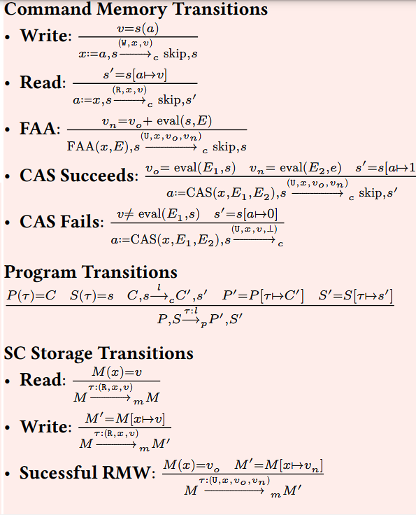

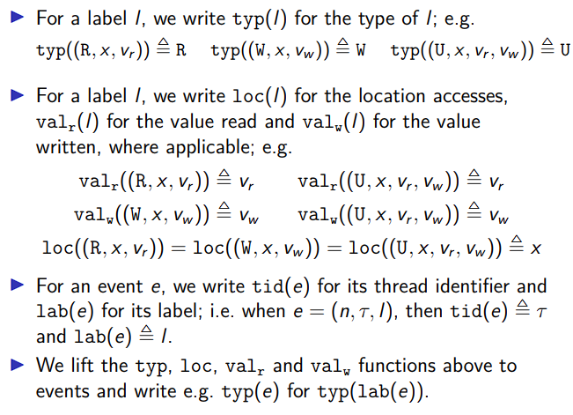
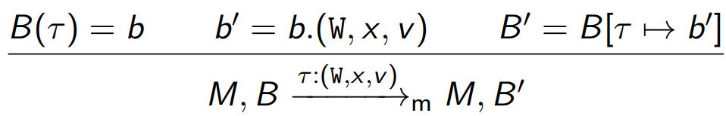
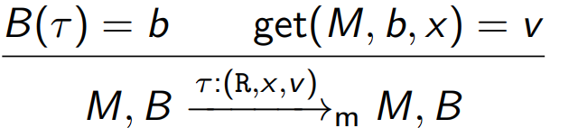
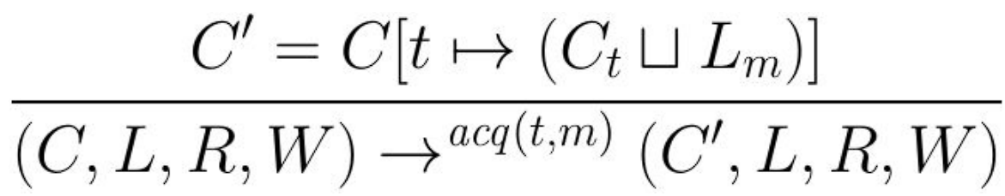
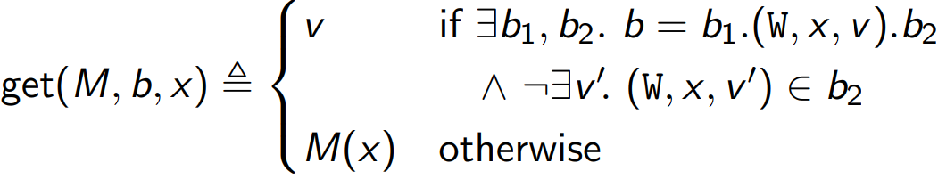
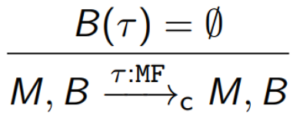
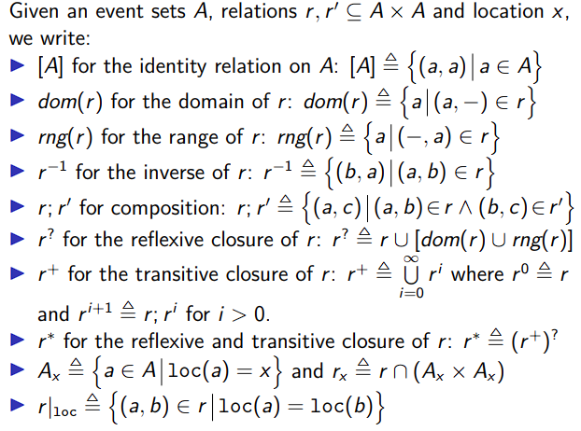
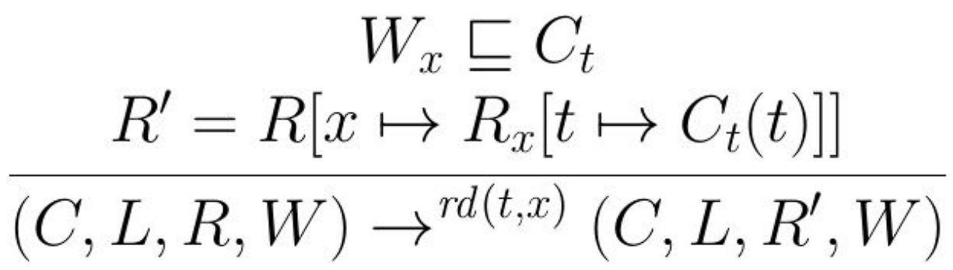
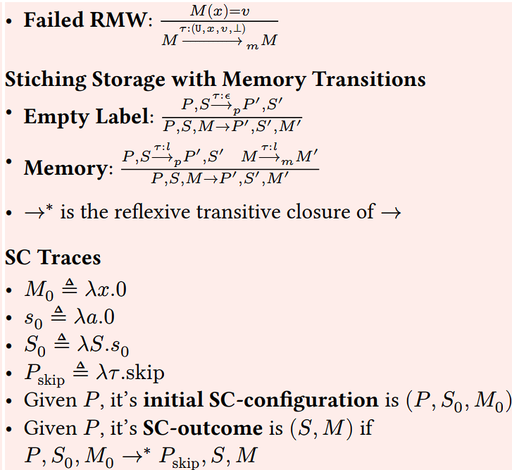
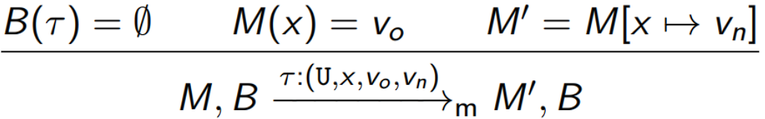
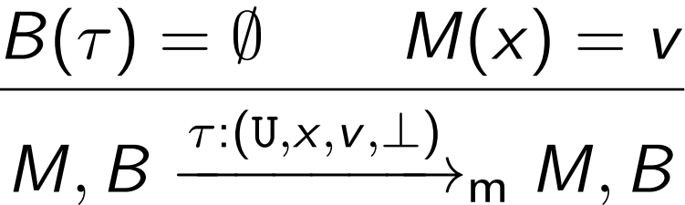
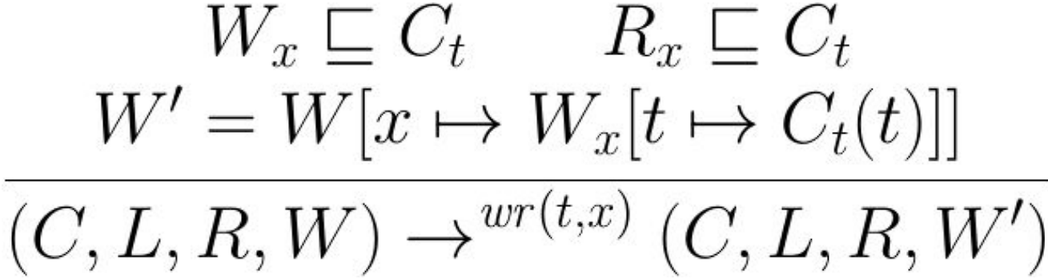
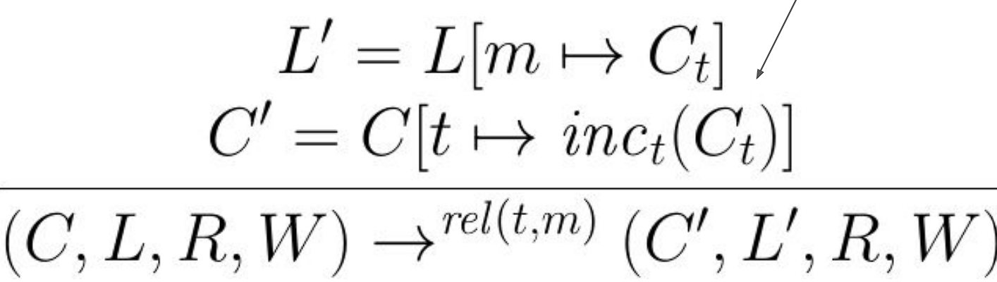

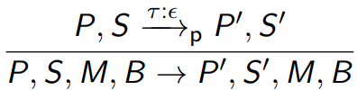
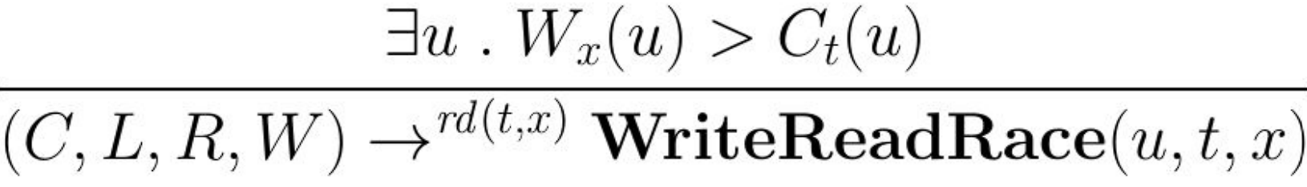

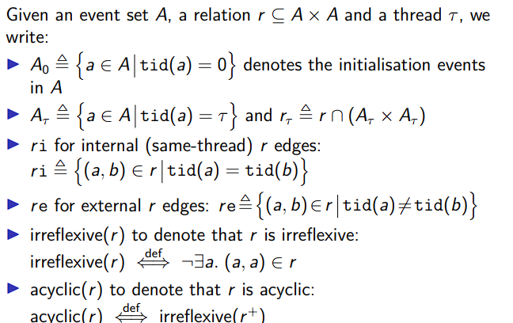
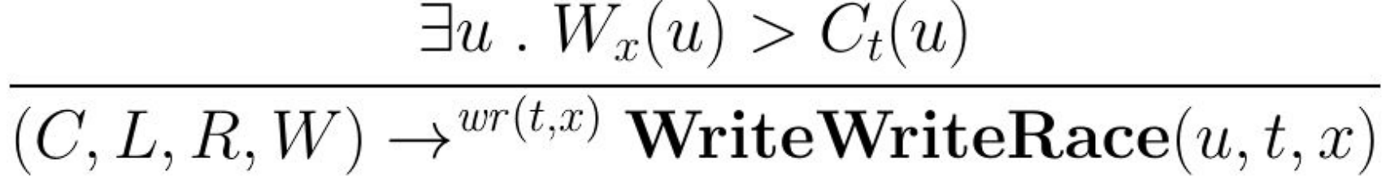
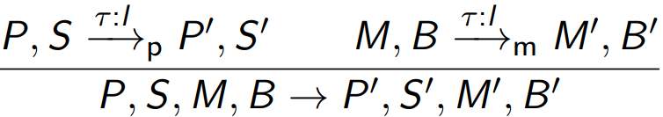
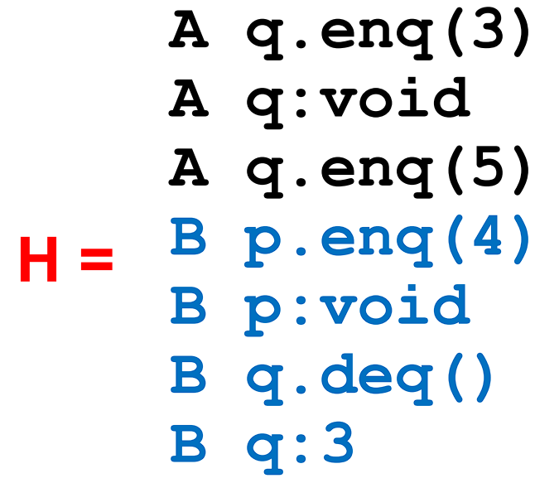
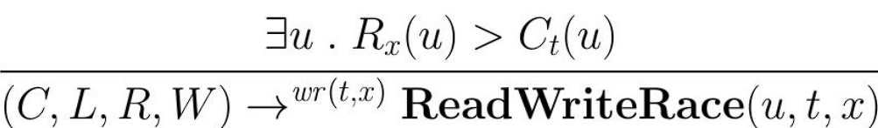
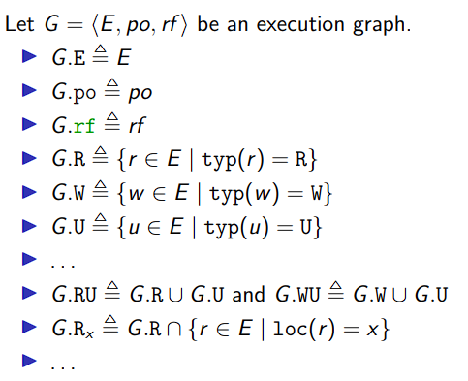
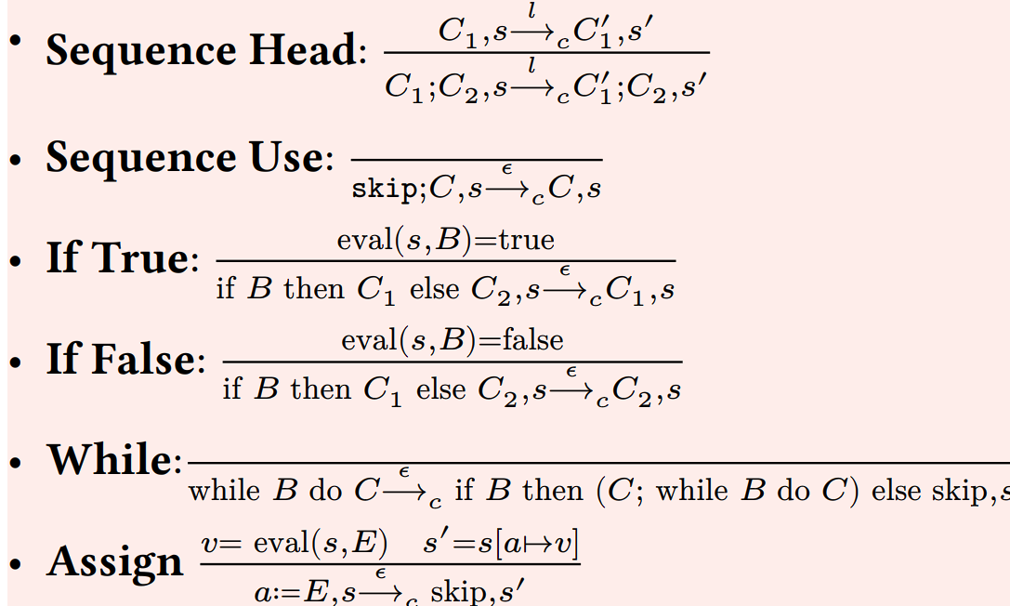
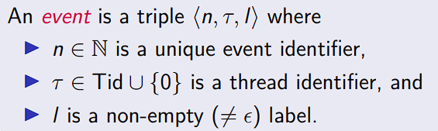
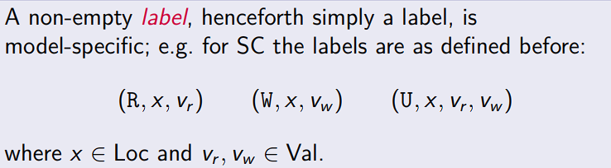
Intercepted Operations: Every read/write from/to possibly shared memory is intercepted. Every lock acquire/release is tool:
rd(t, x): interception of a read by thread t from location x
wr(t, x): interception of a write by thread t to location x
acq(t, m): interception of an acquire of m by t
rel(t, m): interception of a release of m by t
Initial Analysis State: C = (inc₀(⊥), …, inc_{N-1}(⊥)) (each thread knows its clock is 1, thinks rest are 0)
L = 𝜆 m . ⊥; R = 𝜆 x . ⊥; W = 𝜆 x . ⊥
ACQUIRE RULE:
IE: we learn about the logical clocks of threads from the Lock, so update our current values (Since the lock has a VC that tracks what threads locked it)
READ RULE:
The first rule prevents a write-read data race. Read clocks same except location x’s read clock’s value for t is set to the reading thread’s value for itself.
3) WRITE RULE – as above, but prevent WW/WR.
4) RELEASE RULE
t increments its logical clock since it has released a mutex
5) WRITE-READ-RACE RULE
We have a WriteReadRace if when we try to do a read on x we see that the value stored at the write clock was actually higher than on the thread clock (SO WE HAVE AN OUTGOING WRITE REQUEST NOT SEEN BY THAT THREAD)
6) WRITE-WRITE-RACE RULE
7) READ-WRITE-RACE RULE
We argue correctness on a rule by supposing contradiction, e.g we have a WriteReadRace but we don’t have W_{x}(u) c > C_{t}(u). This only holds if t & u are the same thread, or if the write read were actually ordered -> move towards contradiction.
Optimizations: only track latest write to a location, (Change each W x from a full vector clock to an epoch, c@t – which means t was the last writer, and its logical clock was c). Only track the latest read from a location until it is detected that multiple threads read from the location (Initially, each R x is an epoch. Turn R x into a full vector clock when multiple readers are detected. Turn R x back into an epoch when a write to x occurs).
Same thread exclusively reading from x is very common ● A lot of “possibly-shared” memory is not actually shared ● Merely that the compiler cannot prove that it is non-shared
In practical workloads: overhead of storing a full vector clock can be avoided for most locations
However: inconvenient to have to cater for dynamically switching between epoch and vector clock ThreadSanitizer takes a practical approach: only track a few reads, and accept losing races
The Theory of Concurrent Programming:
1) Safety and Liveness
Safety Property – Nothing bad ever happens. If it is violated, it is done by a finite computation (so we can think about if something bad can happen)
Liveness Property – something good happens eventually. It cannot be violated by a finite computation (intuition: we can always run longer and see what happens) - that is, only infinite computations which don’t have the good thing happen violate it.
2) Amdahl’s Law
speedup = 1-thread execution time / n-thread execution time
(how many times faster with multithreading)
Taking the 1 thread execution time as some constant we get:
speedup = 1 / ((1-p) + (p/n))
1-p = the sequential fraction of execution (since not everything can be parallelized)
p = the parallel speedup, and we have n threads that execute the parallel part for the speedup. e.g: 10 threads, 40% sequential 60% parallel, exec time = 1 / 46% = only like a 2.2x speedup… The sequential parts (locks etc) cost us a lot!
3) Sequential Consistency - ConWhile
Each thread runs instructions sequentially. Different threads can interleave
Notation:
𝑥, 𝑦, 𝑧, … ∈ Loc: Shared memory locations
𝑎, 𝑏, 𝑐, … ∈ Reg: Private (per thread) registers 𝐸, 𝐸₁ , …: Expressions over ints and regs
𝑎 ≔ 𝑥: Read from shared memory
𝑥 ≔ 𝑎: Write to shared memory
𝑎 ≔ 𝐸: Compute 𝐸 into 𝑎
𝐶 ∈ Com ⩴
| 𝑎 ≔ 𝐸 | 𝑥 ≔ 𝑎 | 𝑎 ≔ 𝑥 | 𝑎 ≔ CAS(𝑥, 𝐸, 𝐸)
| FAA(𝑥, 𝐸) | skip | 𝐶; 𝐶 | while 𝐵 do 𝐶
| if 𝐵 then 𝐶 else 𝐶
ConWhile concurrent programs are a map from TIDs to sequential commands:
SC Configurations:
𝜏 ∈ TID
𝑃 ∈ Prog ≜ Tid → Com: Code of each thread.
𝑀 ∈ Mem ≜ Loc → Val: Shared memory.
𝑠 ∈ Store ≜ Reg → Val: Thread local memory. 𝑆 ∈ SMap ≜ Tid → Store: All local memories.
𝑆(𝜏)(𝑏) is the register 𝑏 on thread
A triple (𝑃, 𝑆, 𝑀) describes program state (SC config)
Transition Labels:
𝑙 ∈ Lab • 𝜖: Silent transition (skip)
(𝚁, 𝑥, 𝑣): Denotes read val 𝑣 from loc 𝑥.
(𝚆, 𝑥, 𝑣): Denotes write 𝑣 to 𝑥.
(𝚄, 𝑥, 𝑣_{𝑜} , 𝑣_{𝑛}): denote update of 𝑥 from 𝑣₀ to 𝑣_{n} (Successful RMW – value of x was equal to v₀) (𝚄, 𝑥, 𝑣_{𝑜}, ⊥): Failed CAS where 𝑥 wasn’t 𝑣₀
Sequential command transitions are of the form:
𝐶, 𝑠 ⟶_{c} 𝐶′, 𝑠′ evaluates 𝐶 with store 𝑙, and produces a simpler command 𝐶′, a new store 𝑠′ , and emits transition 𝑙.
We assume we have function eval(𝐵, 𝑠) and eval(𝐸, 𝑠) that reduce Booleans/Expressions immediately. They can’t access M.
Sequential Transitions:
TSO Memory Transitions Storage transitions are of the form:
updating the memory M to M’ and the buffer map B to B’ when some thread T executes a step with label l.
Memory Write:
Memory Read:
Where:
Mfence:
Successful RMW:
Unsuccessful RMW:
Propagating local write states to memory (silent step):
We thus produce our overall transitions:
if the program takes a silent step, the storage system remains unchanged:
if the storage system takes a silent step, then the program and store maps remain unchanged:
if both the program and storage systems take the same transition, then we can combine them into a transition over a TSO config:
Reflexive Transitive Closure:
P, S, M, B →* P’, S’, M’, B’
⬅➔ (P, S, M, B) = (P’, S’, M’, B’) v
∃P’’, S’’, M’’, B’’ . P, S, M, B → P’’, S’’, M’’, B’’
^ P’’, S’’, M’’, B’’ →* P’, S’, M’, B’
A TSO trace is like a SC trace -> we terminate at P_{skip} the Memory and Store Maps having some values, but the difference is our buffer is empty at the end. And of course, we start with a zeroed, memory, each store being zeroed, and each buffer being empty.
Declarative Semantics
Execution graphs allow us to model candidate executions of a program under some semantics. Contains reads, writes, updates, fences.
Thread 0 is a special thread for initialization (like the x = y = 0 that we saw). typ, loc, val
Reflexive closure = make all items that appear in the set be related to themselves.
transitive closure = add items so that all transitively related items are directly related. Basically any two items for which there exists an edge between them need to be directly related.
Ax is the events from A that have location x. r|loc is the set of events in A with elements that are related to each other that have the same location.
COH is very simple – just draw only PO edges between those on the same location.
Doesn’t allow future read (ie: a read can’t use a value from a future write, an RMW can’t use its return value).
Write-Write, RW, WR, can’t be reordered. Think about the case for enough time – if we have a write definitely after another, then consider what the future reads are reading from. Cannot achieve Mutual Exclusion between more than 1 location. Also can’t support message passing.
Release Acquire supports message passing, and locks – strengthening of COH.
Adds a guarantee that Reads are Acquire, Writes are Release, and RMWs are Acquire Release.
COH < RA < TSO < SC
Concurrent Objects
Object Specifications: Correctness, Progress.
Correctness: Sequential Objects – Each object has a state – usually given by fields. Each object has a method – the way to manipulate state. We say (for Sequential Prog Specifications):
IF Preconditions (state of obj before calling method), THEN(postcondition, result) (the method will return a specific value / exception) AND(postcondition, state) (the object will be in some other state when the method returns)
Concurrent Specifications are hard because we can’t describe methods in isolation, and adding new methods changes the descriptions of old ones. To describe these we reduce and then describe with a Sequential Specification.
Linearizable Execution: If we take an execution’s linearizable points (those method calls that actually cause a change to the visible state of the object) and track the execution of those, if we see that none of them overlap we have a linearizable execution. ie: Every method should have a point where it takes effect instantaneously
If we want to show an object is linearizable, all its executions must be linearizable.
To show that an execution is linearizable, we need to identify linearization points, show it as a sequential history and justify the whole effect.
AKA we look at our executed method calls and see if there was a way for this to happen! (Based on the properties of the data structure, and the calls) AKA within our arrows, the instantaneous call could have happened at any of those times. We need to place those instantaneous calls to make the thing valid.
Formalizing Model of Executions
We split method calls into invocation (method name / args) and the response (result / exception): e.g
Invocations: A q.enq(x) (A – thread, q – object, enq – method, x – arg)
A history might thus look like:
Complete Subhistory: Every method call invocation (or response) needs a corresponding response / invocation.
Pending method call: no matching response.
H|q = only events on q. H|p = events on p.
Sequential History – the invocations and responses of a thread do not interleave.
We only deal with Well Formed Histories – ones where the per thread projections are sequential.
Equivalent Histories – threads peering into other thread’s state would see the same thing at all points in two histories that are equivalent.
Legal History - A history that agrees with the properties of the object (eg: for a queue, it is FIFO):A sequential (multi-object) history H is legal if – for every object x – H|x is in the sequential spec for x (SAY IT PER OBJECT IN THE EXAM)
Precedence: A method call precedes another if its response event is before the other’s invocation event. Non Precedence – overlap.
Formal Definition of Precedence:
Given, history H & method executions m₀ and m₁ in H, we say m₀ ➔_{H}m₁, if m₀ precedes m₁. Relation m₀➔_{H}m₁ is a partial order (or a total order if H is sequential)
Linearizable Formal Definition:
History H is linearizable if can be extended to G by – Appending 0+ responses to pending invocations – Discarding other pending invocations
So that G is equivalent to
- Legal sequential history S – where ➔_{G} ⊆ ➔_{S}
AKA in the exam, append the invocations (ADD THEM AT THE END), or discard it, then find a legal sequential history, show that they’re equivalent (per thread projections are the same), then show the precedence ordering.
S is the sequential history, G is the concurrent histories not unified.
If you can, discard the item (if its effect doesn’t matter), else add the pending response.
Composability Theorem: History H is linearizable if and only if for every object x H|x is linearizable
Makes our proofs easier as we prove linearizability of objects in isolation
We can reuse past results
Sequentially Consistent History – same as linearizable but we don’t have the where ➔_{G} ⊆ ➔_{S}
condition (no need to preserve real-time order, Cannot re-order operations done by the same thread; Can re-order non-overlapping operations done by different threads) (IE: we don’t have to preserve the arrows durations, just precedence)
Sequential Consistency is not composable
Progress:
Deadlock-free: some thread trying to acquire the lock eventually succeeds.
Starvation-free: every thread trying to acquire the lock eventually succeeds.
Lock-free: some thread calling a method eventually returns.
Wait-free: every thread calling a method eventually returns.
to prove something isnt linearisable: take the legal history, and see if it conflicts with the original history / with sequentiality. Move to a contradiction, and say if we have acycle that H is not a strict total order which it has to be. to prove it is construct G that is equivalent, and legal and sequential.
TSO: Weaker than SC, Allows for:
1. write-read reordering on different locations: a later read on y can be reordered before an earlier write on x when x ≠ y
2. write-to-read forwarding on the
same location: the value of an earlier write can be copied into an earlier read
3. write-assignment reordering: a later assignment (i.e. one that does not access memory) can be reordered before an
earlier write
TSO uses a storage buffer in its model.
The whole point of a storage buffer is to not eagerly write changes made by the thread to the shared memory (i.e: we commit writes after some sufficient number of them has happened) for performance reasons. This carries out instruction reordering by proxy.
Thus we don’t have coherency. We introduce coherency via:
1) Memory fences (instructions that make us wait until all store buffers have committed to memory / are empty - very expensive)
2) Using RMW instructions (CAS) - this ensures there are no delayed writes in the buffer - and any update to the buffer is also immediately applied to memory.
We extend Com with mfence
We model the shared memory, maps and stores as before, but now each thread has a private store buffer to delay writes:
B ∈ Buff ≜ Seq<WLab>
WLab ≜ {(W, x, v) | x ∈ Loc ^ v ∈ Val}
That is, a buffer entry (W, x, v) denotes a delayed write on x with value v
We then define a buffer map associating each thread with a private buffer:
B ∈ BMap ≜ Tid → Buff.
The quadruple (P, S, M, B) describes the TSO config.
Transition Labels:
Either an SC Label, 𝜖, (𝚁, 𝑥, 𝑣), (𝚆, 𝑥, 𝑣),
(𝚄, 𝑥, 𝑣_{𝑜} , 𝑣_{𝑛}), (𝚄, 𝑥, 𝑣_{𝑜}, ⊥) or MF (mfence)
We lift sequential transitions to the
concurrent level by using the correct store,
as with SC.

