Slide 1
databases
PHP - MySQL

Slide 2
connection PHP - MySQL
PHP
PEAR
Execute SQL commands using PHP
  Incorporating data from database into website
  Writing data from website to database
  …

Slide 3
method
5 steps:
  Connect to MySQL server
  Select correct database
  Execute SQL query
  Process query results in website
  Close database connection

Slide 4
Mysql vs mysQli
pay attention to outdated documentation online
mysqli (i stands for improved) is a renewed and improved version of the mysql commands in php.
use mysqli commands instead of mysql commands
mysqli can be addressed procedurally & OOP. Both remain usable in PHP8.x.

Slide 5
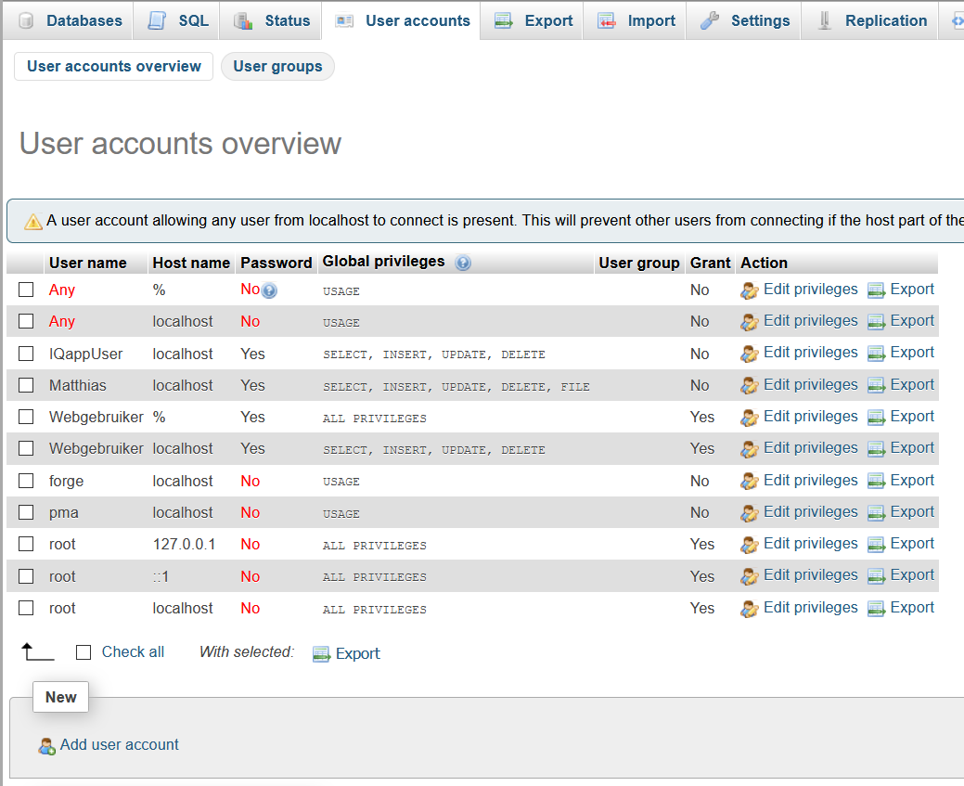
Create and manage users
Create new user for access
from website

Slide 6
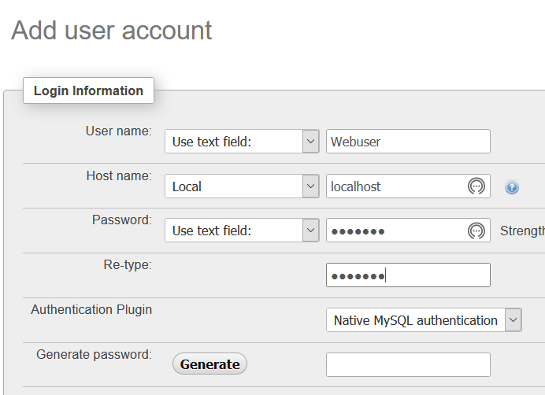
Create and manage users

Slide 7
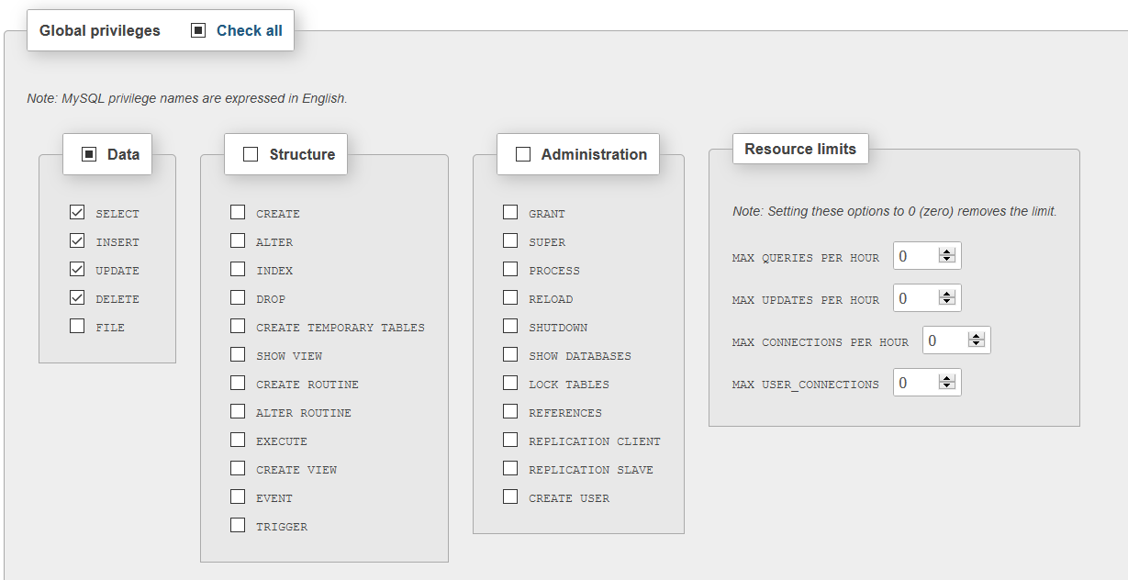
Create and manage users

Slide 8
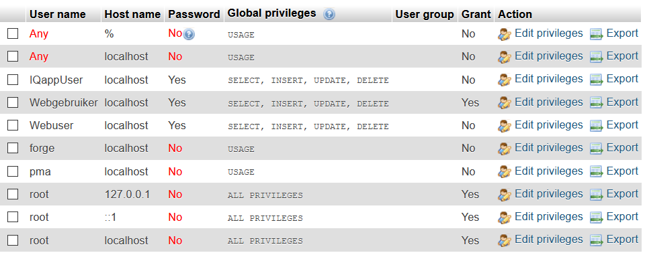
Create and manage users

Slide 9
step1: establishing connection
  $host = "localhost";
  $user = "Webuser";
  $password = "Lab2024";
  $database = "college";
  $link = mysqli_connect($host, $user, $password) or die("Error: no connection can be made to the host");

Slide 10
step 2: select database
mysqli_select_db($link, $database) or die("Error: the database could not be opened");

Slide 11
step 3: create and execute query
$query = "SELECT * FROM students";
$result = mysqli_query($link, $query) or die("Error: an error has occurred while executing the query.");

Slide 12
step 4: write results to screen
echo("<h2>Students</h2>");
$numberRecords = mysqli_num_rows($result);
echo("<table><tr><th>id</th><th>name</th><th>firstname</th><th>postalCode</th>
<th>city</th></tr>");
while($row = mysqli_fetch_array($result))
{
echo("<tr>
<td>".$row['studNo']."</td>
<td>".$row['name']."</td>
<td>".$row['firstname']."</td>
<td>".$row['postalCode']."</td>
<td>".$row['city']."</td>
</tr> ");
}
echo("</table>");
Always takes the next record
from the set of records and
saves that one as an
associative array

Slide 13
step 5: close connection
mysqli_close($link);
result

Slide 14
example: enter search term
<!doctype html>
<html>
<head>
<meta charset="utf-8" />
<title>PHP and MySQL</title>
</head>
<body>
<div class="wrapper">
<form action="<?php echo $_SERVER['PHP_SELF']; ?>" method="post">
in this form you ask the user to enter a search term
</form>
<?php
//put here database access + processing of data
?>
</div>
</body>
</html>

Slide 15
example: form
<div class="wrapper">
<h2>students</h2>
<hr />
<form action="<?php echo $_SERVER['PHP_SELF']; ?>" method="post">
<p>Name:
<input type="text" name="searchName" /> </p>
<p>
<input type ="submit" name="send" value="search" />
</p>
</form>
<hr />

Slide 16
example: find in database
Initialisation:
  if(isset($_POST['searchName']))
  {
  // initialisation
  $host = 'localhost';
  $user = 'Webuser';
  $password = 'Lab2024';
  $database = 'college';
execute only after sending
form data

Slide 17
example: find in database
//step 1:establishing the connection
$link =
mysqli_connect($host, $user, $password)
or die("Error: no connection can be made to the host");

Slide 18
example: find in database
//step 2: check whether the database can be opened
mysqli_select_db($link, $database)
or die("Error: the database could not be opened");

Slide 19
example: execute query
//step 3: create and execute the query
$query = "SELECT * FROM students WHERE name LIKE
'%". $_POST["searchName"]."%'";
$result = mysqli_query($link, $query)
or die("Error: an error has occurred while executing the query");

Slide 20
example: process data
// step 4: write the results to the screen
echo("<h2>Students</h2>");
echo("<table><tr><th>id</th><th>name</th><th>firstname</th><th>postal
code</th><th>city</th></tr>");
while($row = mysqli_fetch_array($result))
{
echo("<tr>
<td>".$row['studNo']."</td>
<td>".$row['name']."</td>
<td>".$row['firstname']."</td>
<td>".$row['postalCode']."</td>
<td>".$row['city']."</td>
</tr> ");
}
echo("</table>");

Slide 21
example: close link
// step 5: closing the connection to the database
mysqli_close($link);
result

Slide 22
Write data to database
if (!empty($_POST['name']) && !empty($_POST['city'])) //check data
{
$query="INSERT INTO students (name, city) VALUES
('". $_POST['name']. "',
'". $_POST['city']. "')";
mysqli_query($link, $query); //run query
}

Slide 23
Sql injection!!
User input can always be abused!!!!
Secure
example possible login check
  SELECT * FROM tblUsers WHERE login = 'Smith' AND password = 'test';
  If answer contains 1 record => person is correctly logged in and gets access to site

Slide 24
Sql injection: example
In php:
$query = "SELECT * FROM tblUsers WHERE
login = '".$_POST['login']."' AND
password = '".$_POST['password']."'";
Suppose user enters as password:
  test'OR'a'='a
  Enter in query results in:
SELECT * FROM tblUsers WHERE login = 'Smith' AND
password = 'test' OR 'a' = 'a';
Always true!!!
Access guaranteed!

Slide 25
Sql injection: example
In php:
$query = "SELECT * FROM Products WHERE
Name LIKE '%".$_POST['search']."%'";
Suppose user enters in search field:
  motherboard%’ UNION SELECT * FROM information_schema.tables WHERE table_name LIKE '%user
  query results in:
SELECT * FROM Products WHERE Name LIKE
'%motherboard%’
UNION SELECT * FROM information_schema.tables
WHERE table_name like '%user%';
Allows you to find the name of the user table

Slide 26
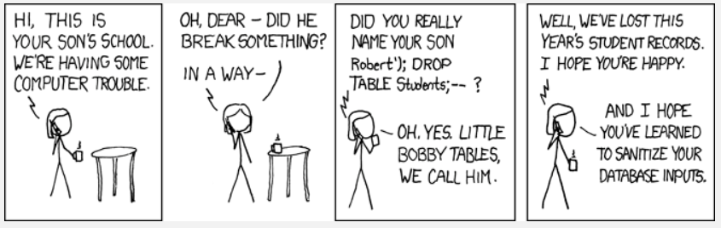
SQL INJECTION: EXAMPLE

Slide 27
Protection against Sql injection
Adapt user input string:
  mysqli_real_escape_string($link, $string):
    escapes all ' and " without writing backslashes to the database
    turns the string into a valid SQL statement and takes into account the charset of the connection
  Older functions:
    magic_quotes: escapes ', ", \ and null automatically => too general => disable if enabled!!
    addslashes(): too general!

Slide 28
Protection against Sql injection
Check user input:
  filter_var($string, FILTERTYPE, options);
    Validate filters:
      FILTER_VALIDATE_BOOLEAN
      FILTER_VALIDATE_EMAIL
      FILTER_VALIDATE_FLOAT
      FILTER_VALIDATE_INT
      FILTER_VALIDATE_IP
      FILTER_VALIDATE_REGEXP
      FILTER_VALIDATE_URL

Slide 29
Protection against Sql injection
Check user input:
  preg_match(string $pattern, string $subject)
test input against regular expression or pattern
examples of syntax:
  ^ = start of the string
  $ = end of the string
  . = every possible char
  \ = escape sign; example \$ means literally a $-sign
  + = minimum one char
  ? = zero or one char
  [A-Z] = all capital letters are allowed

Slide 30
REGEX
example check email:
  It needs to contain an @
  After the @ a domain must be present and that domain must contain at least a dot followed by two or three chars
  Simple email check:
  . + @ . + \. . +
Every possible char,
once or more
Escape-sign \ to indicate that there
must be literally a dot here
There must be an @
but not at the start

Slide 31
regex
More accurate:
[A-Za-z0-9_]+@[A-Za-z0-9_]+\.[A-Za-z0-9_]+
or
^[_a-z0-9-]+(\.[_a-z0-9-]+)*@[a-z0-9-]+(\.[a-z0-9-]+)*(\.[a-z]{2,3})$

Slide 32
Protection against Sql injection: prepared statements
  3 steps to execute query:
  Prepare:
    Template of SQL statement where user input values are left out (replaced by ?) => server.
  e.g.: "SELECT * FROM students where name LIKE ?"
  Process:
    Database parses, compiles and executes query optimization on
    SQL statement template, and stores it without execution
  Execute:
    later => application binds values to the parameters => execute.
    The same query can be executed several times with different values for the parameters

Slide 33
Protection against Sql injection: prepared statements
  Pros:
  Less time needed for parsing => query can be performed several times with just 1 query preparation.
  Less data traffic: only send parameters instead of a whole query each time
  SQL injection protection: parameters sent separately and only valid if correctly escaped! No SQL injection possible if template does not contain any external input.

Slide 34
Prepared statements
// step 3: create and execute the query
// 3a: create prepared statement
$query = "SELECT * FROM students where name LIKE ?"
$stmt = mysqli_prepare($link, $query);
//3b: bind parameters
$searchName = "%".$_POST["searchName"]."%";
mysqli_stmt_bind_param($stmt, "s", $searchName);
//3c: execute query
mysqli_stmt_execute($stmt);
//3d: bind results
mysqli_stmt_bind_result($stmt, $studNo, $name, $firstname,
$postalCode, $city);
the content of $searchName is a string

Slide 35
Prepared statements
// step 4: write the results to the screen
echo ("<h2>Students</h2>");
echo("<table><tr><th>id</th><th>name</th><th>firstname</th><th>postalCode</th><th>
city</th></tr>");
while (mysqli_stmt_fetch($stmt))
{
echo("<tr><td>$studNo</td><td>$name</td><td>$firstname</td><td>$postalCode</td>
<td>$city</td></tr>");
}
echo("</table>");
// step 5: closing the connection to the database
//5a: close statement
mysqli_stmt_close($stmt);
//5b: close connection
mysqli_close($link);
example

Slide 36
Prepared statements => more parameters
// step 3: create and execute the query
// 3a: create prepared statement
$query = "SELECT * FROM students where name LIKE ? AND
postalCode = ?"
$stmt = mysqli_prepare($link, $query);
//3b: bind parameters
$searchName = "%".$_POST["searchName"]."%";
$postalCode = $_POST["postalCode"];
mysqli_stmt_bind_param($stmt, "si", $searchName, $postalCode);
//3c: execute query
mysqli_stmt_execute($stmt);
//3d: bind results
mysqli_stmt_bind_result($stmt, $studNo, $name, $firstname,
$postalCode, $city);
The first ? represents a string, the second ? an int

Slide 37
Htmlspecialchars()
Needed to prevent HTLM injection!
example:
echo("<tr>
<td>htmlspecialchars($studNo)</td>
<td>htmlspecialchars($name)</td>
<td>htmlspecialchars($firstname)</td>
<td>htmlspecialchars($postalCode)</td>
<td>htmlspecialchars($city)</td>
</tr>");
Use this to clean up all output from the database!!

