Slide 1
AJAX
Asynchronous JavaScript And XML

Slide 2
what?
Asynchronous JavaScript and XML
not a programming language
method to combine existing standards.
exchange data with a server and modify parts of a web page without having to reload the entire page.
Notes:
Asynchronous
This means that when you send a request, you have to wait for the result to come, but meanwhile, you can do whatever you want.
The response may not happen immediately, so use a function that waits for the result and reacts when it is in.
The asynchronous behaviour can improve the user experience, because the browser no longer seems frozen. The user can continue to work, while the server is running the previous request in the background.
JavaScript
Javascript is used to send the request to the server. JavaScript is also used when the result has arrived to modify the current page.
XML
The data you receive from the server will often be a piece of XML that you can easily manipulate with Javascript. In fact, the response data can be anything you want, and as big as you want.

Slide 3
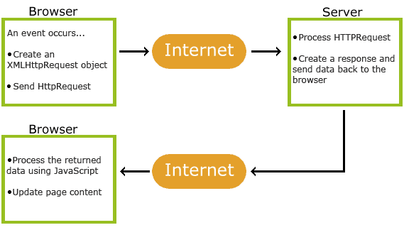
Javascript
eventhandler
Server-sided scripting language
E.g.: PHP, ASP, …
HTML and CSS
Javascript
object
Exchange data with:
XML
Text
…
Asynchronous = process happens in background

Slide 4
Advantages
After uploading page => user takes action => only the part that is adjusted is reloaded
page much more interactive for the user:
  faster interaction between application and server
  asynchronous: the user continues to use the page in the meantime
less network traffic
Less work for the web and data server
Examples: google (Gmail, Google suggest, Google Calendar, Google maps)
facebook

Slide 5
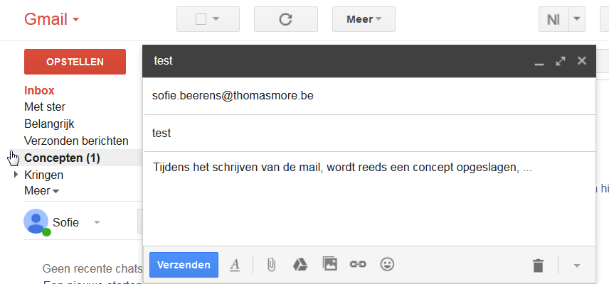
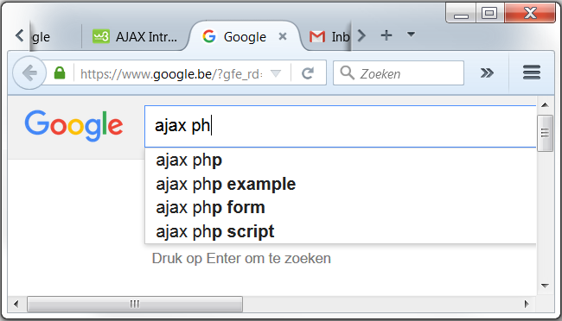
examples

Slide 6
disadvantages
XMLHttpRequest (XHR) not in browser history list => “back-arrow” doesn’t work
Asynchronous => changing pages without the user noticing => confusing?
Ajax uses JavaScript => visible to user => safety risk
Often possible to create interactive web pages without XMLHttpRequest.

Slide 7
Javascript
object

Slide 8
XHR object
XMLHttpRequest => built-in in modern browsers
Create object:
var XHR = new XMLHttpRequest();

Slide 10
Send Request to server
use eventhandler in JS => start function with:
  open() and send() functions
  processing on the server
  process returning data
Method | Description
open(method,url,async) | method: the type of request (GET or POST) url: the location of the file on the server async: true (asynchronous) or false (synchronous)
send(string) | string: only for POST requests null: for GET requests

Slide 11
Send Request to server
GET:
  query string limited in length (length depending on browser);
  data can only be sent in ASCII;
  query string visible to user;
  simpler and faster than POST.
POST
  if a file on the server needs to be modified;
  in case of large amounts of data traffic;
  if input from users has to be transmitted (POST is more robust)
async: true (asynchronous) or false (synchronous = first load all data).
  Asynchronous is safer
  Synchronous: queried server can block your script if there is a problem.

Slide 13
Onreadystatechange event
XHR.onreadystatechange = function
Add eventlistener to XMLHttpRequest object: detects any state change

Slide 14
readystate property
if readySate == 4 and status == 200 => process data
Property | Description
readyState | Holds status of XMLHttpRequest. Changes from 0 to 4: 0: request not initialized 1: server connection established 2: request received 3: processing request 4: request finished and response is ready
status | 200 = "OK“ 204 = no content 400 = bad request 401 = unauthorized 403 = forbidden 404 = Page not found 50X = fout

Slide 15
Server response
2 options:
  Text => responseText
  XML => responseXML

Slide 16
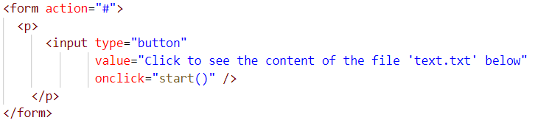
Text response: example 1
Read and show text file
result
In the body:

Slide 17
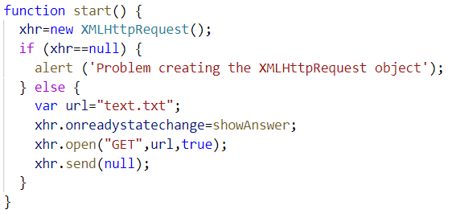
Text response: example 1
Create XMLHttpRequest object
Add eventlistener
Configure request
Send HttpRequest

Slide 18
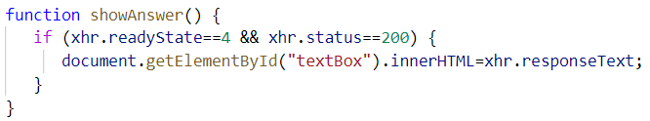
Text response: example 1
answer from server in text format

Slide 19
Caching
In web browser
=> caching of data to avoid new request to server
=> XHR requests to the same URL sometimes cashed by browser!
Make URL unique:
  var url = "text.txt?t=" + Math.random();
  var url = "text.txt?t=" + new Date().getTime();

Slide 20
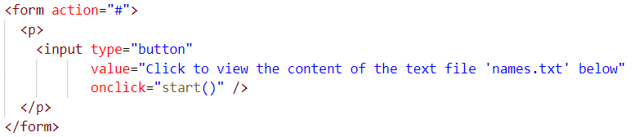
Text response: example 2
Read and show text file
result
In the body:

Slide 21
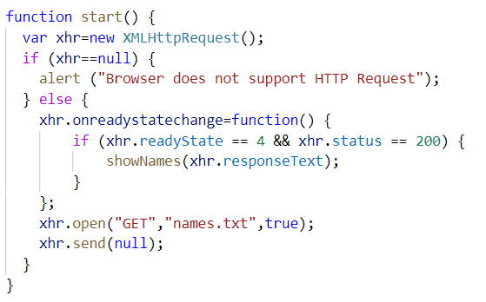
Text response: example 2
create XMLHttpRequest object
add eventlistener
answer from server in text format
configure and
send HttpRequest

Slide 22
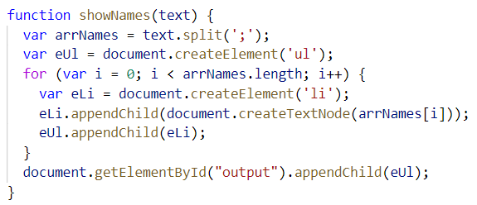
Text response: example 2

Slide 23
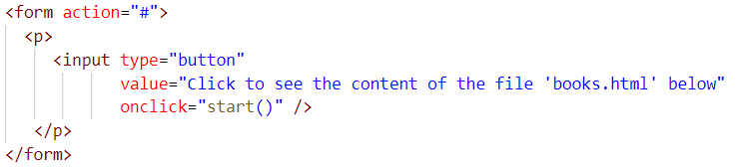
Text response: example 3
Read and show text file
result
In the body:

Slide 24
Server response
2 options:
  Text => responseText
  XML => responseXML

Slide 25
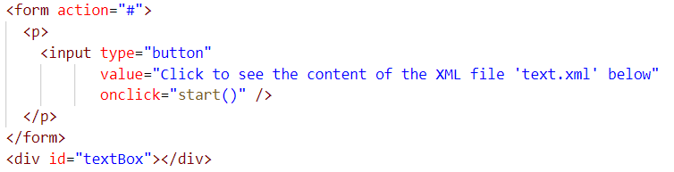
XML response: example 1
Read and show XML
result
In the body:

Slide 26
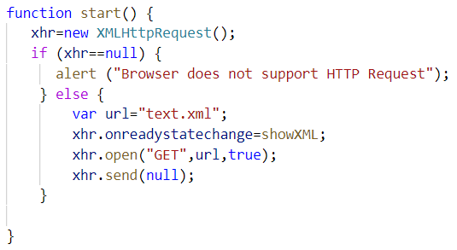
XML response: example 1
create XMLHttpRequest object
add eventlistener
configure and send HttpRequest

Slide 27
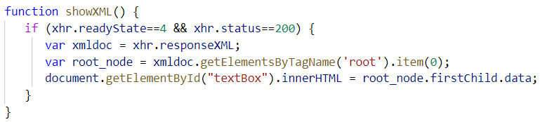
XML response: example 1
answer from server in XML format

Slide 28
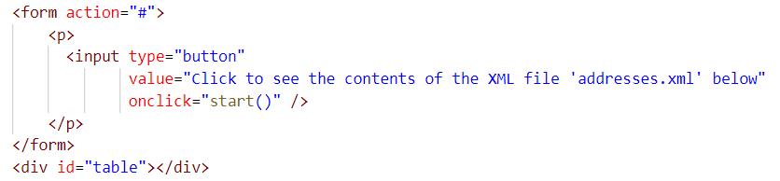
XML response: example 2
Read XML and show in HTML table
result
In de body:

Slide 29
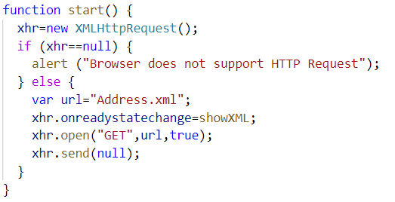
XML response: example 2
create XMLHttpRequest object
add eventlistener
configure and send HttpRequest

Slide 30
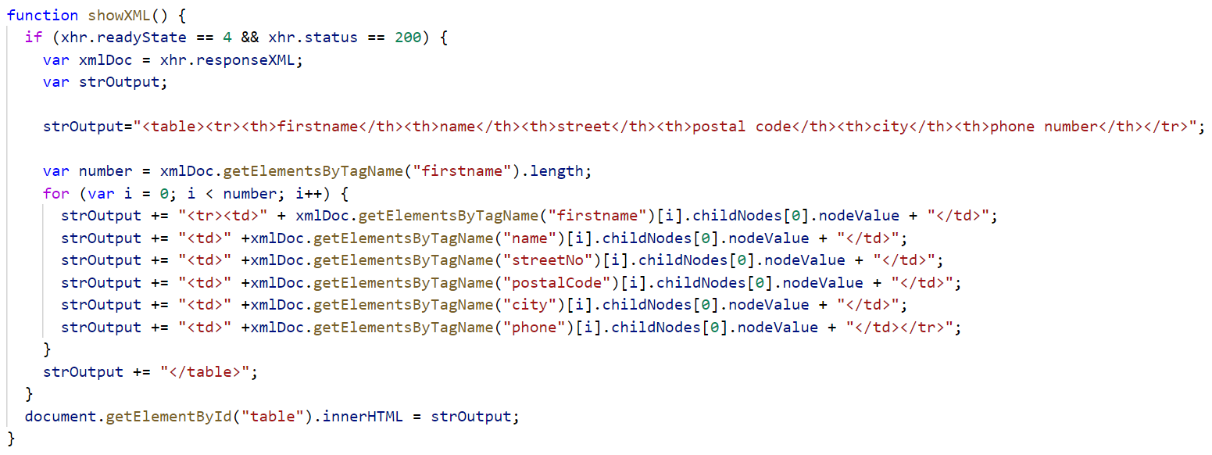
XML response: example 2
answer from server in XML format

Slide 31
XML response: example 3 & 4
example 3:
  Read XML and show as HTML text
  result
example 4:
  Read XML and show as HTML list
  result

Slide 32
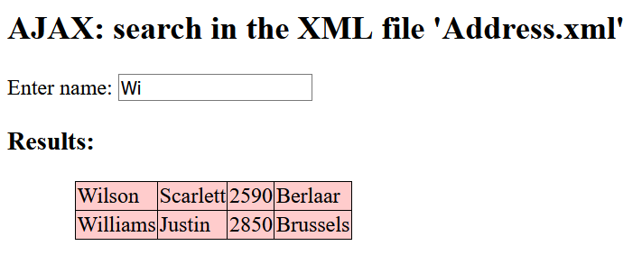
change page dynamically
Search function for file of addresses

Slide 33
AJAX and PHP
Problem: entire xml file sent to user
Better: asking detailed questions to the server
Remark: sandbox system:
  Data requested by the XMLHttpRequest object must be located in the same domain from which the calling script originates.
  Starting everything from localhost

Slide 34
AJAX AND PHP
url contains address of php file on server
get:
  add data for php script to url
post:
  add additional HTTP header
  enclose data for php script in send

Slide 35
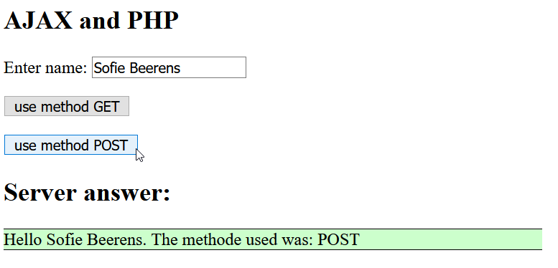
AJAX AND PHP: example 1

Slide 36
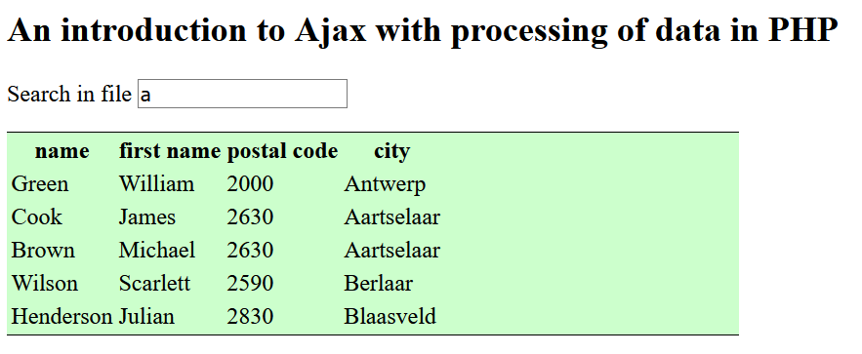
AJAX and PHP: example 2
Search students by address (from database)

Slide 37
Jquery and ajax
Show new output with effect?
use jQuery instead of JavaScript
$.get(), $.post(), .load()
$.ajax()
Notes:
$.get(), $.post() and .load() all use $.ajax()

Slide 38
Jquery => freshen up
Link Jquery:
Wait until page is loaded:
<script src="https://ajax.googleapis.com/ajax/libs/jquery/1.11.3/jquery.min.js"></script>
$(document).ready(function()
{
//put here the scripts
});

Slide 39
jQuery => freshen up
detect event :
$(document).ready(function()
{
$("#search").keyup(function()
{
$searchString = $("#search").val();
console.log($searchString);
//here follows the AJAX call
});
});

Slide 40
$.AJAX() call
Overview of all possible parameters:
http://api.jquery.com/jQuery.ajax/
$request = $.ajax({
method:"GET",
url:"process_searchAddress.php",
data: {search: $searchString}
});
$request = $.ajax({
method:"POST",
url:"process_searchAddress_POST.php",
data: {search: $searchString}
});

Slide 41
Process Results
$request.done(function(msg)
{
$("#feedback").fadeOut("slow", function()
{
$("#feedback").html(msg);
$("#feedback").fadeIn("slow");
});
});
$request.fail(function(jqXHR, textStatus)
{
$("#feedback").html("Request failed: "+textStatus);
});

