Slide 1


Formalized Generalization Bounds for Perceptron-Like Algorithms
Thesis Defense
10 July 2020
Robin Kelby
Adviser: Dr. Gordon Stewart
github.com/OUPL/MLCert

Slide 2

github.com/OUPL/MLCert
Outline
Background
Motivation for Software Verification in Machine Learning: MLCert
Perceptron and Kernel Perceptron Algorithms
Kernel Perceptron Variants: Budget and Description
Results
Implementations of three Kernel Perceptron variants in Coq
Generalization Proofs
Experimental Results:
Generalization error
Runtime Analysis
Budget Kernel Perceptron in Python

Slide 3

github.com/OUPL/MLCert
Background: Motivation
Software Verification:
Verify software correctness through mathematical, machine-checked proofs, facilitated by proof assistants such as Coq
Machine Learning:
Class of computer programs that automatically learn from experience
MLCert:
Framework in Coq for the formal verification of machine learning algorithms [BS19]

Slide 4
github.com/OUPL/MLCert
Background: Motivation
Why verify Machine Learning?
ML is heavily integrated into social media and commerce [GHHA19]
Increased use in critical systems, such as healthcare and infrastructure, with few regulations and safety principles [Var16]
Models produced by machine learning algorithms are difficult for humans to verify, as models may have thousands or millions of parameters
Few machine learning algorithms have correctness properties with proofs of correctness, such as a property that an algorithm will terminate or have generalization guarantees

Slide 5

github.com/OUPL/MLCert
Background: Motivation
MLCert Framework
Provides software tools and libraries in the Coq proof assistant for verified machine learning
Proves generalization bounds for machine learning algorithms as a guarantee of performance, as generalization error is the difference between training and testing error
Features:
Generic definitions and proofs for machine learning algorithms
Example algorithms: Perceptron
Extensions for neural network implementation and training

Slide 6
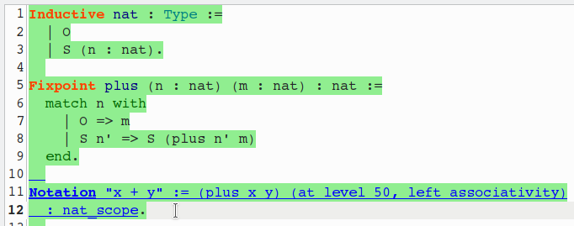
github.com/OUPL/MLCert
Background: Motivation
Software Verification in Action
Typically performed in a proof assistant such as Coq
Implementation of systems, data structures, and algorithms in the same environment as proofs
Proofs are implemented in software and checked by machine using tactics to manipulate the proof state

Slide 7
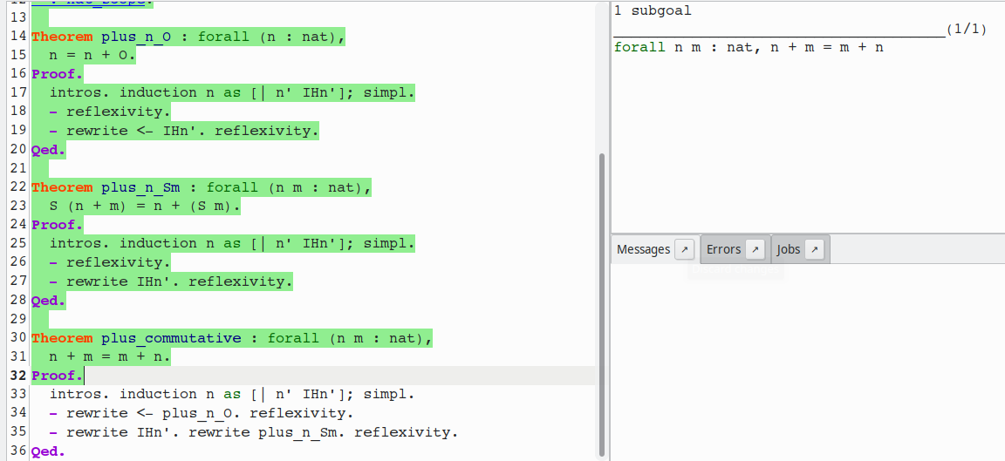
github.com/OUPL/MLCert
Background: Motivation

Slide 8
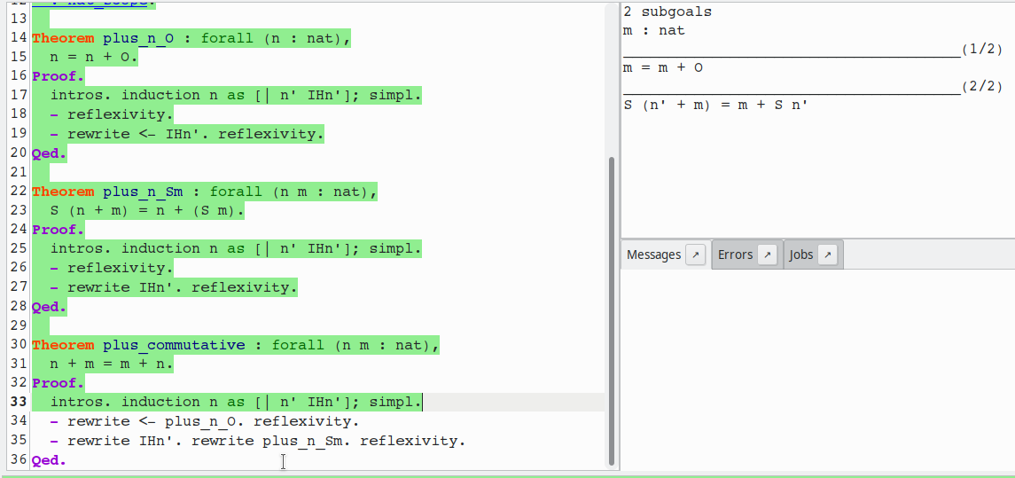
github.com/OUPL/MLCert
Background: Motivation

Slide 9
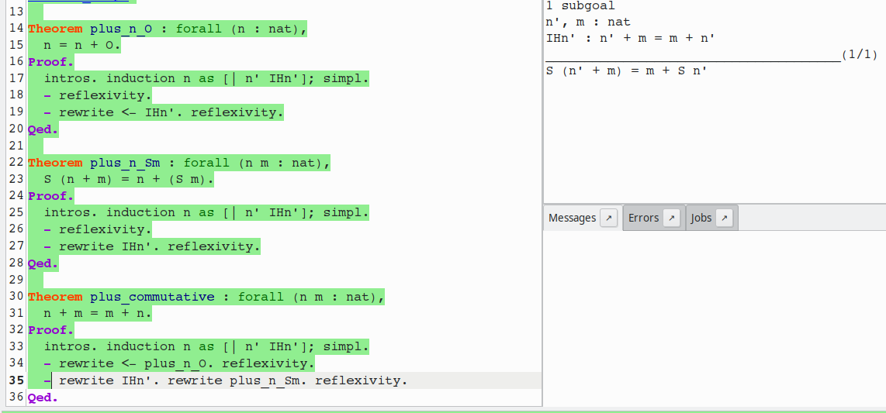
github.com/OUPL/MLCert
Background: Motivation

Slide 10
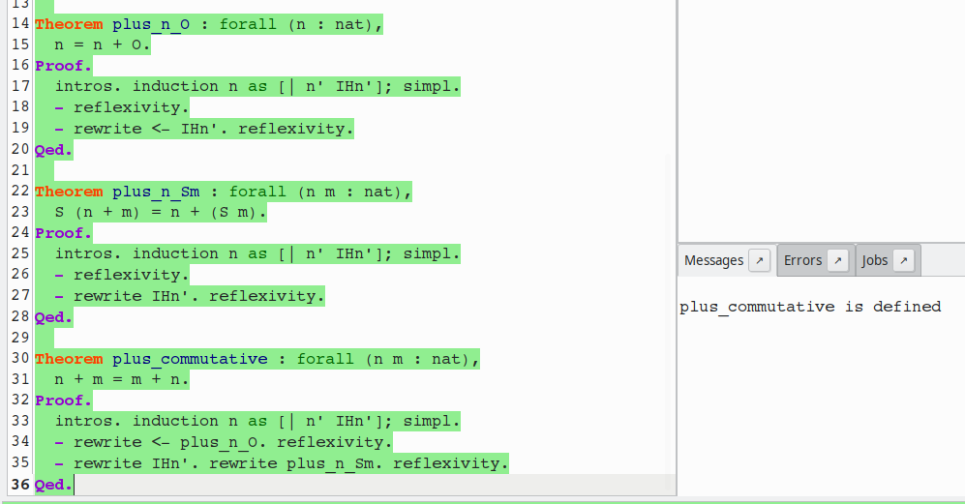
github.com/OUPL/MLCert
Background: Motivation

Slide 11
github.com/OUPL/MLCert
Background: Perceptron
Perceptron History and Characteristics
Initially published in 1957 by Frank Rosenblatt [Ros57]
One of the earliest methods for computers to learn to classify data into discrete categories
Highly influential in the early growth and development of Artificial Intelligence
Guaranteed to converge to a solution on linearly separable datasets. Proven on paper in 1961 [Pap61] and 1962 [Blo62] and verified by machine in 2017 [MGS17]
Two main calculations in the Perceptron algorithm: Prediction and Update

Slide 12
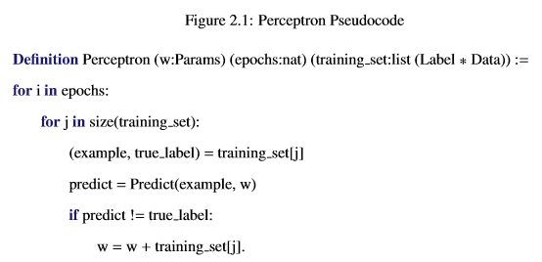
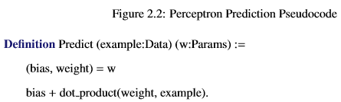
github.com/OUPL/MLCert
Background: Perceptron

Slide 13
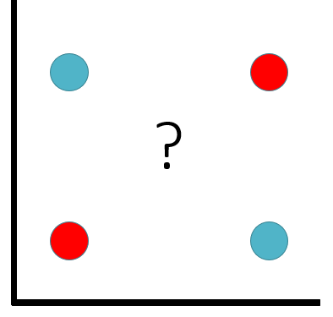
github.com/OUPL/MLCert
Background: Perceptron
Perceptron Limitations
Cannot classify data that is not linearly separable with 100% accuracy
As outlined by Minsky and Papert, the Perceptron cannot perfectly classify the exclusive-OR function [MP69]
Limitations led to a decline in Perceptron and neural network research in the 1970’s

Slide 14
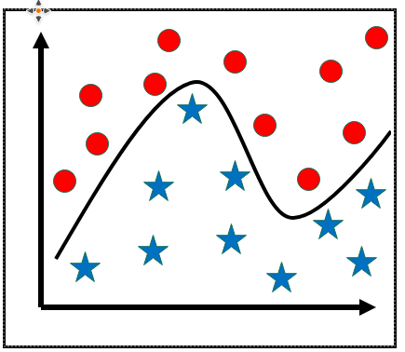
github.com/OUPL/MLCert
Background: Kernel Perceptron
Kernel Perceptron History and Characteristics
Refinement of the Perceptron introduced by Aizerman, Braverman, and Rozoner [ABR64]
The kernel trick, a method for using kernel functions, expands classification to non-linearly separable data

Slide 15
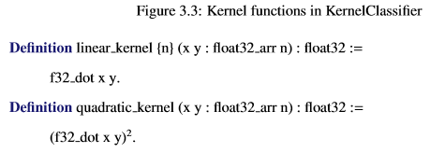
github.com/OUPL/MLCert
Background: Kernel Perceptron
Kernel Perceptron Requirements
Type of training examples: arrays of n 32-bit floating point values
Type of labels: Boolean values
Type of Parameters: The training set, which contains m training examples, paired with a float array of size m
Kernel Function for prediction

Slide 16
github.com/OUPL/MLCert
Background: Kernel Perceptron
Kernel Perceptron Limitations
Impractical in applications where memory is at a premium
Size of the parameters depends on the number of training examples
Not guaranteed to converge to a solution or terminate

Slide 17
github.com/OUPL/MLCert
Background: Budget Kernel Perceptron
Budget Kernel Perceptron Motivation
Use a fixed budget of training examples during training to reduce the size of the support set in the parameters
Must determine how the support set should be chosen and maintained
Random removal [CCBG07]
Decrease the impact of older support vectors over time so the oldest support vector has least impact and can be “forgotten” [DSSS07]
Store both a support set and a condensed projection onto the support set [OKC09]
Removing important examples reduces accuracy of the model

Slide 18
github.com/OUPL/MLCert
Background: Description Kernel Perceptron
Description Kernel Perceptron Motivation
Limit the Kernel Perceptron to a fixed number of mistakes, bounded by some value L
Called Description because the model records every misclassification made during training
Only misclassified training examples become part of the support set
Hybrid Budget/Description Kernel Perceptron described by [CKS03] which removes redundant support vectors with each newly misclassified example

Slide 19
github.com/OUPL/MLCert
Results Outline
Main Contributions:
Implementations in Coq of three Kernel Perceptron Variants
Generalization proofs in Coq
Experimental results

Slide 20
github.com/OUPL/MLCert
Results: MLCert Workflow
Each algorithm is implemented using 4 Coq sections
The Coq algorithms must be extracted to Haskell to be run on data
The extracted Haskell modules are run by unverified driver programs which create or read in datasets for training and testing
Prediction (Coq)
Generalization Proofs (Coq)
Full Algorithm (Coq)
Extraction Directives (Coq)
Haskell Module
Unverified Haskell Driver

Slide 21
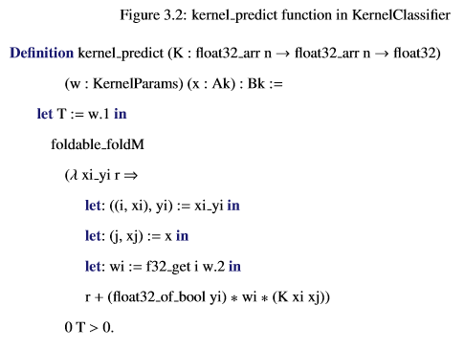
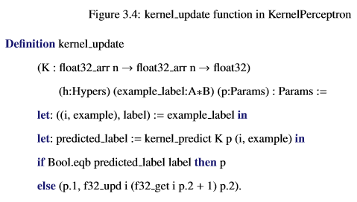
github.com/OUPL/MLCert
Results: Kernel Perceptron Coq

Slide 22
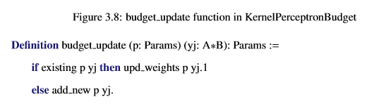
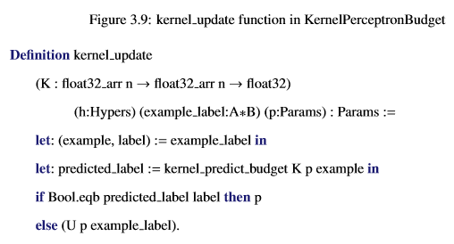
github.com/OUPL/MLCert
Results: Budget Kernel Perceptron Coq

Slide 23
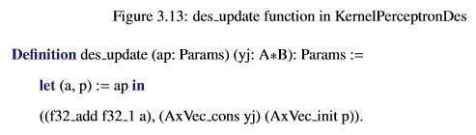
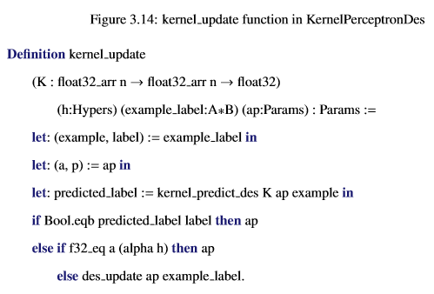
github.com/OUPL/MLCert
Results: Description Kernel Perceptron Coq

Slide 24
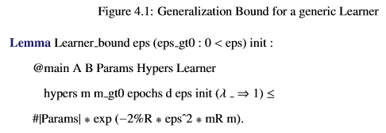
github.com/OUPL/MLCert
Results: Generalization Bound Proofs

Slide 25
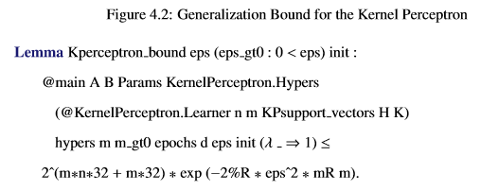
github.com/OUPL/MLCert
Results: Generalization Bound Proofs

Slide 26
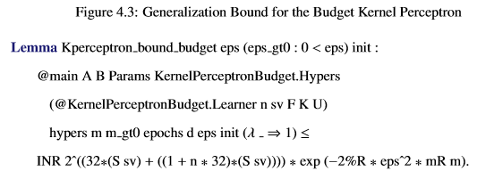
github.com/OUPL/MLCert
Results: Generalization Bound Proofs

Slide 27
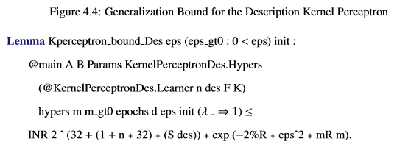
github.com/OUPL/MLCert
Results: Generalization Bound Proofs

Slide 28
github.com/OUPL/MLCert
Results: Experiments Overview
Questions Investigated:
How do the Kernel Perceptron variants perform on real and synthetic datasets?
How does experimental generalization error compare with the proven generalization bounds?
How do the runtimes of the Kernel Perceptron variants compare to each other?
How does the verified Budget Kernel Perceptron implementation compare to implementations in Python, a language commonly used for machine learning?

Slide 29
github.com/OUPL/MLCert
Results: Experimental Setup
Types of Haskell Drivers:
XOR: Tests that the Kernel Perceptron with quadratic kernel can correctly classify the XOR function, only nonlinear dataset
Test: Randomly generates a linearly separable dataset and classifies this dataset
RunFile: Reads in a dataset from training and testing files for classification
FileIO: Reads in one or more datasets and prints runtimes for training and testing
Datasets Tested:
Synthetic Trials: 20 training and testing sets designed to be linearly separable by construction
Iris Dataset [Fis36], with two splits: 50/50 split training/testing and 75/25 split
Sonar Mines vs. Rocks Dataset [SG88], also 50/50 and 75/25 splits

Slide 30
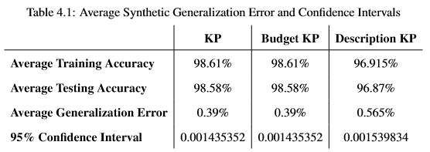
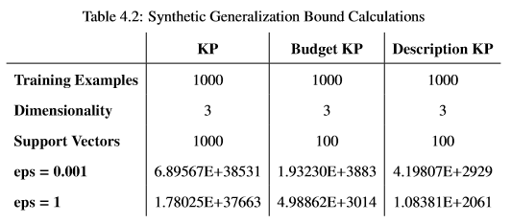
github.com/OUPL/MLCert
Results: Synthetic Generalization Error

Slide 31
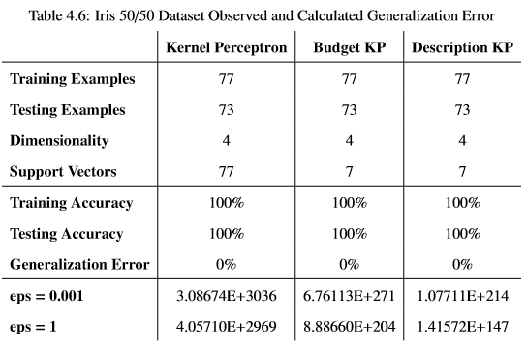
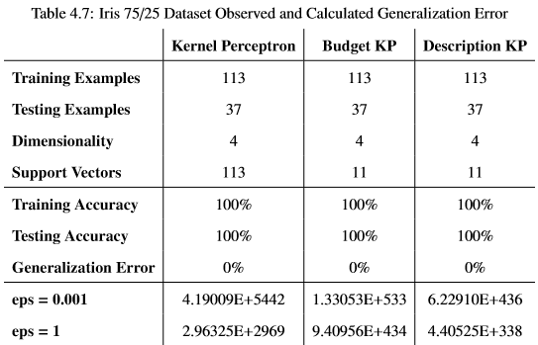
github.com/OUPL/MLCert
Results: Iris Generalization Error

Slide 32
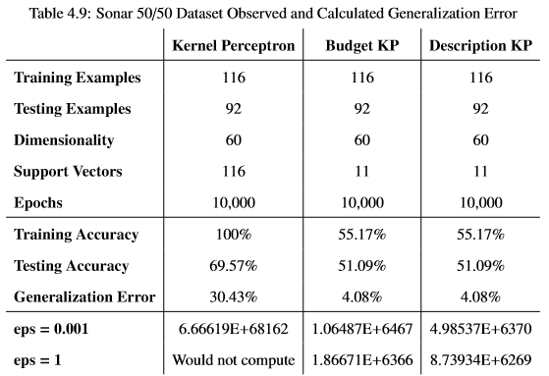
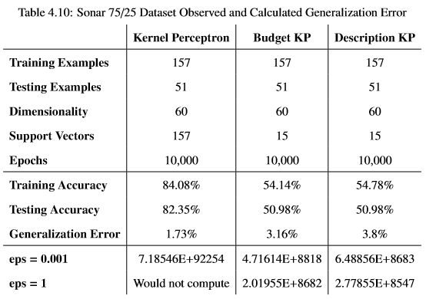
github.com/OUPL/MLCert
Results: Sonar Generalization Error

Slide 33
github.com/OUPL/MLCert
Results: Experimenal vs. Calculated Bounds
Kernel Perceptron:
Because the size of the Kernel Perceptron’s parameters grows exponentially as the number of training examples increases, the Kernel Perceptron only produces vacuous bounds, despite the generalization proof in Coq
Parameters for the smallest possible dataset with a single one-dimensional example:
The Budget and Description Kernel Perceptrons can produce nonvacuous bounds if their support sets are sufficiently smaller than the number of training examples. Nonvacuous bounds were found using the synthetic dataset.

Slide 34
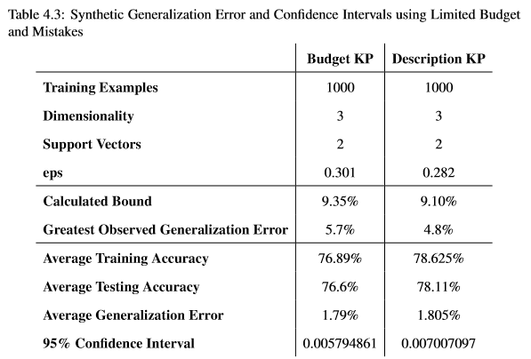
github.com/OUPL/MLCert
Results: Experimental vs. Calculated Bounds

Slide 35
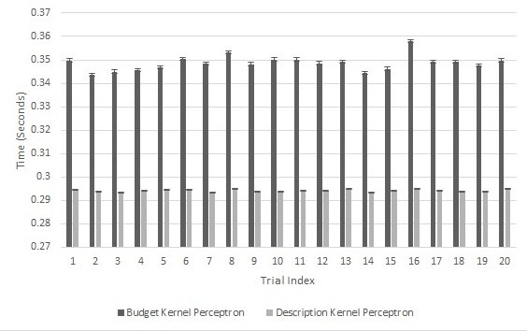
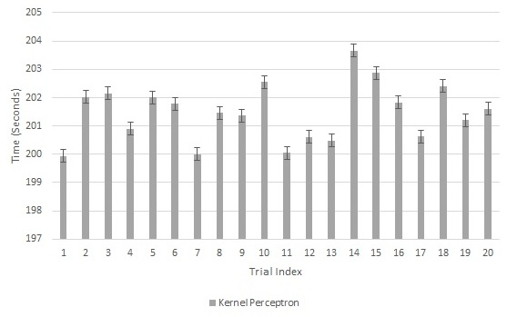
github.com/OUPL/MLCert
Results: Synthetic Timing Analysis
Figure 4.7: Budget and Description Synthetic Timing
Figure 4.8: Kernel Perceptron Synthetic Timing

Slide 36
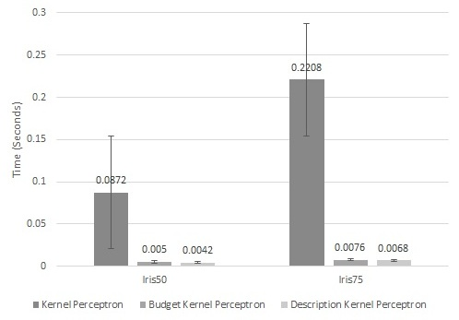
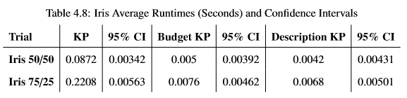
github.com/OUPL/MLCert
Results: Iris Timing Analysis
Figure 4.10: Iris Data Set Timing

Slide 37
github.com/OUPL/MLCert
Results: Python Budget Kernel Perceptron
Machine Learning in Python
Language of choice for machine learning due to advanced libraries
Compared Haskell runtimes to two Python implementations:
Naïve Python: Close to a direct translation of the Haskell implementation into Python without modifications to improve Python performance
Numpy Python: Reimplements the Budget Kernel Perceptron using Numpy data structures and functions for vectorization
Both Python implementations have the same accuracy as in Haskell
Timed using the synthetic dataset

Slide 38
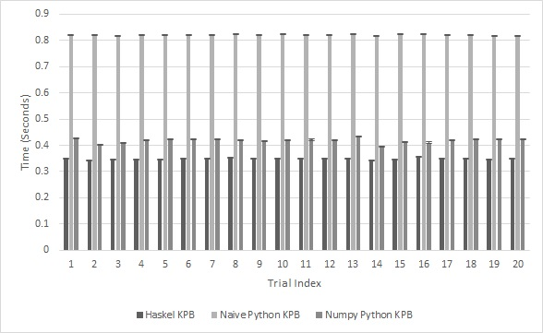
github.com/OUPL/MLCert
Results: Python Budget Kernel Perceptron
Figure 4.9: Python and Haskell Budget Kernel Perceptron Synthetic Timing

Slide 39
github.com/OUPL/MLCert
Conclusions
Limitations:
Kernel Perceptron bounds are always vacuous, regardless of dataset
Budget and Description Kernel Perceptrons require many training examples for every support vector or mistake in order for their generalization to be nonvacuous
Future Work:
Implementation of additional machine learning algorithms in MLCert
Modifications to the Budget and Description Kernel Perceptron to further improve generalization bounds

Slide 40
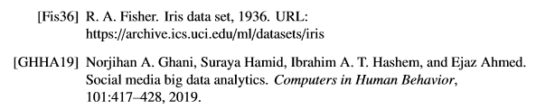

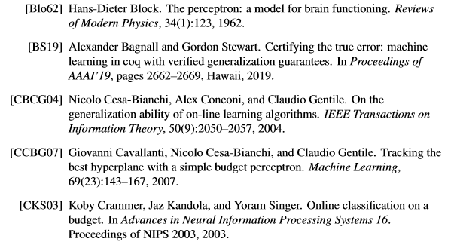
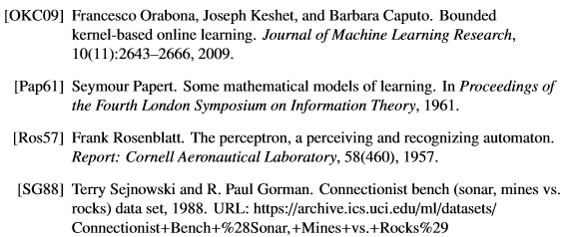

github.com/OUPL/MLCert
References

