Slide 1
CS4101 嵌入式系統概論
Design and Development
金仲達教授
國立清華大學資訊工程學系
Slides from Computers as Components: Principles of Embedded Computing System Design, Wayne Wolf, Morgan Kaufman;
An Embedded Software Primer, David E. Simon, Addison Wesley

Slide 2
Recap
More and more physical things will be augmented or embedded with computing
  Things become “smarter”
  Computing becomes ubiquitous
An embedded system is a system that is embedded with programmable computers for specific applications of that system
Why embedded systems?
  Faster, more flexible development at lower cost
  More complex functionalities

Slide 3
Suppose You Have a Product Idea
To develop a device that can record, for each day, the number of stairs that the user has climbed up or down
  From this number, we can then calculate the amount of CO₂ saved and calories burned
  Let us call this device stair counter
How to start from here?

Slide 4
Typical Design Flow
requirements
Top-down
design
specification
architecture
Bottom-up
design
Real design
often iterative
component
development
system
integration

Slide 5
Requirements
requirements
specification
Plain language description of what the
user wants and expects to get
  e.g. to develop a device that can record,
  for each day, the number of stairs that
  the user has climbed up or down
  Describe how the end product is used
  by the user
May be developed in several ways:
  talking directly to customers
  talking to marketing representatives
  providing prototypes to users for comment
architecture
component
development
system
integration

Slide 6
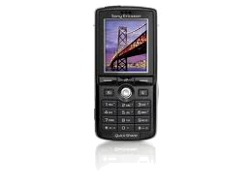
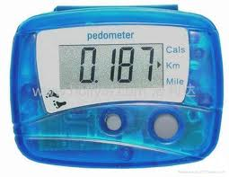
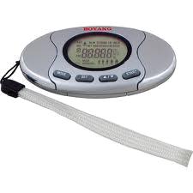
Requirements
Often need to know target customers and business model
  Stair counter as an add-on of cell phone
  Stair counter as a consumer product
  Stair counter as a gift
  …

Slide 7
Requirements
Functional requirements:
Internals as a black box and describe only the outputs as a function of input;
  Show number of stairs climbed up or down
  Show amount of CO₂ saved
  Do not count in other cases
Non-functional requirements:
  Performance, reliability, etc.
  Size, weight, etc.
  Power consumption
  Cost
  …
Describe “WHAT”, not “HOW”

Slide 8
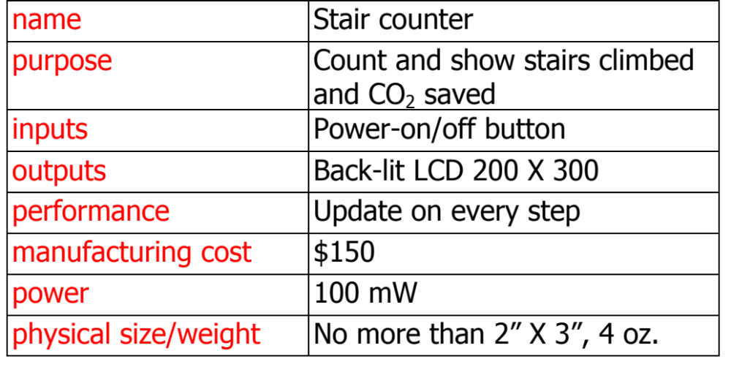
Requirements Form

Slide 9
Specification
requirements
specification
More precise, usually quantitative
description of the system:
  Should not imply a particular architecture
  List assumptions
  e.g., update screen 0.25 sec after each
  step, error rate < 95%, cost < $300
May include functional and
non-functional elements
May be executable or may be in mathematical form for proofs
  e.g. UML (Unified Modeling Language)
architecture
component
development
system
integration

Slide 10
Architecture Design
requirements
specification
What major components satisfy the specification? → HOW
  Need to know what are available
Hardware components:
  CPUs, peripherals, etc.
  e.g. MSP430 CPU, 3-axis accelerometer
Software components:
  Major programs and their operations
  e.g. no OS, accelerometer driver, LCD driver
Must take into account functional and non-functional specifications
architecture
component
development
system
integration

Slide 11
Design Considerations
Environment which the embedded system is in
External and internal stimulus sources that interact with the embedded system ← I/O
  Actions and events caused by stimulus
  Elements of the embedded system that could be affected by the stimulus
Desired system responses to the stimulus, which reflects one or more system requirements
← algorithm/workflow
How the system responses can be measures

Slide 12
Component Development
requirements
specification
Actual implementation of individual
hardware and software components
  Must spend time architecting the system
  before you start coding
Some components are ready-made,
some can be modified from existing
designs, others are to be designed
from scratch
  e.g. MSP430 CPU, 3-axis accelerometer
Good surveys help
architecture
component
development
system
integration

Slide 13
System Integration
requirements
specification
Put together the components
  Many bugs appear only at this stage
  Require good interface definition from
  the start
Have a plan for integrating
components to uncover bugs quickly,
test as much functionality as early
as possible → test and verification
architecture
component
development
system
integration

Slide 14
System Development
Now that you have better idea of the requirements, specifications, and
architecture of the stair counter
How to proceed to develop the
components and integrate the
system?
  But,
  Real hardware?
  Programming environment?
requirements
specification
architecture
component
development
system
integration

Slide 15

Development Environment
Host: a computer running programming tools for development
Target: the HW on which code will run
After program is written, compiled, assembled and linked, it is transferred to the target
X86
MSP430
Host system
Target system

Slide 16
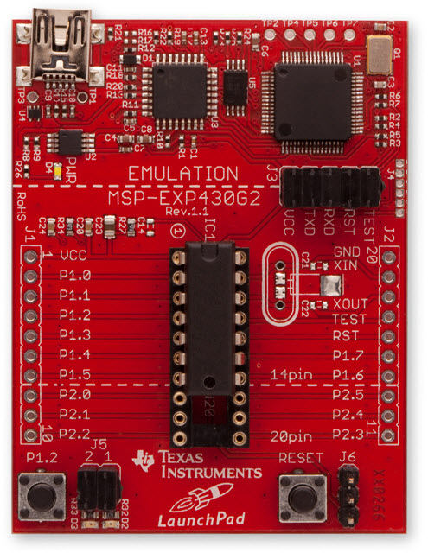
What If Real HW Not Available?
Development board:
  Before real hardware is built, software can be developed and tested using development boards
  Development boards usually have the same CPU as the end product and provide many IO peripherals for the developed software to use
  as if it were running on the
  real end product
Tools for program development
  Integrated Development Environment
  (IDE): cross compiler, linker, loader, …
  OS and related libraries and packages

Slide 17
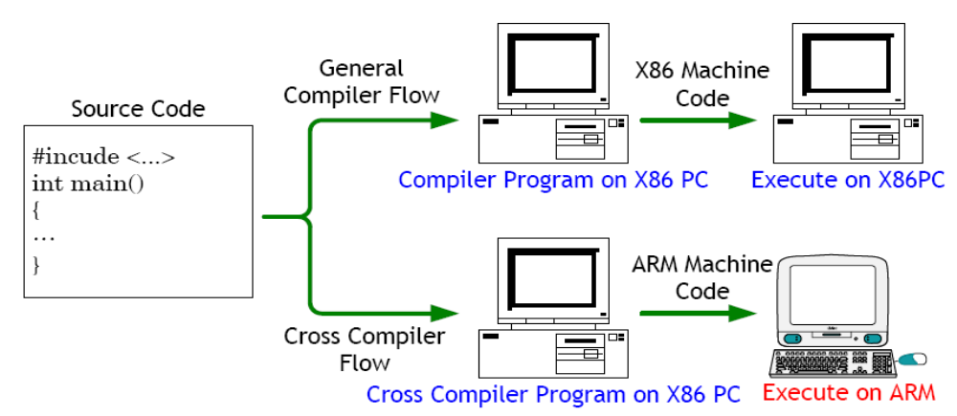
Cross Compiler
Runs on host but generates code for target
  Target usually have different architecture from host. Hence compiler on host has to produce binary instructions that will be understood by target

Slide 18
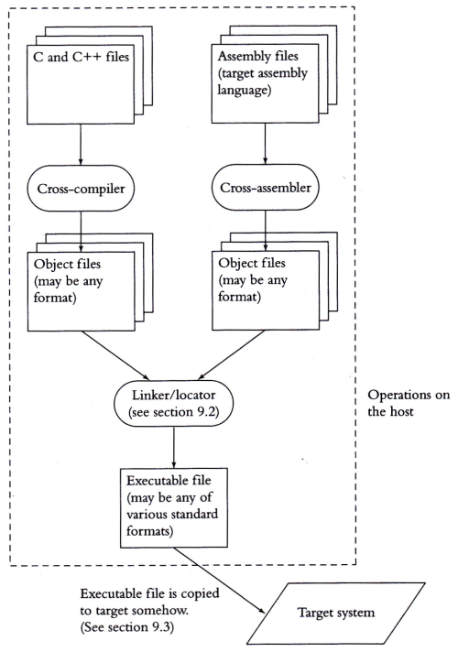
Development
Process
Process for creating
instructions that are
built on host but
meant for the target
Tools are compatible
with each other
→ a toolchain
  Binutils: as, ld
  Glibc：C runtime Lib
  GCC：C/C++ compiler

Slide 19
Linker/Locators
For computers:
  Linker: creates an image file to be run on host
  Loader: loads image file into memory during run-time
For embedded systems:
  Locater: creates a file, containing binary image or other format, that will be copied onto target, which run on its own (not through loader)
  It needs exact addresses beforehand
Certain parts of program need in ROM and some in RAM
  Normally done by dividing program in segments
  Locator needs to be told where in memory to place segments

Slide 20
Summary
Development of a system usually involves:
  Requirement, specification, architecture design, component development, system integration, test and validation
Development environment of an embedded system often includes
  Development host with toolchain: cross compiler, linker/loader, library, emulator
  Development board

