Slide 1
CS4101 嵌入式系統概論
Introduction to LaunchPad
金仲達教授
國立清華大學資訊工程學系
Materials from MSP430 Microcontroller Basics, John H. Davies, Newnes, 2008

Slide 2
Outline
MSP430 LaunchPad
MSP430 Microcontroller
  Processor
  Memory
  I/O
First Program on LaunchPad
  C
  Assembly
LaunchPad Development Environment

Slide 3
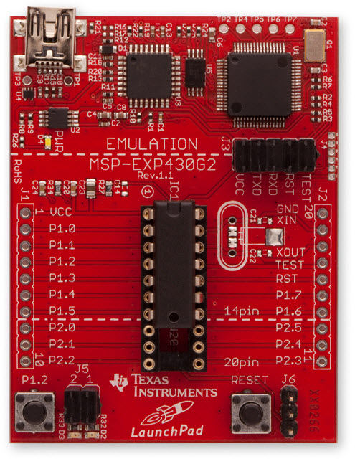
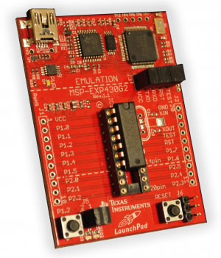
MSP430 LaunchPad Development Kit
LaunchPad development board
Mini-USB cable, 10-pin PCB connectors
2 MSP430 MCUs: MSP430G2211, MSP430G2231
Micro Crystal 32.768kHz Oscillator

Slide 4
MSP430 Microcontroller
LaunchPad development kit uses microcontroller such as MSP430G2231
Microcontroller:
  A small computer on a single IC containing a processor core, memory, programmable I/O peripherals
MSP430 microcontroller:
  Incorporates a 16-bit RISC CPU, peripherals, and a flexible clock system that are interconnected using a von-Neumann common memory address bus (MAB) and memory data bus (MDB)

Slide 5
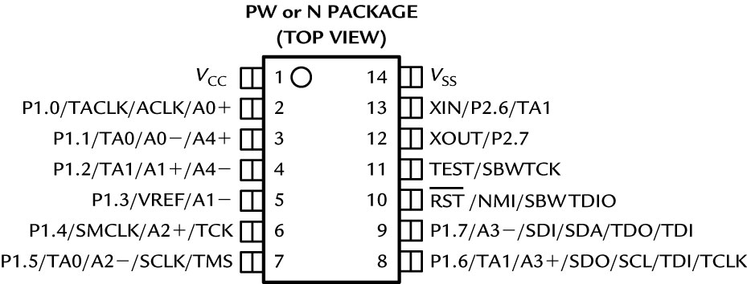
MSP430 Microcontroller
MSP430G2231 outside view (pin-out):
  VCC , VSS : supply voltage and ground
  P1.0~P1.7, P2.6 and P2.7 are for digital input and output, grouped into ports P1 and P2
  TACLK, TA0, and TA1 are associated with Timer_A

Slide 6
MSP430 Microcontroller
MSP430G2231 outside view: (cont’d)
  A0−, A0+, and so on, up to A4±, are inputs to the analog-to-digital converter
  VREF is the reference voltage for the converter
  ACLK and SMCLK are outputs for the microcontroller’s clock signals
  SCLK, SDO, and SCL are used for the universal serial interface
  XIN and XOUT are the connections for a crystal
  RST is an active low reset signal
  NMI is the nonmaskable interrupt input

Slide 7
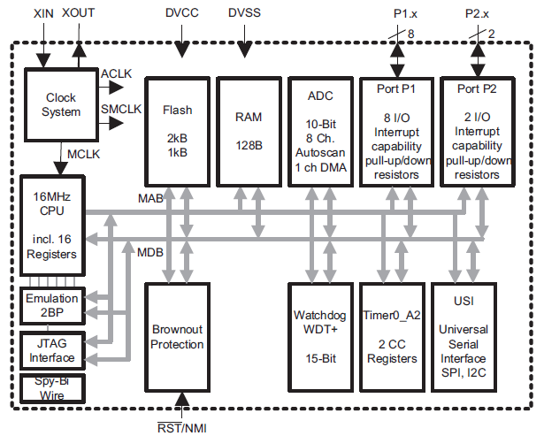
MSP430G2231 Inside View

Slide 8
MSP430 CPU
RISC with 27 instructions and 7 addressing modes
16 16-bit registers with full register access including program counter, status registers, and stack pointer
16-bit address bus allows direct access and branching throughout entire memory range
16-bit data bus allows direct manipulation of word-wide arguments
Constant generator provides six most used immediate values and reduces code size
Direct memory-to-memory transfers without intermediate register holding
Word and byte addressing and instruction formats

Slide 9
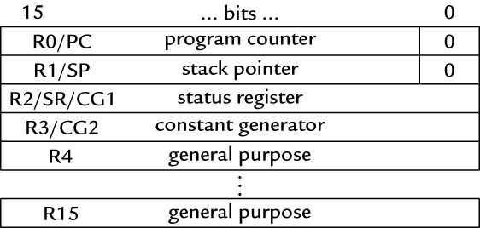
MSP430 CPU Registers
Sixteen 16-bit registers
  R0, R1, R2, and R3 have dedicated functions
  R4 to R15 are working registers for general use

Slide 10
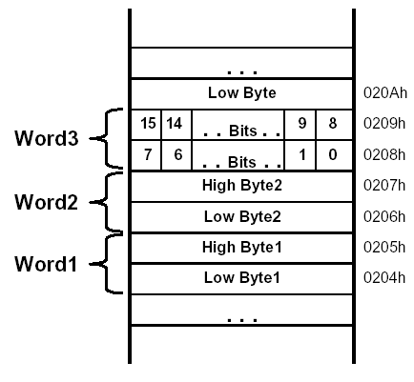
Memory Organization
16-bit addresses, addressing to bytes
Aligned words:
The address of a word is the address of the byte with the lower address, which must be even
Little-endian ordering: The low-order byte is stored at the lower address and the high-order byte at the higher address.

Slide 11
MSP430G2231 Memory Map
0FFFFh
0FFC0h
Interrupt Vector Table
Code Memory
Information Memory
RAM
16-bit Peripherals
8-bit Peripherals
8-bit Special Function Registers
Flash/ROM
(2kB)
0FFBFh
0F800h
Information memory: A 256B block of flash memory that is intended for storage of nonvolatile data, including serial numbers to identify the equipment
010FFh
01000h
Flash/ROM
(256 bytes)
027Fh
0200h
RAM
(128 bytes)
01FFh
0100h
0FFh
010h
?
0Fh
0h
Notes:
The Flash memory of the MSP430 can be programmed very fast using several different methods.
The Flash is segmented into 512B main memory segments with two additional 128B information memory segments. The only difference between main and information memory is size – code and data can be located anywhere. The total number of main memory segments depends on the device - for example, a 4KB device has eight main memory segments.
ISP F2xx Flash is reduced from 2.7V to 2.2V - This 0.5V reduction has a significant impact on an application that is powered by two common alkaline batteries with a useful operating range from 3.3V-1.8V. Considering that the alkaline discharge is almost perfectly linear, an ISP reduction from 2.7V to 2.2V represents almost a 50% increase in the application time ISP and can be useful.
The programming time has been reduced to as little as 17us per byte and the mass erase time reduced to 20ms.
Faster programming/erase combined with smaller 64 byte information segments and interruptible ISP allows embedded Flash to replace external EEPROM in most cases. This capability saves cost and board real estate.

Slide 12
MSP430 Input/Output
Simple digital input and output of MSP430 takes place through sets of pins on the package of the IC called ports
  MSP430G2231 has two ports: P1 (8 bits: P1.0~P1.7), P2 (2 bits: P2.6~P2.7)
  Typical pins can be configured for either input or output and some inputs may generate interrupts when the voltage on the pin changes
  The ports appear to the CPU as registers (memory-mapped I/O ), each bit corresponds to a pin and a port may be associated to many registers for different purposes (next page)

Slide 13
Registers Associated with Port 1
Register
P1IN | Input from port 1 | The 8 bits of data from port P1
P1OUT | Output to port 1 | Outputs 8 bits of data to port P1
P1DIR | Direction of port 1 data transfer | Bits written as 1 (0) configure corresponding pin for output (input)
P1SEL | Select function for port 1 | Bits written as 1 configure the corresponding pin for use by the specialized peripheral; 0 configure general-purpose I/O

Slide 14
Outline
MSP430 LaunchPad
MSP430 Microcontroller
  Processor
  Memory
  I/O
First Program on LaunchPad
  C
  Assembly
LaunchPad Development Environment

Slide 15
LaunchPad Development Board
USB Emulator
Connection
Embedded Emulation
6-pin eZ430 Connector
Crystal Pads
Chip Pinouts
Part and Socket
P1.3 Button
Power Connector
LEDs and Jumpers
P1.0 & P1.6
Reset Button

Slide 16
LaunchPad Pinouts
On-board features of LaunchPad are pinned in the following fashion:
  LED1 (red) = P1.0
  LED2 (green) = P1.6
  Switch1 = P1.3
  Switch2 = Reset
  Timer UART Transmit = P1.1
  Timer UART Receive = P1.2
In order to blink the Red and Green LEDs, we have to set Ports 1.0 and 1.6 as outputs, and toggle them

Slide 17
Sample Code (msp430g2xx1_1.c)
#include <msp430x2231.h> void main(void) { WDTCTL = WDTPW + WDTHOLD; // Stop watchdog timer P1DIR |= 0x41; // set P1.0 & 6 to outputs //(red & green LEDs) for(;;) { volatile unsigned int i; P1OUT ^= 0x41; // Toggle P1.0 & 6 using XOR i = 50000; // Delay do (i--); while (i != 0); } }

Slide 18
Sample Code (cont’d)
Configure the LED connected to the GPIO line
  The green and red LED are located on Port 1 Bit 0 and Bit 6 → make these pins to be output
  → P1DIR set to 0x41 = 01000001
To turn on/off LED, set bit in register to 1/0
  Use XOR to toggle P1OUT
WDTCTL = WDTPW + WDTHOLD; // Stop watchdog timer P1DIR |= 0x41; // P1.0 & 6 outputs
0100 0001
P1OUT ^= 0x41; // toggle P1.0 & 6 on/off

Slide 19
Characteristics of Sample Code
No printf(), no GUI operations
Do not end
Do I/O mainly
  More on control of peripherals through their special registers → details of individual bits, bytes, words are important → manipulations of bits, bytes, words
Complete ownership of CPU
No OS

Slide 20
Notes of Sample Code
volatile variable:
  volatile unsigned int i;
  The variable may appear to change “spontaneously,” with no direct action by the user’s program
  → may be due to memory-mapped I/O devices
  Compiler must be careful in optimizing it
    Ex.: should not keep a copy of the variable in a register for efficiency; should not assume the variable remains constant when optimizing the structure of the program, e.g., rearranging loops
  The peripheral registers associated with the input ports should be declared as volatile

Slide 21

Notes of Sample Code
Example from wikipedia:
  Optimizing compiler will think that foo is never changed and will optimize the code into
static int foo; void bar(void) { foo = 0; while (foo != 255) ; }
static int foo; void bar(void) { foo = 0; while (true) ; }
The volatile keyword in declaration of foo prevents this optimization

Slide 22
Notes of Sample Code
Bit manipulation:
  Important ISA feature for embedded processors
  Bit mask:
  set a bit P1OUT = P1OUT | BIT3
  clear a bit P1OUT &= ~BIT3
  toggle a bit P1OUT ˆ= BIT3
  Bit field:
  struct {
  unsigned short TAIFG:1;
  unsigned short TAIE:2;
  unsigned short TACLR:5;
  } TACTL_bit;
Set with TACTL_bit.TAIFG = 1

Slide 23
Other Aspects of Embedded C
Programs for small embedded systems tend not to contain a lot of complicated manipulation of complex data objects
  Much code is usually devoted to the control of peripherals through their special registers
  Details of individual bits, bytes, words are important
Important operations
  Shifting and rotating bits
  Bit-level Boolean logic (A && B) and bitwise operator (A & B)
  Bit mask for testing and modifying individual bits

Slide 24
Other Aspects of Embedded C
Union for manipulating individual bits or the whole byte/word as a unit
  union {
  unsigned short TACTL; // Timer_A Control
  struct {
  unsigned short TAIFG : 1; // Timer_A counter interrupt flag
  unsigned short TAIE : 1; // Timer_A counter interrupt enable
  unsigned short TACLR : 1; // Timer_A counter clear
  unsigned short : 1;
  unsigned short TAMC : 2; // Timer_A mode control
  unsigned short TAID : 2; // Timer_A clock input divider
  unsigned short TASSEL : 2; // Timer_A clock source select
  unsigned short : 6;
  } TACTL_bit;
  } TimerA;
bit 0

Slide 25
Sample Code (Assembly)
ORG 0F800h ; Program Toggle Toggle mov.w #0280h,SP ; Initialize SP StopWDT mov.w #WDTPW+WDTHOLD,&WDTCTL ; Stop WDT SetupP1 bis.b #001h,&P1DIR ; P1.0 output Mainloop xor.b #001h,&P1OUT ; Toggle P1.0 Wait mov.w #050000,R15 ; Delay to R15 L1 dec.w R15 ; Decrement R15 jnz L1 ; Delay over? jmp Mainloop ; Again ; Interrupt Vectors ORG 0FFFEh ; MSP430 RESET Vector DW Toggle END
Notes:
Load the program starting 0F800h (flash memory) and upward
Initialize SP to 0280h, just above RAM; stack grow downward
bis.b = bit set on a byte
Interrupt vector at 0FFFEh

Slide 26
Notes of Assembly Code
Where to store the program in memory?
  The code should go into the flash ROM and variables should be allocated in RAM
  → code at start of flash: 0F800h
  → stack at end of RAM: 0280h
Where should execution of the program start?
  Address of the first instruction to be executed is stored at a specific location in flash, called reset vector, which occupies the 2 bytes at 0FFFEh:0FFFFh
  Use an ORG 0xFFFE directive to tell the assembler where to store the reset vector
  The DW directive (“define word”) tells the assembler to store the following word (2 bytes) in memory

Slide 27
Notes of Assembly Code
The style of program shown above is known as absolute assembly because the memory addresses are given explicitly in the source using ORG directives
An alternative is to rely on the linker/loader to determine the address, which is called relocatable assembly
  The program must not contain absolute addresses, e.g., jump to a 16-bit address, only relative addresses, e.g., relative to current program counter

Slide 28
Outline
MSP430 LaunchPad
MSP430 Microcontroller
  Processor
  Memory
  I/O
First Program on LaunchPad
  C
  Assembly
LaunchPad Development Environment

Slide 29
Notes on Code Composer Studio
Download code to LaunchPad from CCS
  After application program is entered and all the changes are made, we can now download this code to the MSP430 MCU plugged into LaunchPad’s DIP target socket
  Make sure LaunchPad is plugged in to your PC
  Next, click the “Debug” button, which will check the code and load it into the MSP430 device
  When the code successfully loads, we will enter the Debug view of CCS. We can execute the code by clicking the green “Run” arrow and start debugging

Slide 30
Summary
Basic structure of MSP430 LaunchPad:
  MSP430 CPU and memory
  MSP430 I/O ports and LaunchPad I/O connections
First MSP430 program
  C and assembly
  Importance of bit/byte manipulation
  Management and allocation of memory

