Slide 1
CS4101 嵌入式系統概論
Interrupt
金仲達教授
國立清華大學資訊工程學系
(Materials from MSP430 Microcontroller Basics, John H. Davies, Newnes, 2008)

Slide 2
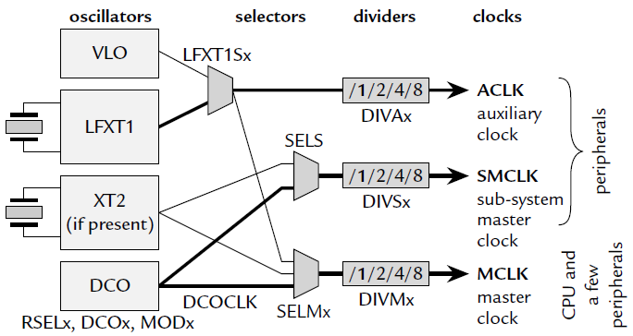
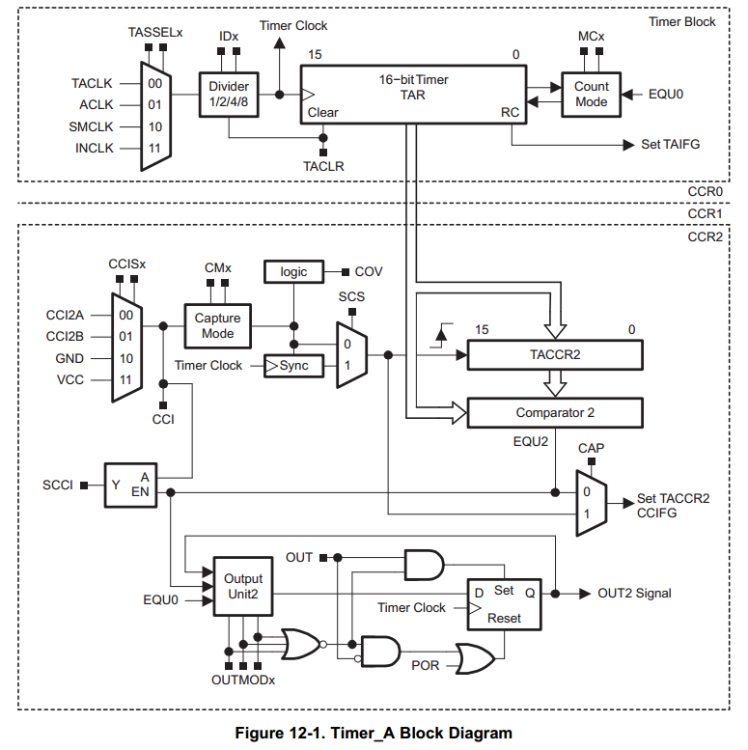
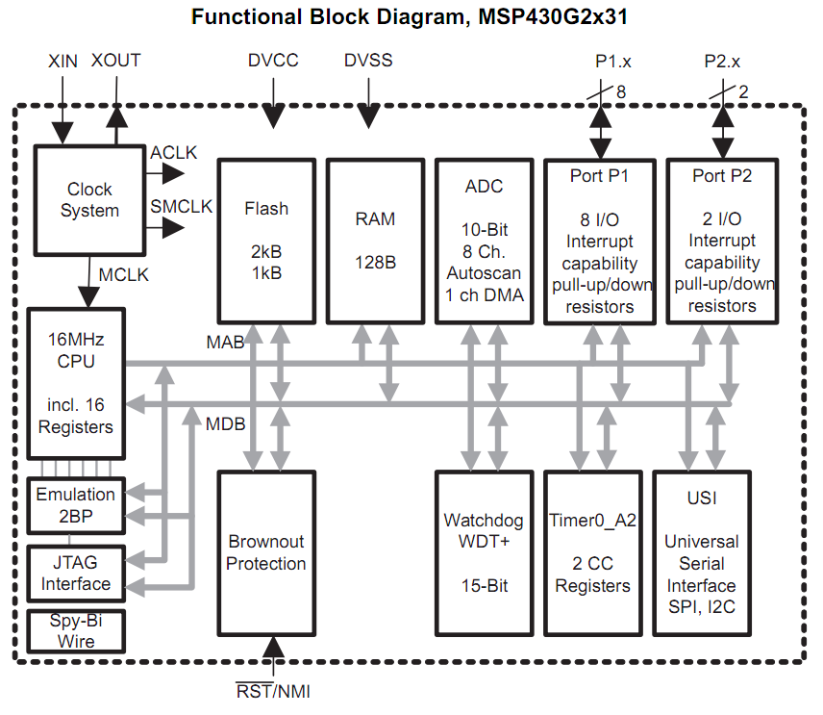
Inside MSP430 (MSP430G2x31)
Clock System
Timer System
Notes:
@ Datasheet page 5, functional block diagram

Slide 3
Introduction
When MSP430 processor executes the following code, it will loop forever
Question: How can it execute other codes that handle external events, e.g. I/O, timer?
StopWDT mov.w #WDTPW+WDTHOLD,&WDTCTL SetupP1 bis.b #001h,&P1DIR ; P1.0 output Mainloop xor.b #001h,&P1OUT ; Toggle P1.0 Wait mov.w #050000,R15 ; Delay to R15 L1 dec.w R15 ; Decrement R15 jnz L1 ; Delay over? jmp Mainloop ; Again

Slide 4
Option 1
Put codes that handle external events in your main program → polling
StopWDT mov.w #WDTPW+WDTHOLD,&WDTCTL SetupP1 bis.b #001h,&P1DIR ; P1.0 output Mainloop xor.b #001h,&P1OUT ; Toggle P1.0 Wait mov.w #050000,R15 ; Delay to R15 L1 dec.w R15 ; Decrement R15 jnz L1 ; Delay over? bit.b #B1,&P2IN ; Test bit B1 jnz ButtonUp ; Jump if not zero ButtonUp:bis.b #LED1,&P2OUT ; Turn LED1 off jmp Mainloop ; Again

Slide 5
Option 2
Keep your program unchanged and force the processor to jump to the code handling the external event when that event occurs
Requirements:
  Must let the processor know when the event occurs
  Must let the processor know where to jump to execute the handling code
  Must not allow your program know!!
  → you program must execute as if nothing happens
  → must store and restore your program state
This is called interrupt!

Slide 6
Outline
Introduction to interrupt
The shared-data problem
Interrupts of MSP430

Slide 7
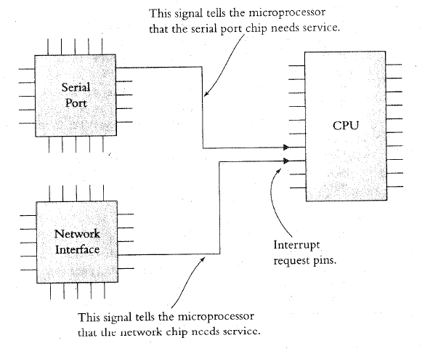
Interrupt: Processor’s Perspective
How does the processor know when there is an interrupt?
  Usually when it receives a signal from one of the IRQ (interrupt request) pins

Slide 8
Interrupt: Processor’s Perspective
What does the processor do in handling an interrupt?
  When receiving an interrupt signal, the processor stops at the next instruction and saves the address of the next instruction on the stack and jumps to a specific interrupt service routine (ISR)
  ISR is basically a subroutine to perform operations to handle the interrupt with a RETURN at the end
How to be transparent to the running prog.?
  The processor has to save the “state” of the program onto the stack and restoring them at the end of ISR

Slide 9
Interrupt Service Routine
The following shows an example of an ISR
      Task Code ISR
        ...
        MOVE R1, R7
        MUL R1, 5 PUSH R1
        ADD R1, R2 PUSH R2
        DIV R1, 2 ...
        JCOND ZERO, END ;ISR code comes here
        SUBTRACT R1, R3 ...
        ... POP R2
        ... POP R1
    END: MOVE R7, R1 RETURN
        ... ...

Slide 10
Interrupt: Program’s Perspective
To a running program, an ISR is like a subroutine, but is invoked by the hardware at an unpredictable time
  Not by the control of the program’s logic
Subroutine:
  Program has total control of when to call and jump to a subroutine

Slide 11
Disabling Interrupts
Programs may disable interrupts
  In most cases the program can select which interrupts to disable during critical operations and which to keep enabled by writing corresponding values into a special register.
  Nonmaskable interrupts cannot be disabled and are used to indicate power failures or serious event.
Certain processors assign priorities to interrupts, allowing programs to specify a threshold priority so that only interrupts having higher priorities than the threshold are enabled and the ones below it are disabled.

Slide 12
Where to Put ISR Code?
Challenges:
  Locations of ISRs should be fixed so that the processor can easily find them
  But, different ISRs may have different lengths
  → hard to track their starting addresses
  Worse yet, application programs may supply their own ISRs; thus ISR codes may change dynamically
Possible solutions:
  ISR is at a fixed location, e.g., in 8051, the first interrupt pin always causes 8051 to jump to 0x0003
  A table in memory contains addresses of ISR
  → the table is called interrupt vector table

Slide 13
How to Know Who Interrupts?
Simple answer: according to interrupt signal
  One interrupt signal corresponds to one ISR
Difficult problem: same interrupt signal shared by several devices/events
  Option 1: inside the corresponding ISR, poll and check these devices/events in turn
  → devices are passive
  Option 2: devices/events provide the address of ISRs
  → devices are proactive
  → vectored interrupt

Slide 14
Some Common Questions
Can a processor be interrupted in the middle of an instruction?
  Usually not
  Exceptions: critical hardware failure, long-running instructions (e.g. moving data in memory)
If two interrupts occur at the same time, which ISR does the process do first?
  Prioritize the interrupt signals
Can an interrupt signal interrupt another ISR?
  Interrupt nesting usually allowed according to priority
  Some processor may require re-enabling by your ISR

Slide 15
Some Common Questions
What happens when an interrupt is signaled while the interrupt is disabled?
  Processors usually remember the interrupt signals and jump to the ISR when the interrupt is enabled
What happens when we forget to re-enable disabled interrupts?
What happens if we disable a disabled interrupt?
Are interrupts enabled or disabled when the processor first starts up?

Slide 16
Interrupt Latency
Interrupt latency is the amount of time taken to respond to an interrupt. It depends on:
  Longest period during which the interrupt is disabled
  Time to execute ISRs of higher priority interrupts
  Time for processor to stop current execution, do the necessary ‘bookkeeping’ and start executing the ISR
  Time taken for the ISR to save context and start executing instructions that count as a ‘response’
Make ISRs short
  Factors 4 and 2 are controlled by writing efficient code that are not too long.
  Factor 3 depends on HW, not under software control

Slide 17
Sources of Interrupt Overhead
Handler execution time
Interrupt mechanism overhead
Register save/restore
Pipeline-related penalties
Cache-related penalties

Slide 18
Outline
Introduction to interrupt
The shared-data problem
Interrupts of MSP430

Slide 19
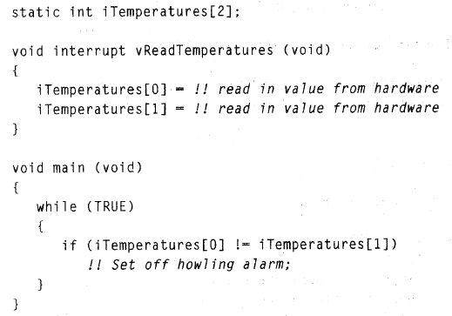
The Shared-Data Problem
In many cases the ISRs need to communicate with the task codes through shared variables.
Example:
  Task code
  monitors 2
  temperatures
  and alarm
  if they differ
  An ISR reads
  temperatures
  from
  hardware

Slide 20
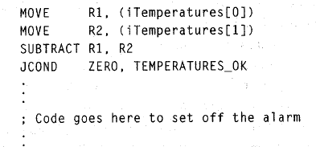
The Shared-Data Problem
Now, consider the assembly code:
  When temperatures are 70 degrees and an interrupt occurs between the two MOVES
  The temperatures now become 75 degrees
  On returning from ISR, iTemp[1] will be assigned 75 and an alarm will be set off even though the temperatures were the same

Slide 21
The Shared-Data Problem
Problem is due to shared array iTemperatures.
These bugs are very difficult to find as they occur only when the interrupt occurs in between the first 2 MOVE instructions, other than which code works perfectly.

Slide 22
Solving Shared-Data Problem
Disable interrupts during instructions that use the shared variable and re-enabling them later
  while (TRUE)
  {
  disable(); // Disable interrupts
  iTemp0 = iTemperatures[0];
  iTemp1 = iTemperatures[1];
  enable(); // Re-enable interrupts
  ...
  }

Slide 23
Solving Shared-Data Problem
“Atomic” and “Critical Section”
  A part of a program that be interrupted
Example:
  An ISR that updates iHours, iMinutes and iSeconds every second through a hardware timer interrupt:
  long iSecondsSinceMidnight (void) {
  long lReturnVal;
  disable();
  lReturnVal =
  (((iHours*60)+iMinutes)*60)+iSeconds; enable();
  return (lReturnVal);
  }

Slide 24
Outline
Introduction to interrupt
The shared-data problem
Interrupts of MSP430

Slide 25
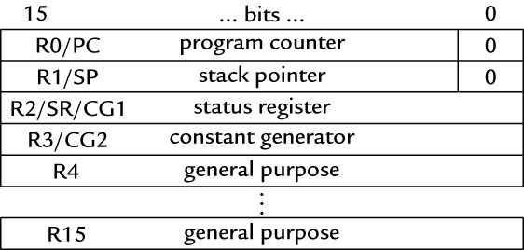
Know When an Interrupt Occurs
An interrupt will be detected and serviced if
  The global interrupt-enable bit is set
  → GIE bit of Status Register (SR) in CPU
  A peripheral device enables interrupt
  → For Timer_A: TAIE bit in TACTL register, CCIE bit in TACCTLx register
  The peripheral signals an
  interrupt
  → For Timer_A: TAIFG,
  CCIFG

Slide 26
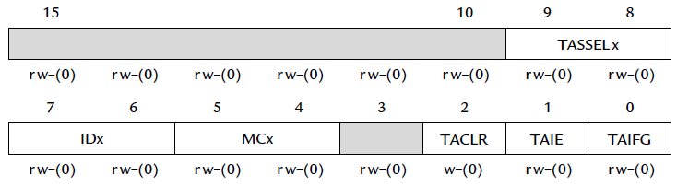
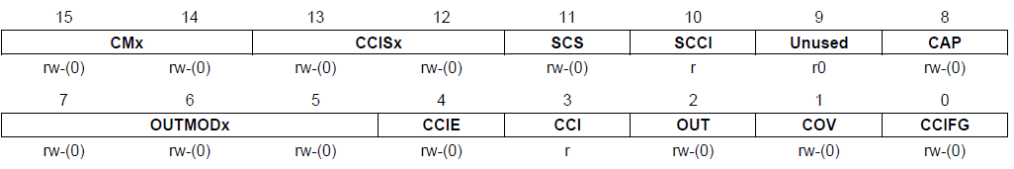
Ex: Timer_A Interrupt Enabling
TACTL
TACCTL

Slide 27
When an Interrupt Is Requested
Any currently executing instruction is completed. MCLK is started if the CPU was off.
The PC, which points to the next instruction, is pushed onto the stack.
The SR is pushed onto the stack.
The interrupt with the highest priority is selected.
The interrupt request flag is cleared automatically for vectors that have a single source.
The SR is cleared, and maskable interrupts are disabled.
The interrupt vector is loaded into the PC and the CPU starts to execute the ISR at that address.
These operations take about 6 cycles

Slide 28
After an Interrupt Is Serviced
An interrupt service routine must always finish with the return from interrupt instruction reti:
  The SR pops from the stack. All previous settings of GIE and the mode control bits are now in effect.
  → enable maskable interrupts and restores the previous low-power mode if there was one.
  The PC pops from the stack and execution resumes at the point where it was interrupted. Alternatively, the CPU stops and the device reverts to its low-power mode before the interrupt.

Slide 29
Where to Find ISRs?
The MSP430 uses vectored interrupts.
  Each ISR has its own vector, which is stored at a predefined address in a vector table at the end of the program memory (addresses 0xFFC0–0xFFFF).
  The vector table is at a fixed location, but the ISRs themselves can be located anywhere in memory.

Slide 30
Interrupt Source | Interrupt Flag | System Interrupt | Word Address | Priority
Power-up/external reset/Watchdog Timer+/flash key viol./PC out-of-range | PORIFG RSTIFG WDTIFG KEYV | Reset | 0FFFEh | 31 (highest)
NMI/Oscillator Fault/ Flash access viol. | NMIIFG/OFIFG/ ACCVIFG | Non-maskable | 0FFFCh | 30
 |  |  | 0FFFAh | 29
 |  |  | 0FFF8h | 28
 |  |  | 0FFF6h | 27
Watchdog Timer+ | WDTIFG | maskable | 0FFF4h | 26
Timer_A2 | TACCR0 CCIFG | maskable | 0FFF2h | 25
Timer_A2 | TACCR1 CCIFG, TAIFG | maskable | 0FFF0h | 24
 |  |  | 0FFEEh | 23
 |  |  | 0FFECh | 22
ADC10 | ADC10IFG | maskable | 0FFEAh | 21
USI | USIIFG USISTTIFG | maskable | 0FFE8h | 20
I/O Port P2 (2) | P2IFG.6, P2IFG.7 | maskable | 0FFE6h | 19
I/O Port P1 (8) | P1IFG.0 to P1IFG.7 | maskable | 0FFE4h | 18
 |  |  | 0FFE2h | 17
 |  |  | 0FFE0h | 16
Unused |  |  | 0FFDEh 0FFCDh | 15 - 0
Notes:
The MSP430 uses vectored interrupts, which means that the address of each ISR—its vector—is stored in a vector table at a deﬁned address in memory. In most cases each vector is associated with a unique interrupt but some sources share a vector. The ISR itself must locate the source of interrupts that share vectors. For example, TAIFG shares a vector with the capture/compare interrupts for all channels of Timer_A other than 0. Channel 0 has its own interrupt ﬂag TACCR0 CCIFG and separate vector.

Slide 31
Sample Code
Toggle LEDs using interrupts from Timer_A in up mode
#include <io430x11x1.h> // Specific device #include <intrinsics.h> // Intrinsic functions #define LED1 BIT0 #define LED2 BIT4 void main (void) { WDTCTL = WDTPW|WDTHOLD; // Stop watchdog timer P1OUT = ˜LED1; P1DIR = LED1; TACCR0 = 49999; // Upper limit of count for TAR TACCTL0 = CCIE; // Enable interrupts TACTL = MC_1|ID_3|TASSEL_2|TACLR; // Up mode, divide clock by 8, clock from SMCLK, clear __enable _interrupt(); // Enable interrupts (intrinsic) for (;;) { // Loop forever doing nothing } } // Interrupt service routine for Timer_A #pragma vector = TIMERA0_VECTOR __interrupt void TA0_ISR (void){ P2OUT ˆ= LED1|LED2; // Toggle LEDs }

Slide 32
Summary
Interrupts: a subroutine generated by the hardware at an unpredictable time
Issues to consider:
  How to set up and know there is an interrupt?
  How to know where is the interrupt service routine?
  Must not interfere the original program
  The shared-data problem
MSP430 interrupt mechanism

