Slide 1
CS4101 嵌入式系統概論
Analog-to-Digital Converter
金仲達教授
國立清華大學資訊工程學系
(Materials from MSP430 Microcontroller Basics, John H. Davies, Newnes, 2008)

Slide 2
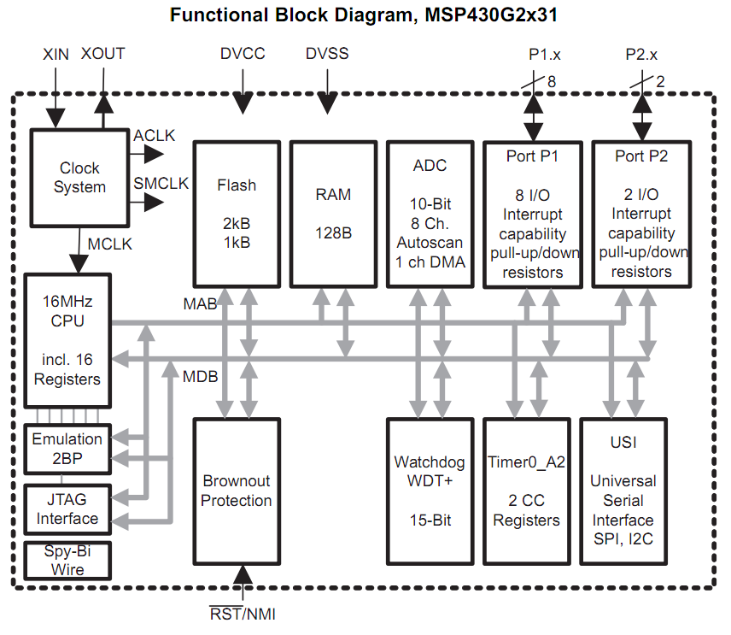
We Have Learned ...
ADC
Clock System
IO
Timer System
Notes:
They are all related to control of the clocks

Slide 3
Outline
Introduction to analog-to-digital conversion
ADC of MSP430
Sample code of using ADC10 in MSP430

Slide 4
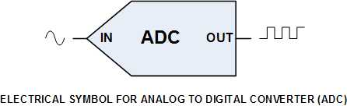
Analog-to-Digital Converter (ADC)
To know nature phenomena, which is analog, and make it feasible for computer to handle, we need to convert it into digital signals
To transform the analog, continuous signals into digital ones, the ADC samples the input at fixed interval and do the conversion
Analog signal
Digital signal
Notes:
The ADC10CLK is used both as the conversion clock and to generate the sampling period. The ADC10
source clock is selected using the ADC10SSELx bits and can be divided from 1-8 using the ADC10DIVx
bits. Possible ADC10CLK sources are SMCLK, MCLK, ACLK and an internal oscillator ADC10OSC .
The ADC10OSC, generated internally, is in the 5-MHz range, but varies with individual devices, supply
voltage, and temperature. See the device-specific data sheet for the ADC10OSC specification.
The user must ensure that the clock chosen for ADC10CLK remains active until the end of a conversion. If
the clock is removed during a conversion, the operation will not complete, and any result will be invalid.

Slide 5
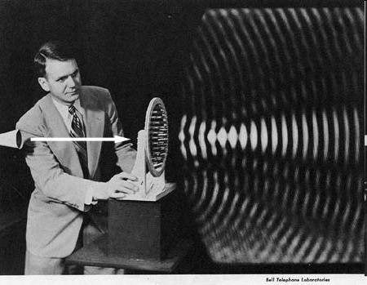
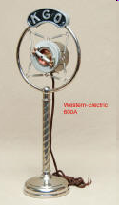
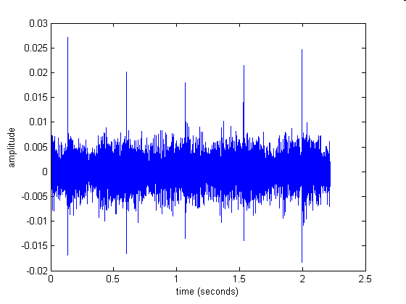
Analog Signals
A signal representing continuous things, e.g.
  Fluctuations in air pressure (i.e. sound) strike the diaphragm of a microphone, which causes corresponding fluctuations in a voltage or the current in an electric circuit
  The voltage or current is an "analog" of the sound
strength
voltage
time
time

Slide 6
Analog-to-Digital Conversion
ADC: convert an analog input, e.g., a voltage V, into a binary value that processor can handle
  The input V(t) is a continuous function, i.e., V can take any value within a permitted range and can change in any way as a function of time t
  The output V[n] is a sequence of binary values. Each has a fixed number of bits and can represent only a finite number of values.
  Typically input is sampled regularly at intervals of Ts, so the continuous nature of time has also been lost.
Of course, we also have DAC
(digital-to-analog converter)!

Slide 7
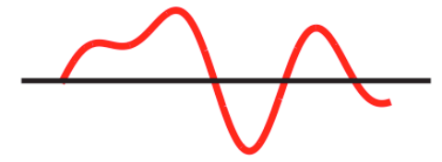
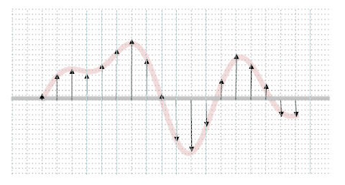
Analog-to-Digital Conversion
Digital representations of analog waveforms
Continuous time
Continuous values
Discrete time
Discrete values

Slide 8
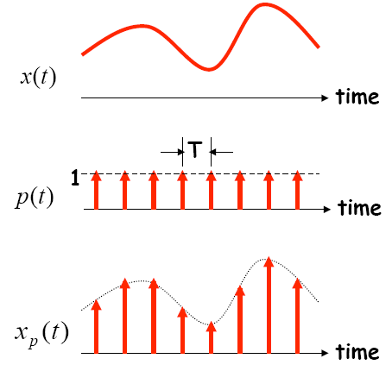
Sampling in Time
The value of the analog signal is measured at certain intervals in time. Each measurement is referred to as a sample
A series of “snapshots”

Slide 9
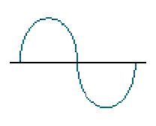
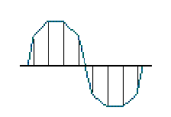
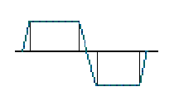
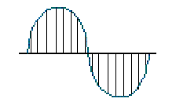
Terminologies in Sampling
Sampling rate:
  How often analog signal is measured (samples per second, Hz), e.g. 44,100 Hz?
Sampling resolution:
  Number of bits to represent each sample (“sample word length,” “bit depth”), e.g. 16 bit
Analog
Input
4 Samples/cycle
8 Samples/cycle
16 Samples/cycle

Slide 10
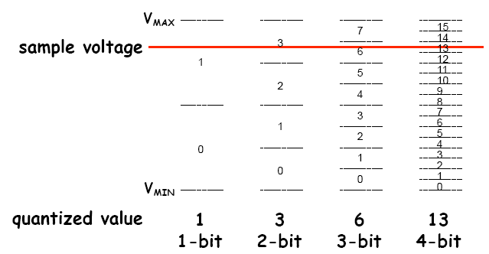
Encoding of Discrete Signals
If we use N bits to encode the magnitude of one of the discrete-time samples, we can capture 2^{N} possible values

Slide 11
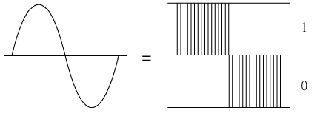
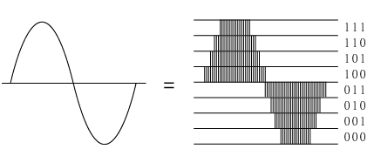
Sampling Rate and Encoding Bits
1-bit
3-bit

Slide 12
Outline
Introduction to analog-to-digital conversion
ADC of MSP430
Sample code of using ADC10 in MSP430

Slide 13
ADC in MSP430
MSP430 may contain one or more converters:
Comparator:
  Compare the voltages on its two input terminals and return 0 or 1, e.g., Comparator_A+
Successive-approximation ADC:
  Use binary search to determine the closest digital representation of the input signal, e.g., ADC10 and ADC12 to give 10 and 12 bits of output
Sigma-delta ADC:
  A more complicated ADC that gives higher resolution (more bits) but at a slower speed, e.g., SD16 and SD16_A, both of which give a 16-bit output

Slide 14
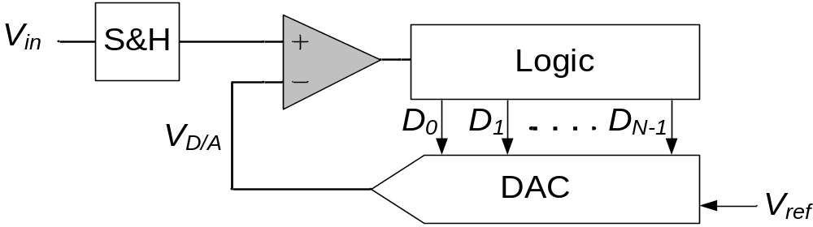
Successive-Approximation ADC
Generate internal analog signal V_{D/A} by DAC
Compare V_{D/A} with input signal V_{in}
Modify V_{D/A} by D₀D₁D₂…D_{N-1} until closest possible value to V_{in} is reached
Dr.-Ing. Frank Sill, Department of Electrical Engineering, Federal University of Minas Gerais, Brazil

Slide 15
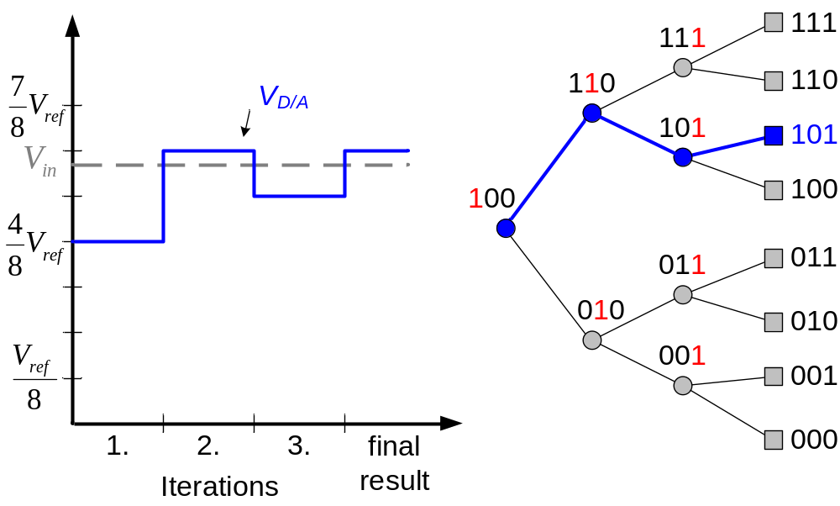
Successive-Approximation ADC
P. Fischer, VLSI-Design - ADC und DAC, Uni Mannheim, 2005

Slide 16
Requirements of MSP430 for ADC
Provide continuous sampling of multiple analog inputs and store sampled data
ADC10AE0
INCH in
ADC10CTL1

Slide 17
Requirements of MSP430 for ADC
Provide continuous sampling of multiple analog inputs and store sampled data
SHS, ADC10SSEL,
CONSEQ in
ADC10CTL1

Slide 18
Requirements of MSP430 for ADC
Provide continuous sampling of multiple analog inputs and store sampled data
By software and
interrupts
ADC10MEM

Slide 19
Requirements of MSP430 for ADC
Provide continuous sampling of multiple analog inputs and store sampled data
Data Transfer
Control

Slide 20
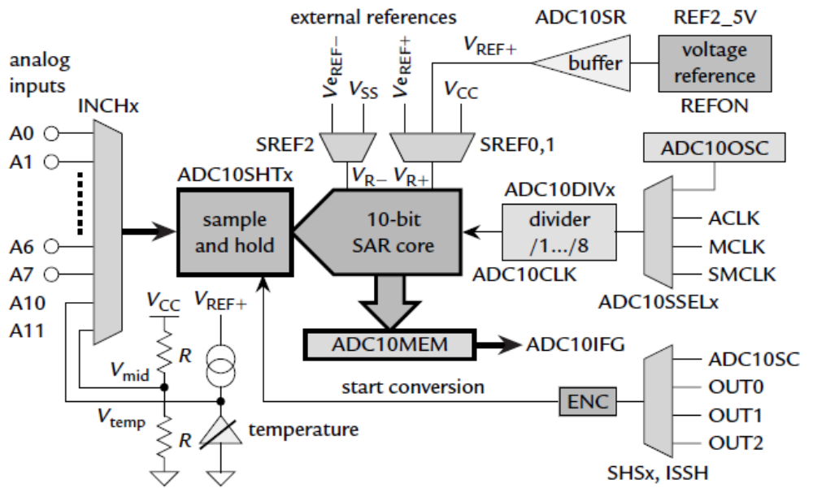
Simplified Block Diagram of ADC10
Voltage reference
Clock sources
Conversion trigger

Slide 21
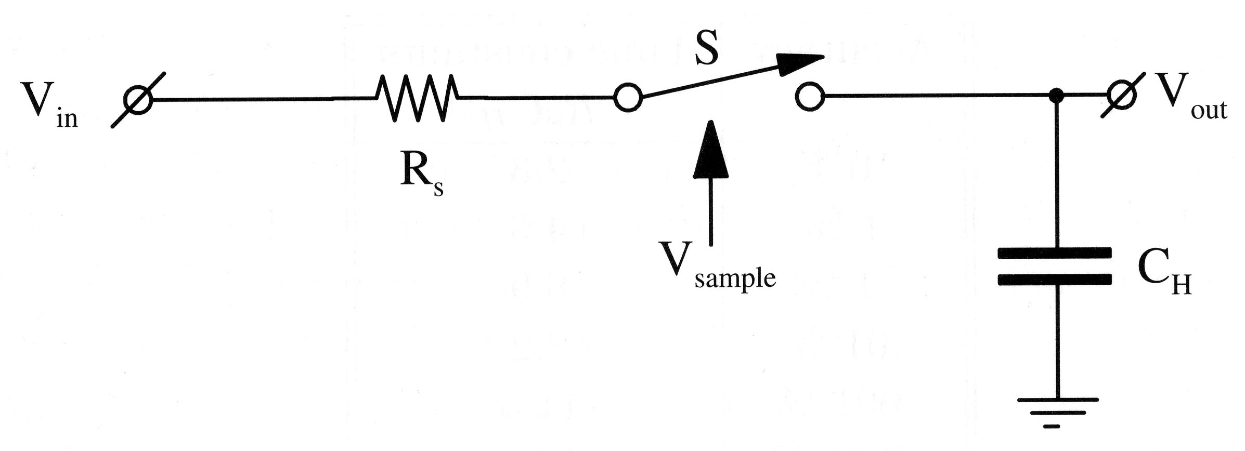
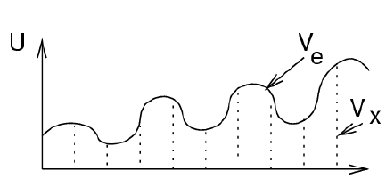
Main Components of ADC10
Sample-and-Hold circuit:
  V_{out} = V_{in} when V_{sample} = 1
SAR (Successive-Approximation Register):
  10-bit
  Result written to ADC10MEM and raising ADC10IFG
V_{in}
V_{out}

Slide 22
Main Components of ADC10
Built-in voltage reference:
  Two selectable voltage levels, 2.5 V and 1.5 V
  Setting REFON in ADC10CTL0 register to 1 enables the internal reference
  Setting REF2_5V in ADC10CTL0 to 1 selects 2.5 V as the internal reference, otherwise 1.5 V
  After voltage reference is turned on, we must wait about 30µs for it to settle

Slide 23
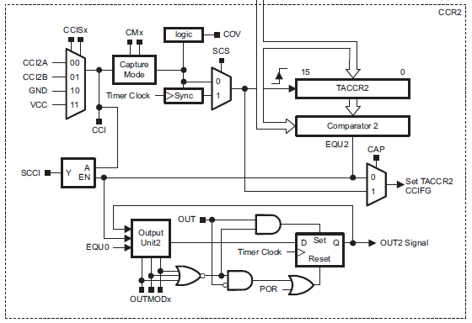
Main Components of ADC10
Sources of sample-and-hold circuit:
  ADC10SC bit in ADC10CTL0 register, which can be set (and is thus triggered) by software, or
  OUTx from
  Timer_A: for
  periodic
  sampling
Capture/Compare Block 2
of Timer_A

Slide 24
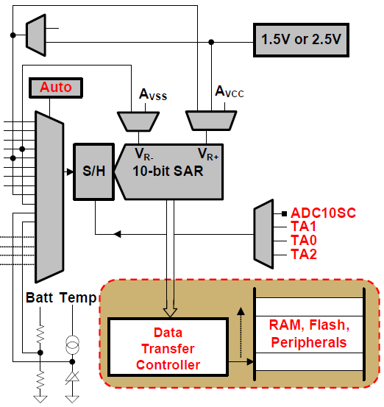
Data Transfer Controller (DTC)
1.5V or 2.5V or Reference
Transfer conversion
results from
ADC10MEM to
other on-chip
memory locations
  Each load of
  ADC10MEM
  triggers a data
  transfer until a set
  amount
  During each DTC
  transfer, CPU is
  halted
Input channel
ADC10MEM
Notes:
@ userguide 22.2.1 10-Bit ADC Core ,Page 542
The eight external and four internal analog signals are selected as the channel for conversion by the analog input multiplexer.
The ADC core converts an analog input to its 10-bit digital representation and stores the result in the ADC10MEM register. The core uses two programmable/selectable voltage levels (VR+ and VR-) to define the upper and lower limits of the conversion. The digital output (NADC) is full scale (03FFh) when the input signal is equal to or higher than VR+, and zero when the input signal is equal to or lower than VR-. The
input channel and the reference voltage levels (VR+ and VR-) are defined in the conversion-control memory. Conversion results may be in straight binary format or 2s-complement format.
The ADC10 core is configured by two control registers, ADC10CTL0 and ADC10CTL1. The core is enabled with the ADC10ON bit. With few exceptions the ADC10 control bits can only be modified when ENC = 0. ENC must be set to 1 before any conversion can take place.
SAR: successive approximation register

Slide 25
ADC10 Interrupts
One interrupt and one interrupt vector
  When DTC is not used (ADC10DTC1 = 0), ADC10IFG is set when conversion results are loaded into ADC10MEM
  When DTC is used (ADC10DTC1 > 0), ADC10IFG is set when a block transfer completes
If both ADC10IE and GIE bits are set, then ADC10IFG generates an interrupt request
  ADC10IFG is automatically reset when interrupt request is serviced, or it may be reset by software

Slide 26
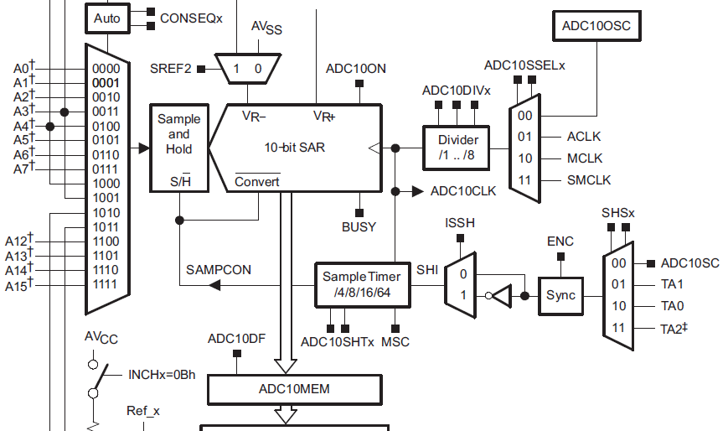
Enabling Sampling and Conversion

Slide 27
Steps for Single Conversion
(1) Configure ADC10, including the ADC10ON bit to enable the module.
  The ENC bit must be clear so that most bits in ADC10CTL0 and ADC10CTL1 can be changed.
(2) Set the ENC bit to enable a conversion.
  This cannot be done while the module is being configured in the previous step.
(3) Trigger the conversion, either by setting the ADC10SC bit or by an edge from Timer_A.
ADC10ON, ENC, ADC10SC are all in control register ADC10CTL0

Slide 28
ADC10 Registers
Register | Short Form | Register Type | Addr. | Initial State
ADC10 input enable register 0 | ADC10AE0 | Read/write | 04Ah | Reset with POR
ADC10 input enable register 1 | ADC10AE1 | Read/write | 04Bh | Reset with POR
ADC10 control register 0 | ADC10CTL0 | Read/write | 01B0h | Reset with POR
ADC10 control register 1 | ADC10CTL1 | Read/write | 01B2h | Reset with POR
ADC10 memory | ADC10MEM | Read | 01B4h | Unchanged
ADC10 data transfer control register 0 | ADC10DTC0 | Read/write | 048h | Reset with POR
ADC10 data transfer control register 1 | ADC10DTC1 | Read/write | 049h | Reset with POR
ADC10 data transfer start address | ADC10SA | Read/write | 01BCh | 0200h with POR
Where the data is saved
Notes:
power-on reset (PoR)

Slide 29
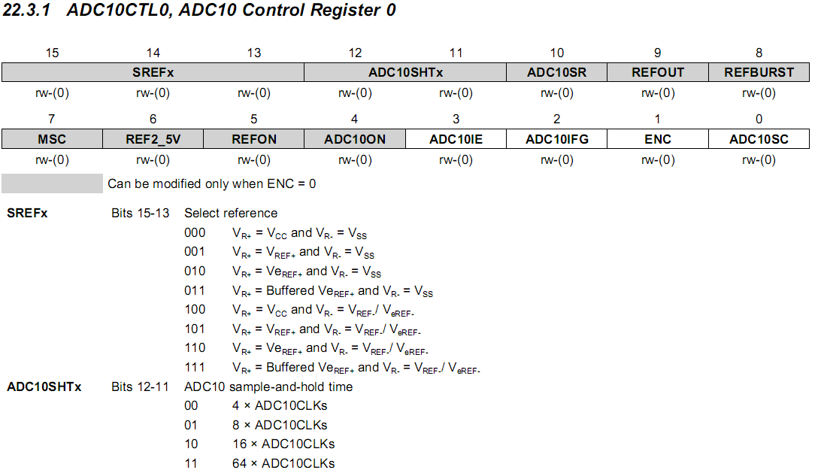
ADC10CTL0
ideal for the temperature sensor
ideal for the temperature sensor

Slide 30
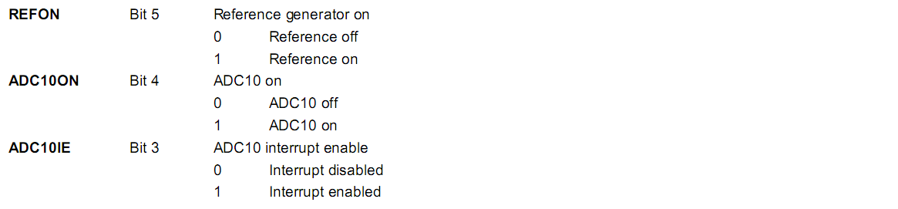
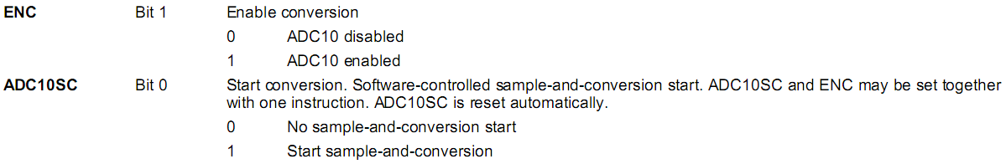
ADC10CTL0 cont’d
ADC10CTL0 = SREF_2 + ADC10SHT_1; // Reference range & SH time
Notes:
˙The settling time for the internal reference is < 30µs. A value of 5 cycles would be 40µs.
˙we should allow thirteen ADC10CLK cycles before we read the conversion result.
Thirteen cycles of the 5MHz ADC10CLK is 2.6µs. Even a single cycle of the DCO/8
would be longer than that. We will leave the LED on and use the same delay so that we
can see it with our eyes.
˙When the conversion is complete, the encoder and reference need to be turned off.

Slide 31
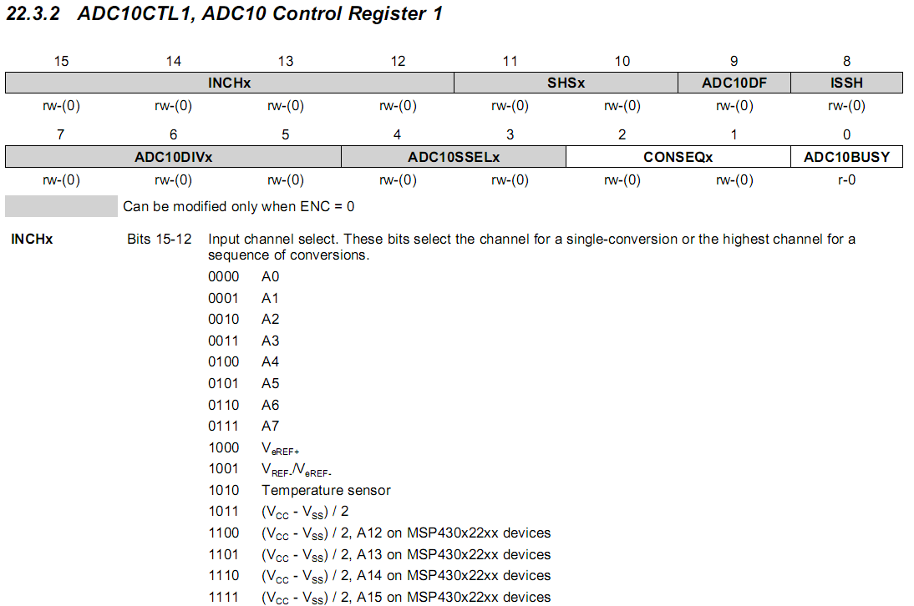
ADC10CTL1

Slide 32
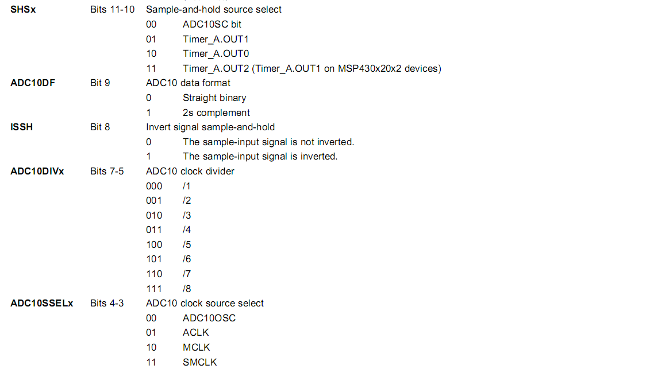
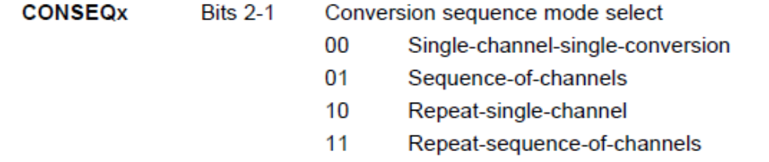
ADC10CTL1 cont’d
ADC10CTL1 = INCH_10 + ADC10DIV_0; // Temp Sensor ADC10CLK

Slide 33
Outline
Introduction to analog-to-digital conversion
ADC of MSP430
Sample code of using ADC10 in MSP430

Slide 34
Sample Code 1 for ADC10
Repetitive single conversion:
  A single sample is made on A1 with reference to Vcc
  If A1 > 0.5*Vcc, P1.0 set, else reset.
  Software sets ADC10SC to start sample and conversion. ADC10SC automatically cleared at end of conversion.
  Use ADC10 internal oscillator to time the sample and conversion.

Slide 35
Sample Code 1 for ADC10
#include "msp430g2231.h" void main(void) { WDTCTL = WDTPW + WDTHOLD; // Stop WDT // H&S time 16x, interrupt enabled ADC10CTL0 = ADC10SHT_2 + ADC10ON + ADC10IE; ADC10CTL1 = INCH_1; // Input A1 ADC10AE0 |= 0x02; // Enable pin A1 for analog in P1DIR |= 0x01; // Set P1.0 to output for (;;) { ADC10CTL0 |= ENC + ADC10SC; // Start sampling __bis_SR_register(CPUOFF + GIE); // Sleep if (ADC10MEM < 0x1FF) // 0x1FF = 511 P1OUT &= ~0x01; // Clear P1.0 LED off else P1OUT |= 0x01; // Set P1.0 LED on } }
Notes:
Pulse-width modulation (PWM): The load is switched on and off periodically so that the average voltage has the desired value. The fraction of the time while the load is active is called the duty cycle D.

Slide 36
Sample Code 1 for ADC10
// ADC10 interrupt service routine #pragma vector=ADC10_VECTOR __interrupt void ADC10_ISR(void) { __bic_SR_register_on_exit(CPUOFF); // Clear CPUOFF bit from 0(SR) }

Slide 37
Sample Code 2 for ADC10
Continuous sampling driven by Timer_A
  A1 is sampled 16/second (ACLK/2048) with reference to 1.5V, where ACLK runs at 32 KHz driven by an external crystal.
  If A1 > 0.5Vcc, P1.0 is set, else reset.
  Timer_A is run in up mode and its CCR1 is used to automatically trigger ADC10 conversion, while CCR0 defines the sampling period
  Use internal oscillator times sample (16x) and conversion (13x).

Slide 38
Sample Code 2 for ADC10
#include "msp430g2231.h" void main(void) { WDTCTL = WDTPW + WDTHOLD; // Stop WDT // TA1 trigger sample start ADC10CTL1 = SHS_1 + CONSEQ_2 + INCH_1; ADC10CTL0 = SREF_1 + ADC10SHT_2 + REFON + ADC10ON + ADC10IE; __enable_interrupt(); // Enable interrupts. TACCR0 = 30; // Delay for Volt Ref to settle TACCTL0 |= CCIE; // Compare-mode interrupt. TACTL = TASSEL_2 + MC_1; // SMCLK, Up mode. LPM0; // Wait for settle. TACCTL0 &= ~CCIE; // Disable timer Interrupt __disable_interrupt();
Notes:
Pulse-width modulation (PWM): The load is switched on and off periodically so that the average voltage has the desired value. The fraction of the time while the load is active is called the duty cycle D.

Slide 39
Sample Code 2 for ADC10
ADC10CTL0 |= ENC; // ADC10 Enable ADC10AE0 |= 0x02; // P1.1 ADC10 option select P1DIR |= 0x01; // Set P1.0 output TACCR0 = 2048-1; // Sampling period TACCTL1 = OUTMOD_3; // TACCR1 set/reset TACCR1 = 2047; // TACCR1 OUT1 on time TACTL = TASSEL_1 + MC_1; // ACLK, up mode // Enter LPM3 w/ interrupts __bis_SR_register(LPM3_bits + GIE); }
Timer_A CCR1 out mode 3: The output (OUT1) is set when the timer counts to the TACCR1 value. It is reset when the timer counts to the TACCR0 value.

Slide 40
Sample Code 2 for ADC10
// ADC10 interrupt service routine #pragma vector=ADC10_VECTOR __interrupt void ADC10_ISR(void){ if (ADC10MEM < 0x155) // ADC10MEM = A1 > 0.5V? P1OUT &= ~0x01; // Clear P1.0 LED off else P1OUT |= 0x01; // Set P1.0 LED on } #pragma vector=TIMERA0_VECTOR __interrupt void ta0_isr(void){ TACTL = 0; LPM0_EXIT; // Exit LPM0 on return }

Slide 41
Summary
ADC: analog-to-digital conversion
DAC: digital-to-analog conversion
  Conversions will necessarily introduce errors. Important to understand constraints and limitations
ADC10 in MSP430
  Convert an analog signal into 10-bit digitals
  Registers associated with ADC10
Sample program of ADC10
  Single conversion
  Continuous conversion driven by Timer_A

