Slide 1
CS4101 嵌入式系統概論
Program Organization
Prof. Chung-Ta King
Department of Computer Science
National Tsing Hua University, Taiwan
(Materials from MSP430 Microcontroller Basics, John H. Davies; Computers as Components: Principles of Embedded Computing System Design, Wayne Wolf; An Embedded Software Primer, David E. Simon)

Slide 2
Outline
Embedded program design patterns
Embedded software architecture

Slide 3
Embedded Program Design Pattern
A design pattern is a generalized description of a certain type of programs that can be customized and used in different circumstances
  Designer fills in details to customize the pattern to a particular programming problem
  Help developers to identify essential elements of the system and facilitate the development of embedded software
Two patterns introduced here
  Data stream pattern
  State machine pattern

Slide 4
Data Stream Pattern
Commonly used in signal processing:
  New data constantly arrives, e.g., from ADC
  Each datum has a limited lifetime
  Processing a datum requires previous data elements
Use a circular buffer to hold the data stream
→ shift window
x1
x2
x3
x4
x5
x6
x1
x5
x2
x6
x3
x4
t₁
t₂
t₃
Data stream
Circular buffer

Slide 5
Circular Buffer
Indexes locate currently used data, current input data:
d1
d5
input
use
d2
input
d2
d3
d3
d4
d4
use
time t1
time t1+1

Slide 6
Example: FIR Filter
int circ_buffer[N], circ_buffer_head = 0;
int c[N]; /* coefficients */
…
int ibuf, ic;
for (f=0, ibuff=circ_buff_head, ic=0;
ic<N; ibuff=(ibuff==N-1?0:ibuff++), ic++)
f = f + c[ic]*circ_buffer[ibuf];

Slide 7
State Machine Pattern
Identify states in the problems and describe the state transitions in a state machine
  State machine keeps internal state as a state variable, changes state based on inputs and performs operations on state transitions
State machine is useful in many contexts:
  Parsing user input
  Responding to complex stimuli
  Controlling sequential outputs
  For control-dominated code, reactive systems

Slide 8
Recall Basic Lab of Lab 7
Flash green LED at 1 Hz using interrupt from Timer_A, driven by SMCLK sourced by VLO. While green LED flashing at 1 Hz, pushing the button flashes red LED at 2Hz and releasing the button turns off red LED. Use low-power mode as much as possible.
How do you organize your program?
If apply state machine pattern, how many states can you identify?

Slide 9
State Machine of Lab 7
Why don’t we consider the flashing green LED?
no P1.3 in
P1.3 in/set red LED flashing, set P1.3 edge
no P1.3 in
BTN_off
BTN_on
P1.3 in/reset red LED flashing, set P1.3 edge
an event
triggering interrupt
works to do
in ISR
Notes:
Green LED: ISR short → consider instantaneous; no interrupt in between → non-preemptive;
Otherwise, should be set as a state

Slide 10
State Table of Lab 7
From the state machine, we can set up a state transition table with a column for the actions associated with each transition
Present state | Enable input | Next state | Actions
BTN_off | no P1.3 | BTN_off | none
 | P1.3 | BTN_on | set red LED flashing, set P1.3 edge
BTN_on | no P1.3 | BTN_on | none
 | P.1.3 | BTN_off | reset red LED flashing, set P1.3 edge

Slide 11
C Code Structure
Create a variable to record the state
State table can be implemented as a switch
  Cases define states
  States can test inputs, make state transitions, perform corresponding actions
  Switch can be executed repetitively (polling) or invoked by interrupts (in ISR)
switch (state) {
case state1: …
case state2: …
}

Slide 12
Outline
Embedded program design patterns
Embedded software architecture

Slide 13
Embedded Software Architecture
Basic architecture to put your code to run
Most important factor in choosing architecture:
→ How much control on system responses?
  Depending on system requirements, costs, etc.
  e.g., whether must respond rapidly to many different events and that has various processing requirements, with different deadlines and priorities, etc.
Four software architectures are introduce here
  Round-robin, interrupt-driven, task queue, real-time operating system (RTOS)

Slide 14
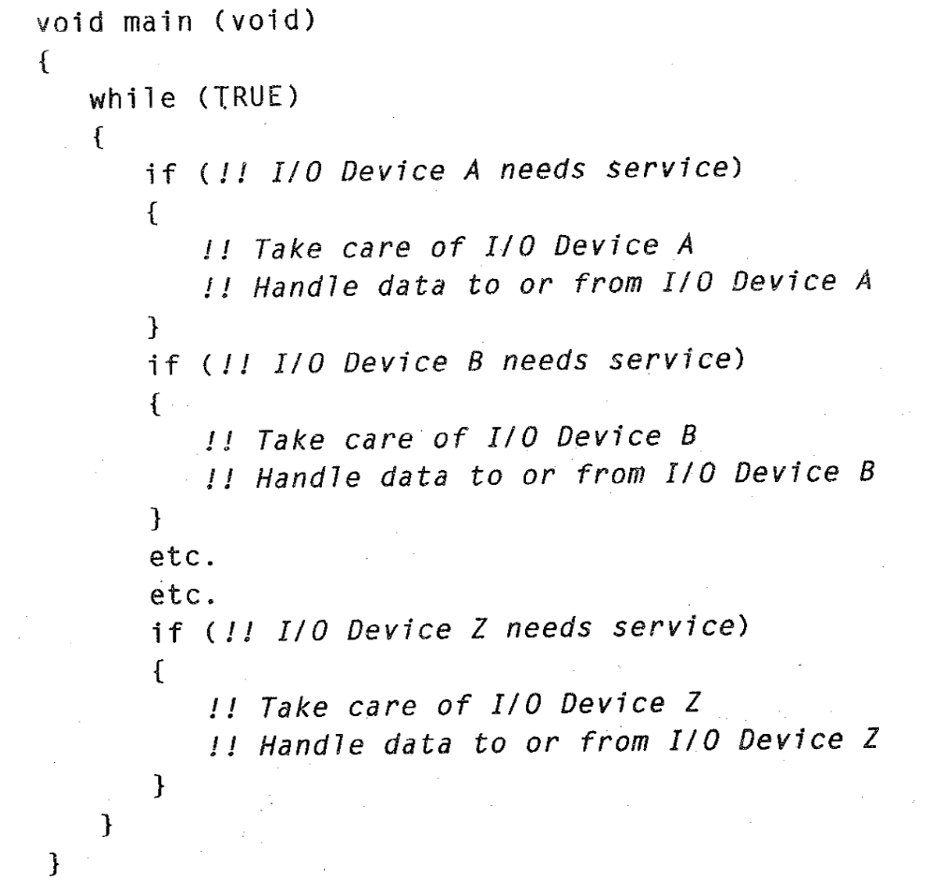
Round-Robin
Check each event or I/O device in turn and service them as needed
  A C code written for it would consist of a switch-case loop that performs functions based on the detected events

Slide 15
Round-Robin
Simplest architecture without interrupts or shared-data concerns → no priority, no preemption, no control of responses
Problems:
  When a device needs response in less time than it takes the CPU to loop through in the worst case, e.g., device Z needs <7 ms to respond, but A and B take 5 ms each to process
  When a device needs lengthy processing → worst case response time will be as bad as that
  Architecture is not robust → addition of a single device might cause all deadlines to be missed

Slide 16
Interrupt-Driven
Events trigger interrupts, which perform corresponding actions in ISRs
  Most of our labs use this architecture
  When there is no event to handle, main function goes into low power modes
Characteristics:
  If no interrupt allowed inside an interrupt
  → non-preemptive
  Execution order depends on the order and/or priority of interrupts (not fixed as in round-robin)
  → limited control of responses

Slide 17
Task Queue
All the labs we have studied so far perform very simple work on interrupts.
In practice, an event may trigger complex computations, which may not be suitable for processing within ISRs.
  Example: Need to handle button events while in the middle of sending a byte to the PC using software UART. If the button event requires more time to process than the duration of transmitting a single bit, we may miss the deadline to transmit the next bit.
Solution: move non-critical works out of ISR

Slide 18
Task Queue
Interrupts for checking events and urgent works and main loop proceeds with follow-up works
  ISRs put action requests in some priority queue, and main function picks next task from queue for works
  #pragma vector=EVENTA_VECTOR
  __interrupt void EventA_ISR(void) {
  // put event A request in queue }
  void main (void) {
  while (TRUE) {
  // pick next request from queue
  // process corresponding actions }
  }

Slide 19
Task Queue
More control over priorities and better response
  Events can be assigned priorities, giving better responses especially for devices with hard deadlines
Disadvantage:
  Complexity of working with shared-data variables
  Limited task scheduling capability and handle scheduling in application
  → need to wait till current action done before next scheduling
  Difficult to implement preemptions of low-priority tasks

Slide 20
Real-Time Operating System
Task code is separated into threads
ISRs handle important works and request corresponding threads be scheduled
  RTOS will decide which thread to run based on urgency (priority)
  RTOS can suspend a thread to run another (usually higher priority) one
  → Response is independent of task code length
  Changes to code lengths of low priority tasks don’t affect higher priority tasks.

Slide 21
Selecting an Architecture
Select the simplest architecture meeting response requirements.
RTOSs should be used where response requirements demand them.
Hybrid architectures can be used if required. e.g. you can use an RTOS with a low-priority task polling the relatively slower hardware.

