Slide 1
CS4101 嵌入式系統概論
RTOS and MQX
Prof. Chung-Ta King
Department of Computer Science
National Tsing Hua University, Taiwan
(Materials from Freescale; Prof. P. Marwedel of Univ. Dortmund)

Slide 2
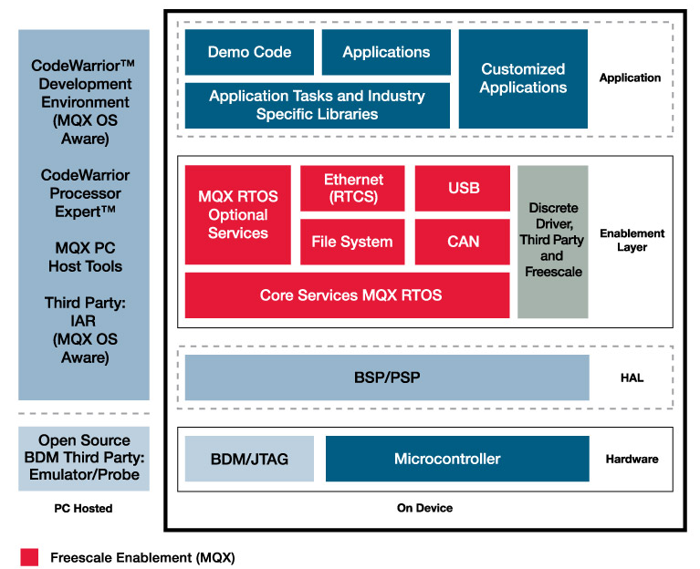
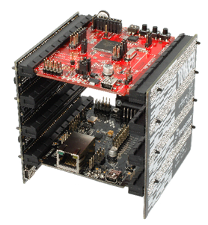
Recall Tower System
+
Tower System
MQX RTOS
CodeWorrier IDE

Slide 3
Outline
Introduction to embedded operating systems
  Comparison with desktop operating systems
  Characteristics of embedded operating systems
Introduction to real-time operating systems
  Requirements for an OS to be a real-time OS
  Classification of RTOS
Introduction to MQX and sample code

Slide 4
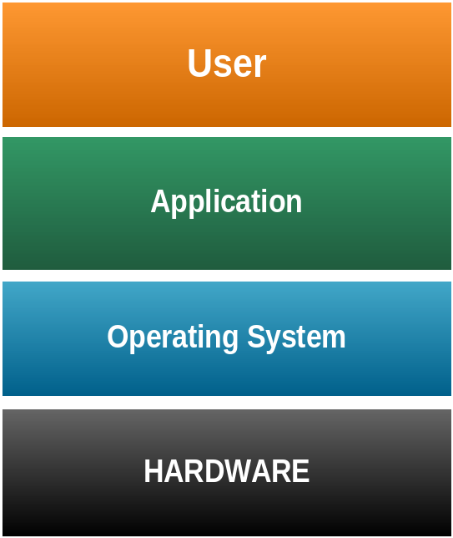
Operating Systems
The collection of software that manages a
system’s hardware resources
  Often include a file system module,
  a GUI and other components
Often times, a “kernel” is
understood to be a subset of
such a collection
Characteristics
  Resource management
  Interface between application and hardware
  Library of functions for the application
Notes:
Resource management - e.g. memory, processor, hard disk, cd-rom, printer
Interface between application and hardware
Creation of an operating system-API for hardware - leads to a simple handling of the hardware for the programmer (minor knowledge of hardware)
Library of functions for application
Use:
The operating system has a big influence at software reliability, productivity, maintenance and service.
Allocation of resources (cpu, memory, etc) for the application
Deletion of conflict situations

Slide 5
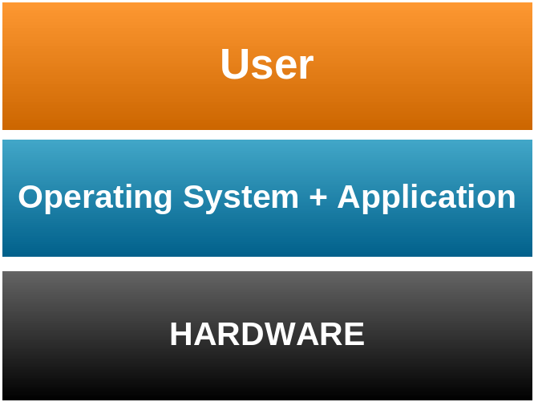
Embedded Operating Systems
Fusion of the application and the OS to one unit
Characteristics:
  Resource management
    Primary internal resources
  Less overhead
  Code of the OS and the
  application mostly reside in
  ROM
Notes:
Resources management
Optimising to less memory requirement
Processor
Mostly no management of the ports and periphery (limitation to operating system kernel)
Less Overhead
Run time
Memory requirement (RAM, ROM)
Interface: Relation to the outside world (input.- and output signals)
Kind of operating system:
Single-/multi-user system
Timesharing (multi-access)
Multitasking
Batch

Slide 6
Desktop vs Embedded OS
Desktop: applications are compiled separately from the OS
Embedded: application is compiled and linked together with the embedded OS
  On system start, application usually gets executed first, and it then starts the RTOS.
  Typically only part of RTOS (services, routines, or functions) needed to support the embedded application system are configured and linked in
(Dr Jimmy To, EIE, POLYU)

Slide 7

Characteristics of Embedded OS
Configurability:
  No single OS fit all needs, no overhead for
  unused functions → configurability
Techniques for implementing configurability
  Simplest form: remove unused functions (by linker ?)
  Conditional compilation (using #if and #ifdef commands)
  Advanced compile-time evaluation and optimization
  Object-orientation specialized to a derived subclasses

Slide 8
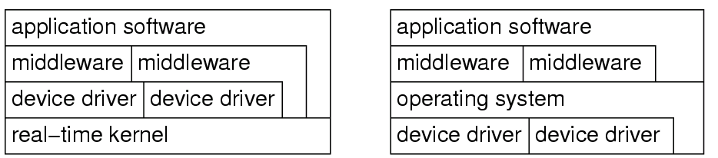
Characteristics of Embedded OS
Device drivers often not integrated into kernel
  Embedded systems often application-specific → specific devices → move device out of OS to tasks
  For desktop OS, many devices are implicitly assumed to be presented, e.g., disk, network, audio, etc.
  → they need to be integrated to low-level SW stack
Embedded OS
Standard OS
kernel

Slide 9
Characteristics of Embedded OS
Protection is often optional
  Embedded systems are typically designed for a single purpose, untested programs rarely loaded, and thus software is considered reliable
  Privileged I/O instructions not necessary and
  tasks can do their own I/O
  Example: Let switch be the address of some switch
  Simply use
  load register,switch
  instead of OS call

Slide 10
Characteristics of Embedded OS
Interrupts not restricted to OS
  Embedded programs can be considered to be tested
  Protection is not necessary
  Efficient control over a variety of devices is required
  → can let interrupts directly start or stop tasks
  (by storing task’s start address in the interrupt table)
  → more efficient than going through OS services
  But for standard OS: serious source of unreliability
  Reduced composability: if a task is connected to an interrupt, it may be difficult to add another task which also needs to be started by an event.

Slide 11

Characteristics of Embedded OS
Real-time capability
  Many embedded systems are real-time (RT) systems and, hence, the OS used in these systems must be real-time operating systems (RTOSs)
Features of a RTOS:
  Allows multi-tasking
  Scheduling of the tasks with priorities
  Synchronization of the resource access
  Inter-task communication
  Time predictable
  Interrupt handling

Slide 12
Outline
Introduction to embedded operating systems
  Comparison with desktop operating systems
  Characteristics of embedded operating systems
Introduction to real-time operating systems
  Requirements for an OS to be a real-time OS
  Classification of RTOS
Introduction to MQX and sample code

Slide 13
Requirements for RTOS
Predictability of timing
  The timing behavior of the OS must be predictable
  For all services of the OS, there is an upper bound on the execution time
  Scheduling policy must be deterministic
  The period during which interrupts are disabled must be short (to avoid unpredictable delays in the processing of critical events)

Slide 14
Requirements for RTOS
OS should manage timing and scheduling
  OS possibly has to be aware of task deadlines;
  (unless scheduling is done off-line).
  Frequently, the OS should provide precise time services with high resolution.
    Important if internal processing of the embedded system is linked to an absolute time in the physical environment
Speed:
  The OS must be fast

Slide 15
Functionality of RTOS Kernel
Processor management
Memory management
Timer management
Task management (resume, wait etc)
Inter-task communication and synchronization
resource management

Slide 16
Why Use an RTOS?
Can use drivers that are available with an RTOS
Can focus on developing application code, not on creating or maintaining a scheduling system
Multi-thread support with synchronization
Portability of application code to other CPUs
Resource handling by RTOS
Add new features without affecting higher priority functions
Support for upper layer protocols such as:
  TCP/IP, USB, Flash Systems, Web Servers,
  CAN protocols, Embedded GUI, SSL, SNMP

Slide 17
Classification of RTOS
RT kernels vs modified kernels of standard OS
  Fast proprietary kernels: may be inadequate for complex systems, because they are designed to be fast rather than to be predictable in every respect, e.g., QNX, PDOS, VCOS, VTRX32, VxWORKS
  RT extensions to standard OS: RT-kernel runs all RT-tasks and standard-OS executed as one task on it
General RTOS vs RTOS for specific domains
Standard APIs vs proprietary APIs
  e.g. POSIX RT-Extension of Unix, ITRON, OSEK)
Source: R. Gupta, UCSD

Slide 18
Ex.: RT-Linux
Init
Bash
Mozilla
RT-tasks
cannot use standard OS calls (www.fsmlabs.com)
Linux-Kernel
scheduler
RT-Task
RT-Task
driver
interrupts
RT-Linux
RT-Scheduler
interrupts
I/O
interrupts
Hardware

Slide 19
Ex.: Posix RT-extensions to Linux
Standard scheduler can be replaced by POSIX scheduler implementing priorities for RT tasks
RT-Task
RT-Task
Init
Bash
Mozilla
Special RT-calls and standard OS calls available.
Easy programming, no guarantee for meeting deadline
Linux-Kernel
POSIX 1.b scheduler
driver
I/O, interrupts
Hardware

Slide 20
Outline
Introduction to embedded operating systems
  Comparison with desktop operating systems
  Characteristics of embedded operating systems
Introduction to real-time operating systems
  Requirements for an OS to be a real-time OS
  Classification of RTOS
Introduction to MQX and sample code

Slide 21
What is MQX?
Multi-threaded, priority-based RTOS provides
  Task scheduling
  Task management
  Interrupt handling
  Task synchronization: mutexes, semaphores, events, messages
  Memory management
  IO subsystems
  Kernel logging

Slide 22
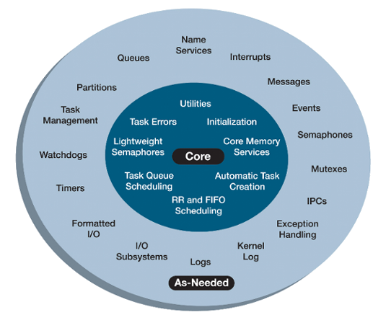
MQX Facilities
Required
Optional
MQX, RTCS, etc are structured as a set of C files built by the user into a library that is linked into the same code space as the application. Libraries contain all functions but only called functions are included with the image.
Notes:
Here is a closer look at what MQX has to offer.
Note first that MQX is very configurable : referring to the diagram to the right, you can pick and choose the services from the outer ring as needed to fine tune the system. This component based architecture provides tunable scalability by choosing components and services required for your applications. Lightweight services also enable control of RAM and ROM utilization to balance code size with performance requirements. Also, selecting the services that fits your design will help reduce the overhead of the system.
The standard release from Freescale enables the majority of the features to showcase the capabilities of MQX as can been in the out of box labs. However, a user can edit configure files base on application needs creating a smaller footprint or faster solution.
This scalability is ideal for enabling an RTOS on a variety of processor classes, from 8-bit microcontrollers to microprocessors clocked at hundreds of megahertz.

Slide 23
MQX Tasks
Applications running on MQX are built around tasks → a system consists of multiple tasks
  Tasks take turns running
  Only one task is active (has the processor) at any given time
  MQX manages how the tasks share the processor (context switching)
Task context
  Data structure stored for each task, including registers and a list of owned resources
Notes:
To start things off, lets think about how we solve problems as engineers. You have a big problem to solve. In order to make it more manageable, you then break it down into little problems to tackle individually.
It is the same idea when using an RTOS. You have a software problem you’re trying to solve, and so you break it down into chunks, which are called tasks. An RTOS system consists of one or more tasks that work together to solve a larger problem.
The tasks takes turns running, as only one task, called the active task, has the processor at any one time. The RTOS then uses what is called a scheduler to determine how those tasks share the processor. And when a new task takes control of the processor, that’s called a context switch.
By performing many context switches quickly, you can create the illusion of concurrency. However only task is active at a time.

Slide 24
Hello World on MQX
#include <mqx.h> #include <bsp.h> #include <fio.h> #define HELLO_TASK 5 /* Task IDs */ extern void hello_task(uint_32); const TASK_TEMPLATE_STRUCT MQX_template_list[] = { /* Task Index, Function, Stack, Priority, Name, Attributes, Parameters, Time Slice */ {HELLO_TASK, hello_task, 1500, 8, "hello", MQX_AUTO_START_TASK, 0, 0 }, { 0 } }; void hello_task(uint_32 initial_data){ printf("Hello World\n"); _task_block(); }

Slide 25
Hello World 2 on MQX (1/2)
#include <mqx.h> #include <bsp.h> #include <fio.h> /* Task IDs */ #define HELLO_TASK 5 #define WORLD_TASK 6 extern void hello_task(uint_32); extern void world_task(uint_32); const TASK_TEMPLATE_STRUCT MQX_template_list[] = { /* Task Index, Function, Stack, Priority, Name, Attributes, Parameters, Time Slice */ {WORLD_TASK, world_task, 1000, 9, "world", MQX_AUTO_START_TASK, 0, 0}, {HELLO_TASK, hello_task, 1000, 8, "hello", 0,0,0}, { 0 } };

Slide 26
Hello World 2 on MQX (2/2)
/* world_task:create hello_task & print " World " */ void world_task(uint_32 initial_data) { _task_id hello_task_id; hello_task_id = _task_create(0, HELLO_TASK, 0); if (hello_task_id == MQX_NULL_TASK_ID) { printf ("\n Could not create hello_task\n"); } else { printf(" World \n"); } _task_block(); } void hello_task(uint_32 initial_data) { printf("\n Hello\n"); _task_block(); }

