Slide 1
CS4101 嵌入式系統概論
Tasks and Scheduling
Prof. Chung-Ta King
Department of Computer Science
National Tsing Hua University, Taiwan
(Materials from Freescale and MQX User Guide)

Slide 2
Outline
Introduction to MQX
Initializing and starting MQX
Managing tasks
Scheduling tasks

Slide 3
What is MQX?
Multi-threaded priority-based RTOS, provides
  Task scheduling
  Task management
  Interrupt handling
  Task synchronization: mutexes, semaphores, events, messages
  Memory management
  IO subsystems
  Kernel logging
Can be downloaded from
  http://www.freescale.com/mqx
  Default MQX folder:
  C:\Program Files\Freescale\Freescale MQX 3.5

Slide 4
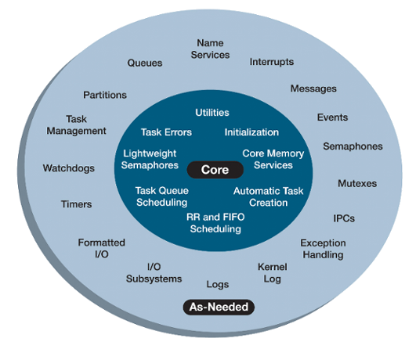
MQX Facilities
Required
Optional
MQX, RTCS, etc are structured as a set of C files built by the user into a library that is linked into the same code space as the application. Libraries contain all functions but only called functions are included with the image.
Notes:
Here is a closer look at what MQX has to offer.
Note first that MQX is very configurable : referring to the diagram to the right, you can pick and choose the services from the outer ring as needed to fine tune the system. This component based architecture provides tunable scalability by choosing components and services required for your applications. Lightweight services also enable control of RAM and ROM utilization to balance code size with performance requirements. Also, selecting the services that fits your design will help reduce the overhead of the system.
The standard release from Freescale enables the majority of the features to showcase the capabilities of MQX as can been in the out of box labs. However, a user can edit configure files base on application needs creating a smaller footprint or faster solution.
This scalability is ideal for enabling an RTOS on a variety of processor classes, from 8-bit microcontrollers to microprocessors clocked at hundreds of megahertz.

Slide 5
NQX Directory Structure
Described in MQX Release Notes
  config: user_config.h for each board, changing for MQX configuration → libraries re-compilation needed
  demo:
  doc
  lib: pre-compiled libraries for each board, overwritten when libraries are compiled (application will look here when calling the mqx function calls)
  mqx
  tools: PC host tools
  RTCS, USB, MFS stacks
Notes:
The first is the config directory. You’ll see that it contains all the different hardware platforms that are supported by MQX, and inside each of those folders is a user_config.h file that contains the configuration settings for that board. Most changes to MQX configuration take place in that file.
You’ll also see a folder for the CodeWarrior 7.2 compiler, which contains a project file for re-compiling the MQX libraries. If any changes are made to the user_config.h file, the libraries must be re-compiled.
Going back up to the MQX root directory, the next folder is the demo folder. This contains the out of box demos and full-featured example code.
The next folder is the documentation folder. Inside you’ll see the MQX release notes, which contain a lot of very useful information on the example projects available, what drivers and stacks are supported by each particular board, and what’s new in this version of MQX.
A little deeper down you’ll find the reference manuals for the different stacks, as well as the MQX user’s guide. This document provides a good summary of how to use the MQX kernel and the features available.
The next folder to look at is the library folder. Looking in there, you’ll see the pre-compiled libraries for each board that MQX supports. The files in this folder should not be edited, as they will be overwritten the next time the libraries are compiled. However this is the path your application will look for when calling the mqx function calls.
mqx folder will be discussed in the next slide
Going back up to the main MQX directory, you’ll also find directories for the MS-Dos File System stack, the Real Time Communication Suite (or Ethernet) stack, and the USB stacks. Their directory structure is the same as the mqx folder, with “build”,”example”, and “source” directories.
The MQX release notes also include more information on the other directories.

Slide 6
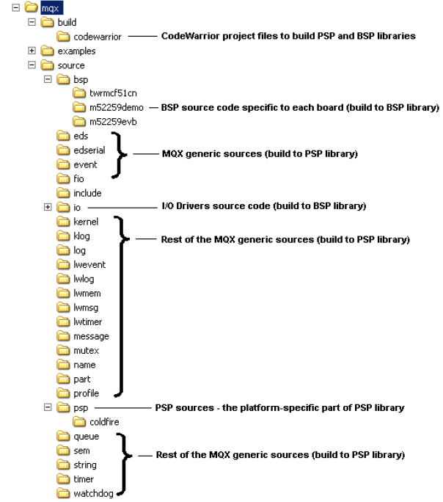
MQX
Directory
“mqx” dir.:
  build
  examples
  source
    bsp
    io
    psp
    MQX API
Notes:
Skipping over the mfs folder for the moment and diving into the mqx folder, you’ll see three sub directories. The build directory contains the project files to individually compile that particular library. In the mqx directory, there are two project files: One for the Board Support Package, and one for the Processor Support Package. There are project files for each board supported by MQX.
Going back up a level, the next directory is the example directory. Here you’ll find very simple examples showcasing specific MQX features like mutexes and events. This is a good place to find sample code to get started with a particular feature.
Finally there is the source folder. This contains the source code for mqx, from the kernel to the features like events and semaphores.
The bsp directory includes the board support package files specific to a board. Meanwhile the io directory is where the IO drivers are located. Generally you will never have to edit these files, but they are useful to know about.
A board support package (BSP) is a collection of hardware-dependent files that rely on the specific
features of a single-board computer. It contains low-level startup
code, processor, and board initialization code. The BSP also contains data structures used to initialize
various I/O drivers in a way suitable for a given board.
This code compiles (together with the I/O drivers code) into the BSP library.
The mqx\source\psp directory contains the platform-dependent code of the PSP library.

Slide 7
Outline
Introduction to MQX
Initializing and starting MQX
Managing tasks
Scheduling tasks

Slide 8
MQX Tasks
Applications running on MQX are built around tasks → a system consists of multiple tasks
  Tasks are like threads and take turns running
  Only one task is active (has the processor) at any given time
  MQX manages how the tasks share the processor (context switching)
Notes:
To start things off, lets think about how we solve problems as engineers. You have a big problem to solve. In order to make it more manageable, you then break it down into little problems to tackle individually.
It is the same idea when using an RTOS. You have a software problem you’re trying to solve, and so you break it down into chunks, which are called tasks. An RTOS system consists of one or more tasks that work together to solve a larger problem.
The tasks takes turns running, as only one task, called the active task, has the processor at any one time. The RTOS then uses what is called a scheduler to determine how those tasks share the processor. And when a new task takes control of the processor, that’s called a context switch.
By performing many context switches quickly, you can create the illusion of concurrency. However only task is active at a time.

Slide 9
“Hello World” on MQX
#include <mqx.h> #include <bsp.h> #include <fio.h> #define HELLO_TASK 5 /* Task IDs */ extern void hello_task(uint_32); const TASK_TEMPLATE_STRUCT MQX_template_list[] = { /* Task Index, Function, Stack, Priority, Name, Attributes, Parameters, Time Slice */ {HELLO_TASK, hello_task, 1500, 8, "hello", MQX_AUTO_START_TASK, 0, 0 }, { 0 } }; void hello_task(uint_32 initial_data){ printf("Hello World\n"); _task_block(); // block the task }
Notes:
The hello_task is an autostart task. So, at initialization, MQX creates one instance of the task with a
creation parameter of zero. The application defines the task template index (HELLO_TASK). The task is of
priority 8. The function hello_task() is the code-entry point for the task. The stack size is 0x1500
single-addressable units.

Slide 10
“Hello World” Explained
There is no main() defined
  main() in mqx\source\bsp\twrk60d100m\mqx_main.c
  _mqx() starts MQX and initializes it according to the MQX initialization structure defined in mqx_init.c
int main(void) { extern const MQX_INITIALIZATION_STRUCT MQX_init_struct; /* Start MQX */ _mqx( (MQX_INITIALIZATION_STRUCT_PTR) &MQX_init_struct ); return 0; }

Slide 11
“Hello World” Explained
A task is a unique instance of a task template
  Can have multiple tasks from same template, and each is its own instance
  Each task has a unique 32-bit task ID used by MQX
  Automatic clean up of resources when terminates
Tasks are managed by MQX_template_list, an array of task templates for creating tasks
  Terminated by a zero-filled task template

Slide 12
“Hello World” Explained
A task template contains these fields:
_mqx_uint TASK_TEMPLATE_INDEX
void (_CODE_PTR_)(uint_32 TASK_ADDRESS
_mem_size TASK_STACKSIZE
_mqx_uint TASK_PRIORITY
char _PTR_ TASK_NAME
_mqx_uint TASK_ATTRIBUTES
uint_32 CREATION_PARAMETER
_mqx_uint DEFAULT_TIME_SLICE
TASK_TEMPLATE_STRUCT defined in mqx\source\include\mqx.h

Slide 13
MQX_template_list Examples
{ MAIN_TASK, world_task, 0x3000, 9, "world_task", MQX_AUTO_START_TASK, 0L, 0},
{ HELLO, hello_task, 0x1000, 8, "hello_task", MQX_TIME_SLICE_TASK, 0L, 100},
{ LED, float_task, 0x2000, 10, "Float_task", MQX_AUTO_START_TASK | MQX_FLOATING_POINT_TASK, 0L, 0},
Notes:
world_task
The world_task is an autostart task. So, at initialization, MQX creates one instance of the task with a
creation parameter of zero. The application defines the task template index (MAIN_TASK). The task is of
priority 9. The function world_task() is the code-entry point for the task. The stack size is 0x3000
single-addressable units.
hello_task
The hello_task task is a time-slice task with a time slice of 100, in milliseconds, if the default compile-time
configuration options are used.
Float_task
The Float_task task is both a floating-point task and an autostart task.

Slide 14
More on Task Attributed
Any combination of the following attributes can be assigned to a task:
  Autostart: When MQX starts, it creates one instance of the task.
  DSP: MQX saves the DSP co-processor registers as part of the task’s context.
  Floating point: MQX saves floating-point registers as part of the task’s context.
  Time slice: MQX uses round robin scheduling for the task (the default is FIFO scheduling).

Slide 15
Outline
Introduction to MQX
Initializing and starting MQX
Managing tasks
Scheduling tasks

Slide 16
MQX Tasks
Multiple tasks, created from same or different task template, can coexist
  MQX maintains each instance by saving its context: program counter, registers, and stack.
  Each task has an application-unique 32-bit task ID, which MQX and other tasks use to identify the task.
A task is defined by its task descriptor:
  Task ID
  Context: program counter, stack, registers
  Priority
  Resources and task-specific parameters

Slide 17
Priorities
Priorities run from 0 to N
  Priority 0: interrupts disabled, 1 highest priority
N is set by the highest priority in MQX_Template_List
  Idle task runs at N+1
MQX creates one ready queue for each priority up to lowest priority → priorities are consecutive
Can change priority during runtime _task_set_priority()
Any tasks at priority below 6 can mask certain levels of interrupts. So user tasks should start at 7 or above.

Slide 18
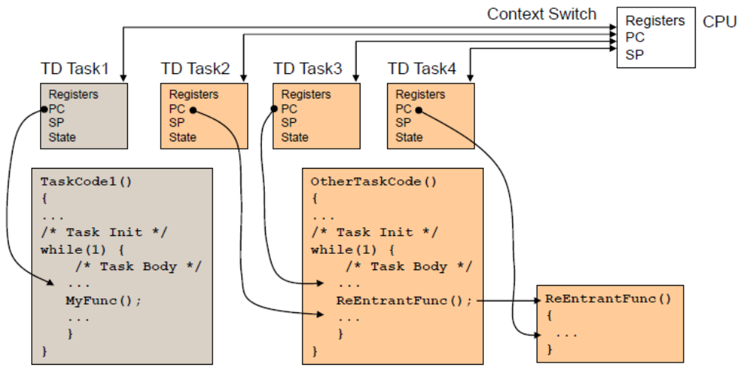
Task Environment

Slide 19
“Hello World 2” on MQX (1/2)
#include <mqx.h> #include <bsp.h> #include <fio.h> /* Task IDs */ #define HELLO_TASK 5 #define WORLD_TASK 6 extern void hello_task(uint_32); extern void world_task(uint_32); const TASK_TEMPLATE_STRUCT MQX_template_list[] = { /* Task Index, Function, Stack, Priority, Name, Attributes, Parameters, Time Slice */ {WORLD_TASK, world_task, 1000, 9, "world", MQX_AUTO_START_TASK, 0, 0}, {HELLO_TASK, hello_task, 1000, 8, "hello", 0,0,0}, { 0 } };

Slide 20
“Hello World 2” on MQX (2/2)
/* world_task:create hello_task & print " World " */ void world_task(uint_32 initial_data) { _task_id hello_task_id; hello_task_id = _task_create(0, HELLO_TASK, 0); if (hello_task_id == MQX_NULL_TASK_ID) { printf ("\n Could not create hello_task\n"); } else { printf(" World \n"); } _mqx_exit(0); } void hello_task(uint_32 initial_data) { printf("\n Hello\n"); _task_block(); }

Slide 21
“Hello World 2” Explained
When MQX starts, it creates world_task.
The world_task creates hello_task by calling _task_create() with hello_task as a parameter.
If _task_create() is successful, it returns the task ID of the new child task; otherwise, it returns MQX_NULL_TASK_ID.
The new hello_task task has a higher priority than world_task, it becomes active and prints “Hello”.
The world_task is then scheduled and prints “World”.
Notes:
If you change the priority of world_task to be of the same priority as hello_task, the output is World only.
The world_task runs before hello_task, because world_task has the same priority and does not relinquish
control with a blocking function. Since world_task calls _mqx_exit() after printing World, nothing else
can be printed, because hello_task does not have the opportunity to run again.

Slide 22
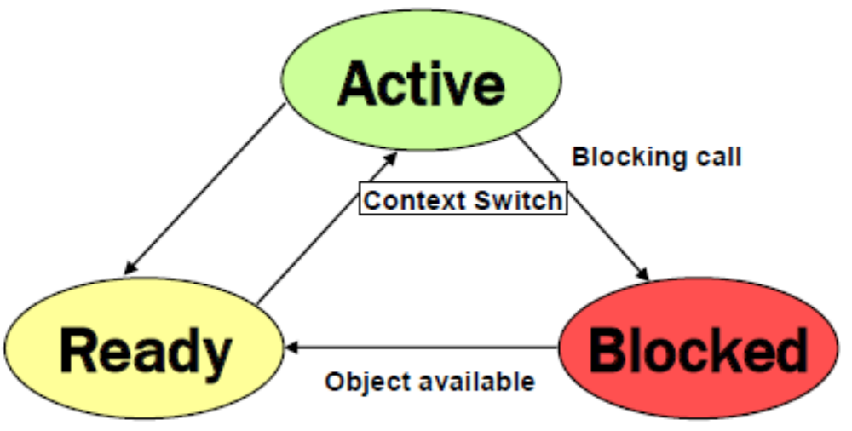
Task States
A task is in one of these logical states:
  Blocked: the task is blocked and is not ready, waiting for a condition to be true
  Active: the task is ready and is running because it is the highest-priority ready task
  Ready: the task is ready,
  but not running because
  it is not the highest-priority
  ready task
Higher-priority task ready
Time slice expires
Interrupt comes in

Slide 23
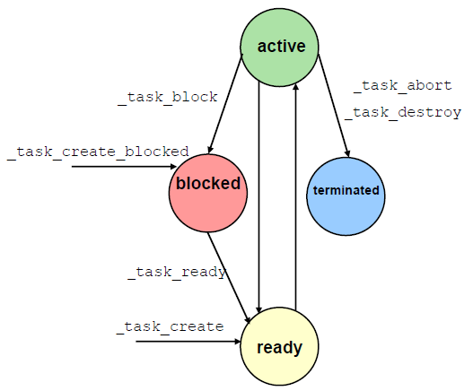
Task States
Tasks can be automatically created when MQX starts; also, any task can create another task by calling _task_create() or _task_create_blocked()
  _task_create() puts the new task in
  the ready state and the scheduler
  runs the highest priority task
  If _task_create_blocked is
  used, the task is not
  ready until _task_ready()
  is called
Notes:
Now that we’ve covered the concept of tasks in an RTOS, lets link it with specific MQX calls. Tasks can be created when MQX starts, and also by calling the task_create function.
The active task can be put into the blocked state if it calls task_block on itself. Another task can then call task_ready on the blocked task to put it back into the ready state. And the active task can also end itself or any other task by calling task_abort or task_destory.
There are many other ways that a task can enter or leave these states. However this diagram shows some of the explicit commands that can be used to manipulate the task states directly.

Slide 24
Steps for Creating a Task
Make the task prototype and index definition
Add the task in the Task Template List:
#define INIT_TASK 5
extern void init_task(uint_32);
TASK_TEMPLATE_STRUCT MQX_template_list[] =
{
{TASK_INDEX, TASK, STACK, TASK_PRIORITY, TASK_NAME,
TASK_ATTRIBUTES, CREATION_PARAMETER, TIME_SLICE}
}
TASK_TEMPLATE_STRUCT MQX_template_list[] =
{
{INIT_TASK, init_task, 1500, 9, "init",
MQX_AUTO_START_TASK, 0, 0},
}
Notes:
In the Task Template Structure:
TASK_INDEX is usually a Define with an index number (other than the priority) of each task
TASK refers to the function name; the documentation calls it task address pointer but when using the task name C takes the address of the function
STACK is the defines stack size.
TASK_PRIORITY; the lower number, the higher priority. Task with priority 0 disables all the interrupts and priorities 0 to 8 are used by the OS Kernel
TASK_NAME is a string that helps to identify the task. It is also used to get the task ID.
TASK_ATTRIBUTES. You can use more than one attribute for each task on the list. The allowed Task attributes are:
• Auto start — when MQX starts, it creates one instance of the task.
• DSP — MQX saves the DSP co-processor registers as part of the task’s context.
• Floating point — MQX saves floating-point registers as part of the task’s context.
• Time slice — MQX uses round robin scheduling for the task (the default is FIFO scheduling).
CREATION_PARAMETER is the parameter to be passed to the task when it is created.
TIME_SLICE. Time slice (in milliseconds usually) used for the task when using round-robin scheduling.

Slide 25
Steps for Creating a Task
Make the task definition
During execution time, create the task using
  (if it is not an autostart task)
void init_task(void)
{
/* Put the Task Code here */
}
task_create()
Notes:
In the Task Template Structure:
TASK_INDEX is usually a Define with an index number (other than the priority) of each task
TASK refers to the function name; the documentation calls it task address pointer but when using the task name C takes the address of the function
STACK is the defines stack size.
TASK_PRIORITY; the lower number, the higher priority. Task with priority 0 disables all the interrupts and priorities 0 to 8 are used by the OS Kernel
TASK_NAME is a string that helps to identify the task. It is also used to get the task ID.
TASK_ATTRIBUTES. You can use more than one attribute for each task on the list. The allowed Task attributes are:
• Auto start — when MQX starts, it creates one instance of the task.
• DSP — MQX saves the DSP co-processor registers as part of the task’s context.
• Floating point — MQX saves floating-point registers as part of the task’s context.
• Time slice — MQX uses round robin scheduling for the task (the default is FIFO scheduling).
CREATION_PARAMETER is the parameter to be passed to the task when it is created.
TIME_SLICE. Time slice (in milliseconds usually) used for the task when using round-robin scheduling.

Slide 26
Task Creation Example
{INIT_TASK, init_task, 1500, 11, "init", MQX_AUTO_START_TASK, 0, 0},
void init_task(void)
{
_task_create(0,TASK_A,0);
...
_task_ready(Task_B);
...
}
init_task is created when MQX starts
{TASK_A, Task_A, 1500, 10, “Task A", 0, 0, 0},
void Task_A(void)
{
...
_task_create_blocked(0,TASK_B,0);
...
_task_abort(TASK_A);
}
{TASK_B, Task_B, 1500, 9, “Task B", 0, 0, 0},
void Task_B(void)
{
...
_task_abort(TASK_B);
}
CPU Time
Notes:
Task flow example
Init_task starts first because of the MQX_AUTO_START_TASK configuration flag
It continues until it creates TaskA. Because Task A has a higher priority, it begins to run.
Inside Task A, it creates Task B, but puts it in a blocked state. Then Task A ends.
Control goes back to the init_task(). It continues until it makes Task B ready. Since Task B is a higher priority, it then begins to run. It goes until the task terminates itself.
Then control goes back once again to the init_task, until it also ends.

Slide 27
Outline
Introduction to MQX
Initializing and starting MQX
Managing tasks
Scheduling tasks

Slide 28
MQX Scheduling Policies
FIFO: (default policy)
  Active task is the highest-priority task that has been ready the longest
Round Robin:
  Active task is the highest-priority task that has been ready the longest without consuming its time slice
  The scheduler is explicitly called after a specified period of time, a time slice.
    Allows other tasks at same priority level to be active
    Tasks in an application may have combinations of FIFO and round-robin with different time slice values.
Explicit: using task queues
Notes:
How does MQX determine which of the ready tasks gets to become the active task? By using a scheduler.
There are several scheduling policies that MQX supports. The most commonly used is First In-First Out. This means the task that becomes active is the highest priority task that has been ready the longest. A task will continue running as long as it is the highest priority ready task.
The next scheduling policy is called Round Robin. This behaves exactly the same as First In-First Out, except that the scheduler is explicitly called after a specified period of time, called a time slice. This allows other tasks at the same priority level to gain control of the processor. The length of the time slice can be set on a per-task basis, so not all tasks necessarily have to use round-robin, nor have the same time slice value.
Finally there is a way to explicitly schedule the tasks using task queues in MQX, but it is not used very often and will not be covered here

Slide 29
Priority-Based FIFO Scheduling
priority
high
low
FIFO
list of
ready
tasks
Ready
CPU
Scheduler active
processor time
Notes:
This diagram shows First In-First Out scheduling. Each priority has a queue associated with it, representing tasks was placed into the ready state at that priority level. The schedule first looks at the highest priority ready queue, and runs that task. That task will run as long as it needs until the task finishes.
Once the green task is finished, the scheduler is called and it looks at the highest priority queue. That queue is now empty, so it moves down to the next highest priority queue. The red task then runs until it is finished. The scheduler is called again, and it takes the next ready task that has been waiting the longest, which is the blue task. This continues on with the yellow task and so on until all the ready queues are empty.

Slide 30
Priority-Based FIFO Scheduling
priority
high
low
FIFO
list of
ready
tasks
Ready
CPU
Scheduler active
processor time
Notes:
FIFO (also called priority-based preemptive) scheduling is a core component — the active task is the highest-priority task that has been ready the longest. FIFO is the default scheduling in Freescale MQX.
The active task runs, until any of the
following occurs:
-The active task voluntarily relinquishes the processor, because it calls a blocking MQX function.
-An interrupt occurs that has higher priority than the active task.
-A task that has priority higher than the active task, becomes ready.

Slide 31
Priority-Based FIFO Scheduling
priority
high
low
FIFO
list of
ready
tasks
Ready
CPU
Scheduler active
processor time
Notes:
FIFO (also called priority-based preemptive) scheduling is a core component — the active task is the highest-priority task that has been ready the longest. FIFO is the default scheduling in Freescale MQX.
The active task runs, until any of the
following occurs:
-The active task voluntarily relinquishes the processor, because it calls a blocking MQX function.
-An interrupt occurs that has higher priority than the active task.
-A task that has priority higher than the active task, becomes ready.

Slide 32
Round-Robin Scheduling
Task 1
75ms
Same Priority
Task 2
50ms
Time Slice = 50ms
Task 3
60ms
time
Ready
Task1
Task2
Task3
Task1
Task3
T0
50ms
100ms
150ms
200ms
time
Notes:
Round Robin scheduling works similarly. We have 3 tasks all with the same priority, but each take different amounts of time to finish executing their code.
Task1 runs first, but because the timeslice is set to 50ms, the scheduler is called before Task1 can finish. Task 2 then gets to run, and is able to finish in the 50ms time slice. Then task 3 becomes the active task (as it has been waiting the longest) and also runs for 50ms before being interrupted by the scheduler. Now task1 gets to run again until it completes its work, and then the scheduler is called one last time to let task3 become the active task until it also finishes its work.

Slide 33
Context Switching
A task A will stop running and call scheduler if:
  It calls a blocking function
  Its time slice expires (Round Robin)
  A higher priority task is made ready
  An interrupt occurs
Then:
  Context of Task A is stored
  Context of highest priority task in ready queue is restored
Task A is put at the end of ready or wait queue,
  If called a blocking function, is put in wait queue
  Else is put back in ready queue

Slide 34
Preemption
Preemption occurs when a higher-priority task becomes ready, and thus becomes active
  The previously active task is still ready, but is no longer the active task
Occurs when:
  An interrupt handler causes a higher-priority task to become ready
  Active task makes a higher-priority task ready

Slide 35
Idle Task
Lowest priority task
Simply increments a counter, which can be used to determine how long nothing is happening in the system
Optional
  MQX_USE_IDLE_TASK
  Located in mqx\source\kernel\idletask.c in the PSP project, under the kernel directory

Slide 36
Summary
MQX is a multi-threaded priority-based RTOS
  Provides task scheduling and management, interrupt handling, task synchronization, and more
MQX task structures in task template
Multiple tasks may be defined and created
Tasks have priorities and are scheduled with FIFO and round robin

