Slide 1
CS4101 嵌入式系統概論
Embedded C Programming
Prof. Chung-Ta King
Department of Computer Science
National Tsing Hua University, Taiwan
(Materials from Derrick Klotz of FreeScale and Prof. Stephen A. Edwards of Columbia University)

Slide 2
Outline
Operations in C
Variables and storages in C
Multithreading

Slide 3
Embedded vs Desktop Programming
Main characteristics of embedded programming environments:
  Cost sensitive
  Limited ROM, RAM, stack space
  Limited power
  Limited computing capability
  Event-driven by multiple events
  Real-time responses and controls
  → critical timing (interrupt service routines, tasks, …)
  Reliability
  Hardware-oriented programming

Slide 4
Embedded vs Desktop Programming
Successful embedded C programs must keep the code small and “tight”.
In order to write efficient C code, there has to be good knowledge about:
  Architecture characteristics
  Tools for programming/debugging
  Data types native support
  Standard libraries
  Difference between simple code vs. efficient code

Slide 5
Embedded Programming
Basically, optimize the use of resources:
  Execution time
  Memory
  Energy/power
  Development/maintenance time
Time-critical sections of program should run fast
  Processor and memory-sensitive instructions may be written in assembly
  Most of the codes are written in a high level language (HLL): C, C++, or Java

Slide 6
Use of an HLL
Short development cycle
  Can use modular building blocks for code reusability
  Can use standard library functions, e.g. delay( ), wait( ), sleep( )
Support for basic data types, control structures, conditions
Support for type checking:
  Type checking during compilation makes the program less prone to errors
  e.g. type checking on a char does not permit subtraction, multiplication, division

Slide 7
Arithmetic
Integer arithmetic
→ Fastest
Floating-point arithmetic in hardware
→ Slower
Floating-point arithmetic in software
→ Very slow
+,−
×
÷
sqrt, sin, log, etc.
slower

Slide 8
Arithmetic Lessons
Try to use integer addition/subtraction
Avoid multiplication unless you have hardware
Avoid division
Avoid floating-point, unless you have hardware
Really avoid math library functions

Slide 9
Bit Manipulation
C has many bit-manipulation operators:
& Bit-wise AND
| Bit-wise OR
^ Bit-wise XOR
~ Negate (one’s complement)
>> Right-shift
<< Left-shift
Plus assignment versions of each
Used often in embedded systems

Slide 10
Faking Multiplication
Addition, subtraction, and shifting are fast
  Can sometimes supplant multiplication
Like floating-point, not all processors have a dedicated hardware multiplier
Multiplication by addition and subtraction:
101011
× 1101
101011
10101100
+ 101011000
1000101111
= 43 + 43 << 2 + 43 << 3 = 559

Slide 11
Faking Multiplication
Even more clever if you include subtraction:
101011
× 1110
1010110
10101100
+ 101011000
1001011010
Only useful
  for multiplication by a constant
  for “simple” multiplicands
  when hardware multiplier not available
= 43 << 1 + 43 << 2 + 43 << 3
= 43 << 4 - 43 << 2
= 602

Slide 12
Faking Division
Division is a much more complicated algorithm that generally involves decisions
But, division by a power of two is just a shift:
  a / 2 = a >> 1
  a / 4 = a >> 2
No general shift-and-add replacement for division, but sometimes can use multiplication:
  a / 1.33333333
  = a * 0.75
  = a * 0.5 + a * 0.25
  = a >> 1 + a >> 2

Slide 13
Struct Bit Fields
Aggressively packs data to save memory
struct {
unsigned int baud : 5;
unsigned int div2 : 1;
unsigned int use_clock : 1;
} flags;
  Compiler will pack these fields into words
  Implementation-dependent packing, ordering, ...
  Usually not very efficient in terms of execution time: requires masking, shifting, read-modify-write
  → a tradeoff between space and time!

Slide 14
C Unions
Like structs, but shares the same storage space and only stores the most-recently-written field
  union {
  int ival;
  float fval;
  char *sval;
  } u;
  Useful for arrays of dissimilar objects to save space
  Potentially very dangerous: not type-safe
  Good example of C’s philosophy: provide powerful mechanisms that can be abused

Slide 15
Lazy Logical Operators
”Short circuit” tests save time
if (a == 3 && b == 4 && c == 5) { ... }
equivalent to
if (a == 3) { if (b ==4) { if (c == 5) { ... }
Strict left-to-right evaluation order provides safety
if ( i <= SIZE && a[i] == 0 ) { ... }

Slide 16
Multi-way branches
if (a == 1)
foo();
else if (a == 2)
bar();
else if (a == 3)
baz();
else if (a == 4)
qux();
else if (a == 5)
quux();
else if (a == 6)
corge();
switch (a) {
case 1:
foo(); break;
case 2:
bar(); break;
case 3:
baz(); break;
case 4:
qux(); break;
case 5:
quux(); break;
case 6:
corge(); break;
}
Which one is faster? Shorter?

Slide 17
Code for if-then-else
ldw r2, 0(fp) # Fetch a from stack
cmpnei r2, r2, 1 # Compare with 1
bne r2, zero, .L2 # not 1, jump to L2
call foo # Call foo()
br .L3 # branch out
.L2:
ldw r2, 0(fp) # a from stack again
cmpnei r2, r2, 2 # Compare with 2
bne r2, zero, .L4 # not 1, jump to L4
call bar # Call bar()
br .L3 # branch out
.L4:
...

Slide 18
Code for Switch (1/2)
ldw r2, 0(fp) # Fetch a
cmpgeui r2, r2, 7 # Compare with 7
bne r2, zero, .L2 # Branch if greater or equal
ldw r2, 0(fp) # Fetch a
muli r3, r2, 4 # Multiply by 4
movhi r2, %hiadj(.L9) # Load address .L9
addi r2, r2, %lo(.L9)
add r2, r3, r2 # = a * 4 + .L9
ldw r2, 0(r2) # Fetch from jump table
jmp r2 # Jump to label
.section .rodata
.align 2
.L9:
.long .L2 # Branch table
.long .L3
.long .L4
.long .L5
.long .L6
.long .L7
.long .L8

Slide 19
Code for Switch (2/2)
.section .text
.L3:
call foo
br .L2
.L4:
call bar
br .L2
.L5:
call baz
br .L2
.L6:
call qux
br .L2
.L7:
call quux
br .L2
.L8:
call corge
.L2:

Slide 20
Interesting Switch Code
Sparse labels tested sequentially
if (e == 1) goto L1;
else if (e == 10) goto L10;
else if (e == 100) goto L100;
Dense cases uses a jump table:
/* uses gcc extensions */
static void *table[] =
{&&L1, &&L2, &&Default, &&L4, &&L5};
if (e >= 1 && e <= 5) goto *table[e];

Slide 21
Computing Discrete Functions
There are many ways to compute a “random” function of one variable, especially for sparse domain:
if (a == 0) x = 0;
else if (a == 1) x = 4;
else if (a == 2) x = 7;
else if (a == 3) x = 2;
else if (a == 4) x = 8;
else if (a == 5) x = 9;

Slide 22
Computing Discrete Functions
Better for large, dense domains
  switch (a) {
  case 0: x = 0; break;
  case 1: x = 4; break;
  case 2: x = 7; break;
  case 3: x = 2; break;
  case 4: x = 8; break;
  case 5: x = 9; break;
  }
Best: constant time lookup table
  int f[] = {0, 4, 7, 2, 8, 9};
  x = f[a]; /* assumes 0 <= a <= 5 */

Slide 23
Strength Reduction
Why multiply when you can add?
struct {
int a;
char b;
int c;
} foo[10];
int i;
for(i=0; i<10; ++i){
foo[i].a = 77;
foo[i].b = 88;
foo[i].c = 99;
}
Good optimizing compilers do this automatically
struct {
int a;
char b;
int c;
} *fp, *fe, foo[10];
fe = foo + 10;
for (fp=foo; fp != fe; ++fp){
fp ->a = 77;
fp ->b = 88;
fp ->c = 99;
}

Slide 24
Function Calls
Modern processors, especially RISC, strive to make this cheap
  Arguments passed through registers
  Still has noticeable overhead in calling, entering, and returning:
int foo(int a, int b) {
int c = bar(b, a);
return c;
}

Slide 25
Code for foo() (Unoptimized)
foo:
addi sp, sp, -20 # Allocate stack
stw ra, 16(sp) # Store return address
stw fp, 12(sp) # Store frame pointer
mov fp, sp # Frame ptr is new SP
stw r4, 0(fp) # Save a on stack
stw r5, 4(fp) # Save b on stack
ldw r4, 4(fp) # Fetch b
ldw r5, 0(fp) # Fetch a
call bar # Call bar()
stw r2, 8(fp) # Store result in c
ldw r2, 8(fp) # Return value in r2=c
ldw ra, 16(sp) # Restore return address
ldw fp, 12(sp) # Restore frame pointer
addi sp, sp, 20 # Release stack space
ret # Return

Slide 26
Code for foo() (Optimized)
foo:
addi sp, sp, -4 # Allocate stack space
stw ra, 0(sp) # Store return address
mov r2, r4 # Swap arguments r4,r5
mov r4, r5 # using r2 as temporary
mov r5, r2
call bar # Call (return in r2)
ldw ra, 0(sp) # Restore return addr
addi sp, sp, 4 # Release stack space
ret

Slide 27
Macro
A named collection of codes
  A function is compiled only once. On calling that function, the processor has to save the context, and on return restore the context
  Preprocessor puts macro code at every place where the macro-name appears. The compiler compiles the codes at every place where they appear.
Function versus macro:
  Time: use function when T_{overheads} << T_{exec}, and macro when T_{overheads} ~= or > T_{exec}, where T_{overheads} is function overheads (context saving and return) and T_{exec} is execution time of codes within a function
  Space: similar argument

Slide 28
Features in Increasing Cost
1. Integer arithmetic
2. Pointer access
3. Simple conditionals and loops
4. Static and automatic variable access
5. Array access
6. Floating-point with hardware support
7. Switch statements
8. Function calls
9. Floating-point emulation in software
10. Malloc() and free()
11. Library functions (sin, log, printf, etc.)
12. Operating system calls (open, sbrk, etc.)

Slide 29
Variables
The type of a variable determines what kinds of values it may take on
The greatest savings in code size and execution time can be made by choosing the most appropriate data type for variables, e.g.,
  Natural data size for an 8-bit MCU is an 8-bit variable
  While C preferred data type is ‘int’, in 16-bit and 32-bit architectures, there are needs to address either 8- or 16-bits data efficiently
  Double precision and floating point should be avoided wherever efficiency is important

Slide 30
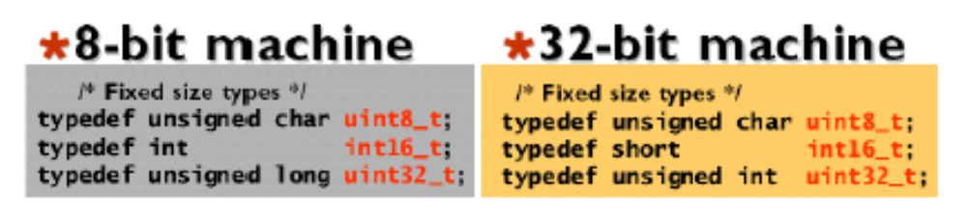
Data Type Selection
Mind the architecture
  Same C source code could be efficient or inefficient
  Should keep in mind the architecture’s typical instruction size and choose the appropriate data type accordingly
3 rules for data type selection:
  Use the smallest possible type to get the job done
  Use unsigned type if possible
  Use casts within expressions to reduce data types to the minimum required
Use typedefs to get fixed size
  Change according to compiler and system
  Code is invariant across machines

Slide 31
Storage Classes in C
/* fixed address: visible to other files */
int global_static;
/* fixed address: visible within file */
static int file_static;
/* parameters always stacked */
int foo(int auto_param) {
/* fixed address: only visible to func */
static int func_static;
/* stacked: only visible to function */
int auto_i, auto_a[10];
/* array explicitly allocated on heap */
double *auto_d=malloc(sizeof(double)*5);
/* return value in register or stacked */
return auto_i;
}

Slide 32
Static Variables
When applied to variables, “static” means:
  A variable declared static within body of a function maintains its value between function invocations
  A variable declared static within a module, but outside the body of a function, is accessible by all functions within that module
For embedded systems:
  Encapsulation of persistent data
  Modular coding (data hiding)
  Hiding of internal processing in each module
Note that static variables are stored globally, and not on the stack

Slide 33
Volatile Variables
A volatile variable is one whose value may be change outside the normal program flow
In embedded systems, there are two ways this can happen:
  Via an interrupt service routine
  As a consequence of hardware action
It is considered to be very good practice to declare all peripheral registers in embedded devices as volatile
Volatile variables are never optimized

Slide 34
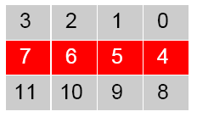
Layout of Storage
Modern processors have byte-addressable memory
  But, many data types (integers, addresses, floating-point) are wider than a byte
Modern memory systems read data in 32-, 64-, or 128-bit chunks
  Reading an aligned 32-bit value is fast: a single operation

Slide 35
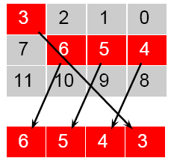
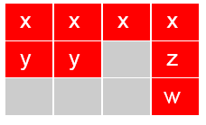

Layout of Storage
Slower to read unaligned
value: 2 reads plus shift
Most languages “pad”
layout of records for
alignment restrictions
struct padded {
int x; /* 4 bytes */
char z; /* 1 byte */
short y; /* 2 bytes */
char w; /* 1 byte */
};

Slide 36
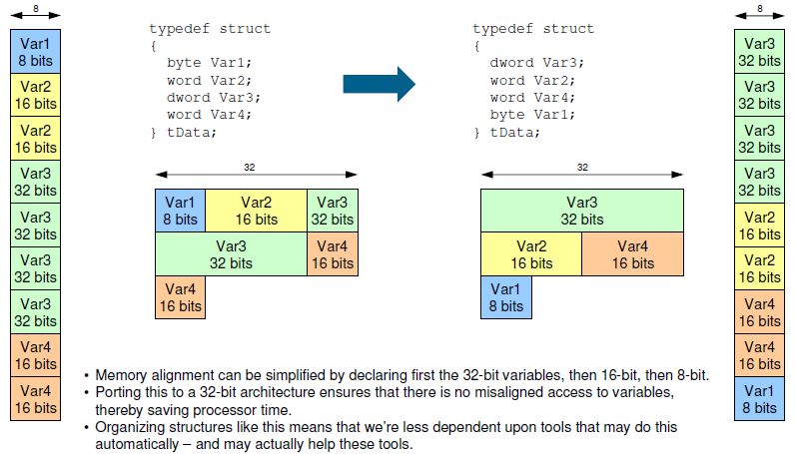
Memory Alignment
Memory alignment can be simplified by declaring first 32-bit variables, then 16-bit, then 8-bit.
Porting this to a 32-bit architecture ensures that there is no misaligned access to variables, thereby saving processor time.
Organizing structures like this means that we are less dependent upon tools that may do this automatically – and may actually help these tools.

Slide 37
malloc() and free()
Flexible than (stacked) automatic variables
More costly in time and space
Use non-constant-time algorithms
Two-word overhead for each allocated block:
  Pointer to next empty block
  Size of this block
Common source of errors:
  Using uninitialized memory Using freed memory
  Not allocating enough Indexing past block
  Neglecting to free disused blocks (memory leaks)
Good or bad for embedded applications?

Slide 38
malloc() and free() Variants
Memory pools: differently-managed heap areas
Stack-based pool: only free whole pool at once
  Nice for build-once data structures
Single-size-object pool:
  Fit, allocation, etc. much faster
  Good for object-oriented programs

Slide 39
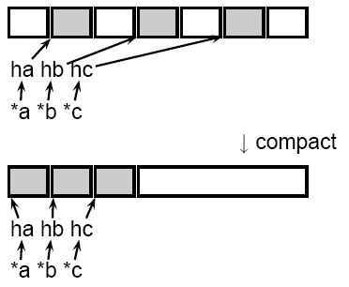
Fragmentation and Handles
Standard CS solution: add another layer of indirection
  Always reference memory through “handles”

Slide 40
Storage Classes Compared
On most processors, access to automatic (stacked) data and globals is equally fast
  Automatic usually preferable since the memory is reused when function terminates
  Danger of exhausting stack space with recursive algorithms. Not used in most embedded systems.
The heap (malloc) should be avoided if possible:
  Allocation/deallocation is unpredictably slow
  Danger of exhausting memory
  Danger of fragmentation
  Best used sparingly in embedded systems

Slide 41
Memory-Mapped I/O
“Magical” memory locations that, when written or read, send or receive data from hardware
Hardware that looks like memory to the processor, i.e., addressable, bidirectional data transfer, read and write operations.
Does not always behave like memory:
  Act of reading or writing can be a trigger (data irrelevant)
  Often read- or write-only
  Read data often different than last written
  Latency of operations

Slide 42
Thread/Task Safety
Since every thread/task has access to virtually all the memory of every other thread/task, flow of control and sequence of accesses to data often do not match what would be expected by looking at the program
Need to establish the correspondence between the actual flow of control and the program text
  To make the collective behavior of threads/tasks deterministic or at least more disciplined

Slide 43
Races: Two Simultaneous Writes
Thread 1 Thread 2
count = 3 count = 2
At the end, does count contain 2 or 3?

Slide 44
Races: A Read and a Write
Thread 1 Thread 2
if (count == 2) count = 2
return TRUE;
else
return FALSE;
If count was 3 before these run, does Thread 1 return TRUE or FALSE?

Slide 45
Read-modify-write: Even Worse
Consider two threads trying to execute count += 1 and count += 2 simultaneously
Thread 1 Thread 2
tmp1 = count tmp2 = count
tmp1 = tmp1 + 1 tmp2 = tmp2 + 2
count = tmp1 count = tmp2
If count is initially 1, what outcomes are possible?
Must consider all possible interleaving

Slide 46
Interleaving 1
Thread 1 Thread 2
tmp1 = count (=1)
tmp2 = count (=1)
tmp2 = tmp2 + 2 (=3)
count = tmp2 (=3)
tmp1 = tmp1 + 1 (=2)
count = tmp1 (=2)

Slide 47
Interleaving 2
Thread 1 Thread 2
tmp2 = count (=1)
tmp1 = count (=1)
tmp1 = tmp1 + 1 (=2)
count = tmp1 (=2)
tmp2 = tmp2 + 2 (=3)
count = tmp2 (=3)

Slide 48
Interleaving 3
Thread 1 Thread 2
tmp1 = count (=1)
tmp1 = tmp1 + 1 (=2)
count = tmp1 (=2)
tmp2 = count (=2)
tmp2 = tmp2 + 2 (=4)
count = tmp2 (=4)

Slide 49
Thread Safety
A piece of code is thread-safe if it functions correctly during simultaneous execution by multiple threads
  Must satisfy the need for multiple threads to access the same shared data
  Must satisfy the need for a shared piece of data to be accessed by only one thread at any given time
Potential thread unsafe code:
  Accessing global variables or the heap
  Allocating/freeing resources that have global limits (files, sub-processes, etc.)
  Indirect accesses through handles or pointers

Slide 50
Achieving Thread Safety
Re-entrance:
  A piece of code that can be interrupted, reentered under another task, and then resumed on its original task
  Usually precludes saving of state information, such as by using static or global variables
  A subroutine is reentrant if it only uses variables from the stack, depends only on the arguments passed in, and only calls other subroutines with similar properties
  → a "pure function"

Slide 51
Achieving Thread Safety
Mutual exclusion:
  Access to shared data is serialized by ensuring only one thread is accessing the shared data at any time
  Need to care about race conditions, deadlocks, livelocks, starvation, etc.
Thread-local storage:
  Variables are localized so that each thread has its own private copy

Slide 52
Achieving Thread Safety
Atomic operations:
  Operations that cannot be interrupted by other threads
  Usually requires special machine instructions
  Since the operations are atomic, the protected shared data are always kept in a valid state, no matter what order that the threads access it
Manual pages usually indicate whether a function is thread-safe

Slide 53
Critical Section
For ensuring only one task/thread accessing a particular resource at a time
  Make sections of code involving the resource as critical sections
    The first thread to reach the critical section enters and executes its section of code
    The thread prevents all other threads from their critical sections for the same resource, even after it is context-switched!
    Once the thread finished, another thread is allowed to enter a critical section for the resource
This mechanism is called mutual exclusion

Slide 54
Mutex Strategy
Lock strategy may affect the performance
Each mutex lock and unlock takes a small amount of time
  If the function is frequently called, the overhead may take more CPU time than the tasks in critical section

Slide 55
Lock Strategy A
Put mutex outside the loop
  If plenty of code involving the shared data
  If execution time in critical section is short
thread_function()
{
pthread_mutex_lock();
while(condition is true) {
access shared_data;
//code strongly associated with shared data
//or the execution time in loop is short
}
pthread_mutex_unlock();
}

Slide 56
Lock Strategy B
Put mutex in loop
  If code loop too “fat”
  If code involving shared variable too few
thread_function()
{
while(condition is true) {
tasks that does not involve the shared data
pthread_mutex_lock();
access shared_data;
pthread_mutex_unlock();
}
}

