Slide 1
Interactive CPU-based Ray Tracing
Nathan Slobody & Adam Wright
CMU 15-618
Parallel Computer Architecture & Programming

Slide 2
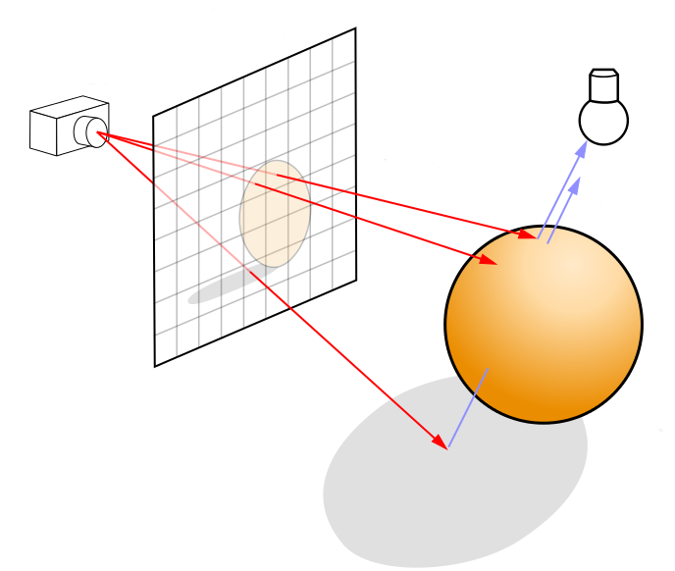
Background: Ray Tracing
Compute the color of every pixel on the screen
Trace rays from viewer's eye to light sources
Bounce off objects as you go
Image credit: Wikipedia

Slide 3
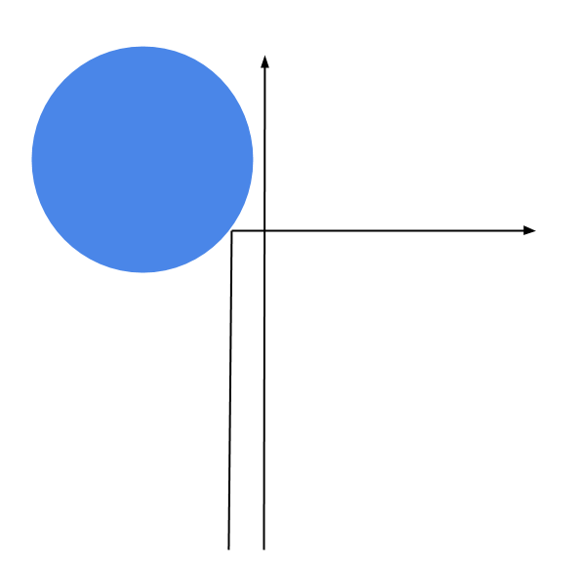
Implementation & Complexity
Computationally expensive search problem
Data parallel, but divergent
  def trace_pixel(ray):
    for all pixels:
      for all objects:
        find closest hit
      for all lights:
        for all objects:
          compute light contribution
      trace_pixel(reflected)
      trace_pixel(refracted)

Slide 4
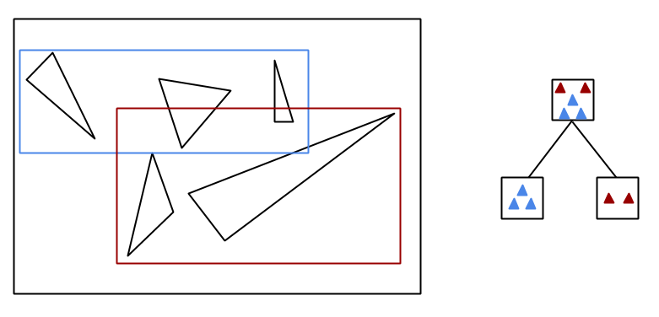
Approach
Bounding Volume Hierarchy
  Build a tree around triangles
  Surface Area Heuristic
  Build once for static scene

Slide 5
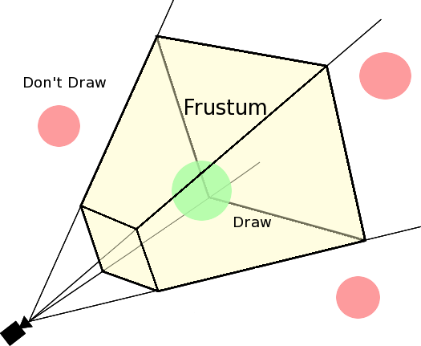
Approach
Packets
  Trace multiple rays together
  Frustum intersections
  Threads process one packet at a time
Image credit: http://blog.jaxgl.com/

Slide 6
Results & Demo
Basic interactivity
Stanford Happy Buddha
  1.1 million triangles
  ~1 million primary rays/sec
  0.5 seconds per frame at 800x600

Slide 7
Next Steps
Re-order data structures to take advantage of SIMD
  Array of Structures → Structure of Arrays
8-ary BVH tree
  For SIMD intersection tests

