Slide 1
Review of Linear Algebra
1/31/20 Recitation
Yuhan Liu

Slide 2
In this review
Recall concepts we’ll need in this class
Geometric intuition for linear algebra
Outline:
  Matrices and vectors
  Vector spaces
  Eigenvalues & eigenvectors

Slide 3
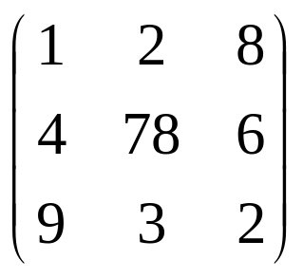


Basic concepts
m-by-n matrix is an object with m rows and n columns, each entry fill with a real number:
Vector in R^{n} is an ordered set of n real numbers.
  e.g. v = (1,6,3,4) is in R⁴
  “(1,6,3,4)” is a column vector:
  as opposed to a row vector:

Slide 4
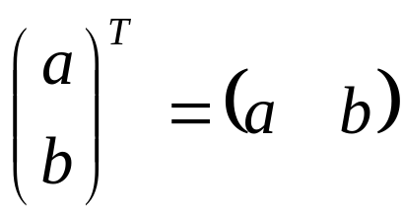
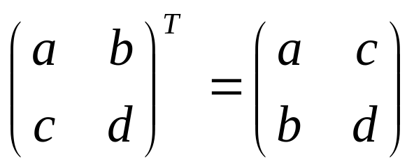
Basic concepts
Transpose: reflect vector/matrix on line:
  Note: (Ax)^{T}=x^{T}A^{T} (We’ll define multiplication soon…)
Vector norms:
  L_{p} norm of v = (v₁,…,v_{k}) is (Σ_{i} |v_{i}|^{p})^{1/p}
  Common norms: L₁, L₂
  L_{infinity} = max_{i} |v_{i}|
Length of a vector v is L₂(v)

Slide 5
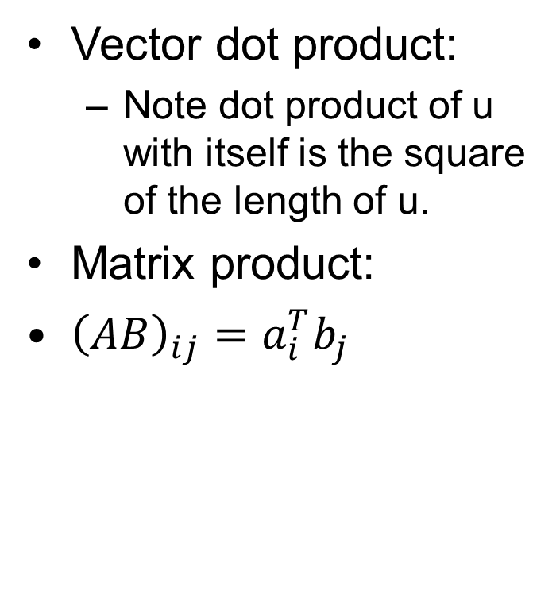
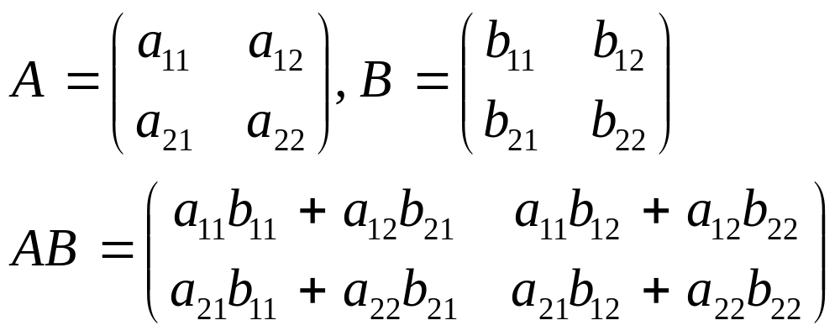
Basic concepts

Slide 6
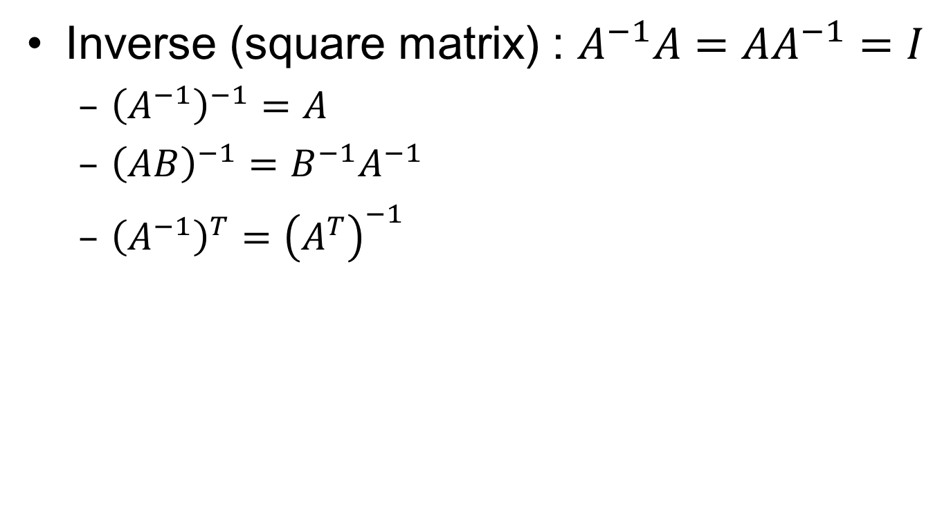
Matrix Operations

Slide 7
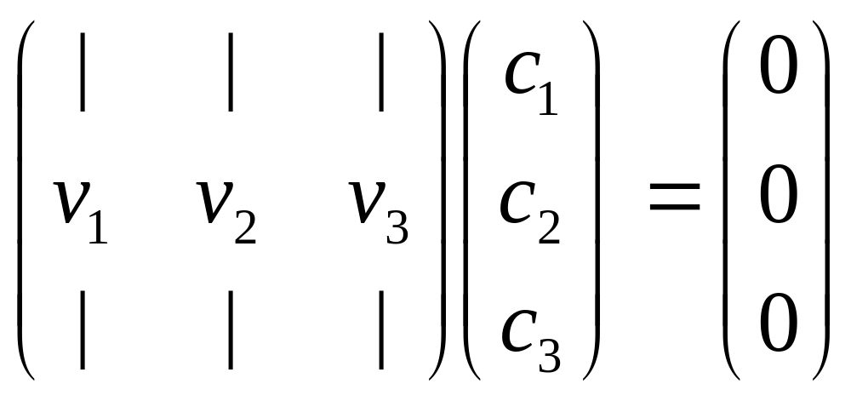
Matrix as a set of vectors
(2,2)
(0,1)
(1,1)
(1,0)

Slide 8
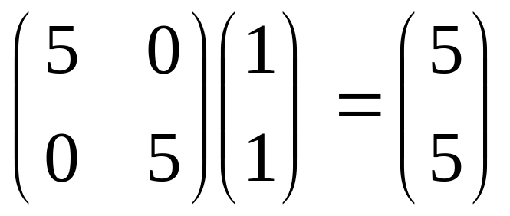
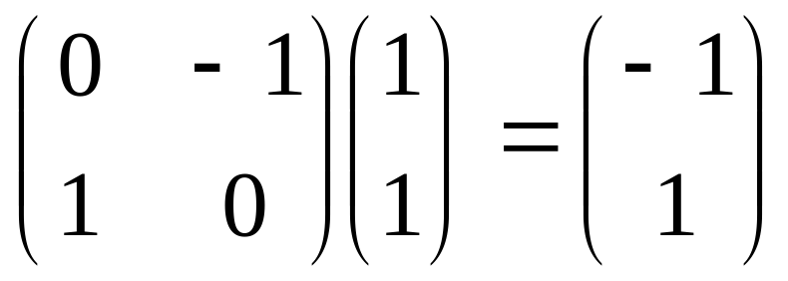
Matrices as linear transformations
(stretching)
(rotation)

Slide 9
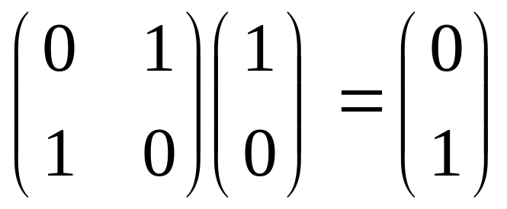
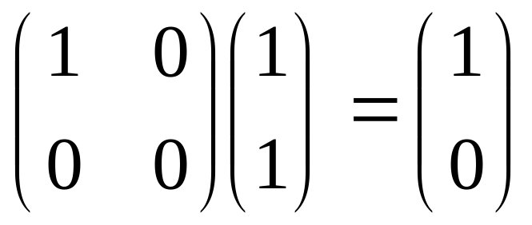
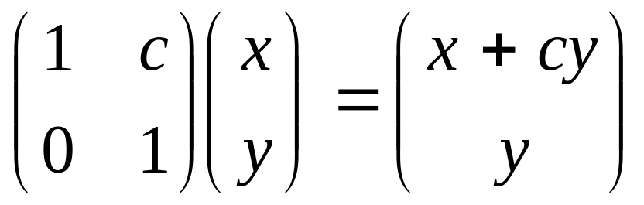
Matrices as linear transformations
(reflection)
(projection)
(shearing)

Slide 10
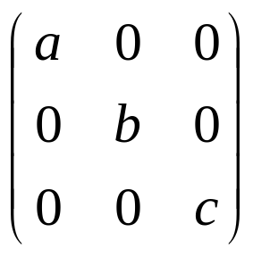
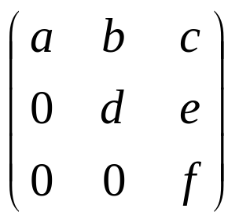
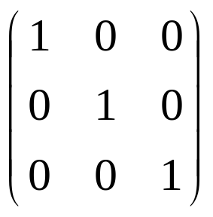
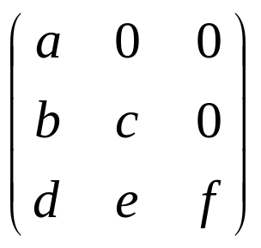
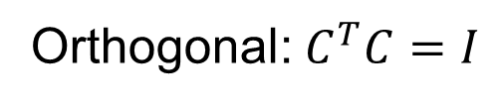
Special matrices
diagonal
upper-triangular
I (identity matrix)
lower-triangular

Slide 11
Special matrices
Matrix A is symmetric if A = A^{T}
A is positive definite if x^{T}Ax>0 for all non-zero x (positive semi-definite if inequality is not strict)
Useful fact: Any matrix of form A^{T}A is positive semi-definite.
To see this, x^{T}(A^{T}A)x = (x^{T}A^{T})(Ax) = (Ax)^{T}(Ax) ≥ 0

Slide 12
Vector spaces
Formally, a vector space is a set of vectors which is closed under addition and multiplication by real numbers.
A subspace is a subset of a vector space which is a vector space itself, e.g. the plane z=0 is a subspace of R³ (It is essentially R².).
We’ll be looking at R^{n} and subspaces of R^{n}
Our notion of planes in R³ may be extended to hyperplanes in R^{n} (of dimension n-1)
Note: subspaces must include the origin (zero vector) Why?.

Slide 13
Orthogonality
Two vectors are orthogonal if their dot product is 0
A vector is orthogonal to a subspace if the vector is orthogonal to all vectors in the subspace

Slide 14
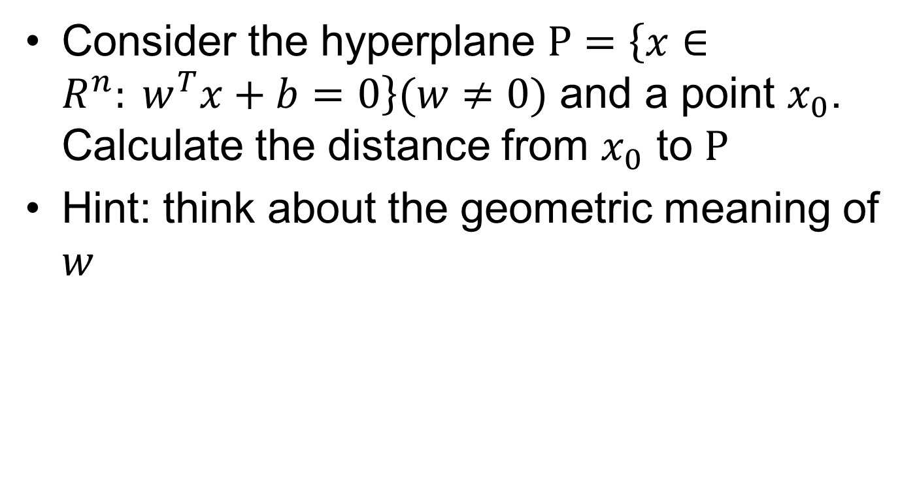
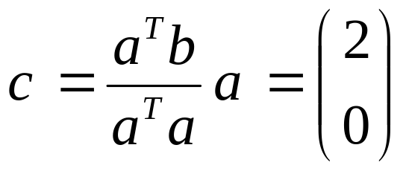
Exercise:
b = (2,2)
a = (1,0)

Slide 15
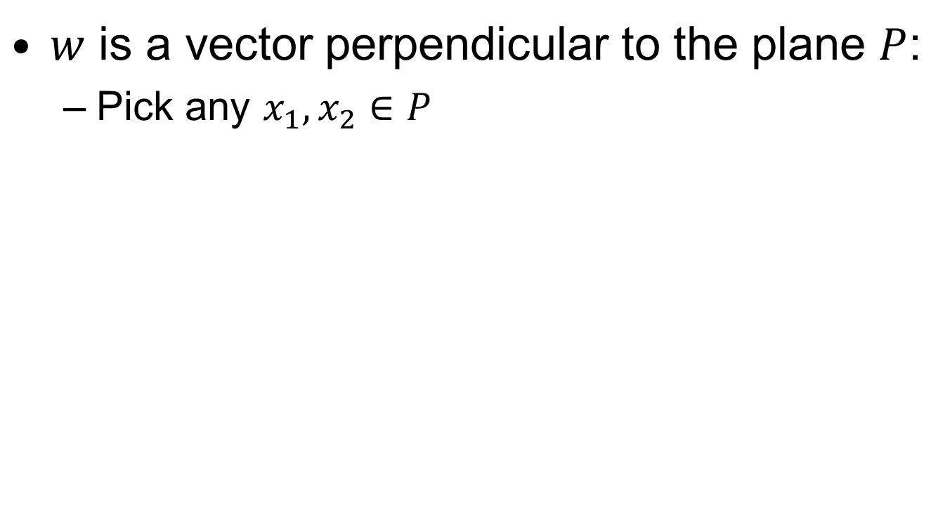
Answer

Slide 16
Linear independence and basis
Vectors v₁,…,v_{k} are linearly independent if c₁v₁+…+c_{k}v_{k} = 0 implies c₁=…=c_{k}=0
(2,2)
(0,1)
(1,1)
(1,0)

Slide 17
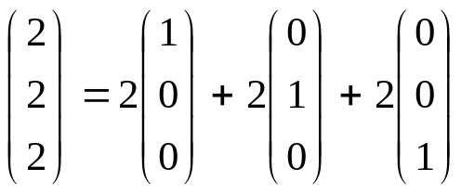
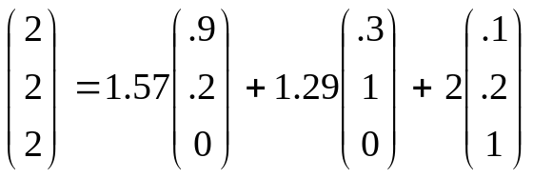
Linear independence and basis
If all vectors in a vector space may be expressed as linear combinations of v₁,…,v_{k}, then v₁,…,v_{k} span the space, or equivalently, the space is generated by v₁,…,v_{k}
(0,0,1)
(.1,.2,1)
(0,1,0)
(.3,1,0)
(1,0,0)
(.9,.2,0)

Slide 18
Linear independence and basis
A basis is a set of linearly independent vectors which span the space.
The dimension of a space is the # of “degrees of freedom” of the space; it is the number of vectors in any basis for the space.
A basis is a maximal set of linearly independent vectors and a minimal set of spanning vectors.
(0,0,1)
(.1,.2,1)
(0,1,0)
(.3,1,0)
(1,0,0)
(.9,.2,0)

Slide 19
Linear independence and basis
Two vectors are orthogonal if their dot product is 0.
An orthogonal basis consists of orthogonal vectors.
An orthonormal basis consists of orthogonal vectors of unit length.
(0,0,1)
(.1,.2,1)
(0,1,0)
(.3,1,0)
(1,0,0)
(.9,.2,0)

Slide 20
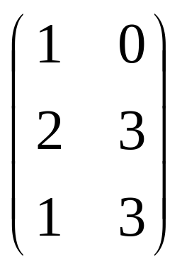
About subspaces
The rank of A is the dimension of the column space of A.
  Column space: a vector space generated by the column vectors of A
It also equals the dimension of the row space of A
(1,3) = (2,3) – (1,0)
Only 2 linearly independent rows, so rank = 2.

Slide 21
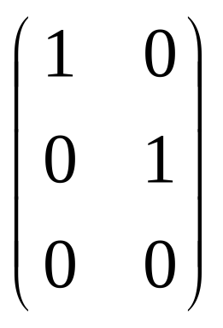
About subspaces
Fundamental Theorem of Linear Algebra:
If A is m x n with rank r,
  Column space(A) has dimension r
  Nullspace(A) has dimension n-r (= nullity of A)
  Row space(A) = Column space(A^{T}) has dimension r
  Left nullspace(A) = Nullspace(A^{T}) has dimension m - r
Rank-Nullity Theorem: rank + nullity = n
(0,0,1)
m = 3
n = 2
r = 2
(0,1,0)
(1,0,0)

Slide 22
Eigenvalues & eigenvectors
How can we characterize matrices?
The solutions to Ax = λx in the form of eigenpairs (λ,x) = (eigenvalue,eigenvector) where x is non-zero
To solve this, (A – λI)x = 0
λ is an eigenvalue iff det(A – λI) = 0

Slide 23
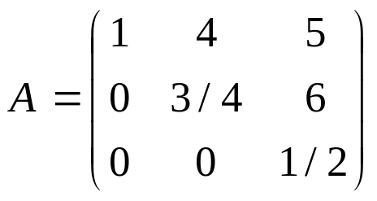
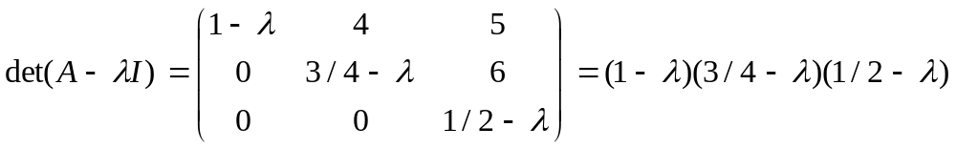

Eigenvalues & eigenvectors
(A – λI)x = 0
λ is an eigenvalue iff det(A – λI) = 0
Example:

Slide 24
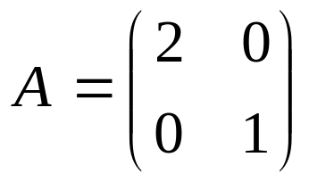
Eigenvalues & eigenvectors
Eigenvalues λ = 2, 1 with eigenvectors (1,0), (0,1)
Eigenvectors of a linear transformation A are not rotated (but will be scaled by the corresponding eigenvalue) when A is applied.
(0,1)
Av
v
(1,0)
(2,0)

Slide 25
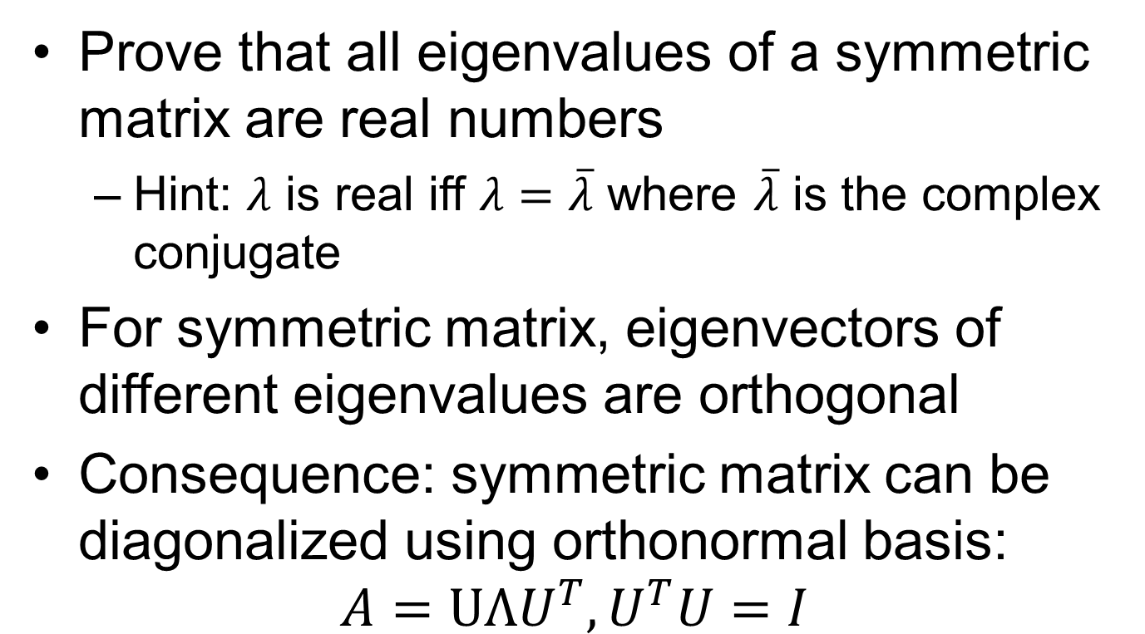
Exersises

Slide 26
Reference
Credit to:
http://www.cs.cmu.edu/~guestrin/Class/10725/recitations/r1/Review_of_Linear_Algebra.ppt
l2r.cs.uiuc.edu/~danr/Teaching/CS546-13/Lectures/Opt.pptx
mpawankumar.info/teaching/cdt-optimization/lecture1_2.pptx
Resources:
cs229.stanford.edu/section/cs229-linalg.pdf
http://ee364a.stanford.edu/lectures/functions.pdf

