Slide 1
GENERAL CHEMISTRY
5
States of Matter
Gases, Liquids and Solids
General, Organic, and Biochemistry
9th Edition
Katherine J. Denniston
Joseph J. Topping
Danaè R. Quirk Dorr
Robert L. Caret
Copyright © 2017 McGraw-Hill Education. Permission required for reproduction or display

Slide 2
Changes in State
Changes in state are considered to be physical changes
During a change of physical state, many other physical properties may also change
This chapter focuses on the important differences in physical properties among
  Gases
  Liquids
  Solids

Slide 3
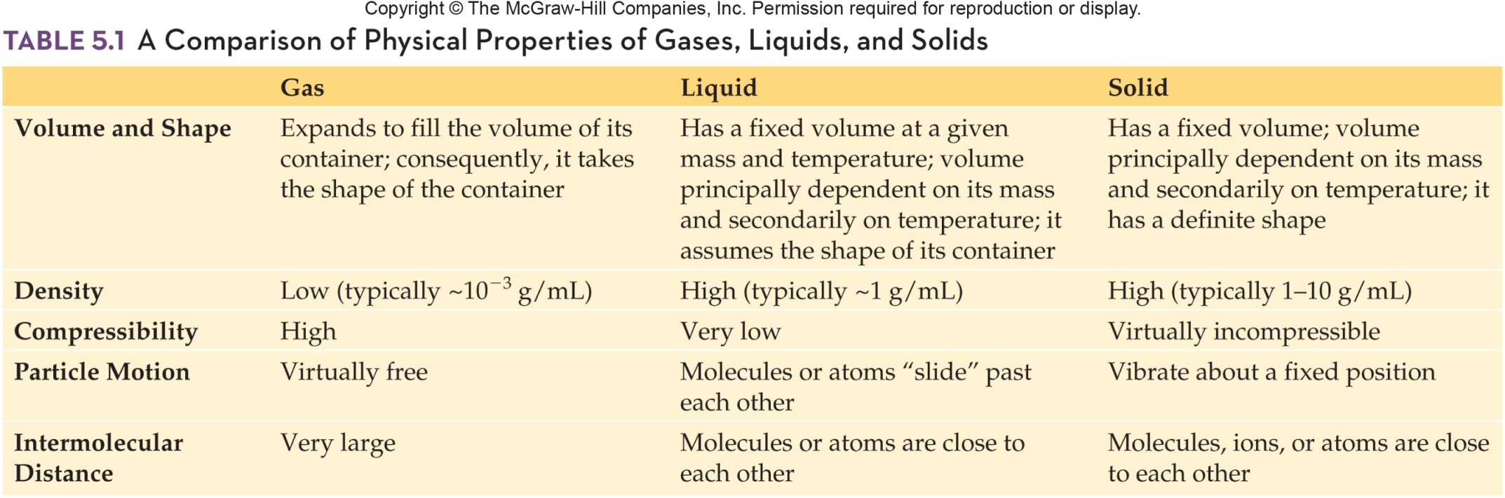
Comparison of Physical Properties of Gases, Liquids, and Solids

Slide 4
5.1 The Gaseous State
Ideal Gas Concept
Ideal gas - a model of the way that gas particles behave at the atomic/molecular level
We can measure the following of a gas:
  temperature
  volume
  pressure
  mass
We can systematically change one of the properties and see the effect on the others

Slide 5
Measurement of Gases
Gas laws involve the relationship between:
  number of moles (n) of gas
  volume (V)
  temperature (T)
  pressure (P)
Pressure - force per unit area
Gas pressure is a result of force exerted by the collision of particles with the walls of the container
5.1 The Gaseous State

Slide 6
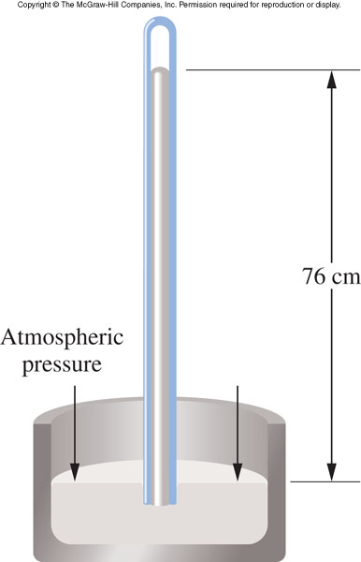
Barometer
Measures atmospheric pressure
  Invented by Evangelista Torricelli
Common units of pressure
  atmosphere (atm)
  torr (in Torricelli’s honor)
  pascal (Pa) (in honor of Blaise Pascal)
1 atm is equal to:
  760 mmHg
  760 torr
  76.0 cmHg
5.1 The Gaseous State
1

Slide 7
Kinetic Molecular Theory of Gases
2
Gases are made up of small atoms or molecules that are in constant, random, and linear motion
The distance of separation is very large compared to the size of the individual atoms or molecules
  Gas is mostly empty space
All gas particles behave independently
  No attractive or repulsive forces exist between them
5.1 The Gaseous State

Slide 8
Kinetic Molecular Theory – pt 4
Gas particles collide with each other and with the walls of the container without losing energy
  The energy is transferred from one atom or molecule to another
  These collisions cause random changes
  in direction
5.1 The Gaseous State

Slide 9
Kinetic Molecular Theory – pt 5
The average kinetic energy of the atoms or molecules increases or decreases in proportion to absolute temperature
  As temperature increases, particle speed (kinetic energy) also increases
5.1 The Gaseous State

Slide 10
Properties of Gases
3
Gases are easily compressible
  Gas is mostly empty space, and particles can be pushed together
Gases will expand to fill any available volume
  They move freely with sufficient energy to overcome attractive forces
Gases readily diffuse through each other as they are in continuous motion and paths are readily available
  Due to large space between adjacent particles
5.1 The Gaseous State

Slide 11
Gases have low density
  They are mostly empty space, gases have low mass per unit volume
Gases exert pressure on their containers
  This pressure results from the collisions of gas particles with the walls of their container
Gases behave most ideally at low pressure and high temperature:
  At low pressure the average distance of separation is greatest, which minimizes interactive forces
  At high temperature, rapid motion overcomes interactive forces more easily
5.1 The Gaseous State

Slide 12
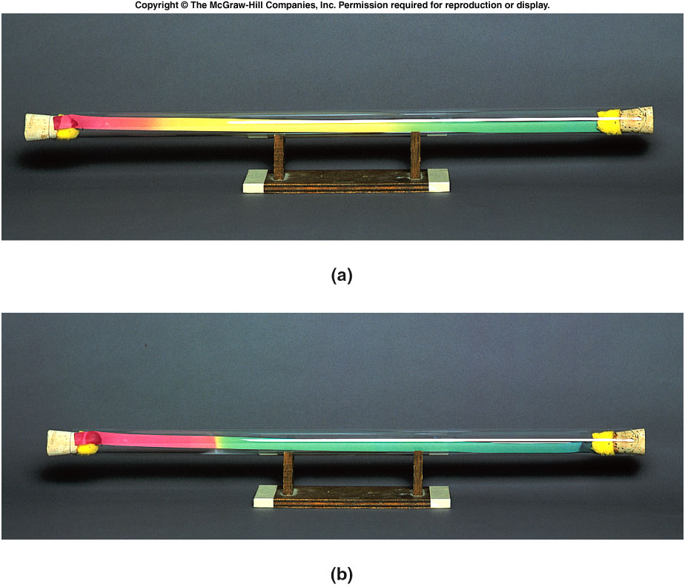
Gaseous Diffusion
Top:
Start of expt
5.1 The Gaseous State
Hydrogen chloride (36.5g/mol)
Ammonia (17.0g/mol)
Bottom:
End of expt
Ammonia diffused farther in same time; lighter moves faster.

Slide 13
Boyle’s Law
4
Boyle’s law - volume of a gas varies inversely with the pressure exerted by the gas if the temperature and number of moles are held constant
The product of pressure (P) and volume (V) is a constant (k_{b}):
5.1 The Gaseous State
PV = k_{b}

Slide 14
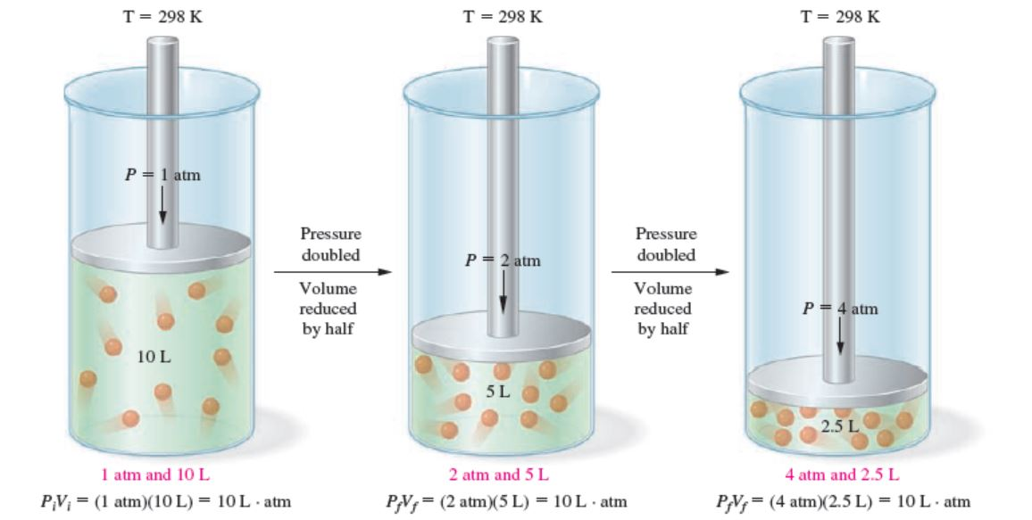
Boyle’s Law Equation
Used to calculate:
  Volume resulting from pressure change
  Pressure resulting from volume change
5
P_{i}V_{i} = P_{f}V_{f}
5.1 The Gaseous State
Copyright © 2017 McGraw-Hill Education. Permission required for reproduction or display

Slide 15
Application of Boyle’s Law
5
A gas occupies 10.0 L at 1.00 atm pressure.
If I doubled, the pressure to 2.0 atm, it would cause the volume to become:
5.1 The Gaseous State
P_{i}V_{i} = P_{f}V_{f}
(10.0 L) (1.00 atm) = (2.0 atm) V_{f}
5.0 L = V_{f}
The volume would decrease to 5.0 L.

Slide 16
Boyle’s Law Practice
A 5.0 L sample of a gas at 25ºC and 3.0 atm is compressed at constant temperature to a volume of 1.0 L. What is the new pressure?
A 3.5 L sample of a gas at 1.0 atm is expanded at constant temperature until the pressure is 0.10 atm. What is the volume of the gas?
5.1 The Gaseous State

Slide 17
Charles’s Law
4
Charles’s law - volume of a gas varies directly with the absolute temperature (K) if pressure and number of moles of gas are constant
Ratio of volume (V) and temperature (T) is a constant (k_{c}).
5.1 The Gaseous State
V
T
= k_{c}

Slide 18
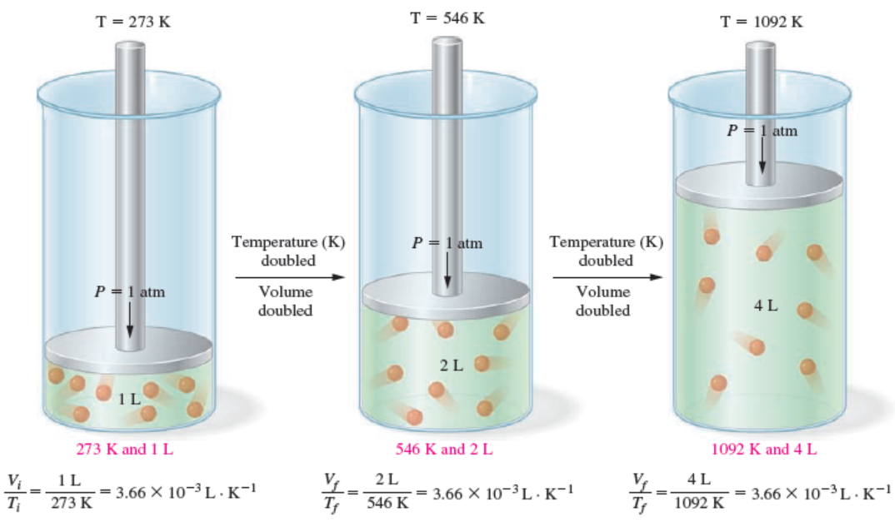
Charles’s Law Equation
V_{i}
T_{i}
V_{f}
T_{f}
4
=
5.1 The Gaseous State
Copyright © 2017 McGraw-Hill Education. Permission required for reproduction or display

Slide 19
Application of Charles’s Law
A gas occupies 10.0 L at 273 K.
If I doubled the temperature to 546 K, it would cause the volume to become:
5
5.1 The Gaseous State
V_{i}
T_{i}
V_{f}
T_{f}
10.0 L
273 K
V_{f}
546 K
=
=
20.0 L = V_{f}
The volume would increase to 20.0 L.

Slide 20
Practice with Charles’s Law
A 2.5 L sample of gas at 25ºC is heated to 50ºC at constant pressure. Will the volume double?
What would be the volume?
What temperature would be required to double the volume?
5.1 The Gaseous State

Slide 21
Combined Gas Law
4
If a sample of gas undergoes change involving volume, pressure, and temperature simultaneously, use the combined gas law
Derived from a combination of Boyle’s law and Charles’s law
5.1 The Gaseous State
P_{i}V_{i}
T_{i}
P_{f}V_{f}
T_{f}
=

Slide 22
Using the Combined Gas Law
5
Calculate the volume of N₂ resulting when 0.100 L of the gas is heated from 300. K to 350. K at 1.00 atm.
Summarize the data:
5.1 The Gaseous State
P_{i}V_{i}
T_{i}
P_{f}V_{f}
T_{f}
=
P_{i} = 1.00 atm P_{f} = 1.00 atm
V_{i} = 0.100 L V_{f} = ? L
T_{i} = 300. K T_{f} = 350. K

Slide 23
Using the Combined Gas Law – continued
Calculate the volume of N₂ resulting when 0.100 L of the gas is heated from 300. K to 350. K at 1.00 atm.
5.1 The Gaseous State
P_{i}V_{i}
T_{i}
P_{f}V_{f}
T_{f}
=
(1.00 atm) (0.100 L)
300. K
(1.00 atm) V_{f}
350. K
=
0.117 L = V_{f}

Slide 24
Practice With the Combined
Gas Law
Calculate the temperature when a 0.50 L sample of gas at 1.0 atm and 25ºC is compressed to 0.05 L of gas at 5.0 atm.
5.1 The Gaseous State

Slide 25
Avogadro’s Law
4
Avogadro’s Law - equal volumes of any ideal gas contain the same number of moles if measured under the same conditions of temperature and pressure
Changes in conditions can be calculated by rewriting the equation
5.1 The Gaseous State
V
n
= k_{a}
V_{i}
n_{i}
V_{f}
n_{f}
=

Slide 26
Using Avogadro’s Law
5
If 5.50 mol of CO occupy 20.6 L, how many liters will 16.5 mol of CO occupy at the same temperature and pressure?
5.1 The Gaseous State
V_{i}
n_{i}
V_{f}
n_{f}
20.6 L
5.50 mol
V_{f}
16.5 mol
=
=
61.8 L = V_{f}
The volume would increase to 61.8 L

Slide 27
Molar Volume of a Gas
6
Molar volume - the volume occupied by 1 mol of any gas at standard temperature and pressure.
STP – Standard Temperature and Pressure
  T = 273 K (or 0ºC)
  P = 1 atm
At STP the molar volume of any gas is 22.4 L
5.1 The Gaseous State

Slide 28
Gas Densities
Density = mass / volume
Calculate the density of 4.00 g He at STP.
  What is the mass of 1 mol of He? 4.00 g
  At STP the molar volume of any gas is 22.4 L
Density_{He} = 4.00g / 22.4L
= 0.178 g/L at STP
5.1 The Gaseous State

Slide 29
The Ideal Gas Law
4
Combining:
  Boyle’s law (relating volume and pressure)
  Charles’s law (relating volume and temperature)
  Avogadro’s law (relating volume to the number of moles)
gives the Ideal Gas Law:
5.1 The Gaseous State
PV = nRT

Slide 30
The Ideal Gas Law and Constant
3
PV = nRT
R is a constant called the ideal gas constant
R = 0.0821 L.Atm/mol.K
If units are P in atm, V in L, n in number of moles, T in K
5.1 The Gaseous State

Slide 31
Calculating a Molar Volume
4
Demonstrate molar volume of O₂ gas
at STP:
PV = nRT
5.1 The Gaseous State
L•atm
mol•K
(1 atm) V = (1 mol) (0.0821 )(273 K)
V = 22.4 L

Slide 32
Practice Using the Ideal Gas Law
What is the volume of gas occupied by 5.0 g CH₄ at 25ºC and 1 atm?
What is the mass of N₂ required to occupy 3.0 L at 100ºC and 700 mmHg?
5.1 The Gaseous State

Slide 33
Dalton’s Law of Partial Pressures
4
Dalton’s law – a mixture of gases exerts a pressure that is the sum of the pressures that each gas would exert if it were present alone under the same conditions
5.1 The Gaseous State
P_{t} = p₁ + p₂ + p₃ + …

Slide 34
Dalton’s Law of Partial Pressures Equation
Total pressure of our atmosphere is equal to the sum of the pressures of N₂ and O₂
  (principal components of air)
5.1 The Gaseous State
P_{air} = p_{N} + p_{O}
2
2

Slide 35
Ideal Gases vs. Real Gases
7
In reality there is no such thing as an ideal gas
  It is a useful model to explain gas behavior
Nonpolar gases behave more ideally than polar gases because attractive forces are present in polar gases
5.1 The Gaseous State

Slide 36
5.2 The Liquid State
Compressibility - liquids are practically incompressible
  Enables brake fluid to work in your car
Viscosity - a measure of a liquid’s resistance to flow
  A function of both attractive forces between molecules and molecular geometry
  Complex or polar molecules tend to have higher viscosity than simpler or nonpolar molecules
  Viscosity decreases as temperature increases
8

Slide 37
Surface Tension
Surface tension - a measure of the attractive forces exerted among molecules at the surface of a liquid
  Surface molecules are surrounded and attracted by fewer liquid molecules than those below
  Net attractive forces on surface molecules pull them downward
Surfactant - substance added which decreases the surface tension (soap)
5.2 The Liquid State

Slide 38
Vapor Pressure of a Liquid
Place water in a sealed container
  Both liquid water and water vapor will exist in the container
How does this happen below the boiling point?
  Temperature is too low for boiling conversion
Kinetic theory - liquid molecules are in continuous motion, with their average kinetic energy directly proportional to the Kelvin temperature
9
5.2 The Liquid State

Slide 39
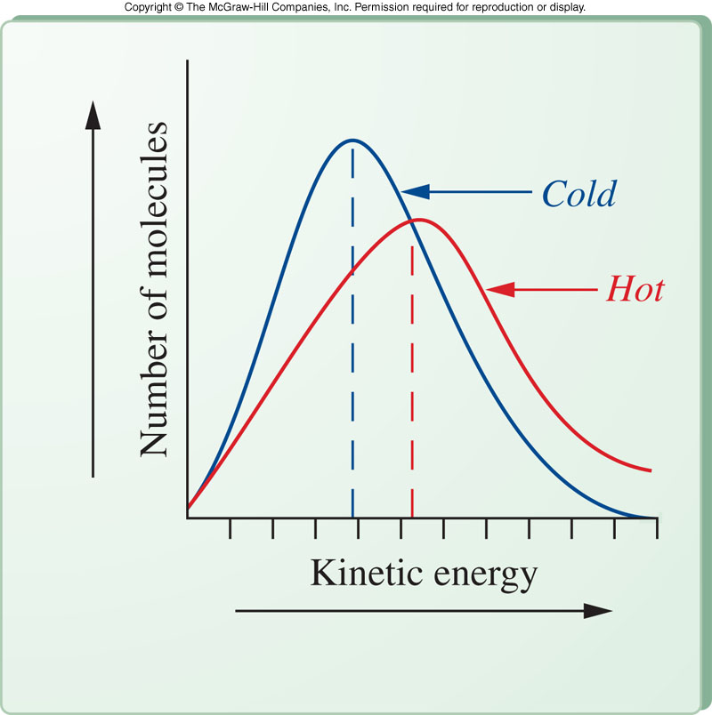
Temperature Dependence of Liquid Vapor Pressure
energy + H₂O(l) → H₂O(g)
Average molecular kinetic energy increases as temperature increases
Some high energy molecules have sufficient energy to escape from the liquid phase
Even at cold temperatures, some molecules can be converted
5.2 The Liquid State

Slide 40
Movement From Gas Back to Liquid
H₂O(g) → H₂O(l) + energy
Molecules in the vapor phase can lose energy and be converted back to the liquid phase
Evaporation - the process of conversion of liquid to gas at a temperature too low to boil
Condensation - conversion of gas to the liquid state
5.2 The Liquid State

Slide 41
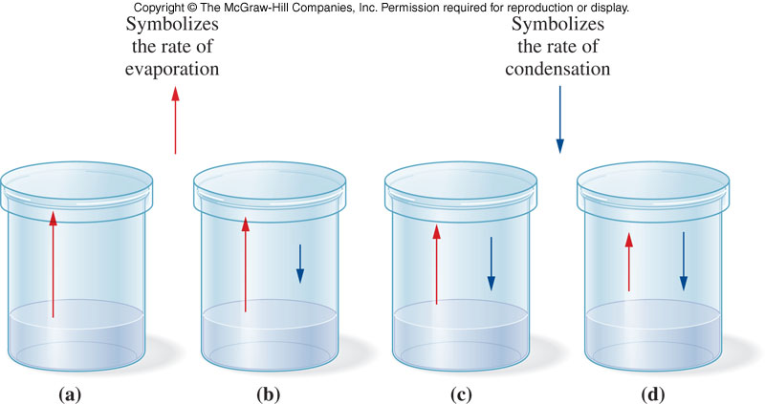
Liquid Water in Equilibrium With Water Vapor
5.2 The Liquid State
When the rate of evaporation equals the rate of condensation, the system is at equilibrium
Vapor pressure of a liquid - the pressure exerted by the vapor at equilibrium

Slide 42
Boiling Point
Boiling point - the temperature at which the vapor pressure of the liquid becomes equal to the atmospheric pressure
Normal boiling point - temperature at which the vapor pressure of the liquid is equal to 1 atm
What happens when you go to a mountain where the atmospheric pressure is lower than 1 atm?
  The boiling point lowers
Boiling point is dependent on intermolecular forces
  Polar molecules have higher b.p. than nonpolar molecules
5.2 The Liquid State

Slide 43
Van der Waals Forces
10
Physical properties of liquids are explained in terms of their intermolecular forces
Van der Waals forces are intermolecular forces having two subtypes:
  Dipole-dipole interactions
    Attractive forces between polar molecules
  London dispersion forces
    As electrons are in continuous motion, a nonpolar molecule could have an instantaneous dipole
    These temporary dipoles attract other temporary dipoles
5.2 The Liquid State

Slide 44
Hydrogen Bonding
11
Hydrogen bonding:
  not considered a Van der Waals force
  is a special type of dipole-dipole attraction
  is a very strong intermolecular attraction causing higher than expected boiling point and melting point
Requirement for hydrogen bonding:
  molecules have hydrogen directly bonded to O, N, or F
5.2 The Liquid State

Slide 45
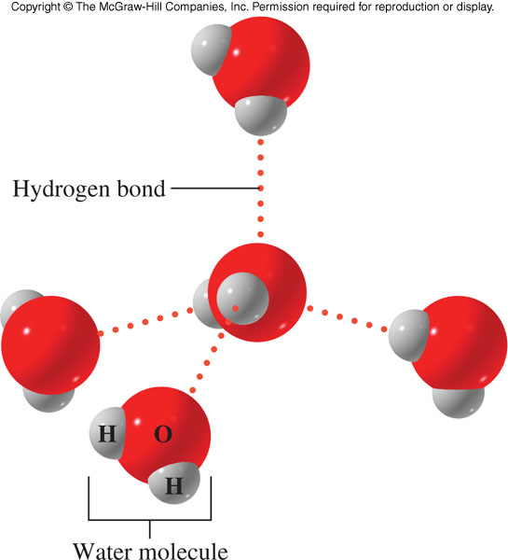
Examples of Hydrogen Bonding
Hydrogen bonding has an extremely important influence on the behavior of many biological systems
H₂O
NH₃
HF
5.2 The Liquid State

Slide 46
5.3 The Solid State
12
Particles are closely packed due to attractive forces strong enough to resist motion
Solids have a fixed shape and volume
Properties of solids:
  Virtually incompressible
  Melting point depends on strength of attractive force between particles
  May be a crystalline solid or an amorphous solid

Slide 47
Types of Crystalline Solids
1. Ionic solids
  Made up of positive and negative ions
  High melting and boiling points
  Hard and brittle
    Example: NaCl
2. Covalent solids
  Held together by covalent bonds
  High melting and boiling points
  Extremely hard
    Example: Diamond
5.3 The Solid State

Slide 48
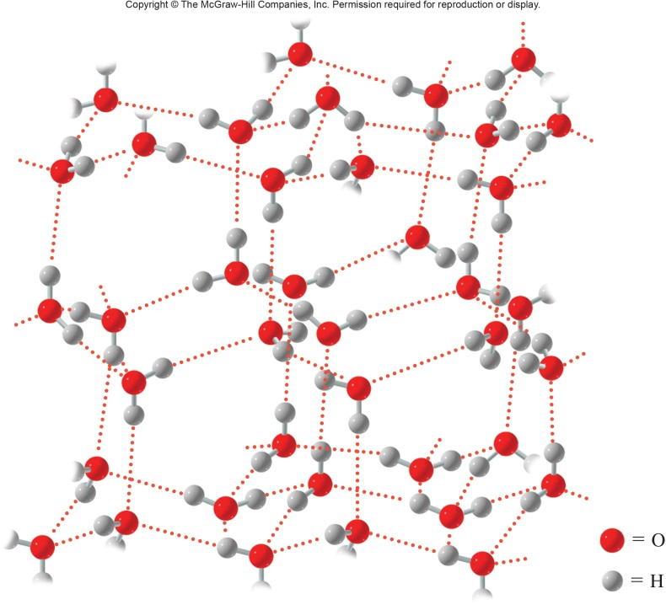
3rd Type of Crystalline
3. Molecular Solids
  Made up of molecules held together by intermolecular attractive forces
  Usually soft with low melting point
  Volatile and poor electrical conductors
    Example: Ice
5.3 The Solid State

Slide 49
4th Type of Crystalline Solids
4. Metallic Solids
  Made up of metal atoms held together by metallic bonds
    Metallic bonds are formed by the overlap of metal atomic orbitals
  Regions of high electron density, which are very mobile and move freely from atom to atom
  High conductivity
    Examples: Ag and Cu
5.3 The Solid State

Slide 50
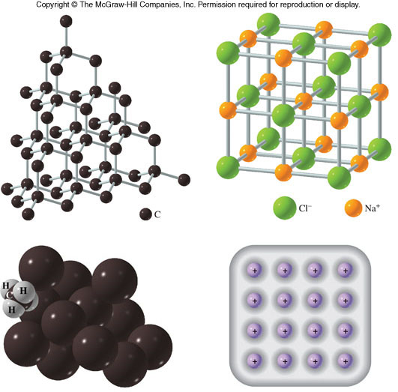
Four Types of Crystalline Solids
5.3 The Solid State

Slide 51
Sublimation of Solids
Sublimation – process of conversion of molecules in the solid state directly to the gaseous state
Example: Dry ice, solid carbon dioxide
  Converts directly to a gas at atmospheric pressure
5.3 The Solid State

