Slide 1
CaMkOx Corridor Elasticities of Agglomeration
Research question:
Can we estimate agglomeration elasticities within a transport model?
Assumptions:
1: We can estimate rents within a transport model
2: Agglomeration economies show up in rents (eventually)
References:
1. Matthew P Drennan and Hugh F Kelly. Measuring urban agglomeration economies with office rents. Journal of Economic Geography, 11(3):481–507, 2011
2. Hans RA Koster. Rocketing rents the magnitude and attenuation of agglomeration economies in the commercial property market. Technical Report SERC Discussion Paper No. 125,Spatial Economics Research Centre (SERC), London School ofEconomics, London,UK, January 2013
3. Robin Morphet. Von Th¨unens Legendre Transform. Working Paper, Bartlett Centre for Advanced Spatial Analysis, UCL,July 2013

Slide 2
Sources of Agglomeration Economies
Sharing- sharing indivisible facilities
Matching- matching labour to employment and vice versa
Learning- generation and diffusion of knowledge
Also we have the development of non-traded intermediates
G. Duranton and D. Puga. Micro-foundations of Urban Agglomeration Economies. Working Paper 9931, NBER, 2004.

Slide 3
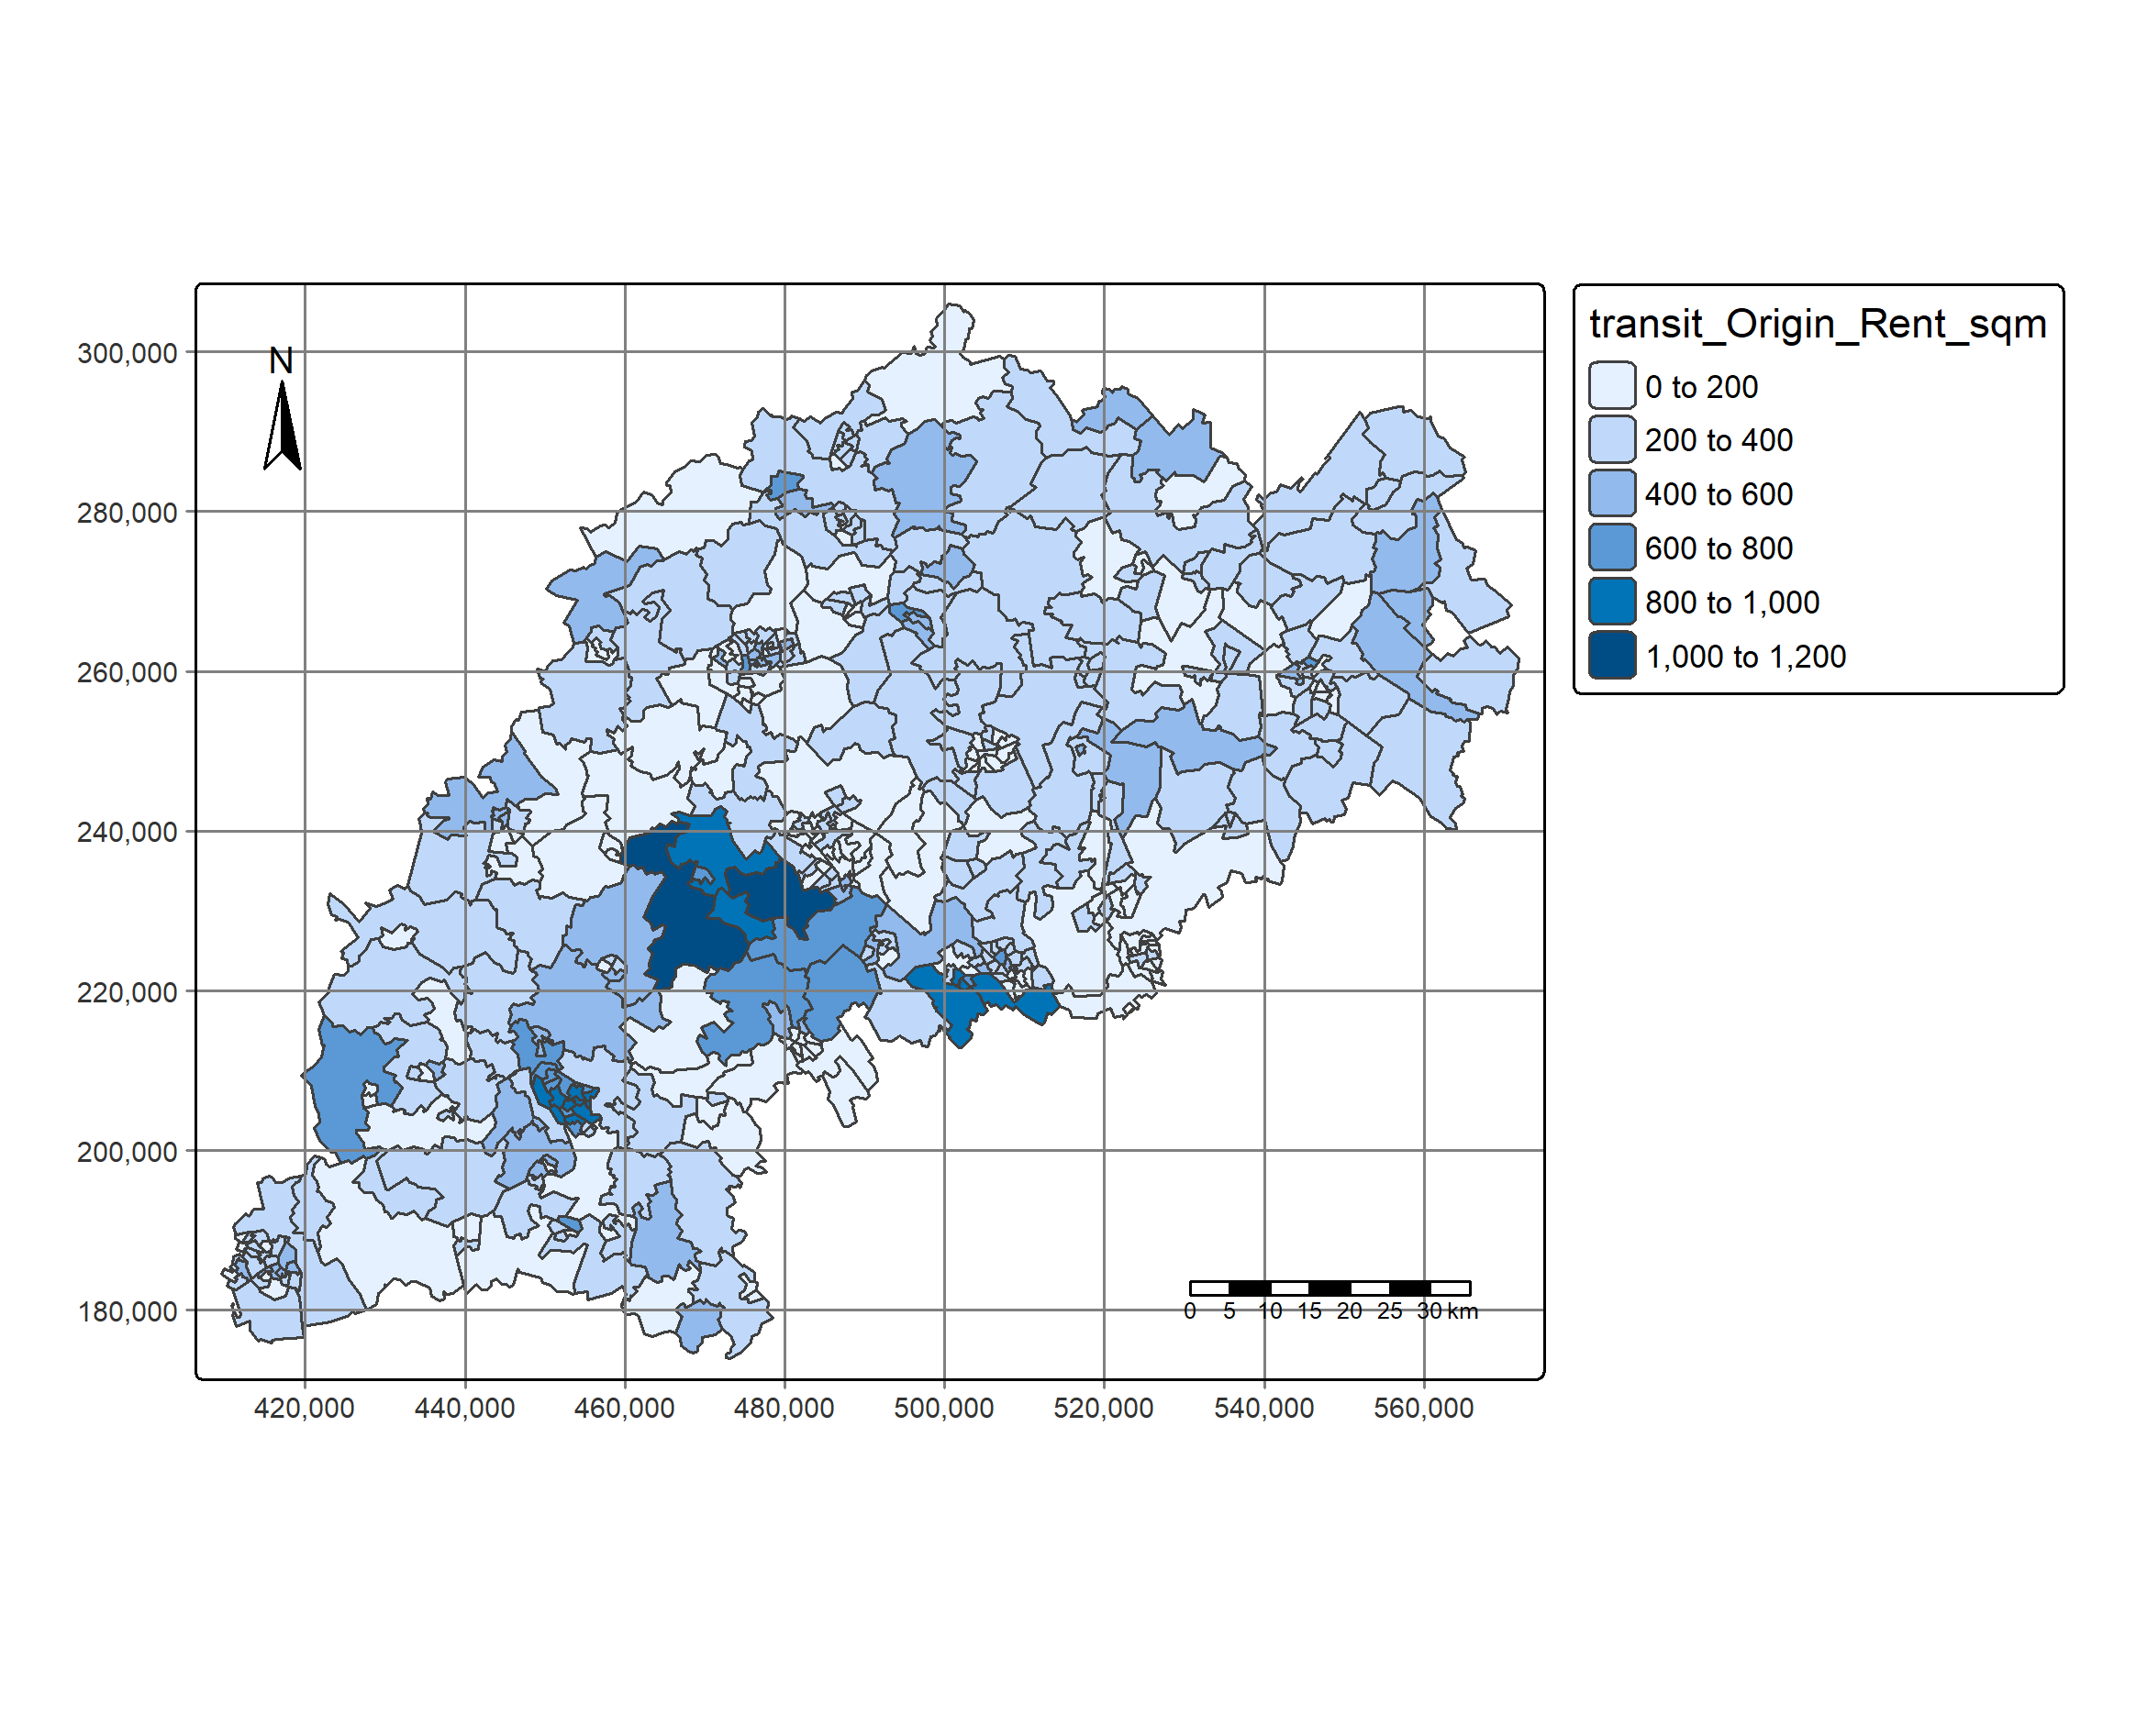
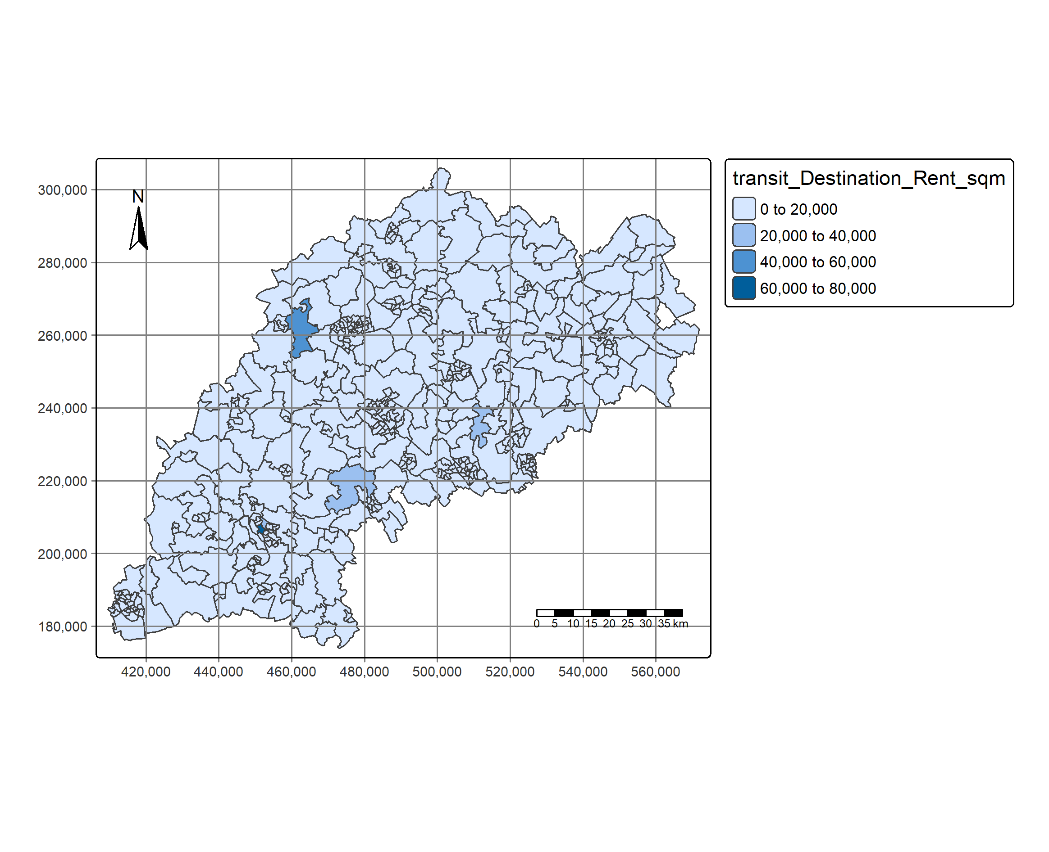
Transit Rents/sqm

Slide 4
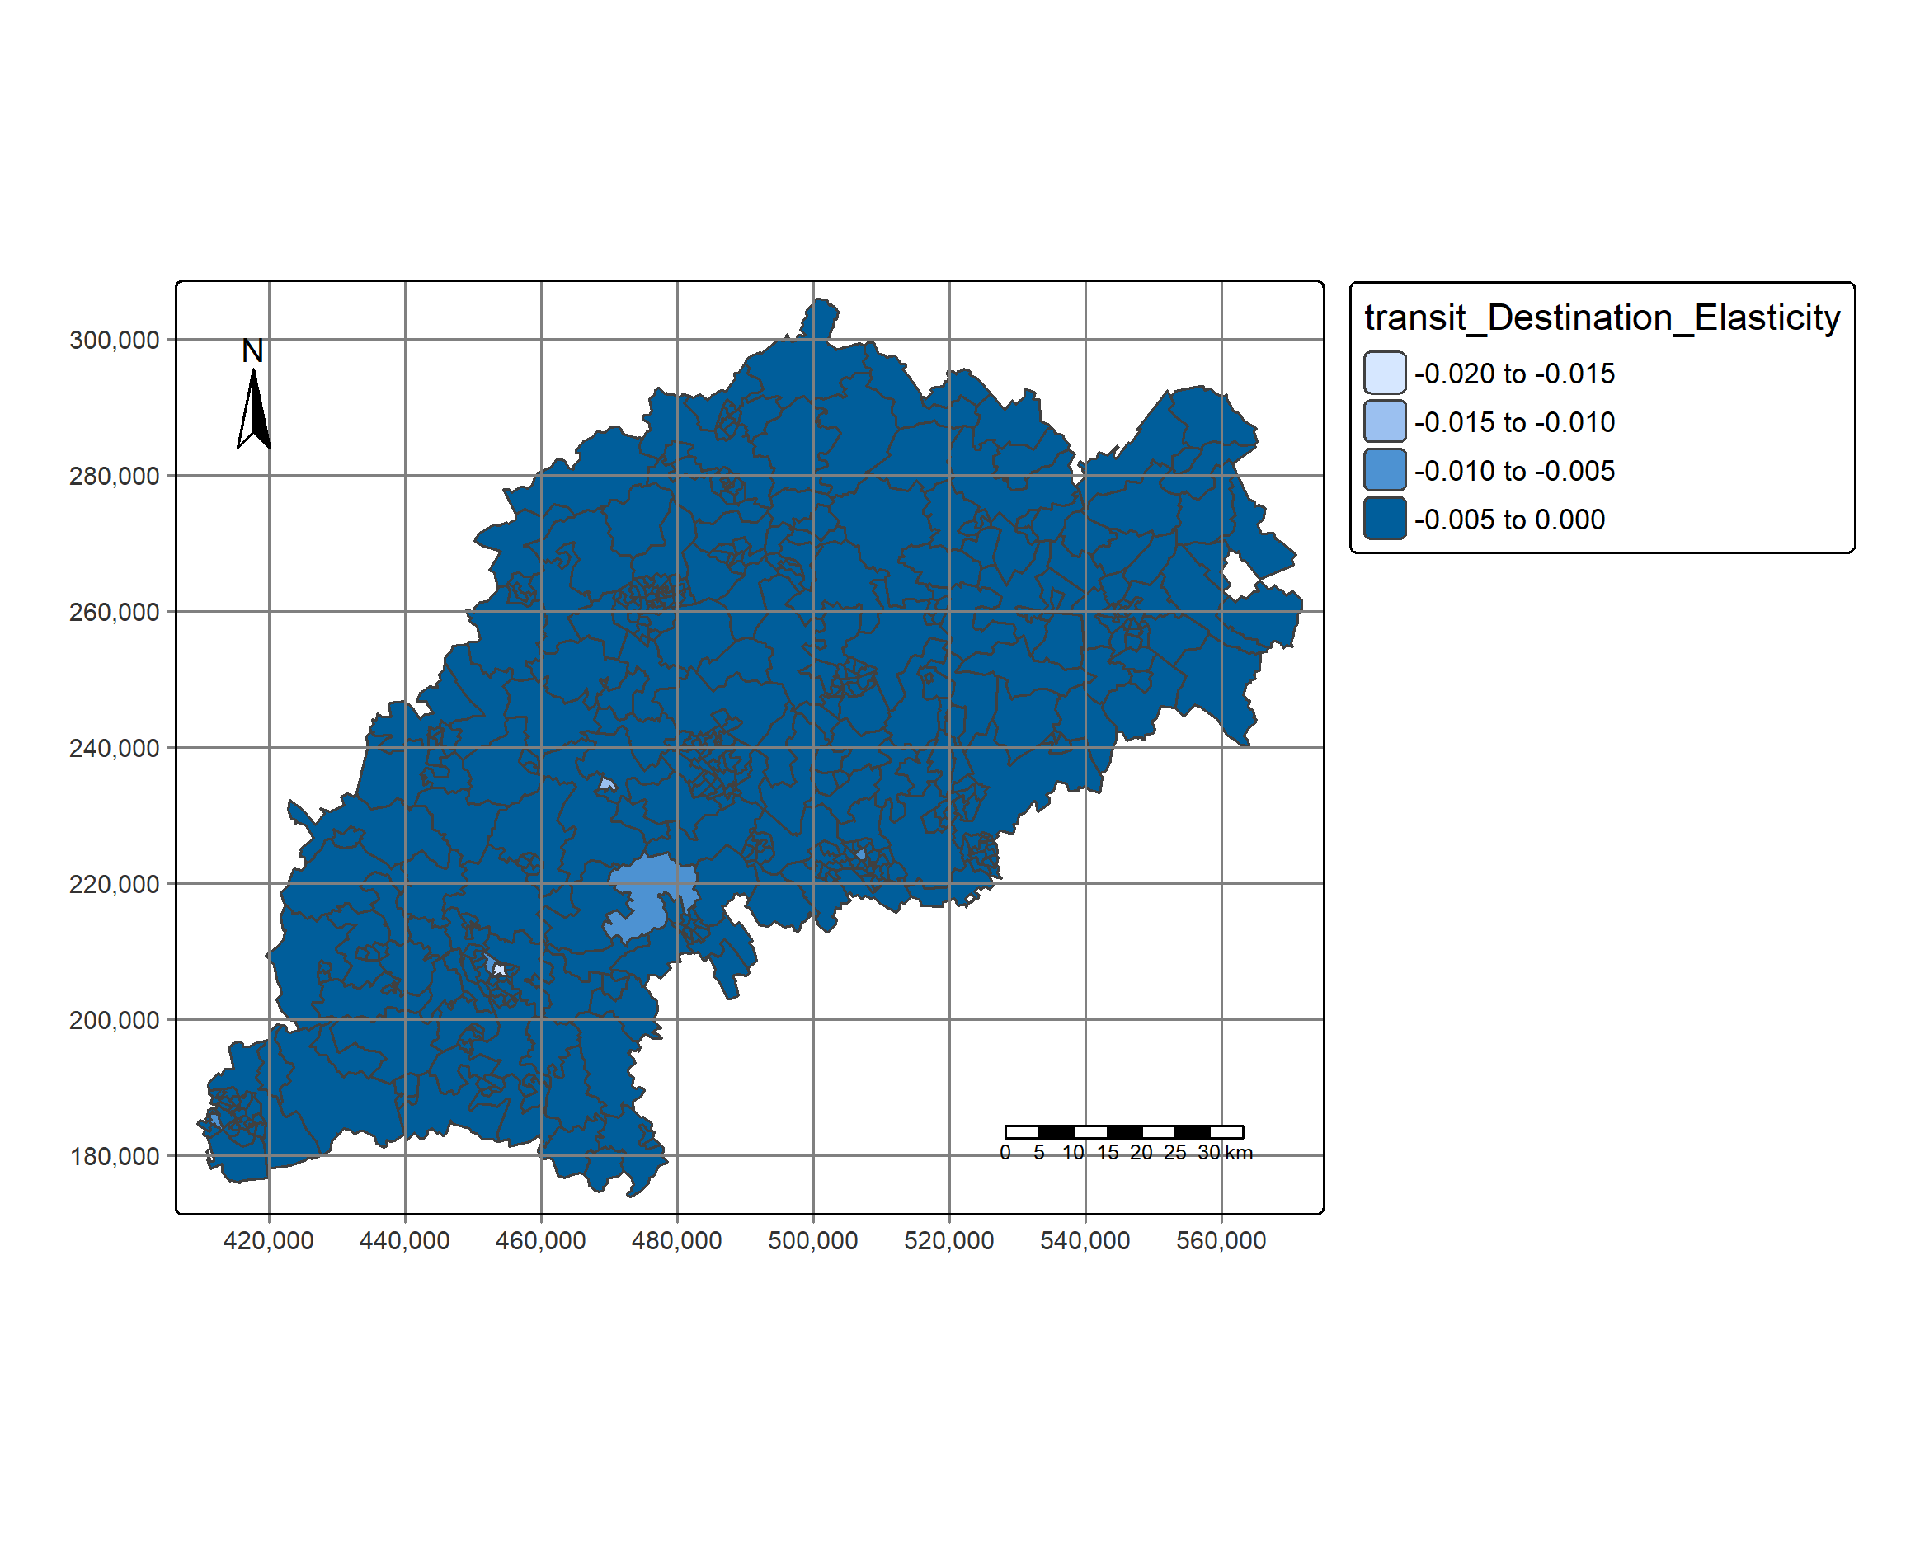
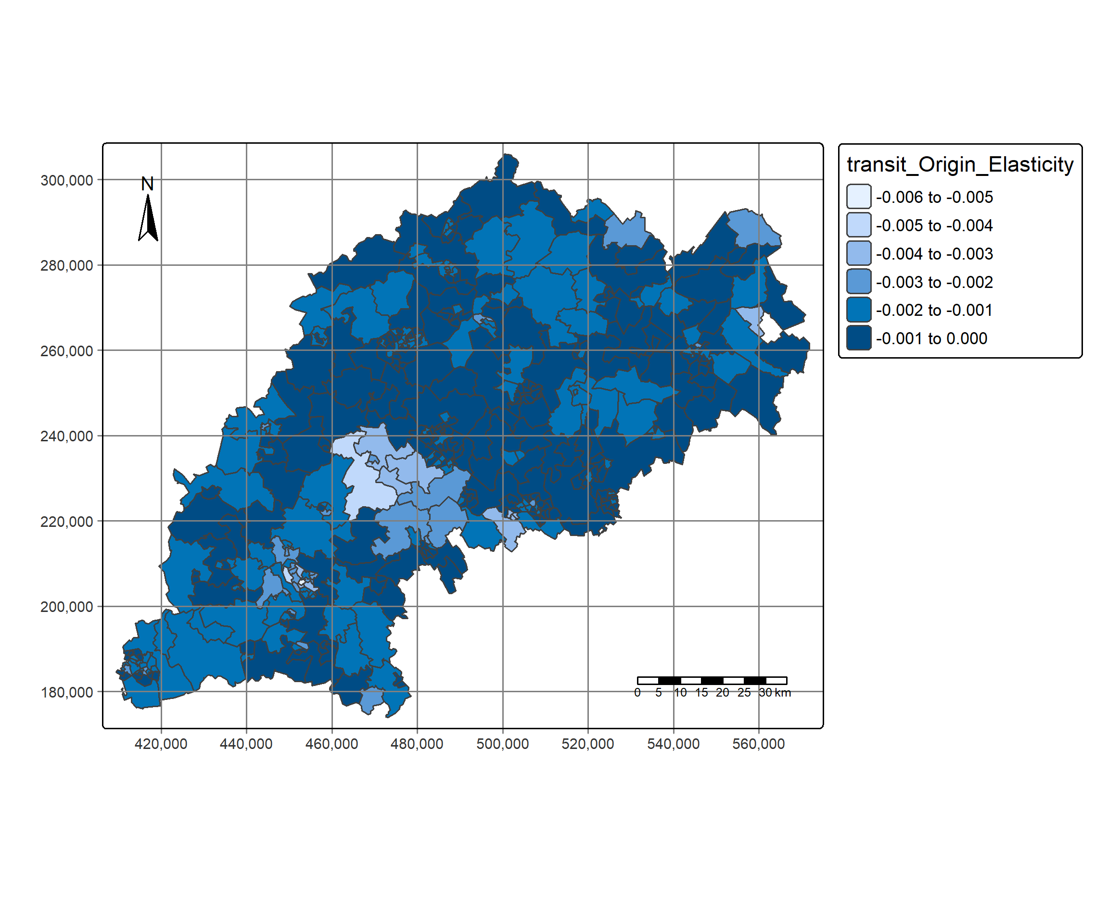
Transit Elasticities

Slide 5
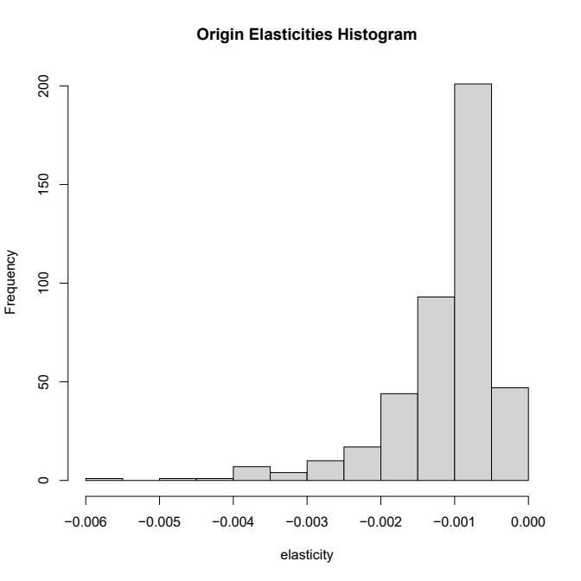
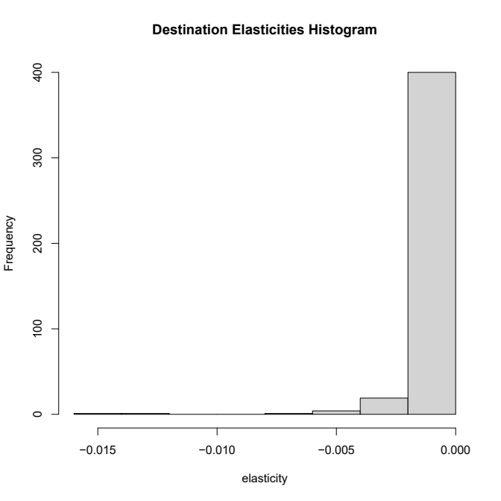
Transit Elasticities

Slide 6
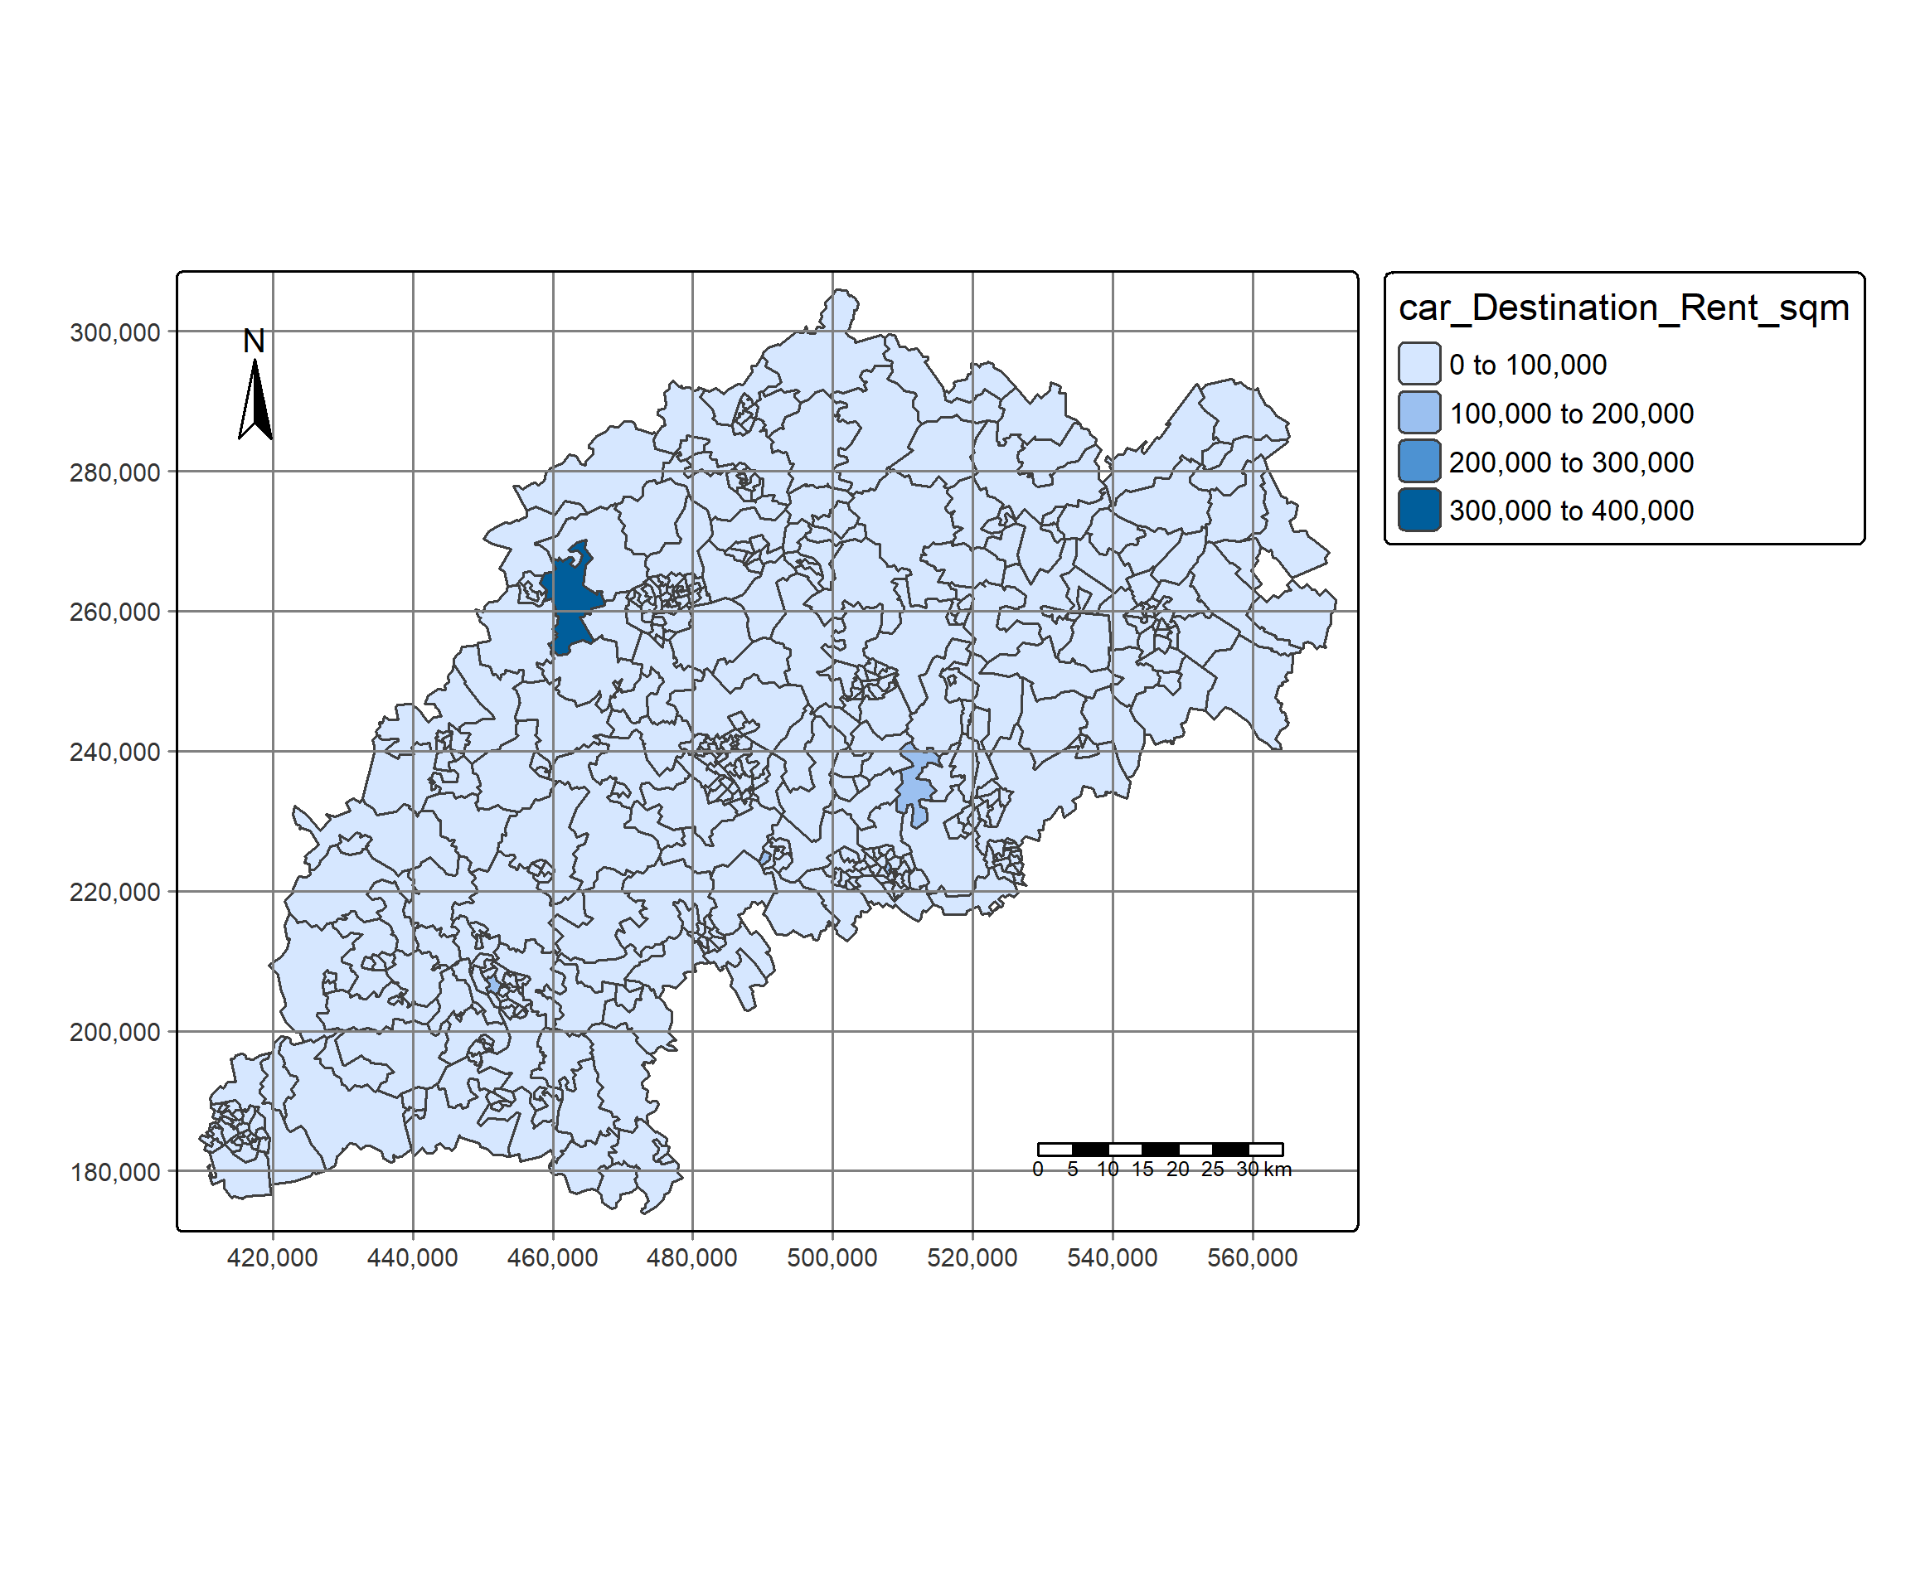
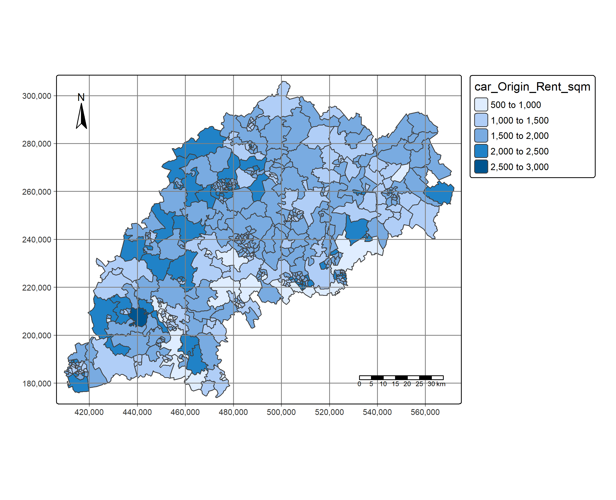
Car Rents/sqm

Slide 7
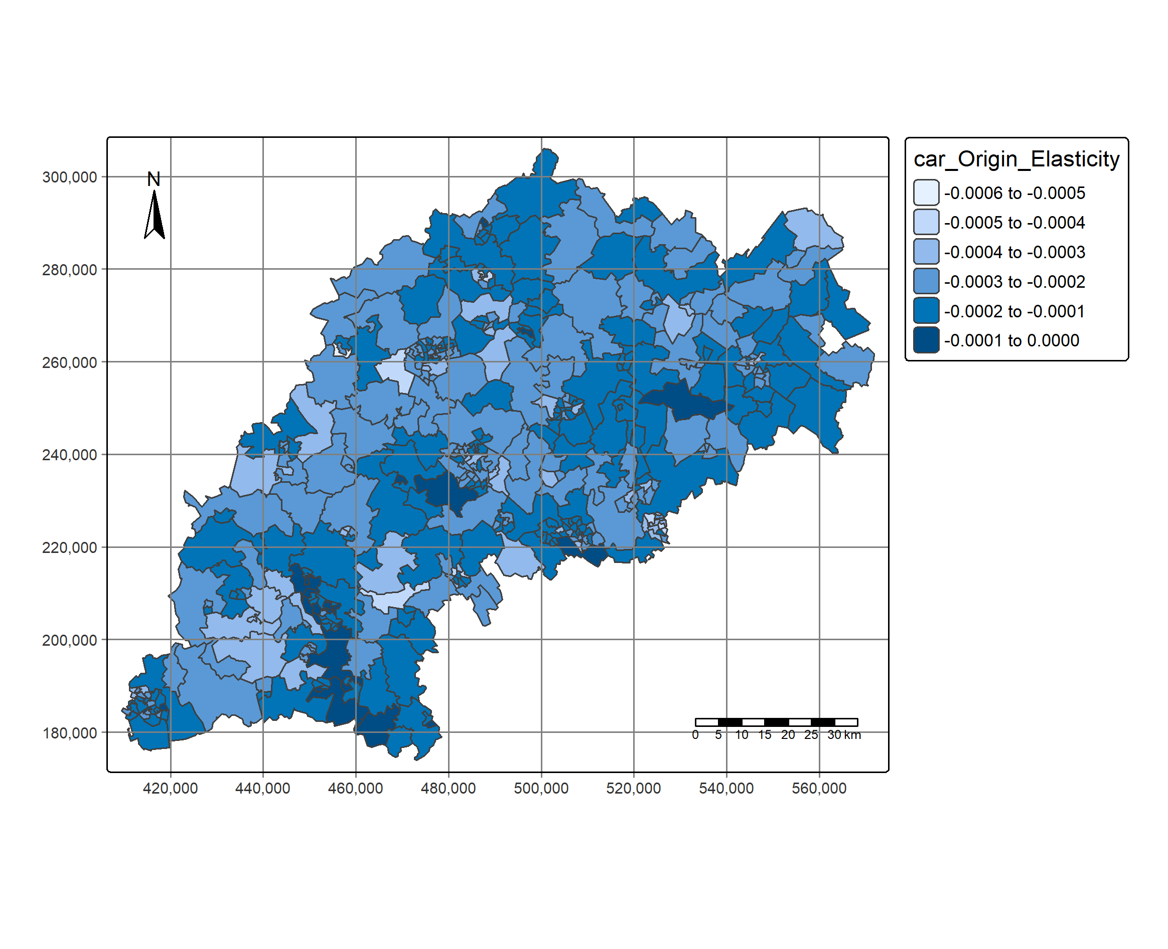
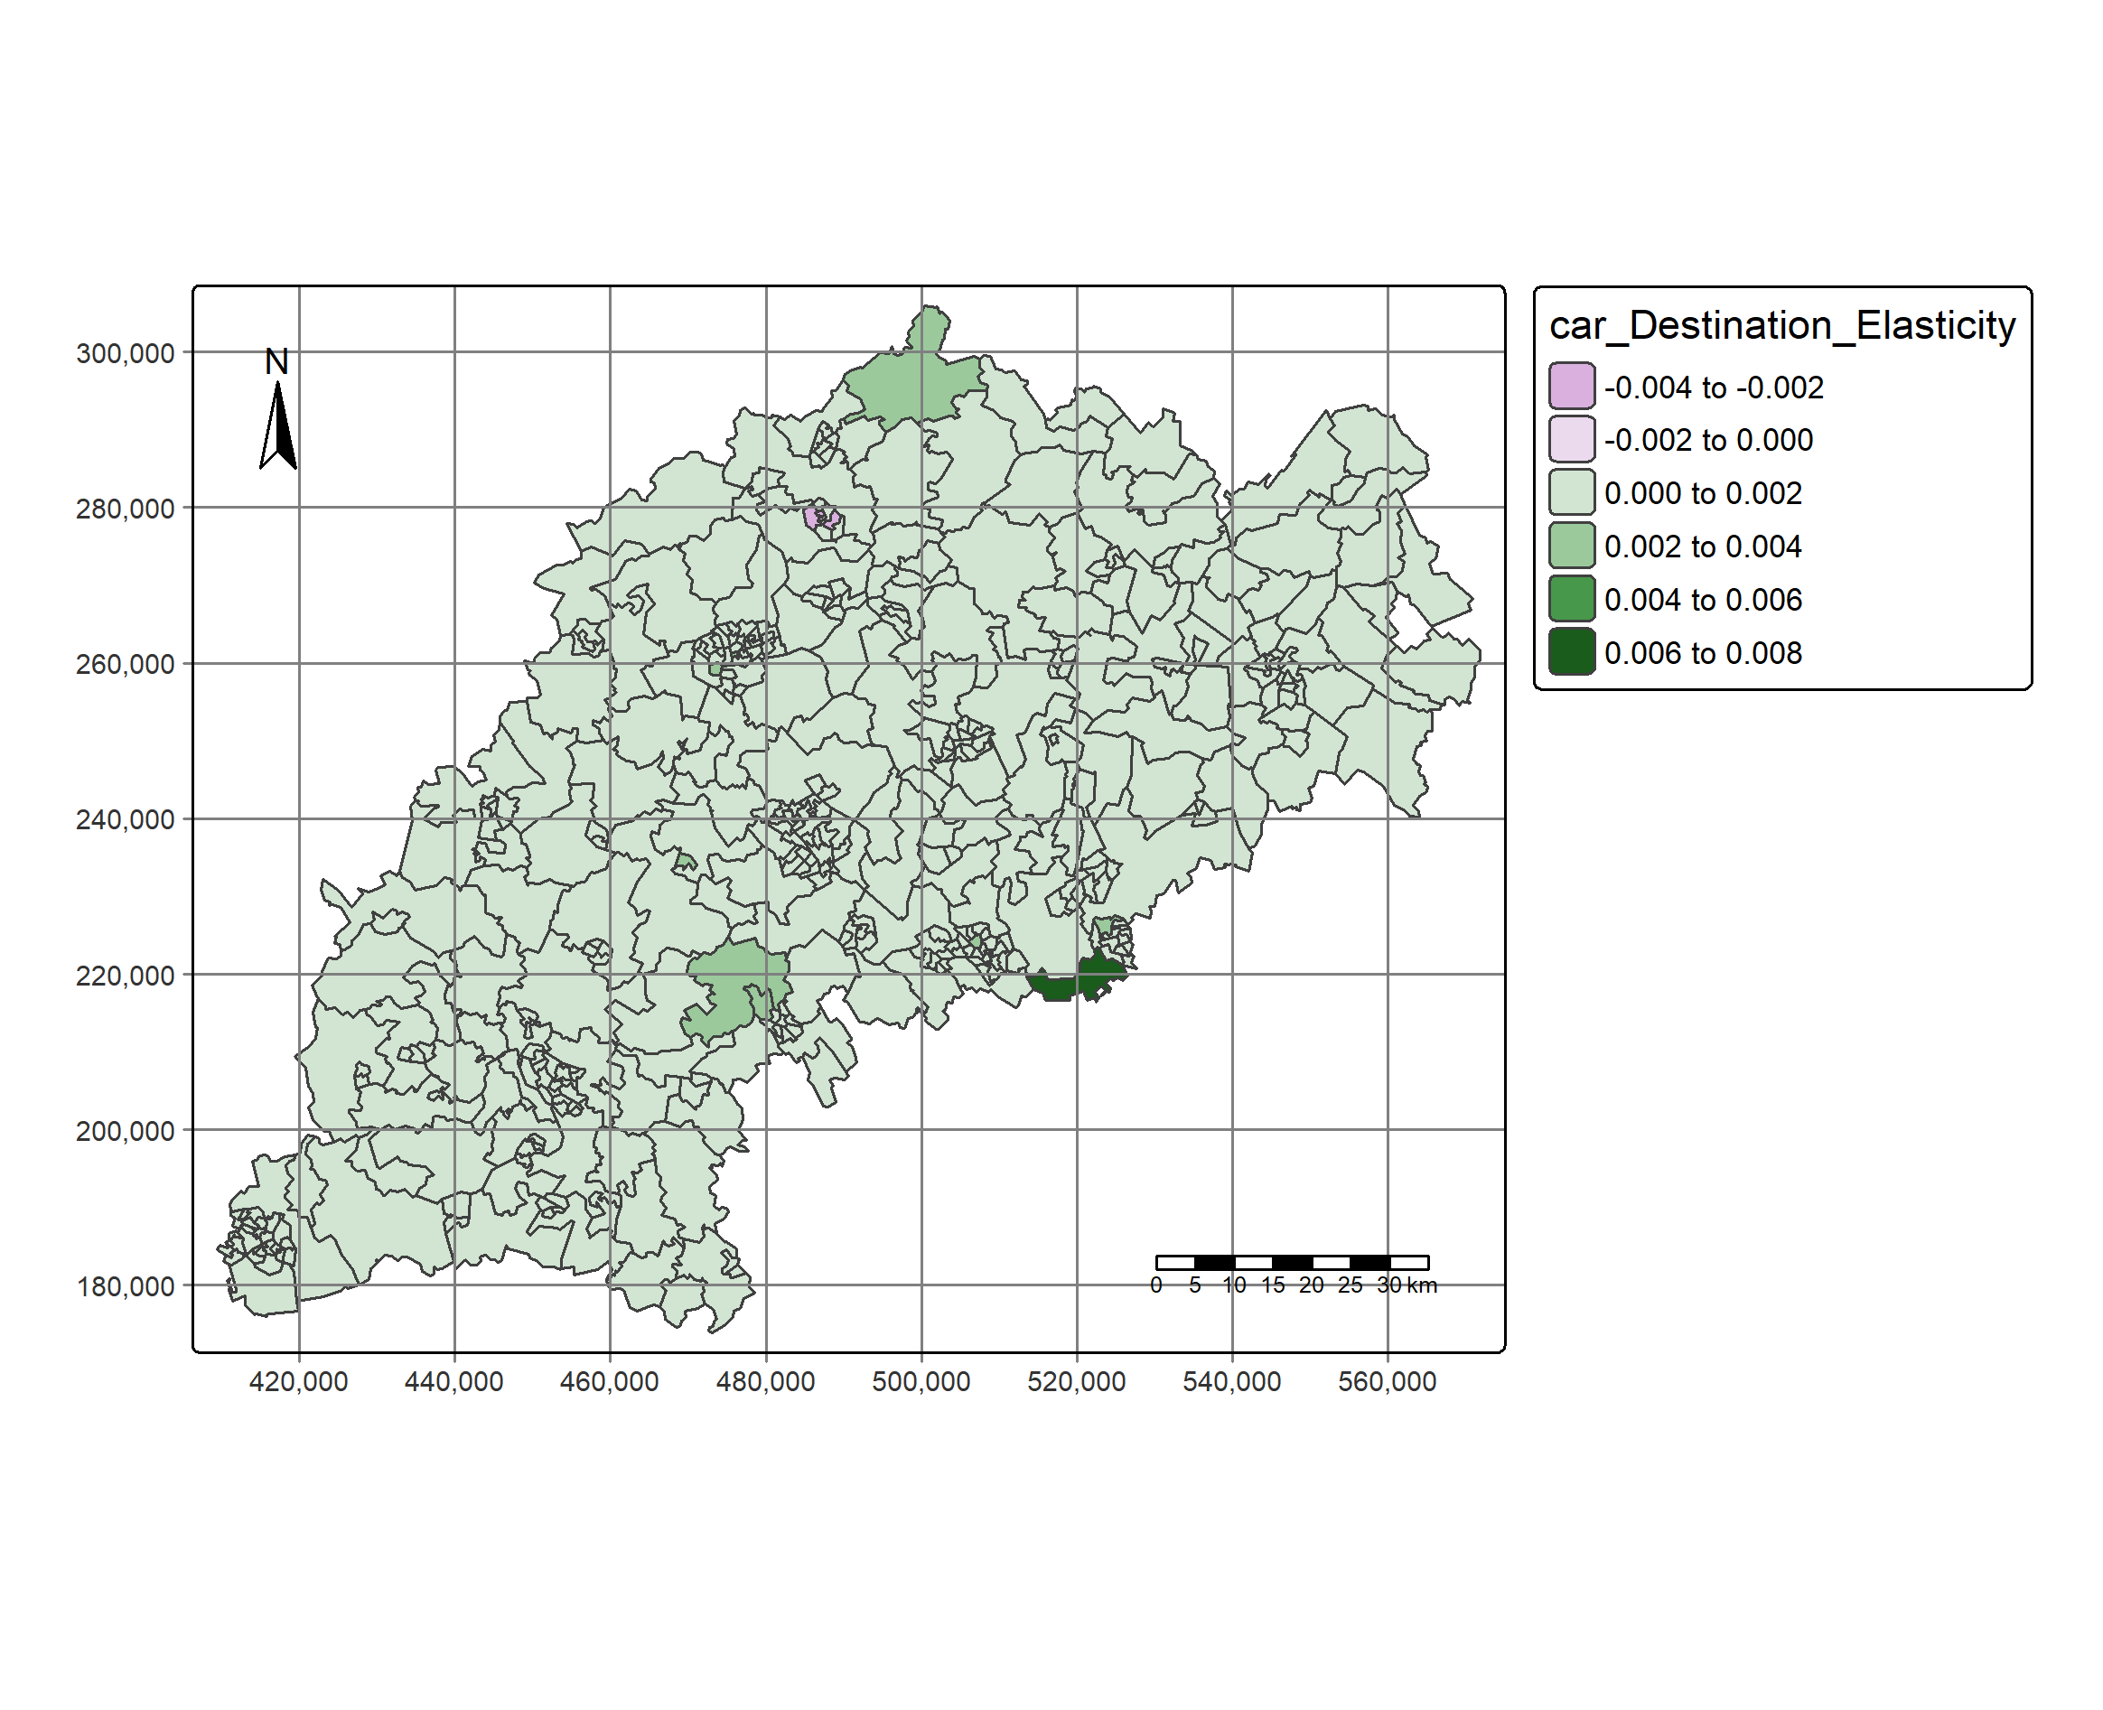
Car Elasticities

Slide 8
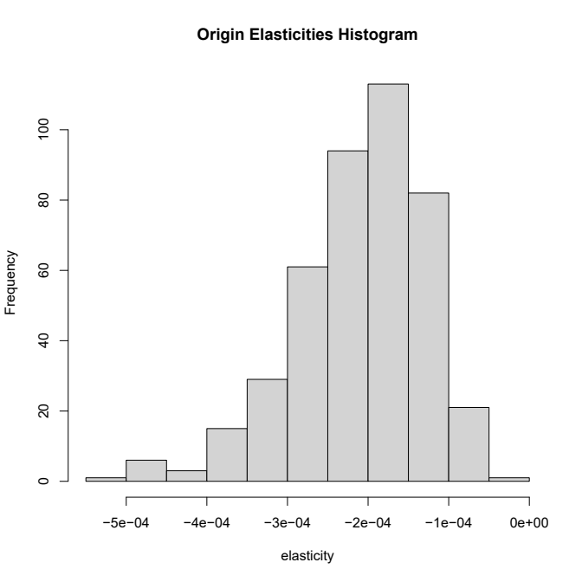
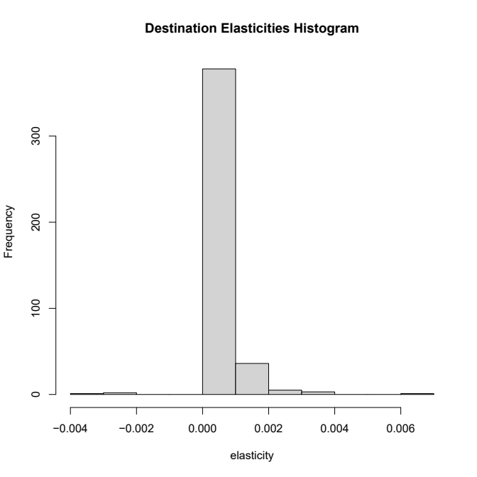
Car Elasticities

Slide 9
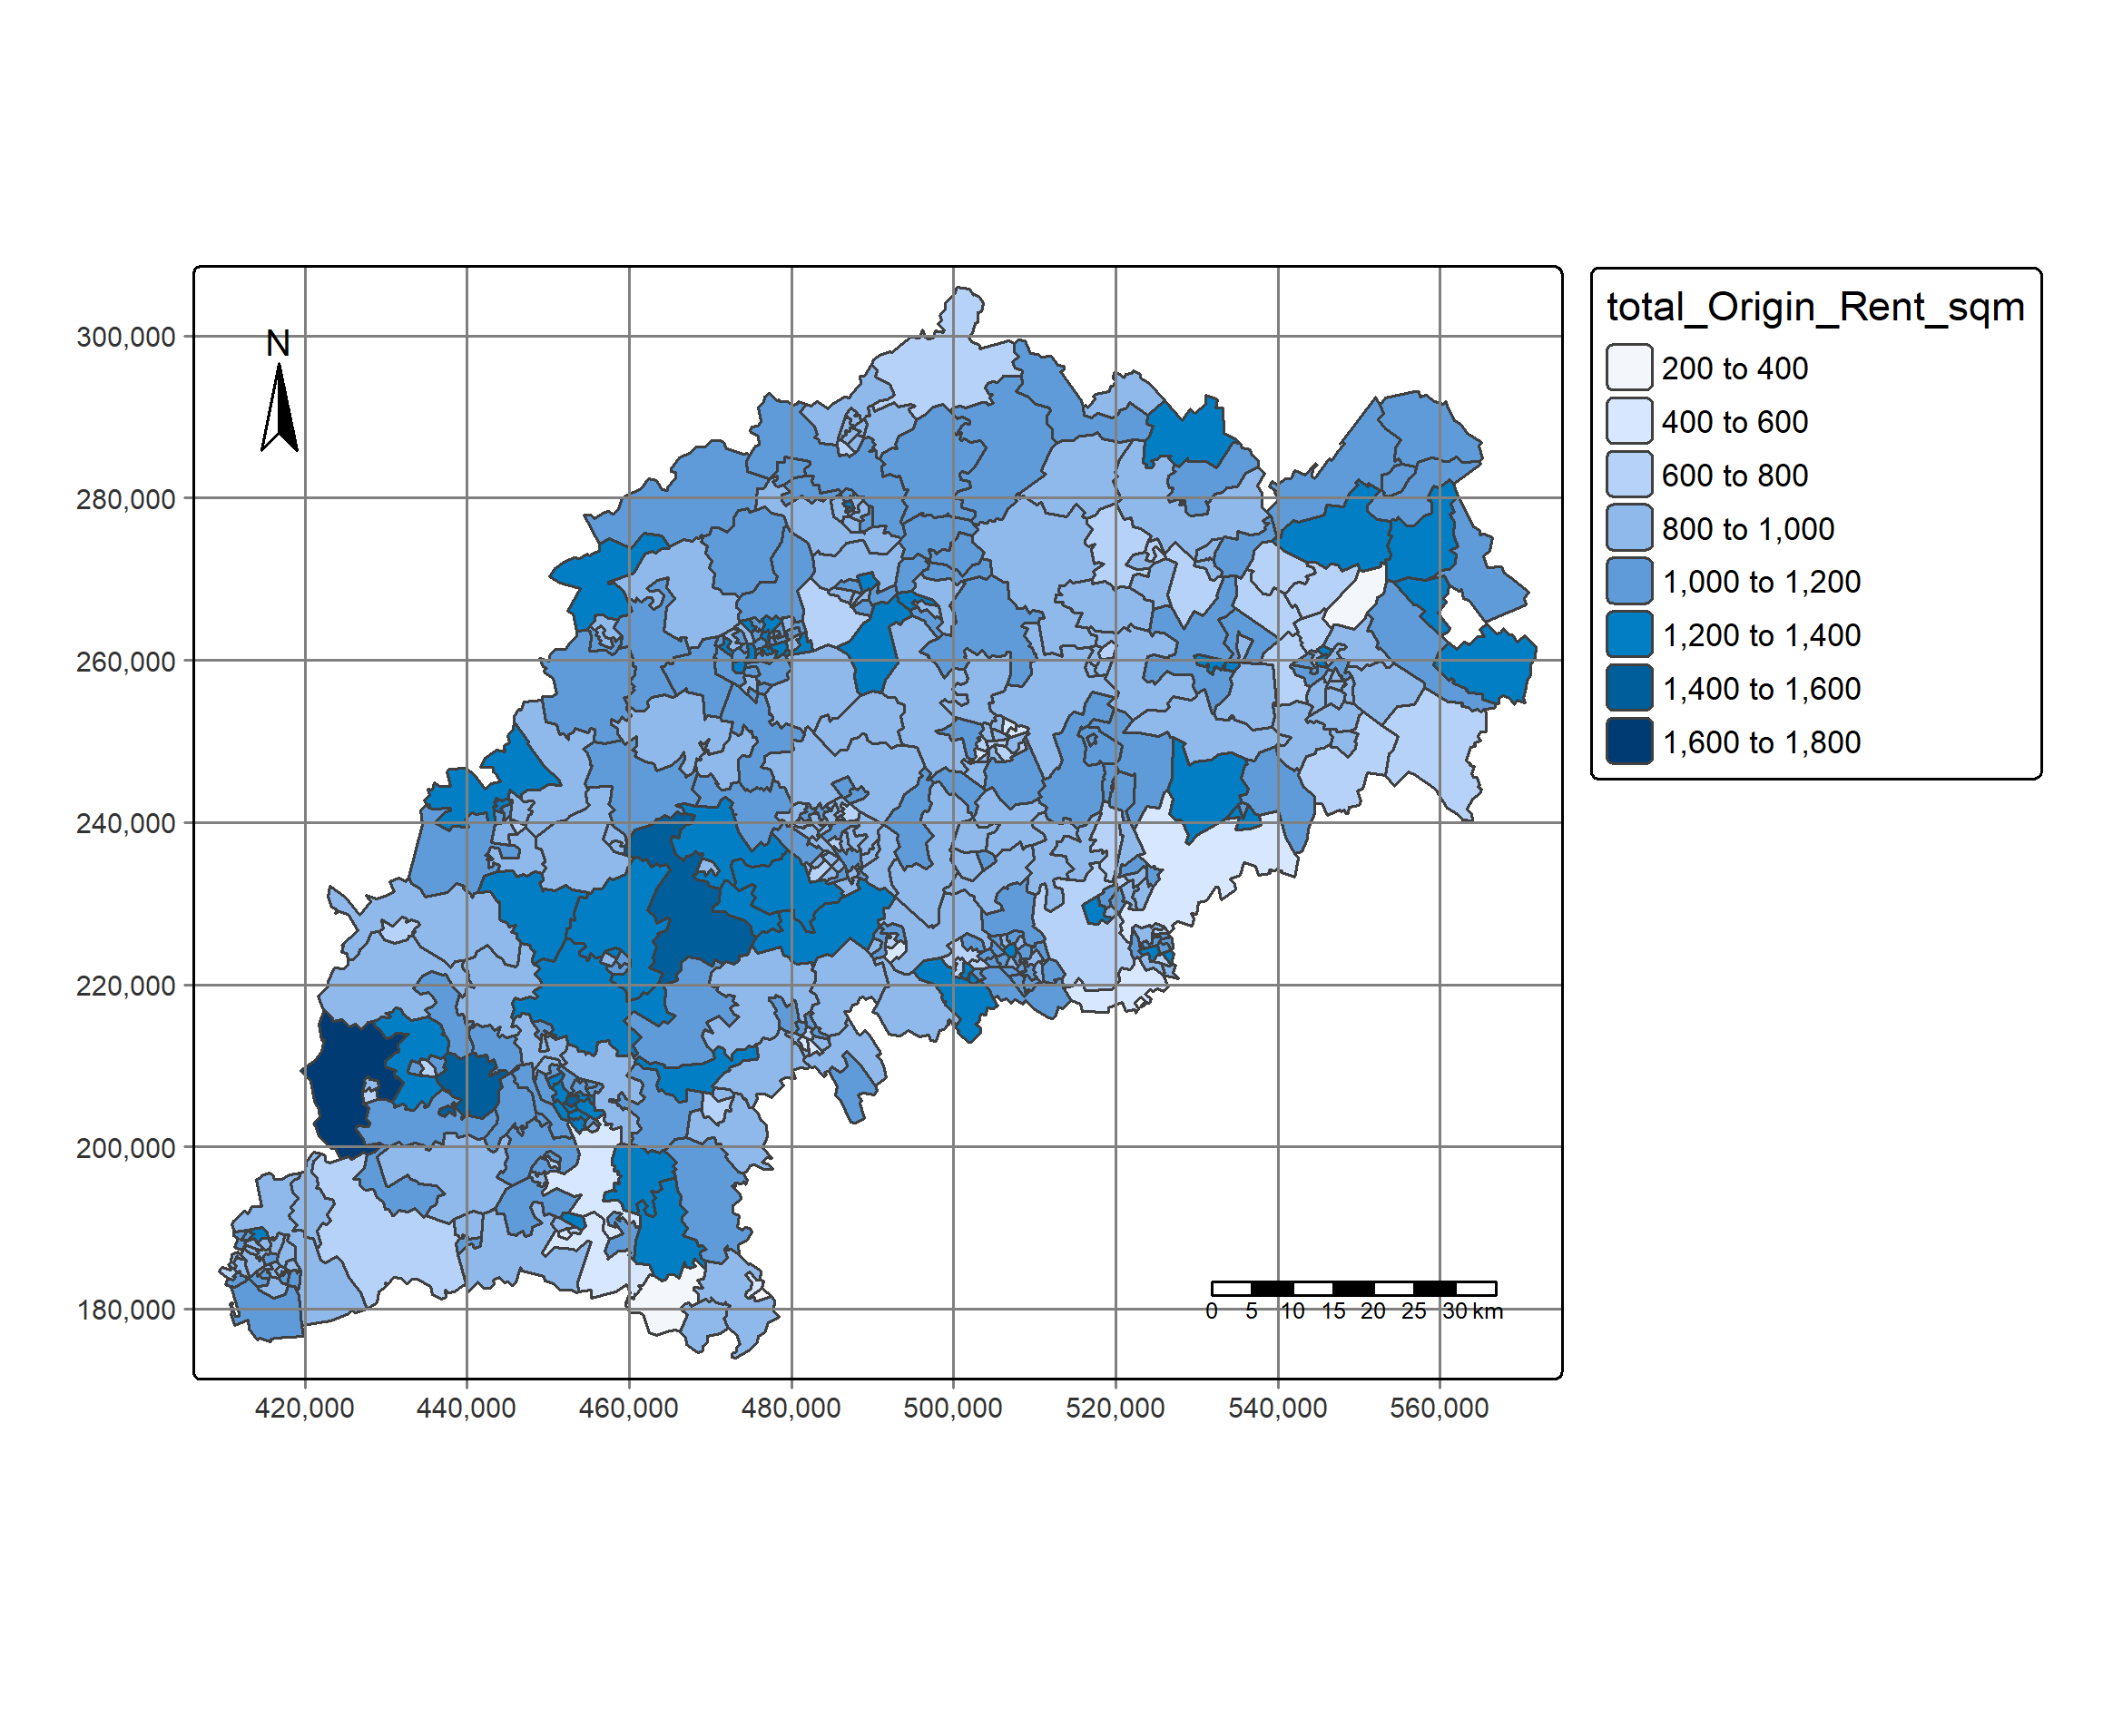
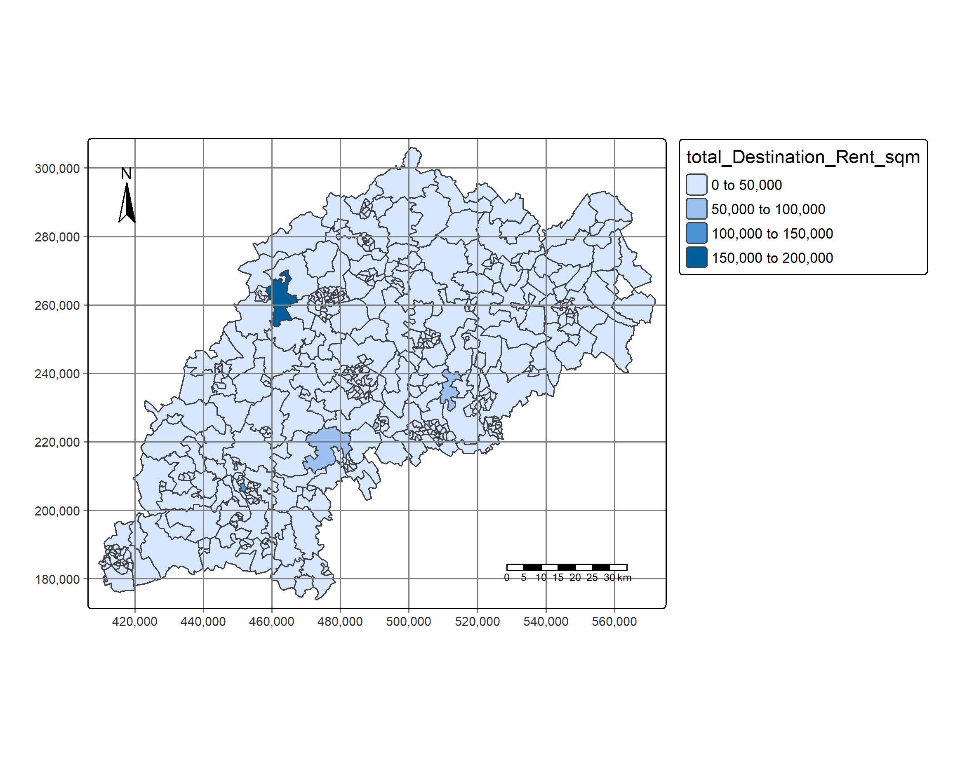
Combined Modes Rent/sqm

Slide 10
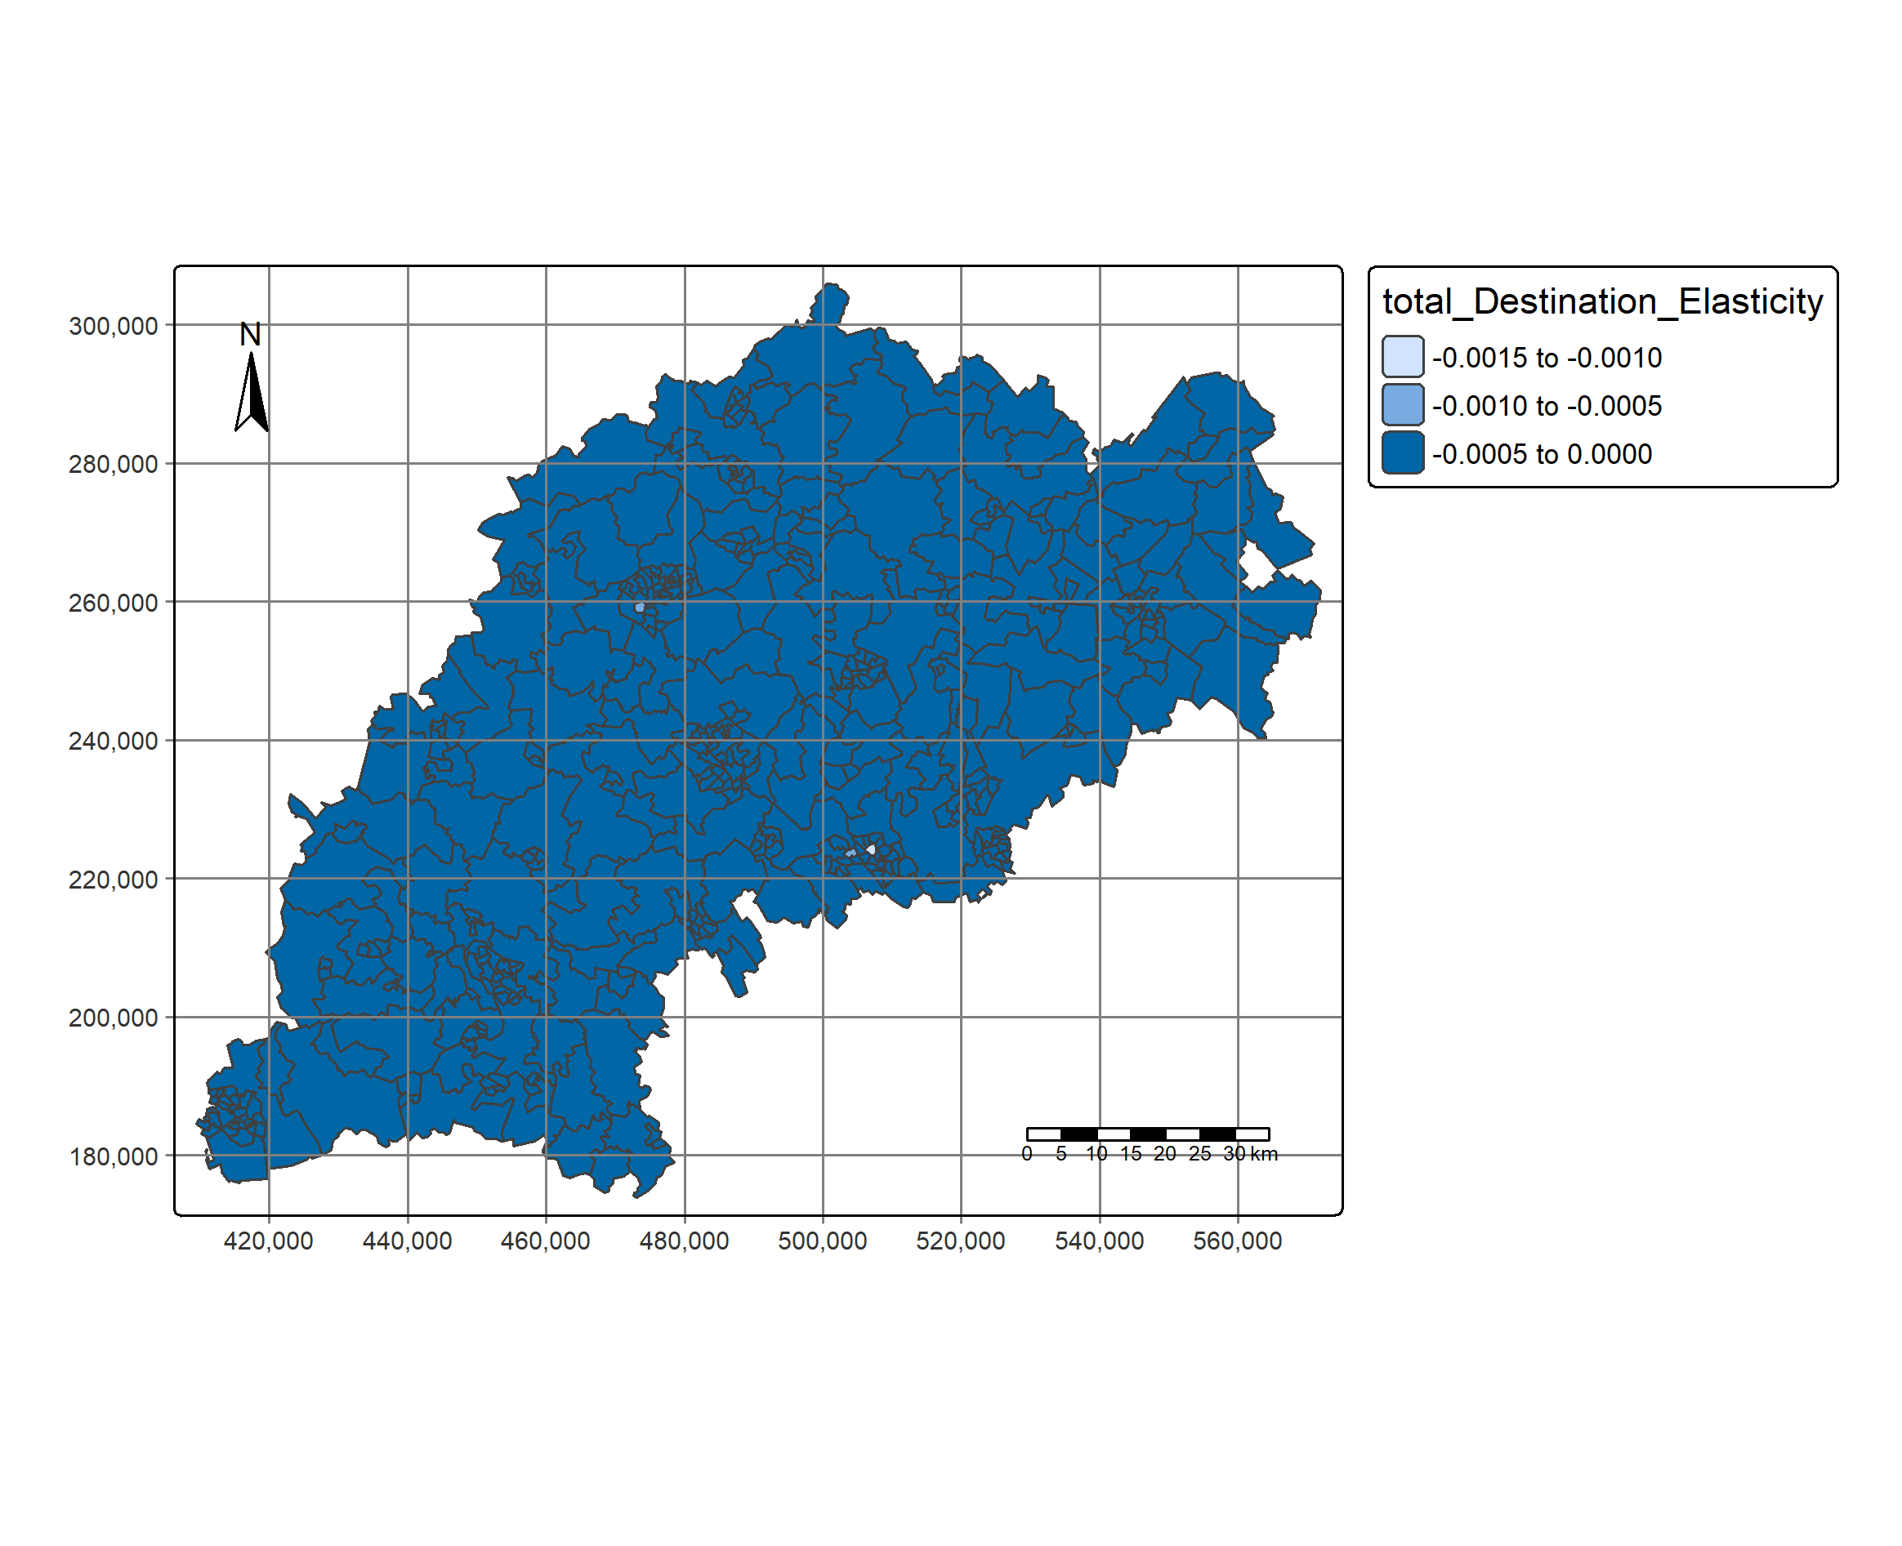
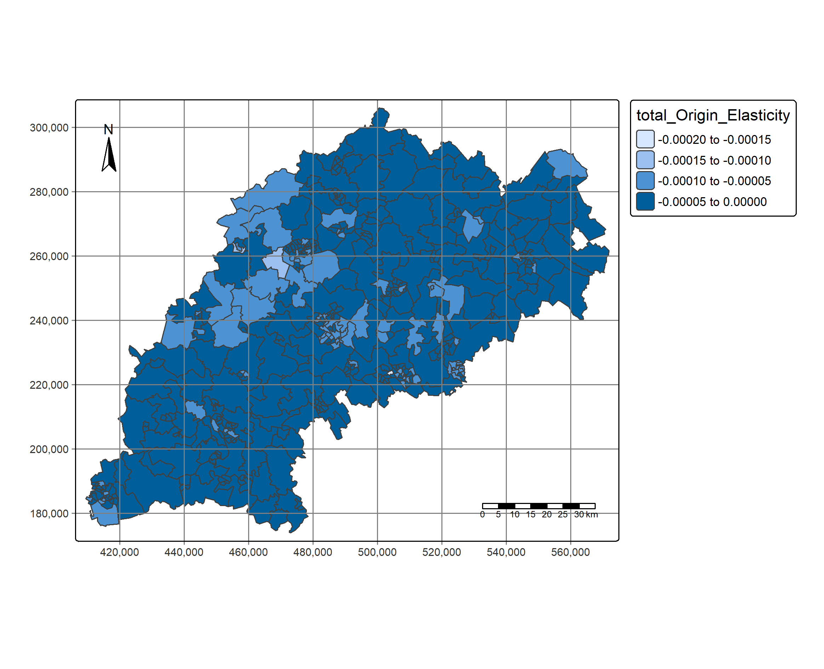
Combined Modes Elasticity

Slide 11
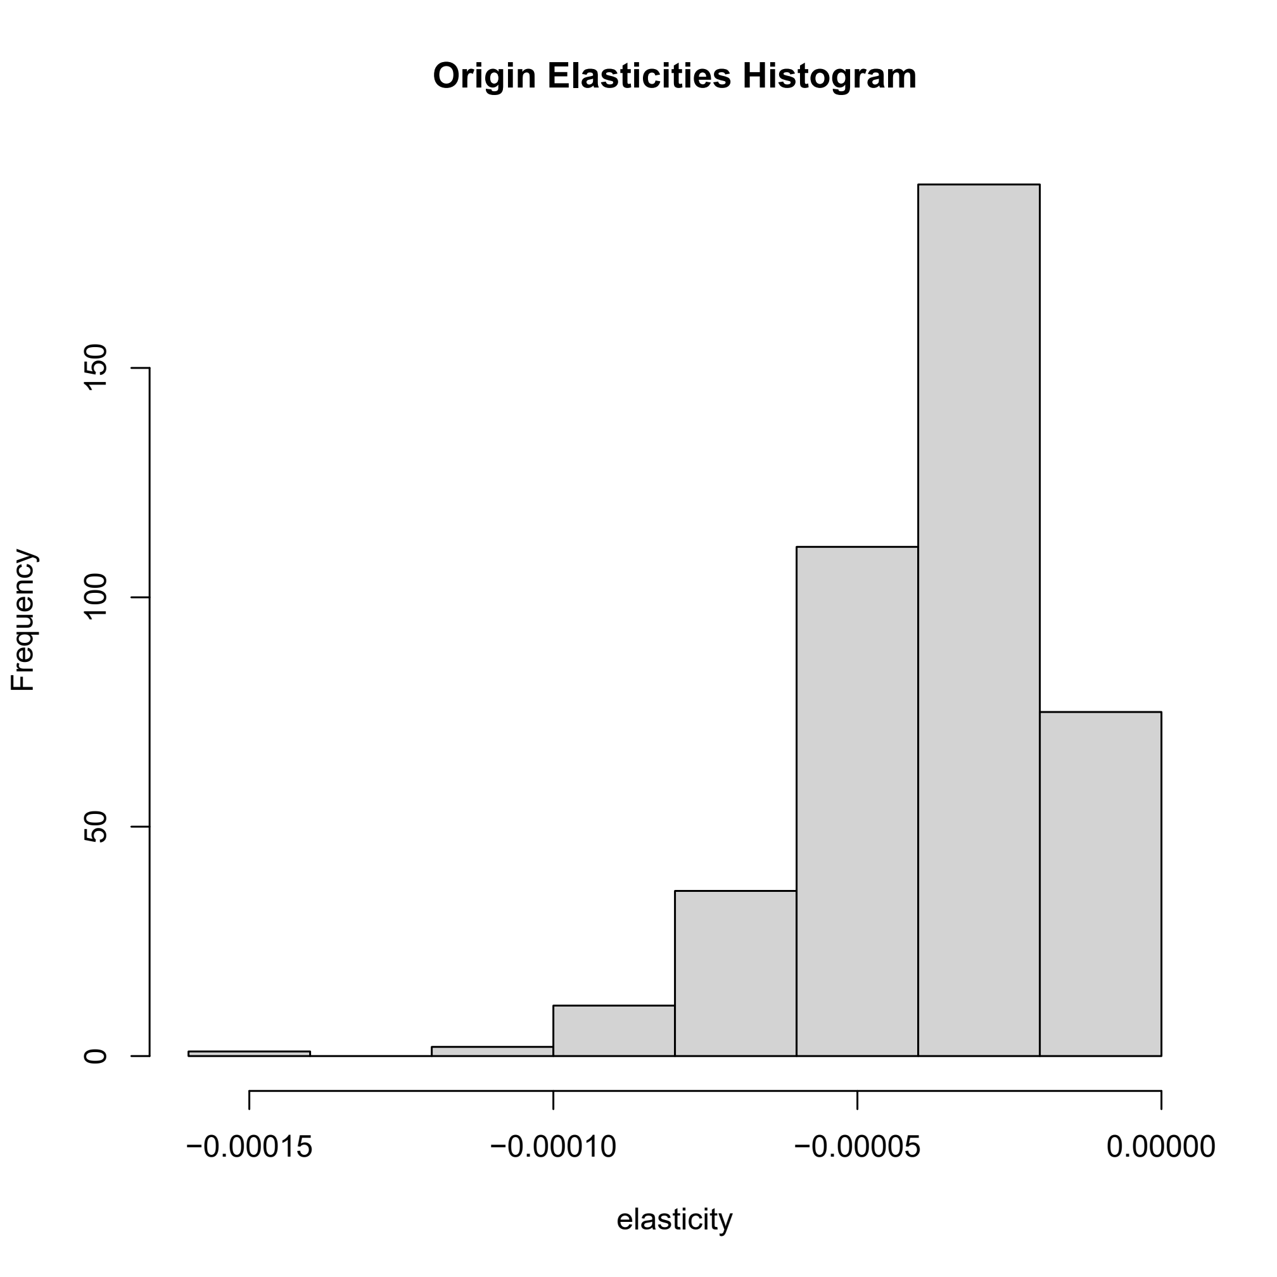
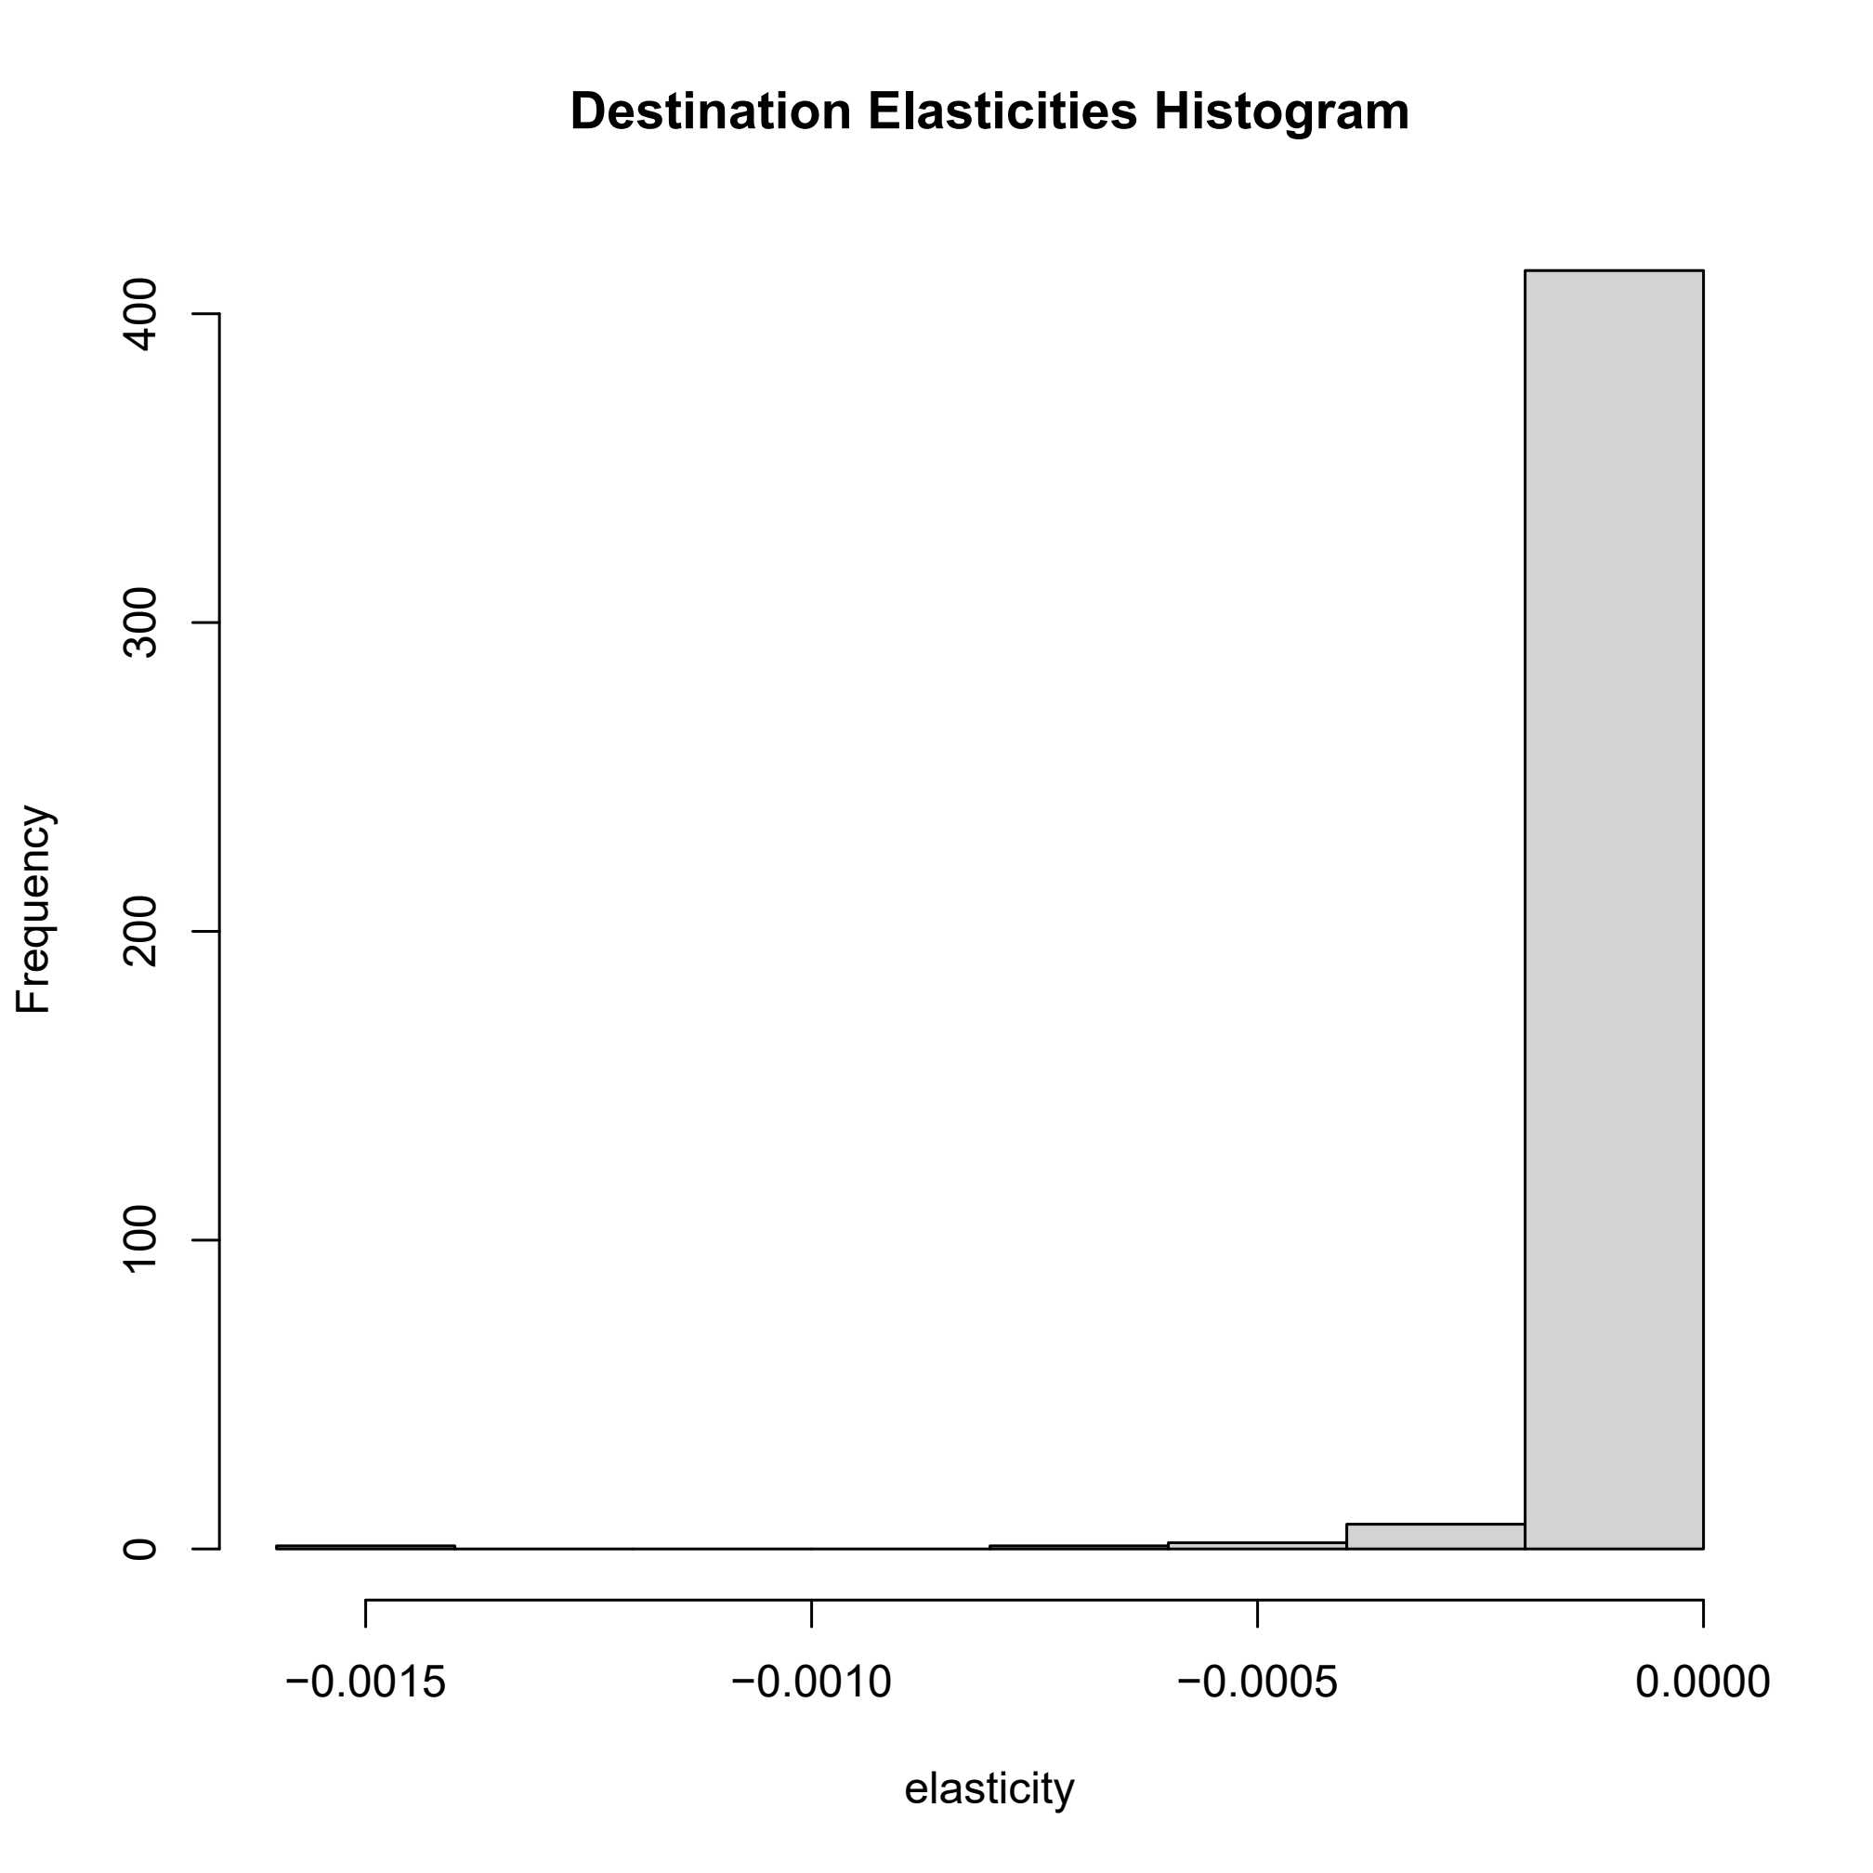
Combined Modes Elasticities

Slide 12
Further Work and Conclusions
Further work
1: Expansion of study area to include effects of London and Birmingham
2: Examine individual trips to identify trip origins of high destination elasticities
3: Further analysis of model rents to disaggregate mixing effects
4: Examine inflows and outflows
Conclusions
1: Not particularly promising either in analysis or in prospects for corridor
2: Accessibility rents may only capture part of agglomeration effects
3: Housing developments may succeed
Stuart S Rosenthal and William C Strange. How close is close? the spatial reach of agglomeration economies. Journal ofeconomic perspectives, 34(3):27–49, 2020.
Valler, D., Allmendinger, P. and Nelles, J., 2023. The sinking of the Oxford-Cambridge Arc: strategic planning in England at a nadir? Town Planning Review, 94(6), pp.611–633.

