Slide 1



UCL CENTRE FOR ADVANCED SPATIAL ANALYSIS
THE BARTLETT
18th European Colloquium on Theoretical and
Quantitative Geography (5-9 September 2013)
The Effect of Transport on Land Use
Von Thünen’s Legendre Transform
Robin Morphet
6th September 2013

Slide 2
Aims
von Thünen
Laplace
Lagrange
Legendre
Boltzman
Helmholtz
Gibbs
Jaynes
land use
Lösch
Lowry
location
spatial interaction
Launhardt, Weber, Christaller
Reilly, Tobler, Wilson

Slide 3
Outline and Structure of Proof
Describe von Thunen construction
Show relation to Legendre transform
Maximum entropy derivation of the von Thunen model
Identify the maximum entropy model’s Legendre transform and hence its rent parameter
Extend to doubly constrained model
Examine potential uses and exploitation
Examine empirical case study

Slide 4
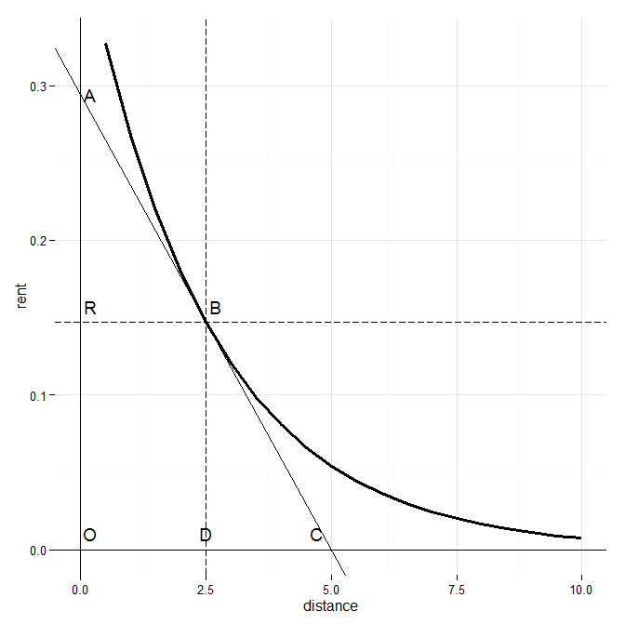
travel cost
distance

Slide 5
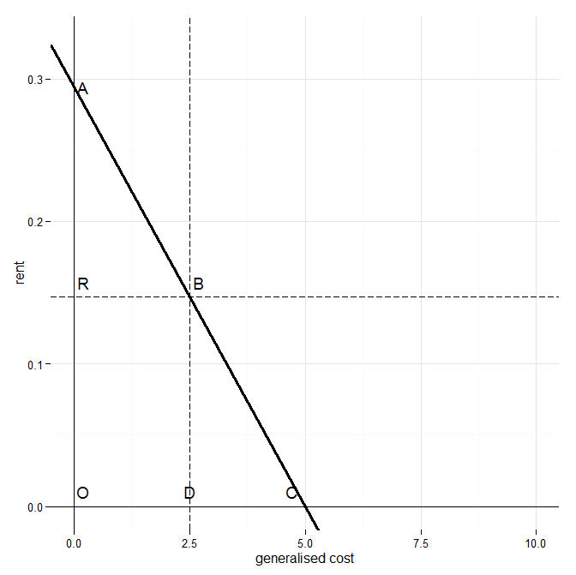



transport cost
The Legendre Transform
transport
cost

Slide 6


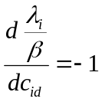




The von Thünen Maximum Entropy Derivation
d
First set up the Lagrangian
normalisation
Origin constraint
p_{id}
entropy
cost constraint
This gives the singly constrained model
knowing gives and
so
By comparing this Legendre transform with the von Thünen
Legendre transform we infer

Slide 7


The Spatial Interaction Model
origin and destination
constraints
entropy
average cost
normalisation
This equation is dimensionless
It gives the equation
which is the spatial interaction model ( in slightly unfamiliar form)
Now divide all through by
average cost
origin and destination
constraints
normalisation
entropy cost
This equation has dimensions of cost
It corresponds to the transportation problem of operational research

Slide 8



The Doubly Constrained Spatial Interaction Model
1. The consumer surplus includes terms due to rent and this is likely to
substantially increase the cost benefit ratios of transport investments
2. Over time rents are likely to rise and absorb the consumer surplus

Slide 9








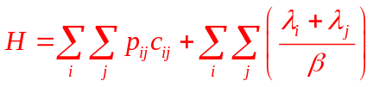

A
S

Slide 10
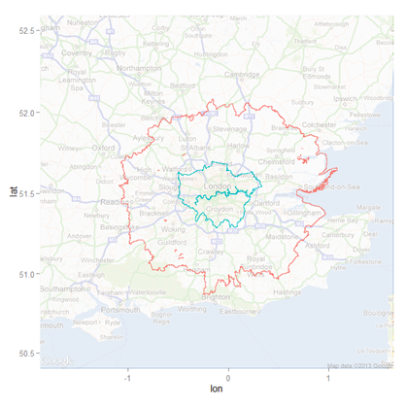
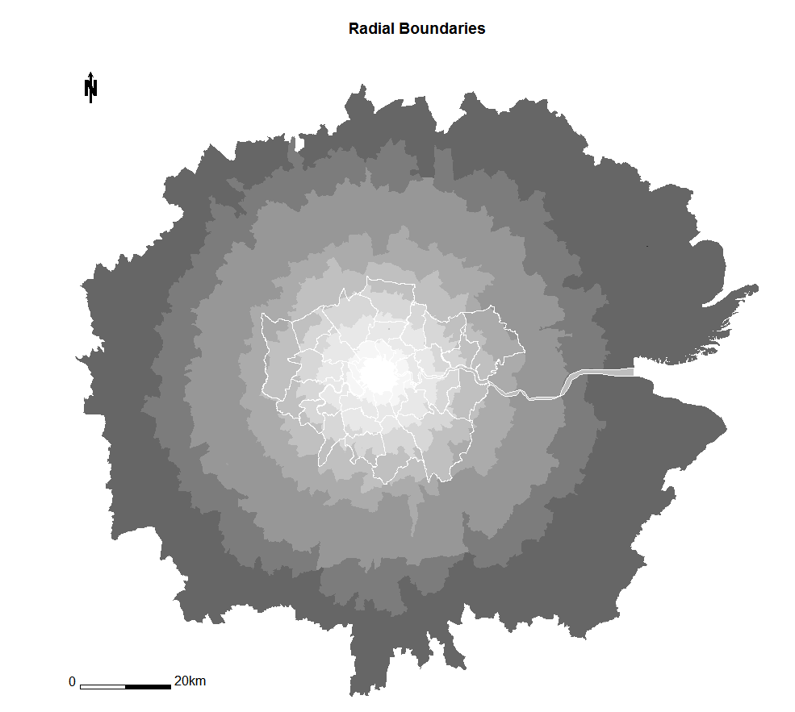
The Study Area

Slide 11
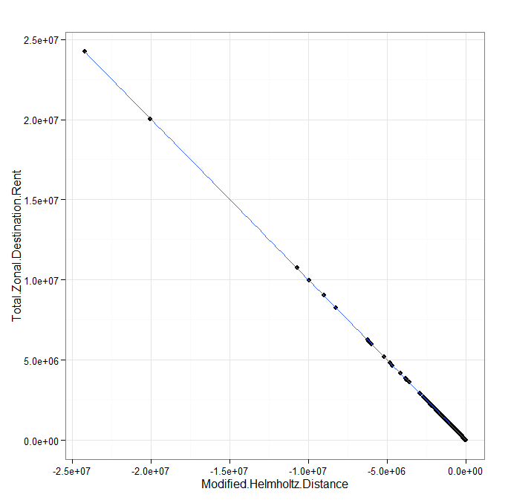
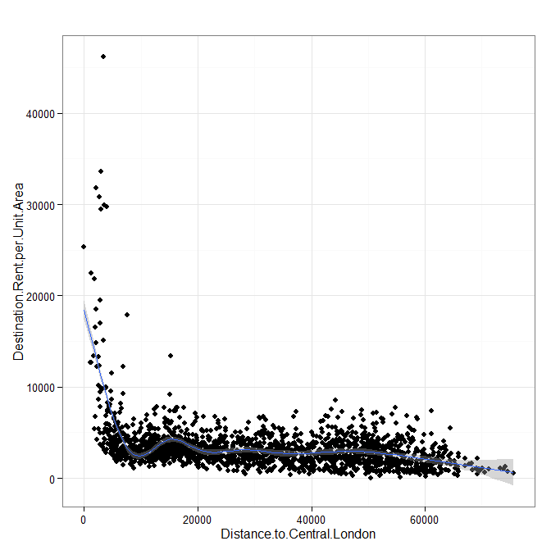
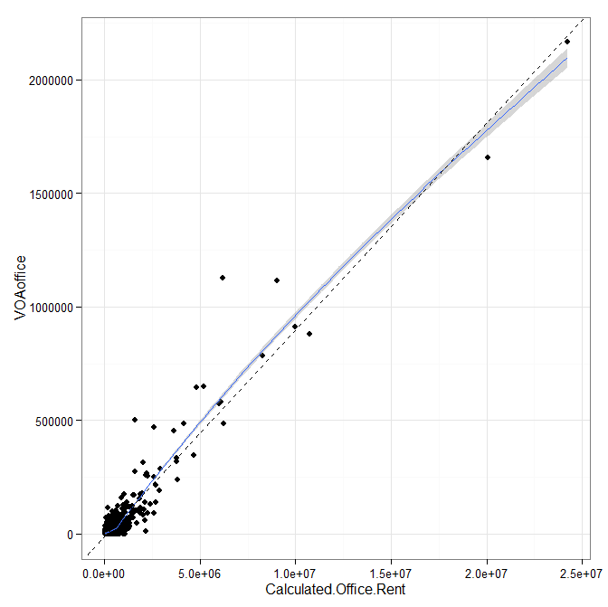
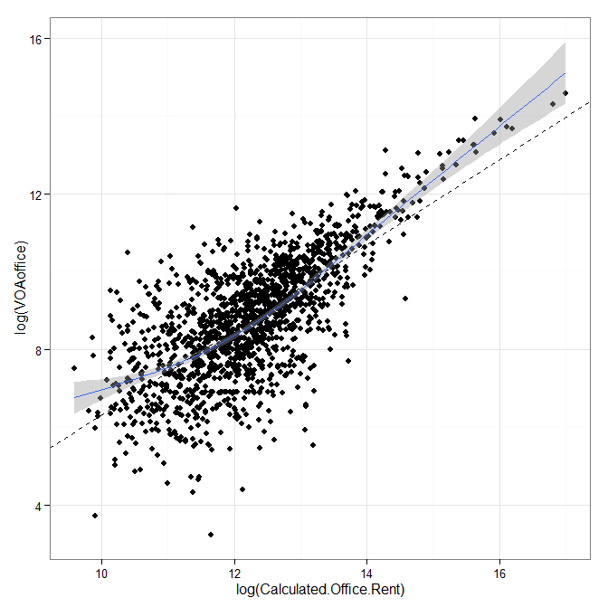
Destination Rent Plots

Slide 12
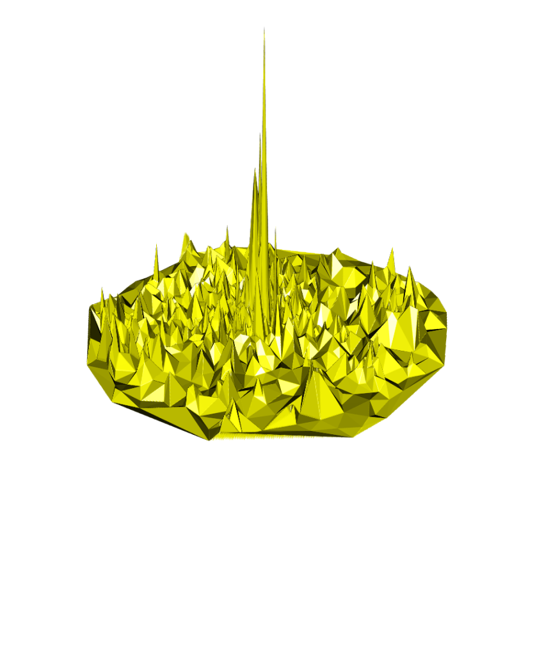
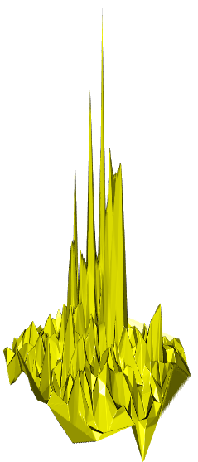
Rent Surfaces 1
Destination rents: Study Area
Origin rents: Greater London

Slide 13


Rent Surfaces 2
Löschian Market Areas
Study Area:
Destination Rents
Greater London:
Origin Rents

Slide 14
Summary
Determined the Legendre transform of rent in the von Thünen model
Used generalised cost to linearise the bid rent curve
Developed the entropy maximising derivation of the von Thünen model
Determined rent in the MaxEnt model from the Legendre transform of cost
Applied this definition of rent to the doubly constrained transport model
Developed the Legendre diagram for the city
Modelled rents in the London area and tested them against surveyed rents
Further Work
Develop the economic analysis following the work of Solow
Assess the value of the analysis in project evaluation
Examine the use of calculated rents as a measure of agglomeration economies
Test the model on more detailed multimode transportation studies

Slide 15
The Effect of Transport on Land Use
Von Thünen’s Legendre Transform
Thank you for listening.
Are there any questions?
Robin Morphet
Centre for Advanced Spatial Analysis
The Bartlett
University College London
r.morphet@ucl.ac.uk

