Slide 1
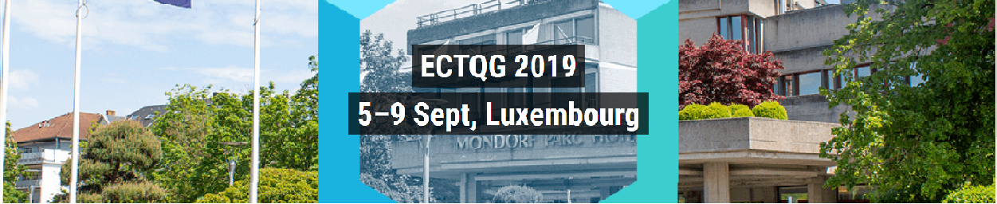

Gravity Model Dynamics as Heat Cycles
Robin Morphet
THE BARTLETT
CENTRE FOR ADVANCED SPATIAL ANALYSIS

Slide 2
THE BARTLETT
CENTRE FOR ADVANCED SPATIAL ANALYSIS
Research Questions
What is the value of Z the partition function in the gravity model?
How do the balancing factors relate to rent?
What is the measure of imperfect competition in the gravity model?
To what extent does equipartition apply to the gravity model?
How might the thermodynamics of heat engines apply to the interacting
dynamics of transport and land-use?

Slide 3
UCL CENTRE FOR ADVANCED SPATIAL ANALYSIS
THE BARTLETT
THE BARTLETT
CENTRE FOR ADVANCED SPATIAL ANALYSIS
A comparison of model formulations
Traditional formulation
Rewritten as
trip cost
origin rent
Statistical mechanics version
destination rent

Slide 4
THE BARTLETT
CENTRE FOR ADVANCED SPATIAL ANALYSIS
The argument on rents in the gravity model
Balancing factors as functions of rent first introduced by Dieter in Toronto Study
Dismissed by others arguing that balancing factors were terminal costs like parking
Reintroduced by Senior et al as penalty functions
In fact they are von Thunen location rents per trip. They represent the inescapable
costs of trip making whereas terminal costs like parking are escaped if the trip is
not made
Dieter, K.H., Distribution of Work Trips in Toronto, Journal of the City Planning Division, Proceedings of the American Society of Civil Engineers, CP1, pp 9-28, August 1962
Kirby, Howard R., Normalizing Factors of the Gravity Model – An Interpretation. Transportation Research, Vol. 4, pp 37-50 1970
Williams H.C.W.L. and Senior M.L. 1978. Accessibility, Spatial Interaction and the Evaluation of Land Use-Transportation Plans. En A. Karlqvist, L. Lundqvist, F. Snickars and J.W. Weibull (Eds.). Spatial Interaction Theory and Planning Models, 253-287. North Holland, Amsterdam

Slide 5
THE BARTLETT
CENTRE FOR ADVANCED SPATIAL ANALYSIS
The Entropy Maximising Derivation of von Thunen
 | The City
O₁ | d_{1d}
O₂ | d_{2d}
... | ...
O_{i} | d_{id}
... | ...
O_{n} | d_{nd}
 | The City
O₁ | c_{1d}
O₂ | c_{2d}
... | ...
O_{i} | c_{id}
... | ...
O_{n} | c_{nd}
 | The City
p₁ | p_{1d}
p₂ | p_{2d}
... | ...
p_{i} | p_{id}
... | ...
p_{n} | p_{nd}
 | The City
p₁
p₂
... | ...
p_{i}
... | ...
p_{n}
 | The City
O₁ | d_{1d}
O₂ | d_{2d}
... | ...
O_{i} | d_{id}
... | ...
O_{n} | d_{nd}
 | The City
O₁ | c_{1d}
O₂ | c_{2d}
... | ...
O_{i} | c_{id}
... | ...
O_{n} | c_{nd}
 | The City
p₁ | p_{1d}
p₂ | p_{2d}
... | ...
p_{i} | p_{id}
... | ...
p_{n} | p_{nd}
 | The City
p₁
p₂
... | ...
p_{i}
... | ...
p_{n}
von Thunen
model
MaxEnt
probability
estimates
The Legendre
transform
von Thunen
model
von Thunen +
generalised cost
Observed trip
matrix
MaxEnt
probability
estimates
The Legendre
transform

Slide 6
THE BARTLETT
CENTRE FOR ADVANCED SPATIAL ANALYSIS
Imperfect Competition and Consumer Deadweight Loss
Perfect competition requires zero trip cost
-this gives us Harberger’s triangle, the deadweight loss. Hence we can estimate the deviation from perfect competition
The demand curve is a Chamberlinian industry demand
Notes:
The conventional single demand curve for a reduction in cost. Sliding up it produces a consumer surplus Y + Z
The deadweight loss reduces by X + Y but the trip cost increases by X and decreases by Z
This is a helpful simplification but reality is more complex in particular the different values of Pij correspond to different values of Z, i.e. to different demand curves
There is no reason (in the model) why PiPj should represent the lowest cost
The Pijs may straddle PiPj

Slide 7
THE BARTLETT
CENTRE FOR ADVANCED SPATIAL ANALYSIS
The Equipartition Theorem
The equipartition theorem says that energy averaged out over degrees of freedom
i.e.
We do not find that but we find
In retrospect this is not so surprising and follows from the Maxwell relations applied
to a constant area(volume) process
What is surprising is that the canonical equation of state
In its differential form splits into two
and
suggesting a similar decomposition may be possible in handling gravity model dynamics
Fraundorf, P. (2003). Heat capacity in bits. American Journal of Physics, 71(11), 1142-1151

Slide 8
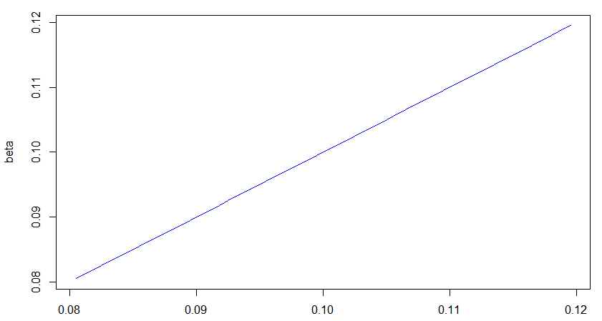
THE BARTLETT
CENTRE FOR ADVANCED SPATIAL ANALYSIS
The numerical demonstration of the linear relation of beta and ΔS/ΔU
ΔS/ΔU

Slide 9
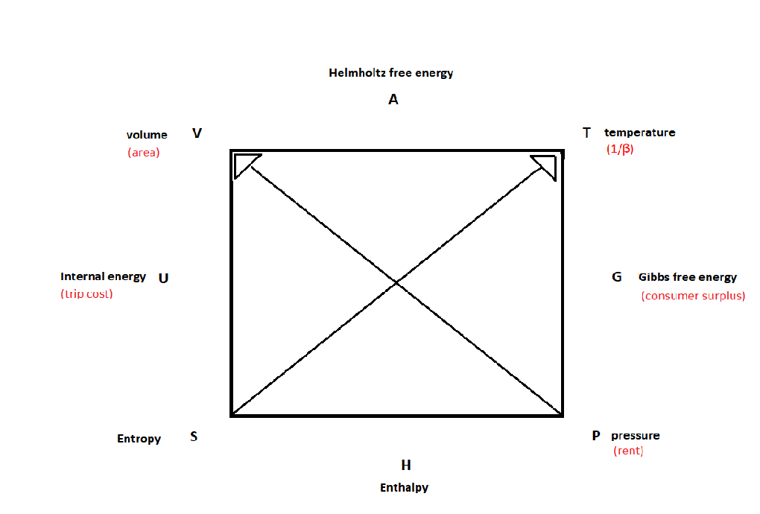
THE BARTLETT
CENTRE FOR ADVANCED SPATIAL ANALYSIS
Maxwell’s Relations diagram

Slide 10
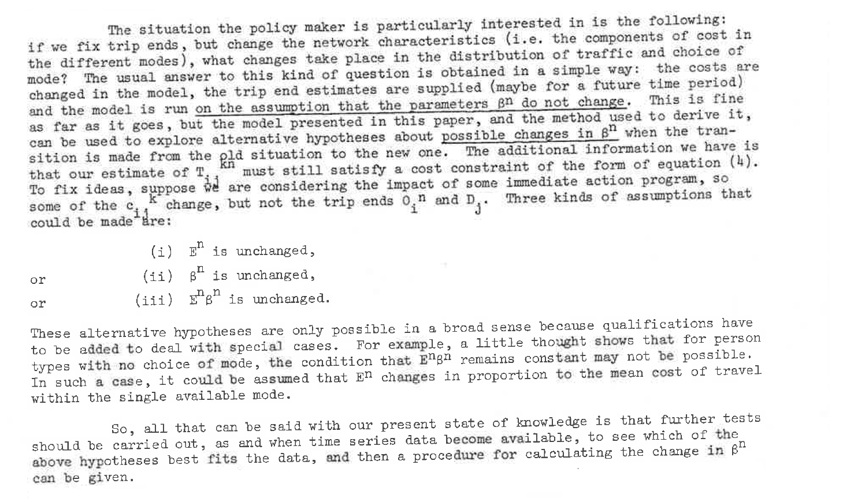
THE BARTLETT
CENTRE FOR ADVANCED SPATIAL ANALYSIS
The projection problem (1)
Hyman, G. M., & Wilson, A. G. (1969). The effects of changes in travel costs on trip distribution and modal split. High Speed Ground Transportation Journal, 3(1), 79-85

Slide 11
THE BARTLETT
CENTRE FOR ADVANCED SPATIAL ANALYSIS
The projection problem (2)
The Hyman and Wilson alternatives correspond to
U is unchanged: dU = 0
β is unchanged: dT = 0
S is unchanged : dS = βdU = 0
Of these options only (i) seems acceptable which implies repeat calibration for predictive models.

Slide 12
THE BARTLETT
CENTRE FOR ADVANCED SPATIAL ANALYSIS
The land-use transport development process
Initiated by a reduction in transport cost by infrastructure investment
Leading to improved accessibility and hence increased rent/ua
Resulting in increased investment in higher density property where land restricted
and new high value property where land available
Leading to increased demand on transport infrastructure and hence increased
infrastructure investment
et seq.

Slide 13
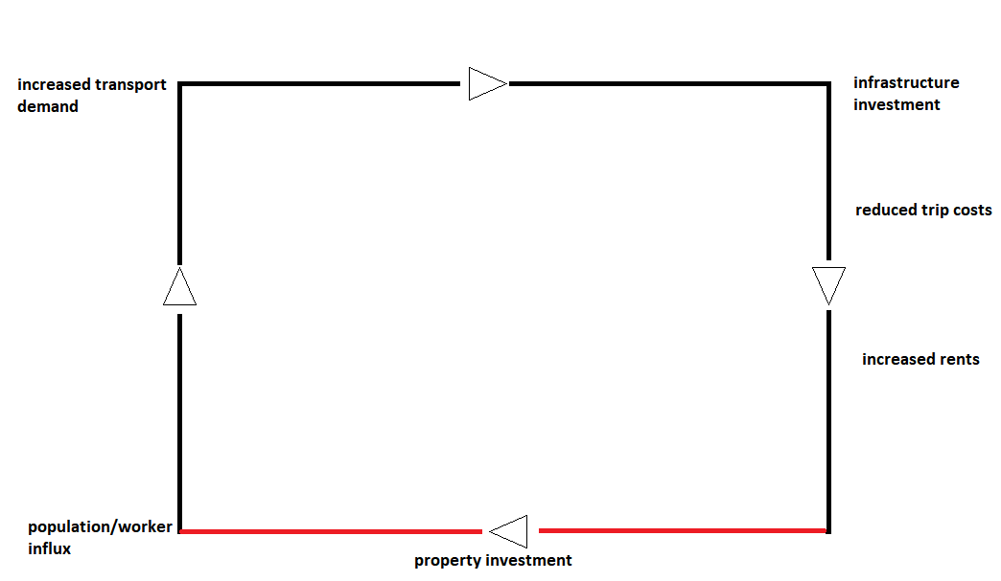
THE BARTLETT
CENTRE FOR ADVANCED SPATIAL ANALYSIS

Slide 14
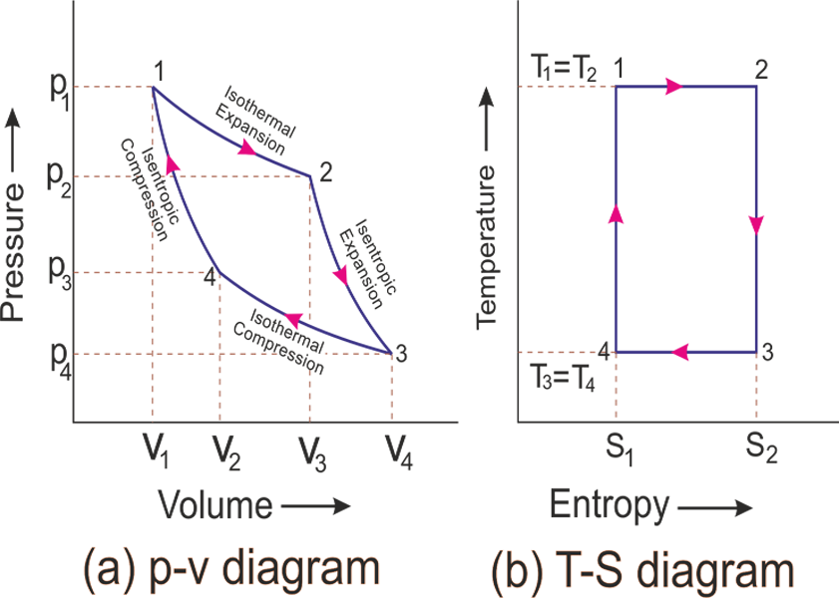
THE BARTLETT
CENTRE FOR ADVANCED SPATIAL ANALYSIS
Carnot analysis
The Carnot cycle is reversible when it acts as a refrigerator
The isentropic processes are idealised and unachievable in practice
Notes:
Although we can keep temperature constant we cannot at the same time change entropy other than by manipulating the balancing factors.

Slide 15
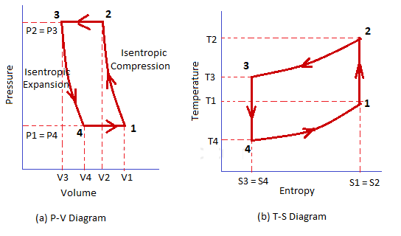
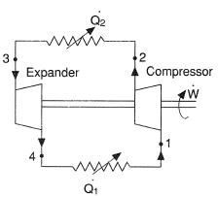
THE BARTLETT
CENTRE FOR ADVANCED SPATIAL ANALYSIS
Refrigeration gas cycle
Economic pressure attracts people
Density and traffic congestion increase
Q2. Transport investment reduces congestion
3-4. Construction increases floor area
Q1. -
4-1. Economic pressure builds again
Driven by economic growth but not
reversible because of work in expansion. Path dependent

Slide 16
THE BARTLETT
CENTRE FOR ADVANCED SPATIAL ANALYSIS
The gravity model cycle

Slide 17
THE BARTLETT
CENTRE FOR ADVANCED SPATIAL ANALYSIS
Conclusions
Just a model
Calibration more difficult than previously thought
Still an equilibrium model although cities change
quite slowly given that we analyse a single working day

Slide 18
THE BARTLETT
CENTRE FOR ADVANCED SPATIAL ANALYSIS
Thank you
Robin Morphet
r.morphet@ucl.ac.uk
@rmorphet

