Slide 1
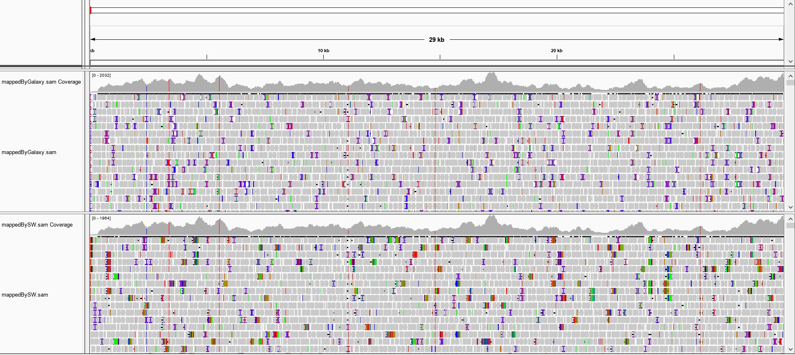
Reference
*
*
*
*
*
*
Galaxy
Proposed SDSoC
solution

