Slide 1
Sending data from ESP32 to InfluxDB
Data Streaming and Realtime Analytics
Krisna Pintong 631040695 AIML

Slide 2
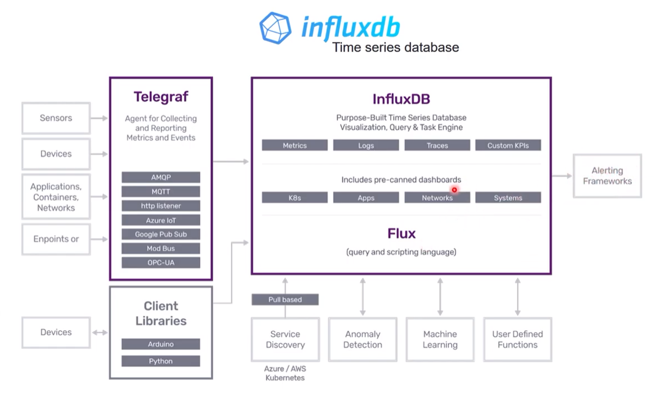
Data Pipeline

Slide 3




Tools & Software

Slide 4
version: '2'
services:
influxdb:
image: influxdb:latest
ports:
- '8086:8086'
volumes:
- influxdb-storage:/var/lib/influxdb
environment:
- INFLUXDB_DB=db0
- INFLUXDB_ADMIN_USER=${INFLUXDB_USERNAME}
- INFLUXDB_ADMIN_PASSWORD=${INFLUXDB_PASSWORD}
grafana:
image: grafana/grafana:latest
ports:
- '3000:3000'
volumes:
- grafana-storage:/var/lib/grafana
- ./grafana-provisioning/:/etc/grafana/provisioning
depends_on:
- influxdb
environment:
- GF_SECURITY_ADMIN_USER=${GRAFANA_USERNAME}
- GF_SECURITY_ADMIN_PASSWORD=${GRAFANA_PASSWORD}
volumes:
influxdb-storage:
grafana-storage:
Docker Compose
[ 1st Run ]
- docker-compose up –d
[ 2nd ]
- docker-compose up -d --build

Slide 5
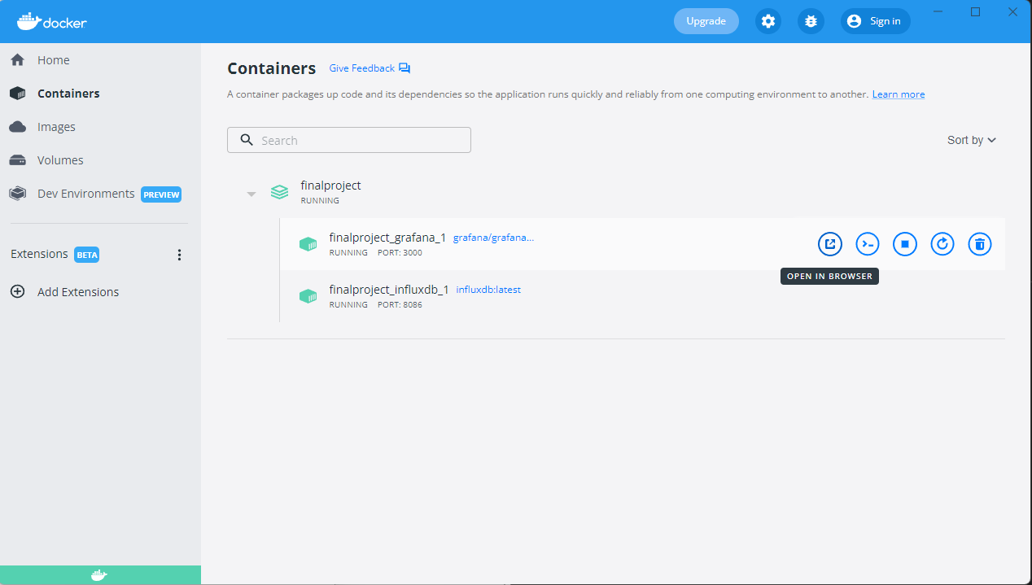
Docker

Slide 6
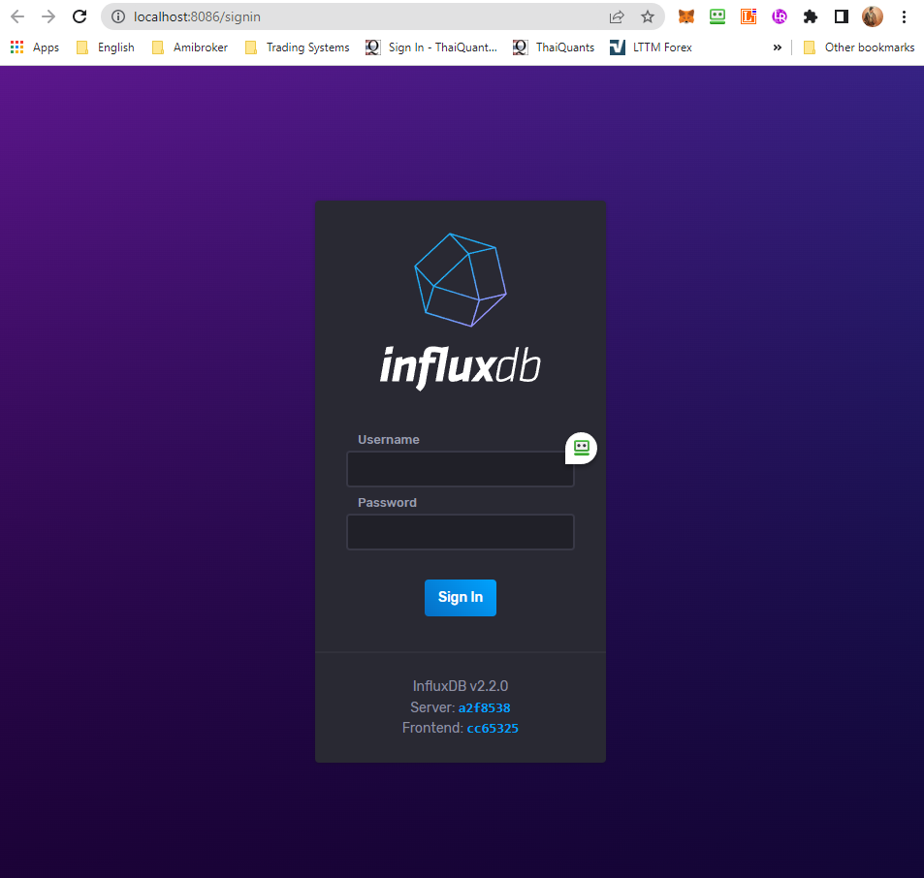
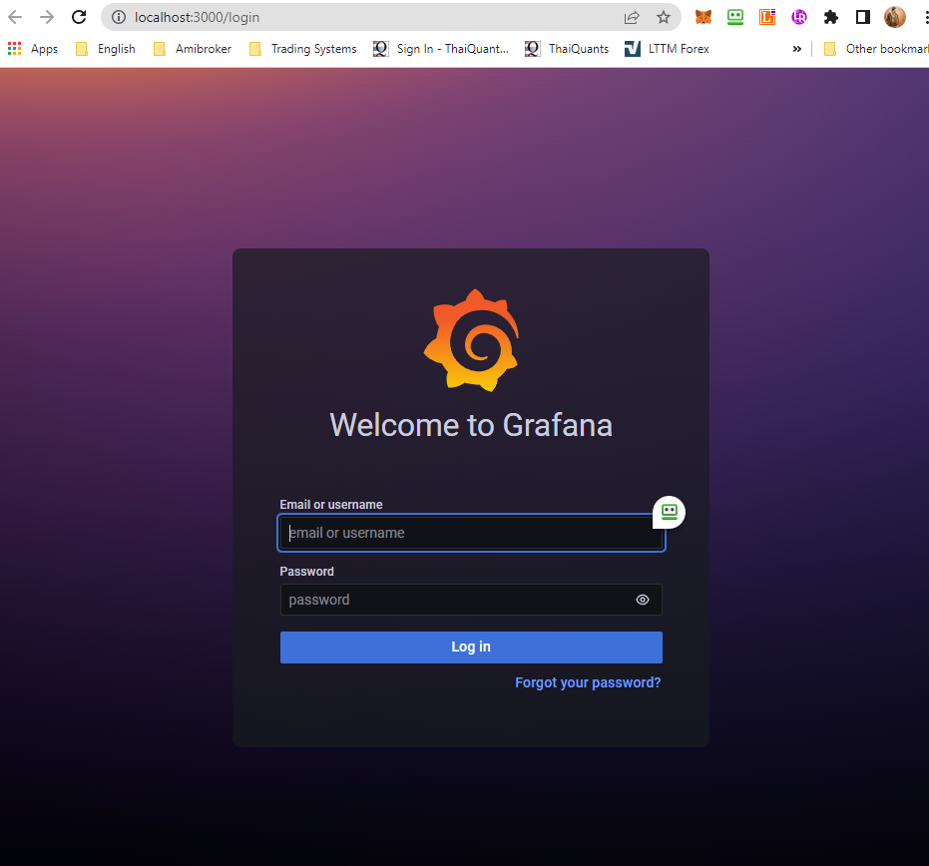
Login

Slide 7
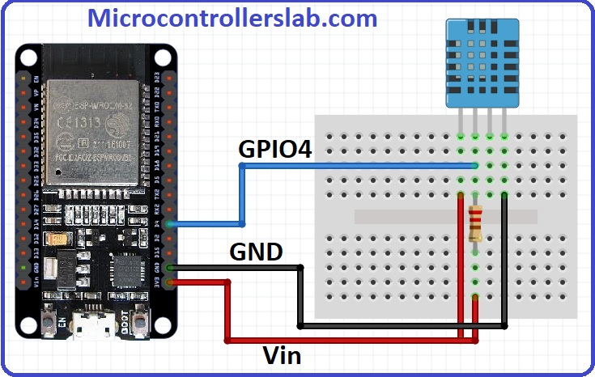
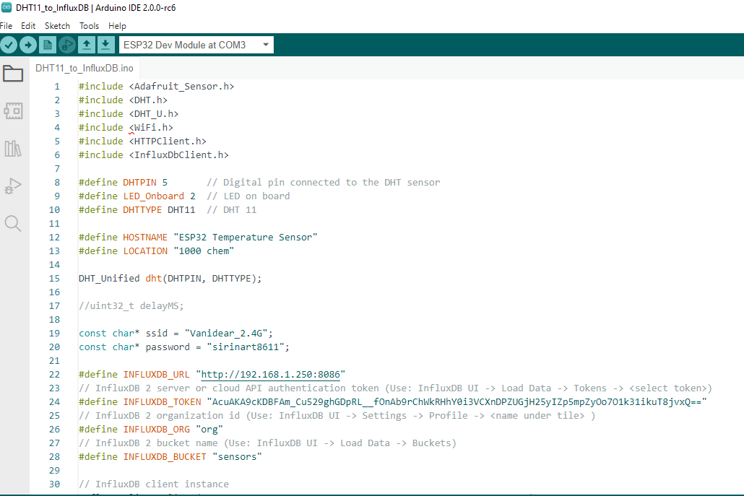
DHT11 to InfluxDB

Slide 8
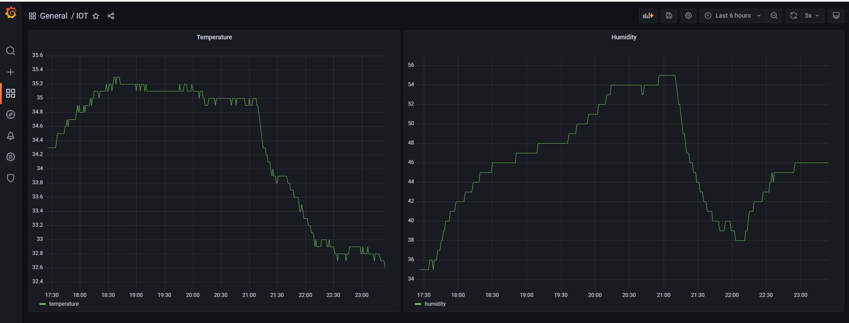
Grafana Realtime Monitor

Slide 9
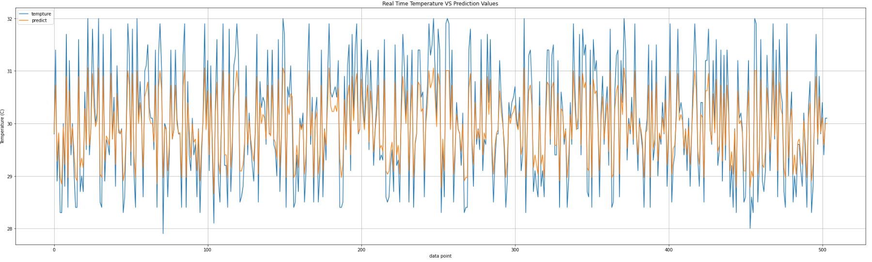
Real time Temperatures VS Prediction Values
Github : https://github.com/robinoud/DTH11_to_InfluxDB

