Slide 1
Noodles Crypto Analytics
Richa Singh

Slide 2
Noodles Crypto Analytics
From fragmented crypto data to a trusted, executive-ready analytics platform.
Python ETL, a star-schema warehouse, and Power BI dashboards now deliver reliable business insight for market, sentiment, and top-performer analysis.
Data Sources
4+ feeds
Warehouse
Star schema
Dashboards
2 executive views
Value
Decision-ready
Executive summary
Trusted data foundation
Stakeholder-ready reporting

Slide 3
Executive Summary
Why the solution matters to leadership
Built a unified analytics platform for crypto market and sentiment data.
Transformed raw JSON feeds into a clean warehouse and business-ready dashboards.
Enabled faster, more confident decision-making for portfolio and market monitoring.
Business value at a glance
Trusted reporting foundation
Faster insight discovery
Scalable for future expansion

Slide 4
Business Challenge
Why a structured analytics platform was needed
Crypto data is fragmented across multiple sources and formats.
Executives need a clear and reliable view of performance trends and sentiment.
Manual analysis was slow and prone to inconsistencies.
Outcome
A single, trusted source of truth for reporting and decision support.

Slide 5
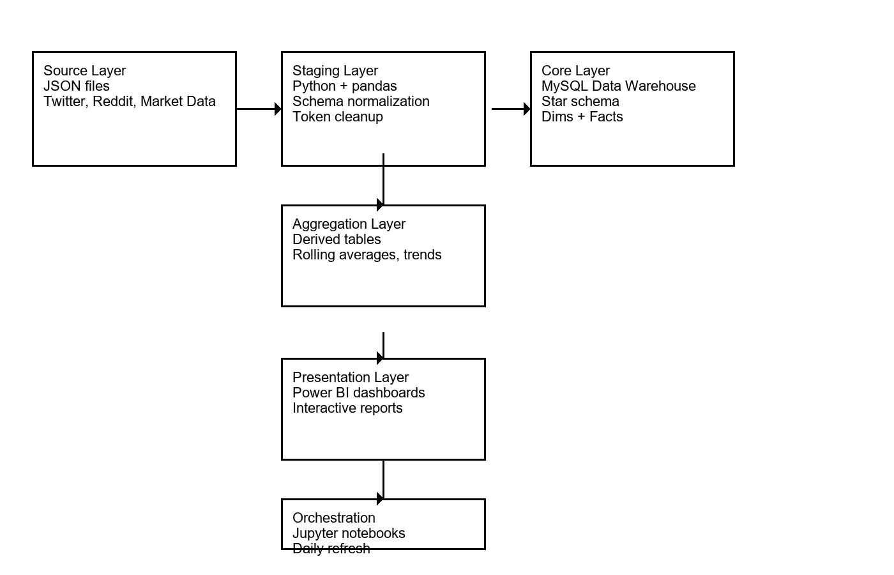
Solution Architecture
From ingestion to executive reporting
Raw data ingestion
Transformation and validation
Warehouse and views
Power BI delivery

Slide 6
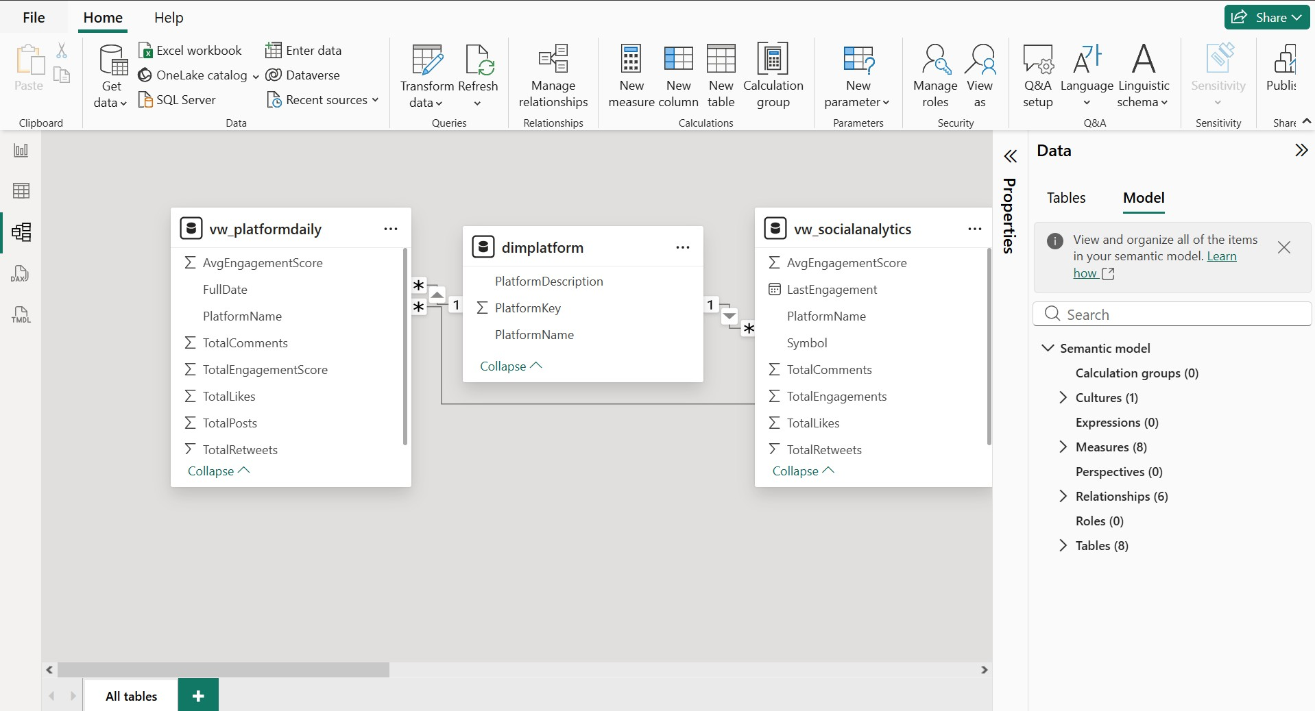
Data Model & Design
Star schema designed for fast analytics
Core dimensions: Currency, Date, and Platform
Fact tables support market and social engagement metrics
Relationships are normalized for accurate and efficient reporting

Slide 7
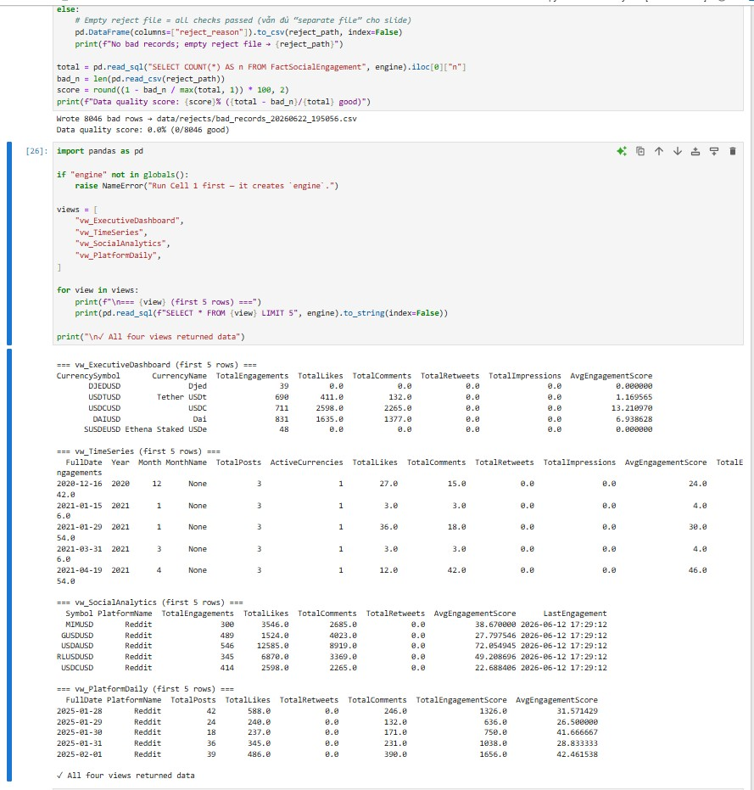
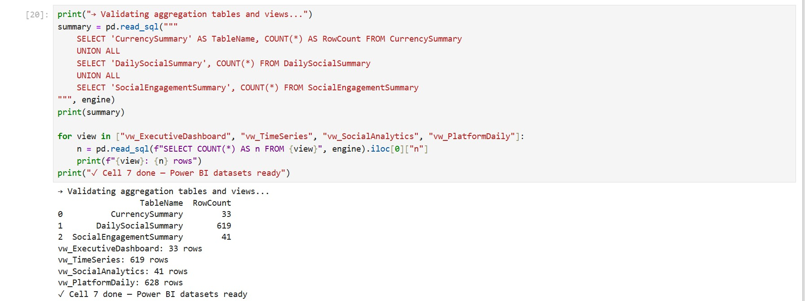
Data Pipeline & Quality
Automation with quality controls
Python notebooks automate extraction and loading.
Validation checks ensure completeness and consistency.
Quality controls improve trust in downstream dashboards.

Slide 8
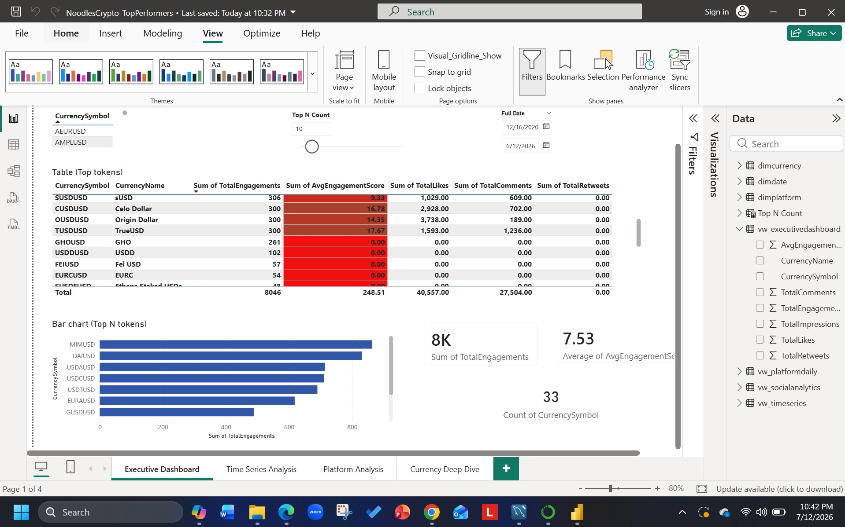
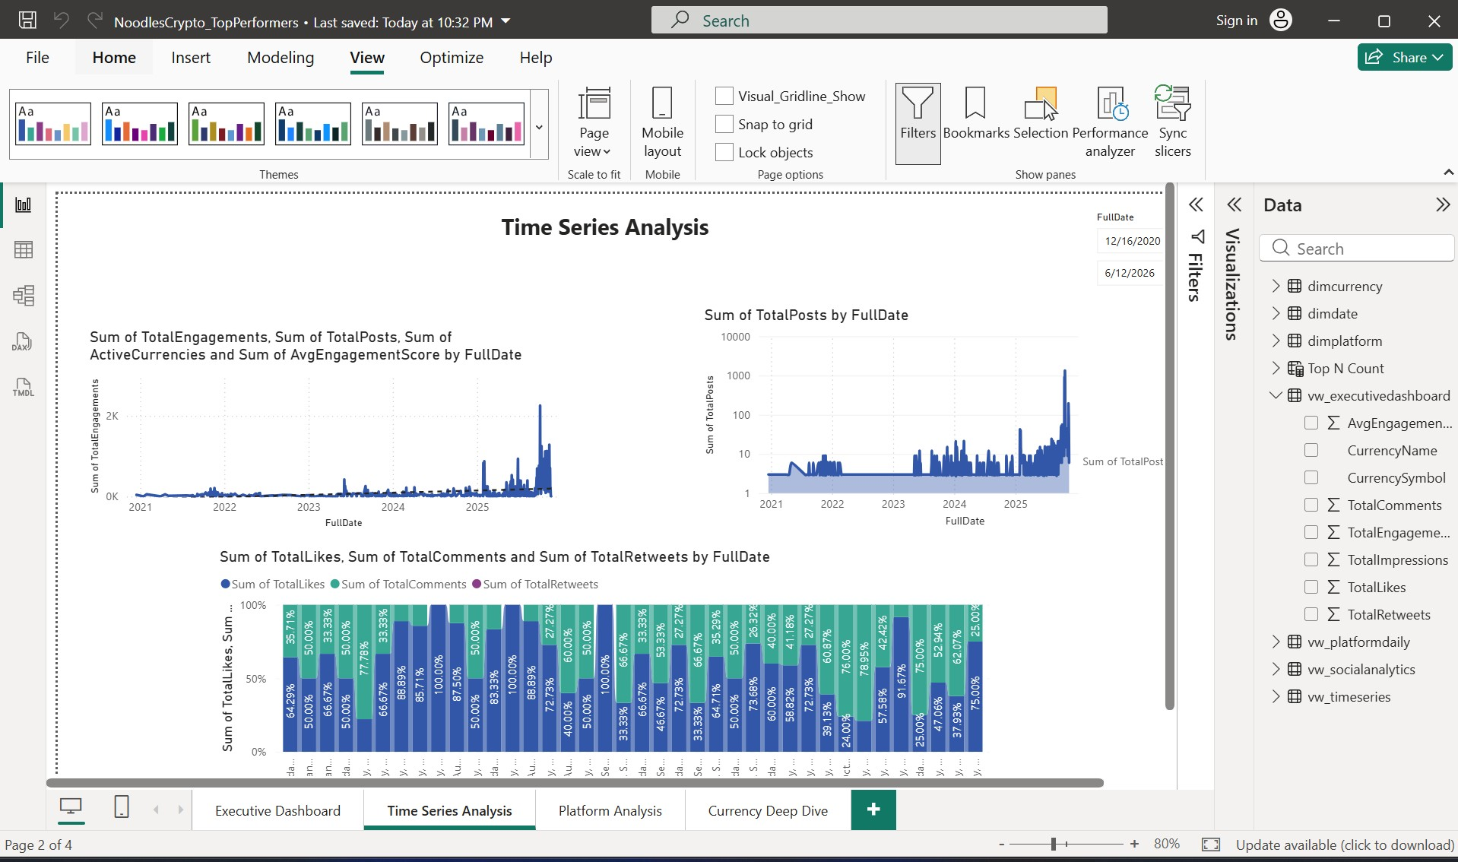
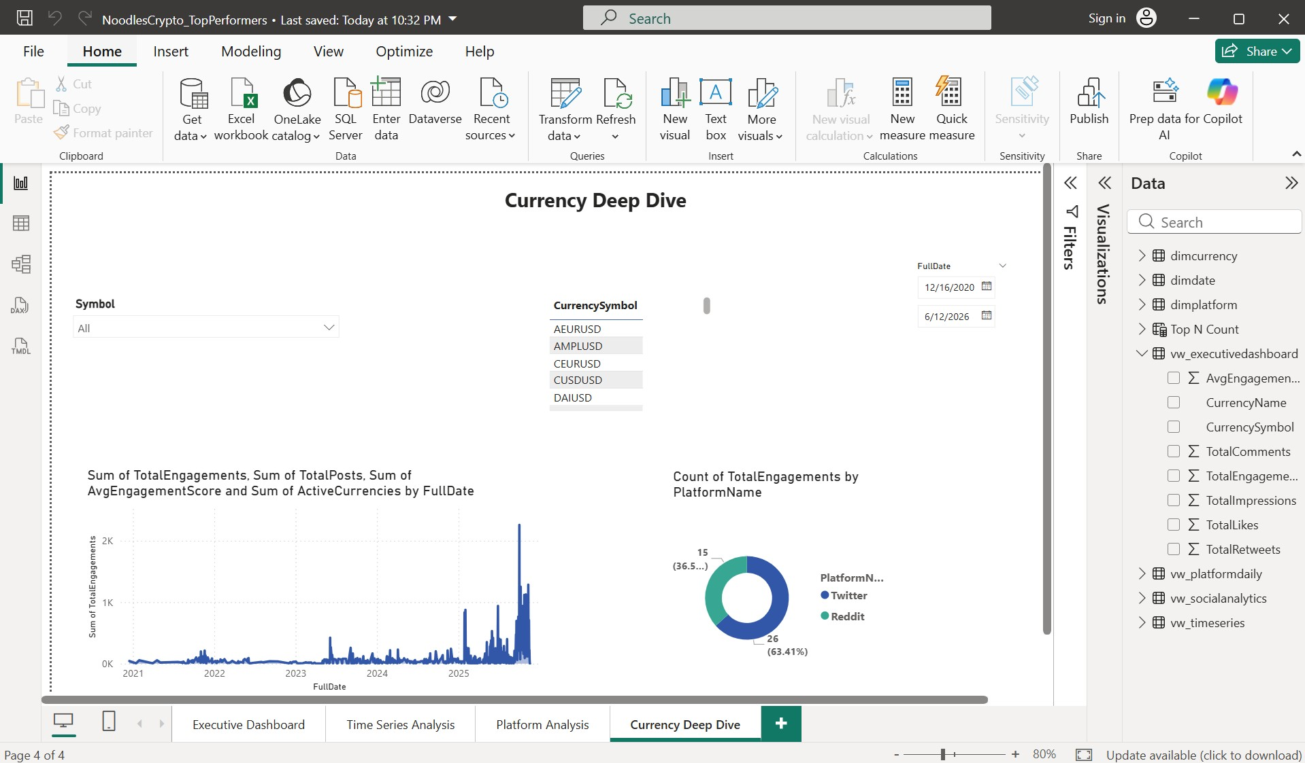
Dashboard Experience
Stakeholder-first reporting experience
KPI-driven layout
Trend views for rapid understanding
Actionable visual storytelling

Slide 9
Top Performers
Key market opportunities surfaced clearly
Highlights the strongest-performing currencies and momentum shifts.
Supports quick comparisons across price, volume, and sentiment.
Useful for both analysts and senior stakeholders.

Slide 10
Strategic Insights
What the analysis shows
Bitcoin dominance remains influential in market movement.
Social engagement provides a useful signal for momentum and attention.
The solution makes these insights easier to monitor and explain.
Executive takeaway
The platform turned fragmented data into a scalable, decision-ready reporting solution.

Slide 11
Next Steps & Q&A
Where the platform goes next
Next Steps
Where the platform goes next
Automate refresh schedules and monitoring.
Expand the dashboard with richer KPIs and alerts.
Scale the solution for more assets, regions, and reporting scenarios.
Refresh
Automated
Coverage
Scalable
Refresh
Automated
Coverage
Scalable

Slide 12
Thank You!!
Any queries feel free to contact
Name- Richa Singh
Email – robinricha14@gmail.com

