Slide 1
UNIT-III

Slide 2
Content
Electronic Mail Security
IP Security

Slide 3
E-mail Security
PGP, S/MIME
Certificates and PKI

Slide 4
E-mail Security
E-mail is one of the most widely used network services
One of the old killer applications of the Internet
Normally message contents not secured
Can be read/modified either in transit or at destination by the attacker
E-mail service is like postcard service
just pick it and read it

Slide 5
Email Security Enhancements
confidentiality
protection from disclosure
authentication
of sender of message
message integrity
protection from modification
non-repudiation of origin
protection from denial by sender

Slide 6
Pretty Good Privacy (PGP)
widely used secure e-mail software
originally a file encryption/decryption facility
developed by Phil Zimmermann
a security activist who has had legal problems due to PGP
best available crypto algorithms are employed
available on several platforms with source code
originally free, now commercial versions exist
not controlled by a standardization body
although there are RFCs

Slide 7
PGP is a remarkable phenomenon. Largely the effort of a single person, Phil Zimmermann, PGP provides a confidentiality and authentication service that can be used for electronic mail and file storage applications.
In essence, Zimmermann has done the following:

Slide 8
Selected the best available cryptographic algorithms as building blocks.
Integrated these algorithms into a general-purpose application that is independent of operating system and processor and that is based on a small set of easy-to-use commands.
Made the package and its documentation, including the source code, freely available via the Internet, bulletin boards, and commercial networks such as AOL (America On Line).
Entered into an agreement with a company (Viacrypt, now Network Associates) to provide a fully compatible, low-cost commercial version of PGP.

Slide 9
PGP has grown explosively and is now widely used. A number of reasons can be cited for this growth.
It is available free worldwide in versions that run on a variety of platforms, including Windows, UNIX, Macintosh, and many more. In addition, the commercial version satisfies users who want a product that comes with vendor support.
It is based on algorithms that have survived extensive public review and are considered extremely secure. Specifically, the package includes RSA, DSS, and Diffie-Hellman for public-key encryption;CAST-128, IDEA, and 3DES for symmetric encryption; and SHA-1 for hash coding.
3. It has a wide range of applicability, from corporations that wish to select and enforce a standardized scheme for encrypting files and messages to individuals who wish to communicate securely with others worldwide over the Internet and other networks.

Slide 10
It was not developed by, nor is it controlled by, any governmental or standards organization. For those with an instinctive distrust of “the establishment,” this makes PGP attractive.
PGP is now on an Internet standards track (RFC 3156; MIME Security with Open PGP). Nevertheless, PGP still has an aura of an antiestablishment endeavor.

Slide 11
We begin with an overall look at the operation of PGP. Next, we examine how cryptographic keys are created and stored. Then, we address the vital issue of public-key management.

Slide 12
PGP OPERATIONS
Digital Signatures (and consequently message authentication and integrity)
RSA, DSS
Message Encryption
CAST, IDEA, 3DES, AES (all at least 128 bits)
symmetric keys are used once and encrypted using RSA or ElGamal (based on discrete logs)
Compression using ZIP
Radix-64 conversion (to ASCII)
for e-mail compatibility

Slide 13
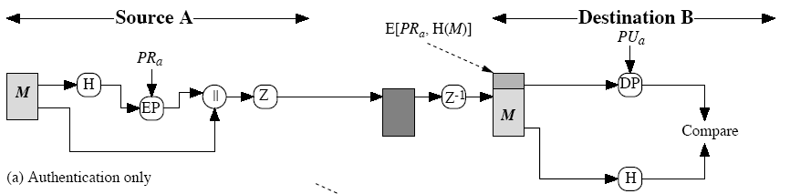
PGP Operation – Authentication
Classical application of public key crypto
This figure is actually for RSA
for DSA refer to previous lectures
Z is zip function
radix-64 conversion is done after zip at sender, before Z⁻¹ at receiver
may be done only for signature or for the whole message

Slide 14
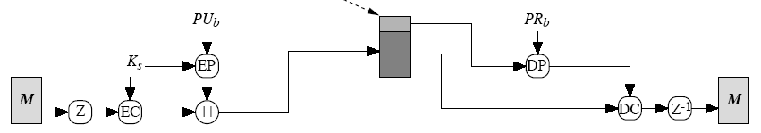
PGP Operation – Confidentiality
E[PU_{b}, K_{s}]
One-time session key, K_{s}
generated at random
encrypted using a public key cryptosystem, EP
RSA or ElGamal
Message is compressed before encryption
This is the default case

Slide 15
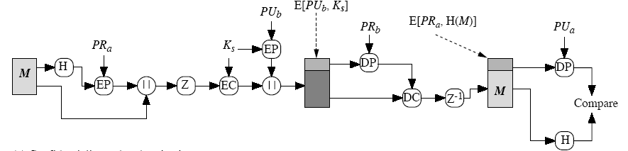
PGP Operation – Confidentiality and Authentication
uses both services on same message
create signature and attach to message
compress and encrypt both message & signature
attach encrypted session key
radix-64 conversion is for everything at the end

Slide 16
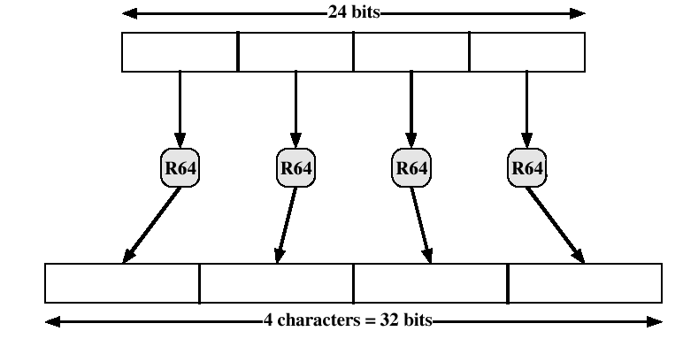
PGP Operation – E-mail compatibility radix-64 conversion
Encrypted text and signatures create binary output
however email was designed only for text
hence PGP must encode raw binary data into printable ASCII characters
uses radix-64 algorithm (See CS408 notes)
maps 3 bytes to 4 printable chars

Slide 17
Compression
As a default, PGP compresses the message after applying the signature but before encryption. This has the benefit of saving space both for e-mail transmission and for file storage. The placement of the compression algorithm, indicated by Z for compression and Z-1.
1. The signature is generated before compression for two reasons:
a. It is preferable to sign an uncompressed message so that one can store only the uncompressed message together with the signature for future verification. If one signed a compressed document, then it would be necessary either to store a compressed version of the message for later verification or to recompress the message when verification is required.

Slide 18
b. Even if one were willing to generate dynamically a recompressed message for verification, PGP’s compression algorithm presents a difficulty. The algorithm is not deterministic; various implementations of the algorithm achieve different tradeoffs in running speed versus compression ratio and, as a result, produce different compressed forms. However, these different compression algorithms are interoperable because any version of the algorithm can correctly decompress the output of any other version. Applying the hash function and signature after compression would constrain all PGP implementations to the same version of the compression algorithm.
2. Message encryption is applied after compression to strengthen cryptographic security. Because the compressed message has less redundancy than the original plaintext, cryptanalysis is more difficult.

Slide 19
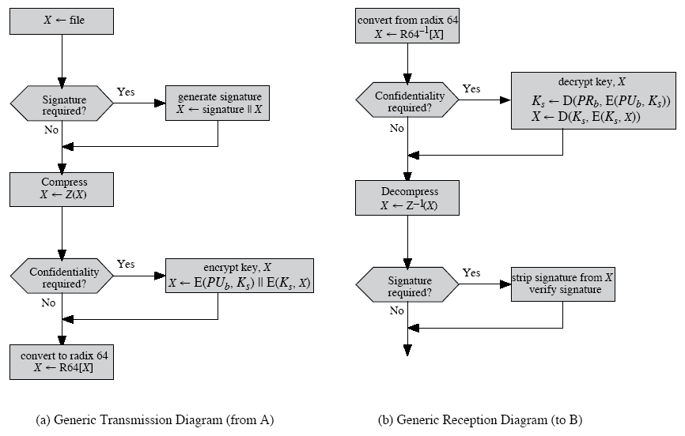
PGP Operation – Summary

Slide 20
Cryptographic Keys and Key Rings
PGP makes use of four types of keys: one-time session symmetric keys, public keys, private keys, and passphrase-based symmetric keys (explained subsequently).
Three separate requirements can be identified with respect to these keys.
A means of generating unpredictable session keys is needed.

Slide 21
We would like to allow a user to have multiple public-key/private-key pairs.
One reason is that the user may wish to change his or her key pair from time to time.
When this happens, any messages in the pipeline will be constructed with an obsolete key.
Furthermore, recipients will know only the old public key until an update reaches them.
In addition to the need to change keys over time, a user may wish to have multiple key pairs at a given time to interact with different groups of correspondents or simply to enhance security by limiting the amount of material encrypted with any one key.
The upshot of all this is that there is not a one-to-one correspondence between users and their public keys.
Thus, some means is needed for identifying particular keys.

Slide 22
Each PGP entity must maintain a file of its own public/private key pairs as well as a file of public keys of correspondents.

Slide 23
SESSION KEY GENERATION
Each session key is associated with a single message and is used only for the purpose of encrypting and decrypting that message.
Recall that message encryption/decryption is done with a symmetric encryption algorithm.
CAST-128 and IDEA use 128-bit keys; 3DES uses a 168-bit key.
For the following discussion, we assume CAST-128.
Random 128-bit numbers are generated using CAST-128 itself.
The input to the random number generator consists of a 128-bit key and two 64-bit blocks that are treated as plaintext to be encrypted. Using cipher feedback mode, the CAST-128 encrypter produces two 64-bit cipher text blocks, which are concatenated to form the 128-bit session key.
The algorithm that is used is based on the one specified in ANSI X12.17.

Slide 24
KEY IDENTIFIERS
As we have discussed, an encrypted message is accompanied by an encrypted form of the session key that was used for message encryption.
The session key itself is encrypted with the recipient’s public key.
Hence, only the recipient will be able to recover the session key and therefore recover the message.
If each user employed a single public/private key pair, then the recipient would automatically know which key to use to decrypt the session key: the recipient’s unique private key.
We have stated a requirement that any given user may have multiple public/private key pairs.

Slide 25
How, then, does the recipient know which of its public keys was used to encrypt the session key?
One simple solution would be to transmit the public key with the message.
The recipient could then verify that this is indeed one of its public keys, and proceed.
This scheme would work, but it is unnecessarily wasteful of space.
An RSA public key may be hundreds of decimal digits in length.
Another solution would be to associate an identifier with each public key that is unique at least within one user.
That is, the combination of user ID and key ID would be sufficient to identify a key uniquely.
Then only the much shorter key ID would need to be transmitted.
This solution, however, raises a management and overhead problem: Key IDs must be assigned and stored so that both sender and recipient could map from key ID to public key.
This seems unnecessarily burdensome.

Slide 26
The solution adopted by PGP is to assign a key ID to each public key that is, with very high probability, unique within a user ID.
The key ID associated with each public key consists of its least significant 64 bits.
That is, the key ID of public key
This is a sufficient length that the probability of duplicate key IDs is very small.
A key ID is also required for the PGP digital signature. Because a sender may use one of a number of private keys to encrypt the message digest, the recipient must know which public key is intended for use.
Accordingly, the digital signature component of a message includes the 64-bit key ID of the required public key.
When the message is received, the recipient verifies that the key ID is for a public key that it knows for that sender and then proceeds to verify the signature.

Slide 27
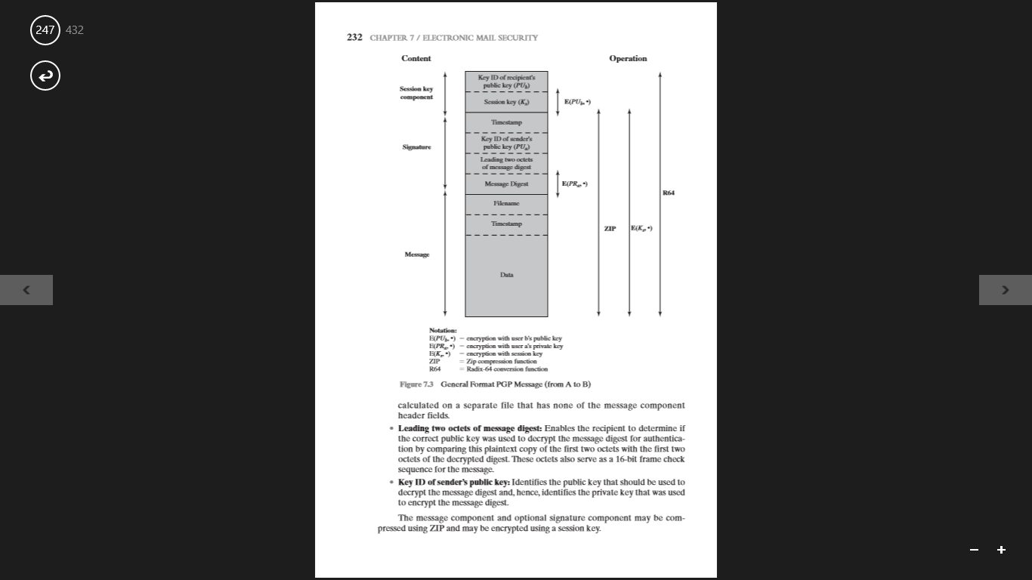
PGP Key ID concept

Slide 28
The message component includes the actual data to be stored or transmitted, as well as a filename and a timestamp that specifies the time of creation.
The signature component includes the following.
Timestamp: The time at which the signature was made.
Message digest: The 160-bit SHA-1 digest encrypted with the sender’s private signature key. The digest is calculated over the signature timestamp concatenated with the data portion of the message component. The inclusion of the signature timestamp in the digest insures against replay types of attacks.
The exclusion of the filename and timestamp portions of the message component ensures that detached signatures are exactly the same as attached signatures prefixed to the message.

Slide 29
Leading two octets of message digest: Enables the recipient to determine if the correct public key was used to decrypt the message digest for authentication by comparing this plaintext copy of the first two octets with the first two octets of the decrypted digest. These octets also serve as a 16-bit frame check sequence for the message.
Key ID of sender’s public key: Identifies the public key that should be used to decrypt the message digest and identifies the private key that was used to encrypt the message digest.
The session key component includes the session key and the identifier of the recipient’s public key that was used by the sender to encrypt the session key.

Slide 30
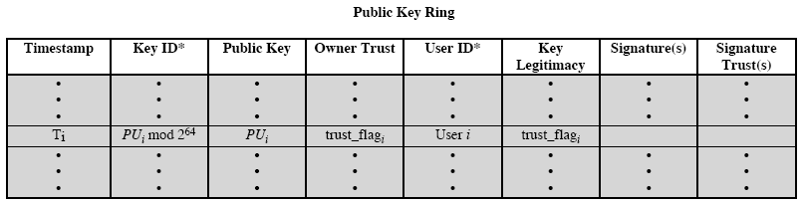
PGP Key Rings
each PGP user has a pair of keyrings to store public and private keys
public-key ring contains all the public-keys of other PGP users known to this user

Slide 31
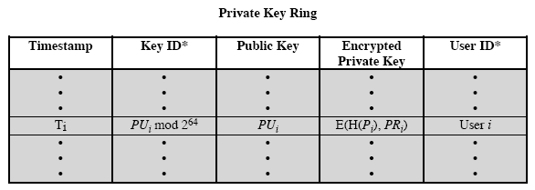
PGP Key Rings
private-key ring contains the public/private key pair(s) for this user,
private keys are encrypted using a key derived from a hashed passphrase

Slide 32
Private-key ring
Timestamp: The date/time when this key pair was generated.
Key ID: The least significant 64 bits of the public key for this entry.
Public key: The public-key portion of the pair.
Private key: The private-key portion of the pair;this field is encrypted.
User ID: Typically,this will be the user’s e-mail address (e.g.,stallings@acm.org). However, the user may choose to associate a different name with each pair (e.g., Stallings,WStallings,WilliamStallings, etc.) or to reuse the same User ID more than once.

Slide 33
The private-key ring can be indexed by either User ID or Key ID
Although it is intended that the private-key ring be stored only on the machine of the user that created and owns the key pairs and that it be accessible only to that user, it makes sense to make the value of the private key as secure as possible.
Accordingly the private key itself is not stored in the key ring.
Rather this key is encrypted using CAST-128 (or IDEA or 3DES).The procedure is as follows:
The user selects a passphrase to be used for encrypting private keys.
When the system generates a new public/private key pair using RSA it asks the user for the passphrase. Using SHA-1, a 160-bit hash code is generated from the passphrase and the passphrase is discarded.
The system encrypts the private key using CAST-128 with the 128 bits of the hash code as the key. The hash code is then discarded, and the encrypted private key is stored in the private-key ring.
Subsequently, when a user accesses the private-key ring to retrieve a private key, he or she must supply the passphrase. PGP will retrieve the encrypted private key, generate the hash code of the passphrase, and decrypt the encrypted private key using CAST-128 with the hash code.

Slide 34
Public-key ring
Timestamp: The date/time when this entry was generated.
Key ID: The least significant 64 bits of the public key for this entry.
Public Key: The public key for this entry.
User ID: Identifies the owner of this key. Multiple user IDs may be associated with a single public key.

Slide 35
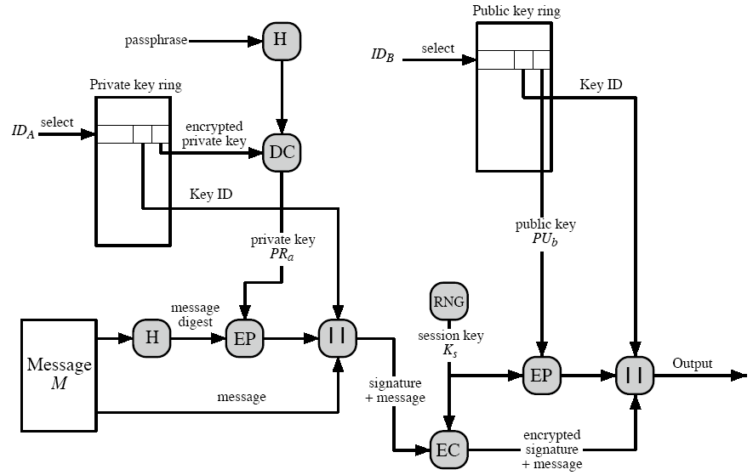
Key rings and message generation

Slide 36
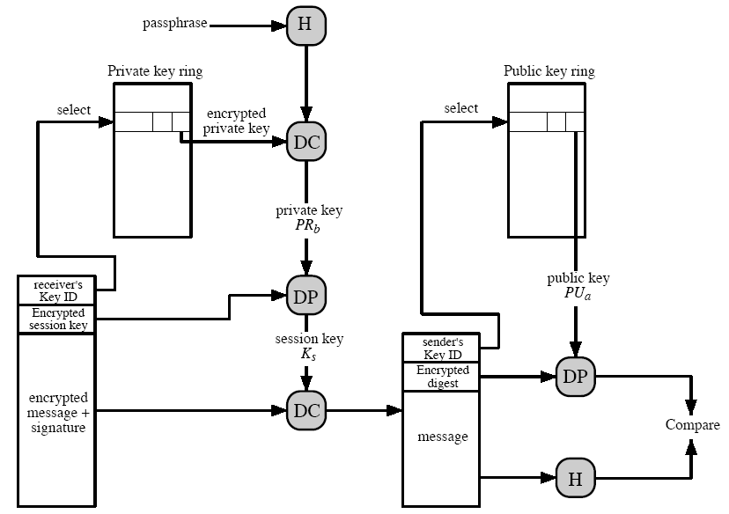
Key rings and message reception

Slide 37
PGP Key Management - 1
From PGP documentation:
“This whole business of protecting public keys from tampering is the most difficult problem in practical public key applications”
You have to make sure about the legitimacy of the public key of your party
exchange public-keys manually (using CDs, USB sticks, etc.)
verify fingerprint of a public key over the phone
trust another individual who signs public keys
public key signatures

Slide 38
PGP Key Management - 2
Public keys could be signed by
Certification Authorities (CA)
trusted entities
the mechanism of S/MIME, not in PGP
in PGP each user is a CA
everybody can sign keys of users they know directly
other users’ key signatures can also be used, if those users are trusted
The only ultimately trusted entity is yourself
all other keys should either be directly signed by you or there should be a trusted path of key signatures
you reflect your own trust assessment in your public key ring (no system enforcement)
key ring includes trust indicators
“web of trust”

Slide 39
key legitimacy field that indicates the extent to which PGP will trust that this is a valid public key for this user
Signature trust field that indicates the degree to which this PGP user trusts the signer to certify public keys
Owner trust field is included that indicates the degree to which this public key is trusted to sign other public-key certificates

Slide 40
States
ultimate trust
Unknown
untrusted
marginally trusted
completely trusted.

Slide 41
PGP Key Management - 3
A trusted signature on a public key means that
the key really belongs to its owner
But does not mean that key owner is trusted to sign other keys
key owner can sign other keys, but their trustworthiness is determined by the verifier (the owner of the pubkey ring)
Making sure about the legitimacy of a key and trusting the key owner to find out other keys are two different concepts
Keys and signatures on them are generally obtained from PGP public keyservers
there might be several signatures on a single key

Slide 42
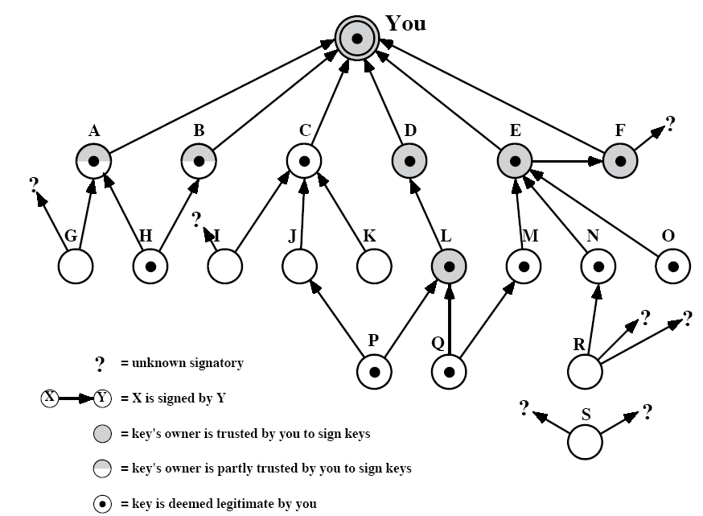
PGP Key Management - 4
A public key ring owned by “you”
These are assigned by you
This is calculated

Slide 43
REVOKING PUBLIC KEYS
A user may wish to revoke his or her current public key either because compromise is suspected or simply to avoid the use of the same key for an extended period.
Note that a compromise would require that an opponent somehow had obtained a copy of your unencrypted private key or that the opponent had obtained both the private key from your private-key ring and your passphrase.
The convention for revoking a public key is for the owner to issue a key revocation certificate, signed by the owner.This certificate has the same form as a normal signature certificate but includes an indicator that the purpose of this certificate is to revoke the use of this public key

Slide 44
S/MIME
Secure/Multipurpose Internet Mail Extensions
A standard way for email encryption and signing
IETF effort (RFCs 2632, 2633 – for version 3.0; RFCs 3850, 3851 for version 3.1; 5750, 5751 for version 3.2)
Industry support
Not a standalone software, a system that is to be supported by email clients
such as MS Outlook and Thunderbird
S/MIME handles digital signatures
Also provides encryption

Slide 45
Quick E-mail History
SMTP and RFC 822 (later RFC 5322)
SMTP is the email transfer protocol running over TCP
RFC 822/5322 defines the message format and headers
only ASCII messages (7-bit)
MIME (Multipurpose Internet Mail Extensions)
content type
Almost any type of information can appear in an email message
transfer encoding
specifies how the message body is encoded into textual form (radix64 is common)
S/MIME: Secure MIME
new content types, like signature, encrypted data

Slide 46
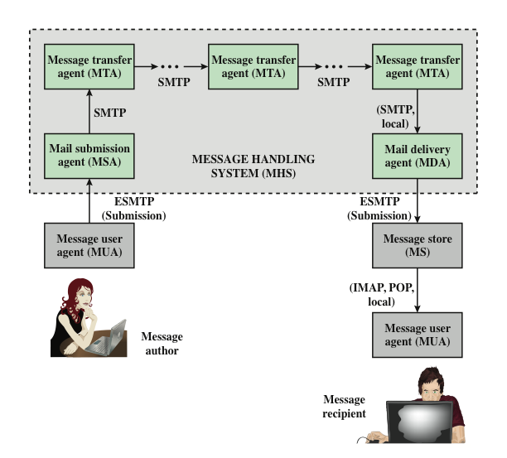
More on Internet Email Architecture
Notes:
At its most fundamental level, the Internet mail architecture consists of a
user world in the form of Message User Agents (MUA), and the transfer world, in
the form of the Message Handling Service (MHS), which is composed of Message
Transfer Agents (MTA). The MHS accepts a message from one user and delivers
it to one or more other users, creating a virtual MUA-to-MUA exchange environment.
This architecture involves three types of interoperability. One is directly between
users: messages must be formatted by the MUA on behalf of the message
author so that the message can be displayed to the message recipient by the destination
MUA. There are also interoperability requirements between the MUA and the
MHS—first when a message is posted from an MUA to the MHS and later when
it is delivered from the MHS to the destination MUA. Interoperability is required
among the MTA components along the transfer path through the MHS.
Figure 19.1 illustrates the key components of the Internet mail architecture,
which include the following.
• Message User Agent (MUA): Operates on behalf of user actors and user applications.
It is their representative within the e-mail service. Typically, this
function is housed in the user’s computer and is referred to as a client e-mail
program or a local network e-mail server. The author MUA formats a message
and performs initial submission into the MHS via a MSA. The recipient
MUA processes received mail for storage and/or display to the recipient user.
• Mail Submission Agent (MSA): Accepts the message submitted by an MUA
and enforces the policies of the hosting domain and the requirements of
Internet standards. This function may be located together with the MUA or
as a separate functional model. In the latter case, the Simple Mail Transfer
Protocol (SMTP) is used between the MUA and the MSA.
• Message Transfer Agent (MTA): Relays mail for one application-level hop.
It is like a packet switch or IP router in that its job is to make routing assessments
and to move the message closer to the recipients. Relaying is performed
by a sequence of MTAs until the message reaches a destination MDA. An
MTA also adds trace information to the message header. SMTP is used between
MTAs and between an MTA and an MSA or MDA.
• Mail Delivery Agent (MDA): Responsible for transferring the message from
the MHS to the MS.
• Message Store (MS): An MUA can employ a long-term MS. An MS can be
located on a remote server or on the same machine as the MUA. Typically,
an MUA retrieves messages from a remote server using POP (Post Office
Protocol) or IMAP (Internet Message Access Protocol).
Two other concepts need to be defined. An administrative management
domain (ADMD) is an Internet e-mail provider. Examples include a department
that operates a local mail relay (MTA), an IT department that operates an enterprise
mail relay, and an ISP that operates a public shared e-mail service. Each
ADMD can have different operating policies and trust-based decision making. One
obvious example is the distinction between mail that is exchanged within an organization
and mail that is exchanged between independent organizations. The rules for
handling the two types of traffic tend to be quite different.
The Domain Name System (DNS) is a directory lookup service that provides
a mapping between the name of a host on the Internet and its numerical address.

Slide 47
RFC 5322
RFC 5322 defines a format for text messages that are sent using electronic mail.
It has been the standard for Internet-based text mail messages and remains in common use.
In the RFC 5322 context, messages are viewed as having an envelope and contents.
The envelope contains whatever information is needed to accomplish transmission and delivery.
The contents compose the object to be delivered to the recipient.
The RFC 5322 standard applies only to the contents.
However, the content standard includes a set of header fields that may be used by the mail system to create the envelope, and the standard is intended to facilitate the acquisition of such information by programs.

Slide 48
A message consists of some number of header lines (the header) followed by unrestricted text (the body).
The header is separated from the body by a blank line.
Put differently, a message is ASCII text, and all lines up to the first blank line are assumed to be header lines used by the user agent part of the mail system.
A header line usually consists of a keyword, followed by a colon, followed by the keyword’s arguments; the format allows a long line to be broken up into several lines.
The most frequently used keywords are From, To, Subject, and Date.
Another field that is commonly found in RFC 5322 headers is Message-ID.
This field contains a unique identifier associated with this message.

Slide 49
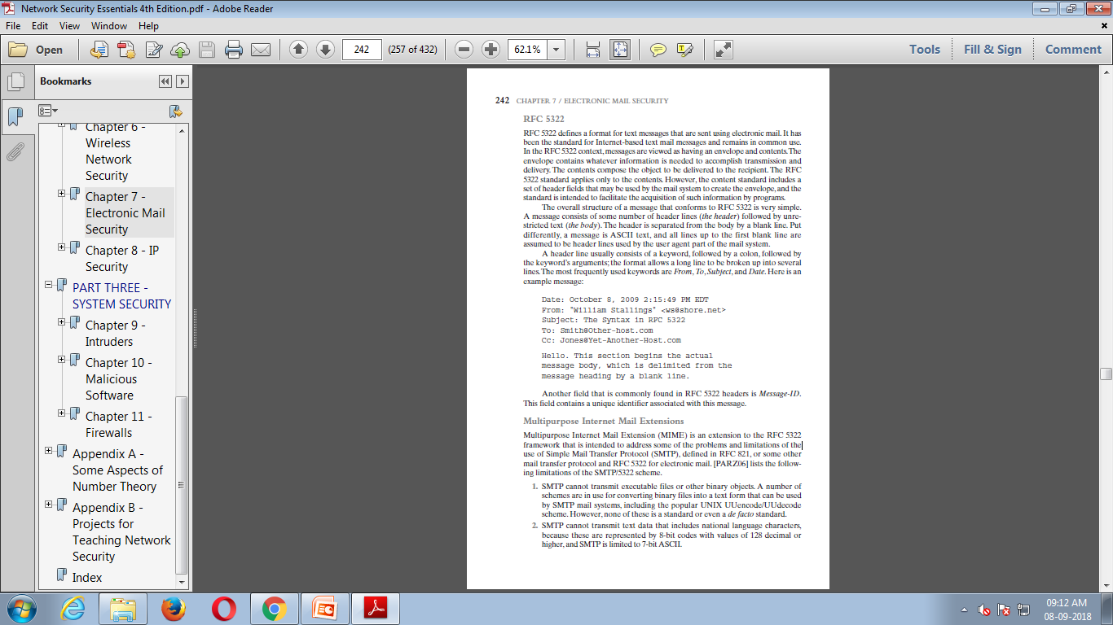

Slide 50
Limitations of the SMTP/5322 scheme
SMTP cannot transmit executable files or other binary objects
SMTP cannot transmit text data that includes national language characters
SMTP servers may reject mail message over a certain size.
SMTP gateways that translate between ASCII and the character code EBCDIC do not use a consistent set of mappings, resulting in translation problems.
SMTP gateways to X.400 electronic mail networks cannot handle non textual data included in X.400 messages.

Slide 51
Some SMTP implementations do not adhere completely to the SMTP standards defined in RFC 821.
Common problems include:
Deletion, addition, or reordering of carriage return and linefeed
Truncating or wrapping lines longer than 76 characters
Removal of trailing white space (tab and space characters)
Padding of lines in a message to the same length
Conversion of tab characters into multiple space characters
MIME is intended to resolve these problems in a manner that is compatible with existing RFC 5322 implementations.

Slide 52
MIME Elements
Five new message header fields are defined, which may be included in an RFC 5322 header.
These fields provide information about the body of the message.
A number of content formats are defined, thus standardizing representations that support multimedia electronic mail.
Transfer encodings are defined that enable the conversion of any content format into a form that is protected from alteration by the mail system.

Slide 53
More on MIME
Multipurpose Internet Mail Extensions
Addresses the limitations of SMTP/5322 scheme
Most important one: binary data transfer
Attachments
Adds some fields to the email messages: Important ones:
Content-Type
Describes the data contained in the body with sufficient detail that the receiving user agent can pick an appropriate agent or mechanism to represent the data to the user
Content-Transfer-Encoding
Indicates the type of transformation that has been used to represent the body of the message in a way that is acceptable for mail transport

Slide 54
Message Header Fields
MIME-Version: Must have the parameter value 1.0. This field indicates that the message conforms to RFCs 2045 and 2046.
Content-Type: Describes the data contained in the body with sufficient detail that the receiving user agent can pick an appropriate agent or mechanism to represent the data to the user or otherwise deal with the data in an appropriate manner.
Content-Transfer-Encoding: Indicates the type of transformation that has been used to represent the body of the message in a way that is acceptable for mail transport.
Content-ID: Used to identify MIME entities uniquely in multiple contexts.
Content-Description: A text description of the object with the body; this is useful when the object is not readable (e.g., audio data).

Slide 55
MIME CONTENT TYPES
For the text type of body, no special software is required to get the full meaning of the text aside from support of the indicated character set.
The primary subtype is plain text, which is simply a string of ASCII characters or ISO 8859 characters.
The enriched subtype allows greater formatting flexibility.
The multipart type indicates that the body contains multiple, independent parts.
The Content-Type header field includes a parameter (called a boundary) that defines the delimiter between body parts. This boundary should not appear in any parts of the message. Each boundary starts on a new line and consists of two hyphens followed by the boundary value. The final boundary, which indicates the end of the last part, also has a suffix of two hyphens.
Within each part, there may be an optional ordinary MIME header.

Slide 56
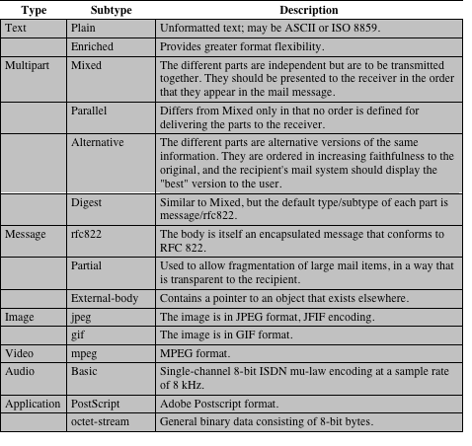
MIME Content Types
(Table is on page 602 in textbook)
Notes:
The bulk of the MIME specification is concerned with the
definition of a variety of content types. This reflects the need to provide standardized
ways of dealing with a wide variety of information representations in a multimedia
environment.
Table 19.1 lists the content types specified in RFC 2046. There are seven different
major types of content and a total of 15 subtypes. In general, a content type
declares the general type of data, and the subtype specifies a particular format for
that type of data.
For the text type of body, no special software is required to get the full meaning
of the text aside from support of the indicated character set. The primary subtype
is plain text , which is simply a string of ASCII characters or ISO 8859 characters. The
enriched subtype allows greater formatting flexibility.
The multipart type indicates that the body contains multiple, independent
parts. The Content-Type header field includes a parameter (called a boundary) that
defines the delimiter between body parts. This boundary should not appear in any
parts of the message. Each boundary starts on a new line and consists of two hyphens
followed by the boundary value. The final boundary, which indicates the end
of the last part, also has a suffix of two hyphens. Within each part, there may be an
optional ordinary MIME header.
There are four subtypes of the multipart type, all of which have the same overall
syntax. The multipart/mixed subtype is used when there are multiple independent
body parts that need to be bundled in a particular order. For the multipart/
parallel subtype, the order of the parts is not significant. If the recipient’s system is
appropriate, the multiple parts can be presented in parallel. For example, a picture
or text part could be accompanied by a voice commentary that is played while the
picture or text is displayed.
For the multipart/alternative subtype, the various parts are different representations
of the same information.
The multipart/digest subtype is used when each of the body parts is interpreted
as an RFC 5322 message with headers. This subtype enables the construction
of a message whose parts are individual messages. For example, the moderator of a
group might collect e-mail messages from participants, bundle these messages, and
send them out in one encapsulating MIME message.
The message type provides a number of important capabilities in MIME.
The message/rfc822 subtype indicates that the body is an entire message, including
header and body. Despite the name of this subtype, the encapsulated message may
be not only a simple RFC 5322 message but also any MIME message.
The message/partial subtype enables fragmentation of a large message into a
number of parts, which must be reassembled at the destination. For this subtype,
three parameters are specified in the Content-Type: Message/Partial field: an id
common to all fragments of the same message, a sequence number unique to each
fragment, and the total number of fragments.
The message/external-body subtype indicates that the actual data to be conveyed
in this message are not contained in the body. Instead, the body contains the
information needed to access the data. As with the other message types, the message/
external-body subtype has an outer header and an encapsulated message with
its own header. The only necessary field in the outer header is the Content-Type
field, which identifies this as a message/external-body subtype. The inner header is
the message header for the encapsulated message. The Content-Type field in the
outer header must include an access-type parameter, which indicates the method of
access, such as FTP (file transfer protocol).
The application type refers to other kinds of data, typically either uninterpreted
binary data or information to be processed by a mail-based application.

Slide 57
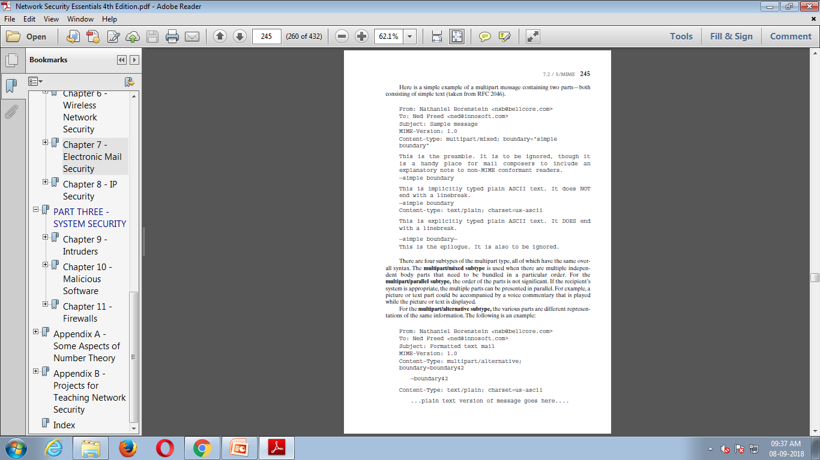
MIME CONTENT TYPES

Slide 58
MIME CONTENT TYPES
There are four subtypes of the multipart type, all of which have the same overall syntax.
The Multipart/Mixed subtype is used when there are multiple independent body parts that need to be bundled in a particular order.
For the multipart/parallel subtype, the order of the parts is not significant. If the recipient’s system is appropriate, the multiple parts can be presented in parallel.
For example, a picture or text part could be accompanied by a voice commentary that is played
while the picture or text is displayed.
For the multipart/alternative subtype, the various parts are different representations of the same information.
The following is an example:

Slide 59

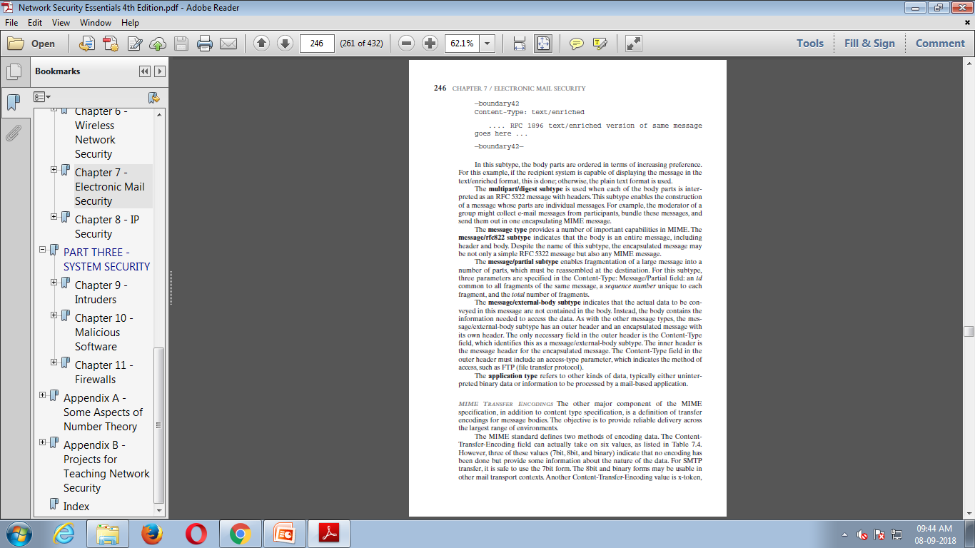
MIME CONTENT TYPES

Slide 60
MIME CONTENT TYPES
The multipart/digest subtype is used when each of the body parts is interpreted as an RFC 5322 message with headers.
This subtype enables the construction of a message whose parts are individual messages. For example, the moderator of a group might collect e-mail messages from participants, bundle these messages, and send them out in one encapsulating MIME message.

Slide 61
MIME CONTENT TYPES
The message type provides a number of important capabilities in MIME.
The message/rfc822 subtype indicates that the body is an entire message, including header and body. Despite the name of this subtype, the encapsulated message may be not only a simple RFC 5322 message but also any MIME message.
The message/partial subtype enables fragmentation of a large message into a number of parts, which must be reassembled at the destination. For this subtype, three parameters are specified in the Content-Type: Message/Partial field: an id common to all fragments of the same message, a sequence number unique to each fragment, and the total number of fragments.

Slide 62
MIME CONTENT TYPES
The message/external-body subtype indicates that the actual data to be conveyed in this message are not contained in the body. Instead, the body contains the information needed to access the data. As with the other message types, the message/ external-body subtype has an outer header and an encapsulated message with its own header.
The only necessary field in the outer header is the Content-Type field, which identifies this as a message/external-body subtype. The inner header is the message header for the encapsulated message.
The Content-Type field in the outer header must include an access-type parameter, which indicates the method of access, such as FTP (file transfer protocol).
The application type refers to other kinds of data, typically either uninterpreted binary data or information to be processed by a mail-based application.

Slide 63
MIME TRANSFER ENCODINGS
The objective is to provide reliable delivery across the largest range of environments.
The MIME standard defines two methods of encoding data. The Content- Transfer-Encoding field can actually take on six values

Slide 64
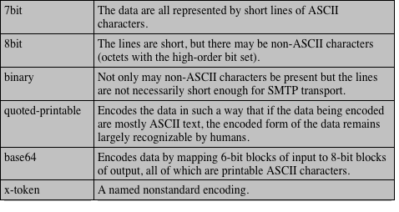
MIME Transfer Encodings
(Table is on page 605 in textbook)
Notes:
The other major component of the MIME specification,
in addition to content type specification, is a definition of transfer encodings
for message bodies. The objective is to provide reliable delivery across the largest
range of environments.
The MIME standard defines two methods of encoding data. The Content-
Transfer-Encoding field can actually take on six values, as listed in Table 19.2.
However, three of these values (7bit, 8bit, and binary) indicate that no encoding
has been done but provide some information about the nature of the data. For
SMTP transfer, it is safe to use the 7bit form. The 8bit and binary forms may be usable
in other mail transport contexts. Another Content-Transfer-Encoding value is
x-token, which indicates that some other encoding scheme is used for which a name
is to be supplied. This could be a vendor-specific or application-specific scheme.
The two actual encoding schemes defined are quoted-printable and base64. Two
schemes are defined to provide a choice between a transfer technique that is essentially
human readable and one that is safe for all types of data in a way that is
reasonably compact.
The quoted-printable transfer encoding is useful when the data consists largely
of octets that correspond to printable ASCII characters. In essence, it represents
nonsafe characters by the hexadecimal representation of their code and introduces
reversible (soft) line breaks to limit message lines to 76 characters.
The base64 transfer encoding, also known as radix-64 encoding, is a common
one for encoding arbitrary binary data in such a way as to be invulnerable to the
processing by mail-transport programs. It is also used in PGP and is described in
Appendix X.

Slide 65
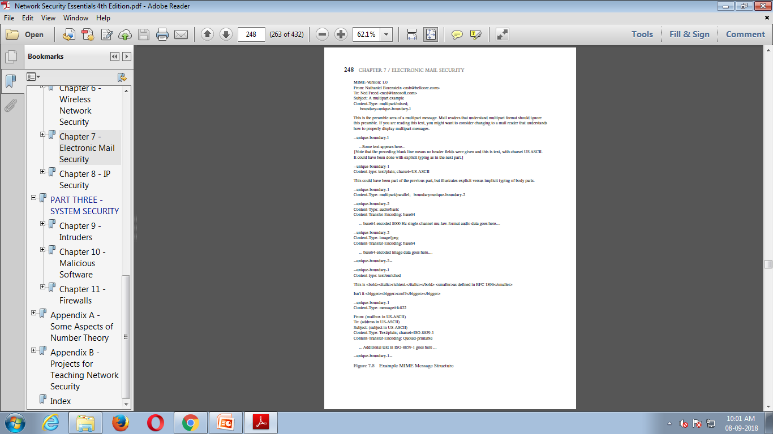

Slide 66
S/MIME Functions
enveloped data
encrypted content and associated keys
signed data
encoded message + encoded signed message digest
clear-signed data
cleartext message + encoded signed message digest
signed and enveloped data
Nested signed and encrypted entities

Slide 67
S/MIME Cryptographic Algorithms
hash functions: switched to SHA256
digital signatures: Mostly RSA is used
session key encryption: Mostly RSA is used
message encryption: Triple-DES, AES and others, but AES-128 is preferred
Base64 (radix64) encoding is used for email compatibility (ASCII conversion)
sender should know the capabilities of the receiving entity (public announcement or previously received messages from receiver)
otherwise sender takes a risk of sending unintelligible e-mail.

Slide 68
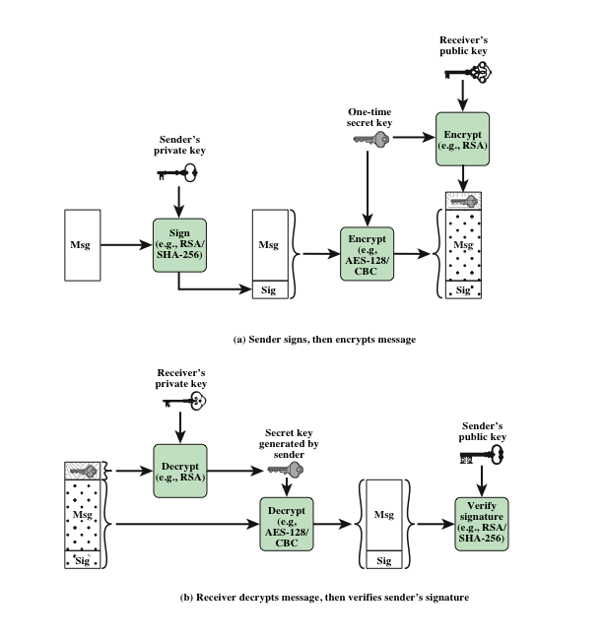
S/MIME Security Functionality: Simplified View

Slide 69
Scope of S/MIME Security
S/MIME secures a MIME entity
a MIME entity is entire message except the headers
so the header is not secured
First MIME message is prepared
This message and other security related data (algorithm identifiers, certificates, etc.) are processed by S/MIME
and packed as one of the S/MIME content type

Slide 70
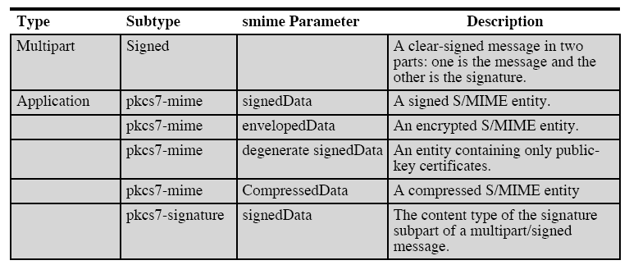
S/MIME Content Types

Slide 71
EnvelopedData
For message encryption
Similar to PGP
create a random session key, encrypt the message with that key and a conventional crypto, encrypt the session key with recipient’s public key
Unlike PGP, recipient’s public key comes from an X.509 certificate
trust management is different

Slide 72
SignedData
For signed message
both message and signature are encoded so that the recipient only sees some ASCII characters if he does not use an email client with S/MIME support
Similar to PGP
first message is hashed, then the hash is encrypted using sender’s private key
Message, signature, identifiers of algorithms and the sender’s certificate are packed together
again difference between S/MIME and PGP in trust management

Slide 73
Clear Signing
Another mechanism for signature
but the message is not encoded, so an email client with no S/MIME support could also view the message
of course the signature will not be verified and will be seen as a meaningless attachment
multipart/signed content type
2 parts
Clear text message
Signature
Let’s see an example

Slide 74
S/MIME Certificate Processing
S/MIME uses X.509 v3 certificates
Certification Authorities (CAs) issue certificates
unlike PGP, a user cannot be a CA
each client has a list of trusted CA certificates
actually that list comes with e-mail client software or OS
and own public/private key pairs and certs
It is very hard for an average user to maintain the list of trusted CAs
Generally OS and/or email client software default trusted CA certificate lists are directly used.
So trust management is not user-centric in practice

Slide 75
S/MIME Certificate Processing and CAs
One should obtain a certificate from a CA in order to send signed messages
Certificates classes (common practice by most CAs)
Class 1
Class 2
Class 3
CA certification policies (Certificate Practice Statement)
ID-control practices
Class 1: only email address check
Class 2: class1 + against third party database / fax documents
Class 3: class1 + apply in person and submit picture IDs and/or paper documents
Stronger identity validation
Easier to issue

Slide 76
X.509 Certificates and PKIs
SSL and S/MIME uses X.509 certificates
now we will see the details of them
later we will continue with PKIs (Public Key Infrastructures)

Slide 77
Certificates
Yet another public-key distribution method
first (conceptually) offered by Kohnfelder (1978)
Binding between the public-key and its owner
Issued (digitally signed) by the Certificate Authority (CA)

Slide 78
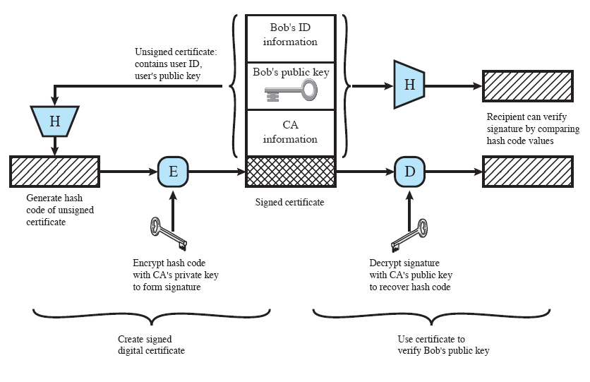
Certificates

Slide 79
Certificates
Certificates are verified by the verifiers to find out correct public key of the target entity
Certificate verification is the verification of the signature on certificate
In order to verify a certificate, the verifier
must know the public key of the CA
must trust the CA

Slide 80
Certificates
CA
Certified Entity
Albert
Levi
Albert Levi
Albert Levi
Verifier

Slide 81
Issues Related Certificates
CA certification policies (Certificate Practice Statement)
how reliable is the CA?
certification policies describe the methodology of certificate issuance
ID-control practices
loose control: only email address
tight control: apply in person and submit picture IDs and/or hard documentation

Slide 82
Issues Related Certificates
TRUST
verifiers must trust CAs
CAs need not trust the certified entities
certified entities need not trust its CA
What is “trust” in certification systems?
Answer to the question: “How correct is the certificate information?”
related to certification policies

Slide 83
Issues Related Certificates
Certificate types
ID certificates
discussed here
authorization certificates
no identity
binding between public key and authorization info
Certificate storage and distribution
along with a signed message
distributed/centralized databases

Slide 84
Issues Related Certificates
Certificate Revocation
certificates have lifetimes, but they may be revoked before the expiration time
Reasons:
certificate holder key compromise/lost
CA key compromise
end of contract (e.g. certificates for employees)
Certificate Revocation Lists (CRLs) hold the list of certificates that are not expired but revoked
each CA periodically issues such a list with digital signature on it

Slide 85
Real World Analogies
Is a certificate an “electronic identity”?
Concerns
a certificate is a binding between an identity and a key, not a binding between an identity and a real person
anyone can submit someone else’s certificate
one must submit its certificate to identify itself, but submission is not sufficient, the key must be used in a protocol

Slide 86
Real World Analogies
Result: Certificates are not picture IDs
So, what is the real world analogy for certificates?
Endorsed document/card that serves as a binding between the identity and signature

Slide 87
Public Key Infrastructure (PKI)
PKI is a complete system and well-defined mechanisms for certificates
certificate issuance
certificate revocation
certificate storage
certificate distribution

Slide 88
PKI
Business Practice: Issue certificates and make money
several CAs
Several CAs are also necessary due to political, geographical and trust reasons
3 interconnection models
hierarchical
cross certificates
hybrid

Slide 89
Hierarchical PKI Example
Root CA
Upper level CAs
CAs
End users

Slide 90
Cross Certificate Based PKI Example
CAs
End users
Cross certificates

Slide 91
Hybrid PKI example

Slide 92
Certificate Paths

Slide 93
Certificate Paths
Verifier must know public key of the first CA
Other public keys are found out one by one
All CAs on the path must be trusted by the verifier

Slide 94
Certificate Paths with Reverse Certificates
Reverse certificates

Slide 95
Organization-wide PKI
Local PKI for organizations
may have global connections, but the registration facilities remain local
generally to solve local problems
local secure access to resources

Slide 96
Organization-wide PKI
PKI Server
Certificate Processor/Authority
CP (CA)
Databases / Directories
Administration
Registration Authority
Certificate Distribution
RA
CD
PKI Client
Architecture of a typical organization
-
wide PKI

Slide 97
Hosted vs. Standalone PKI
Hosted (outsourced) PKI
PKI vendor acts as CA
PKI owner is the RA
Standalone PKI
PKI owner is both RA and CA

Slide 98
Hosted vs. Standalone PKI

Slide 99
X.509
ITU-T standard (recommendation)
ISO 9495-2 is the equivalent ISO standard
part of X.500 family for “directory services”
distributed set of servers that store user information
an utopia that has never been carried out
X.509 defines the authentication services and the pubic-key certificate structure (certificates are to be stored in the directory)
so that the directory would contain public keys of the users

Slide 100
X.509
Defines identity certificates
attribute (authorization) certificates are added in 4th edition (2000)
Defines certificate structure, not PKI
Supports both hierarchical model and cross certificates
End users cannot be CAs

Slide 101
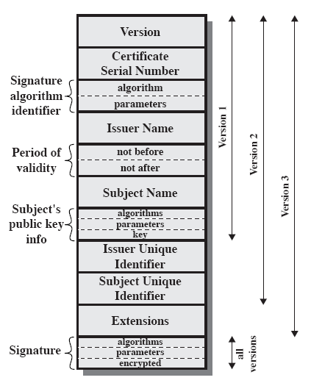
X.509 Certificate Format

Slide 102
X.509v3 Extensions
Not enough flexibility in X.509 v1 and v2
mostly due to “directory” specific fields
real-world security needs are different
email/URL names should be included in a certificate
key identification was missing (so should be included)
policy details should indicate under which conditions a certificate can be used (was not the case in v1 and v2)
avoidance of blind trust was not possible in v1 and v2
Rather than explicitly naming new fields a general extension method is defined
An extension consists of an extension identifier, value and criticality indicator

Slide 103
X.509v3 Extensions
Key and policy information
subject & issuer key identifiers
indicators of certificate policies supported by the cert
key usage (list of purposes like signature, encryption, etc)
Alternative names, in alternative formats for certificate subject and issuer
Certificate path constraints
For CA certs and to restrict certificate issuance based on
path length (restricting number of subordinate CAs)
policy identifiers
names
Verifier could exercise its own restrictions during verification as well
No blind trust to CAs

