Slide 1
Cryptography and Network Security
UNIT-V
Fifth Edition
by William Stallings
Notes:
Lecture slides by Lawrie Brown for “Cryptography and Network Security”, 5/e, by William Stallings, Chapter 20 – “Intruders”.

Slide 2
Intruders
significant issue for networked systems is hostile or unwanted access
either via network or local
can identify classes of intruders:
  masquerader
  misfeasor
  clandestine user
varying levels of competence
Notes:
A significant security problem for networked systems is hostile, or at least unwanted, trespass being unauthorized login or use of a system, by local or remote users; or by software such as a virus, worm, or Trojan horse.
One of the two most publicized threats to security is the intruder (or hacker or cracker), which Anderson identified three classes of:
• Masquerader: An individual who is not authorized to use the computer (outsider)
• Misfeasor: A legitimate user who accesses unauthorized data, programs, or resources (insider)
• Clandestine user: An individual who seizes supervisory control of the system and uses this control to evade auditing and access controls or to suppress audit collection (either)
Intruder attacks range from the benign (simply exploring net to see what is there); to the serious (who attempt to read privileged data, perform unauthorized modifications, or disrupt system).

Slide 3
A significant security problem for networked systems is hostile, or at least unwanted, trespass by users or software.
User trespass can take the form of unauthorized logon to a machine or, in the case of an authorized user, acquisition of privileges or performance of actions beyond those that have been authorized.
Software trespass can take the form of a virus, worm, or Trojan horse.
All these attacks relate to network security because system entry can be achieved by means of a network.
However, these attacks are not confined to network based attacks.
A user with access to a local terminal may attempt trespass
without using an intermediate network.

Slide 4
A virus or Trojan horse may be introduced into a system by means of an optical disc.
Only the worm is a uniquely network phenomenon.
Thus, system trespass is an area in which the concerns of network security and computer security overlap.

Slide 5
One of the two most publicized threats to security is the intruder (the other is viruses), often referred to as a hacker or cracker. In an important early study of intrusion, Anderson [ANDE80] identified three classes of intruders:
    • Masquerader: An individual who is not authorized to use the computer and
    who penetrates a system’s access controls to exploit a legitimate user’s account
    • Misfeasor: A legitimate user who accesses data, programs, or resources for
    which such access is not authorized, or who is authorized for such access but
    misuses his or her privileges
    • Clandestine user: An individual who seizes supervisory control of the system and uses this control to evade auditing and access controls or to suppress audit collection
The masquerader is likely to be an outsider; the misfeasor generally is an insider; and the clandestine user can be either an outsider or an insider.

Slide 6
Intruder attacks range from the benign to the serious.
At the benign end of the scale, there are many people who simply wish to explore internets and see what is out there.
At the serious end are individuals who are attempting to read privileged data, perform unauthorized modifications to data, or disrupt the system.

Slide 7
Examples of Intrusion
remote root compromise
web server defacement
guessing / cracking passwords
copying viewing sensitive data / databases
running a packet sniffer
distributing pirated software
using an unsecured modem to access net
impersonating a user to reset password
using an unattended workstation
Notes:
[GRAN04] lists the following examples of intrusion:
• Performing a remote root compromise of an e-mail server
• Defacing a Web server
• Guessing and cracking passwords
• Copying a database containing credit card numbers
• Viewing sensitive data, including payroll records and medical information, without authorization
• Running a packet sniffer on a workstation to capture usernames and passwords
• Using a permission error on an anonymous FTP server to distribute pirated software and music files
• Dialing into an unsecured modem and gaining internal network access
• Posing as an executive, calling the help desk, resetting the executive’s e-mail password, and learning the new password
• Using an unattended, logged-in workstation without permission

Slide 8
Intrusion Techniques
aim to gain access and/or increase privileges on a system
often use system / software vulnerabilities
key goal often is to acquire passwords
  so then exercise access rights of owner
basic attack methodology
  target acquisition and information gathering
  initial access
  privilege escalation
  covering tracks
Notes:
The objective of the intruder is to gain access to a system or to increase the range of privileges accessible on a system. Most initial attacks use system or software vulnerabilities that allow a user to execute code that opens a back door into the system. Alternatively, the intruder attempts to acquire information that should have been protected. In some cases, this information is in the form of a user password. With knowledge of some other user's password, an intruder can log in to a system and exercise all the privileges accorded to the legitimate user.
Knowing the standard attack methods is a key element in limiting your vulnerability. The basic aim is to gain access and/or increase privileges on some system. The basic attack methodology list is taken from McClure et al "Hacking Exposed”.

Slide 9
The objective of the intruder is to gain access to a system or to increase the range of privileges accessible on a system.
Most initial attacks use system or software vulnerabilities
that allow a user to execute code that opens a back door into the system.
Alternatively, the intruder attempts to acquire information that should have been protected.
In some cases, this information is in the form of a user password.
With knowledge of some other user’s password, an intruder can log in to a system and exercise all the privileges accorded to the legitimate user.
Typically, a system must maintain a file that associates a password with each authorized user.

Slide 10
If such a file is stored with no protection, then it is an easy matter to gain access to it and learn passwords. The password file can be protected in one of two ways:
• One-way function: The system stores only the value of a function based on the user’s password. When the user presents a password, the system transforms that password and compares it with the stored value. In practice, the system usually performs a one-way transformation (not reversible) in which the password is used to generate a key for the one-way function and in which a fixed-length output is produced.
• Access control: Access to the password file is limited to one or a very few accounts.

Slide 11
Techniques for learning passwords
Try default passwords used with standard accounts that are shipped with the system. Many administrators do not bother to change these defaults.
Exhaustively try all short passwords (those of one to three characters).
Try words in the system’s online dictionary or a list of likely passwords. Examples of the latter are readily available on hacker bulletin boards.
Collect information about users, such as their full names, the names of their spouse and children, pictures in their office, and books in their office that are related to hobbies.
Try users’ phone numbers, Social Security numbers, and room numbers.
Try all legitimate license plate numbers for this state.
Use a Trojan horse (described in Chapter 21) to bypass restrictions on access.
Tap the line between a remote user and the host system.

Slide 12
Other Intrusion Techniques
  Other intrusion techniques do not require learning a password. Intruders can get access to a system by exploiting attacks such as buffer overflows on a program that runs with certain privileges.
  Privilege escalation can be done this way as well.
We turn now to a discussion of the two principal countermeasures: detection and prevention.
Detection is concerned with learning of an attack, either before or after its success.
Prevention is a challenging security goal and an uphill battle at all times.

Slide 13
Viruses and ”Malicious Programs”
Computer “Viruses” and related programs have the ability to replicate themselves on an ever increasing number of computers. They originally spread by people sharing floppy disks. Now they spread primarily over the Internet (a “Worm”).
Other “Malicious Programs” may be installed by hand on a single machine. They may also be built into widely distributed commercial software packages. These are very hard to detect before the payload activates (Trojan Horses, Trap Doors, and Logic Bombs).
Henric Johnson

Slide 14
Taxanomy of Malicious Programs
Malicious Programs
Need Host Program
Independent
Trapdoors
Logic Bombs
Trojan
Horses
Viruses
Bacteria
Worms
Henric Johnson

Slide 15
Definitions
Virus - code that copies itself into other programs.
A “Bacteria” replicates until it fills all disk space, or CPU cycles.
Payload - harmful things the malicious program does, after it has had time to spread.
Worm - a program that replicates itself across the network (usually riding on email messages or attached documents (e.g., macro viruses).
Henric Johnson

Slide 16
Definitions
Trojan Horse - instructions in an otherwise good program that cause bad things to happen (sending your data or password to an attacker over the net).
Logic Bomb - malicious code that activates on an event (e.g., date).
Trap Door (or Back Door) - undocumented entry point written into code for debugging that can allow unwanted users.
Easter Egg - extraneous code that does something “cool.” A way for programmers to show that they control the product.
Henric Johnson

Slide 17
Virus Phases
Dormant phase - the virus is idle
Propagation phase - the virus places an identical copy of itself into other programs
Triggering phase – the virus is activated to perform the function for which it was intended
Execution phase – the function is performed
Henric Johnson

Slide 18
Virus Protection
Have a well-known virus protection program, configured to
scan disks and downloads automatically for known viruses.
Do not execute programs (or "macro's") from unknown
sources (e.g., PS files, Hypercard files, MS Office documents,
Avoid the most common operating systems and email
programs, if possible.
Henric Johnson

Slide 19
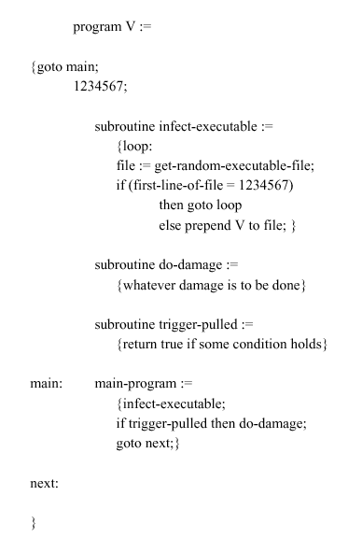
Virus Structure
Henric Johnson

Slide 20
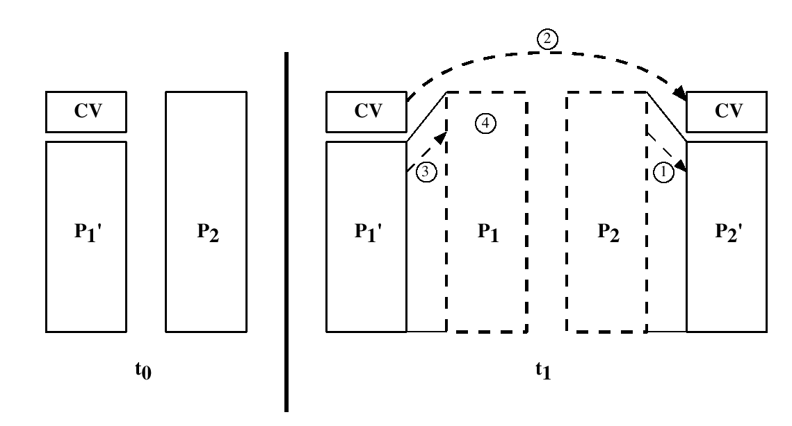
A Compression Virus
Henric Johnson

Slide 21
Types of Viruses
Parasitic Virus - attaches itself to executable files as part of their code. Runs whenever the host program runs.
Memory-resident Virus - Lodges in main memory as part of the residual operating system.
Boot Sector Virus - infects the boot sector of a disk, and spreads when the operating system boots up (original DOS viruses).
Stealth Virus - explicitly designed to hide from Virus Scanning programs.
Polymorphic Virus - mutates with every new host to prevent signature detection.
Henric Johnson

Slide 22
Macro Viruses
Microsoft Office applications allow “macros” to be part of the document. The macro could run whenever the document is opened, or when a certain command is selected (Save File).
Platform independent.
Infect documents, delete files, generate email and edit letters.
Henric Johnson

Slide 23
Outline
Firewall Design Principles
  Firewall Characteristics
  Types of Firewalls
  Firewall Configurations
Trusted Systems
  Data Access Control
  The Concept of Trusted systems
  Trojan Horse Defense
Henric Johnson

Slide 24
Firewalls
Effective means of protection a local system or network of systems from network-based security threats while affording access to the outside world via WAN`s or the Internet
Henric Johnson

Slide 25
Firewall Design
Principles
Information systems undergo a steady evolution (from small LAN`s to Internet connectivity)
Strong security features for all workstations and servers not established
Henric Johnson

Slide 26
Firewall Design
Principles
The firewall is inserted between the premises network and the Internet
Aims:
  Establish a controlled link
  Protect the premises network from Internet-based attacks
  Provide a single choke point
Henric Johnson

Slide 27
Firewall Characteristics
Design goals:
  All traffic from inside to outside must pass through the firewall (physically blocking all access to the local network except via the firewall)
  Only authorized traffic (defined by the local security police) will be allowed to pass
Henric Johnson

Slide 28
Firewall Characteristics
Design goals:
  The firewall itself is immune to penetration (use of trusted system with a secure operating system)
Henric Johnson

Slide 29
Firewall Characteristics
Four general techniques:
Service control
  Determines the types of Internet services that can be accessed, inbound or outbound
Direction control
  Determines the direction in which particular service requests are allowed to flow
Henric Johnson

Slide 30
Firewall Characteristics
User control
  Controls access to a service according to which user is attempting to access it
Behavior control
  Controls how particular services are used (e.g. filter e-mail)
Henric Johnson

Slide 31
Types of Firewalls
Three common types of Firewalls:
  Packet-filtering routers
  Application-level gateways
  Circuit-level gateways
  (Bastion host)
Henric Johnson

Slide 32
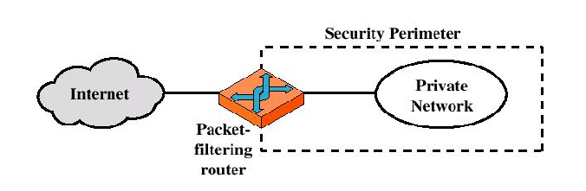
Types of Firewalls
Packet-filtering Router
Henric Johnson

Slide 33
Types of Firewalls
Packet-filtering Router
  Applies a set of rules to each incoming IP packet and then forwards or discards the packet
  Filter packets going in both directions
  The packet filter is typically set up as a list of rules based on matches to fields in the IP or TCP header
  Two default policies (discard or forward)
Henric Johnson

Slide 34
Types of Firewalls
Advantages:
  Simplicity
  Transparency to users
  High speed
Disadvantages:
  Difficulty of setting up packet filter rules
  Lack of Authentication
Henric Johnson

Slide 35
Types of Firewalls
Possible attacks and appropriate countermeasures
  IP address spoofing
  Source routing attacks
  Tiny fragment attacks
Henric Johnson

Slide 36
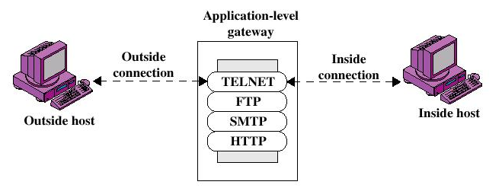
Types of Firewalls
Application-level Gateway
Henric Johnson

Slide 37
Types of Firewalls
Application-level Gateway
  Also called proxy server
  Acts as a relay of application-level traffic
Henric Johnson

Slide 38
Types of Firewalls
Advantages:
  Higher security than packet filters
  Only need to scrutinize a few allowable applications
  Easy to log and audit all incoming traffic
Disadvantages:
  Additional processing overhead on each connection (gateway as splice point)
Henric Johnson

Slide 39
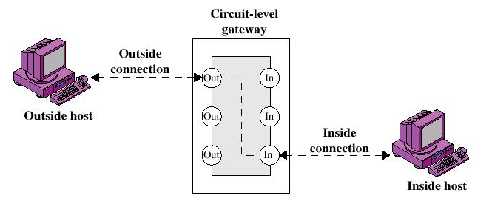
Types of Firewalls
Circuit-level Gateway
Henric Johnson

Slide 40
Types of Firewalls
Circuit-level Gateway
  Stand-alone system or
  Specialized function performed by an Application-level Gateway
  Sets up two TCP connections
  The gateway typically relays TCP segments from one connection to the other without examining the contents
Henric Johnson

Slide 41
Types of Firewalls
Circuit-level Gateway
  The security function consists of determining which connections will be allowed
  Typically use is a situation in which the system administrator trusts the internal users
  An example is the SOCKS package
Henric Johnson

Slide 42
Types of Firewalls
Bastion Host
  A system identified by the firewall administrator as a critical strong point in the network´s security
  The bastion host serves as a platform for an application-level or circuit-level gateway
Henric Johnson

Slide 43
Firewall Configurations
In addition to the use of simple configuration of a single system (single packet filtering router or single gateway), more complex configurations are possible
Three common configurations
Henric Johnson

Slide 44
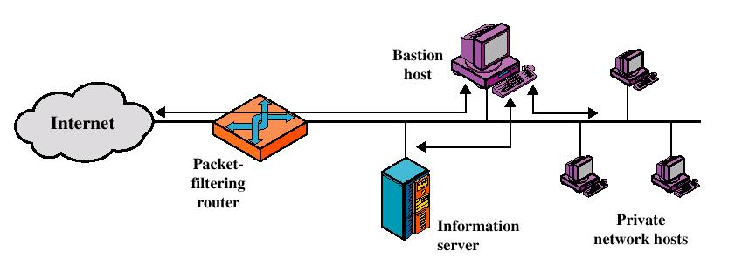
Firewall Configurations
Screened host firewall system (single-homed bastion host)
Henric Johnson

Slide 45
Firewall Configurations
Screened host firewall, single-homed bastion configuration
Firewall consists of two systems:
  A packet-filtering router
  A bastion host
Henric Johnson

Slide 46
Firewall Configurations
Configuration for the packet-filtering router:
  Only packets from and to the bastion host are allowed to pass through the router
The bastion host performs authentication and proxy functions
Henric Johnson

Slide 47
Firewall Configurations
Greater security than single configurations because of two reasons:
  This configuration implements both packet-level and application-level filtering (allowing for flexibility in defining security policy)
  An intruder must generally penetrate two separate systems
Henric Johnson

Slide 48
Firewall Configurations
This configuration also affords flexibility in providing direct Internet access (public information server, e.g. Web server)
Henric Johnson

Slide 49
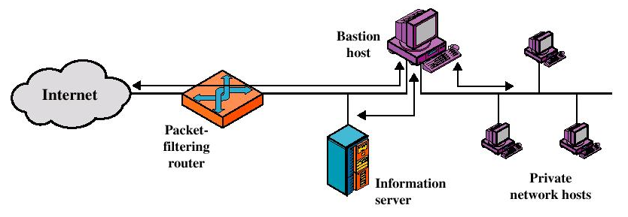
Firewall Configurations
Screened host firewall system (dual-homed bastion host)
Henric Johnson

Slide 50
Firewall Configurations
Screened host firewall, dual-homed bastion configuration
  The packet-filtering router is not completely compromised
  Traffic between the Internet and other hosts on the private network has to flow through the bastion host
Henric Johnson

Slide 51
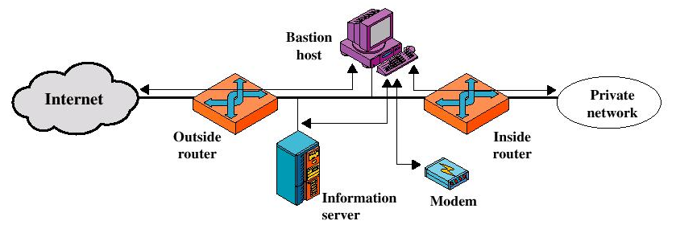
Firewall Configurations
Screened-subnet firewall system
Henric Johnson

Slide 52
Firewall Configurations
Screened subnet firewall configuration
  Most secure configuration of the three
  Two packet-filtering routers are used
  Creation of an isolated sub-network
Henric Johnson

Slide 53
Firewall Configurations
Advantages:
  Three levels of defense to thwart intruders
  The outside router advertises only the existence of the screened subnet to the Internet (internal network is invisible to the Internet)
Henric Johnson

Slide 54
Firewall Configurations
Advantages:
  The inside router advertises only the existence of the screened subnet to the internal network (the systems on the inside network cannot construct direct routes to the Internet)
Henric Johnson

Slide 55
Trusted Systems
One way to enhance the ability of a system to defend against intruders and malicious programs is to implement trusted system technology
Henric Johnson

Slide 56
Data Access Control
Through the user access control procedure (log on), a user can be identified to the system
Associated with each user, there can be a profile that specifies permissible operations and file accesses
The operation system can enforce rules based on the user profile
Henric Johnson

Slide 57
Data Access Control
General models of access control:
  Access matrix
  Access control list
  Capability list
Henric Johnson

Slide 58
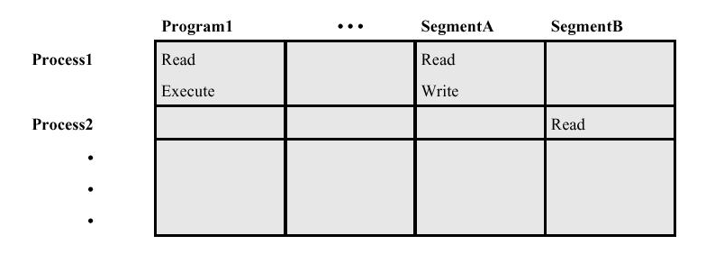
Data Access Control
Access Matrix
Henric Johnson

Slide 59
Data Access Control
Access Matrix: Basic elements of the model
  Subject: An entity capable of accessing objects, the concept of subject equates with that of process
  Object: Anything to which access is controlled (e.g. files, programs)
  Access right: The way in which an object is accessed by a subject (e.g. read, write, execute)
Henric Johnson

Slide 60
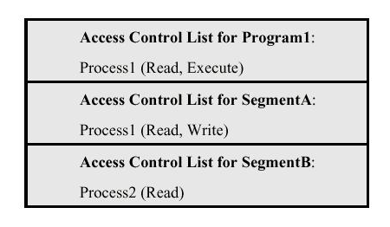
Data Access Control
Access Control List: Decomposition of the matrix by columns
Henric Johnson

Slide 61
Data Access Control
Access Control List
  An access control list lists users and their permitted access right
  The list may contain a default or public entry
Henric Johnson

Slide 62
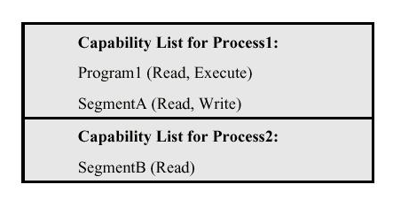
Data Access Control
Capability list: Decomposition of the matrix by rows
Henric Johnson

Slide 63
Data Access Control
Capability list
  A capability ticket specifies authorized objects and operations for a user
  Each user have a number of tickets
Henric Johnson

Slide 64
The Concept of
Trusted Systems
Trusted Systems
  Protection of data and resources on the basis of levels of security (e.g. military)
  Users can be granted clearances to access certain categories of data
Henric Johnson

Slide 65
The Concept of
Trusted Systems
Multilevel security
  Definition of multiple categories or levels of data
A multilevel secure system must enforce:
  No read up: A subject can only read an object of less or equal security level (Simple Security Property)
  No write down: A subject can only write into an object of greater or equal security level (*-Property)
Henric Johnson

Slide 66
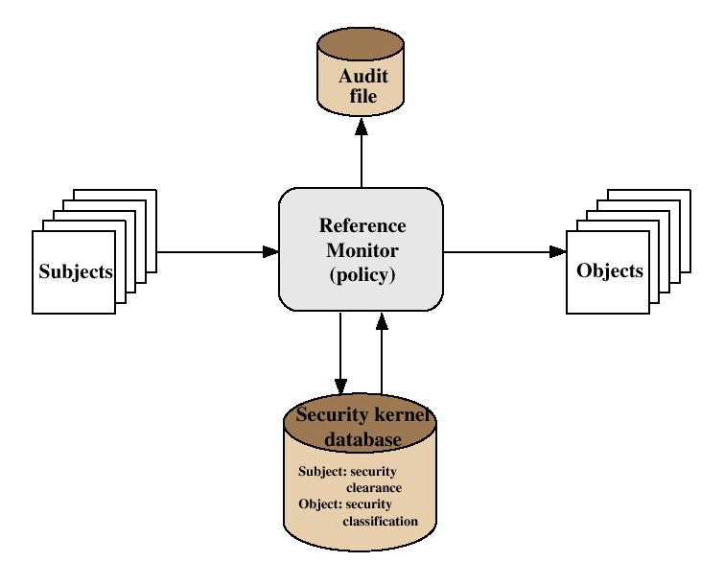
The Concept of
Trusted Systems
Reference Monitor Concept: Multilevel security for a data processing system
Henric Johnson

Slide 67
The Concept of
Trusted Systems
Henric Johnson

Slide 68
The Concept of
Trusted Systems
Reference Monitor
  Controlling element in the hardware and operating system of a computer that regulates the access of subjects to objects on basis of security parameters
  The monitor has access to a file (security kernel database)
  The monitor enforces the security rules (no read up, no write down)
Henric Johnson

Slide 69
The Concept of
Trusted Systems
Properties of the Reference Monitor
  Complete mediation: Security rules are enforced on every access
  Isolation: The reference monitor and database are protected from unauthorized modification
  Verifiability: The reference monitor’s correctness must be provable (mathematically)
Henric Johnson

Slide 70
The Concept of
Trusted Systems
A system that can provide such verifications (properties) is referred to as a trusted system
Henric Johnson

Slide 71
Trojan Horse Defense
Secure, trusted operating systems are one way to secure against Trojan Horse attacks
Henric Johnson

Slide 72
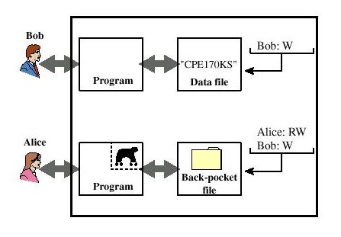
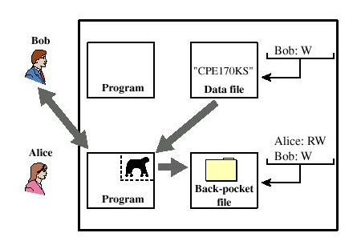
Trojan Horse Defense
Henric Johnson

Slide 73
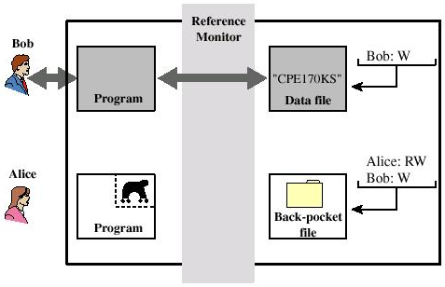
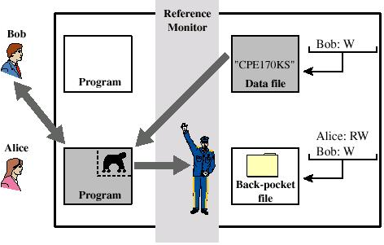
Trojan Horse Defense
Henric Johnson

