Slide 1
OpenVoter
Open Source Voting Software to Remove Oppressors
Prof. Robin Rowe
ANM Green Conference
Thursday, July 15th, 2021
2:00-3:20pm Eastern
1:00-2:20pm Central
12:00-1:20pm Mountain
11:00am-12:20pm Pacific
10:00-11:20am Alaska
8:00-9:20am Hawaii

Slide 2
Why OpaVote Isn't a Solution
Anonymity – Who has our emails and voting records?
Transparency – What does the voting code actually do?
Audit – How do we check when the result is close or seems off?
Bad Actors – Hackers? Infiltrators?
Disrupters – Zoombomb kids
Crooks – Mobsters, phishers
Opposition parties
State surveillance

Slide 3
A Personal Electronic Voting Experience
I ran for mayor of Beverly Hills in 2020, my first election attempt
VSAP, Los Angeles Country created its own voting software
Secretary of State picks me in lottery to be first on VSAP ballot
Beverly Hills files lawsuit Against Los Angeles Country
Beverly Hills is suing to roll back electronic voting, doesn’t want a non-incumbent being #1 on the ballot again
Incumbents backed by hedge fund and gentrification developers
Incumbent campaign budget expended $20 per vote received

Slide 4
A Personal Green Committee Voting Experience
I ran for Eco-Action Secretary, but not because I needed to win
I ran because I wanted to know first-hand the Green committee voting system
I ran because it is poor practice to hold “elections” with candidates running unopposed
My opponent was hostile to my running, indignant at not being unopposed
All the votes except for the chair who endorsed my opposing candidate were invalid because of the chair’s botched directions to voters
I declined calls to re-run the election

Slide 5
Voting Methodologies
Black Ball – Passed unanimously
RCV – Ranked Choice Voting
FPP – First Past the Post
Star
Approval
Downvote

Slide 6
Ranked Choice Voting
https://en.wikipedia.org/wiki/Ranked-choice_voting_in_the_United_States
Endorsed by Green Party, in founding bylaws
RCV has since been adopted in many locations
Complexity makes audit difficult
May result in audit chaos like Arizona times 10
Botched New York RCV decreases confidence
Has yet to elect any Greens

Slide 7
First Past the Post Voting
FPP - https://en.wikipedia.org/wiki/First-past-the-post_voting
Traditional winner-takes-all
California state elections are Top-2 FPP
Top two candidates from jungle primary run in general election
California local elections are open to all comers and are non-partisan per California state constitution

Slide 8
California Top-2 Voting
FPP Top-2 placed Green candidate Matt Gonzalez on the ballot against Gavin Newsom in the San Francisco general election
Newsom won by 11,000 votes, flipping just 6,000 votes would have made a Green the mayor of San Francisco
After serving as San Francisco mayor twice, Newsom was elected governor of California
Had Gonzalez won San Francisco in 2003, it is conceivable Gonzalez would have gone on to become the first Green governor of California (and no recall of Newsom now)

Slide 9
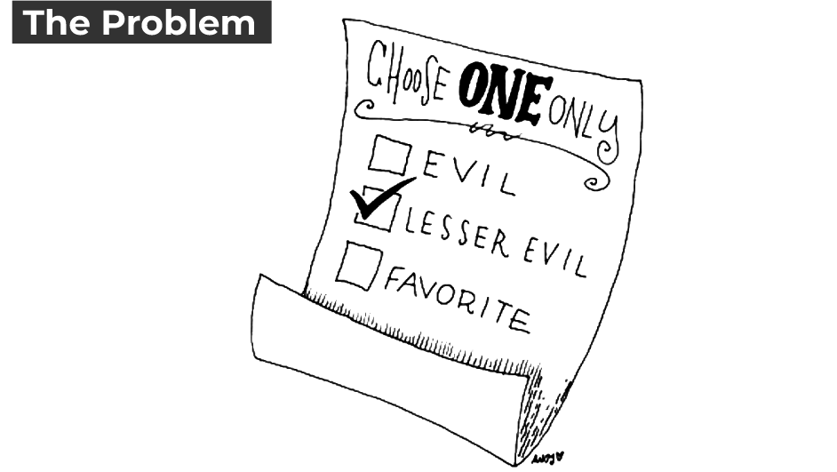
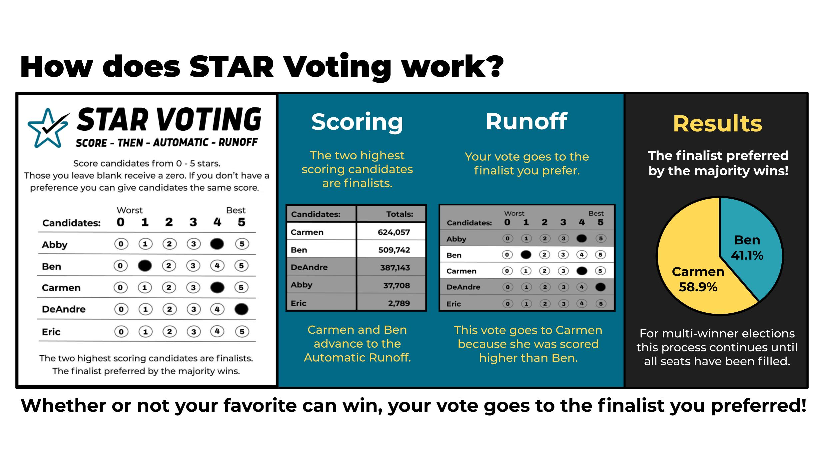
Star Voting
https://www.starvoting.us/

Slide 10
Approval Voting
https://electionscience.org/approval-voting-101/
Approval voting is similar in goal to RCV
In Approval voting, voters vote for all the candidates they approve of
The candidate with the most votes wins
Easier for voters who don’t know the candidates well enough to confidently rank them

Slide 11
Downvote Voting
How the Internet deals with toxic content
Downvote voting may draw disaffected voters to the polls
Voters who do not vote because they like none of the candidates
Stops protest votes being misrepresented as support or a mandate by opposing candidate

Slide 12

Free Open Source Software
Linux (FOSS) powers the Internet
I’m the project leader for CinePaint (FOSS), an alternative to Photoshop used in the making of the Harry Potter and Lord of the Rings films

Slide 13
Open Source Voting Software
Green Vote (Perl)
DemoChoice (PHP)
CIVS (Perl, Javascript)
Every Election (Scala, Python)
VSAP. promised open source coming soon?

Slide 14
Desirable Voting Software Capabilities
Identity - make sure votes are coming from the people who are allowed to vote
Privacy - make sure that no one can find out how a particular individual voted
Audit - prove that all the votes counted were the votes that were cast
Traceable - how can an individual see that their vote was counted
Usability - how easy is it for a user to understand and use the system
Reliability - Ballots are ACID and blockchained and the system
Fault-tolerant, a crash cannot result in a half-cast ballot
Security - Fraudulent ballots have a clear process resolution

Slide 15
Voting System Configurability
A voter can review his or her vote after it has been cast
A voter can/cannot refund (change) his or her vote after it has been cast, before the election deadline closes
If vote refunds are allowed, the second vote overrides the first, but may require permission of admin
How the system handles two ballots from the same voter is the same as with vote refund, but if vote refunds not allowed the voter may be marked for audit
Anyone can/cannot see vote totals as they are collected
An admin may change vote totals visibility mid-vote from “cannot” to “can”, but not from “can” to “cannot”
Spoiled ballots are handled as vote refunds and marked for audit
Choose voting methodologies, with the support for every type: plurality, approval, rank choice, score, star, black ball...
A ballot may contain different voting methodologies for different races in the same election

Slide 16
Want to use FOSS voting software? Want to help?
https://github.com/robinrowe/OpenVoter
Robin Rowe robin@robinsrowe.com 323-535-0952 Los Angeles
LibreOffice slide design under Creative Common License .by Mateus Machado Luna.

