Slide 1

Detailed Analysis about Sustainability
of
by
Shweta Prasad - pd15_015
Mohit Verma - pd15_084
Vasireddy Adarsh - pd15_170
Robin - pd15_065

Slide 2
MICRO ECONOMIC ANALYSIS
Rivalry and Existing
Competitors:
HIGH
Bargaining Power of
Suppliers:
LOW
Threats of substitutes :
MEDIUM
PORTER’S FIVE FORCES
Bargaining Power of Buyers:
HIGH
Threat of New Entrants:
MEDIUM

Slide 3
About
Pharm Easy is India’s leading digital healthcare platform.
It provides information, consultations, diagnostics tests, medicines, healthcare products and services from registered and trusted pharmacies, leading diagnostic laboratories and trusted doctors across India, serving every habitable zip code of the country.
The journey of Pharm Easy was started in 2015, when founders Dharmil Sheth, an MBA from IMT Ghaziabad and Dr Dhaval Shah, MBBS from Rajiv Gandhi Medical College and MBA from XLRI Jamshedpur, came up with the idea of an online pharmacy to make healthcare affordable and accessible to one and all.

Slide 4

Founder’s

Slide 5
Company SIZE
Presently, the company extends its supplies to nearly 98% of the Indian pin codes.
25 Million Registered Users as of Jun 30, 2021.
8.8 Million Pharm Easy Orders as of FY21.
2.4 Million Transacting customers as of FY21.
CUSTOMERS
Employees
1001-5000 Employees.
Pharm Easy has 12 lead investors among 43 total investors that it has Vestin Wolf Capital, Trifecta Capital, Stead view Capital, Amansa Capital, IIFL Finance and more are among the lead investors of Pharm Easy.
Stakeholders and Investors

Slide 6
Started the journey in Mumbai and received angel funding.
2015
F
U
N
D
I
N
G
Received Series—A funding and expanded into 5 cities. Some
year they started home—diagnostics service.
2016
Received Series - B funding and expanded into 700 cities. Launched online delivery of health care products.
2017
2018
Received Series— C funding and expanded PAN India presence.
Received Series - D funding and expanded more than 22000+ PIN codes.
2019
It has merged with Ascent Health and 5 other companies to form API
Holdings, to form India‘s biggest online healthcare company.
2020
It has purchased 66% stakes. in Thyrocare and this is the first listed company to be acquired by any Unicorn in India.
2021

Slide 7
About Market
Total Visits
11.4M
Bounce Rate
65.04%
Pages per Visit
2.76
Avg Visit Duration
00:01:47
Global Rank
#6,010
Country Rank
#424
India
Category Rank
#3

Slide 8
BUSINESS MODEL
Target Market
Chronic care segment Males and females above 35 years and the others such as the influencers.
It offers a variety of medicines against a prescription provided to the customer by a registered medical practitioner and also OTC medicines.
E-pharmacy Model
A convenient and easy way to buy medicines and delivered at door step. Cheaper medicines as compared to the medical stores. Dosage reminders Discounts and cashback on medicines.
Value Added Services
Sponsored Listing Advertisements Commissions from the sale from drugs and health equipment Lab and diagnostic tests
Revenue Streams

Slide 9
REVENUE MODEL
ADVERTISING
Advertising is a major source of revenue and this e-pharmacy leverages it to the hilt. The brand also earns through the delivery charges that get levied on the products.
TARGET AUDIENCE
Patients with chronic illnesses, regular medicine buyers, hospital or local pharmacy store visitors.
DISCOUNTS
Attractive discounts also contribute to PharmEasy's revenue.
COMMISSION
PharmEasy earns from commission from its customers for the healthcare products and medicines that sell via the platform.
DELIVERY CHARGE
The brand also earns through the delivery charges that get levied on the products.

Slide 10
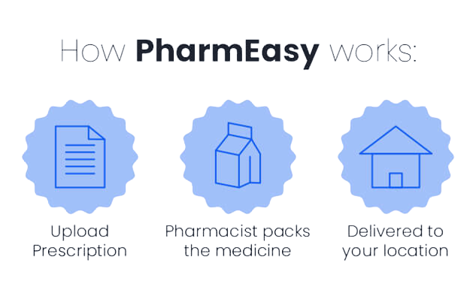
PRODUCT/SERVICES ANALYSIS
1
Medicines
2
Lab Tests
3
Health Care
Free
Consultation
4
Medicines Through Prescription
5

Slide 11
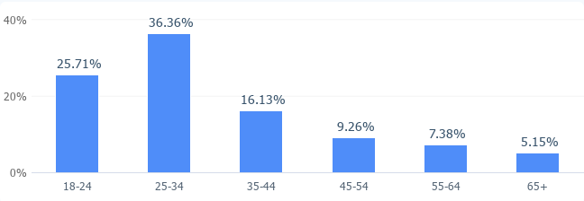
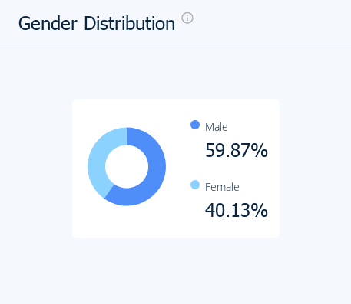
CUSTOMERS’S ANALYSIS
JULY 2022-SEPT 2022
Age Distribution
Gender Distribution

Slide 12
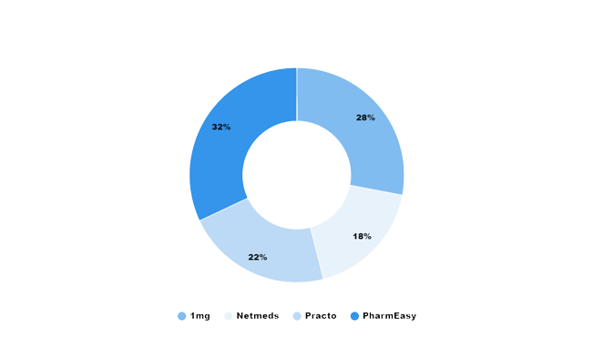
Direct Competitors
Tata 1MG
NetMeds
Practo
Indirect Competitors
Dunzo
Swiggy Genie
Local Pharmacies

Slide 13
SWOT Analysis
Strength
First-mover advantage in a booming sector.
Added capacity following the merger with Medlife, Thyrocare, aknamed.
Currently in Series 7 Funding.
Increase use of mobile health solution.
Increase use of internet.
Weakness
Limited service portfolio - Services offerings are limited with a scope of expansion.
Non-trained pharmacists.
Unavailability of Express shipping facility.
Opportunity
Internet penetration and reduced data tariffs.
Increasing preferences for online shopping.
Changing disease patterns with more focus on NCDs.
Covid-19 .
Threat
Prescription fraud.
Political instability.
Intense competition from brick and motor shops, other start-ups, and the e-commerce sector.
Lack of government regulation in the e-pharmacies sector.
Circulation of tempered and fake drugs without proper storage facilities.

Slide 14
Failure Cause and Effect Analysis
ETA
Complaints on change in ETA and quantity of medicines.
Glitches
Payment related glitches and long refund duration.
Cash back
The cash back earned has very limited days for use(3 days). People don't order medicines at such frequency.
Medication
If prescribed medicine is not available, alternative options are not provided.
Delivery
Cannot be used for urgent needs as delivery takes several days

Slide 15
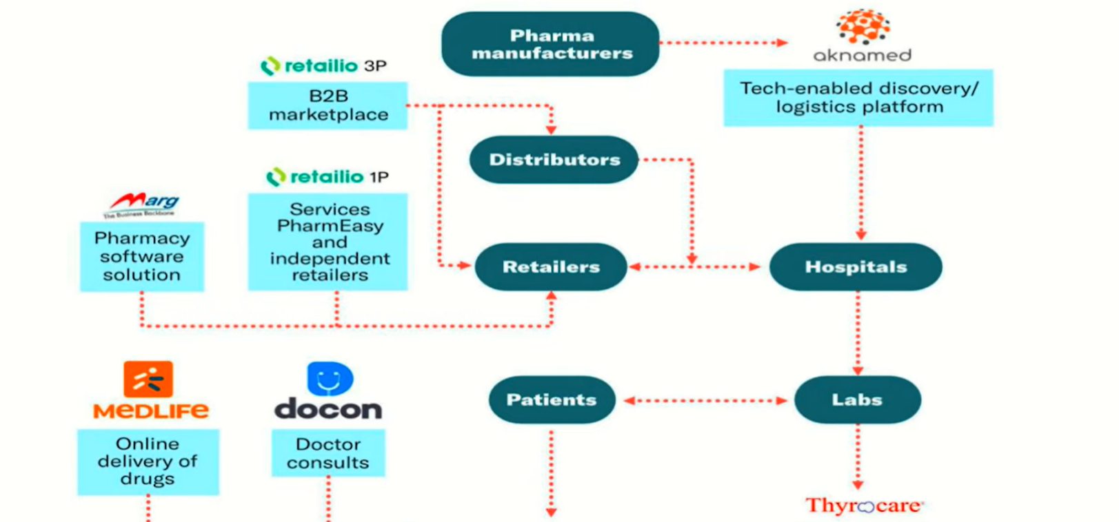
Sustainability of pharmeasy
Wider-Network

Slide 16
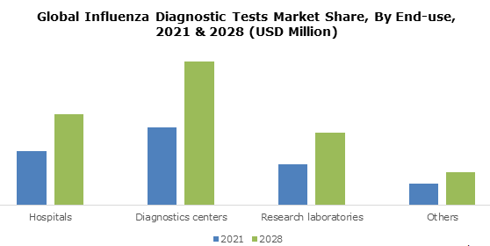
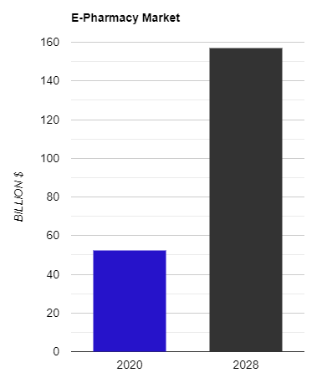
Medlife & thyrocare : Diagnostic Business of Thryocare which fetch margin of 70% as to normal online medicine of 10 - 20 % .
Acquisition
E-pharmacy market size was valued at USD 52.43 billion in 2020 and is projected to reach USD 157.07 billion by 2028, growing at a CAGR of 14.7 % from 2021 to 2028.
E-pharmacy Market Size And Forecast

Slide 17
SUMMARY
Given the phenomenal performance of PharmEasy in getting customers to transact on its platform, frequency of serving these customers and the price premium it enjoys, PharmEasy emerges as the clear market leader with over 40% of the market, Medlife also has strong underlying metrics, becoming the second largest player at nearly quarter of transaction value share. While it is still early days in the online pharmacy space the entry of corporate conglomerates and consolidation amongst incumbent.
To conclude, the growth of online pharmacy in India depends upon
Continual growth of digital revolution.
Serving consumer interests i.e. Safety, Authenticity and Faster access.
Unbiased regulatory protocols.

Slide 18
Challenges & Learnings:
Challenges: 1: Data is not publicly available. 2: Difficulties in find right framework to structure the ppt.
Learnings: 1: Teamwork. 2: Analytical skills. 3: Time management

Slide 19


