Slide 1
Sentiment analysis on restaurant reviews
By: Saheb Singh

Slide 2
Introduction
Zomato is a food delivery and a table booking app similar to Door Dash in the United States.
The number of restaurant are increasing day by day. Currently which stands at approximately 12,000 restaurants.
We are looking into analyzing the Zomato dataset is to get a fair idea about the factors affecting the establishment of different types of restaurant at different places in Bengaluru.

Slide 3
Problem Statement
Bengaluru being an IT capital of India. Most often people here are dependent mainly on the restaurant food as they don’t have time to cook for themselves.
In spite of increasing demand it however has become difficult for new restaurants to compete with established restaurants. Most of them serving the same food.
The key issues that continue to pose a challenge to them include high real estate costs, rising food costs, shortage of quality manpower, fragmented supply chain and over-licensing.

Slide 4
Data description
Data contains customer reviews and ratings for various restaurants in Bangalore. The data also contains information about the locality of the restaurant, it’s menu and restaurant type.
We have total 51,717 reviews for 8,792 restaurants of 93 different types.

Slide 5
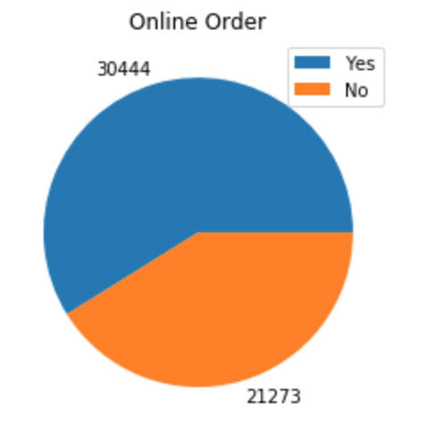
Online order
As clearly indicated, almost 60 per cent of restaurants in Bangalore accepts online orders. Nearly 40 per cent of the restaurants do not accept online orders.
This might be because of the fact that these restaurants cannot afford to pay commission to zomato for giving them orders online. Zomato may want to consider giving them some more benefits if they want to increase the number of restaurants serving their customers online.

Slide 6
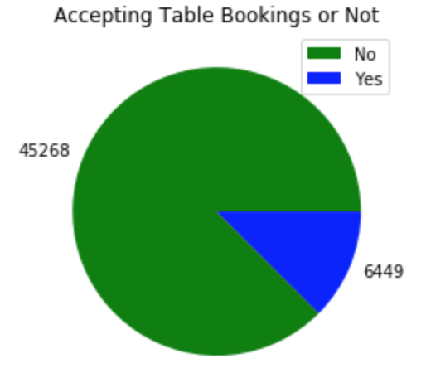
Table Booking
Almost 90 percent of restaurants in Bangalore do not provide table booking facility.
In India you cannot find table booking facility in any average restaurants, usually only five star restaurants provides table booking.

Slide 7
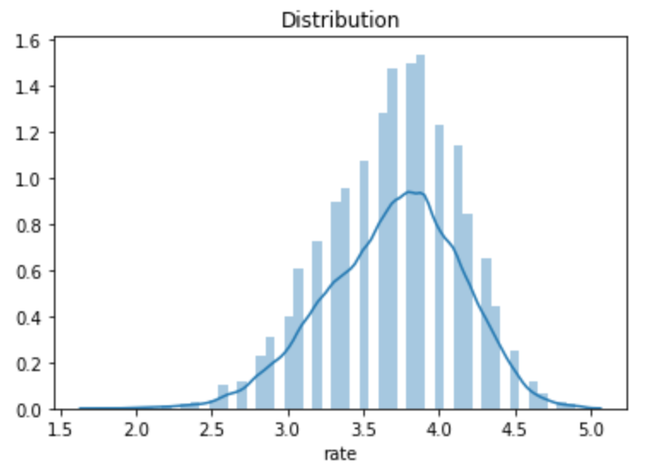
Distribution of ratings
Almost more than 50 percent of restaurants has rating between 3 and 4. Restaurants having rating more than 4.5 are very rare.

Slide 8
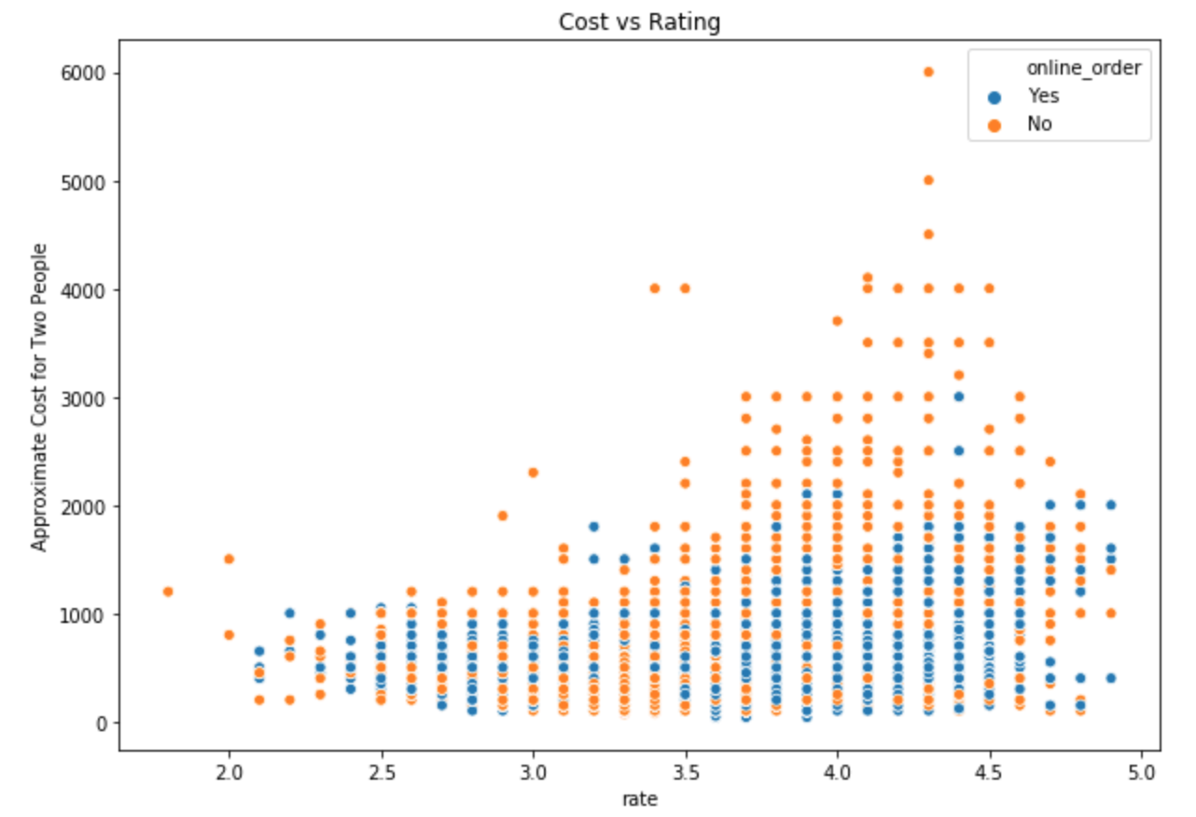
cost and rating analysis
We see that almost 90 percent of food vendors sell food for less than 2000Rs. (Indian Currency.

Slide 9
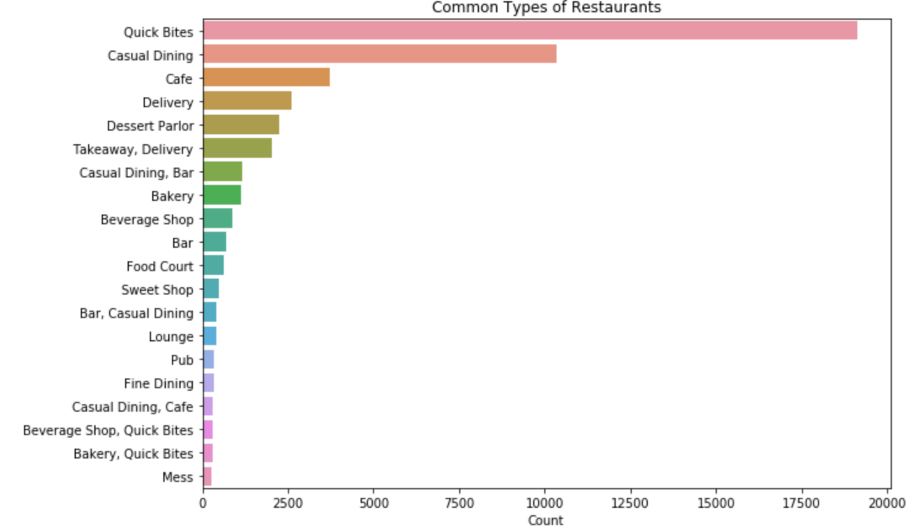
Common type of restaurant
No surprise that quick bites dominates as Bangalore being IT capital of India, people prefer Quick Bites.
Surprised to see that Mess is at the lowest. It might be that most Mess are not on Zomato.

Slide 10
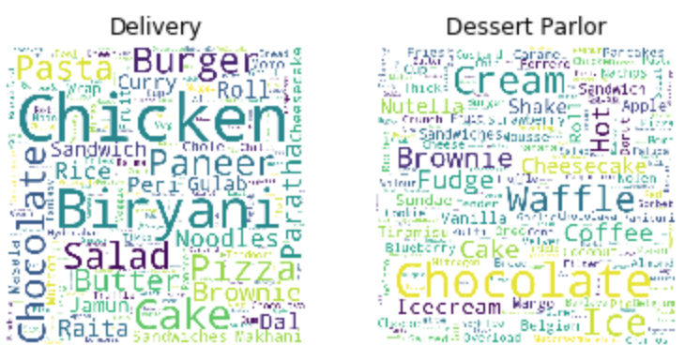
Word cloud for restaurant type
One of the way to find the most common dish is to find the frequent words in the document. To answer this question we draw a word cloud and look at the most used words.
We see that for delivery the most common dish is Chicken. And for desert parlor most common dish is chocolate which should be a part of some dish.

Slide 11
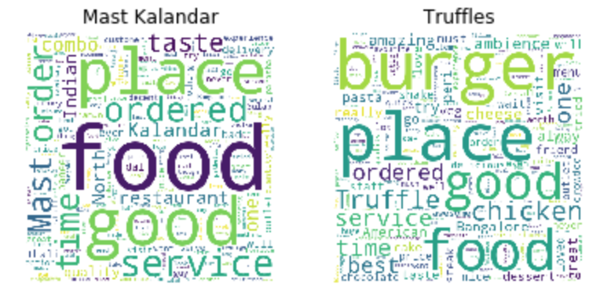
WORD CLOUD FOR DIFFERENT restaurants
One of the way to find the most common dish is to find the frequent words in the document. To answer this question we draw a word cloud and look at the most used words.
We see that for Mast Kalandar the most review word is service and food. And for Truffles most common dish is burger which Truffles is actually really famous for.

Slide 12
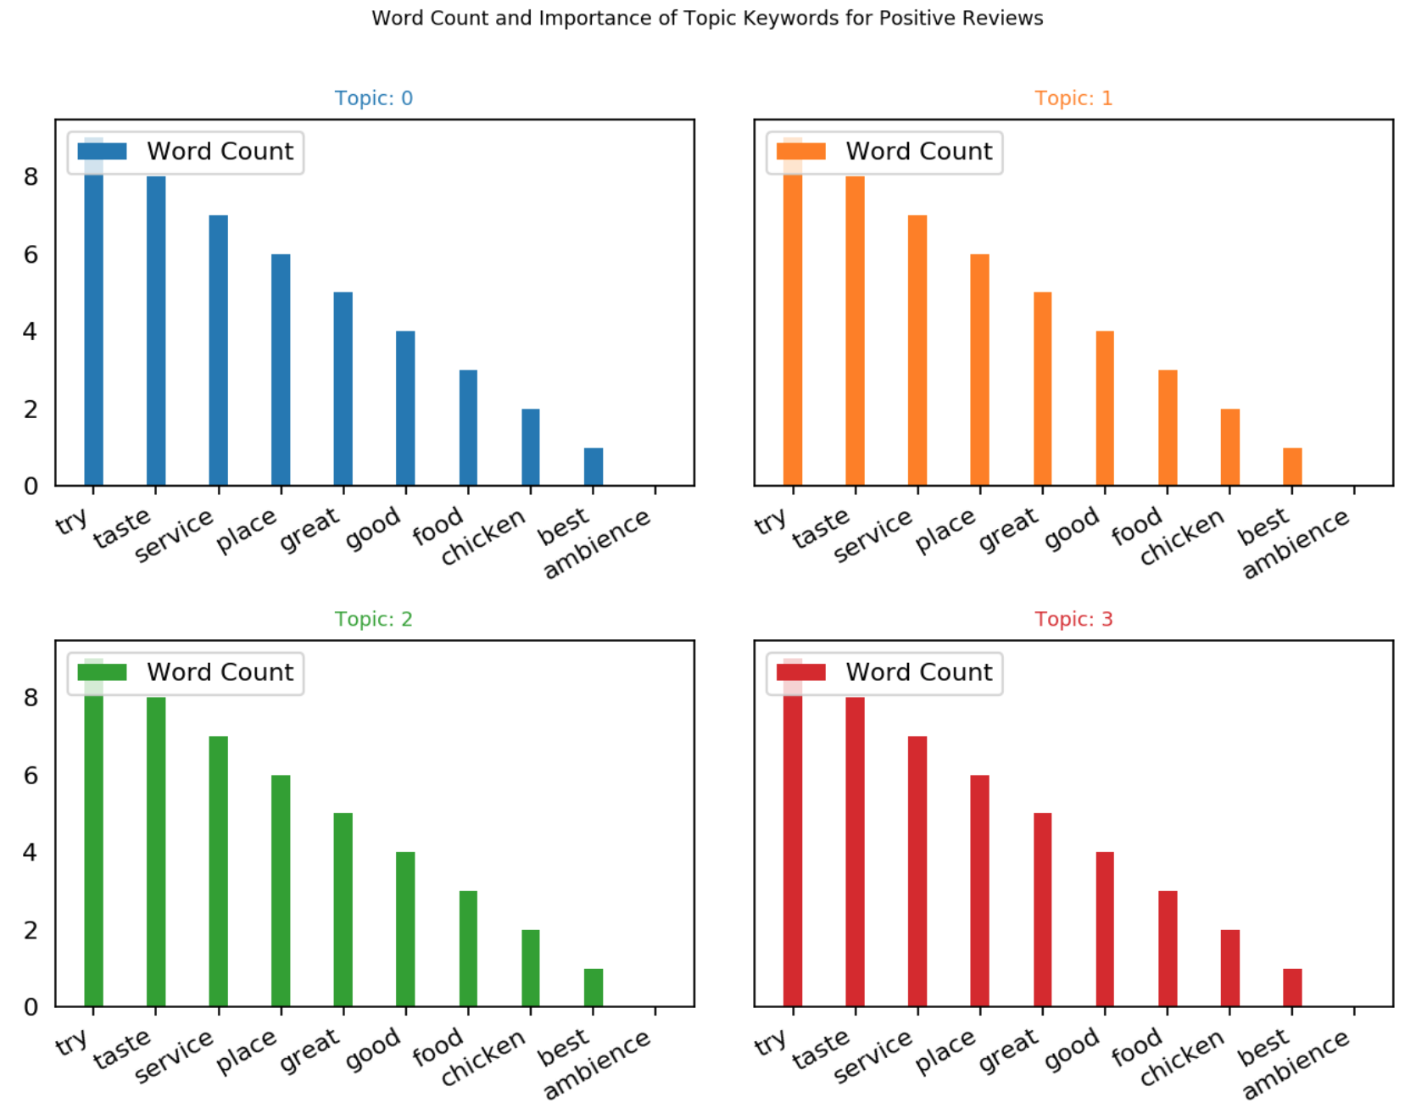
TOPIC MODELING for positive reviews
When it comes to the keywords in the topics, the importance (count) of the keywords matters. To find what are the most important things customer look for.
We also keep an eye out on the words that occur in multiple topics and the ones whose relative frequency is more than the weight. Often such words turn out to be less important.

Slide 13
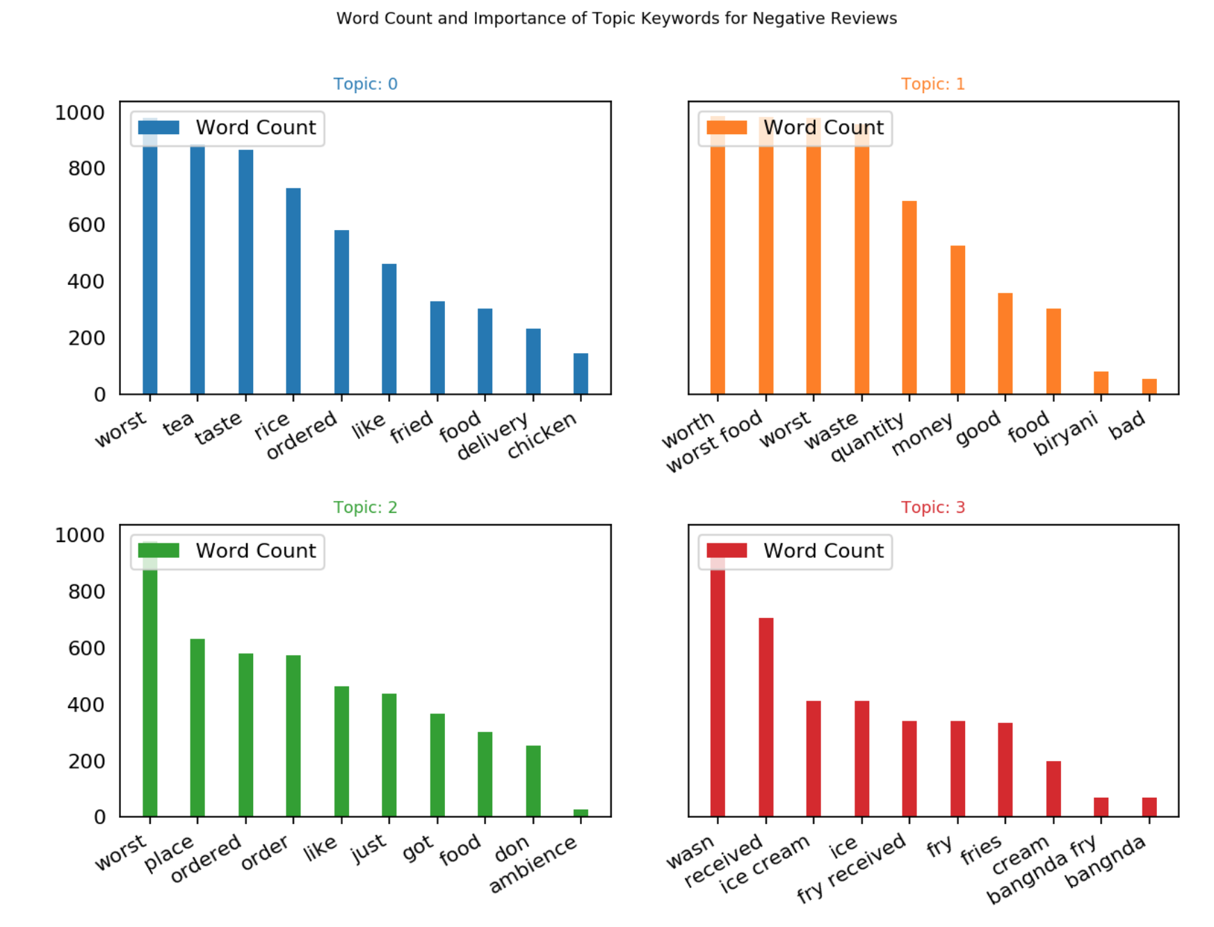
TOPIC MODELING ON NEGATIVE REVIEWS
We are more interested in negative reviews as those represents the area we can improve the most.
Interesting thing to notice is that in both positive and negative reviews words such as chicken, taste and service appear, along with negative words such as bad, worse etc. This means that customer's review is strongly influenced by small amount of words

Slide 14
Sentiment analysis
For doing sentiment analysis we prepared our data in appropriate format. We will map positive and negative ratings on the basis of the ratings provided by each user.
We will map reviews to negative if the rating given is less than 3.0 and positive if rating is greater than 3.0.
To find more accurate topics and to even predict the reviews of a particular type of restaurant based upon it’s review we will apply sentiment analysis using Naïve Bayes. For vectorization we used Bigram Boolean Vectorizer.
Notes:
SVM

Slide 15
Sentiment analysis
After applying Sentiment Analysis we looked onto the least and most influenced words. Most influential words were service, chicken, ambiance, and food. Which are similar to the words we got during Topic Modeling.
Therefore we can conclude that most of the customers look for ambiance when dining in, quick service when ordering and taking out. And the chicken dishes are the most important.
Using testing data we got an accuracy of 95%.

Slide 16
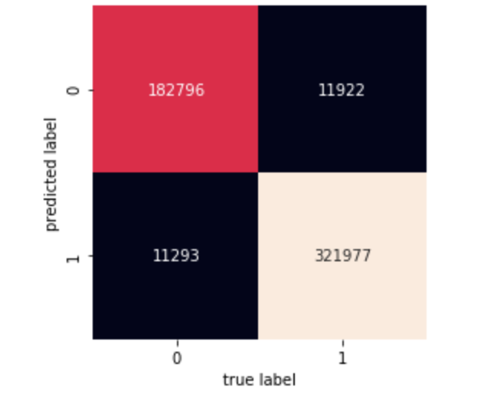
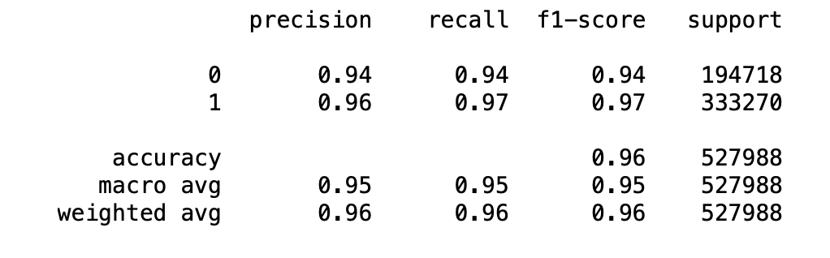
Evaluation
Confusion Matrix

Slide 17
Conclusion
We can conclude that the most common foods in Bangalore are quick bites, not surprising considering most of the people work 10 hour shifts and therefore would not be tempted to go out and eat.
For the foods we find that the most common dish for Non Vegetarians is Butter Chicken and for Vegetarians is Paneer. Whereas Pasta is the most common dish in restaurants.
For customer satisfaction both Topic Modeling and Sentiment Analysis concluded that Ambience, Quick Service and Chicken Dishes are most related towards customer satisfaction.

Slide 18
Thank You

Slide 19
resources
Github Repository: https://github.com/robinsaheb/ResturantReviews

