Slide 1
GTASS – Team 15
Robin Schiro
Samuel Roman
Raphael (Alex) Saint-Louis
Julian Rojas

Slide 2
Notes:
Eliminated redundancy in data storage by creating tables in BCNF (all functional dependencies are key constraints)
You may wonder about GPA column for NomineeInfoTable. While GPA is affected by grades in courses, the requirements imply that it cannot be calculated from them alone. (otherwise, why would the requirement require that the nominee input the GPA as part of the form)?
Note that NomineeInfoForm ISA NominationForm. This was done so that same info would not be stored in NomineeInfoForm (this info is pre-filled for nominee). Separation was important because New graduates do not have NomineeInfoForm entries.
Also note that primary key for NominationForm is SessionID and PID. This is based on assumption that the same student cannot be nominated by two nominators in the same session.
It’s important to store GCMembersInSession so that former GC Members do not accidentally have ability to create scores for current session.

Slide 3
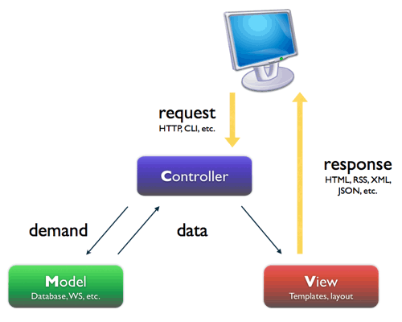
MVC Design Pattern
What is MVC?
Model
Interfaces with our database
View
All the elements that make up the UI
Controller
Handles user interaction
Why use MVC?
Reduced code complexity
Code Reuse
Easier to work in teams, i.e. Increased flexibility
Notes:
What is MVC?
Why MVC?
- It reduces code complexity by essentially enforcing modularity. Rather than having some blob of a function we would have a function
that verifies our input, another to send out the necessary emails, and finally another to save the data to our db.
Since it is highly modular it would lend itself towards functions and views to be used in multiple locations and thus reducing points of failure.
Given that code is broken up we could assign so that one user for example works on the UI of some form, another to work on the code that would submit the data to the db, and finally a controller that would act as the glue and would use the data work on it in some way and finally call the service that saves it to our db. Since we are working one completely different it minimizes the likelihood of merge conflicts.

Slide 4
Robin’s Contribution
Finalized design of the database
Created ER diagram, wrote the CreateTables script
Set up project on Google App Engine, created CloudSQL database
Developed back-end PHP/SQL support and front end for following views:
Wrote logic to handle authentication and redirection from email links
Created message handling for missing deadlines
Create Session (back end only)
Current Session
Score Table (with Julian)
Account
Nominee Information Form
Nominee Approval (with Alex)

Slide 5
Julian’s Contribution
On the Documentation
Created the Use Case Diagram
On Front End Development
Used JavaScript to develop the dynamic input algorithm and the input validation.
Used CSS for the styling of the tables found in the allSessionsView and scoreTable
Used HTML and PHP for views such as:
Back End Development
Used PHP/SQL for obtaining the Nominee’s already stored Info
allSessionsView
ScoreTable (w/ Robin)
clickedNominee
createSession (w/ Alex)
nomineeForm
gcHome

Slide 6
Alex’s Contribution
Documentation
Worked on the documentation/user manual with Sammy
Front End Development (HTML/CSS/PHP/JS)
Worked on the following views
Designed the common CSS that is used in most of the forms
Back End Development (PHP, SQL)
View for nominee approval (with Robin)
View for querying and displaying incomplete nominations
Add Nominees
incompleteNominations (w/ Sammy)
createSession (w/ Julian)
currentSession
addNominators
Persistent sidebar

Slide 7
Sammy’s Contribution
Worked on the user manual
Wrote the initial schema design for the project
Was minimally modified as we worked on the project
Organized the original project directories in compliance to the MVC design pattern
Backend Development:
Email Service
Automated 2 day reminder to nominees script
View All Sessions
Admin Controller
Complete Login System w/ hashed passwords
Nominator and Nominee Creation
Session Creation form + controller
Implemented Route Authentication

Slide 8
URL
gtass-1256.appspot.com

