Slide 1
INTRODUCTION
Understanding Gen Z Career Aspirations
Objectives:
Explore what Gen Z values in work, learning, and
leadership.
Identify challenges organizations face in meeting these
expectations.

Slide 2
Scope:
Focused on three areas:
Learning aspirations,
Workplace preferences,
Leadership needs.

Slide 3
Problem Statement:
Many organizations struggle to attract and retain Gen Z
talent due to misaligned workplace practices and values.

Slide 4
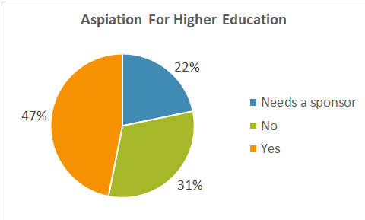
KEY FINDINGS
What We Learned About Gen Z
1. Learning Preferences:
47% want higher
education,
22% need financial
support.
.

Slide 5
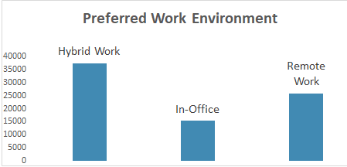
Hybrid work is the most preferred setup.

Slide 6
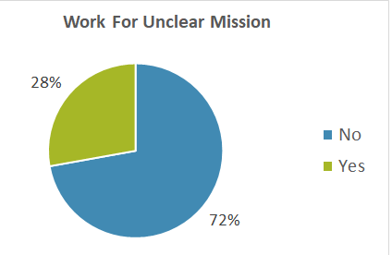
2. Workplace Expectations:
72% won’t work for companies
with unclear missions.
Transparency and flexibility are
critical for engagement.

Slide 7
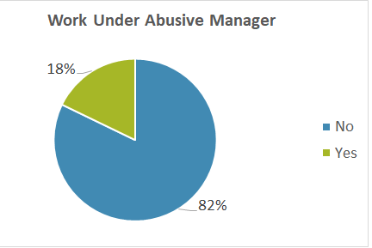
3. Leadership Preferences:
Only 18% tolerate abusive managers.

Slide 8
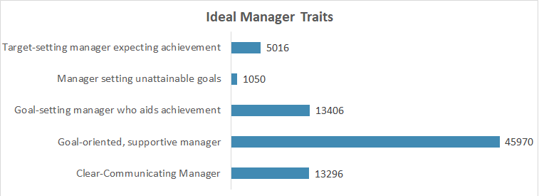
Work-life balance and supportive leadership are essential.

Slide 9
KEY "WOW" INSIGHT
The Most Impactful Discovery
Surprising Insight: Hybrid work is non-negotiable for most Gen Z
employees. Flexibility, autonomy, and technology-
enabled setups dominate their workplace
preferences.

Slide 10
Why It Matters:
Traditional 9-to-5, fully on-site roles are
losing appeal.
Organizations need to adapt quickly or risk
losing talent to more flexible competitors.

Slide 11
RECOMMENDATIONS
How Organizations Can Adapt
Offer Financial Support: Scholarships and sponsorships for education can
reduce barriers.
2. Embrace Hybrid Work: Flexible work models should become the standard.
3. Train Leaders: Develop supportive and goal-oriented leadership styles.
4. Engage Influencers: Include parents and mentors in outreach and branding
efforts.
5. Invest in Learning Programs: Focus on personalized, experiential skill-
building opportunities.

Slide 12
TAKEAWAYS
Lessons Learned for the Future
Engagement is Key: Clear missions and flexible workplaces are non-negotiables for
Gen Z.
Leadership Matters: Supportive managers foster trust and long-term commitment.
Flexibility Wins: Hybrid work isn’t a luxury—it’s an expectation.
Strategic Adaptation: Organizations that align with Gen Z’s values will build a motivated,
future-ready workforce.
Continuous Learning: Tailored development programs keep employees engaged and
skilled.

Slide 13
THANK YOU

