Slide 1
An Intro to Tor
By Adam Levin

Slide 2
What is Tor?
From ‘https://www.torproject.org’
“Tor network is a group of volunteer-operated servers that allows people to improve their privacy and security on the Internet”
Rather than making a direct connection to a website, the Tor software connects users to destinations through a series of virtual tunnels.

Slide 3
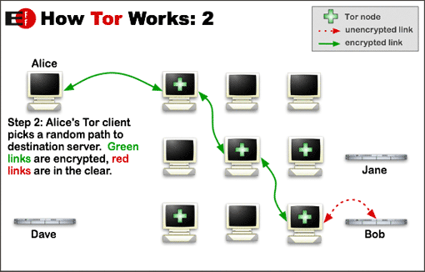
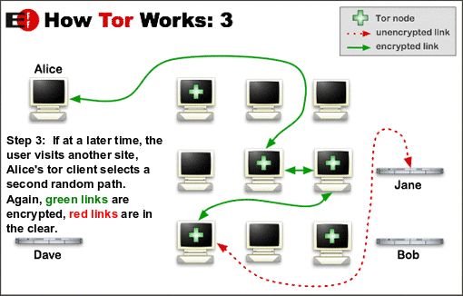

Slide 4
Who uses Tor?
Legitimate use cases:
Government
Intelligence gatherers who want to obscure their identity online
Citizens or visitors in countries that have blocked certain websites (you can specify IP address only from certain locations)
Whistleblowers who want to remain anonymous
Lower prices on ecommerce?
Corporations who want to avoid being monitored by competitors

Slide 5
Data Science?
Scraping!
Potentially avoid being locked out as a results of scraping sites manually over and over
Scraping google is tricky. Other sites might not be as smart. You’ll have to see for yourself.

Slide 6
Demo
http://icanhazip.com
http://www.infobyip.com
https://check.torproject.org

Slide 7
Gist
https://gist.github.com/adamwlev/ce14a988a0b859d424d01543970b45d0

Slide 8
Credits/References
Credit: Michelle for telling me about Tor
References: https://www.torproject.org

