Slide 1


Slide 2
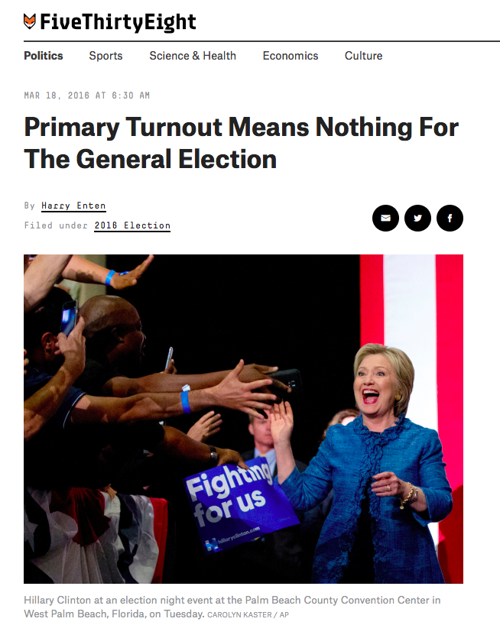
Primaries vs. General Election: Apples and Oranges?

Slide 3
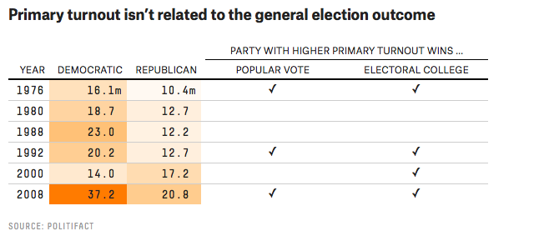
A meager analysis…

Slide 4
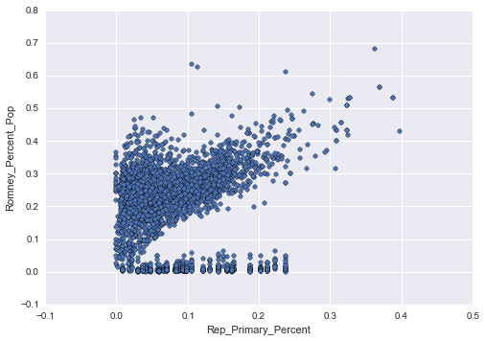
A closer look…

Slide 5
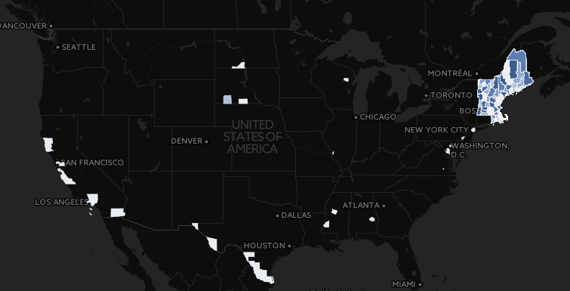

Slide 6
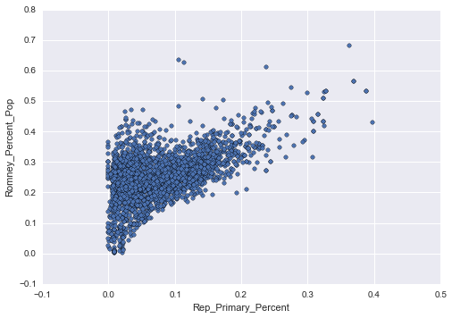
Excluding New England:

Slide 7
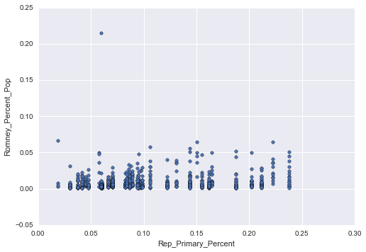
New England:

Slide 8
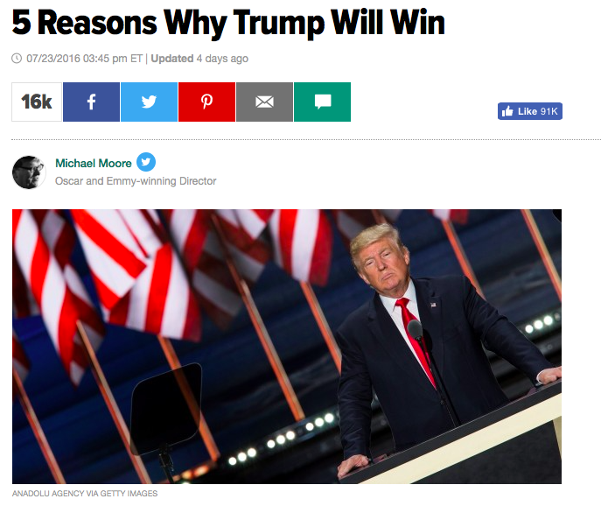
Are there specific correlations within geographies?
Michigan
Ohio
Pennsylvania
Wisconsin

Slide 9
