Slide 1

Regularization

Slide 3
# parameters
Log likelihood
While awarding goodness of fit, penalize model complexity

Slide 4
While awarding goodness of fit, penalize model complexity
Why not do that while we are fitting?

Slide 5
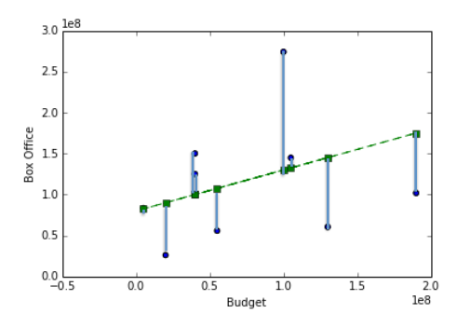
Cost function
Takes a model (specific parameter values), returns a score

Slide 6

$$x107$$

Slide 8
Cost function

Slide 9
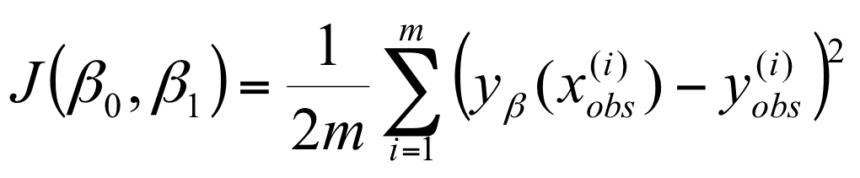
Cost function

Slide 10
Cost function
Add a penalty for the size of each parameter!

Slide 11
L2 Regularization

Slide 12
Ridge Regression

Slide 13
Effect of λ?

Slide 14
zero

Slide 15
very small

Slide 16
“just right”

Slide 17
VERY LARGE

Slide 18
VERY LARGE
≈0
≈0
≈0
≈0
≈0

Slide 19
Error vs. regularization λ

Slide 20
Error vs. regularization λ
High λ
Low λ

Slide 21
Underfit
Overfit
High λ
Low λ

Slide 22
Ridge Regularization (L2)

Slide 23
Ridge Regularization (L2)
Lasso Regularization (L1)

Slide 24
Ridge Regularization (L2)
Lasso Regularization (L1)
Elastic Net (L1 + L2)

Slide 25
How can I use this?
We were doing:
from sklearn.linear_model import LinearRegression model = LinearRegression()
model.fit(X,Y)

Slide 26
How can I use this?
We were doing:
from sklearn.linear_model import LinearRegression model = LinearRegression()
model.fit(X, y)
To use Ridge Regularization:
from sklearn.linear_model import Ridge
model = Ridge(1.0)
model.fit(X, y)
λ (sklearn Calls It alpha)

Slide 27
How can I use this?
We were doing:
from sklearn.linear_model import LinearRegression model = LinearRegression()
model.fit(X, y)
To use Lasso:
from sklearn.linear_model import Lasso
model = Lasso(1.0)
model.fit(X, y)
λ (sklearn Calls It alpha)

Slide 28
How can I use this?
We were doing:
from sklearn.linear_model import LinearRegression model = LinearRegression()
model.fit(X, y)
To use Elastic Net:
from sklearn.linear_model import ElasticNet
model = ElasticNet(1.0, l1_ratio = 0.5)
model.fit(X, y)
total weight for the full penalty term
ratio of l1/l2 penalty

Slide 29
My model is not
awesome
enough.
What do I do?

Slide 30
Try these and check test error
(and AIC,BIC,etc.) again:
Use a smaller set of features
Regularization: Increase/decrease λ
Try adding polynomials
Check functional forms for each feature
Try including other features
Use more data (bigger training set)

