Slide 1
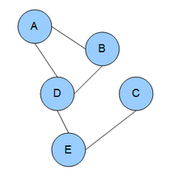

Conditional Random Field
&
Graphical Model
한건수 연구원
2018. 11
Copyright© 2018 TmaxData. All Rights Reserved.

Slide 2
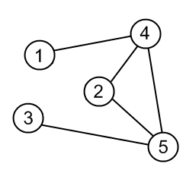
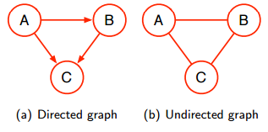
Graphical Model (1/5)
Probabilistic Graphical Model (PGM)
확률 모델의 구조를 쉽게 시각화
구조를 분석함으로써 모델 속성에 대한 직관을 얻을 수 있다
예) 조건부 분포 (conditional probability distribution)의 독립 속성 (independent features)들을 그래프를 통해 파악
구조
일반적으로 그래프는 노드와 엣지로 표현된다
노드: 랜덤 변수 (random variable)를 하나의 노드로 표시
엣지: 랜덤 변수 사이의 관계를 나타낸다
종류
방향성 그래프 (Directed Graphical Model /DGM) : 엣지가 한쪽 방양으로의 관계만 성립 (화살표로 표기)
예) Bayesian Network, HMM
비방향성 그래프(Undirected Graphical Model /UGM) : 노드간 양 방향으로 관계가 맺어지고 화살표 표기가 없음
예) CRF, Markov Random Field
Node
Edge
https://medium.com/@neerajsharma_28983/intuitive-guide-to-probability-graphical-models-be81150da7a

Slide 3
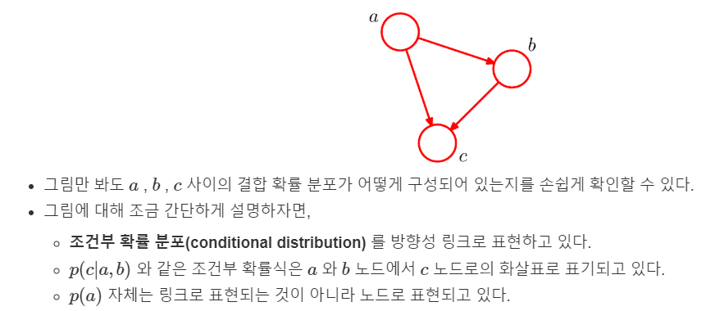
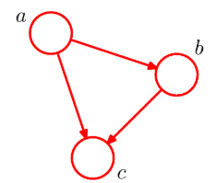

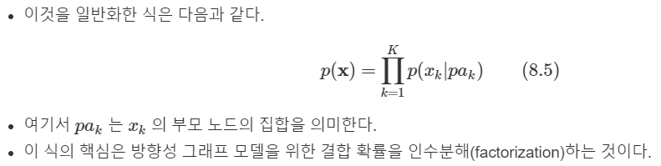
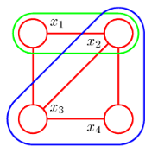
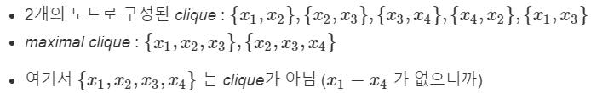
Graphical Model (2/5)
Directed Graphical Model
Undirected Graphical Model
노드들 사이에 화살표가 없지만 locality / conditional independence 정보는 clique 에 저장
그래프 노드들의 부분 집합
이 부분 집합의 노드들은 fully connected 상태여야 한다 = 즉 모든 노드의 pair 사이에 링크가 존재해야 한다

Slide 4


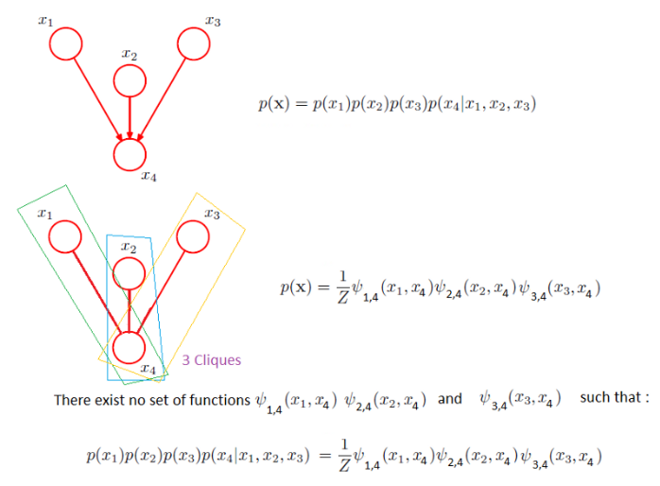
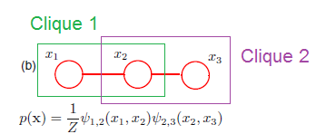


Graphical Model (3/5)
Undirected Graphical Model
Potential function
The joint distribution → product of potential functions $Ψ_{C}\left(X_{c}\right)$ over the maximal cliques of the graph
$X_{c}$ : Clique C에 속해 있는 변수 집합
$Z$: Partition function (normalizing constant)
Potential function 해석
딱히 어떤 형태의 함수를 선택한다는 제약이 없다
특정 확률적 해석이 없다 (조건부 분포, 주변 확률 분포 등으로 굳이 해석되지 않아도 된다)
따라서 상황에 따라 적절한 potential function을 선택 ( Common choice : $\exp\left(X_{c}\right)$ )
DGM
UGM

Slide 5
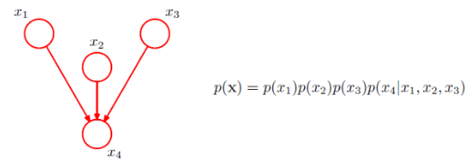
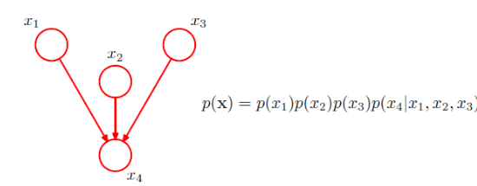
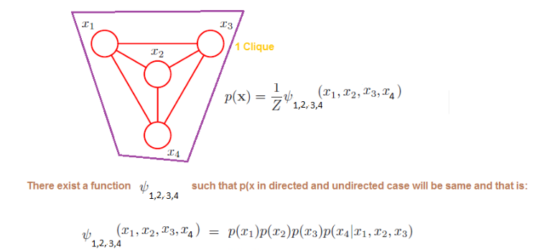
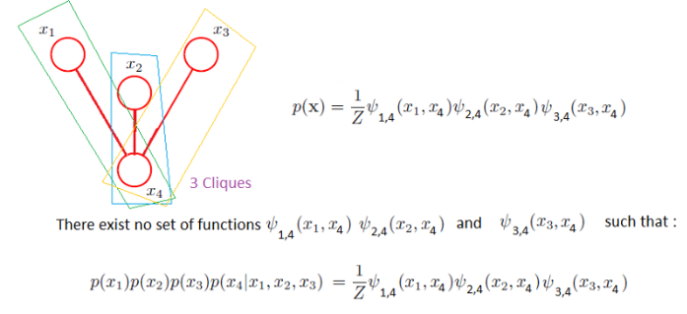
Graphical Model (4/5)
DGM
UGM

Slide 6
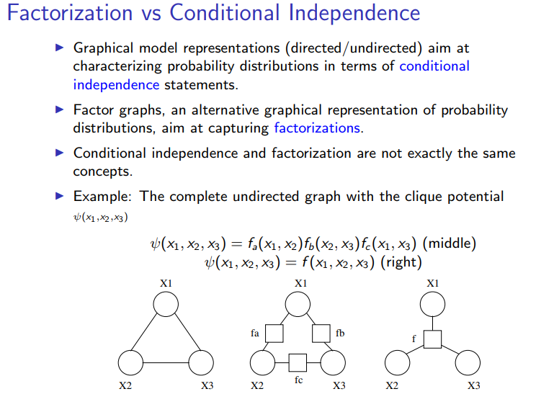
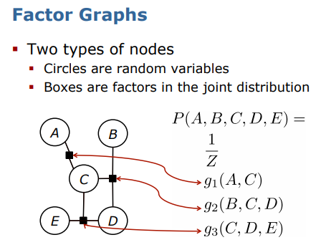
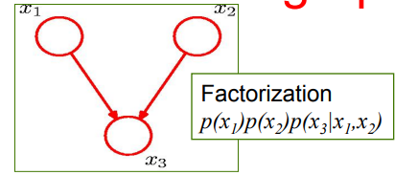
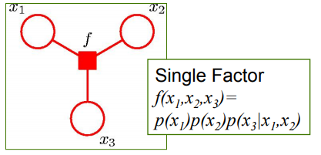
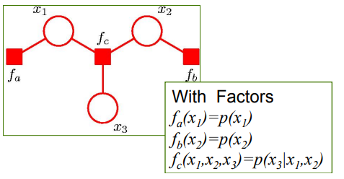
Graphical Model (5/5)
Factor Graph
Unification of DGM and UGM

Slide 7
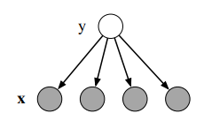
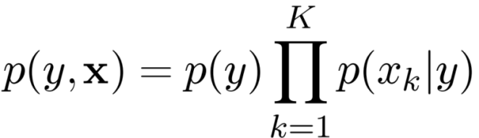
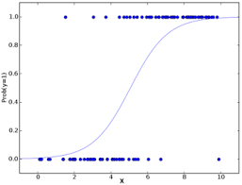

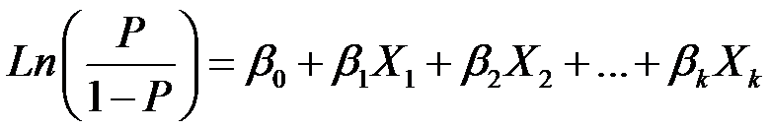
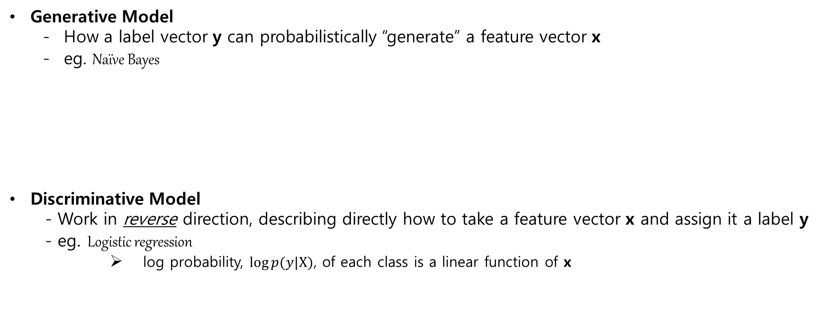
Generative vs Discriminative Model (1/2)
Generative Model
How a label vector y can probabilistically “generate” a feature vector x
eg. Naïve Bayes
Discriminative Model
- Work in reverse direction, describing directly how to take a feature vector x and assign it a label y
- eg. Logistic regression
log probability, $log⁡p(y|Χ)$, of each class is a linear function of x
Joint probability
Graphical Model for NB
Conditional distribution
출처: http://www.aclweb.org/anthology/J81-4002

Slide 8

Generative vs Discriminative Model (2/2)
Both GM and DM describe distributions over $(y,x)$, but they work in different directions
A GM is a family of joint probability distribution $p(y,x)$ that factorizes as $p(y)p(X|y)$
Describe how to “generate” values for features given the label
A DM is a family of conditional distributions $p\left(y | Χ\right)$
Model the classification rule directly
Conceptual Difference
$p\left(y | Χ\right)$ does not include a model of $p\left(X\right)$
Modeling $p\left(X\right)$ involves in highly dependent features which are difficult to model
Eg. NER → HMM relies on only one feature – word’s identity
Many Proper names do not appear in the training dataset
To label unseen words capitalization, neighbor words, prefixes and suffixes should be used
출처: http://www.aclweb.org/anthology/J81-4002

Slide 9
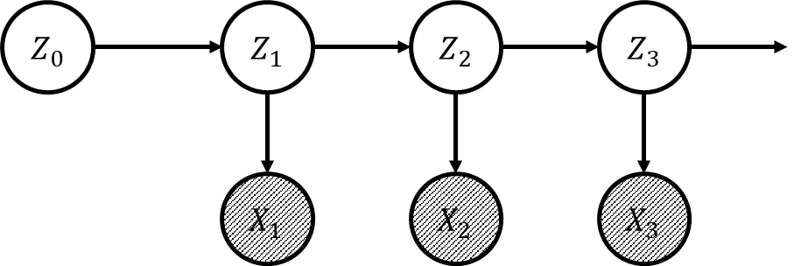

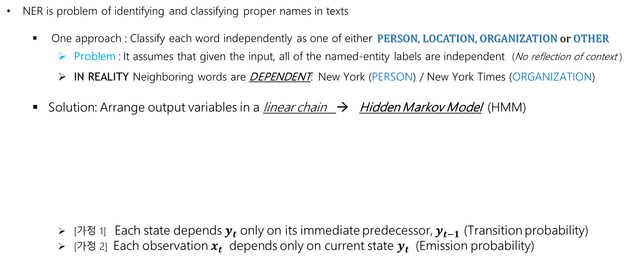
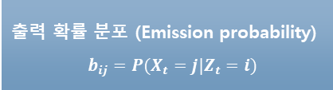
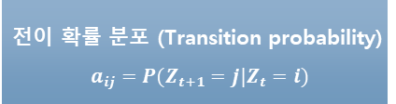
HMM – Named Entity Recognition (NER)
NER is problem of identifying and classifying proper names in texts
One approach : Classify each word independently as one of either PERSON, LOCATION, ORGANIZATION or OTHER
Problem : It assumes that given the input, all of the named-entity labels are independent (No reflection of context )
IN REALITY Neighboring words are DEPENDENT: New York (PERSON) / New York Times (ORGANIZATION)
Solution: Arrange output variables in a linear chain → Hidden Markov Model (HMM)
[가정 1] Each state depends $y_{t}$ only on its immediate predecessor, $y_{t−1}$ (Transition probability)
[가정 2] Each observation $x_{t}$ depends only on current state $y_{t}$ (Emission probability)
출력 확률 분포 (Emission probability)
$$b_{ij}=P(X_{t}=j|Z_{t}=i)$$
전이 확률 분포 (Transition probability)
$$a_{ij}=P(Z_{t+1}=j|Z_{t}=i)$$
Joint probability

Slide 10
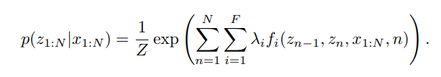

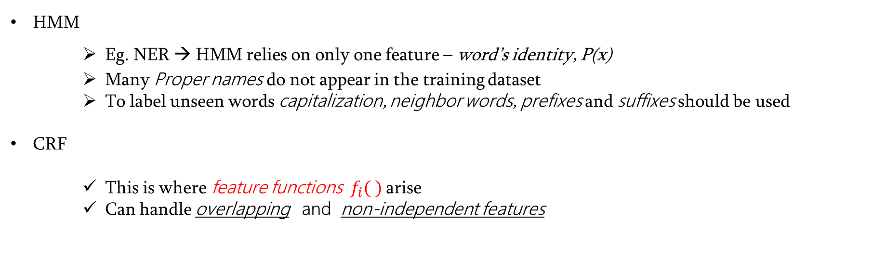
HMM vs CRF
HMM
Eg. NER → HMM relies on only one feature – word’s identity, P(x)
Many Proper names do not appear in the training dataset
To label unseen words capitalization, neighbor words, prefixes and suffixes should be used
CRF
This is where feature functions$f_{i}( )$ arise
Can handle overlapping and non-independent features
A linear chain CRF defines a conditional probability (whereas HMM defines the joint distribution)

Slide 11


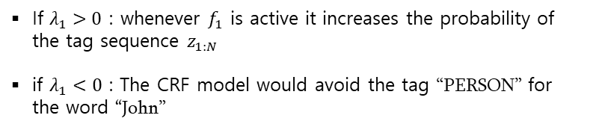
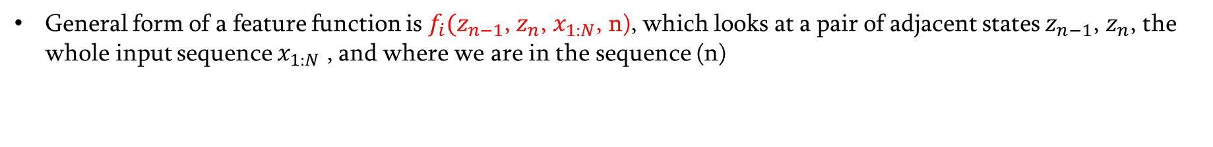





CRF – Feature Functions
General form of a feature function is $f_{i}(z_{n−1}$, $z_{n}$, $x_{1:N}$, n), which looks at a pair of adjacent states $z_{n−1}$, $z_{n}$, the whole input sequence $x_{1:N}$ , and where we are in the sequence (n)
$z_{1:N}$ (tag)
PERSON
If $λ_{1}>0$ : whenever $f_{1}$ is active it increases the probability of the tag sequence $z_{1:N}$
if $λ_{1}<0$ : The CRF model would avoid the tag “PERSON” for the word “John”
$X_{1:N}$ (word)
John
We could guess $λ_{2}>0$
Furthermore, both $f_{1}$ and $f_{2}$ can be active for sentence like
“John said so” , and $z_{1}$ = $PERSON$
This is an example of “overlapping features ” – boost up the belief of $z_{1}=PERSON to λ_{1}$+ $λ_{2}$
HMM cannot do this – it cannot look at the next work nor can it use overlapping features
$z_{1:N}$ (tag)
PERSON
$X_{1:N}$ (word)
Said

Slide 12




General CRF
Linear Chain CRF
If $F=\{Ψ_{a}\}$ is the set of factors in G, then the conditional distribution for a CRF is
Useful log$Ψ_{a}$ to be linear over a set of feature functions
therefore
Both the feature functions $f_{ak}$ and the weights $θ_{ak}$ are indexed by the factor index , $a$ to emphasize that each factor has its own set of weights.
Now the normalization constant is a function of the input $X$

Slide 13


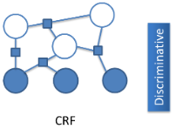

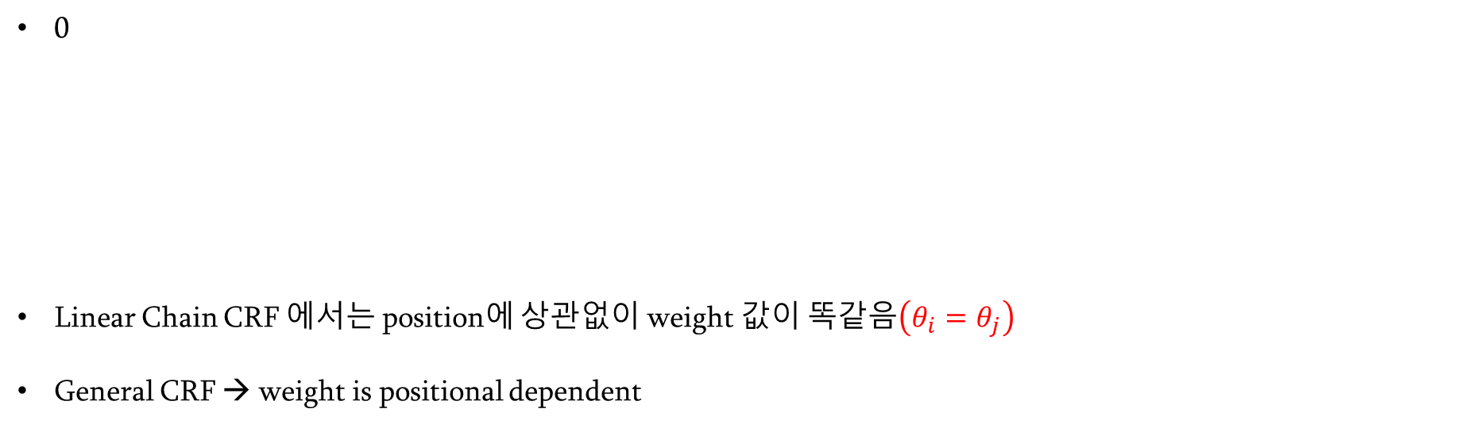





General CRF
0
Linear Chain CRF 에서는 position에 상관없이 weight 값이 똑같음$\left(θ_{i}=θ_{j}\right)$
General CRF → weight is positional dependent
$z_{1:N}$ (tag)
PERSON
PERSON
$X_{1:N}$ (word)
John
John
$$i^{th}$$
$$j^{th}$$
$C=\left\{C1, C2,…C_{p}\right\}$ where each $C_{p}$ is a clique template
$$j^{th} clique$$
$$i^{th} clique$$
같은 { z x } pair 를 같더라도 다른 clique 에 있어서 $θ$값이 다르다 $\left(θ_{i}≠θ_{j}\right)$

Slide 14







CRF Training
Maximum Likelihood
from
Log Likelihood
Add an L2 regularization (which is a penalty on weight vectors whose norm is too large)
Differentiate with respect to $θ_{k}$

Slide 15
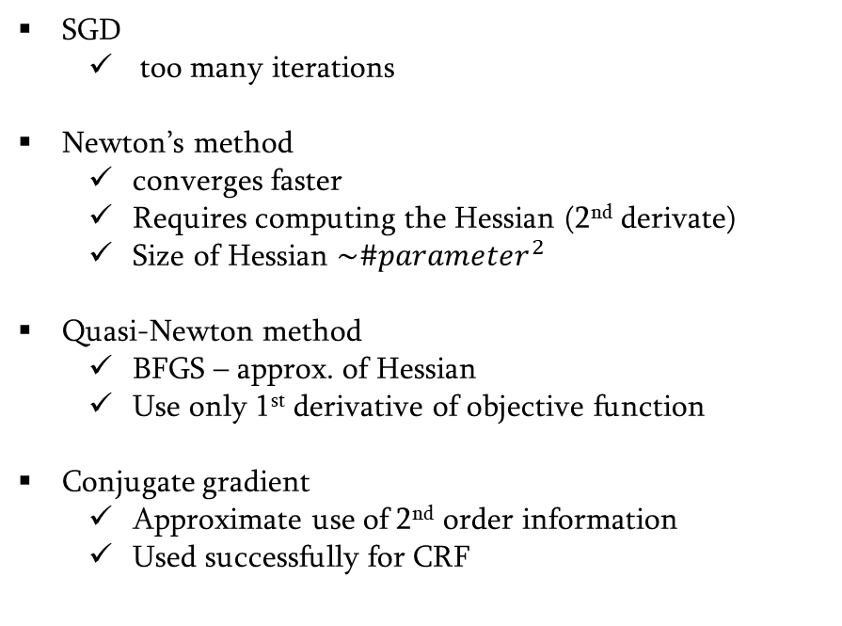
CRF Training
Objective function
SGD
too many iterations
Newton’s method
converges faster
Requires computing the Hessian (2nd derivate)
Size of Hessian $\sim {\#parameter}^{2}$
Quasi-Newton method
BFGS – approx. of Hessian
Use only 1st derivative of objective function
Conjugate gradient
Approximate use of 2nd order information
Used successfully for CRF

Slide 16
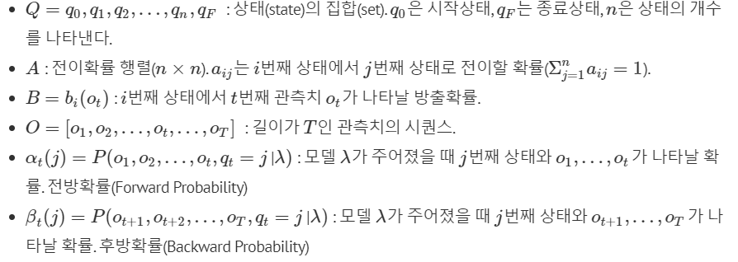
Inference
Forward & Backward algorithm + Viterbi algorithm (as in HMM)
Notation
https://ratsgo.github.io/machine%20learning/2017/03/18/HMMs/

Slide 17
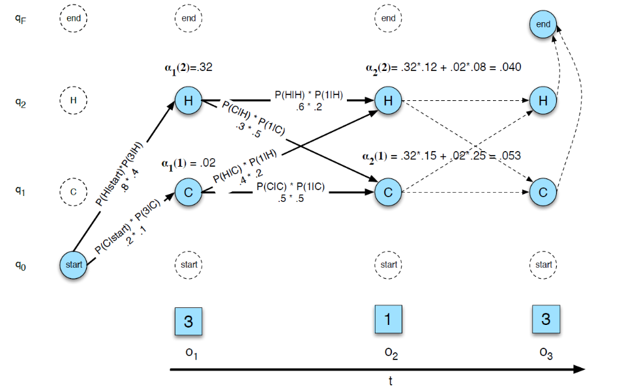
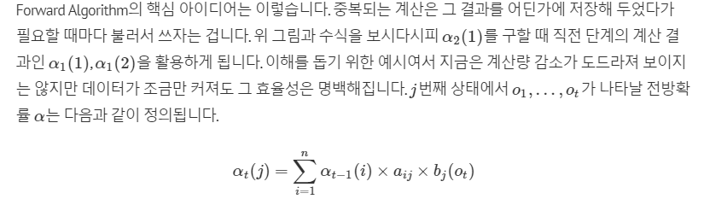

Forward & Backward Algorithm
비슷하게 Backward Algorithm 은 다음과 같이 정의됩니다.

Slide 18
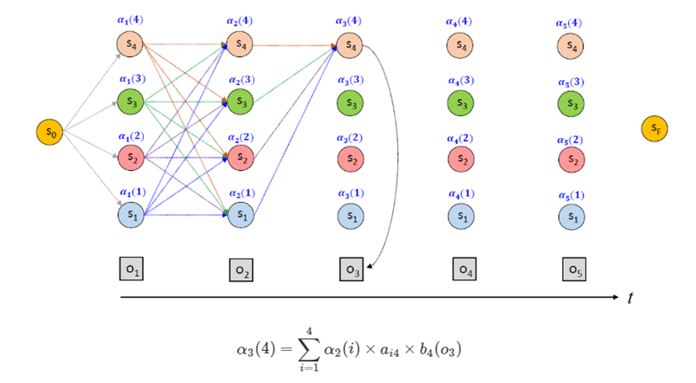
Forward Algorithm

Slide 19
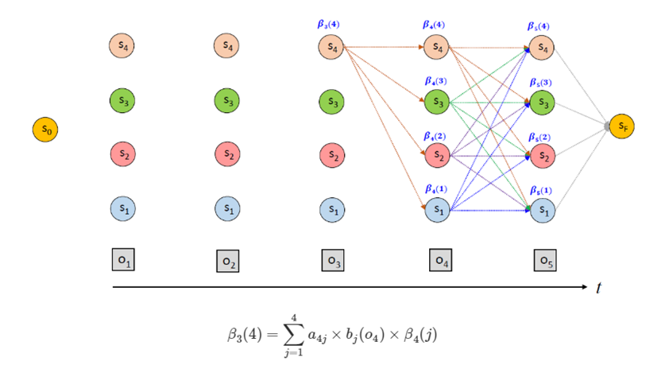
Backward Algorithm

Slide 20
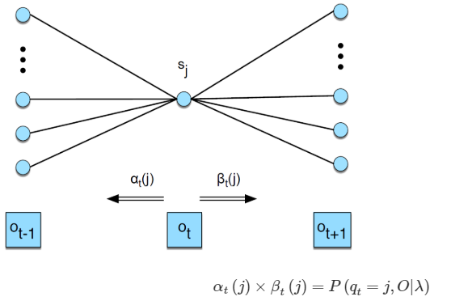
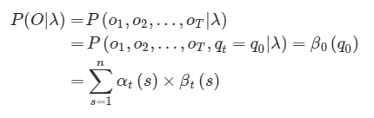
Forward & Backward Algorithm

Slide 21


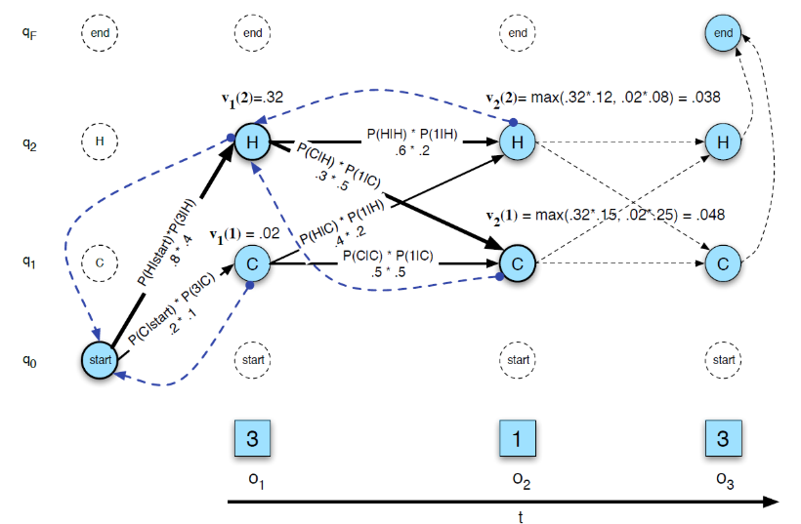
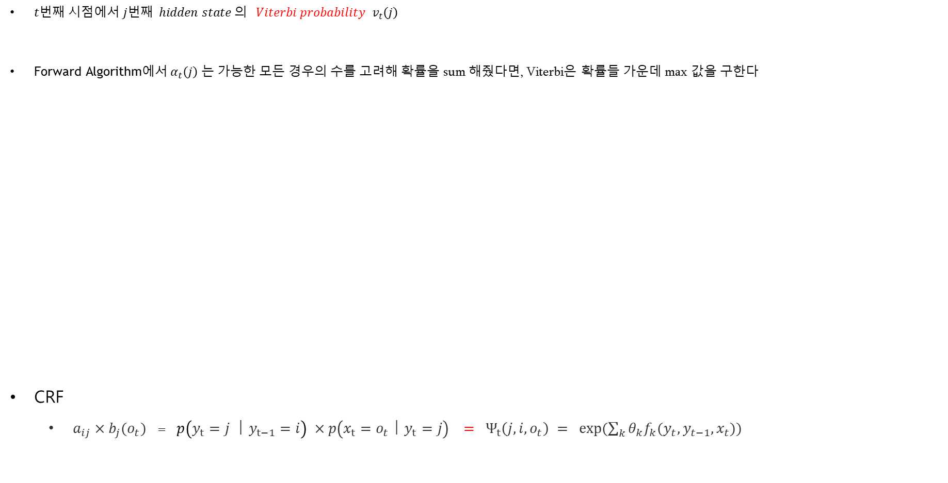

Viterbi Algorithm
$t번째 시점에서 j번째 hidden state 의 Viterbi probability { v}_{t}\left(j\right)$
$\text{Forward} \text{Algorithm}\text{에서} α_{t}\left(j\right)$는 가능한 모든 경우의 수를 고려해 확률을 sum 해줬다면, Viterbi은 확률들 가운데 max 값을 구한다
CRF
$a_{ij}×b_{j}(o_{t})$ = $p\left(y_{t}=j ㅣy_{t−1}=i\right) ×p\left(x_{t}=o_{t}ㅣy_{t}=j\right) = Ψ_{t}\left(j,i,o_{t}\right) = exp⁡(\sum_{k}{θ_{k}f_{k}(y_{t},y_{t−1},x_{t}))}$
Forward 와 Viterbi 알고리즘 사이에 가장 큰 차이점
→ 비터비는 역추적(backtracking) 과정이 있다는 점이다.
Viterbi의 목적은 최적 상태열 (backtrace state) 찾기
$t_{2}$의 1번째 상태 $q_{1}\left(=Cold\right)$의 backtrace $b_{t_{2}}\left(1\right)$→ $q_{2}(=HOT)$
$q_{2}$를 거쳐 나온 우도값 (0.32x0.15)이 $q_{1}$(0.02*0.25)보다 크기 때문
$t번째 시점, j번째 상태의$backtrace $는 다음과 같이 정의$
$b_{t_{2}}\left(j\right)=arg\max_{i=1}{[v_{t−1}(i)} ×a_{ij}×b_{j}(o_{t})$
emission
transition
factor
Linear chain CRF

Slide 22

Next Time
Combination of Bi-LSTM + CRF
https://www.aclweb.org/anthology/N16-1030

