Slide 1


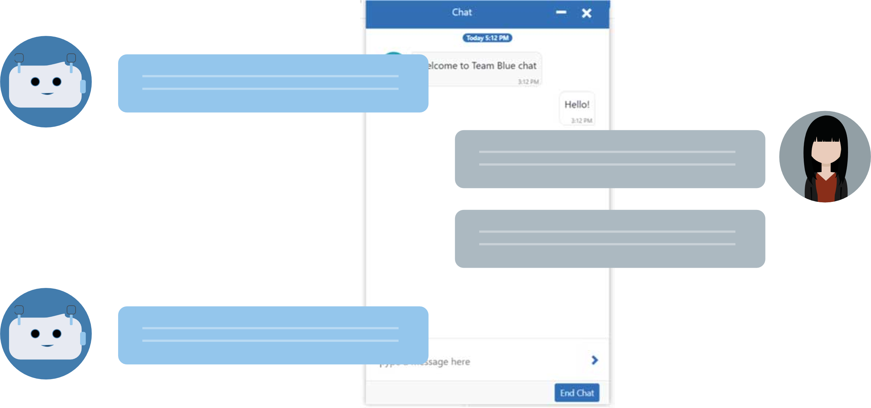



CHATBOT SYSTEM SAP0
Robin Staudinger, Irfan Ali, Khang Nguyen and Thu Nguyen

Slide 2

I can’t access to the employee database password etc. is correct
Anna, HR, annyoed
Notes:
This is Anna and she works in HR and has trouble to access the employee database, and she tried everything possible to access it.

Slide 3

CURRENT SITUATION
Hello! I am SAP0, how can I help you?
I have a problem with the software I can’t access database of the employees my password is correct.
Sorry, I have no information about the databases. Please contact the support. 047288392 from mo-fri, 8am-4pm.
Can I help you with somthing else?
Notes:
Anna use the customer service Chatbot but end up to call the service hotline.

Slide 4

. . . .
. . . . .
You are in the waiting line
Notes:
So she calls the hotline and end up in the waiting line for 30 minutes.

Slide 5
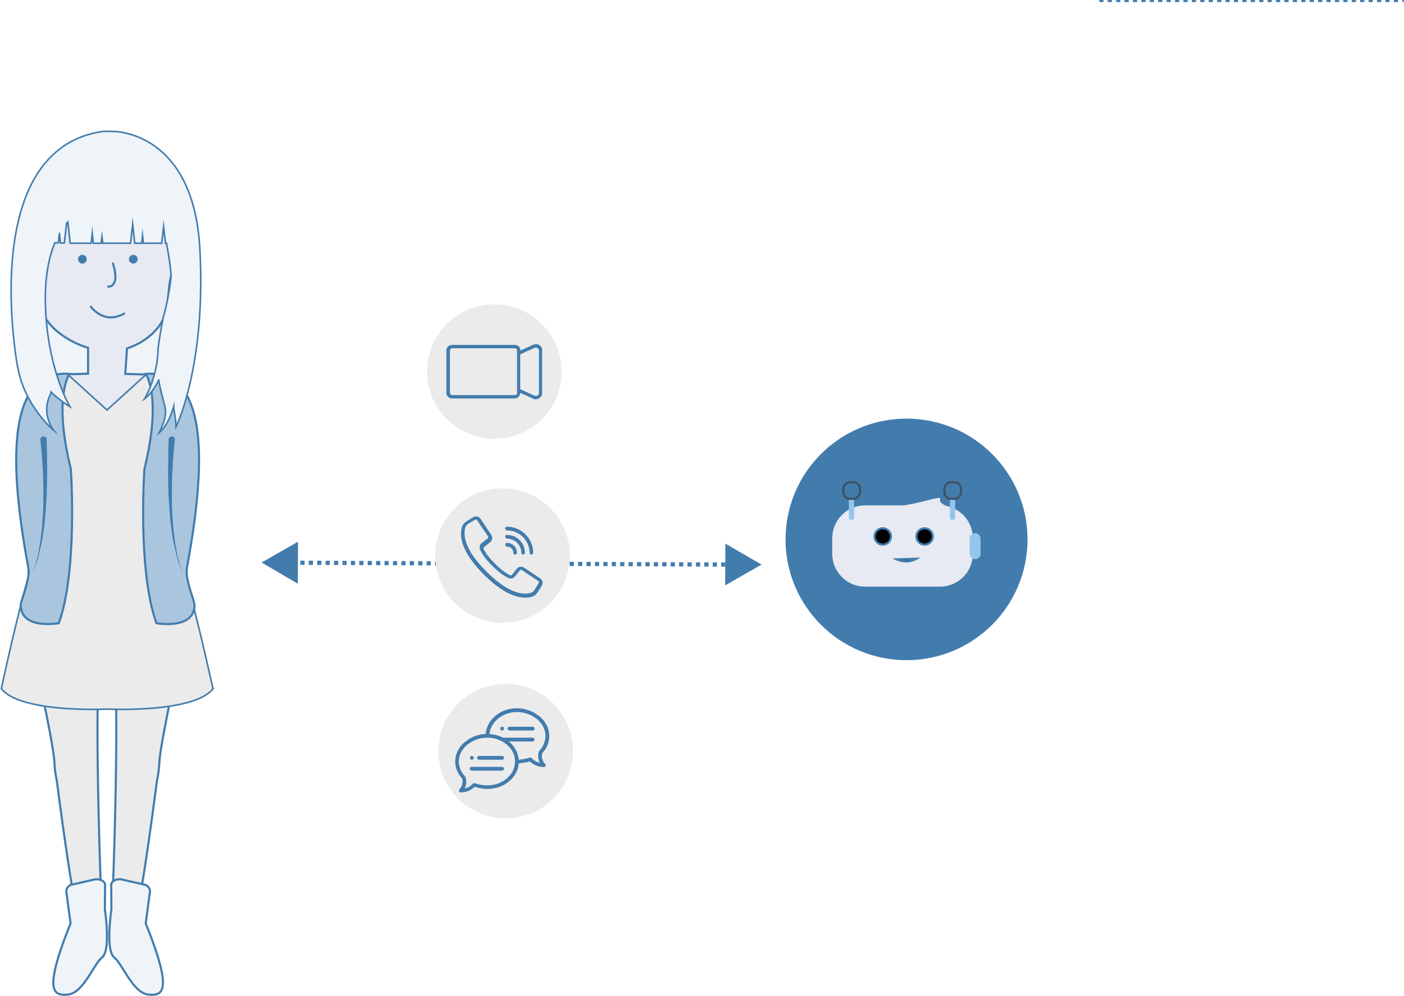
DIFFERENT MEDIA
Customer
Medium
Bot
Notes:
In here is our bot: Why not using the waiting time already with SAP0?

Slide 6



I have a problem [....]
Basic questions
”Since when do you have the problem?”
Notes:
When Anna calls and no agent is there, the bot starts already with the troubleshooting by asking basic questions

Slide 7
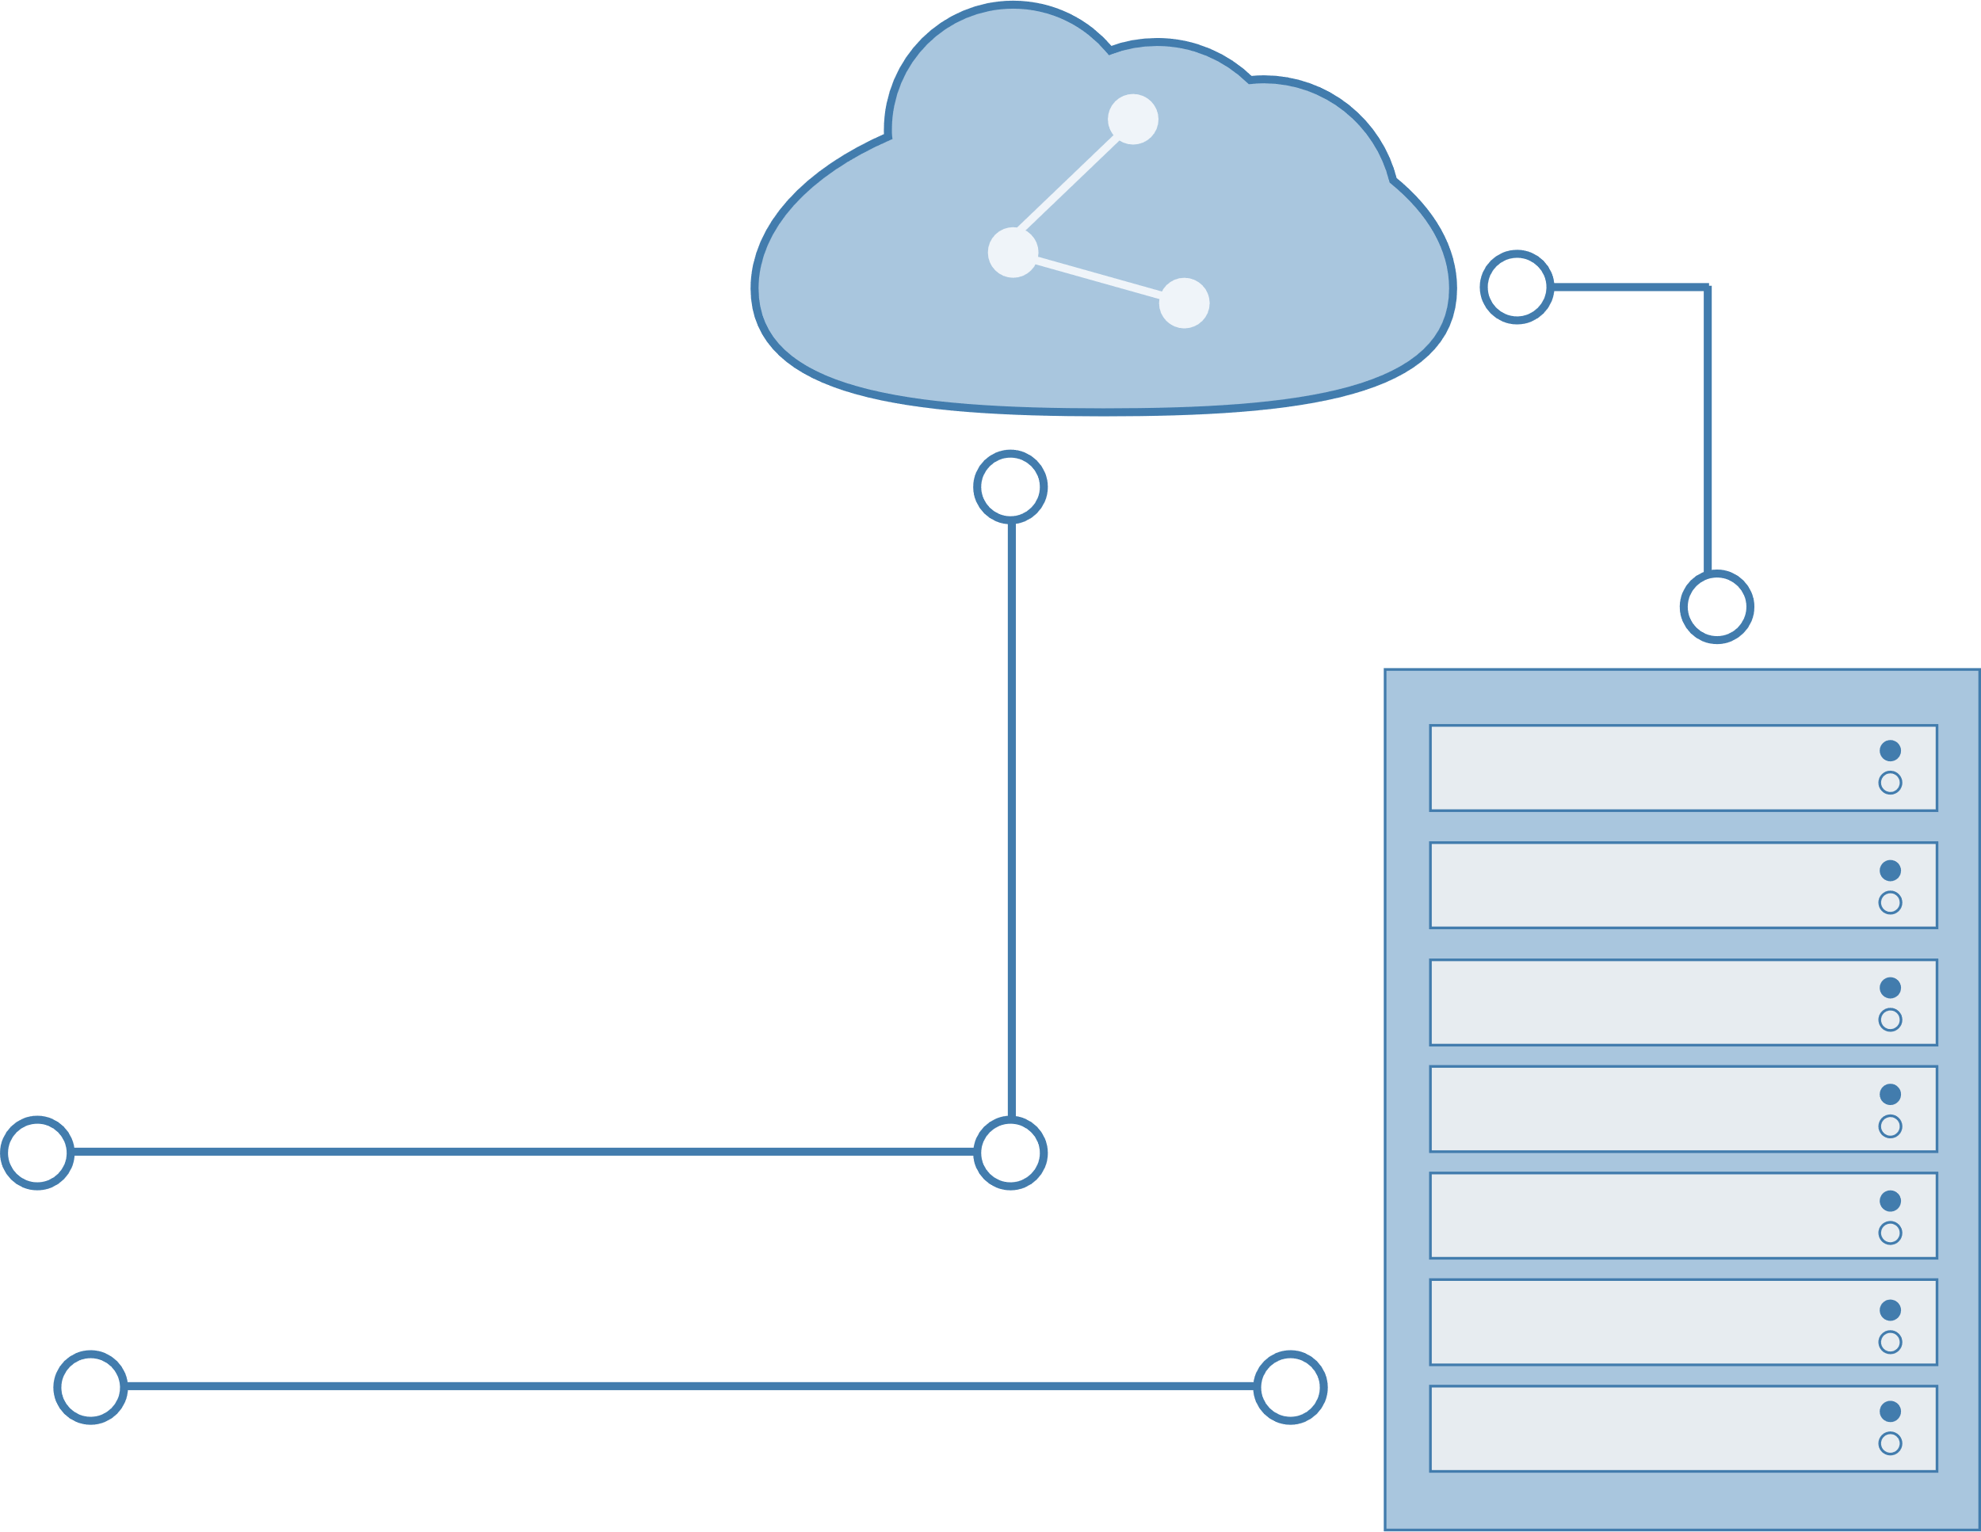
Cloud
Data analysis
Database
SAP0 transcribed the text
Notes:
Based on the information it transcribed the text and analyse the data.

Slide 8
I have a problem [....]
Suggestions
”Sounds like the database is not connected, please reconnect it.”
Notes:
It make possible suggestions

Slide 9
Still don’t work [....]
Connecting to agent
”I connect you now to an agent,
Notes:
And can connect then an agent is available

Slide 10
Waiting for the agent..
Entertaining
”Did you know that SAP means slow and painful?

Slide 11

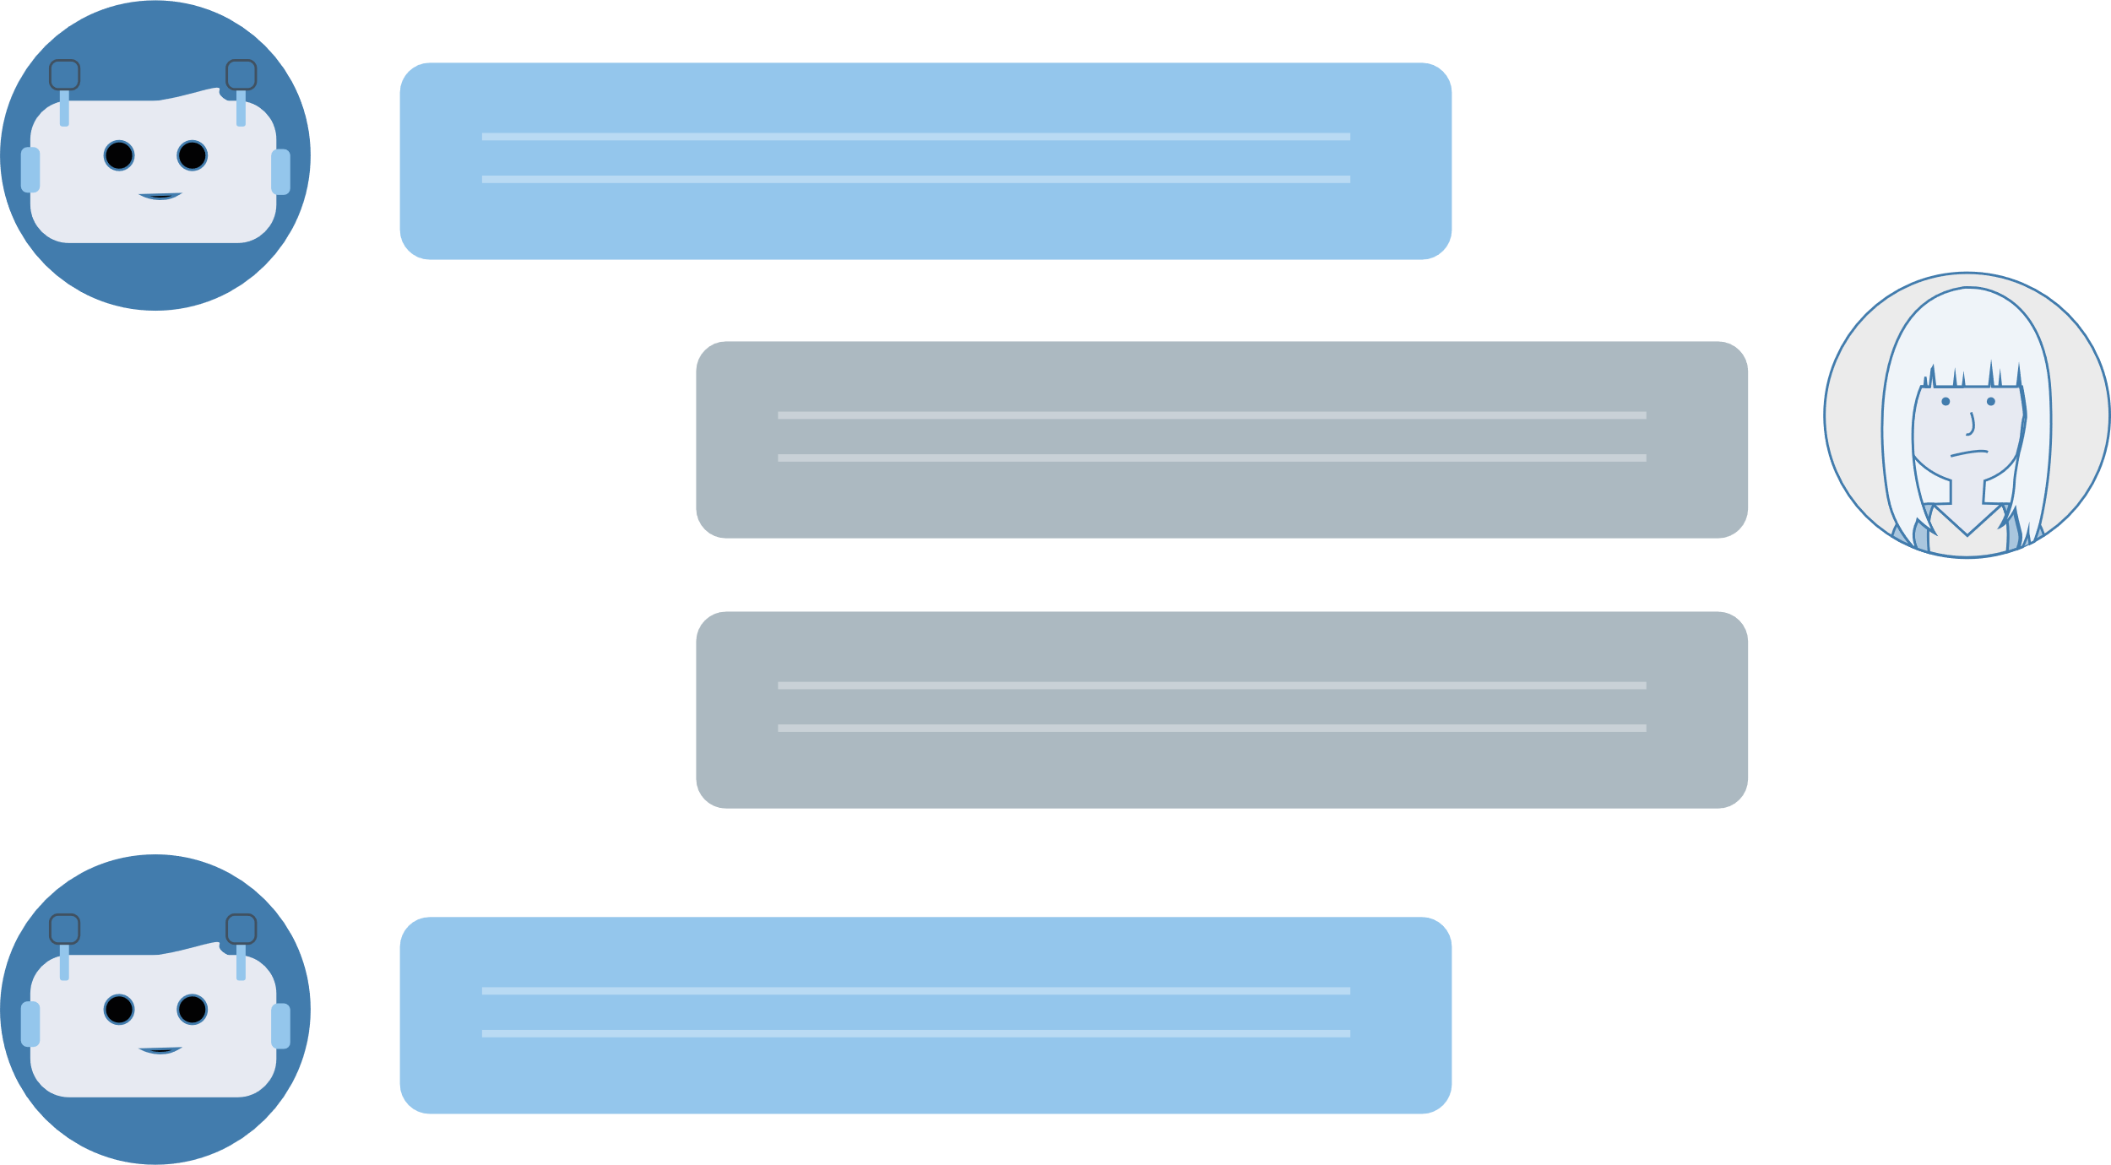
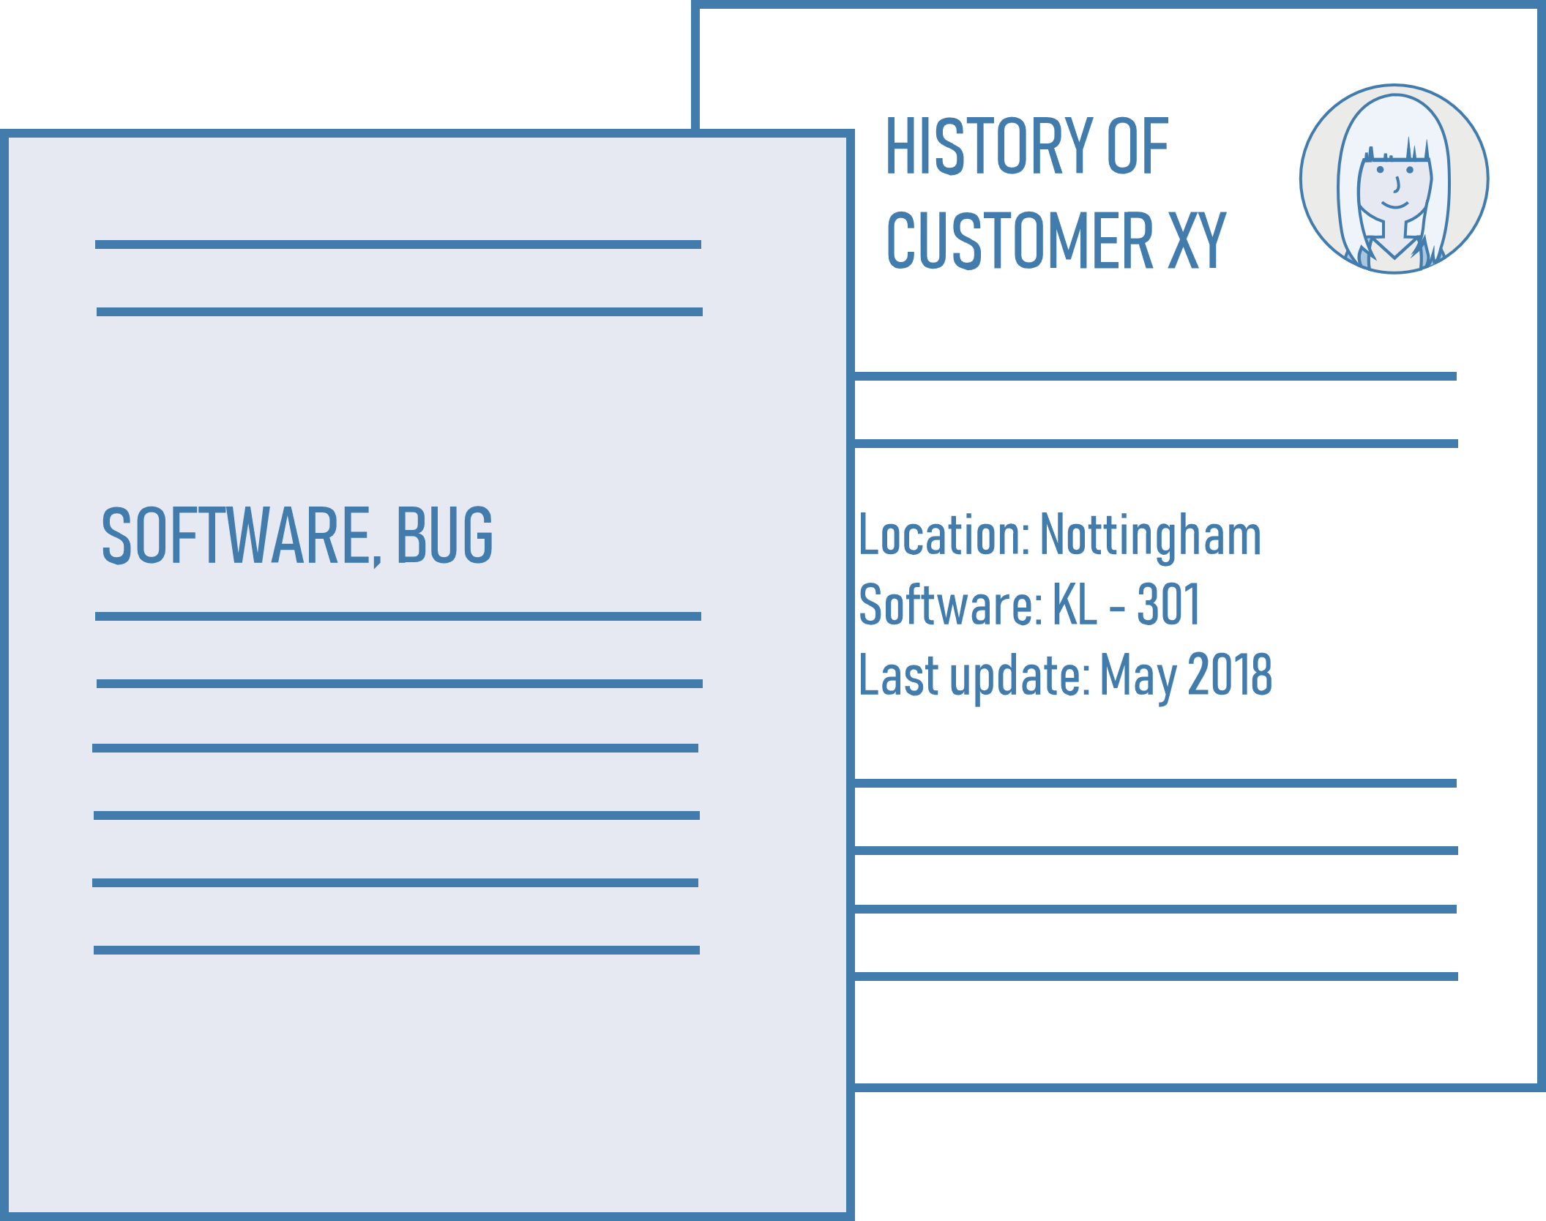

transcribed
Conversation
Report
Notes:
Our bot transcribed the conversation to reports

Slide 12

TIME SAVING
goes to
helps
Report
SAP Agent
Customer
Notes:
And gives the information to

Slide 13
IN SUMMARY
Hello! Great that you are in Junction! Do you need any help for the challenge?
Interact based on the customer information
Data analysis with common issues
Make suggestions/guidance
Different media

