Slide 1
ADMM in Smart Grid
Advisor: Prof. Ermin Wei
Author: Ding Xiang
Course Project of Distributed Optimization
Northwestern University

Slide 2
Overall purpose
Explore ADMM’s potential in Smart Grid.
ADMM
Smart Grid
Explorations
Find candidate ADMM problems in Smart Grid.
Pick one of them and give a specific case study.
Compare ADMM with other algorithms.
Notes:
Why? ADMM is popular, curious, learned, and smart grid is my research area, then this natural idea came out.

Slide 3
ADMM
ADMM was first proposed in 1975 and analyzed in 1983 [1]. Recently it was used in solving network problems in many different area, [2], [3], [4].
ADMM blends the decomposability of dual decomposition with the superior convergence properties of the method of multipliers[11].
ADMM, as one of distributed algorithm, has the same advantages that distributed algorithms have, such as privacy concern, suitability for complex network problems and use local communication and parallel computing.

Slide 4
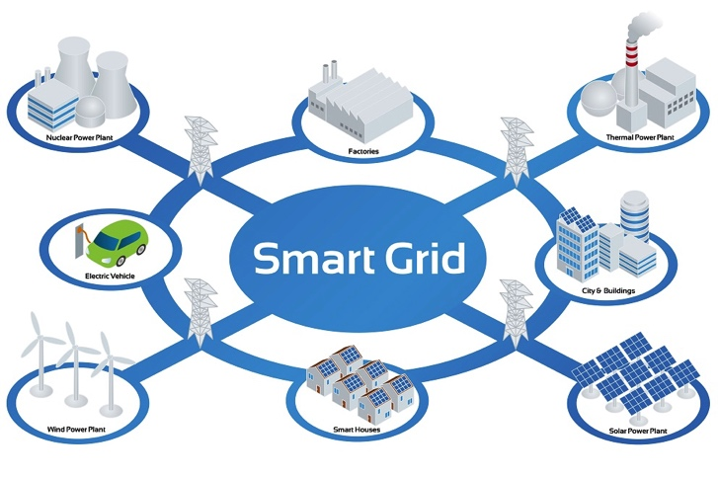
Smart Grid
A blueprint of the power industry. It applies the communication technology in the electricity operation in order to increase the efficiency of the energy usage.

Slide 5
Exploration 1
-- Find candidate ADMM problems in Smart Grid
Optimal Power Flow
How to control the electricity from generation to demand in order to minimize some objective (total generation cost, power loss, etc.).
2. Demand Response
How to let consumers reduce / shift their electricity usage during peak period in response to some financial incentives.

Slide 6
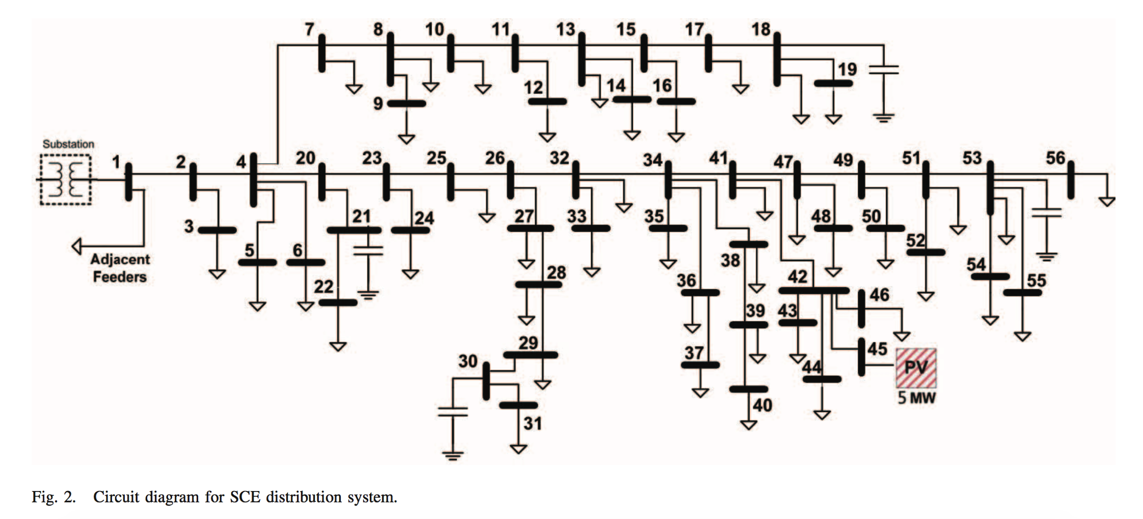
Exploration 2
-- Pick one problem and give a case study
Choose Optimal Power Flow Problem
Problem Description
An electricity company supplies electricity to its customers. How can the company minimize the cost?
Customers
Electricity
Company
Solar Energy

Slide 7
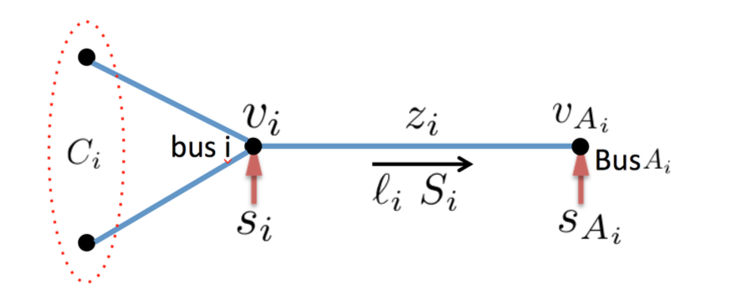
Model
Notes:
The network consists of buses and lines. The line is described by impedance z,

Slide 8
Model
Cost of the electricity company
Kirchholff law
Power balance
Complex power definition
Generation and load power constraints
Voltage magnitude constraints
Notes:
It’s non-convex. It’s hard to solve in a large system.

Slide 9
Model
Original OPF
Relaxation OPF
Tree/radial topology

Slide 10
Apply ADMM
ADMM splitting
ADMM OPF
Relaxation OPF
Y. X. Han et al., "Fully Distributed Optimal Power Flow for Unbalanced Distribution Networks Based on ADMM," (in English), 2016 Ieee Powercon, 2016.

Slide 11
Distributed ADMM
Augmented Lagrangian:
x,y,p iterations
Decompose
|N| subproblems
Decompose
|N| subproblems
Details are not important, but...

Slide 12
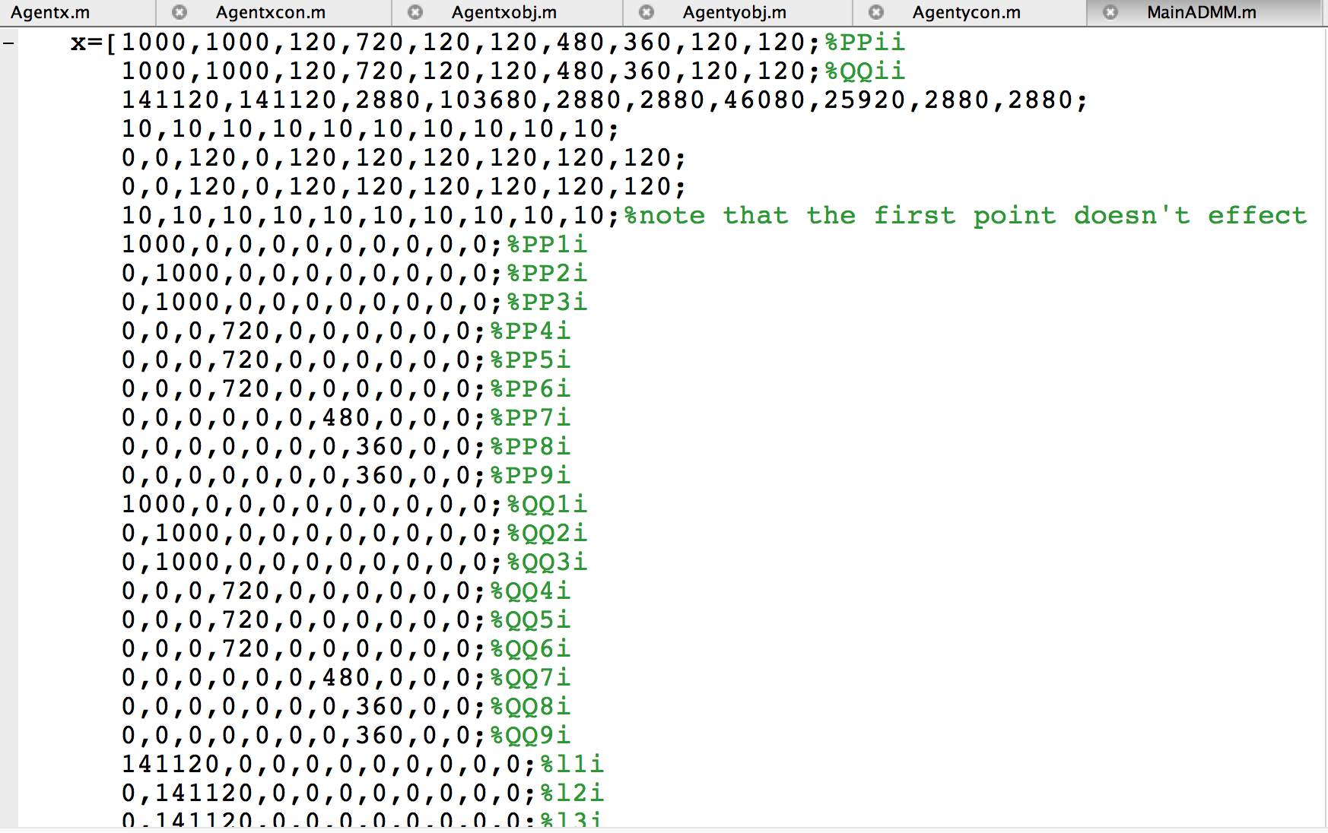
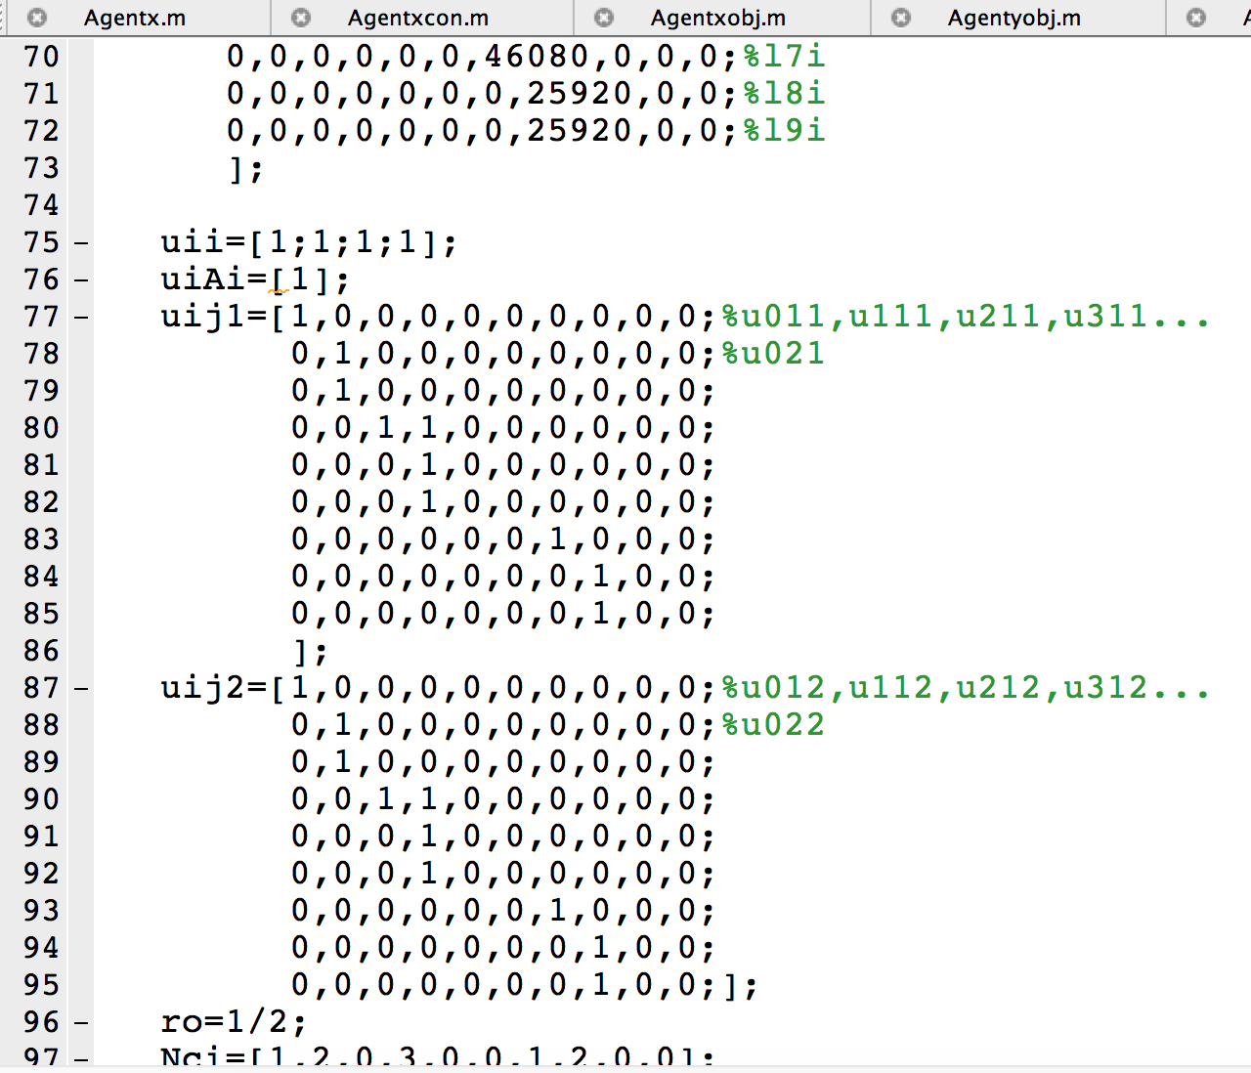
Coding (10 nodes network)

Slide 13
0
1
3
6
7
9
2
4
5
8
PV
0
1
2

