Slide 1
Gentle Introduction to Programming
Session 2: Lists, Loops, Functions
Summer 2014

Slide 2
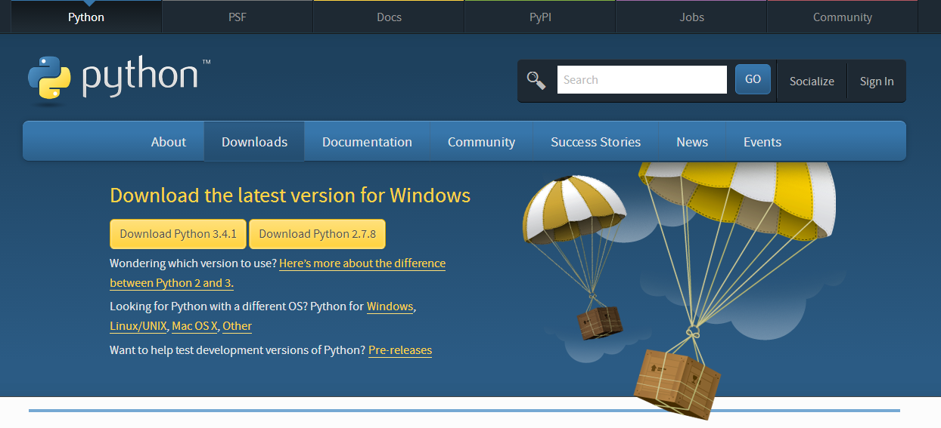
Admin
Python installation status?
https://www.python.org/downloads/

Slide 3
Today
Review
Lists
Loops
Strings & API
Importance of style
Functions
Homework
Sivan Toledo

Slide 4
Review
General terms in CS & programming
Python
Variables & types
Operators
if-else
Python shell

Slide 5
Operators
Arithmetic Operations:
+ plus
- minus
* multiply
/, // divide
% modulo (remainder)
** power
Comparison Operators (Return True or False):
== equal
!= not equal
> greater than
< less than
>= greater than or equal to
<= less than or equal to

Slide 6
Today
Review
Lists
Loops
Strings & API
Importance of style
Functions
Homework for Next Meeting

Slide 7
Lists
An ordered sequence of elements.
Create a list in Python:
>>> my_list = [2,3,5,7,11]
>>> my_list
[2,3,5,7,11]
>>> my_list[0]
2
>>> my_list[-1]
11

Slide 8
Lists are Indexable
4.5 | 9.7 | 8.6 | 5.6 | 3.4
4 | 3 | 2 | 1 | 0
-1 | -2 | -3 | -4 | -5

Slide 9
Lists
Lists can contain strings:
>>> days = [“Sunday”, “Monday", "Tuesday”, “Wednesday”, “Thursday”, “Friday”, “Saturday”]
>>> days[3]
‘Wednesday’
>>> len(days)
7
Lists can mix variables of different types:
>>> pi = [‘pi’, 3.14159, True]
# student: name, age, height, SAT
>>> student = [‘Roi’, 21, 1.83, 782]

Slide 10
Lists – Dynamic
We want to maintain a list of the students here either by name or by id:
>>> students = ['Itay', 9255587, 'Alon', 'Zohar', 744554887]
>>> print(students[2])
‘Alon’
Michal decided to join the course, so we update the list:
# append - add an element to the end of the list
>>> students.append('Michal')
>>> students
['Itay', 9255587, 'Alon', 'Zohar', 744554887, 'Michal']

Slide 11
Lists – Dynamic
But Alon wants lo leave the course:
>>> students.remove('Alon')
>>> students
['Itay', 9255587, 'Zohar', 744554887, 'Michal']
remove removes only the first occurrence of a value.

Slide 12
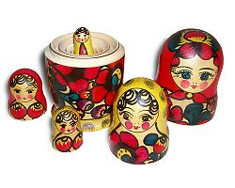
Nested Lists
>>> mat = [ [1, 2, 3], [4, 5, 6], [7, 8, 9] ]
>>> mat[1]
[4, 5, 6]
What is len(mat) ?
>>> family = [‘Grandma’, ‘Grandpa’,
[‘Orit’,’Yossi’, [‘Shiri’] ], [‘Mom’,’Dad’, [‘Tali’,’Ami’,[‘Ran’],[‘Eitan’] ], [’me’, ‘Amir’],
[’Roi’] ] ]

Slide 13
Today
Review
Lists
Loops
Strings & API
Importance of style
Functions
Homework for Next Meeting

Slide 14
For Loop
for elem in a_list:
statement1
statement2
…
Run over all elements in the list. In iteration i:
Assign elem = a_list[i-1]
Execute the statements
Indentation determines the scope of the iteration.
Note: No infinite loops here! (no infinite lists in Python)

Slide 15
For Example
Compute 1 + 2 + … + 100:
partial_sum = 0
for i in range(1,101):
partial_sum = partial_sum + i
print(“Partial sum is:”, partial_sum)
5050
Use Python’s built-in sum function:
sum(range(1,101))
range(stop)
range(start, stop[, step])
Gives numbers from start (or 0) to stop, with steps intervals (defaults to 1)
Notes:
http://revolveapp.com/Portals/218018/images/re-invent-the-wheel-small.png

Slide 16
For Example
Compute factorial of 12 (12!=479,001,600)
n = 12
fact = 1
for i in range(2, n + 1):
fact *= i
print(n, "! = ", fact)

Slide 17
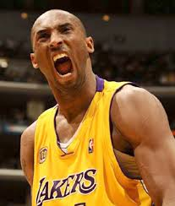
For Loop and Strings
Iterate over strings:
name = ‘Kobe’
for letter in name:
print('Give me', letter)
print('What did we get?', name)
Give me K
Give me o
Give me b
Give me e
What did we get? Kobe

Slide 18
Break - Aborting Iteration
break terminates the nearest enclosing loop, skipping the code that follows the break inside the loop.
Useful for getting out of loops when some predefined condition occurs.
Example:
for elem in a_list:
if elem < 0:
break
print(“Stopped at”, elem)

Slide 19
Break Example
# Find smallest divisor using for:
for div in range(2, n+1):
if n % div == 0:
break
print(“Smallest divisor is”, div)

Slide 20
While Loop
Used to repeat the same instructions until a stop criterion is met
while [expression]:
statement1
statement2
…
expr
false
true
statement(s)

Slide 21
Exercise - Factorial
# factorial of 12 n = 12 fact = 1 i = 1 while i <= n: fact = fact * i i = i + 1 print(n, "! = ", fact)

Slide 22
Exercise – Smallest divisor
# Find the smallest divisor div = 2 while n % div != 0: div = div + 1 print("Smallest divisor of", n, "is", div)
is the while loop above infinite?

Slide 23
Exercise – Primality test
n = 791 div = 2 prime = False
while div < n and prime: prime = n % div != 0 div = div + 1 # <=> div += 1 if prime: print(n, "is prime") else: print(n, "isn’t prime“)

Slide 24
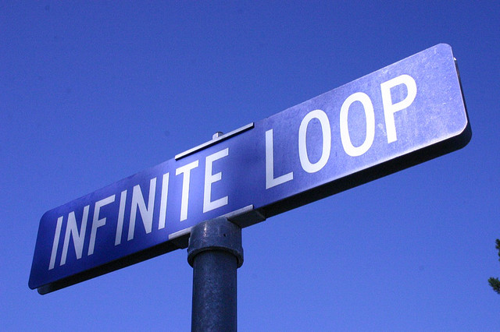
Infinite Loops
Beware!
i = 1
while i < 4:
print i
Notes:
http://farm2.staticflickr.com/1072/582310541_2bfcb04282_z.jpg?zz=1

Slide 25
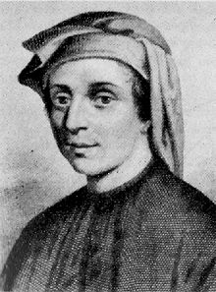
Fibonacci
Fibonacci sequence
0, 1, 1, 2, 3, 5, 8, 13, 21, 34
Definition:
fib(1) = 0
fib(2) = 1
fib(n) = fib(n-1) + fib(n-2)
http://en.wikipedia.org/wiki/Fibonacci_number
Notes:
http://upload.wikimedia.org/wikipedia/commons/thumb/a/a2/Fibonacci.jpg/220px-Fibonacci.jpg
http://upload.wikimedia.org/wikipedia/commons/thumb/9/95/FibonacciBlocks.svg/180px-FibonacciBlocks.svg.png

Slide 26
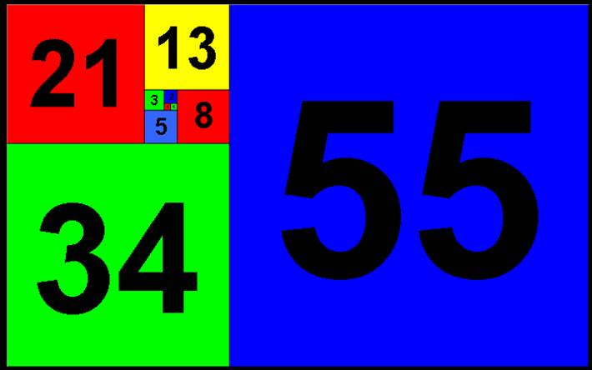

Slide 27
Exercise
Write a program that for an integer n > 0 prints to the screen the n^{th} Fibonacci number.
Use a while loop

Slide 28
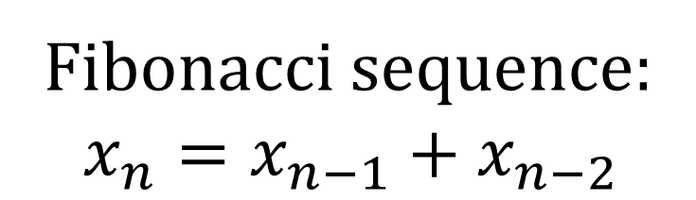
Solution
n = 16 xn_2 = 0 xn_1 = 1 i = 3 while i <= n: x_n = xn_1+ xn_2 xn_2 = xn_1 xn_1 = xn i += 1 print("The", n, "Fibonacci number is", xn)
Fibonacci sequence:
$$x_{n}=x_{n−1}+x_{n−2}$$

Slide 29
When to use for/while?
Most applications are more natural to for, in limited cases we should use while
for - when something is performed a predefined number of times, or when iterating over a list of objects
while - the number of iterations is not known in advance (e.g., asking for legal input from a user, drawing random numbers, waiting for something to happen)

Slide 30
Today
Review
Lists
Loops
Strings & API
Importance of style
Functions
Homework for Next Meeting

Slide 31
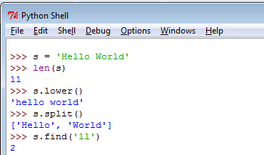
Back to Strings
A string is a sequence of characters that
has additional functionality: methods, built-in functions

Slide 32
Application Programming Interface (API)
How could I know that String has a method lower?
How about checking the Python API docs?
https://docs.python.org/3/library/
Or: in the shell –
>>> help(str)

Slide 33
Programming Style
Comments: #
Indentation
Meaningful variables names
Why is it important?

Slide 34
Today
Review
Lists
Loops
Strings & API
Importance of style
Functions
Homework for Next Meeting

Slide 35
Functions
A function is a block of code that has a unique name, usually returns a value.
Abstraction - a self-contained block of statements that perform a task.
Reusable - can be executed from as many different points in a Program.
Groups a number of statements into a unit.

Slide 36
What are They Good For?
Generalize a repeated set of instructions (Solve bugs once…)
Break the problem into smaller sub-tasks
Easier to solve complex problems
Make a program easier to read and maintain
Abstraction – we don’t have to know how a function is implemented to use it

Slide 37
Function Definition in Python
Function definition
Function name
Parameters
def max(x, y):
if x < y:
return x
else:
return y
Function Body
Return Value

Slide 38
Functions
def function_name(argument1, argument2,...):
statement1
statement2
…
return result1, result2, … # optional
Calling func:
[var1, var2,…] = function_name(val1, val2,...)
A function is:
A named code scope
Can receive input parameters
Can return output parameters

Slide 39
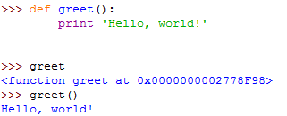
Example

Slide 40
Function Output
Parameters: Python variables. Can be int / float / str / bool / list etc. and even function names! (later)
Return statement – returns a value to the function’s caller.
The type of the returned value – any Python type.
If no value is returned, the function returns None (represent the absence of a value).

Slide 41
Today
Review
Lists
Loops
Strings & API
Importance of style
Functions
Homework for Next Meeting

Slide 42
Exercise – Integer Division
Input:
Two positive integers – A and B
Output:
How many times A contains B (the result of the integer division A/B)
Do not use the operators ‘/’, ‘*’

Slide 43
Exercise – Power of Two
Input: positive integer A
Output:
If there is an integer n such that A == 2^{n} :
return True
Otherwise, return False.

Slide 44
Exercise – Triangle Printout
Write a program that prints an upside-down triangle of *.
Input: The height of the triangle.
*****
****
***
**
*

Slide 45
How to Find Mistakes in Your Code
Runtime errors
Go over the code
Consult course slides
Ask on the forum (see course website)
Ask Google (a useful and legitimate source)
Good forums to ask questions online: stackoverflow.com, underwar.co.il

