Slide 1
Gentle Introduction to Programming
Session 3: Recursion
Summer 2014

Slide 2
Today
Review
Homework review
Functions - continue
Recursion
Recursion vs. Iteration
Homework
Yehuda Afek

Slide 3
Review
More Python:
lists
loops
Strings & API
Importance of style
Functions

Slide 4
Why Functions?
Why do we need functions?
Code reusability
Modularity
Abstraction

Slide 5
Function Definition in Python
Function definition
Function name
Parameters
def max(x, y):
if x < y:
return x
else:
return y
Function Body
Return Value

Slide 6
Today
Review
Homework review
Functions - continue
Recursion
Recursion vs. Iteration
Homework
Yehuda Afek

Slide 7
Exercise – Integer Division
Input:
Two integers – A and B
Output:
How many times A contains B (the result of the integer division A/B)
Do not use the operators ‘/’, ‘*’
Solution sketch

Slide 8
Integer Division Solution
def int_dev(a, b):
ans = 0
while a >= b:
ans += 1
a -= b
return ans
>>> int_dev
<function int_dev at 0x029E5BF0>
>>> int_dev(5, 2)
2
>>> int_dev(6, 2)
3
>>> int_dev(10, 2)
5

Slide 9
Exercise – Power of Two
Input: integer A
Output: is there an integer N such that A == 2^{N}?
Solution:

Slide 10
Power of Two Solution
def is_power_of_two(a):
while a > 1 and a%2 == 0:
a = a // 2
return a == 1
>>> is_power_of_two(8)
True
>>> is_power_of_two(12)
False
>>> is_power_of_two(1)
True
>>> is_power_of_two(16)
True

Slide 11
Exercise – Triangle Printout
Write a program that prints an upside-down half triangle of *.
The height of the pyramid is the input.
*****
****
***
**
*

Slide 12
Triangle Printout Solution
def triangle_printout(w):
for i in range(w, 0, -1):
print('*‘ * i)
>>> triangle_printout(4)
****
***
**
*
>>> triangle_printout(7)
*******
******
*****
****
***
**
*

Slide 13
Today
Review
Homework review
Functions - continue
Recursion
Recursion vs. Iteration
Homework
Yehuda Afek

Slide 14
Functions – Scope
Consider the following function, operating on two arguments:
def linear_combination(x, y):
y = 2 * y
return x + y
The formal parameters x and y are local, and their “life time" is just the execution of the function. They disappear when the function is returned.
3, 4
linear_combination
x, y
11

Slide 15
Functions – Scope
>>> a = 3
>>> b = 4
>>> linear combination(a,b)
11 # this is the correct value
>>> a
3
>>> b
4 # b has NOT changed
The change in y is local - inside the body of the function.

Slide 16
Functions – Scope
>>> x = 3
>>> y = 4
>>> linear_combination(x,y)
11 # this is the correct value
>>> x
3
>>> y
4
The y in the calling environment and the y in the function are not the same variable!
http://pythontutor.com/visualize.html

Slide 17
Other Types of Functions
Method – member of some object (e.g., String – str.lower())
Built-in functions – already defined (e.g., len(lst))

Slide 18
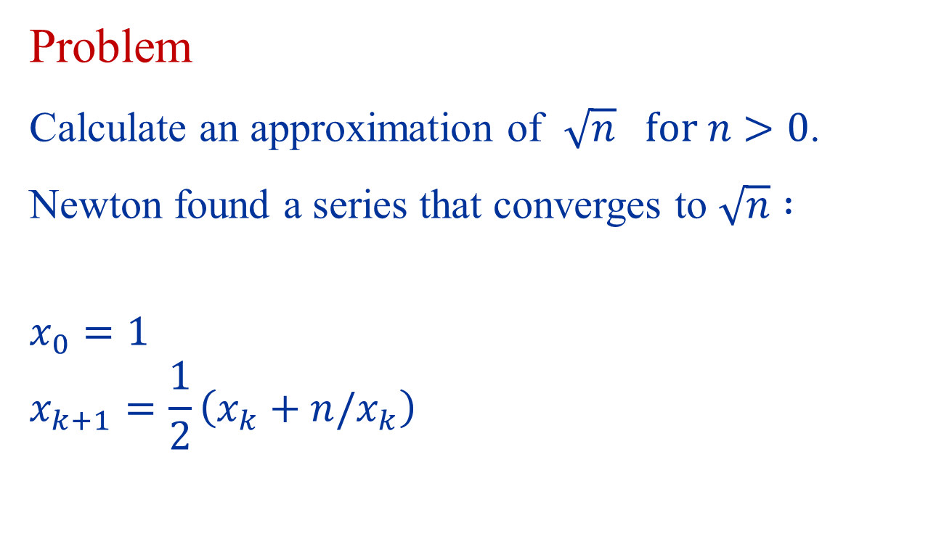
Approximating Square Root
Problem
Calculate an approximation of $\sqrt{n} for n>0$.
Newton found a series that converges to $\sqrt{n} :$
$$x_{0}=1$$
$$x_{k+1}=\frac{1}{2}\left(x_{k}+n/x_{k}\right)$$

Slide 19

Approximating Square Root
Initial guess: x = 1
Repeat:
Improve the guess: average of x and n/x
If the guess is close enough → stop
Example calculate $\sqrt{2}$ = 1.41421356…
n/x | x
2 | 1
4/3 = 1.334 | ½ (1+ 2) = 3/2 = 1.5
24/17 = 1.412 | ½ (3/2 + 4/3) = 17/12 = 1.416666
816/577 = 1.414211… | ½ (17/12 + 24/17) = 577/408 = 1.4142156…

Slide 20
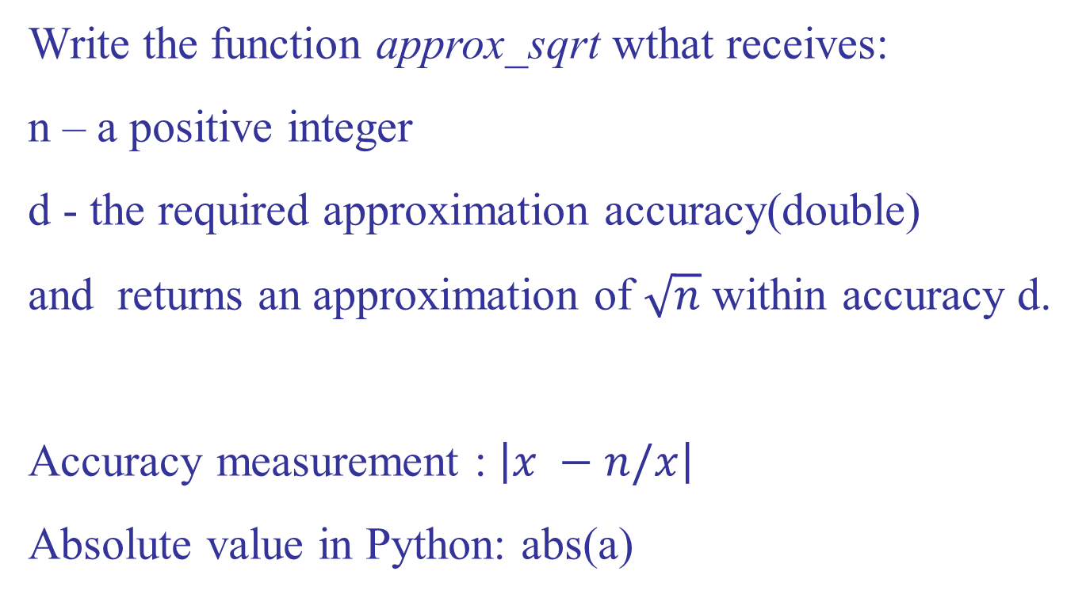
Approximating Square Root
Write the function approx_sqrt wthat receives:
n – a positive integer
d - the required approximation accuracy(double)
and returns an approximation of $\sqrt{n}$within accuracy d.
Accuracy measurement : $\left|x −n/x\right|$
Absolute value in Python: abs(a)

Slide 21
Approximating Square Root
def approx_sqrt(n, d): x = 1.0 while abs(x - n/x) > d: x = (x + n/x) / 2 return x

Slide 22
Today
Review
Homework review
Functions - continue
Recursion
Recursion vs. Iteration
Homework
Yehuda Afek

Slide 23
The Call Stack
g() →h()
f() →g()
main → f()

Slide 24
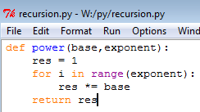

The Call Stack
call stack
result
main
base
= 3
= 5
= 2
= 15
exponent
= 17
= 20
power
i
res

Slide 25
Towers of Hanoi
Objective:
Move the entire stack of disks from rode S (source) to T (target) using A (auxiliary)
S
A
T

Slide 26
The Rules
Only one disk may be moved at a time
Each move consists of taking the upper disk from one of the rods and sliding it onto another rod
No disk may be placed on top of a smaller disk
S
A
T

Slide 27
Examples
S
A
T
S
A
T
1 disk – very easy!
2 disks – very easy!
S
A
T
S
A
T
3 disks – easy
4 disks?

Slide 28
Solution for 4 Disks
S
A
T
S
A
T
S
A
T
S
A
T

Slide 29
For n Disks?
S
A
T

Slide 30
Assume We Have a Solution for n-1 Disks
S
A
T

Slide 31
Solution: Step 1
S
A
T

Slide 32
Solution: Step 2
S
A
T

Slide 33
Solution: Step 3
S
A
T

Slide 34
How to Solve for n-1 Disks?
Easy!

Slide 35
Algorithm for n Disks
S
A
T
If there is only a single disk – easy!
Move n-1 disks from S to A (T is the auxiliary rode)
Move disk from S to T
Move n-1 disks from A to T (S is the auxiliary rode)
Let us write it in Python…

Slide 36
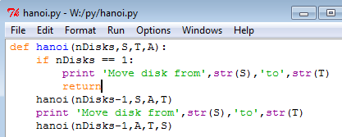
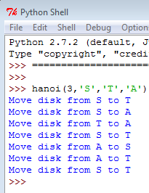
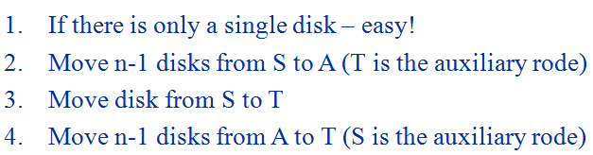
A Python Program for Towers of Hanoi

Slide 37
Remember the Calling Stack?
main
hanoi(3,'S','T','A')
hanoi(2,'S',‘A',‘T')
hanoi(1,‘S',‘T',‘A')
And so on…

Slide 38
Factorial
As we saw, n! = 1*2*3*… *(n-1)*n
Thus, we can also define factorial the following way:
0! = 1
n! = n*(n-1)! for n>0
(n-1)! * n
Recursive
Definition

Slide 39
A Recursive Definition
Functions can call themselves!
Different parameters!
Some functions can be defined using smaller occurrences of themselves
Every recursive function has a “termination condition” - the function stops calling itself when the condition is satisfied.

Slide 40
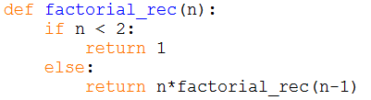
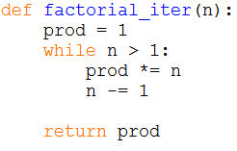
Example - Factorial
factorial.py
Termination Condition
Recursive Call

Slide 41
Example - factorial
factRec(1)
factRec(2) ->2*factRec (1)
factRec(3) ->3*factRec (2)
main -> factRec (3)

Slide 42
Recursive factorial – step by step
FactRec(4)
n
4
Returns…

Slide 43
Recursive factorial – step by step
FactRec(4)
n
4
Returns…
4*…

Slide 44
Recursive factorial – step by step
FactRec(4)
n
FactRec(3)
4
n
3
Returns…
4*…
Returns…

Slide 45
Recursive factorial – step by step
FactRec(4)
n
FactRec(3)
4
n
3
Returns…
4*…
Returns…

Slide 46
Recursive factorial – step by step
FactRec(4)
n
FactRec(3)
4
n
3
Returns…
4*…
Returns…
3*…

Slide 47
Recursive factorial – step by step
FactRec(4)
n
FactRec(3)
4
n
FactRec(2)
3
n
Returns…
4*…
2
Returns…
3*…
Returns…

Slide 48
Recursive factorial – step by step
FactRec(4)
n
FactRec(3)
4
n
FactRec(2)
3
n
Returns…
4*…
2
Returns…
3*…
Returns…

Slide 49
Recursive factorial – step by step
FactRec(4)
n
FactRec(3)
4
n
FactRec(2)
3
n
Returns…
4*…
2
Returns…
3*…
Returns…
2*…

Slide 50
Recursive factorial – step by step
FactRec(4)
n
FactRec(3)
4
n
FactRec(2)
3
n
Returns…
FactRec(1)
4*…
2
Returns…
n
3*…
1
Returns…
2*…
Returns…

Slide 51
Recursive factorial – step by step
FactRec(4)
n
FactRec(3)
4
n
FactRec(2)
3
n
Returns…
FactRec(1)
4*…
2
Returns…
n
3*…
1
Returns…
2*…
Returns…

Slide 52
Recursive factorial – step by step
FactRec(4)
n
FactRec(3)
4
n
FactRec(2)
3
n
Returns…
FactRec(1)
4*…
2
Returns…
n
3*…
1
Returns…
2*…
Returns…
1

Slide 53
Recursive factorial – step by step
FactRec(4)
n
FactRec(3)
4
n
FactRec(2)
3
n
Returns…
2
Returns…
Returns…
2*1

Slide 54
Recursive factorial – step by step
FactRec(4)
n
FactRec(3)
4
n
3
Returns…
Returns…
3*2

Slide 55
Recursive factorial – step by step
FactRec(4)
n
4
Returns…
4*6

Slide 56
General Form of Recursive Algorithms
test + base case
recursive case
Base case: small (non-decomposable) problem
Recursive case: larger (decomposable) problem
At least one base case, and at least one recursive case.

Slide 57
Short Summary
Design a recursive algorithm by
1. Solving big instances using the solution to smaller instances
2. Solving directly the base cases
Recursive algorithms have
1. test
2. recursive case(s)
3. base case(s)

Slide 58
Today
Review
Homework review
Functions - continue
Recursion
Recursion vs. Iteration
Homework
Yehuda Afek

Slide 59

Example - Modulo
Modulo.py
Given the following iterative version of modulo calculation -
find the recursive definition

Slide 60
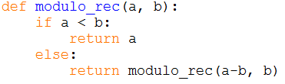
Solution

Slide 61
Fibonacci
“Naturally” recursive
Because the n^{th} term is the sum of the (n-1)^{th} and (n-2)^{th} terms
Therefore, the recursive definition is:
fib(1) = 0 ; fib(2) = 1 /* base */
fib(n) = fib(n-1) + fib(n-2)

Slide 62
Fibonacci
Fibonacci.py
def fib_rec(n): if n < 2: return n else: return fib_rec(n-1) +
fib_rec(n-2)
def fib_iter(n): if n < 2: return n xn_2 = 0 xn_1 = 1 for i in range(2, n+1): xn = xn_2 + xn_1 xn_2 = xn_1 xn_1 = xn return xn

Slide 63
Recursion and Efficiency
Fib(6)
Recursion may be much less efficient
The number of redundant calls grows exponentially!
Fib(5)
Fib(4)
Fib(3)
Fib(2)
Fib(1)
Fib(2)
Fib(3)
Fib(2)
Fib(1)
Fib(4)

Slide 64
Compute a^{b} Iteratively
a^{b} = a * a * a*…*a
b-1
Which is:
a^{b} = a² *a*…*a = a³ *…*a
b-2
Operationally:
Halting condition:
product ← product * a
counter ← counter + 1
counter = b
64

Slide 65
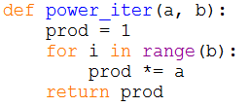
Compute a^{b} Iteratively
Notes:
65

Slide 66
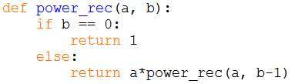
Compute a^{b} (Recursive Approach)
Recursive call: a^{b} = a * a^{(b-1)}
Base case: a⁰ = 1

Slide 67
Today
Review
Homework review
Functions - continue
Recursion
Recursion vs. Iteration
Homework
Yehuda Afek

Slide 68
Exercise 1
Write a program that receives two non-negative integers and computes their product recursively
Hint: The product a*b equals a+a+…+a , b times. How does this help us define the problem recursively?

Slide 69
Exercise 2
Given the following iterative version of sum-of-digits calculation
Write the recursive version
def sum_digits_iter(n(: s = 0 while n > 0: s += n % 10 n /= 10 return s

Slide 70
Exercise 3
Write a (non recursive) function that uses the formula :
∏²/6=1/1+1/4+1/9+1/16+…+1/n² (n goes to infinity)
to approximate ∏ .
The function receives n - the number of terms in the formula, and returns the approximation of ∏.
Calculate a square root:
Add before the code (first row): import math
Use math.sqrt(x)

Slide 71
Today
Review
Homework review
Functions - continue
Recursion
Recursion vs. Iteration
Homework
Yehuda Afek

