Slide 1
Gentle Introduction to Programming
Session 3: Recursion
Summer 2015

Slide 2
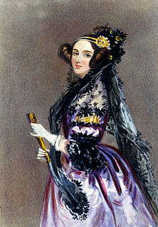
Ada Lovelace
Augusta Ada King, Countess of Lovelace (née Byron)
10/12/1815 – 27/11/1852
English mathematician and writer,
known for her work on Charles Babbage's early mechanical general-purpose computer, the Analytical Engine.
Recognized for the first algorithm
Regarded as the first computer programmer

Slide 3
Today
Noga Oron-Levy
Review
Homework review
Functions - continue
Recursion
Recursion vs. Iteration
Homework
Noga Oron-Levy

Slide 4
Review
More Python:
lists
loops
Strings & API
Importance of style
Functions

Slide 5
Why Functions?
Why do we need functions?
Code reusability
Modularity
Abstraction

Slide 6
Function Definition in Python
Function definition
Function name
Parameters
def max(x, y):
if x < y:
return x
else:
return y
Function Body
Return Value

Slide 7
Today
Noga Oron-Levy
Review
Homework review
Functions - continue
Recursion
Recursion vs. Iteration
Homework

Slide 8
Exercise – Integer Division
Input:
Two integers – A and B
Output:
How many times A contains B (the result of the integer division A/B)
Do not use the operators ‘/’, ‘*’
Solution sketch

Slide 9
Integer Division Solution
def int_dev(a, b):
ans = 0
while a >= b:
ans += 1
a -= b
return ans
>>> int_dev
<function int_dev at 0x029E5BF0>
>>> int_dev(5, 2)
2
>>> int_dev(6, 2)
3
>>> int_dev(10, 2)
5

Slide 10
Exercise – Power of Two
Input: integer A
Output: is there an integer N such that A == 2^{N}?
Solution:

Slide 11
Power of Two Solution
def is_power_of_two(a):
while a > 1 and a%2 == 0:
a = a // 2
return a == 1
>>> is_power_of_two(8)
True
>>> is_power_of_two(12)
False
>>> is_power_of_two(1)
True
>>> is_power_of_two(16)
True

Slide 12
Exercise – Triangle Printout
Write a program that prints an upside-down half triangle of *.
The height of the pyramid is the input.
*****
****
***
**
*

Slide 13
Triangle Printout Solution
def triangle_printout(w):
for i in range(w, 0, -1):
print('*‘ * i)
>>> triangle_printout(4)
****
***
**
*
>>> triangle_printout(7)
*******
******
*****
****
***
**
*

Slide 14
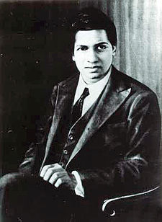
Srinivasa Ramanujan
22 December 1887 – 26 April 1920
Indian mathematician and autodidact
Almost no formal training in mathematics
Made extraordinary contributions to mathematical analysis, number theory, infinite series, and continued fractions
Had a famous partnership with the English mathematician G. H. Hardy.
Independently compiled nearly 3900 results (mostly identities and equations
The Ramanujan Journal, an international publication, was launched to publish work in all areas of mathematics influenced by his work.

Slide 15
Today
Noga Oron-Levy
Review
Homework review
Functions - continue
Recursion
Recursion vs. Iteration
Homework

Slide 16
Functions – Scope
Consider the following function, operating on two arguments:
def linear_combination(x, y):
y = 2 * y
return x + y
The formal parameters x and y are local, and their “life time" is just the execution of the function. They disappear when the function is returned.
3, 4
linear_combination
x, y
11

Slide 17
Functions – Scope
>>> a = 3
>>> b = 4
>>> linear combination(a,b)
11 # this is the correct value
>>> a
3
>>> b
4 # b has NOT changed
The change in y is local - inside the body of the function.

Slide 18
Functions – Scope
>>> x = 3
>>> y = 4
>>> linear_combination(x,y)
11 # this is the correct value
>>> x
3
>>> y
4
The y in the calling environment and the y in the function are not the same variable!
http://pythontutor.com/visualize.html

Slide 19
Other Types of Functions
Method – member of some object (e.g., String – str.lower())
Built-in functions – already defined (e.g., len(lst))

Slide 20
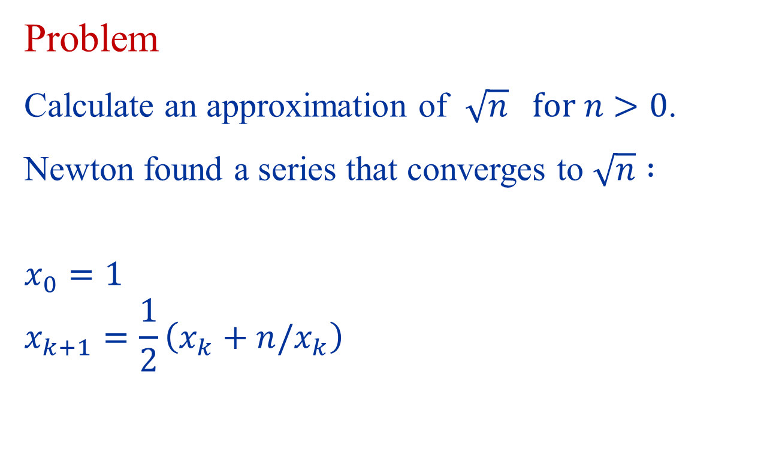
Approximating Square Root
Problem
Calculate an approximation of $\sqrt{n} for n>0$.
Newton found a series that converges to $\sqrt{n} :$
$$x_{0}=1$$
$$x_{k+1}=\frac{1}{2}\left(x_{k}+n/x_{k}\right)$$

Slide 21

Approximating Square Root
Initial guess: x = 1
Repeat:
Improve the guess: average of x and n/x
If the guess is close enough → stop
Example calculate $\sqrt{2}$ = 1.41421356…
n/x | x
2 | 1
4/3 = 1.334 | ½ (1+ 2) = 3/2 = 1.5
24/17 = 1.412 | ½ (3/2 + 4/3) = 17/12 = 1.416666
816/577 = 1.414211… | ½ (17/12 + 24/17) = 577/408 = 1.4142156…

Slide 22
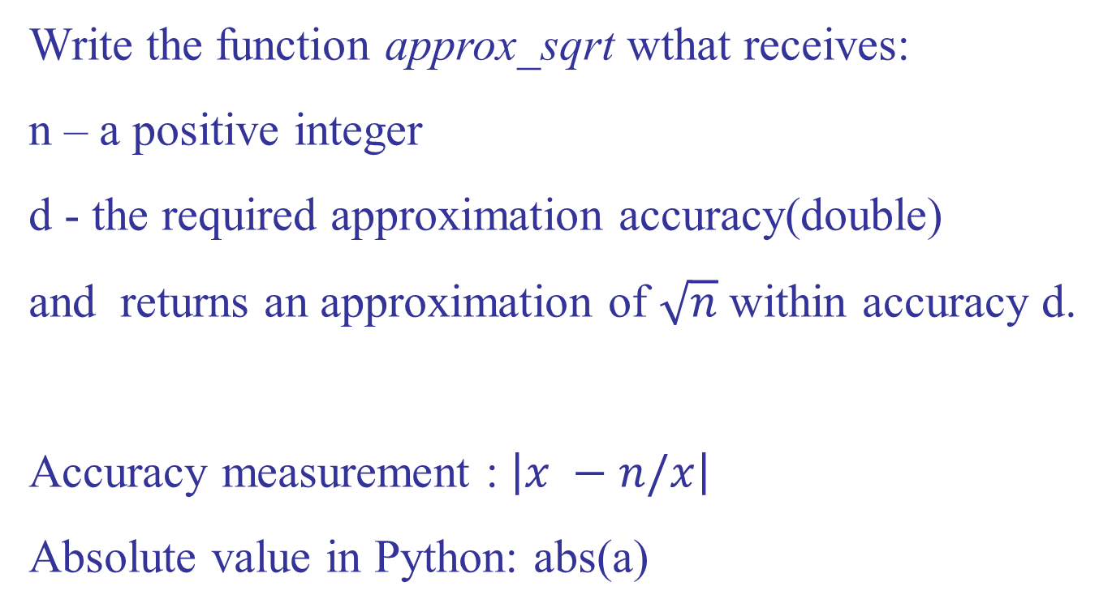
Approximating Square Root
Write the function approx_sqrt wthat receives:
n – a positive integer
d - the required approximation accuracy(double)
and returns an approximation of $\sqrt{n}$within accuracy d.
Accuracy measurement : $\left|x −n/x\right|$
Absolute value in Python: abs(a)

Slide 23
Approximating Square Root
def approx_sqrt(n, d): x = 1.0 while abs(x - n/x) > d: x = (x + n/x) / 2 return x

Slide 24

Hedy Lamarr
Born Hedwig Eva Maria Kiesler
9 November 1914 – 19 January 2000)
Austrian and American film actress and inventor
Developed spread spectrum and frequency hopping technology to defeat jamming of radio communications
Principles of her work are now incorporated into modern Wi-Fi, CDMA and Bluetooth technology

Slide 25
Today
Noga Oron-Levy
Review
Homework review
Functions - continue
Recursion
Recursion vs. Iteration
Homework

Slide 26
The Call Stack
g() →h()
f() →g()
main → f()

Slide 27
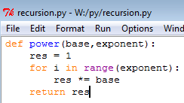

The Call Stack
call stack
result
main
base
= 3
= 5
= 2
= 15
exponent
= 17
= 20
power
i
res

Slide 28
Towers of Hanoi
Objective:
Move the entire stack of disks from rode S (source) to T (target) using A (auxiliary)
S
A
T

Slide 29
The Rules
Only one disk may be moved at a time
Each move consists of taking the upper disk from one of the rods and sliding it onto another rod
No disk may be placed on top of a smaller disk
S
A
T

Slide 30
Examples
S
A
T
S
A
T
1 disk – very easy!
2 disks – very easy!
S
A
T
S
A
T
3 disks – easy
4 disks?

Slide 31
Solution for 4 Disks
S
A
T
S
A
T
S
A
T
S
A
T

Slide 32
For n Disks?
S
A
T

Slide 33
Assume We Have a Solution for n-1 Disks
S
A
T

Slide 34
Solution: Step 1
S
A
T

Slide 35
Solution: Step 2
S
A
T

Slide 36
Solution: Step 3
S
A
T

Slide 37
How to Solve for n-1 Disks?
Easy!

Slide 38
Algorithm for n Disks
S
A
T
If there is only a single disk – easy!
Move n-1 disks from S to A (T is the auxiliary rode)
Move disk from S to T
Move n-1 disks from A to T (S is the auxiliary rode)
Let us write it in Python…

Slide 39
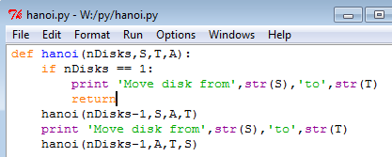
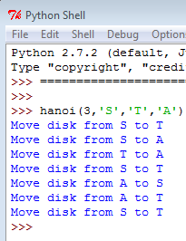
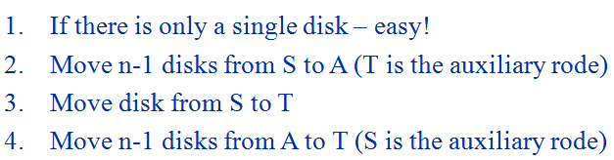
A Python Program for Towers of Hanoi

Slide 40
Remember the Calling Stack?
main
hanoi(3,'S','T','A')
hanoi(2,'S',‘A',‘T')
hanoi(1,‘S',‘T',‘A')
And so on…

Slide 41
Factorial
As we saw, n! = 1*2*3*… *(n-1)*n
Thus, we can also define factorial the following way:
0! = 1
n! = n*(n-1)! for n>0
(n-1)! * n
Recursive
Definition

Slide 42
A Recursive Definition
Functions can call themselves!
Different parameters!
Some functions can be defined using smaller occurrences of themselves
Every recursive function has a “termination condition” - the function stops calling itself when the condition is satisfied.

Slide 43
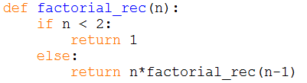
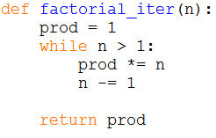
Example - Factorial
factorial.py
Termination Condition
Recursive Call

Slide 44
Example - factorial
factRec(1)
factRec(2) ->2*factRec (1)
factRec(3) ->3*factRec (2)
main -> factRec (3)

Slide 45
Recursive factorial – step by step
FactRec(4)
n
4
Returns…

Slide 46
Recursive factorial – step by step
FactRec(4)
n
4
Returns…
4*…

Slide 47
Recursive factorial – step by step
FactRec(4)
n
FactRec(3)
4
n
3
Returns…
4*…
Returns…

Slide 48
Recursive factorial – step by step
FactRec(4)
n
FactRec(3)
4
n
3
Returns…
4*…
Returns…

Slide 49
Recursive factorial – step by step
FactRec(4)
n
FactRec(3)
4
n
3
Returns…
4*…
Returns…
3*…

Slide 50
Recursive factorial – step by step
FactRec(4)
n
FactRec(3)
4
n
FactRec(2)
3
n
Returns…
4*…
2
Returns…
3*…
Returns…

Slide 51
Recursive factorial – step by step
FactRec(4)
n
FactRec(3)
4
n
FactRec(2)
3
n
Returns…
4*…
2
Returns…
3*…
Returns…

Slide 52
Recursive factorial – step by step
FactRec(4)
n
FactRec(3)
4
n
FactRec(2)
3
n
Returns…
4*…
2
Returns…
3*…
Returns…
2*…

Slide 53
Recursive factorial – step by step
FactRec(4)
n
FactRec(3)
4
n
FactRec(2)
3
n
Returns…
FactRec(1)
4*…
2
Returns…
n
3*…
1
Returns…
2*…
Returns…

Slide 54
Recursive factorial – step by step
FactRec(4)
n
FactRec(3)
4
n
FactRec(2)
3
n
Returns…
FactRec(1)
4*…
2
Returns…
n
3*…
1
Returns…
2*…
Returns…

Slide 55
Recursive factorial – step by step
FactRec(4)
n
FactRec(3)
4
n
FactRec(2)
3
n
Returns…
FactRec(1)
4*…
2
Returns…
n
3*…
1
Returns…
2*…
Returns…
1

Slide 56
Recursive factorial – step by step
FactRec(4)
n
FactRec(3)
4
n
FactRec(2)
3
n
Returns…
2
Returns…
Returns…
2*1

Slide 57
Recursive factorial – step by step
FactRec(4)
n
FactRec(3)
4
n
3
Returns…
Returns…
3*2

Slide 58
Recursive factorial – step by step
FactRec(4)
n
4
Returns…
4*6

Slide 59
General Form of Recursive Algorithms
test + base case
recursive case
Base case: small (non-decomposable) problem
Recursive case: larger (decomposable) problem
At least one base case, and at least one recursive case.

Slide 60
Short Summary
Design a recursive algorithm by
1. Solving big instances using the solution to smaller instances
2. Solving directly the base cases
Recursive algorithms have
1. test
2. recursive case(s)
3. base case(s)

Slide 61
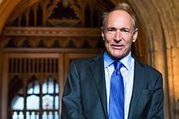

Sir Tim Berners-Lee
Sir Timothy John "Tim" Berners-Lee
8 June 1955
English computer scientist
Inventor of the World Wide Web
First successful communication between a HTTP client and server via the Internet
Director of the World Wide Web Consortium (W3C)
The world's first web server

Slide 62
Today
Noga Oron-Levy
Review
Homework review
Functions - continue
Recursion
Recursion vs. Iteration
Homework

Slide 63

Example - Modulo
Modulo.py
Given the following iterative version of modulo calculation -
find the recursive definition

Slide 64
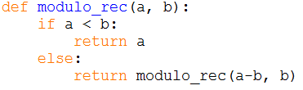
Solution

Slide 65
Fibonacci
“Naturally” recursive
Because the n^{th} term is the sum of the (n-1)^{th} and (n-2)^{th} terms
Therefore, the recursive definition is:
fib(1) = 0 ; fib(2) = 1 /* base */
fib(n) = fib(n-1) + fib(n-2)

Slide 66
Fibonacci
Fibonacci.py
def fib_rec(n): if n < 2: return n else: return fib_rec(n-1) +
fib_rec(n-2)
def fib_iter(n): if n < 2: return n xn_2 = 0 xn_1 = 1 for i in range(2, n+1): xn = xn_2 + xn_1 xn_2 = xn_1 xn_1 = xn return xn

Slide 67
Recursion and Efficiency
Fib(6)
Recursion may be much less efficient
The number of redundant calls grows exponentially!
Fib(5)
Fib(4)
Fib(3)
Fib(2)
Fib(1)
Fib(2)
Fib(3)
Fib(2)
Fib(1)
Fib(4)

Slide 68
Compute a^{b} Iteratively
a^{b} = a * a * a*…*a
b-1
Which is:
a^{b} = a² *a*…*a = a³ *…*a
b-2
Operationally:
Halting condition:
product ← product * a
counter ← counter + 1
counter = b
68

Slide 69
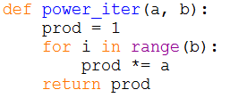
Compute a^{b} Iteratively
Notes:
69

Slide 70
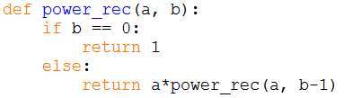
Compute a^{b} (Recursive Approach)
Recursive call: a^{b} = a * a^{(b-1)}
Base case: a⁰ = 1

Slide 71
Today
Noga Oron-Levy
Review
Homework review
Functions - continue
Recursion
Recursion vs. Iteration
Homework

Slide 72
Exercise 1
Write a program that receives two non-negative integers and computes their product recursively
Hint: The product a*b equals a+a+…+a , b times. How does this help us define the problem recursively?

Slide 73
Exercise 2
Given the following iterative version of sum-of-digits calculation
Write the recursive version
def sum_digits_iter(n(: s = 0 while n > 0: s += n % 10 n /= 10 return s

Slide 74
Exercise 3
Write a (non recursive) function that uses the formula :
∏²/6=1/1+1/4+1/9+1/16+…+1/n² (n goes to infinity)
to approximate ∏ .
The function receives n - the number of terms in the formula, and returns the approximation of ∏.
Calculate a square root:
Add before the code (first row): import math
Use math.sqrt(x)

