Slide 1
Gentle Introduction to Programming
Yoav Ram
Summer 2015

Slide 2
Administration
Date & time: 2-17 September, 9:15 – 13:00
Location: see website
Web: http://www.cs.tau.ac.il/courses/gip/2015
E-mail: yoavram@post.tau.ac.il,
No grades!
Notes:
הכי חשוב – הפסקות!
שקפים: עברית ואנגלית מעורבב

Slide 3
About the Course
A gentle introduction to programming using Python
For motivated students with little / no prior experience in programming

Slide 4
Objective
Bridge the gap for students without prior programming knowledge

Slide 5
About the Course
You are expected to work hard!
Lectures will be interactive featuring in-class exercises with lots of support
Practical session in lab
Notes:
לא חייבים לעשות הכל אבל חייבים לנסות
אי אפשר ללמוד תכנות מבלי "ללכלך את הידיים"

Slide 6
Course Plan
Session | Material
1 | Introduction, basic Python
2 | Loops, functions
3 | Recursion
4 | Dictionaries and text analysis, image processing
5 | Exercises

Slide 7
Questions?

Slide 8
Plan for Today
Administration
General introduction
Python programming language:
Variables and Types
Operators
Flow control
Working environment
Homework
Amir Rubinstein

Slide 9
Basic Terms
Computer
Hardware / Software
Algorithm
Input / Output
Pseudo-Code
Programming Language
Computer Program

Slide 10
Computer
מכונה המעבדת נתונים על פי רצף פקודות נתון מראש
מחשב = חומרה + תכנה
אמצעי קלט
מעבד
אמצעי פלט
(עכבר, מקלדת, דיסק קשיח)
(מדפסת, מסך, דיסק קשיח)
זכרון

Slide 11
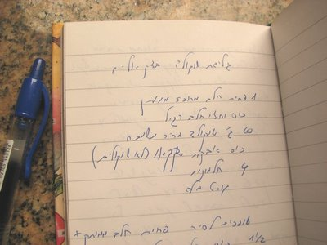
Algorithm
סדרת פעולות סופית לביצוע משימה מסויימת
Input
Output
Algorithm

Slide 12
Pseudo Code
Informal description of the algorithm, human readable

Slide 13
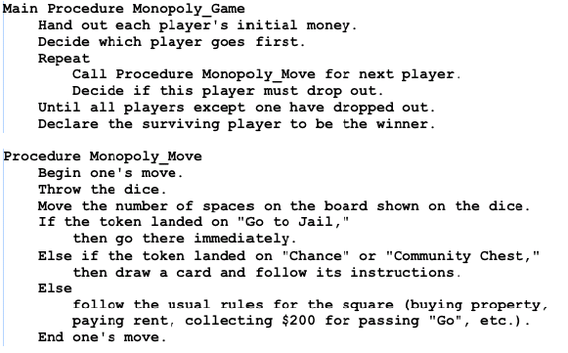
Example

Slide 14
Programming Language
Machine-readable artificial language
Designed to express computations that can be performed by a computer

Slide 15
Machine Code (Language)
Computers understand only machine language
a sequence of 1’s and 0’s
Very inconvenient, non-intuitive
All other languages are created for human convenience
The computer does not understand C/C#/Java/Python
Must be “translated” into machine language

Slide 16
There are Many Programming Languages
Over 500 different computer languages are listed by Wikipedia
C/C++, Java, C#, Python, Perl, Haskell, Ruby, Javascript, NodeJS, D# F#, Julia, R, Matlab, Mathematica, IDL, Maple, Lua, Scheme, Pascal, SmallTalk, …

Slide 17
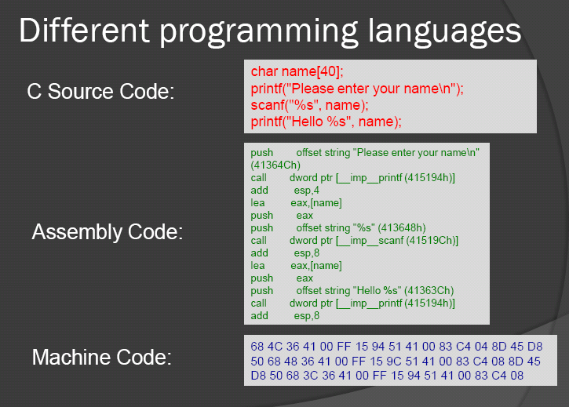

Slide 18
Language Selection
Goal
Runtime vs. Development time
Operating systems

Slide 19
Computer Program
Implementation of the algorithm using a programming language

Slide 20
Computer Program (more technically)
A sequence of processor instructions designed to achieve a specific purpose
The instructions are executed sequentially. No instruction is executed before the previous is completed

Slide 21
Plan for Today
Administration
General introduction
The Python programming language:
Variables and Types
Operators
Flow control
Working environment
Homework
Amir Rubinstein

Slide 22
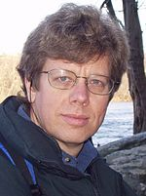

Python
Guido
A general-purpose, high-level programming language
Conceived in the late 1980’s by Guido van Rossum at CWI in the Netherlands
Used by Google, Yahoo!, Civilization 4,Walt Disney, NASA, Nokia, IBM, CIA
Numerous users in many domains
Used as a first programming language in
many universities (MIT, TAU CS)
The origin of the name: the television
series “Monty Python's Flying Circus”
22
Notes:
22
http://jakubdubec.me/images/skills/python.png

Slide 23
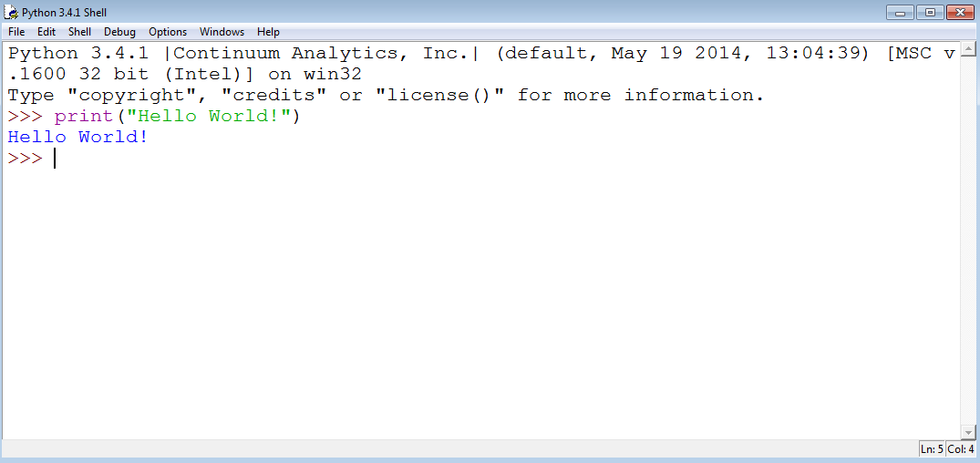
My First Python Program: Hello World!

Slide 24
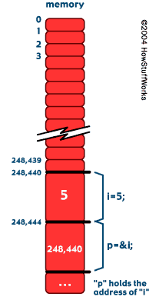
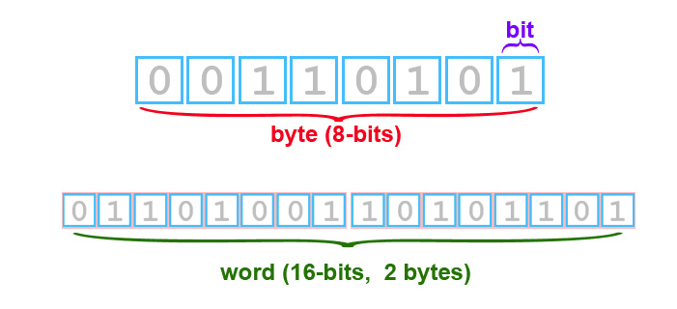
Memory
The computer memory is composed of a long list of bits
Bits are grouped into bytes and words
Every byte is numbered sequentially
This number is called an address

Slide 25
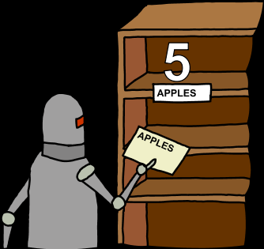
What are Variables ?
A location in the computer’s memory.
A variable:
has a name (for access)
holds a value
has type – according to its
value
Handle Data

Slide 26
Why do We Need Variables?
Computer programs manipulate data
Data
- user input
- calculated throughout the program
Variables must be remembered for later access
→ stored in the memory
Variable name ↔ memory address

Slide 27
Types
The type of the variable determines:
What values it can contain
What operations can be preformed
The memory size taken by the variable

Slide 28
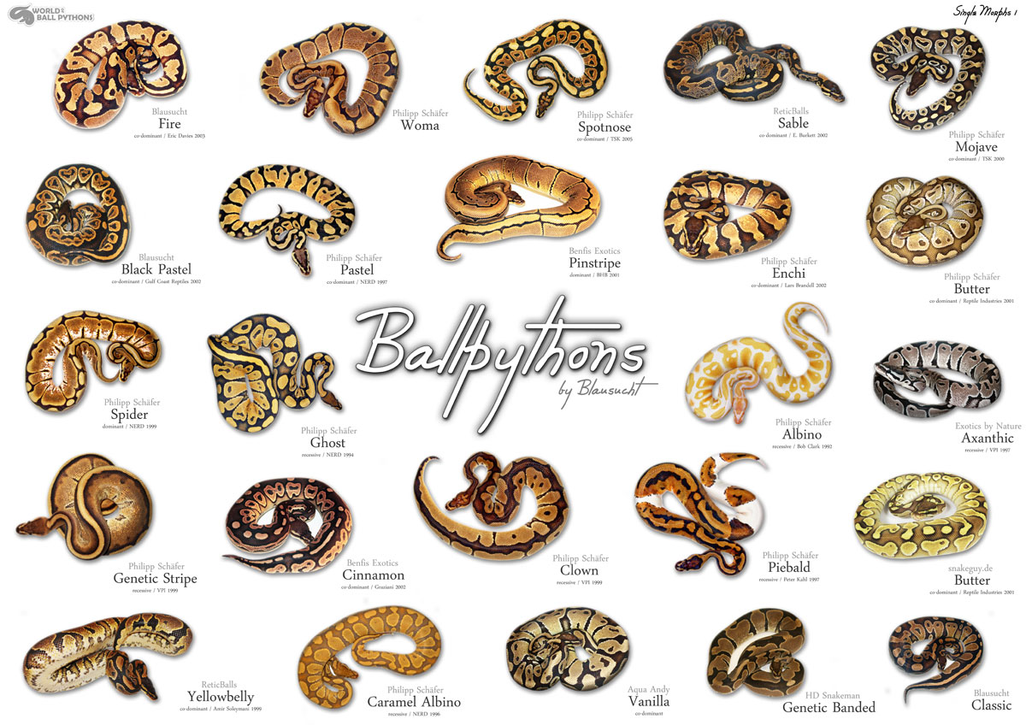
Python: Some Types

Slide 29
Python: Some Types
int – integers: -2147483648,…,-1,0,1,…,2147483647
2147483647=231-1, -2147483648=-2-31
float – decimal fraction: 0.5, 1.0, 3.14159, 1e-7
bool – boolean: True, False
string – text, character sequence: “I love Python!”
There are other types that we will learn (list, dict) and that we won’t (complex, long, set).

Slide 30
Why Do We Need Different Types?
Saving memory
Execution speed
Makes “translation” to machine code easier
Avoid programming mistakes

Slide 31
Documentation and Variable Names
Real computer programs include thousands of code lines, lots of variables.
Readability is very important for code maintenance
Hence:
Choose informative variable names:
Not informative: a_string, does_something, yosi…
Informative: sum_of_expenses, student_name, count_words …
Are i, j, m, n informative names? It depends!
Documentation – add remarks (‘#’), will be disscussed later

Slide 32
Numbers and their Types
>>> 4
4
>>> type(4)
<class 'int'> # integers type
>>> 3.14159
3.14159
>>> type(3.14159)
<class 'float'> # floating point ("reals") type
Arithmetic operations: +, -, *, / , % (modulo), ** (power)
What type is 8/5 ? 8//5? 8/5.0?
Let’s check…

Slide 33
Variables and Assignments
name
value
>>> n = 10
>>> m=(10+4)*5
The left-hand side is a variable. The right-hand side is an expression.
The interpreter:
1. evaluates the expression
2. assigns its value to the variable.
The variable's name is a sequence of letters
and digits, starting with a letter.
name
value
n
10
m
70

Slide 34
Variables and Assignments: An Example
Changing the value of a variable:
>>> n = 11
>>> n
11
Changing the type of a variable:
>>> n = 1.3141
>>> n
1.3141
Variables can be used in expressions:
>>> pi = 3.14159
>>> pi * 2 + 1
7.28318

Slide 35
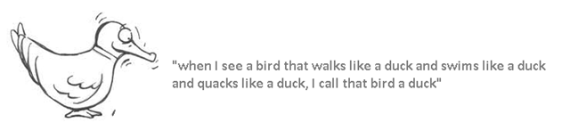
Duck Typing

Slide 36
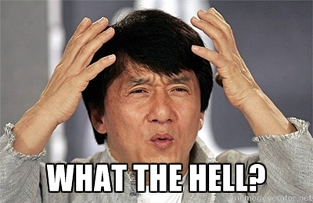
Variables and Assignments – Cont.
Referring to undefined variables leads to runtime error
>>> check_this
Traceback (most recent call last):
File "<pyshell#16>", line 1, in <module>
check_this
NameError: name 'check_this' is not defined
Notes:
http://cdn.memegenerator.net/instances/400x/37490672.jpg

Slide 37
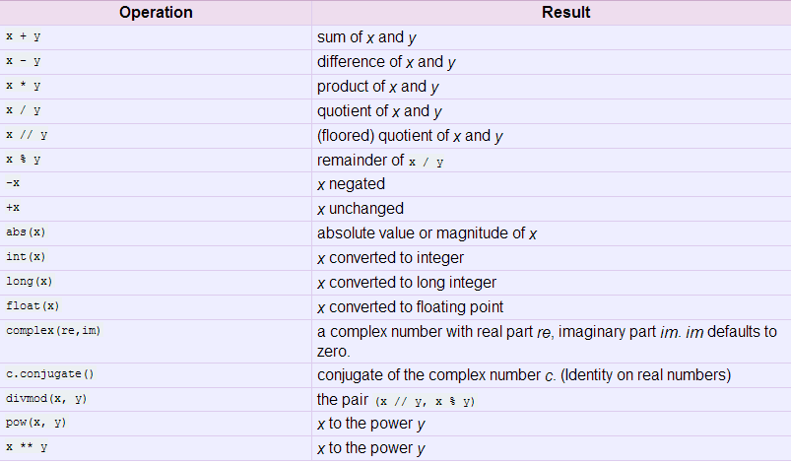
Arithmetic Operators
https://docs.python.org/3/library/stdtypes.html

Slide 38
Playing with Variables
>>> a = 3
>>> a
3
>>> b = 5
5
>>> c = a + b
>>> c
8
>>> c = c * 2
16
>>> first = (a + b) * 2
>>> second = a + b * 2
>>> first, second
(16, 13)
>>> b / a
1
>>> b % a
2
Notes:
8
16
16
13

Slide 39

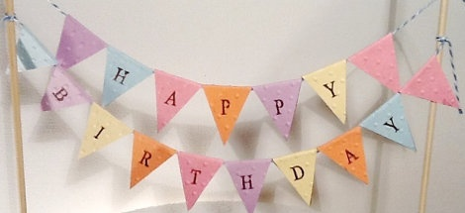
Strings
Strings are text sequences:
an ordered list of characters
H
A
P
P
Y
B
I
R
T
H
D
A
Y

Slide 40
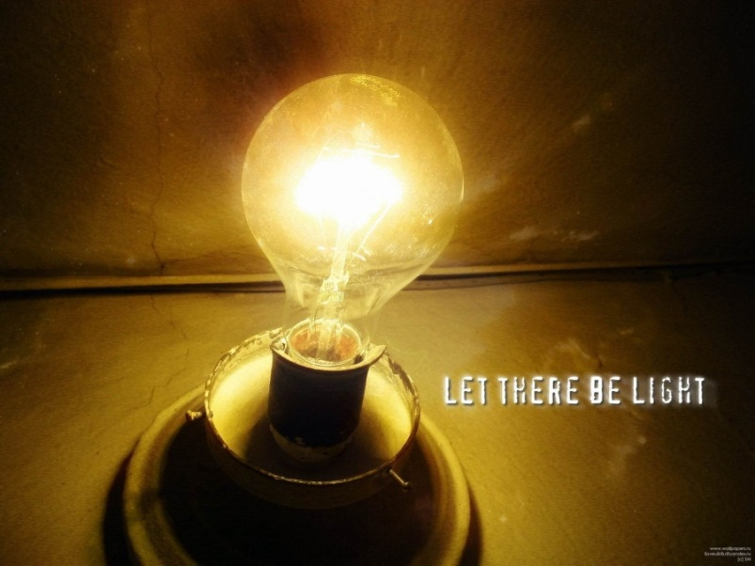
Strings – Cont.
>>> msg1 = "Let there"
>>> msg2 = " be light"
>>> msg1 + msg2
'Let there be light‘
What will the next expression print?
>>> msg1 + msg2 * 2

Slide 41
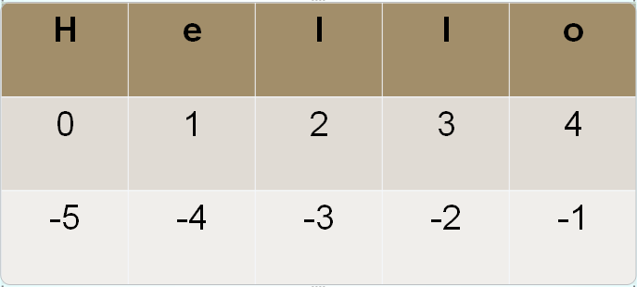
Strings Access
>>> a = ‘Hello’
>>> a[1]
'e'
>>> a[1:3]
'el'
>>> a[1:]
'ello'
>>> a[-4:-2]
'el'
>>> a[:-3]
'He'
>>> a[-3:]
'llo’

Slide 42
Strings concatenation
>>> s1 = “He”
>>> s2 = “llo ”
>>> s3 = s1 + s2
>>> s3
‘Hello’
>>> s4 = s3 + “ World ”
>>> c = ‘!’
>>> s4 + str(2014) + c
‘Hello World 2014!’

Slide 43
Reverse a 3-digits number
num = 765
# split number
ones = num % 10
num = num // 10
tens = num % 10
num = num // 10
hundreds = num
# reverse number
reverse = ones * 100 + tens * 10 + hundreds
print('the reverse number is', reverse)

Slide 44
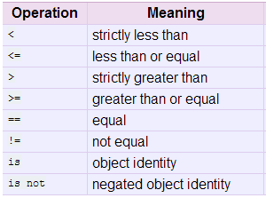
Comparison Operators
Compare two variables and return a Boolean
https://docs.python.org/3/library/stdtypes.html

Slide 45
Plan for Today
Administration
General introduction
The Python programming language:
Variables and Types
Operators
Flow control
Working environment
Homework
Benny Chor

Slide 46
Comparison Operators
>>> 5 == 5.0
True
>>> 6 != 2 * 3
False
>>> -2 >= 1
False
>>> 3 <= 3
True
>>> 3 < 3
False

Slide 47
Comparison Operators
x = 65
y = 6
print(x < y)
?
print(x >= y)
?
print(x != y)
?

Slide 48
Logical Operators
Operate on two Booleans and return a Boolean
Operator | Description
x and y | if both x and y are True: True, otherwise: False.
x or y | if at least one of x or y are True: True, Otherwise: False.
not x | if x is False: True, if x is False: True

Slide 49
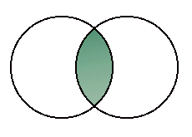
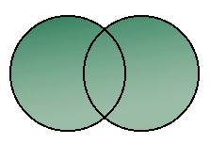
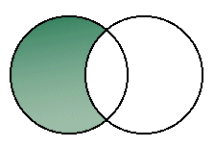
and, or, not
and
or
not
 | 0 | 1
0 | 0 | 1
1 | 1 | 1
0 | 1
1 | 0
 | 0 | 1
0 | 0 | 0
1 | 0 | 1

Slide 50
Logical Operators
>>> a, b = True, True >>> c, d = False, False >>> a and b True >>> a and c False >>> a or c True >>> not a False

Slide 51
Logical Operators
x = 56
y = 6
print(“x < 10 and y < 10 is“, x < 10 and y < 10)
print(“x < 10 or y < 10 is“, x < 10 or y < 10)
result = x < 10 or y < 10
print(“result is“, result)

Slide 52
Plan for Today
Administration
General introduction
The Python programming language:
Variables and Types
Operators
Flow control
Working environment
Compiler, Interpreter
Homework
Benny Chor

Slide 53
Flow Control
Usually a program is executed line after
It is reasonable to expect different execution orders on different inputs
Computer games
Illegal input
Control structures
if-else
for loop
while loop

Slide 54
Conditional Statement: if
Used to execute conditionally a statement (block of code)
Syntax
if expression:
statement1
statement2
…
If expression is True, statement is executed
Indentation!

Slide 55
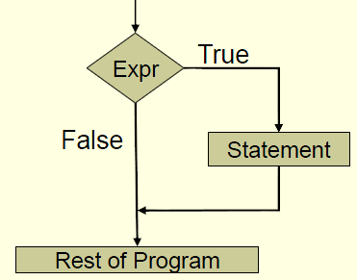
Conditional Statements

Slide 56
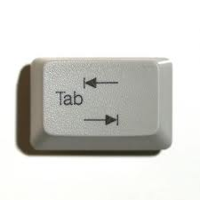
Conditional Statements
Indentation:
Following the if statement:
Open a new scope = one tab to the right.
Indicates the commands within the scope of this if.
Note: tab != four spaces, even though it looks identical!

Slide 57
if-else Statement
if expression:
statement₁
statement₂
else:
statement₃
statement₄
statement₅
If expression is true, statement_{1,2} are executed.
If expression is false, statement_{3,4,5} are executed

Slide 58
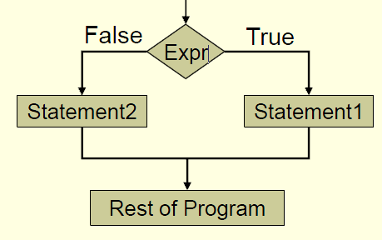
if-else Statement

Slide 59
if-else Statement
width = 56
height = 65
if width == height:
print(“found a square”)
else:
print(“found a rectangle”)
width = height
print(“now it is a square”)
Indentation:
else is not part of the if scope!
The commands under else are indented.

Slide 60
if-else Statement
a = 3
b = 4
c = 5
if a + b <= c or a + c <= b or b + c <= a:
print("Cannot build a triangle“)
else:
print("Building a triangle")

Slide 61
Nested if-else Statement
price = 145.75
if price < 100:
print("too cheap")
else:
if price > 200:
print("too expensive")
else:
print("reasonable price")
Indentation!

Slide 62
Plan for Today
Administration
General introduction
The Python programming language:
Variables and Types
Operators
Flow control
Working environment
Homework
Amir Rubinstein

Slide 63
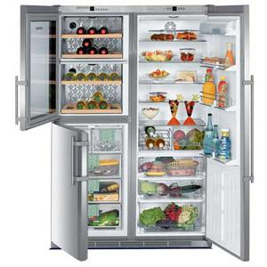
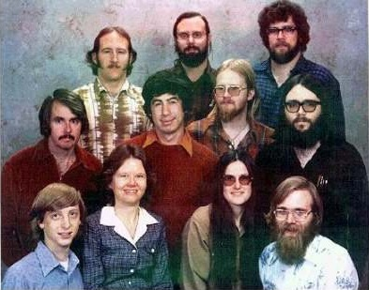
Working Environment
Interpreter vs. scripts
Home vs. labs
VS.

Slide 64
Working Environment
Install (at home):
Windows: https://www.python.org/ftp/python/3.4.3/python-3.4.3.msi
Not on windows? https://www.python.org/downloads/
Make sure you install Python 3.x, NOT 2!
Continue as in class
Open:
Start Menu →
All Programs →
Python 3.4 →
IDLE (Python GUI)

Slide 65
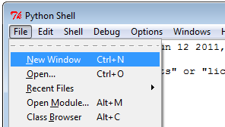
IDLE Editor
We want to save a sequence of commands and run it later in a new Python session.
The Editor:
- Write Python commands
- Execute them in one key-press.
Open the editor from the Shell:
File →
New Window

Slide 66
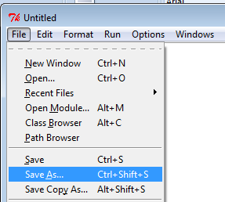
IDLE Editor
The new window is Untitled. First – choose a title:
In the new window:
File → Save as…
Chose a folder and a name. The name must end with ‘.py’

Slide 67
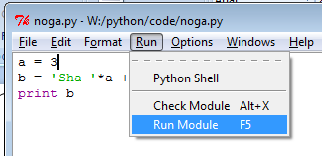
IDLE Editor
Run Python:
The output appears in the Shell window (a new Shell might open)

Slide 68
Plan for Today
Administration
General introduction
The Python programming language:
Variables and Types
Operators
Flow control
Working environment
Homework
Amir Rubinstein

Slide 69
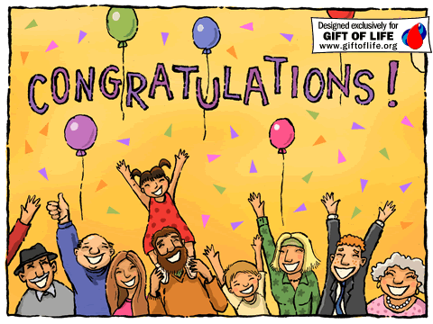
Homework
Assign the string “Hello” to variable a
Assign the string “World!” to variable b
Print a and b in separate lines
Print “Hello World!” using a and b

Slide 70
Next meeting
Recitation 1
כתת מחשבים שרייבר 004
½ group 9-11; ½ group 11-13, by last name
Please make sure you have a working university username before the class!
See http://www.cs.tau.ac.il/system

