Slide 1
Gentle Introduction to Programming
Session 2:
Loops, Functions
Summer 2015

Slide 2
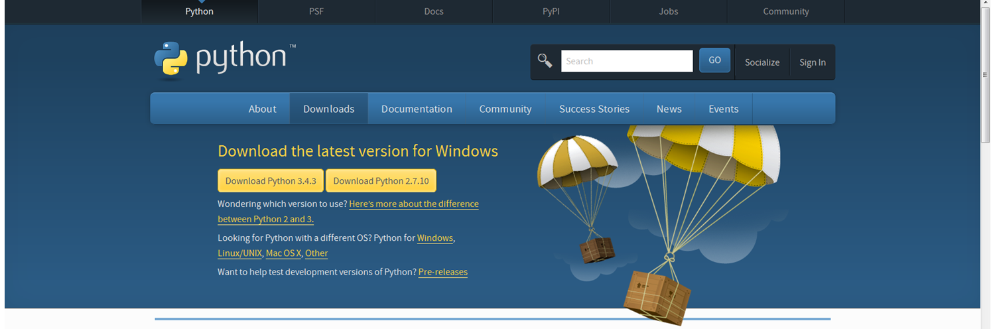
Admin
Python installation status?
https://www.python.org/downloads/

Slide 3
Today
Review
Lists
Loops
Functions
Homework
Ehud Lamm

Slide 4
Review
General terms in CS & programming
Python
Variables & types
int, float, boolean, str
Operators
if-else
Python shell

Slide 5
Operators
Arithmetic Operations:
+ add
- reduce
* multiply
/, // divide
% modulo (remainder)
** power
Comparison Operators (Return True or False):
== equal
!= not equal
> greater than
< less than
>= greater than or equal to
<= less than or equal to

Slide 6
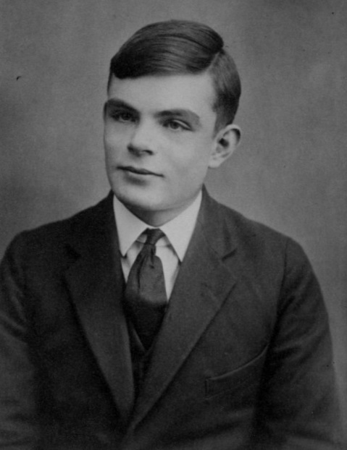
Alan Turing
23 June 1912 – 7 June 1954
British
Pioneering computer scientist, mathematician, logician, cryptanalyst, mathematical biologist, and marathon and ultra distance runner.
Formalisation of the concepts of algorithm and computation with the Turing machine
Father of theoretical computer science and artificial intelligence
Pivotal role in cracking Nazi coded messages

Slide 7
Today
Review
Lists
Loops
Functions
Homework
Ehud Lamm

Slide 8
Lists
An ordered sequence of elements.
Create a list in Python:
>>> my_list = [2,3,5,7,11]
>>> my_list
[2,3,5,7,11]
>>> my_list[0]
2
>>> my_list[-1]
11

Slide 9
Lists are Indexable
4.5 | 9.7 | 8.6 | 5.6 | 3.4
4 | 3 | 2 | 1 | 0
-1 | -2 | -3 | -4 | -5

Slide 10
Lists
Lists can contain strings:
>>> days = [“Sunday”, “Monday", "Tuesday”, “Wednesday”, “Thursday”, “Friday”, “Saturday”]
>>> days[3]
‘Wednesday’
>>> len(days)
7
Lists can mix variables of different types:
>>> pi = [‘pi’, 3.14159, True]
# student: name, age, height, SAT
>>> student = [‘Roi’, 21, 1.83, 782]

Slide 11
Lists – Dynamic
We want to maintain a list of the students here either by name or by id:
>>> students = ['Itay', 9255587, 'Alon', 'Zohar', 744554887]
>>> print(students[2])
‘Alon’
Michal decided to join the course, so we update the list:
# append - add an element to the end of the list
>>> students.append('Michal')
>>> students
['Itay', 9255587, 'Alon', 'Zohar', 744554887, 'Michal']

Slide 12
Lists – Dynamic
But Alon wants lo leave the course:
>>> students.remove('Alon')
>>> students
['Itay', 9255587, 'Zohar', 744554887, 'Michal']
remove removes only the first occurrence of a value.

Slide 13
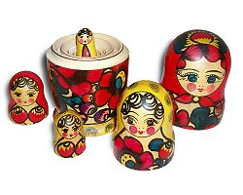
Nested Lists
>>> mat = [ [1, 2, 3], [4, 5, 6], [7, 8, 9] ]
>>> mat[1]
[4, 5, 6]
What is len(mat) ?
>>> family = [‘Grandma’, ‘Grandpa’,
[‘Orit’,’Yossi’, [‘Shiri’] ], [‘Mom’,’Dad’, [‘Tali’,’Ami’,[‘Ran’],[‘Eitan’] ], [’me’, ‘Amir’],
[’Roi’] ] ]

Slide 14
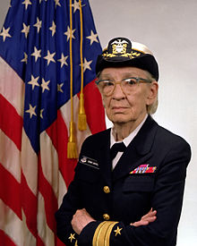
Grace Murray Hopper
December 9, 1906 – January 1, 1992
American
computer scientist and United States Navy rear admiral.
One of the first programmers of the Harvard Mark I computer in 1944
Invented the first compiler
Popularized the idea of high-level programming languages.
Popularizing the term "debugging" for fixing computer glitches (in one instance, removing a moth from a computer).

Slide 15
Today
Review
Lists
Loops
Functions
Homework for Next Meeting

Slide 16
For Loop
for elem in a_list:
statement1
statement2
…
Run over all elements in the list. In iteration i:
Assign elem = a_list[i-1]
Execute the statements
Indentation determines the scope of the iteration.
Note: No infinite loops here! (no infinite lists in Python)

Slide 17
For Example
Compute 1 + 2 + … + 100:
partial_sum = 0
for i in range(1,101):
partial_sum = partial_sum + i
print(“Partial sum is:”, partial_sum)
5050
Use Python’s built-in sum function:
sum(range(1,101))
range(stop)
range(start, stop[, step])
Gives numbers from start (or 0) to stop, with steps intervals (defaults to 1)
Notes:
http://revolveapp.com/Portals/218018/images/re-invent-the-wheel-small.png

Slide 18
For Example
Compute factorial of 12 (12!=479,001,600)
n = 12
fact = 1
for i in range(2, n + 1):
fact *= i
print(n, "! = ", fact)

Slide 19
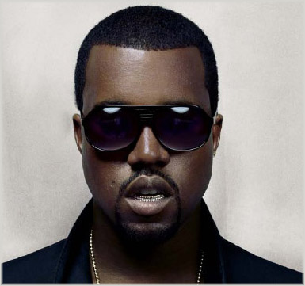
For Loop and Strings
Iterate over strings:
name = ‘Kanye’
for letter in name:
print('Give me', letter)
print('What did we get?', name)
Give me K
Give me a
Give me n
Give me y
Give me e
What did we get? Kanye

Slide 20
Break - Aborting Iteration
break terminates the nearest enclosing loop, skipping the code that follows the break inside the loop.
Useful for getting out of loops when some predefined condition occurs.
Example:
for elem in a_list:
if elem < 0:
break
print(“Stopped at”, elem)

Slide 21
Break Example
# Find smallest divisor using for:
for div in range(2, n + 1):
if n % div == 0:
break
print(“Smallest divisor is”, div)

Slide 22
While Loop
Used to repeat the same instructions until a stop criterion is met
while [expression]:
statement1
statement2
…
expr
false
true
statement(s)

Slide 23
Exercise - Factorial
# factorial of 12 n = 12 fact = 1 i = 1 while i <= n: fact = fact * i i = i + 1 print(n, "! = ", fact)

Slide 24
Exercise – Smallest divisor
# Find the smallest divisor div = 2 while n % div != 0: div = div + 1 print("Smallest divisor of", n, "is", div)
is the above while loop infinite?

Slide 25
Exercise – Primality test
n = 791 div = 2 prime = False
while div < n and prime: prime = n % div != 0 div = div + 1 # <=> div += 1 if prime: print(n, "is prime") else: print(n, "isn’t prime“)

Slide 26
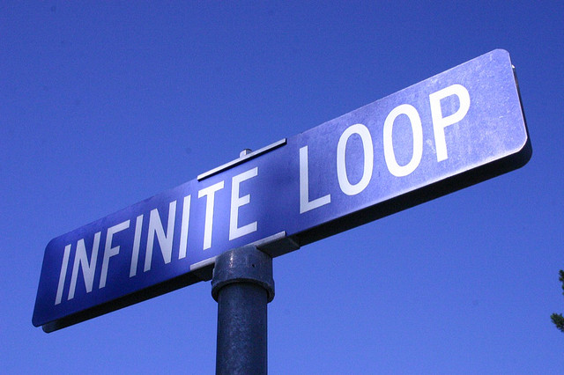
Infinite Loops
Beware!
i = 1
while i < 4:
print i
Notes:
http://farm2.staticflickr.com/1072/582310541_2bfcb04282_z.jpg?zz=1

Slide 27
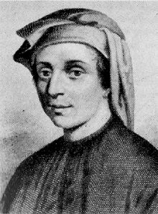
Fibonacci
Fibonacci sequence
0, 1, 1, 2, 3, 5, 8, 13, 21, 34
Definition:
fib(1) = 0
fib(2) = 1
fib(n) = fib(n-1) + fib(n-2)
http://en.wikipedia.org/wiki/Fibonacci_number
Notes:
http://upload.wikimedia.org/wikipedia/commons/thumb/a/a2/Fibonacci.jpg/220px-Fibonacci.jpg
http://upload.wikimedia.org/wikipedia/commons/thumb/9/95/FibonacciBlocks.svg/180px-FibonacciBlocks.svg.png

Slide 28
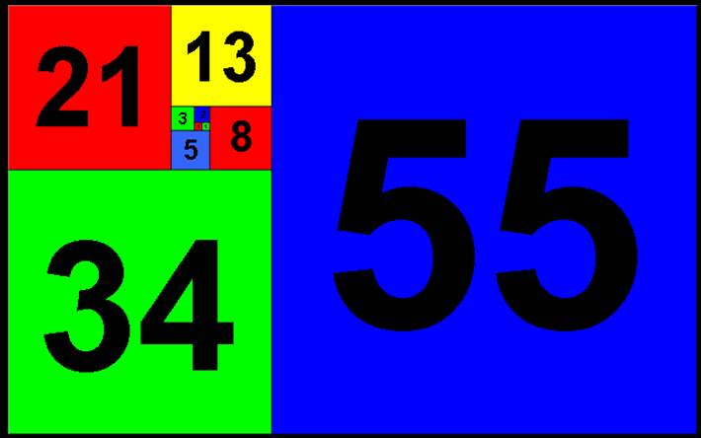

Slide 29
Exercise
Write a program that for an integer n > 0 prints to the screen the n^{th} Fibonacci number.
Use a while loop

Slide 30
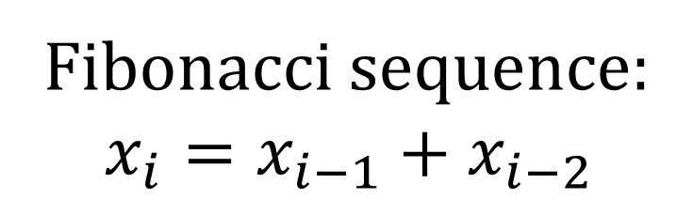
Solution
n = 16 x_i_1 = 1
x_i_2 = 0 i = 3 while i <= n: x_i = x_i_1 + x_i_2 x_i_2 = x_i_1 x_i_1 = x_i i += 1 print("The", n, "Fibonacci number is", x_i)
Fibonacci sequence:
$$x_{i}=x_{i−1}+x_{i−2}$$

Slide 31
When to use for/while?
Most applications are more natural to for, in limited cases we should use while
for - when something is performed a predefined number of times, or when iterating over a list of objects
while - the number of iterations is not known in advance (e.g., asking for legal input from a user, drawing random numbers, waiting for something to happen)

Slide 32
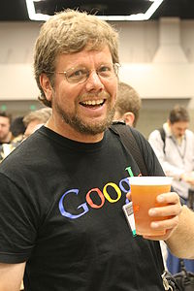
Guido van Rossum
31 January 1956
Dutch
Author of the Python programming language.
Continues to oversee the Python development process
Employed by Google from 2005 until 7 December 2012, where he spent half his time developing the Python language.
In January 2013, Van Rossum started working for Dropbox.

Slide 33
Today
Review
Lists
Loops
Functions
Homework
Ehud Lamm

Slide 34
Functions
A function is a block of code that has a unique name, usually returns a value.
Abstraction - a self-contained block of statements that perform a task.
Reusable - can be executed from as many different points in a Program.
Groups a number of statements into a unit.

Slide 35
What are They Good For?
Generalize a repeated set of instructions (Solve bugs once…)
Break the problem into smaller sub-tasks
Easier to solve complex problems
Make a program easier to read and maintain
Abstraction – we don’t have to know how a function is implemented to use it

Slide 36
Function Definition in Python
Function definition
Function name
Parameters
def max(x, y):
if x < y:
return x
else:
return y
Function Body
Return Value

Slide 37
Functions
def function_name(argument1, argument2,...):
statement1
statement2
…
return result1, result2, … # optional
Calling func:
[var1, var2,…] = function_name(val1, val2,...)
A function is:
A named code scope
Can receive input parameters
Can return output parameters

Slide 38
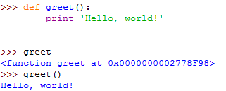
Example
( )

Slide 39
Function Output
Parameters: Python variables. Can be int / float / str / bool / list etc. and even function names! (later)
Return statement – returns a value to the function’s caller.
The type of the returned value – any Python type.
If no value is returned, the function returns None (represent the absence of a value).

Slide 40
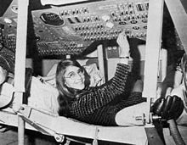
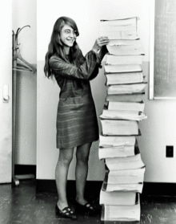
Margaret Hamilton
August 17, 1936
Computer scientist, systems engineer, and business owner.
Was director and supervisor of software programming for Apollo and Skylab
Her work prevented an abort of the Apollo 11 Moon landing
Founder and CEO of Hamilton Technologies, Inc.
Published over 130 papers, proceedings, and reports concerned with the 60 projects and six major programs in which she has been involved.

Slide 41
Today
Review
Lists
Loops
Functions
Homework
Ehud Lamm

Slide 42
Exercise – Integer Division
Input:
Two positive integers – A and B
Output:
How many times A contains B (the result of the integer division A//B)
Do not use the operators ‘/’, ‘//’, ‘*’

Slide 43
Exercise – Power of Two
Input: positive integer A
Output:
If there is an integer n such that A == 2^{n} :
return True
Otherwise, return False.

Slide 44
Exercise – Triangle Printout
Write a program that prints an upside-down triangle of *.
Input: The height of the triangle.
*****
****
***
**
*

Slide 45
How to Find Mistakes in Your Code
Runtime errors
Go over the code
Consult course slides
Ask on the forum (see course website)
Ask Google (a useful and legitimate source)
Good forums to ask questions online: stackoverflow.com, underwar.co.il

