Slide 1
Gentle Introduction to Programming
Session 4: Dictionaries and Text Analysis
Summer 2015

Slide 2
Today
Review
Homework solution
Tuples
Dictionaries
Text analysis
Functions: review and arguments
Amir Rubinstein

Slide 3
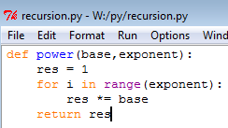

The Call Stack
call stack
result
main
base
= 3
= 5
= 2
= 15
exponent
= 17
= 20
power
i
res

Slide 4
Towers of Hanoi
Objective:
Move the entire stack of disks from rode S (source) to T (target) using A (auxiliary)
S
A
T

Slide 5
The Rules
Only one disk may be moved at a time
Each move consists of taking the upper disk from one of the rods and sliding it onto another rod
No disk may be placed on top of a smaller disk
S
A
T

Slide 6
Examples
S
A
T
S
A
T
1 disk – very easy!
2 disks – very easy!
S
A
T
S
A
T
3 disks – easy
4 disks?

Slide 7
Solution for 4 Disks
S
A
T
S
A
T
S
A
T
S
A
T

Slide 8
For n Disks?
S
A
T

Slide 9
Assume We Have a Solution for n-1 Disks
S
A
T

Slide 10
Solution: Step 1
S
A
T

Slide 11
Solution: Step 2
S
A
T

Slide 12
Solution: Step 3
S
A
T

Slide 13
How to Solve for n-1 Disks?
Easy!

Slide 14
Algorithm for n Disks
S
A
T
If there is only a single disk – easy!
Move n-1 disks from S to A (T is the auxiliary rode)
Move disk from S to T
Move n-1 disks from A to T (S is the auxiliary rode)
Let us write it in Python…

Slide 15
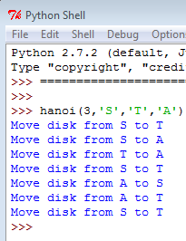
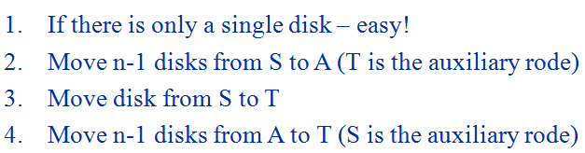
A Python Program for Towers of Hanoi
def hanoi(disks,S,T,A): if disks == 1: print('Move disk from',S,'to',T) return hanoi(disks - 1, S, A, T) print('Move disk from',S,'to',T) hanoi(disks - 1, A, T, S) return hanoi(3,'S','T','A')

Slide 16
Remember the Calling Stack?
main
hanoi(3,'S','T','A')
hanoi(2,'S',‘A',‘T')
hanoi(1,‘S',‘T',‘A')
And so on…

Slide 17
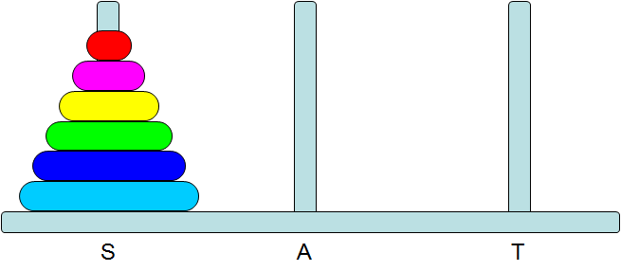
Recursion
Design a recursive algorithm by
1. Solving big instances using the solution to smaller instances
2. Solving directly the base cases
Recursive algorithms have
1. Stopping criteria
2. Recursive case(s)
3. Construction of a solution using solution to smaller instances

Slide 18
Recursion and Efficiency
Fib(6)
Recursion may be much less efficient
The number of redundant calls grows exponentially!
Fib(5)
Fib(4)
Fib(3)
Fib(2)
Fib(1)
Fib(2)
Fib(3)
Fib(2)
Fib(1)
Fib(4)

Slide 19

Exercise 1
Write a program that receives two non-negative integers and computes their product recursively
Hint: Notice that the product a*b is actually a+a+…+a (b times). How does this help us define the problem recursively?

Slide 20
Exercise 2
def sum_digits_iter(n): s = 0 while n > 0: s += n % 10 n //= 10 return s
Given the following iterative version of sum-of-digits calculation
Write the recursive version
def sum_digits_rec(n(: if n == 0: return 0 return n % 10 + sum_digits_rec(n // 10)

Slide 21
Exercise 3 – Approximate ∏
Write a function that uses the formula :
∏²/6=1/1+1/4+1/9+1/16+…+1/n² (n goes to infinity)
to approximate ∏ .
The function receives n - the number of terms in the formula, and returns the approximation of ∏.
To calculate the square root:
x**0.5
or
Add before the code: import math
Use math.sqrt(x)

Slide 22
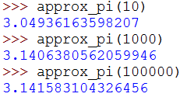
Approximate ∏ Solution
def approx_pi(n): s = 0 for i in range(1, n + 1): s += 1/i**2 return (6 * s) ** 0.5

Slide 23
Lists - reminder
A list is an ordered sequence of elements.
Create a list in Python:
>>> my_list = [2,3,5,7,11]
>>> my_list
[2,3,5,7,11]
>>> my_list[0]
2
>>> my_list[-1]
11

Slide 24
List Methods
lst.append(item) -- append an item to the end of the list.
lst.count(val) -- return the number of occurrences of value.
lst.extend(another_lst) -- extend list by appending items from another list.
lst.index(val) -- return first index of value.
lst.insert(index, item) -- insert an item before index
lst.pop() -- remove and return the last item.
lst.remove(value) -- remove first occurrence of a value.
lst.reverse() --reverse the list
lst.sort() -- sort the list

Slide 25
Tuples
A tuple is similar to a list, but immutable.
Syntax: note the parentheses!
>>> t = (‘don’t’,’worry’,’be’,’happy’) # definition
>>> t
(‘dont’,’worry’,’be’,’happy’)
>>> t[0] # indexing
'dont'
>>> t[-1] # backwords indexing
‘happy'
>>> t[1:3] # slicing
(’worry’,’be’)

Slide 26
Tuples
>>> t[0] = ‘do’ # try to change
Traceback (most recent call last):
File "<pyshell#2>", line 1, in <module>
t[0]=‘do’
TypeError: 'tuple' object does not support item assignment
No append / extend / remove in Tuples!

Slide 27

Tuples
So what are tuples good for?
Safe code
When immutable types are required

Slide 28
Dictionaries
Dictionary: a set of key-value pairs.
>>> dict_name = {key1:val1, key2:val2,…}
Keys are unique and immutable.
Example:
Map names to heights:
>>> heights = {‘Alan Harper’:1.76, ‘John Smith’:1.83, ‘Walden Schmidt’:1.90}
>>> heights
{'Walden Schmidt': 1.9, 'John Smith': 1.83, 'Alan Harper': 1.76}
Note:The pairs order changed
>>> heights[‘John Smith’]
1.83

Slide 29
Dictionaries
Add a new person:
>>> heights[‘Lyndsey Makelroy’] = 1.70
>>> heights
{'Lyndsey Makelroy': 1.7, 'Walden Schmidt': 1.9, ‘John Smith': 1.83, 'Alan Harper': 1.76}
What happens when the key already exists?
>>> heights[‘John Smith’] = 2.02
>>> heights
{'Lyndsey Makelroy': 1.7, 'Walden Schmidt': 1.9, 'John Smith': 2.02, 'Alan Harper': 1.76}
Solutions?

Slide 30
Dictionaries
Idea: Add address to the key
>>> heights = {[‘Alan Harper’, ‘Malibu’]:1.76}
Traceback (most recent call last):
File "<pyshell#46>", line 1, in <module>
heights = {['Alan Harper', 'Malibu']:1.76}
TypeError: unhashable type: 'list‘
What’s the problem?

Slide 31
Dictionaries
Fix:
>>> heights = {(‘Alan Harper’, ‘Malibu’):1.76}
>>> heights
{('Alan Harper', 'Malibu'): 1.76}

Slide 32
Dictionary Methods
Default argument value: An argument shown in [] has a default value. If there are “not enough” arguments, the default value is assigned (must appear in the end of the arguments’ list).
D.get(k, [d]) -- return D[k] for k in D, otherwise d (default: None).
D.has_key(k) -- True if D has a key k, False otherwise.
D.items() -- list of (key, value) pairs, as 2-tuples
D.keys() -- list of D's keys
D.values() -- list of D's values
D.pop(k, [d]) -- remove the specified key k and return its value. If k is not found, return d.

Slide 33
Frequency Counter
Assume you want to learn about the frequencies of English letters.
You find a long and representative text and start counting.
Which data structure will you use to keep your findings?
s u p e r c a l i f r a g i l i s t i c e x p i a l i d o c i o u s

Slide 34
Frequency Counter
text = "supercalifragilisticexpialidocious" # count letters char_count = {} for char in text: char_count[char] = char_count.get(char, 0) + 1 # sort alphabetically sorted_char_tuples = sorted(char_count.items())

Slide 35
Frequency Counter
# print
for char,count in sorted_char_tuples:
print(char , ‘ = ‘, count)
a = 3
c = 3
d = 1
e = 2
f = 1
g = 1
…

Slide 36
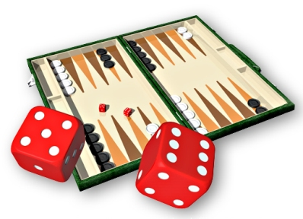
Exercise - Dice Odds
In backgammon, there are 36
combinations of rolling the dice.
We are interested in the sum of the two dice.
Therefore:
count the number of combinations for every possible sum
find the chance of getting it.

Slide 37
Exercise - Dice Odds
Create the following data structure:
Each combination of two dice is a tuple.
All combinations are held in a dictionary, where the key is the sum of the combination.
Each value in the dictionary is a list of tuples – that is, all combinations that sum to key
Keys
Values
2
[ (1 , 1) ]
3
[ (1 , 2) , (2, 1) ]
4
[ (1 , 3) , (2 , 2) , (3 , 1) ]

Slide 38
Exercise - Dice Odds
rolls = {}
for d1 in range(1, 7): # first dice
for d2 in range(1, 7): # second dice
dices = (d1, d2)
key = d1 + d2
# update dict
rolls[key] = rolls.get(key, []) + [dices]
# print result
for key in sorted(rolls.keys()):
print(key, len( rolls[key] ))

Slide 39
Exercise - Dice Odds
>>>
2 1
3 2
4 3
5 4
6 5
7 6
8 5
9 4
10 3
11 2
12 1

Slide 40
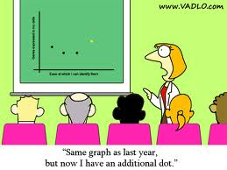
Data Analysis
Analysis of data is a process of inspecting, cleaning, transforming, and modeling data with the goal of highlighting useful information, suggesting conclusions, and supporting decision making. Data analysis has multiple facets and approaches, encompassing diverse techniques under a variety of names, in different business, science, and social science domains.
Descriptive
Predictive

Slide 41
Data Analysis Examples
Google
Stock market trends
Genome-disease association
Face recognition
Production yield
Business intelligence
Speech recognition
Text categorization

Slide 42
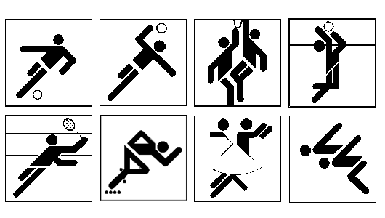




Text Categorization / Document Classification

Slide 43
How is it Done?
Manually ☹
Automatically
Gather document statistics
Measure how similar it is to documents in each category
Today we will collect word-statistics from several well known books

Slide 44
Plan
Find data
Collect word statistics
Observe results

Slide 45
Find Data
This might be the hardest task for many applications!
Project Gutenberg (http://www.gutenberg.org/)
Alice's Adventures in Wonderland (http://www.gutenberg.org/cache/epub/11/pg11.txt)
The Bible, King James version, Book 1: Genesis (http://www.gutenberg.org/cache/epub/8001/pg8001.txt)

Slide 46
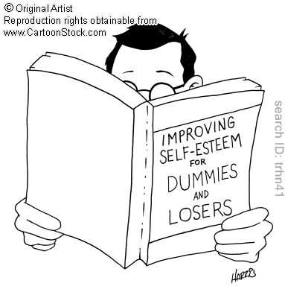
Reading a Book
<<< import urllib.request as req <<< alice = req.urlopen('http://www.gutenberg.org/cache/epub/11/pg11.txt') <<< line = alice.readline() <<< print(line( "Project Gutenberg's Alice's Adventures in Wonderland, by Lewis Carroll\r\n"

Slide 47
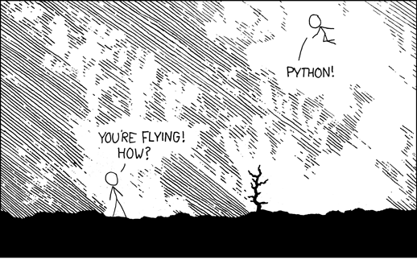
Flying
http://xkcd.com/353/

Slide 48
Print Most Popular Words
(High Level)
>> genesis = req.urlopen('http://www.gutenberg.org/cache/epub/8001/pg8001.txt') >> alice = req.urlopen('http://www.gutenberg.org/cache/epub/11/pg11.txt') >> print_most_popular(genesis, 7, 'Genesis') ***** Genesis *****
the --> 0.149
and --> 0.146
of --> 0.084
And --> 0.074
to --> 0.040
his --> 0.039
he --> 0.038
>> print_most_popular(alice, n, 'Alice In Wonderland')
***** Alice In Wonderland *****
the --> 0.167
and --> 0.078
to --> 0.077
a --> 0.066
of --> 0.060
she --> 0.048
said --> 0.042

Slide 49
Modular Programming
Top-down approach: first write what you plan to do and then implement the details
Clear for readers
Easy to debug and test
Easy to maintain

Slide 50
PrintMostPopular
Build Word-Occurrences Dictionary
def print_most_popular(text, n, book_name): ''' text - text n - num of popular words to print book_name - name of book ''' text = text.read().decode('utf8') words = text.split() dic = {} for w in words: dic[w] = dic.get(w,0) + 1
Continued ->

Slide 51
PrintMostPopular
Sort Words by Occurrences
sorted_words = sorted(dic.items(), key=getvalue, reverse=True) popular_words = sorted_words[0:n] popular_words_count = 0 for word,count in popular_words: popular_words_count += count
print('*****', book_name, '*****') for word, count in popular_words: freq = count / popular_words_count print("%s --> %.3f" % (word, freq))

Slide 52
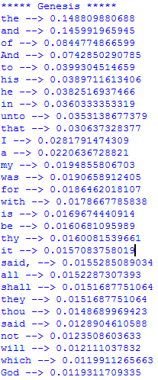
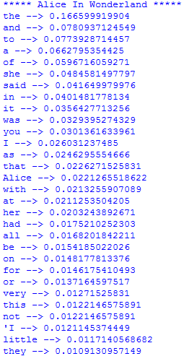
Results

Slide 53
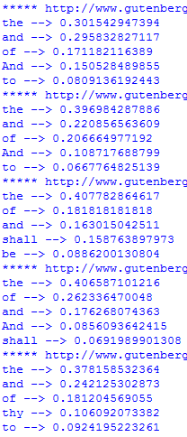
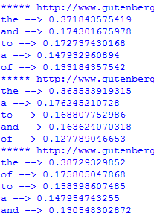
Results
(The word “to” as an example)
Bible
L. Carroll

Slide 54
And Now for Several Books
n = 5 for bible_ch in range(8001,8006): url = 'http://www.gutenberg.org/cache/epub/' + str(bible_ch) + '/pg' + str(bible_ch) + '.txt' book = req.urlopen(url) print_most_popular(book, n, url) for alice_ch in range(11,14): url = 'http://www.gutenberg.org/cache/epub/' + str(alice_ch) + '/pg' + str(alice_ch) + '.txt' book = req.urlopen(url) print_most_popular(book, n, url)

Slide 55
How is it Really Done?
Preprocessing (e.g., words to lower case, remove punctuation signs)
Word count
Enhance statistics
Discard stop words (e.g., and, of, a)
Stemming (e.g., go & went)
Synonyms (מילים נרדפות)
bigrams, trigrams
Similarity measures to existing documents / categories

Slide 56
How is it Really Done?
Categories
Topics:
http://www.cs.tau.ac.il/courses/gip/2012/Sessions/4/topics.rbb
Categories Hierarchy:
http://www.cs.tau.ac.il/courses/gip/2012/Sessions/4/rcv1.topics.hier.orig

Slide 57
How is it Really Done?
Enhance Statistics
Stop words:
http://www.cs.tau.ac.il/courses/gip/2012/Sessions/4/english.stop
After processing:
http://www.cs.tau.ac.il/courses/gip/2012/Sessions/4/lyrl2004-non-v2_tokens_test_pt0.dat

Slide 58
Today
Review
Text analysis
Functions: review and arguments
Amir Rubinstein

Slide 59
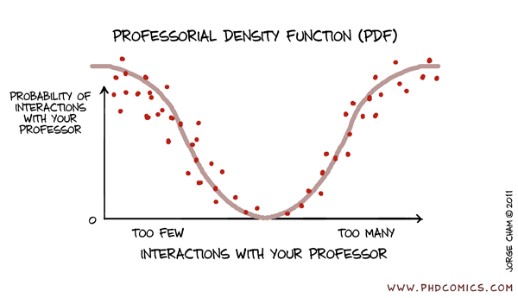

Functions (Quick Overview)

Slide 60
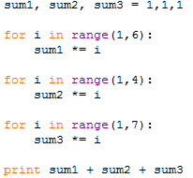
How to Calculate 5! + 3! + 6!?

Slide 61
Problems
Same code duplicated 3 times
More elements → more code duplicates
The program becomes longer and more complicated
May cause bugs, cut & paste errors
Hard to understand what was the writer’s intension
What would we like?
Write the code once!
Use it several times with different arguments

Slide 62
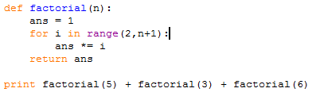
Solution - Functions

Slide 63
Functions
A group of declarations and statements that is assigned a name
Effectively, a named statement block
Usually has a value
A sub-program
Inside a fucntion we can call other functions
Which can themselves use other functions, and so on…
Function output:
Return value to the calling function
If no value is to be returned, ‘None’ is returned

Slide 64
What are They Good For?
Generalize a repeated set of instructions
We don’t have to keep writing the same thing over and over
Solve bugs once…
They can break your problem down into smaller sub-tasks
Easier to solve complex problems
They make a program much easier to read and maintain
Abstraction – we don’t have to know how a function is implemented to use it

Slide 65
In Short
Why do we need functions?
Code reusability
Modularity
Abstraction

Slide 66
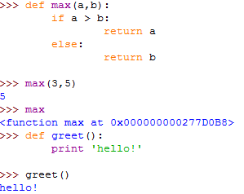
Examples

Slide 67
Passing Arguments to Functions
When a function is called, arguments’ values are attached to function’s formal parameters by order, and an assignment occurs before execution
Values are copied to formal parameters

Slide 68
Passing Arguments to Functions
A reference is passed by reference
Example: lists
This explains why we can change an array’s content within a function
a
4 | 5 | 6 | 7 | 8 | 9

Slide 69
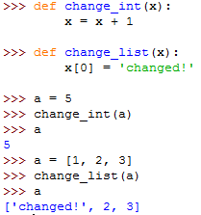
Example

Slide 70
Pyhton Memory Model
Stack: local variables and arguments, every function uses a certain part of the stack
Stack variables “disappear” when scope ends
Heap: global variables and objects, scope independent
Garbage Collector
Partial description

Slide 71
How to Change a Variable via Functions?
So how can a method change an outer variable?
By its return value
By accessing heap-based memory (e.g., lists)

Slide 72
Homework
Solve Q3 in the following mock exam (spell checker): http://www.cs.tau.ac.il/courses/pyProg/1112a/exams/PyProg1112a_mock1.pdf

