Slide 1
Data Analysis Using SQL

Slide 2
Context:
Intro to SQL
Download and install SQL server and SQL server management studio
Database, data types, variables and tables in SQL
Primary key and foreign key
Basic Queries in SQL
Different aggregate functions in SQL
Grouping and joins in SQL
Python and SQL

Slide 3
Intro to SQL

Slide 4
What is SQL?
Structured Query Language (SQL) is a standard computer language for relational database management and data manipulation.
It is used to query, insert, update and modify data
Pronounced as “sequel” or S-Q-L

Slide 5
What is SQL?
Used to communicate with database
Statements are made up of descriptive words and are easy to learn
SQL is a non-procedural language:
Cannot write complete application
Simple but powerful

Slide 6
How is SQL used?
SQL is all about data!
Read/Retrieve data
Write data – add data to table
Update data – insert new data

Slide 7
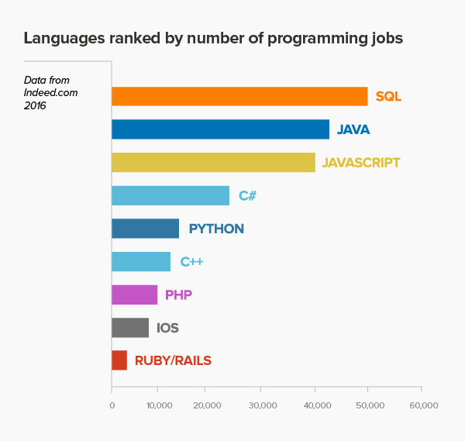
Who uses SQL?

Slide 8
Who uses SQL?
Backend Developer
QA Engineer
Database Admin (DBA)
Data Analyst
System Admin
Data Architect
ETL Developer
System Engineer
Data Scientist

Slide 9
Database Administrator or Data Scientist
Database Administrator:
Manages/Governs entire database
Gives permissions to users
Determines access to data
Manages and creates tables
Uses SQL to query and retrieve data
Data Scientist:
End user of a database
Uses SQL to query and retrieve data

Slide 10
How do Data Scientist use SQL
Retrieve data
May create their own table or test environment
Combine multiple sources together
Writes complex queries for analysis

Slide 11
SQL and Database Management Systems
How you write syntax will depend on what DBMS you’re using
Each DBMS has it’s own “dialect”
SQL can translate
You can tweak based on the “dialect” your DBMS speaks

Slide 12
Relational Database Management Systems
Microsoft SQL Server
IBM DB2 Oracle
Sybase ASE
Postgre SQL
MySQL
Apache Open Office Base
SQLite

Slide 13
Relational Database Management Systems
A relational database refers to a database that stores data in a structured format, using rows and columns.
It is "relational" because the values within each table are related to each other.
Tables may also be related to other tables.
The relational structure makes it possible to run queries across multiple tables at once.

Slide 14
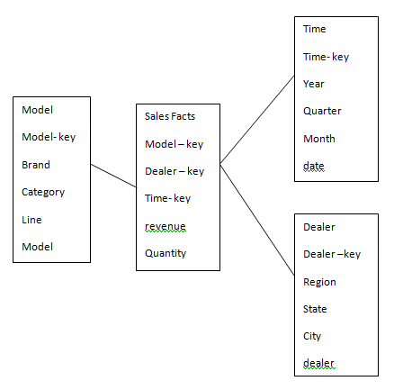
What is Data Modeling in SQL?
Organizes and structures information into multiple, related tables
Can represent a business process or show relationships between business processes
Should closely represent real world

Slide 15
Relational vs. Transactional Model
Relational Model:
Allows for easy querying and data manipulation in an easy, logical and intuitive way.
Transactional Model:
Operational database – insurance claims within a healthcare database.

Slide 16
Relational Model Building Blocks
Entity:
Person, place thing or event distinguishable, unique and distinct
Attribute:
A characteristic of an entity
Relationship:
Describe association among entities
One to Many (customer to invoice)
Many to many (student to classes)
One to one (manager to store)

Slide 17
Installation

Slide 18
Download and Install SQL Server
Step 1) Go to URL: https://www.microsoft.com/en-in/sql-server/sql-server-downloads
Microsoft provides two specialized free editions to work on MS SQL server:
Developer – It has all feature which MS SQL server offers but we cannot use it in production. From the learning perspective, is it an ideal candidate to start.
Express: This is also a free version but with the limited set of features with no business intelligence applications.
We will select the Developer edition for installation.
Step 2) Click on "Download now"

Slide 19
Download and Install SSMS
Step 1) Go to URL: https://docs.microsoft.com/en-us/sql/ssms/download-sql-server-management-studio-ssms?view=sql-server-2017
Step 2) Click on ”Download SSMS”

Slide 20
Database, Data types, Variables and Tables

Slide 21

What is Database?
A container (usually a file or set of files) to store organized data; a set of related information

Slide 22
What is Database?
A database is a collection of objects such as tables, views, stored procedures, triggers, functions, etc.
In SQL Server, there are two types of databases:
System databases: The system databases are created automatically for you when you install the SQL Server. They play a crucial role in the server, especially in ensuring that database objects run correctly. Examples of SQL Server system databases include: Master, MSDB, Model, Tempdb, Resource
User Databases: The user databases are created by the database users like you who have been granted access to create databases

Slide 23
What is Datatype?
A datatype is defined as the type of data which any column or variable can store in MS SQL Server.
While creating any table or variable, in addition to specifying the name, you also set the Type of Data it will store.
How to use MS SQL datatype
You need to define in advance, the type of data a column or variable can store. Determining data type also restricts the user from entering any unexpected or invalid data.
You can make efficient use of memory by assigning an appropriate data type to variable or column which will allocate only the required amount of system memory for the respective column's data.

Slide 24
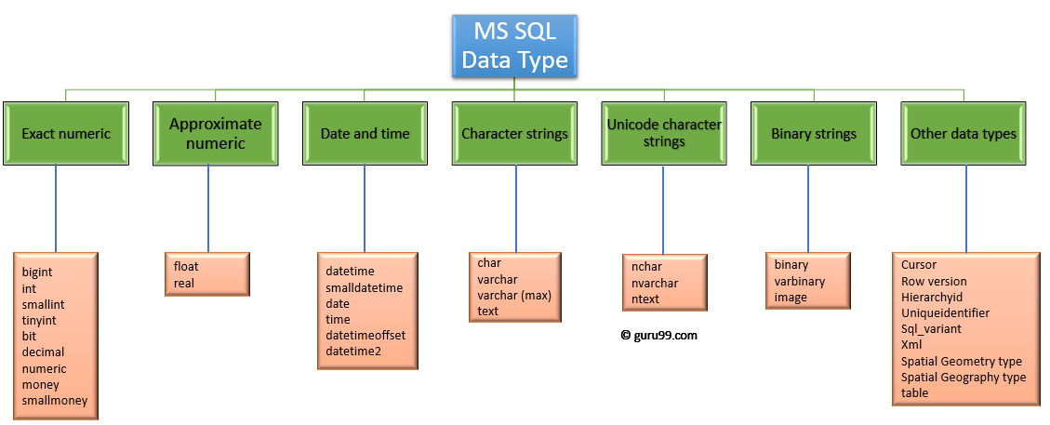
Data type available in MS SQL
Credits: guru99.com

Slide 25
What is Variable?
In MS SQL, variables are the object which acts as a placeholder to a memory location. Variable hold single data value.
Types of Variable:
MS SQL has two types of variables:
Local variable
Global variable

Slide 26
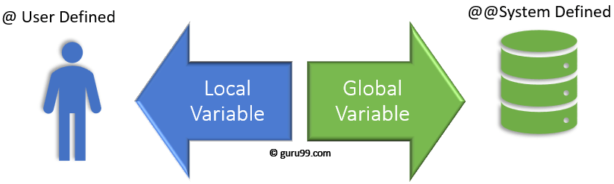
Types of Variable
Credits: guru99.com

Slide 27

What is Table?
A structured list of data or a specific type

Slide 28
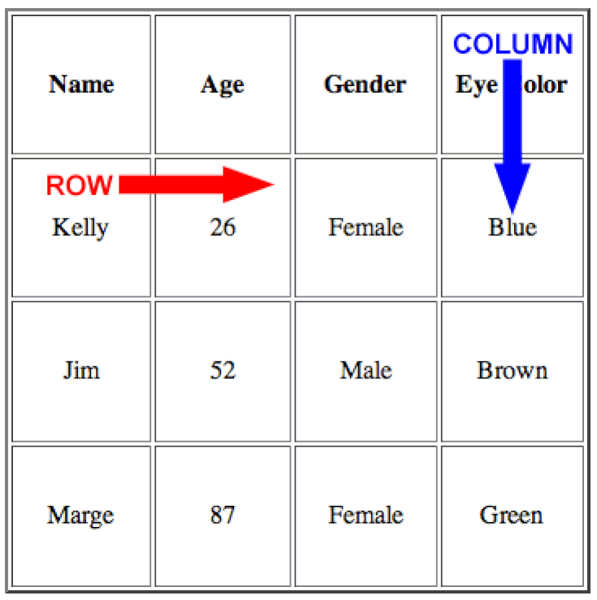
What is Table?
A Table is an object which stores data in Row & Column format. Below Diagram, shows Rows and Column respectively.

Slide 29
How to Create a Table?
The first step to store data in the database is to create a Table where data will reside. Post creation of the table, we can keep inserting the rows in the table.
We can Create a table in the following ways:
T-SQL: Create a New Table by defining all columns and its data type.
T-SQL: Create New Table using an existing table
Using Table Designer
Let's study this in detail:

Slide 30
Primary Key and Foreign Key

Slide 31
What is Primary Key?
A Primary Key is a field or a combination of fields that identify a record uniquely. The Primary key is a column or set of columns which are unique. In other words, every value is unique for Primary Key.
Rules for Primary Key
Each table can have only one Primary Key.
All the values are unique and Primary key value can uniquely identify each row.
The system will not allow inserting a row with a primary key which already exists in the table.
Primary Key cannot be NULL.

Slide 32
How to create Primary Key?
We can Create a Primary Key in 2 ways:
1. SQL Server Management Studio.
2. T-SQL: Create Primary while creating a New Table.

Slide 33
What is Foreign Key?
A foreign key provides a way of enforcing referential integrity within SQL Server. In simple words, foreign key ensures values in one table must be present in another table.
Rules for Foreign key
NULL is allowed in Foreign key.
The table being referenced is called the Parent Table
The table with the foreign key is called Child Table.
The foreign key in child table references the primary key in the parent table.
This parent-child relationship enforces the rule which is known as "Referential Integrity."

Slide 34
How to create Foreign Key?
We can Create a Foreign Key in 2 ways:
SQL Server Management Studio
T-SQL

Slide 35
Basic Queries in SQL

Slide 36
SQL SELECT Statement
The SELECT statement is used to select data from a database.
The data returned is stored in a result table, called the result-set.
SELECT Syntax
SELECT column1, column2, ... FROM table_name;
If you want to select all columns..
SELECT * FROM table_name;

Slide 37
SQL SELECT DISTINCT Statement
The SELECT DISTINCT statement is used to return only distinct (different) values.
SELECT DISTINCT Syntax
SELECT DISTINCT column1, column2, ... FROM table_name;

Slide 38
SQL WHERE Clause
The WHERE clause is used to filter records.
The WHERE clause is used to extract only those records that fulfill a specified condition.
WHERE Syntax
SELECT column1, column2, ... FROM table_name WHERE condition;

Slide 39
SQL ORDER BY Keyword
The ORDER BY keyword is used to sort the result-set in ascending or descending order.
The ORDER BY keyword sorts the records in ascending order by default. To sort the records in descending order, use the DESC keyword.
ORDER BY Syntax
SELECT column1, column2, ... FROM table_name ORDER BY column1, column2, ... ASC|DESC;

Slide 40
SQL UPDATE Statement
The UPDATE statement is used to modify the existing records in a table.
UPDATE Syntax
UPDATE table_name SET column1 = value1, column2 = value2, ... WHERE condition;

Slide 41
SQL DELETE Statement
The DELETE statement is used to delete existing records in a table.
DELETE Syntax
DELETE FROM table_name WHERE condition;

Slide 42
Aggregate functions in SQL

Slide 43
SQL MIN() and MAX() Functions
The MIN() function returns the smallest value of the selected column.
The MAX() function returns the largest value of the selected column.
MIN() Syntax:
SELECT MIN(column_name) FROM table_name WHERE condition;
MAX() Syntax:
SELECT MAX(column_name) FROM table_name WHERE condition;

Slide 44
SQL COUNT(), AVG() and SUM() Functions
The COUNT() function returns the number of rows that matches a specified criteria.
The AVG() function returns the average value of a numeric column.
The SUM() function returns the total sum of a numeric column.
COUNT() Syntax:
SELECT COUNT(column_name) FROM table_name WHERE condition;
AVG() Syntax:
SELECT AVG(column_name) FROM table_name WHERE condition;
SUM() Syntax:
SELECT SUM(column_name) FROM table_name WHERE condition;

Slide 45
Grouping and Joins in SQL

Slide 46
SQL GROUP BY Statement
The GROUP BY statement groups rows that have the same values into summary rows, like "find the number of customers in each country".
The GROUP BY statement is often used with aggregate functions (COUNT, MAX, MIN, SUM, AVG) to group the result-set by one or more columns.
GROUP BY Syntax:
SELECT column_name(s) FROM table_name WHERE condition GROUP BY column_name(s) ORDER BY column_name(s);

Slide 47
SQL Joins
A JOIN clause is used to combine rows from two or more tables, based on a related column between them
Different Types of SQL JOINs
(INNER) JOIN: Returns records that have matching values in both tables
LEFT (OUTER) JOIN: Returns all records from the left table, and the matched records from the right table
RIGHT (OUTER) JOIN: Returns all records from the right table, and the matched records from the left table
FULL (OUTER) JOIN: Returns all records when there is a match in either left or right table

Slide 48
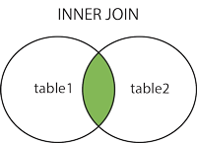
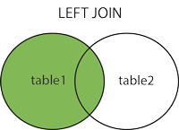
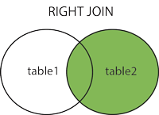
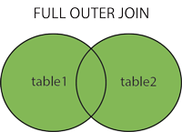
Different Types of SQL Joins

Slide 49
SQL INNER JOIN Keyword
The INNER JOIN keyword selects records that have matching values in both tables.
INNER JOIN SYNTAX
SELECT column_name(s) FROM table1 INNER JOIN table2 ON table1.column_name = table2.column_name;

Slide 50
SQL LEFT JOIN Keyword
The LEFT JOIN keyword returns all records from the left table (table1), and the matched records from the right table (table2). The result is NULL from the right side, if there is no match.
LEFT JOIN SYNTAX
SELECT column_name(s) FROM table1 LEFT JOIN table2 ON table1.column_name = table2.column_name;

Slide 51
SQL RIGHT JOIN Keyword
The RIGHT JOIN keyword returns all records from the right table (table2), and the matched records from the left table (table1). The result is NULL from the left side, when there is no match.
RIGHT JOIN SYNTAX
SELECT column_name(s) FROM table1 RIGHT JOIN table2 ON table1.column_name = table2.column_name;

Slide 52
SQL FULL OUTER JOIN Keyword
The FULL OUTER JOIN keyword returns all records when there is a match in left (table1) or right (table2) table records.
Note: FULL OUTER JOIN can potentially return very large result-sets!
Tip: FULL OUTER JOIN and FULL JOIN are the same.
FULL OUTER JOIN SYNTAX
SELECT column_name(s) FROM table1 FULL OUTER JOIN table2 ON table1.column_name = table2.column_name WHERE condition;

Slide 53
SQL UNION Operator
The UNION operator is used to combine the result-set of two or more SELECT statements.
Each SELECT statement within UNION must have the same number of columns
The columns must also have similar data types
The columns in each SELECT statement must also be in the same order
UNION SYNTAX
SELECT column_name(s) FROM table1 UNION SELECT column_name(s) FROM table2;

Slide 54
SQL and Python

Slide 55
Connect Python to SQL
Step1: Install pyodbc
--pip/conda install pyodbc
Step2: Retrieve Server Name
--You can get your server name by opening SQL Server. You’ll then see the Connect to Server box, where the server name will be displayed.
Step3: Obtain the database name
--You can find the database name under the Object Explorer menu (underneath the Databases section) which is located on the left-hand side of your SQL Server.

Slide 56
Connect Python to SQL
Step4: Get the table name
--The name of your table would also be located under the Object Explorer menu (underneath the Tables section).
Step5: Connect Python to SQL server
--Let’s see in Jupyter notebook..

Slide 57
Let’s get into action with python, see you in next lecture!

