Slide 1
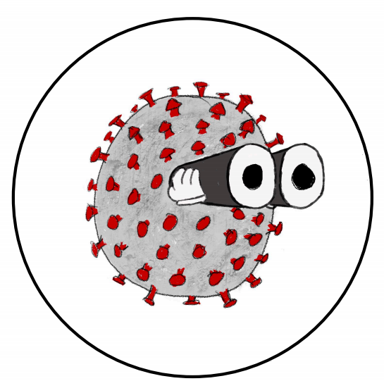
CovidView
Is it safe? Covid-19 hotspot prediction
By Nerd Immunity
Isaac Huen, Mark Manders, Muhammad Nur Hakim Rosli, Rebecca Wong, Robin Vinod

Slide 2
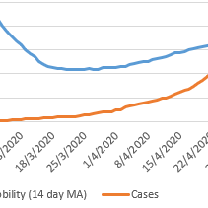
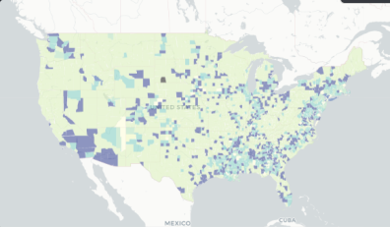
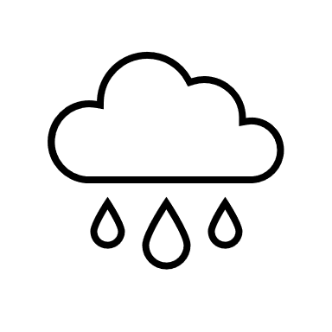




How can human factors be used to predict emerging Covid-19 clusters?
We correlate mobility, environmental, population (density and demographic), testing and positive case related data at the US county level to identify patterns, formulate and train our predictive model.
Data
Analysis
Prediction
Warning
CovidView can predict the emergence of future Covid-19 hotspots by using regression and clustering methods. This website can be used by governments, healthcare professionals or other third parties to monitor at-risk areas to prevent high number of cases (slow the increase of cases).

Slide 3
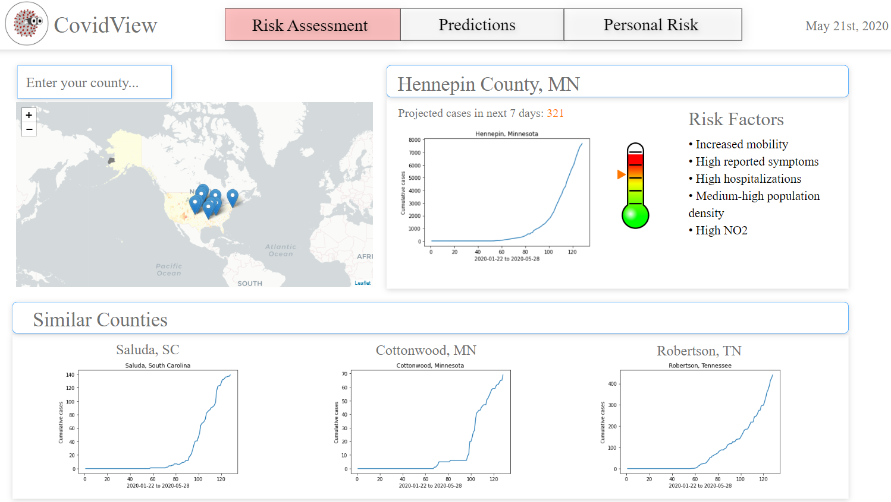

Slide 4
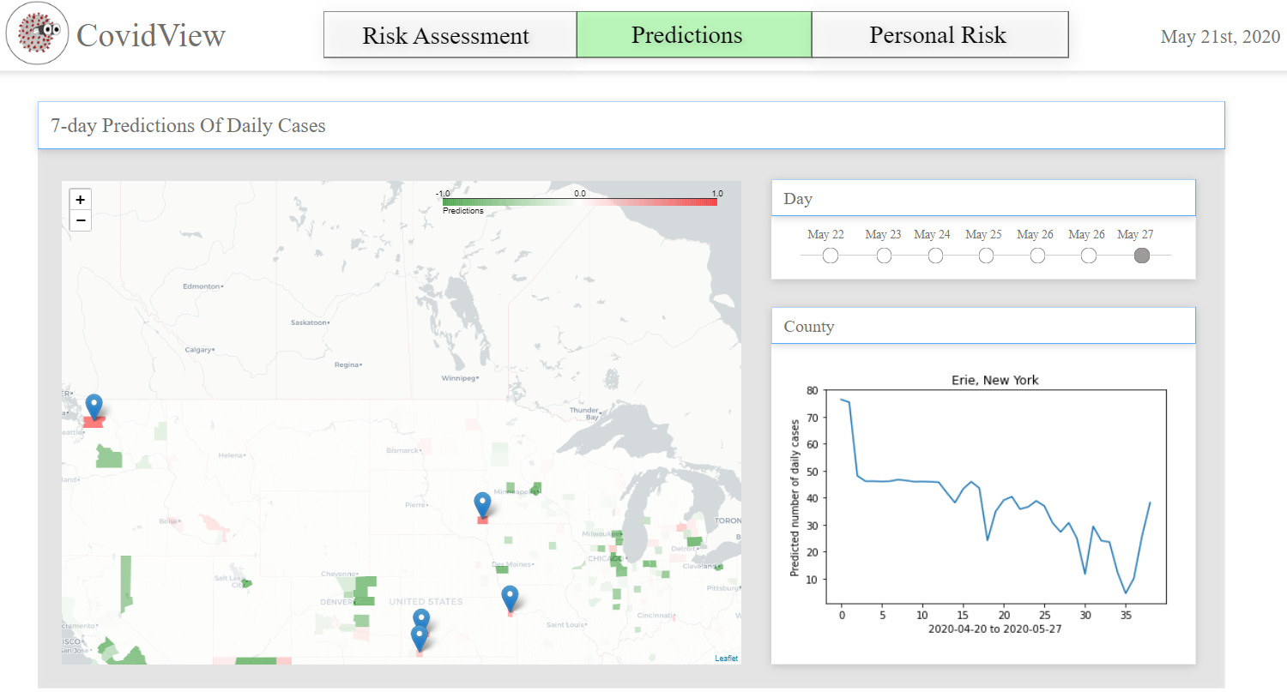

Slide 5
